Slide 1
DTC Induction
Training for New District Test Coordinators
Supervisors Collaboration Events

Slide 2
Welcome
In this session, first-year district test coordinators (DTCs) will:
Gain insight on all statewide assessments
Articulate the roles and responsibilities of the DTC
Review resources available for assessment administration

Slide 3
Agenda
Assessments Overview
District Test Coordinator (DTC) Responsibilities
Supports and Resources

Slide 4
Louisiana’s Assessment System

Slide 5
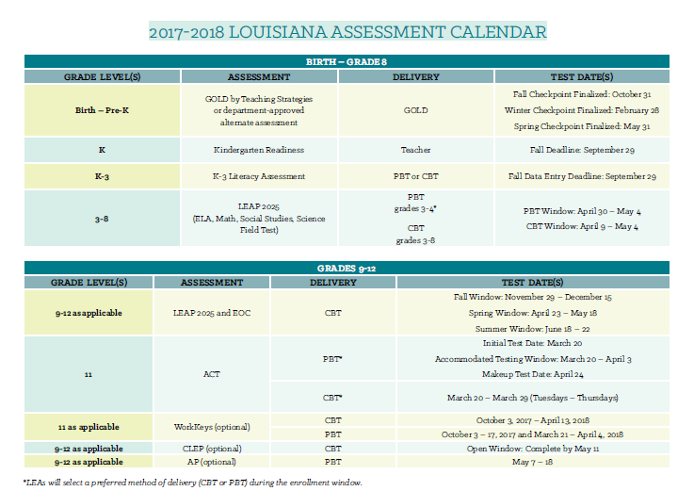
2017-2018 Assessment Calendar

Slide 6
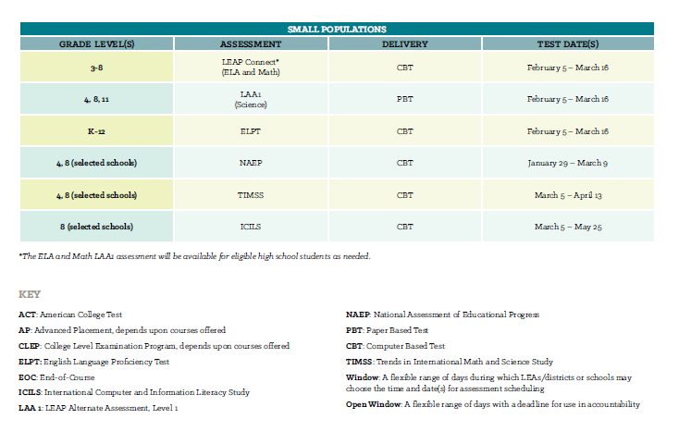
2017-2018 Assessment Calendar

Slide 7
Important Links
Below are helpful links related to assessment preparation and resources. Use the Important Links Note-Taking Guide to list helpful information and next steps for implementation.
Assessment Preparation Links | Assessment Resource Links
Online Tools Training (OTT) eDIRECT ACT State Testing Site | Assessment Library Assessment Guidance Practice Test LEAP 360

Slide 8
Assessments Overview: Turn and Talk
How do you prepare and execute assessment administration in your district?
What are your district’s strengths and areas for improvement?

Slide 9
Agenda
Assessments Overview
District Test Coordinator (DTC) Responsibilities
Supports and Resources

Slide 10
DTC Responsibilities: Bulletin 118
BESE Bulletin 118, Chapter 5, Subchapter A outlines the responsibilities of District Test Coordinators (DTCs) as well as School Test Coordinators (STCs).
The primary responsibilities of DTCs include, but are not limited to, the following:
Assessment administration logistics
Test security supervision
Training staff

Slide 11
DTC Responsibilities: Bulletin 118
Assessment Administration Logistics
DTCs are responsible for appointing and supervising school test coordinators (STCs).
DTCs are responsible for scheduling assessment administrations in accordance with statewide assessment timelines when testing windows allow flexibility in scheduling. This includes:
Scheduling initial testing dates as well as makeup testing dates and times
Arranging for testing students enrolled in approved home study programs and non-public schools
DTCs are responsible for distributing student reports and summary reports to STCs and principals in a timely manner.

Slide 12
DTC Responsibilities: Bulletin 118
Assessment Administration Logistics
DTCs are responsible for overseeing the processes associated with secure and non-secure test materials during each phase of assessment administration. This includes:
Partnering with the Special Education and Section 504 coordinators to ensure that student information in online data systems reflect the correct accessibility features and accommodations required for testing
Completing, submitting, and/or filing all forms as instructed in the Test Coordinators Manuals (TCMs)
Managing the receipt, distribution, and return of all testing materials
Ensuring that an area for secure storage of materials is designated at both district and school facilities

Slide 13
DTC Responsibilities: Bulletin 118
Assessment Administration Logistics
DTCs are responsible for managing the administrative and security functions of online assessment systems. This includes:
Ensuring that appropriate data sharing agreements are in place
Maintaining district and school level passwords for each online system
Distributing user credentials to STCs
Ensuring that all district and school users maintain the security of and access to all student information obtained in online systems*
Confirming the assignment of TA numbers in the systems at each school for each scheduled test administration
*Additional information about online assessment systems is located in Bulletin 118, Chapter 3, subsection 14.

Slide 14
DTC Responsibilities: Bulletin 118
Test Security Supervision
DTCs are responsible for maintaining the security of test materials during all phases of assessment administration. This includes, but is not limited to:
Establishing clearly defined processes for STCs as well as other stakeholders to report possible test security violations to the DTCs.
Notifying the Office of Assessment and Accountability of all possible test security violations
Completing and submitting test security forms as instructed in the Test Coordinators Manuals (TCMs)
Conducting thorough investigations of all actual and/or possible test security violations
Additional Information on Test Security
BESE Bulletin 118, Chapter 3 outlines the LDOE test security policy.
Test security training will be included in Assessment and Accountability monthly calls.

Slide 15
DTC Responsibilities: Bulletin 118
Training Staff
DTCs are responsible for training select district-level staff and school leaders. This includes:
Conducting annual test security training
Delivering training for online assessment systems
Providing assessment administration logistics training and guidelines to STCs
Regularly sharing pertinent information regarding statewide assessment programs with appropriate district and school staff
Ensuring that staff are aware of data privacy laws as they relate to each phase of assessment administration (R.S. 17:3913 (Act 677) and R.S. 17:3914 (Act 837))

Slide 16
Agenda
Assessments Overview
District Test Coordinator (DTC) Responsibilities
Supports and Resources

Slide 17
Support & Resources: Assessment Library
The Assessment Library encompasses resources for DTCs including the 2016-2017 Assessment Schedule and the Assessment and Accountability Month-by-Month Checklist.
Assessment Schedule
The 2017-2018 Assessment Calendar outlines test dates and method of delivery for all statewide assessments.
Month-by-Month Checklist
The 2017-2018 Assessment and Accountability Month-by-Month Checklist:
Identifies key dates and deadlines for statewide assessment programs and accountability processes
Provides action steps to ensure readiness for administering statewide assessments
Recommends resources for district and school staff
The Month-by-Month Checklist is available in the Assessment Library and will be updated throughout the school year.
Documents and Forms
IAP, Limited English Proficient Accommodations, and Personal Needs Profile forms
Accessibility and Accommodations Manual
All other assessment related forms

Slide 18
Support & Resources: Continuous Support
Office Hours and Monthly Calls
Tuesdays at 1:00 PM
Monthly Calls are at 1:00 PM for Public DTCs and 2:00 PM for Nonpublic DTCs
Webinar Link: https://louisianaschools.adobeconnect.com/assessment-accountability/
Enter the meeting room as a guest and provide your name.
Call-In Information: (646) 307-1380
Participant pin code: 89147656
Dates are located in the School System Support Calendar.
Assessment@
All stakeholders are encouraged to email assessment and accountability questions and/or concerns to assessment@la.gov.
Assessment Hotline
District-level staff may call the Assessment Hotline at 844-268-7320 if they have assessment and accountability questions that require immediate assistance.
Weekly Newsletters
Assessment and accountability information and deadlines are released each week in the district newsletter.

Slide 19
Support & Resources: Turn and Talk
How will you utilize the support and communication resources?
How do you communicate with your staff, district leaders, and STCs?
What are some tasks where you need support?

Slide 20
Next Steps
Sign up for weekly newsletter by emailing assessment@la.gov.
Use Month-by-Month Checklist to map out assessment calendar for district.
Review your district’s test security policy.
Add weekly Office Hours and monthly DTC calls to your calendar.
Connect with academic and special education teams in your district.
Develop assessment and accountability communication plan for district leaders and STCs.
Plan for LEA administered assessment administrations (i.e. GEE).
Access and use resources in the Assessment Library and Accountability Library.
Schedule school test coordinator and district staff test security trainings.
Contact assessment@la.gov with any questions.

