Slide 1

Student Learning Targets in the CCSS Classroom:
Mathematics

Slide 2
Objectives
By the end of the session, participants will be able to:
Explain how goals drive classroom instruction
Explain how each step of the goal-setting process supports the instructional priorities in a mathematics course
Explain how the Toolbox resources support the goal-setting process
Identify the aspects of a rigorous mathematics SLT

Slide 3
Agenda
  Why do we set goals?
  How do goals drive what happens in a classroom?
  How does setting goals help achieve the focus areas for mathematics?
  What are our next steps?

Slide 4
Why do we set goals?
Student learning targets (SLTs) are measureable goals for student achievement that reflect an ambitious, but reasonable, expectation for growth.
Strong teacher SLTs:
  Are aligned with a path to college or career readiness;
  Prioritize content that is aligned to CCSS;
  Identify a high-quality assessment to measure student progress;
  Are aligned to leader goals.
Student learning targets establish a vision for what students should know or be able to do at the end of the year and guide the educator’s planning and instructional decisions.

Slide 5
Math Focus in 2014-15
Below are focus areas for students in 2014-15.
Educators’ goals should be built around these key skills.
MATHEMATICS:
Master priority concepts and practice standards (not just procedures)
Master targeted remedial content that allows faster on grade level practice

Slide 6
  How do we align goal-setting with the 2014-15 Math focus areas?
Goal Setting
What should students know/be able to do by the end of the year?
Priority Content
What do you want students to learn?
Conceptual Understanding
What evidence do I have that they’ve learned it?
Daily Instructional Tasks
How can I help them learn it?
Master math concepts of priority, on grade level standards (not just procedures)
Priority content by grade level
Grade level fluencies
Use of math practices to master concepts
Plan, instruct and assess using tasks that build conceptual understanding of priority standards
Master targeted remedial content that allows practice with a faster focus of on grade level content
Plan, instruct and assess using tasks that require fluency and use of math practices to master concepts
Plan, instruct and assess using just enough remediation to help students practice on grade level content as quickly as possible

Slide 7
Math Example or Non-Example?
Based on what you currently know and understand about SLTs and the focus areas for 2014-2015, identify each as a quality example or non-example SLT.
4th Grade Math
80% of my students will achieve a score of 80% or higher on the end of year common assessment focused on the major math content for 4th grade.
3rd Grade Math
By the end of the year, 100% of my students will know from memory all products of two one-digit numbers.

Slide 8
What does this look like in practice?
Partner Activity
Read your assigned section from the Math Guidebooks about the two priorities of Rigor and Remediation.
Note, underline, or highlight aspects of your assigned section that reflect the focus areas.
Be prepared to discuss the following:
  What are the actions a math teacher should take to ensure that students are successful under the two priorities?

Slide 9
Setting Goals that Support Student Priorities (1/2)
SQUARE-SHARE Activity
If students must be able to: | Then educators should set goals for students that:
Master priority concepts and practice standards (not just procedures)
Master targeted remedial content that allows faster on grade level practice

Slide 10
Setting Goals that Support Student Priorities (2/2)
SQUARE-SHARE Activity
If students must be able to: | Then educators should set goals for students that:
Master priority concepts and practice standards (not just procedures) | Require mastery of grade level concepts Require mastery of targeted remedial content, when necessary
Master targeted remedial content that allows faster on grade level practice

Slide 11
Agenda
  Why do we set goals?
  How do we set goals?
  How does setting goals help achieve the focus areas in mathematics?
  What are our next steps?

Slide 12
The Goal-Setting Process
What should students know and be able to do? How will I measure success?
What do students know and what are they able to do now?
3. On which students will I focus the target?
4. How will I monitor progress?

Slide 13
Updated SLT Guide
Step 1: What should students know and be able to do?
How will I measure success?
Step 2: What do students know and what are they able to do now?
Step 3: Is there a group of students on which I should focus this
learning target?
- Student Learning Target
- Scoring Plan
Step 4: How will I monitor Progress?

Slide 14
  Priority Content
MATHEMATICS:
Master priority concepts and practice standards (not just procedures)
Master targeted remedial content that allows faster on grade level practice
What assessment will provide the best evidence of my student’s master of the priority content at the end of the year?
What content will I prioritize?
Step 1: What should students know and be able to do? How will I measure success?

Slide 15
  Understanding Students’ Starting Points
Step 2: What do students know and what are they able to do now?
What knowledge/skills are related to success with this year’s priority content?
What data sources and background information are available?
What diagnostic assessment resources are available?
What can I conclude about students’ mastery of prior knowledge and skills?
Based on the data, what can I conclude about students’ readiness?

Slide 16
  Setting Targets for All Students
MATHEMATICS:
Master priority concepts and practice standards (not just procedures)
Master targeted remedial content that allows faster on grade level practice
Step 3: Is there a group of students on which I should focus this learning target?
Have I set learning targets for all of my students?
Which subgroups in my school population need additional support to achieve success?
Which students will need additional support to achieve success?
Notes:
\

Slide 17
  Setting the Target
Step 3: Student Learning Target
What level of performance on the end-of-year assessment from Step 1 do I expect the identified student population to achieve?

Slide 18
  Defining Success
Step 3: Scoring Plan
How will you measure your students’ success?
Based on students’ baseline data, how many students can reasonably be expected to meet or exceed the expected level of performance?
Based on students’ baseline data, what is the minimum level of performance I expect from the identified students?

Slide 19
  Monitoring Progress
Math teachers plan, instruct & assess using:
Tasks that build conceptual understanding of priority standards
Tasks that require fluency and use of math practices to master concepts
Just enough remediation to help students practice on grade level content as quickly as possible
Step 4: How will I monitor Progress?
Are these assessment methods aligned with the end-of-year assessment identified in Step 1?
What curricular resources and assessment methods will I use to determine students’ mastery of the priority content on an on-going basis?
When will I monitor students’ developing mastery of the priority content?

Slide 20
Agenda
  Why do we set goals?
  How do we set goals?
  How does goal-setting help achieve the focus areas in mathematics?
  What are our next steps?

Slide 21
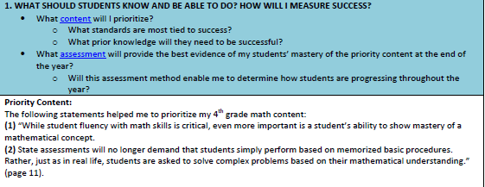
Sample Math SLT (1/4)
MATHEMATICS:
Master priority concepts and practice standards (not just
procedures)
Master targeted remedial content that allows faster on grade level practice

Slide 22
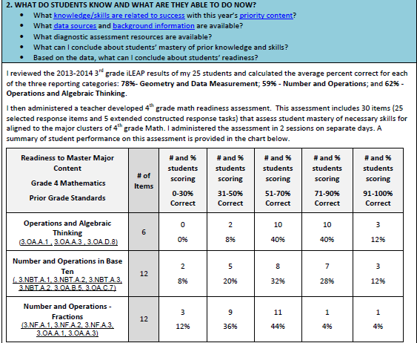
Sample Math SLT (2/4)

Slide 23
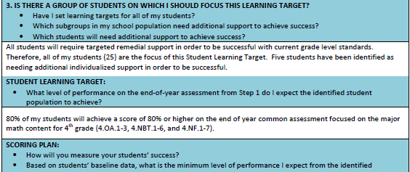
Sample Math SLT (3/4)
Math Teachers Set Goals that:
Require students to master on grade level concepts
Require students to master targeted remedial content, when necessary

Slide 24
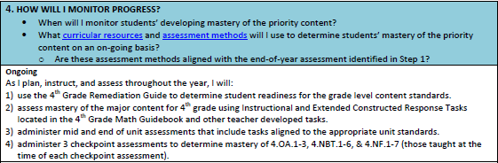
Sample Math SLT (4/4)
Math teachers plan, instruct & assess using:
Tasks that build conceptual understanding of priority standards
Tasks that require fluency and use of math practices to master concepts
Just enough remediation to help students practice on grade level content as quickly as possible

Slide 25
Activity: Developing Strong Math SLTs
Small group activity
Individually, take 5 minutes to review the SLT example in full and consider:
  Does this SLT reflect the student focus areas for math?
  What will it take to get your teachers to set goals such as the exemplar provided?
  What materials/resources are available to guide teachers in this process?

Slide 26
Math Goal-Setting Resources (1/2)
Goal Setting Step | Resources
Step 1: What do they need to know & how will I measure? | CCSS Mathematics 2014-2015 Assessment Guidance LDE Guidebooks: Grades K-2 Mathematics Grades 3-5 Mathematics Grades 6-8 Mathematics High School Mathematics
Step 2: What do they know and what are they able to do? | Baseline Data – readiness assessments, diagnostics Assessment Data (District benchmark data/State test results

Slide 27
Math Goal-Setting Resources (2/2)
Goal Setting Step | Resources
Step 3: Is there a group of students on which I should focus this learning target? | Baseline Data (class, subgroups, major content of prior grades) School Leader SLTs 2013-2014 SLT results Assessment data (District benchmark data/State test results)
Step 4: How will I monitor progress? | CCSS Mathematics 2014-2015 Assessment Guidance Assessment Resources: Common Benchmark Assessments EAGLE Sample Assessment Items Eureka Math - Mid and End of Module Assessments | LDE Guidebooks Tasks & Remediation Guides: Grades K-2 Mathematics Grades 3-5 Mathematics Grades 6-8 Mathematics High School Mathematics

Slide 28
Agenda
  Why do we set goals?
  How do we set goals?
  How does goal-setting help achieve the focus areas in mathematics?
  What are our next steps?

Slide 29
Next Steps
Making a Plan
  Who should be involved in disseminating this information?
  What structures are already in place to guide this process?
  What will teachers need help with?
  How can the Toolbox resources support them?

Slide 30

Questions?
Contact:
Compass@la.gov
or visit
http://www.louisianabelieves.com/teaching/compass

