Slide 1
Data Teams June 3, 2014

Slide 2
Got Data? Presented By:
Erin Granier, Principal, JB Martin Middle School
egranier@stcharles.k12.la.us
Stacy Neighbors, Eighth Grade Reading and Writing Teacher and Support Leader, JB Martin Middle School
sneighbors@stcharles.k12.la.us.

Slide 3
Burning Questions

Slide 4
Instructional Vision
To meet these raised expectations, we must clarify our focus on what our students need. Specifically, we must ensure this year that our students…
English language arts
Comprehend (access) meaningful, on level texts
Speak and write in response to meaningful texts
Math students
Master math concepts of priority, on level content and practice standards (not just procedures)
Master targeted remedial content that allows practice faster focus of on level content

Slide 5
Teacher Leader Summit: Day 1 Ready!
This Summit will prepare teachers to make these shifts beginning the first day of the 14-15 school year. This will include focused training on:
Student Learning Targets
Assessment
Standards, curricula, and instructional strategies

Slide 6
Seminar Goals
Learn the foundational components of the Data Teams structure.
Learn an overview of the Data Teams process as developed by The Leadership and Learning Center and adapted by J.B. Martin Middle School.
.

Slide 7
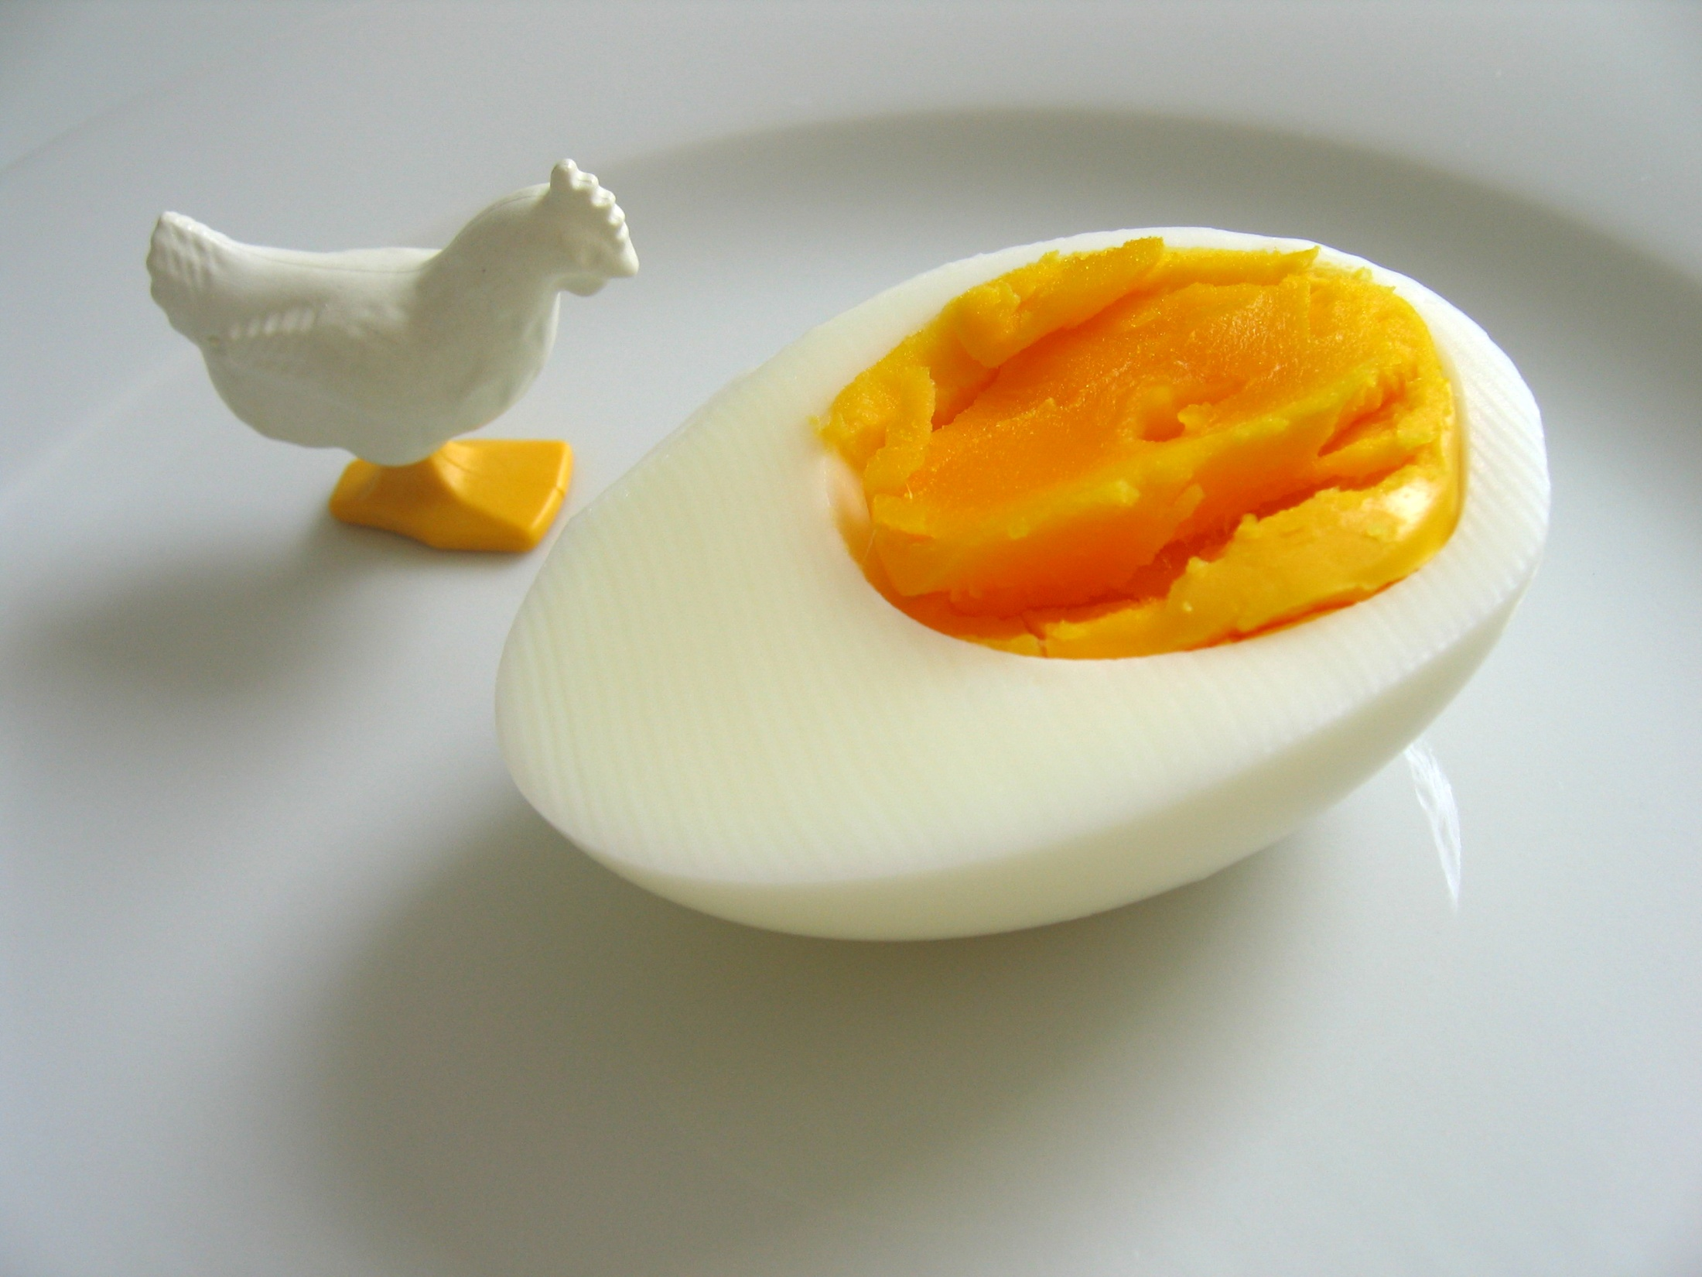
Which comes first – the data or the team?

Slide 8
Data Teams are a model for continuous, collaborative action that inspires and empowers professionals to improve teaching, learning, and leadership for all.

Slide 9
Data Teams have a common focus or common standard, a common formative assessment, and a common scoring guide.

Slide 10
Data Teams are small, grade-level, department, course-alike, or organizational teams that examine work generated from a common formative assessment.

Slide 11
Data Teams meetings are collaborative, structured, scheduled meetings that focus on the effectiveness of teaching and learning.

Slide 12
Data Team Actions
“Data Teams adhere to continuous improvement cycles, examine patterns and trends, and establish specific timelines, roles, and responsibilities to facilitate analysis that results in action.”
S. White, 2005

Slide 13
Be here now. Be someplace else later.

Slide 14
`
We are a Professional Learning Community.
We do Data Teams.

Slide 15
Four Critical Questions that Guide Data Teams
1. What are students supposed to know and be able to do? 2. How do we know when our students have learned?
3. How do we respond when students haven't learned?
4. How do we respond when students already know the content?
POWER STANDARDS
COMMON FORMATIVE ASSESSMENTS
INTERVENTION
DIFFERENTIATION

Slide 16
Seminar Goals
Learn the foundational components of the Data Teams structure.
Learn the Data Teams process.
Plan for implementation and sustainability.

Slide 17
Data Teams:
The Structure

Slide 18
Examine the expectations.
Look at the state standards or frameworks, district power or priority standards, “unwrapped” standards”
Develop a curriculum map.
Create a year-long pacing chart/calendar.
Return to step 1.
Begin the process again with the next critical expectation based on the pacing guide.
Develop a common post-assessment.
What must students master as a result of your teaching?
Meet as a team to determine if the goal was met.
Determine next step for students who did not reach proficiency on the assessment.
Administer the short-cycle, common formative assessment (pre-instruction).
You need to know where the students are in their learning before instruction occurs. What data tell you that the lessons you are preparing are the lessons students need?
8. Score the assessment and submit the data to the Data Team leader.
Follow the Data Teams Process for Results.
1- Collect and chart data
2 – Analyze data and prioritize needs
3 – Set, review, and revise incremental SMART goals
4 – Select common instructional strategies
5 – Determine results indicators
6 – Monitor and evaluate results
7. Administer the common formative assessment (post-instruction).
6. Teach students using common instructional strategies.

Slide 19
Data Teams: The Structure
Notes:
19

Slide 20
Examine the expectations.
Look at the state standards or frameworks, district power or priority standards, “unwrapped” standards”
Develop a curriculum map.
Create a year-long pacing chart/calendar.
Return to step 1.
Begin the process again with the next critical expectation based on the pacing guide.
Develop a common post-assessment.
What must students master as a result of your teaching?
Meet as a team to determine if the goal was met.
Determine next step for students who did not reach proficiency on the assessment.
Administer the short-cycle, common formative assessment (pre-instruction).
You need to know where the students are in their learning before instruction occurs. What data tell you that the lessons you are preparing are the lessons students need?
8. Score the assessment and submit the data to the Data Team leader.
Follow the Data Teams Process for Results.
1- Collect and chart data
2 – Analyze data and prioritize needs
3 – Set, review, and revise incremental SMART goals
4 – Select common instructional strategies
5 – Determine results indicators
6 – Monitor and evaluate results
7. Administer the common formative assessment (post-instruction).
6. Teach students using common instructional strategies.

Slide 21
Data Teams focus only on Priority Standards.

Slide 22
Priority
Standards
School
Life
High-Stakes Assessments

Slide 23
“Unwrapping” allows you to get to what’s most important.

Slide 24
Examine the expectations.
Look at the state standards or frameworks, district power or priority standards, “unwrapped” standards”
Develop a curriculum map.
Create a year-long pacing chart/calendar.
Return to step 1.
Begin the process again with the next critical expectation based on the pacing guide.
Develop a common post-assessment.
What must students master as a result of your teaching?
Meet as a team to determine if the goal was met.
Determine next step for students who did not reach proficiency on the assessment.
Administer the short-cycle, common formative assessment (pre-instruction).
You need to know where the students are in their learning before instruction occurs. What data tell you that the lessons you are preparing are the lessons students need?
8. Score the assessment and submit the data to the Data Team leader.
Follow the Data Teams Process for Results.
1- Collect and chart data
2 – Analyze data and prioritize needs
3 – Set, review, and revise incremental SMART goals
4 – Select common instructional strategies
5 – Determine results indicators
6 – Monitor and evaluate results
7. Administer the common formative assessment (post-instruction).
6. Teach students using common instructional strategies.

Slide 25
Examine the expectations.
Look at the state standards or frameworks, district power or priority standards, “unwrapped” standards”
Develop a curriculum map.
Create a year-long pacing chart/calendar.
Return to step 1.
Begin the process again with the next critical expectation based on the pacing guide.
Develop a common post-assessment.
What must students master as a result of your teaching?
Meet as a team to determine if the goal was met.
Determine next step for students who did not reach proficiency on the assessment.
Administer the short-cycle, common formative assessment (pre-instruction).
You need to know where the students are in their learning before instruction occurs. What data tell you that the lessons you are preparing are the lessons students need?
8. Score the assessment and submit the data to the Data Team leader.
Follow the Data Teams Process for Results.
1- Collect and chart data
2 – Analyze data and prioritize needs
3 – Set, review, and revise incremental SMART goals
4 – Select common instructional strategies
5 – Determine results indicators
6 – Monitor and evaluate results
7. Administer the common formative assessment (post-instruction).
6. Teach students using common instructional strategies.

Slide 26
Assessments
Notes:
26

Slide 27
Formative
What students should know
How instruction needs to be adjusted
How to improve student skills
Assessment FOR learning

Slide 28
Summative
After instruction occurs
Used when determining grades
Various audiences for the data
Assessment OF learning

Slide 29
Remember…
It isn’t the method that determines whether the assessment is summative or formative,
it is how the results are used.

Slide 30
“Schools with the greatest improvements in student achievement consistently used common assessments.”
D. Reeves, 2004

Slide 31
Examine the expectations.
Look at the state standards or frameworks, district power or priority standards, “unwrapped” standards”
Develop a curriculum map.
Create a year-long pacing chart/calendar.
Return to step 1.
Begin the process again with the next critical expectation based on the pacing guide.
Develop a common post-assessment.
What must students master as a result of your teaching?
Meet as a team to determine if the goal was met.
Determine next step for students who did not reach proficiency on the assessment.
Administer the short-cycle, common formative assessment (pre-instruction).
You need to know where the students are in their learning before instruction occurs. What data tell you that the lessons you are preparing are the lessons students need?
8. Score the assessment and submit the data to the Data Team leader.
Follow the Data Teams Process for Results.
1- Collect and chart data
2 – Analyze data and prioritize needs
3 – Set, review, and revise incremental SMART goals
4 – Select common instructional strategies
5 – Determine results indicators
6 – Monitor and evaluate results
7. Administer the common formative assessment (post-instruction).
6. Teach students using common instructional strategies.

Slide 32
Examine the expectations.
Look at the state standards or frameworks, district power or priority standards, “unwrapped” standards”
Develop a curriculum map.
Create a year-long pacing chart/calendar.
Return to step 1.
Begin the process again with the next critical expectation based on the pacing guide.
Develop a common post-assessment.
What must students master as a result of your teaching?
Meet as a team to determine if the goal was met.
Determine next step for students who did not reach proficiency on the assessment.
Administer the short-cycle, common formative assessment (pre-instruction).
You need to know where the students are in their learning before instruction occurs. What data tell you that the lessons you are preparing are the lessons students need?
8. Score the assessment and submit the data to the Data Team leader.
Follow the Data Teams Process for Results.
1- Collect and chart data
2 – Analyze data and prioritize needs
3 – Set, review, and revise incremental SMART goals
4 – Select common instructional strategies
5 – Determine results indicators
6 – Monitor and evaluate results
7. Administer the common formative assessment (post-instruction).
6. Teach students using common instructional strategies.

Slide 33
Examine the expectations.
Look at the state standards or frameworks, district power or priority standards, “unwrapped” standards”
Develop a curriculum map.
Create a year-long pacing chart/calendar.
Return to step 1.
Begin the process again with the next critical expectation based on the pacing guide.
Develop a common post-assessment.
What must students master as a result of your teaching?
Meet as a team to determine if the goal was met.
Determine next step for students who did not reach proficiency on the assessment.
Administer the short-cycle, common formative assessment (pre-instruction).
You need to know where the students are in their learning before instruction occurs. What data tell you that the lessons you are preparing are the lessons students need?
8. Score the assessment and submit the data to the Data Team leader.
Follow the Data Teams Process for Results.
1- Collect and chart data
2 – Analyze data and prioritize needs
3 – Set, review, and revise incremental SMART goals
4 – Select common instructional strategies
5 – Determine results indicators
6 – Monitor and evaluate results
7. Administer the common formative assessment (post-instruction).
6. Teach students using common instructional strategies.

Slide 34
Examine the expectations.
Look at the state standards or frameworks, district power or priority standards, “unwrapped” standards”
Develop a curriculum map.
Create a year-long pacing chart/calendar.
Return to step 1.
Begin the process again with the next critical expectation based on the pacing guide.
Develop a common post-assessment.
What must students master as a result of your teaching?
Meet as a team to determine if the goal was met.
Determine next step for students who did not reach proficiency on the assessment.
Administer the short-cycle, common formative assessment (pre-instruction).
You need to know where the students are in their learning before instruction occurs. What data tell you that the lessons you are preparing are the lessons students need?
8. Score the assessment and submit the data to the Data Team leader.
Follow the Data Teams Process for Results.
1- Collect and chart data
2 – Analyze data and prioritize needs
3 – Set, review, and revise incremental SMART goals
4 – Select common instructional strategies
5 – Determine results indicators
6 – Monitor and evaluate results
7. Administer the common formative assessment (post-instruction).
6. Teach students using common instructional strategies.

Slide 35
Examine the expectations.
Look at the state standards or frameworks, district power or priority standards, “unwrapped” standards”
Develop a curriculum map.
Create a year-long pacing chart/calendar.
Return to step 1.
Begin the process again with the next critical expectation based on the pacing guide.
Develop a common post-assessment.
What must students master as a result of your teaching?
Meet as a team to determine if the goal was met.
Determine next step for students who did not reach proficiency on the assessment.
Administer the short-cycle, common formative assessment (pre-instruction).
You need to know where the students are in their learning before instruction occurs. What data tell you that the lessons you are preparing are the lessons students need?
8. Score the assessment and submit the data to the Data Team leader.
Follow the Data Teams Process for Results.
1- Collect and chart data
2 – Analyze data and prioritize needs
3 – Set, review, and revise incremental SMART goals
4 – Select common instructional strategies
5 – Determine results indicators
6 – Monitor and evaluate results
7. Administer the common formative assessment (post-instruction).
6. Teach students using common instructional strategies.

Slide 36
Examine the expectations.
Look at the state standards or frameworks, district power or priority standards, “unwrapped” standards”
Develop a curriculum map.
Create a year-long pacing chart/calendar.
Return to step 1.
Begin the process again with the next critical expectation based on the pacing guide.
Develop a common post-assessment.
What must students master as a result of your teaching?
Meet as a team to determine if the goal was met.
Determine next step for students who did not reach proficiency on the assessment.
Administer the short-cycle, common formative assessment (pre-instruction).
You need to know where the students are in their learning before instruction occurs. What data tell you that the lessons you are preparing are the lessons students need?
8. Score the assessment and submit the data to the Data Team leader.
Follow the Data Teams Process for Results.
1- Collect and chart data
2 – Analyze data and prioritize needs
3 – Set, review, and revise incremental SMART goals
4 – Select common instructional strategies
5 – Determine results indicators
6 – Monitor and evaluate results
7. Administer the common formative assessment (post-instruction).
6. Teach students using common instructional strategies.
Notes:
Part 9- meet as a team to determine if the goal was met. Determine next step for students who did not reach proficiency on the assessment.

Slide 37
Examine the expectations.
Look at the state standards or frameworks, district power or priority standards, “unwrapped” standards”
Develop a curriculum map.
Create a year-long pacing chart/calendar.
Return to step 1.
Begin the process again with the next critical expectation based on the pacing guide.
Develop a common post-assessment.
What must students master as a result of your teaching?
Meet as a team to determine if the goal was met.
Determine next step for students who did not reach proficiency on the assessment.
Administer the short-cycle, common formative assessment (pre-instruction).
You need to know where the students are in their learning before instruction occurs. What data tell you that the lessons you are preparing are the lessons students need?
8. Score the assessment and submit the data to the Data Team leader.
Follow the Data Teams Process for Results.
1- Collect and chart data
2 – Analyze data and prioritize needs
3 – Set, review, and revise incremental SMART goals
4 – Select common instructional strategies
5 – Determine results indicators
6 – Monitor and evaluate results
7. Administer the common formative assessment (post-instruction).
6. Teach students using common instructional strategies.

Slide 38
How Do All The Powerful Practices
Connect?

Slide 39
The BIG Picture
If the CC state standards
and the state tests
were “bookends” and these powerful practices were the “books” in between…
How would you arrange the “Books”
to show the connections?
39

Slide 40
Data Team Meetings:
The Process
Notes:
40

Slide 41
Collect and chart data.
Data Teams gather and display data from formative assessment results. Through the disaggregation in this step, teams will be able to plan for the acceleration of learning for all students.
6. MONITOR AND EVALUATE RESULTS.
5. Determine results indicators.
Data Teams create descriptors of successful strategy implementation as well as improvements to be seen in ongoing student work that would indicate the effectiveness of the selected strategies.
2. Analyze data and prioritize needs.
Data Teams identify the strengths and needs of student performance and then form inferences based on the data. Data Teams also prioritize by focusing on the most urgent needs of the learners.
Data Teams Process
4. Select common instructional strategies.
Teams collaboratively identify research-based instructional strategies. The determination is based on the analysis in step 2.
3. Set, review, and revise incremental SMART goals.
Teams collaboratively set incremental goals. These short-term goals are reviewed and revised throughout the data cycle.

Slide 42
Now, experience the Data Team process…

Slide 43
Data Teams
Process
for
Results

Slide 44
Step 1 – Collect and Chart Data
Info comes from Common Formative Assessment (CFA’s)
Data should be sent to someone on team prior to meeting so it’s ready to view
Be Prepared, come with this done! Have an understanding of what your data means
Define ‘groups’ by using a scoring guide, should have been established when the CFA was created

Slide 45
Step 2 – Analyze Data and Prioritize Needs
Analysis of students work from CFA to identify the strengths students display in their learning in addition to their most urgent needs
Most urgent needs become the focus for future changes in instruction
Bring CFAs to meeting, organized by proficiency groups
Search for root causes of students’ incorrect responses
Prioritize in order to get the “biggest bang for the buck” in instruction
Linked very closely to Step 4, focus on student needs that are directly within teachers’ control, do not write things that are out of your control
Do every student group and be VERY specific about strengths and obstacles/errors

Slide 46
Step 3 – Set, Review, and Revise Incremental SMART Goals
Having a goal gives us a purpose
SMART has a meaning…Specific, Measurable, Achievable, Relevant, and Timely. Let this guide your smart goal!
Use the Formula: P + C + F
^{Total}
Be careful setting goals too low – may want to set a minimum SMART goal of 80%
Whether or not a goal is met in any given instructional cycle is less important than what the team does in response to the results

Slide 47
Step 4 – Select Common Instructional Strategies
Instructional strategies are the actions of the teacher that increases cognition in relation to an identified learning goal -
Strategies=teacher, activity=students
Prioritize needs, link this to the inferences in step 2, this should meet the need decided in Step 2
For this step to be productive, team must discuss specific research based instructional strategies that will have an immediate impact on student learning
Team commits to implement agreed upon instructional strategy/strategies
Strategies should be researched based TEACHER actions, not activities
Marzano’s Essential 9 Strategies

Slide 48
Step 5 – Determine Results Indicators
DO NOT SKIP THIS STEP!!!
Helps teachers to monitor progress toward the SMART goal and gauge the success of the instructional strategies.
Ensures fidelity. Everyone should complete the SAME agreed upon strategy/strategies the same way.
If______then_______ statements - (If the coach teaches fundamentals of dribbling, then the players will have less turnovers.)
Transform this into teacher behavior and student behavior.
Hypothesis - educated guess as to what teacher actions will do to increase student learning.
Mid-Course correction, stop and double check that your strategies are appropriate to reach your goal.
Plan the specific teacher AND student activities. Describe what you want to see from each.

Slide 49
Step 6 – Monitor and Evaluate Results
Discuss effectiveness of strategies being used
Ask, “Are the strategies we selected having the desired impact on student learning?”
Use work samples to make midcourse corrections if strategies are not working

