Slide 1

Eureka Math: A Story of Units
  Major Work of the Grade Band
  K-2: Addition and Subtraction
Notes:
This full-day session is intended to support a school-wide implementation of A Story of Units. This session highlights the progression of addition and subtraction from kindergarten through 2nd grade. Addition and Subtraction are ways we manipulate units by composing and decomposing number. Educators teaching and supporting these grade levels will understand how the concepts and skills taught at each grade K-2, fit together and ultimately play a key role in the profound understanding of addition and subtraction.
Welcome participants and introduce presentation team.
Fist to Five:
- How familiar are you with A Story of Units?
Poll the participants:
Are you using the lessons on a daily basis? Or to supplement your instruction?
Are you a Kindergarten classroom teacher? 1st grade? 2nd grade?
Are you a math coach? Coordinator? Resource teacher?
Are you a school-level administrator? District-level administrator?
TIME ALLOTTED FOR THIS SLIDE: 5 minutes
MATERIALS NEEDED:
Session PowerPoint

Slide 2
This PowerPoint presentation is provided to individuals who participated in a live training by professional developers certified by, or affiliated with, the copyright holder, Common Core, Inc. It may be not be altered in any way. The presentation may be shared for non-commercial purposes only. However, Common Core makes no representations or warranties about the effectiveness of training provided by non-certified/non-affiliated presenters of the material. Any commercial use of this presentation is illegal and violates the copyrights of Common Core, Inc.

Slide 3
Session Objectives
Examine how addition and subtraction are introduced and developed in A Story of Units.
Study the computation methods used in the primary years to solve addition and subtraction problems.
Level 1: Counting All
Level 2: Counting On
Level 3: Convert to an Easier Problem
Notes:
Our objectives for this session are to:
Examine how addition and subtraction are introduced and developed in A Story of Units.
Study the computation methods used in the primary years to solve addition and subtraction problems.
TIME ALLOTTED FOR THIS SLIDE:
2 minutes
MATERIALS NEEDED:
Session PowerPoint

Slide 4
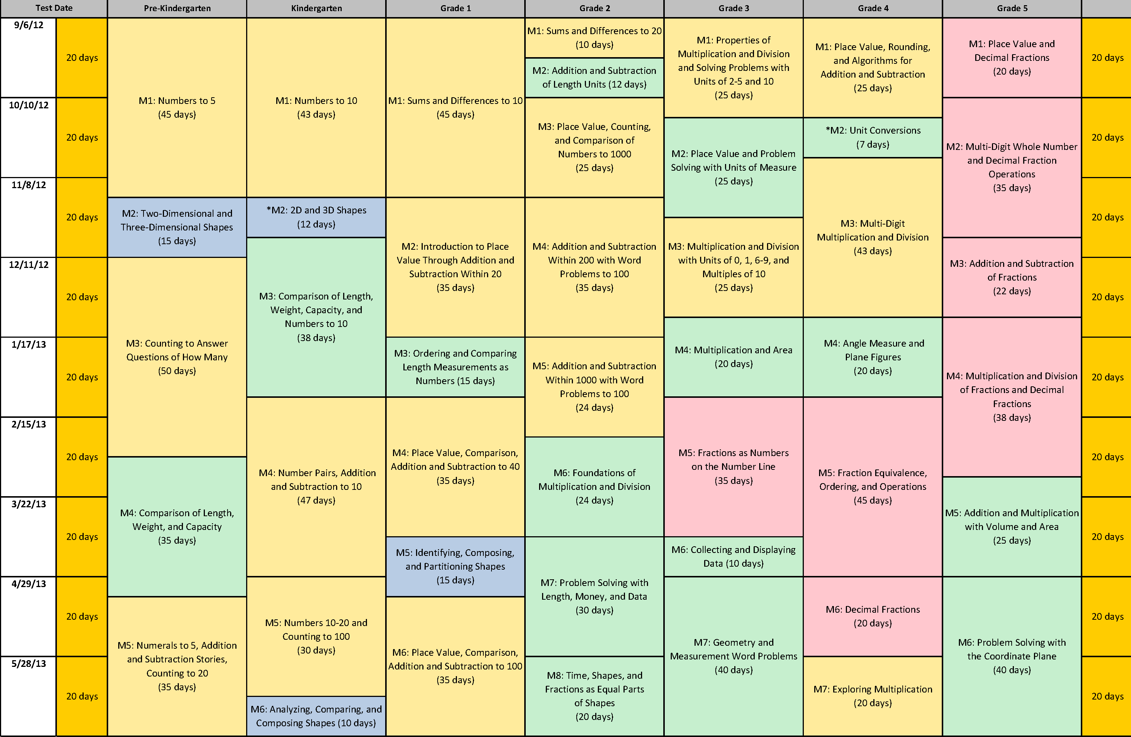
Curriculum Map for A Story of Units
Notes:
This is the curriculum map for A Story of Units. It shows the sequence of five to eight modules for each grade, PK through Grade 5.
(CLICK) Today we are focusing on the skills and concepts of addition and subtraction in Kindergarten, 1st, and 2nd grades. The sections (modules) in yellow for all three grades deal with counting, number, place value, word problems, addition, and subtraction. Coherence means that learning is connected within and across the grades so that students can build new understanding upon the foundational learning from previous years.
As we explore these modules, you will understand the important role of the lessons and topics within your grade level and how they connect with the entire grade band. Knowing the work across the grade band will give you insight into the specific lesson you are teaching.
TIME ALLOTTED FOR THIS SLIDE: 2 minutes
MATERIALS NEEDED:
X

Slide 5
AGENDA
Kindergarten: Addition and Subtraction, Counting All
Grade 1: Addition and Subtraction, Counting On and Converting to an Easier Problem
Grade 2: Addition and Subtraction, Converting to an Easier Problem
Notes:
Children understand addition and subtraction as they encounter problem situations. They learn to compute these problem situations in three levels (found on p. 36 of the OA progression document):
Level 1: Counting all – When students are counting all they recognize 1 object as 1 unit.
Level 2 : Counting on - When counting one, students are able to see one number as a unit to count on from. For example, when the see 4 + 2 they have progressed to see the group of four as one unit and then they can “count on” by adding more units.
Level 3: Making an easier problem – Students are able to see both addends as units and manipulate them to use short cuts.
Make participants aware of the variety of units they use in their everyday life. This will help them to empathize with students just beginning to learn one type of unit system, Base-ten. Our entire number system, addition and subtraction included, relies on our understanding that 10 one units make 1 ten unit, and 10 ten units make 1 hundred unit, and so on .
Use the following examples to demonstrate all the different types of units we have learned to use as adults.
1 unit of playing cards = 52 cards
1 unit of donuts (a dozen) = 12 donuts
1 unit of a week = 7 days
1 unit of a foot = 12 inches
TIME ALLOTTED FOR THIS SLIDE: 4 minutes
MATERIALS NEEDED:
X

Slide 6
AGENDA
Addition and Subtraction
1. Counting all 2. Counting on 3. Convert to an easier problem
Models
Assessment
Fluency
Story Problems
Notes:
For each grade level we will examine the three levels of computation methods in terms of:
Models - Materials can be used to model the counting methods and help students to understand the thinking behind them.
Fluency – Skills needed to carry out procedures flexibility, accuracy, and efficiency.
Story Problems – Increasingly sophisticated story situations and problem types.
Assessment – How students are asked to demonstrate their understanding of addition and subtraction.
TIME ALLOTTED FOR THIS SLIDE: 2 minutes
MATERIALS NEEDED:
X

Slide 7
The Beginning of A Story of Units in Kindergarten
By the end of Kindergarten, students will:
Fluently add and subtract within 5 (K.OA.5)
Represent and Solve Addition and Subtraction Word Problems with Totals to 10 (K.OA.1 and 2)
Decompose numbers less than or equal to 10 (K.OA.3)
For any number 1-9 find the number that makes 10 (K.OA.4)
Compose and decompose numbers from 11-19 as 10 ones and some ones (K.NBT.1)
Notes:
When you read the NBT Progression, you read a beautiful narrative description of how conceptual understanding develops. A Story of Units brings that story to life.
Reaching these standards begins with counting and connecting counting to cardinality.
Materials Needed for GK Portion of Presentation:
Presenter:
Number gloves optional (rubber gloves with numbers written on the fingertips), otherwise, plain hands are fine
Per pair of participants
Dixie cup with 5 beans
Handouts:
Problem types handout (Page 9 from the OA progressions)
Left Hand Mat (GK-M1-L1)
Videos:
Counting On
Number Towers
TIME ALLOTTED FOR THIS SLIDE: 2 minutes
MATERIALS NEEDED:
X

Slide 8
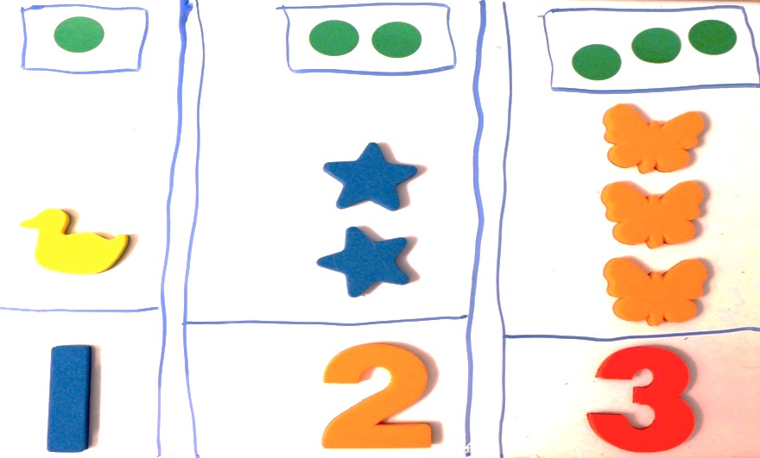
Kindergarten – Foundations to Addition and Subtraction
Level One - Counting All
Students need to know:
Number words in sequence
Number recognition
1:1 correspondence
Cardinality
Concrete-pictorial-abstract
Notes:
Counting All in Kindergarten:
Learning that groups of objects have a numerical value.
Learning how to represent that value with an abstract numeral.
Students learn that 1 object is 1 unit, 2 objects is 2 units. 1 frog, 2 frogs, 3 frogs. And here comes 1 more frog (another unit) Now there are 4 frogs! 1 unit, 1 count.
Accurate, efficient counting of numbers 1-10 is the focus of the first 43 days of Kindergarten.
Matching numerals to quantities of grouped objects
Transitioning from counting concrete objects to pictorial drawings to abstract numerals (Duck=concrete; dot=pictorial; 1=abstract)
Understand the last number named determines the total (The total can compose a new unit, for example, ten 1’s can make a new unit of one 10)
Demonstration vignette of the last number named determines the total:
T: Ask a participant, “How many people are at your table?”
S: Four.
T: Sit down at the table and ask the participant to act as the teacher and ask you how many people are at the table.
T: “One, two, three, four.” Ask the participant to ask you again, “How many people are at the table?”
T: Repeat, “One, two, three, four”.
This is an important concept for students to grasp because it’s the beginning of understanding that the last number named can make a new unit as opposed to each individual unit getting 1 count. This thinking transfers to each table being a unit composed of 4 smaller units.
Composition and Decomposition of numbers 1-10 (Manipulation of units demonstrates the power of the unit; A unit of 5 can be thought about as 1 and 4 or 2 and 3)
Composition and Decomposition of numbers 11-20 “ten ones and some ones” (Module 5)
Composing and decomposing number is foundational to understanding addition and subtraction.
Kindergartners have an innate understanding of putting together and taking apart. We tap into this knowledge by decomposing groups of objects and drawings within 10 into 2 groups and putting them back together again to make the whole (composing). In this way we Kindergartners strengthen their understanding of putting 2 parts together to make a whole and taking a part from the whole leaving the other part. Once this thinking is solidified they are ready to express adding and subtracting with the traditional algorithm.
TIME ALLOTTED FOR THIS SLIDE: 4 minutes
MATERIALS NEEDED:
X

Slide 9
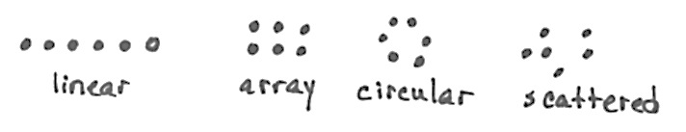

Kindergarten – Fluency
Counting All
Notes:
Counting All fluency activities:
Counting beans and fingers – M1 L1 (counting all; knowing all the fingers on one hand is 5)
T: Take 1 bean out of your cup and put it on your mat. Count how many beans are on your mat.
S: 1.
T: Take another bean out of your cup and put it on your mat. Count how many beans are on your mat now?
S: 1,2.
T: Yes. Take another bean out of your cup and put it on your mat. Count how many beans are on your mat now?
S: 1, 2, 3.
T: Yes. Let’s touch and count them one at a time like this, 1, 2, 3.
S: 1, 2, 3 (as they touch each bean).
T: Move 1 bean to the pinky fingernail. How many fingers have a bean?
S: 1.
Continue to 3 in this manner. Give time for students to touch and count, but take notice of which students must recount each time.
Number glove – M1 L1 (counting all; counting left to right intentionally)
T: Watch my number glove and count with me. Ready? (Begin with closed fist, then show the pinky finger, followed by ring finger, and then middle finger.)
S: 1, 2, 3.
T: Stay here at 3. Let’s count back down to 1. Ready? (Put down the middle finger, then ring finger.)
S: 3, 2, 1. Continue counting up and down a few more times.
T: You’re ready for something harder! This time we’ll count up and down, like a wave. Watch my glove and you’ll know just what to do.
S: 1, 2, 3, 2, 1, 2, 1, 2, 1, 2, 3, 2, 3, 2, 3..... Listen for hesitation as students count, rather than count along with them.
3. Line up, Sprinkle, Circle – M1 L10 (counting all; in more difficult configurations)
Accurate counting of objects in different configurations (linear, array, circular and scattered); One-to one correspondence (Each unit gets one count)
T: Put 5 beans in your cup. (Wait for students to do this.) Spill them onto your mat and put them in a straight line. Touch and count.
S: 1, 2, 3, 4, 5.
T: How many beans?
S: 5!
T: Put them back in your cup. Spill them onto your mat and sprinkle them around. Touch and count.
S: 1, 2, 3, 4, 5.
T: Are there still 5?
S: Yes!
T: Put them back in your cup. Spill them onto your mat and put them in a circle. Touch and count.
T: Are there still 5?
S: Yes!
TIME ALLOTTED FOR THIS SLIDE: 10 minutes
MATERIALS NEEDED:
Dixie cup with 5 beans
Left hand mat
Number glove (optional; rubber gloves with numbers written on the fingertips) Regular, plain hands are fine

Slide 10
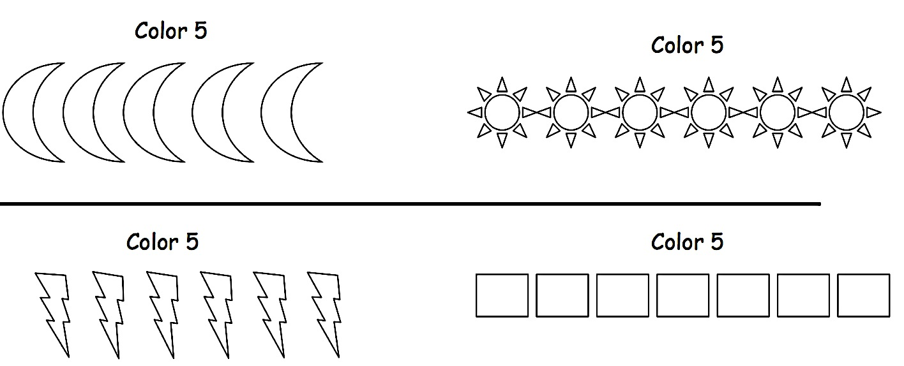
Kindergarten – Foundations for Counting On
Kindergarten – Module 1 Lesson 19
Notes:
The foundation of counting on begins in Module 1 with seeing embedded numbers within a larger group. Students are guided to see embedded numbers as units to count on from.
The importance of moving to Level 2 counting strategies becomes apparent in Kindergarten Module 5 as numbers 10-20 are learned in depth. With the added complexity of larger numbers students are guided to understand the need for efficient ways to accurately count.
TIME ALLOTTED FOR THIS SLIDE: 2 minutes
MATERIALS NEEDED:
X

Slide 11

Kindergarten – Foundations for
Counting On
Counting on the Say Ten Way
Counting on the Regular Way
http://www.engageny.org/resource/common-core-video-series-kindergarten-mathematics-double-10-frames
Notes:
VIDEO – watch a demonstration on of counting on from 10 the math way and the regular way (about 3 minutes).
Teen numbers are learned as “10 ones and some ones” (10 is the unit used to count on from)
Students practice saying teen numbers in English and the “Say 10 way”
Lead participants through this counting on fluency after the video:
Counting around the circle to 5 “Sparkle” – M1 L6 (counting on; counting not starting at 1)
Ask for about 12 volunteers to stand in a circle:
T: Come stand on the edges of the rug. We’re going to play a fast counting game. We’ll count around the circle. Each person says the next 2 numbers. So if I say 1, 2, what would you say?
S: 3, 4
T: Right. The next person only says 5, and since we’re only counting to 5, they will also, sit down. Should you be sad if you have to sit?
S: No.
T: By the end of the game, everyone will be sitting down anyway, it’s part of the fun! So let’s get started.
TIME ALLOTTED FOR THIS SLIDE: 10 minutes (video 3 min./fluency 7min.)
MATERIALS NEEDED:
Counting On Video

Slide 12
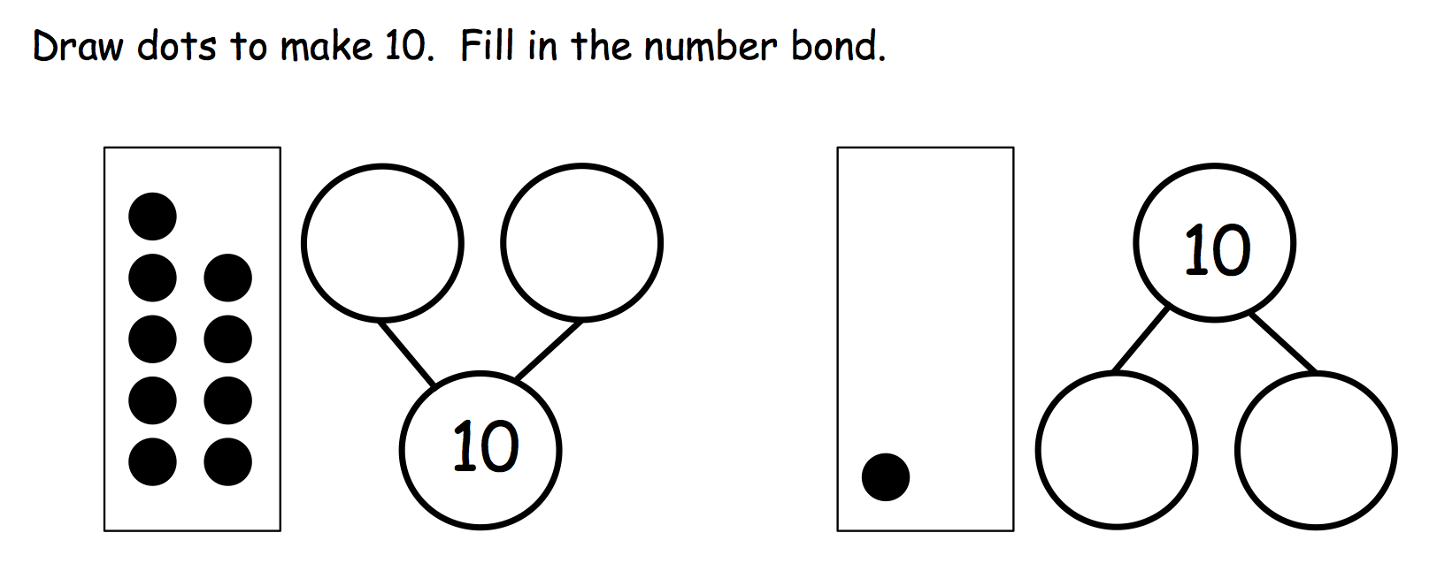
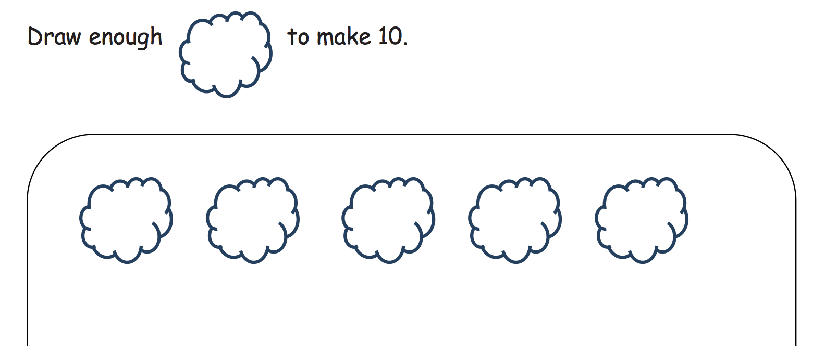
Kindergarten – Make Ten
Notes:
Three key “make ten” ideas in Kindergarten:
1. The decompositions of the numbers to 10.
2. How much more a number needs to make ten.
3. The ten plus facts.
This is the foundation for the make 10 and the take from 10 strategies that will be learned in grade 1 and 2.
TIME ALLOTTED FOR THIS SLIDE: 2 minutes
MATERIALS NEEDED:
X

Slide 13
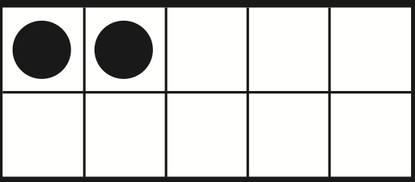
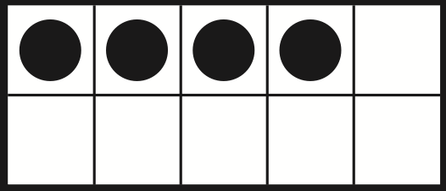
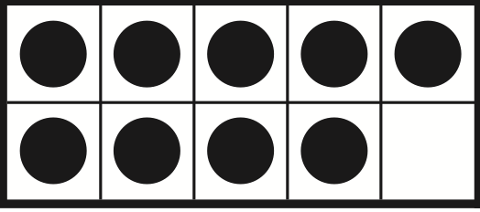
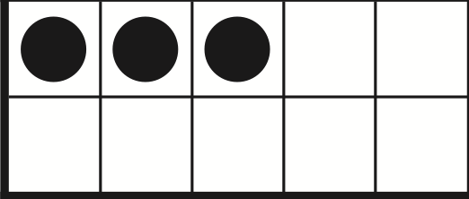
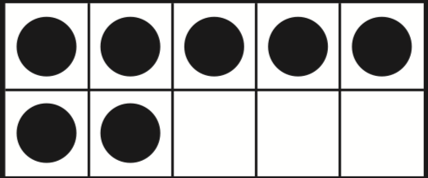
Kindergarten – Fluency
Make Ten
Notes:
Make Ten fluency activities:
Finger number pairs– M4 L11 (easier problem; Decompose number: helps to later make a 10 )
T: You’ve gotten very good at showing fingers the Math way. I want to challenge you to think of other ways to show numbers on your fingers. Hint... you can use two hands! First I’ll ask you to show me fingers the Math way. Then, I’ll ask you to show me the number another way. Ready? Show me 5!
S: (Hold up all the fingers of the left hand.)
T: Now show me another way to make 5, using two hands.
S: (Show 3 fingers on one hand and 2 on the other à Show 1 finger on one hand and 4 on the other.)
T: How we can be sure that we’re still showing 5?
S: Count the fingers on both hands.
Continue the process with 6–8. For numbers where more than one combination is possible, have students try each other’s combinations.
Note: Click to advance slides for the fluency below
2. How many to make 10 with 10 frames (easier problem; Make a 10)
T: How many dots?
S: 7.
T: How many spaces?
S: 3.
T: Say the number sentence.
S: 7 + 3 = 10
Click to advance to next 10 frame, repeat script.
TIME ALLOTTED FOR THIS SLIDE: 5 minutes
MATERIALS NEEDED:
X

Slide 14
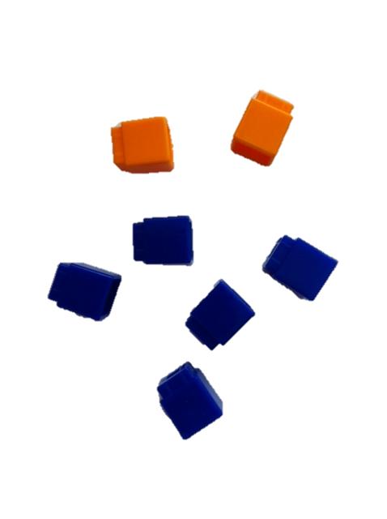
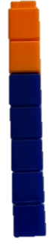
Kindergarten – Models
Number Towers
Concrete representation
Often called sticks (e.g., 5-stick) or trains (horizontal)
Notes:
The models allow students to manipulate the units, i.e. to add and subtract them.
Addition and subtraction are ways to manipulate units. They are beginning to be able to see five as a unit as the year progresses. They find embedded numbers in M1 and "see 2" without counting! That supports them to see 2 as a unit, which eventually leads to being able to understand a unit of ten!! That in turn leads to an understanding of multiplication, or copying a unit, repeating it.
TIME ALLOTTED FOR THIS SLIDE: 2 minutes
MATERIALS NEEDED:
X

Slide 15
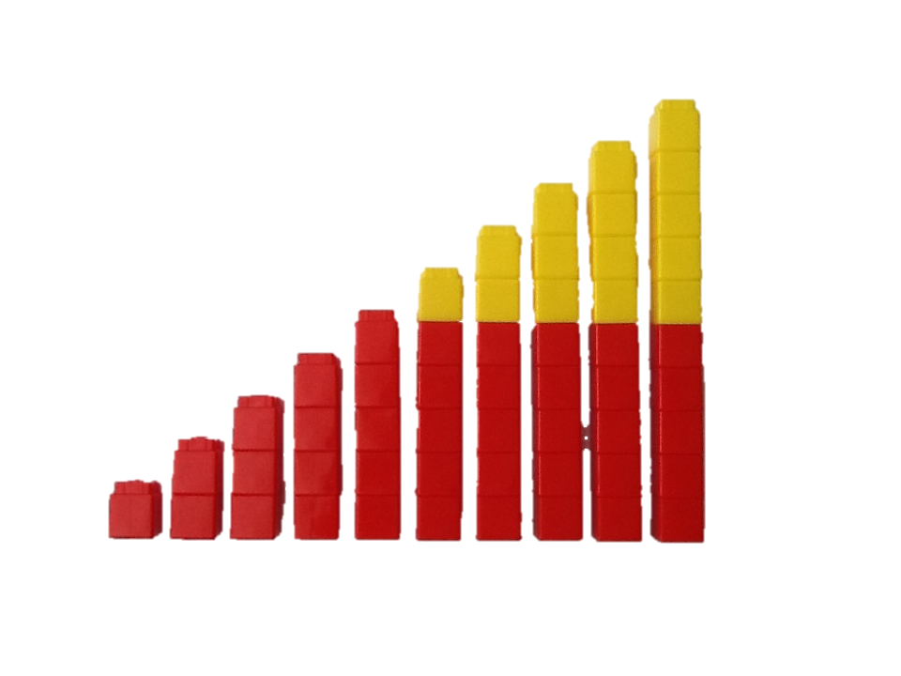
Kindergarten – Models
Number Towers
Number stairs show pattern of 1 more and 1 less (K.CC.4)
Color change at 5 (K.OA.5)
Notes:
Number stairs show a color change at 5 (benchmark fluency).
This representation helps in understanding numbers 6-10 in relation to 5.
Six is 5 + 1
Seven is 5 + 2
Eight is 5 + 3
Nine is 5 + 4
Ten is 5 + 5
We refer to this progression as the 5 + n pattern.
TIME ALLOTTED FOR THIS SLIDE: 2 minutes
MATERIALS NEEDED:
X

Slide 16
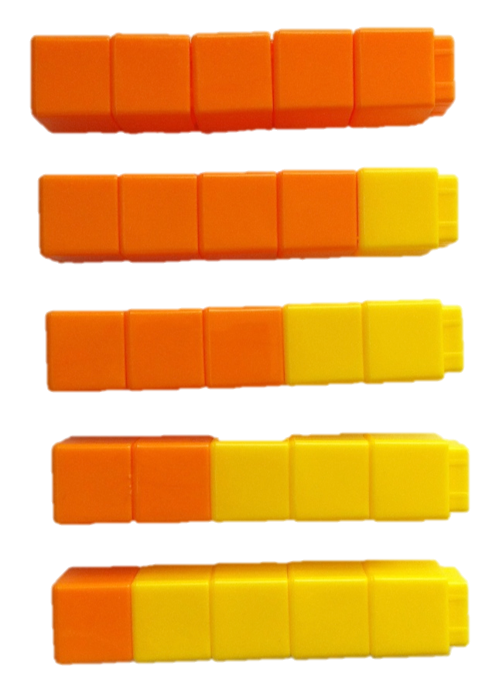
Kindergarten – Models
Number Towers
Decompositions of numbers within 10 (K.OA.3)
5 = 5 + 0
5 = 4 + 1
5 = 3 + 2
5 = 2 + 3
5 = 1 + 4
Notes:
Number towers also help to concretely decompose numbers by breaking the towers into two units, or number pairs. This concrete activity helps students understand the more abstract equation. When decomposing we are starting with the whole and breaking it into two smaller units which is why the total is written first in the equation.
TIME ALLOTTED FOR THIS SLIDE: 2 minutes
MATERIALS NEEDED:
X

Slide 17
Kindergarten – Video
Number Towers
http://www.engageny.org/resource/numbers-through-10-number-towers-number-path-number-bond
Notes:
VIDEO – watch a demonstration on the multiple uses of number towers from 0:00–4:55.
Tell participants that they can find this video on EngagyNY.org if they are interested in watching the rest of the video (on the number path and the number bond).
TIME ALLOTTED FOR THIS SLIDE: 5 minutes
MATERIALS NEEDED:
Number Towers Video

Slide 18
Kindergarten – Models
5-Groups
Represent quantities in relation to 5 and 10.
  Quickly recognize quantities 6-10 based on 5-patterns (5 + n)
Support addition and subtraction operations.
Horizontal 5-groups
Vertical 5-groups
Notes:
The 5-group model plays an important role throughout the grade span and beyond. It is a particularly useful model with numbers 6-10 solidifying the 5 as a unit in each of these numbers and reinforcing the 5 + n. Organizing a unit of ten in this way will be used as students add, subtract, multiply and divide in a place value chart with large numbers in later grades. In order to meet this goal students must be completely comfortable with this model.
In Kindergarten we use both the 10-frame (seen earlier in the presentation, slide 12) and 5-groups.
The 10-frame is used when scaffolding decompositions and compositions of ten. 3 dots and 7 empty boxes help students see 3 needs 7 to be 10, 3 + 7 = 10. The empty boxes helps students to see the “missing dots”.
The 5-group draws the focus to 5 as a unit supporting the 5 + n pattern and also moves students to “see” ten without the boxes. This is an important model as students begin to use the chip method when adding and subtracting large numbers in a place value chart. When using the chip method students will quickly need to be able to represent a unit of 10 using 5-groups in order to change units from one place value to the next.
TIME ALLOTTED FOR THIS SLIDE: 2 minutes
MATERIALS NEEDED:
X

Slide 19
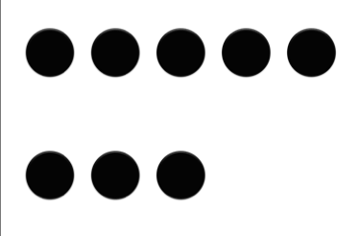
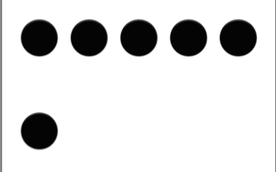
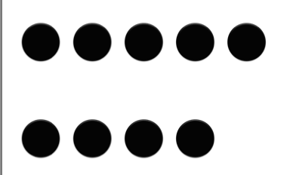
Kindergarten – Fluency
5 + n pattern
Notes:
Lead participants through this fluency:
5-group count on from 5 - M1 L19 (counting on; 5 + n pattern)
Click to advance to the next set of 5-groups. (Horizontal and vertical representations are shown to remind participants to vary the orientation)
T: (Showing dot card.) Raise your hand when you know how many dots? (Wait for all hands to be raised, then signal). Ready?
S: 8!
T: This time, just count the dots on the top row. Raise your hand when you know how many dots on top. (Wait for all hands to be raised, then signal). Ready?
S: 5.
T: This time, just count the dots on the bottom row. Raise your hand when you know how many dots on the bottom. (Wait for all hands to be raised, then signal). Ready?
S: 3.
T: We can count it like this. 5 (slide finger across the row of 5), 6, 7, 8 (crisply pointing to each dot on the bottom row). Try it with me. Ready?
S: 5, 6, 7, 8 (can mimic the sliding and pointing motions if desired).
T: (Showing the 7 dot card.) Raise your hand when you know how many dots? (Wait for all hands to be raised, then signal). Ready?
S: 7!
T: Top? (Wait for all hands to be raised, then signal). Ready?
S: 5.
T: Bottom? (Wait for all hands to be raised, then signal). Ready?
S: 2.
T: Count from 5. Ready?
S: 5, 6, 7.
Reducing the questions to as few words as possible (top, bottom) once students understand the essential task, will allow students to complete a greater volume of problems in a short time, and maintain an energetic pace.
TIME ALLOTTED FOR THIS SLIDE: 5 minutes
MATERIALS NEEDED:
X

Slide 20
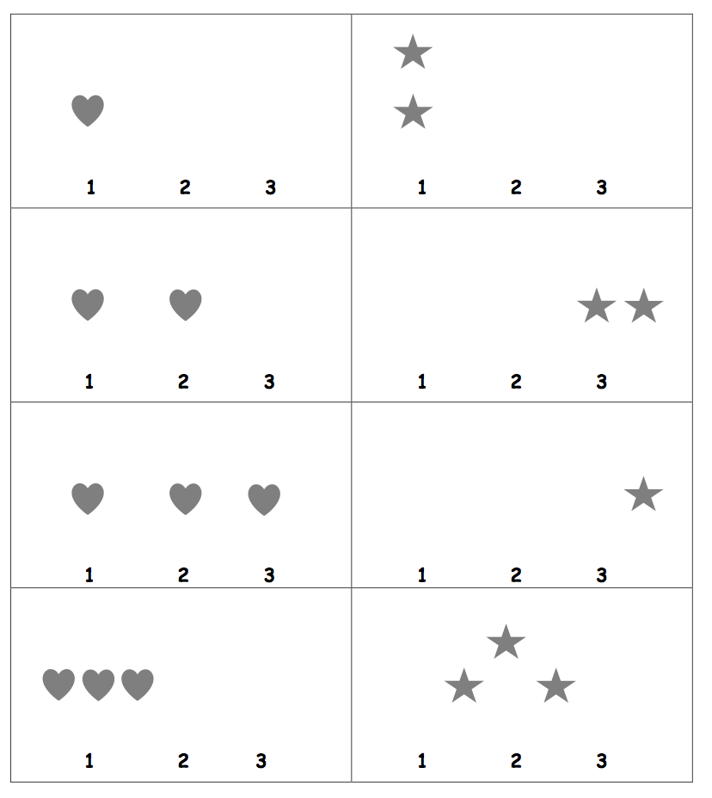
Kindergarten – Fluency
Sprint
Sprint steps:
Starting and stopping at the signal
Teacher role plays taking a sprint
First sprint Module 3 Lesson 21
Notes:
Sprints are timed, skill based exercises that are a set of intentionally laid out problems intended to improve students abilities to carry out procedures such as addition and subtraction.
Sprints are used throughout A Story of Units K-5 and beyond. They are first introduced in Kindergarten Module 3 Lesson 16.
Starting and stopping at the signal.
Practice writing the numbers to 10 and stopping when the bell rings before students are finished.
Teacher role plays
Display baby picture. Role play grading, circling right answers with a crayon and saying “yes!”
First sprint – Only one is given
Two-part sprint – The same sprint is given twice with an exercise in the middle and emphasis is based on the improvement from sprint A to sprint B (same sprint)
Two-part sprint – Same as above except that the second sprint (sprint B) is slightly different than sprint A.
TIME ALLOTTED FOR THIS SLIDE: 2 minutes
MATERIALS NEEDED:
X

Slide 21
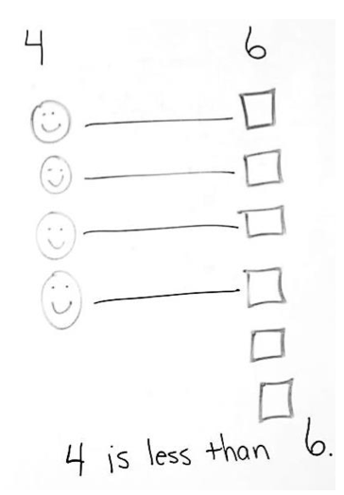
Kindergarten – Story Problems
Application Problems
T: In one straight line, draw to show how many people are sitting at your table.
T: Right next to that line, draw to show how many pencils are at your table.
T: Draw lines to match each person to one pencil. Are there more pencils or people?
T: Show your work to your partner and tell what you .
Notes:
In a Story of Units Application Problems are a part of each lesson. In Kindergarten, module 3, students solve problems involving measurement. Measurement in Kindergarten supports students’ understanding of amounts and their developing number sense. For example, comparing pencils to students and stating if there is enough, how many more are needed, and which has more or less, “There are more pencils than people because 6 is more than 4”.
LDS – Listen, Draw, Say is a pre-cursor to RDW in Grade 1 and 2.
RDW stands for read, draw, write (both a number sentence and a statement to answer the question).
The comparison work of Kindergarten and Grade 1 will apply to numbers in Grade 2.
TIME ALLOTTED FOR THIS SLIDE: 2 minutes
MATERIALS NEEDED:
X

Slide 22
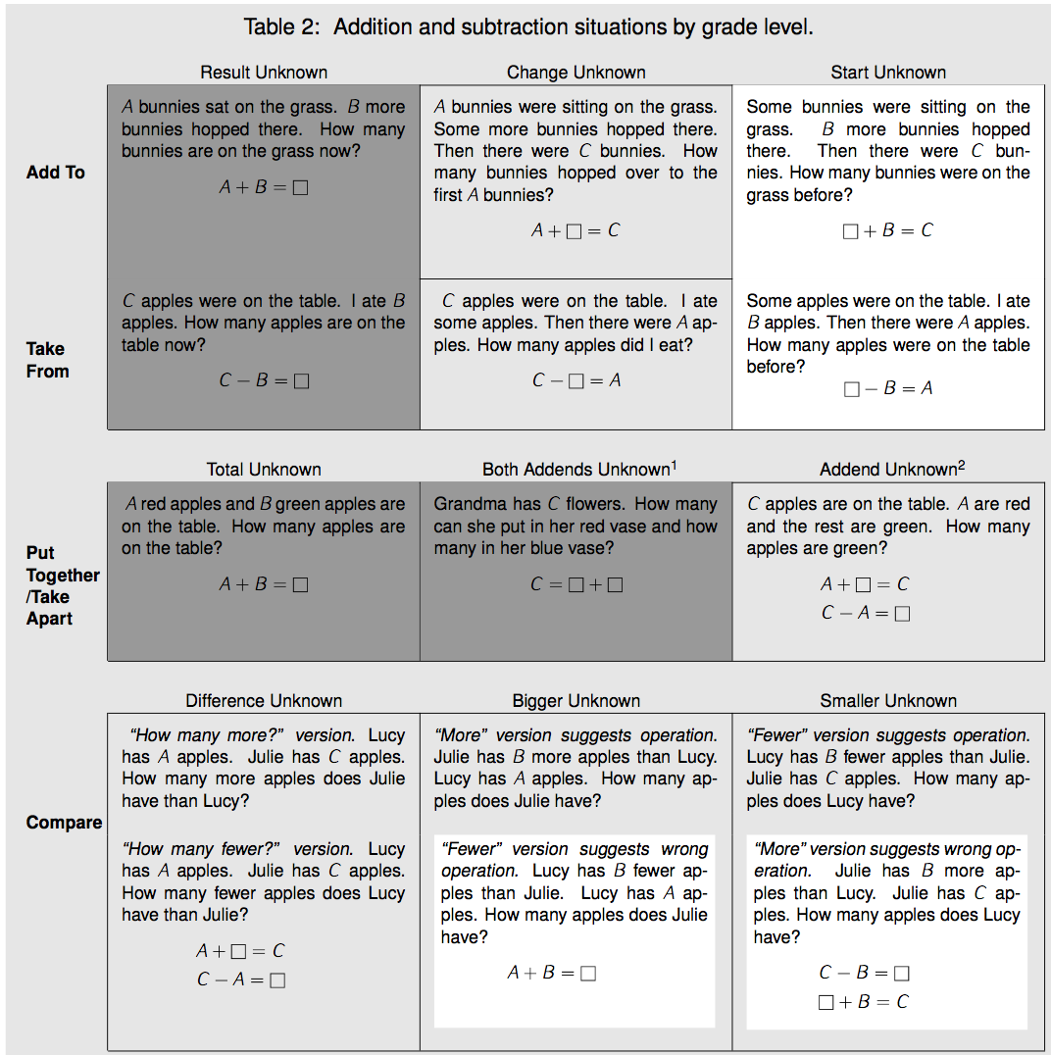
Story Problem Types
Notes:
Addition and Subtraction problem types are listed in the table above. This table is found in the Operations and Algebraic Thinking portion of the progressions.
Darker shading indicates the four Kindergarten problem subtypes. Grade 1 and 2 students work with all subtypes and variants. Un-shaded (white) problems are the four difficult subtypes or variants that students should work with in Grade 1 but need not master until Grade 2.
When teaching addition and subtraction at any grade level it is important to refer to this table to ensure equity among all of the problem types.
TIME ALLOTTED FOR THIS SLIDE: 3 minutes
MATERIALS NEEDED:
Problem types handout (page 9 from the OA progressions)

Slide 23
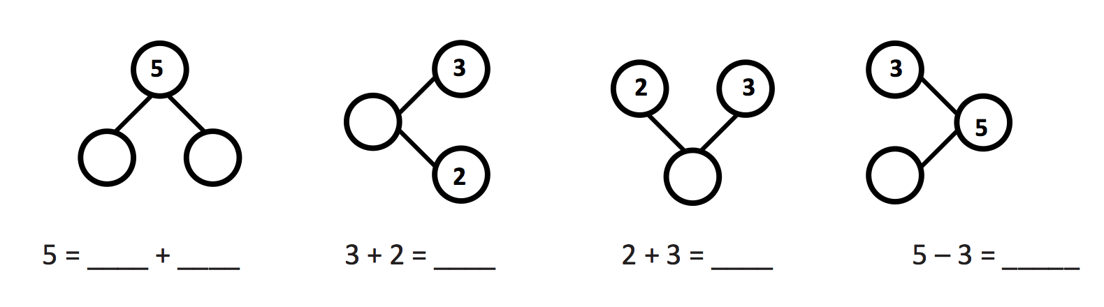

Kindergarten
Problem Type Number Bonds
Notes:
Tell a story to your partner that matches one of these bonds/equations and see if they can guess which number bond model you are using. (Refer to problem type chart if needed)
(Be sure to de-emphasize the orientation of the number bond but the relationship between the parts and wholes and what the unknowns refer to from the story problem.)
The image here is taken from the topic openers written for teacher content knowledge. In Kindergarten the number bonds begin with a proportionate model and emphasis is placed on the relationship between the parts and the whole, not the orientation of the bond. Throughout the module the bond is presented to the students in all the above orientations to promote understanding of the relationship of the parts to the whole and to reinforce the thinking that orientation doesn’t affect the relationship of the parts to the whole.
TIME ALLOTTED FOR THIS SLIDE: 7 minutes
MATERIALS NEEDED:
Problem types handout (page 9 from the OA progressions)

Slide 24
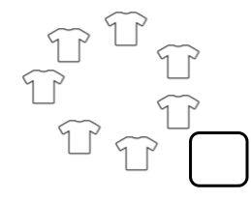
Kindergarten – Story Problems
Decomposition
Seven children were sitting in a circle. 4 of them were wearing green shirts. The rest were wearing yellow shirts. How many children were in the circle?
Kindergarten – Module 1 – Lesson 28
Notes:
In Kindergarten almost everything we do is embedded in a story. Kindergarten students use their innate story telling skills to “mathematize” real-world situations. After extensive counting activities and finding embedded numbers within 10 students begin to see two units making up a third unit “4 and 3 make 7”.
TIME ALLOTTED FOR THIS SLIDE: 2 minutes
MATERIALS NEEDED:
X

Slide 25
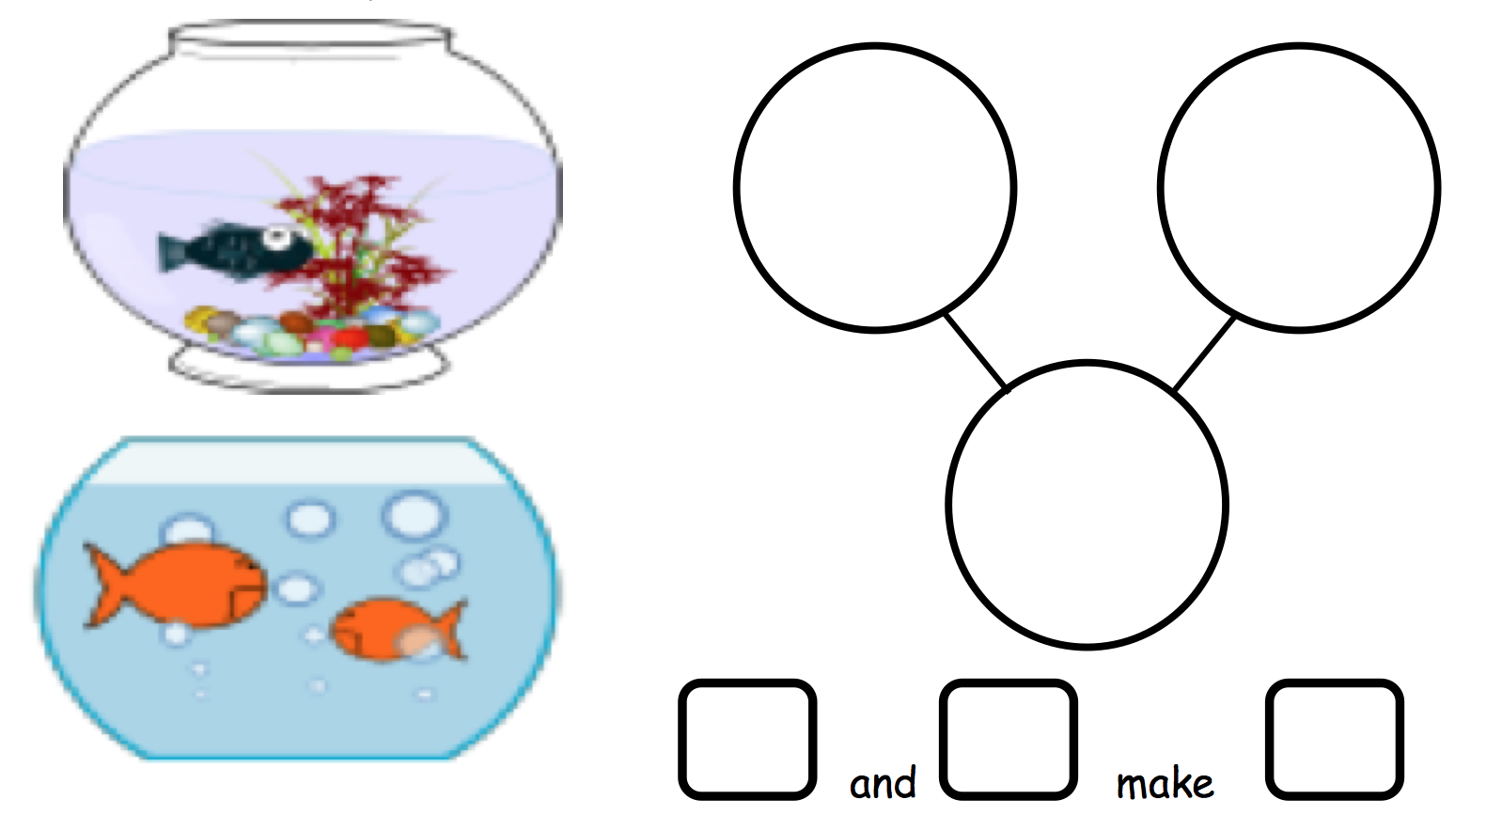
Kindergarten – Story Problems
Kindergarten – Module 4 – Lesson 1
Notes:
Learning to use and understand the number bond model is powerful in that it represents both addition and subtraction concepts. Students should understanding the parts and whole regardless of the orientation or the information given. This is crucial as students are posed with increasingly sophisticated problem types to be able to make a decision about which operations to use based on the information given in the problem.
TIME ALLOTTED FOR THIS SLIDE: 2 minutes
MATERIALS NEEDED:
X

Slide 26
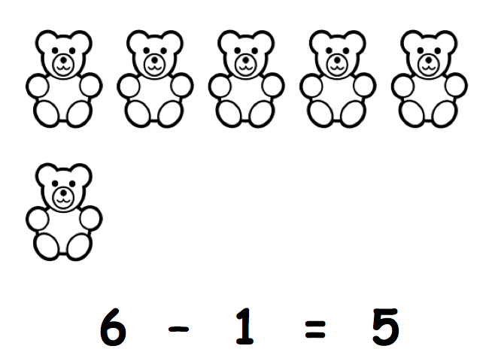
Kindergarten – Story Problems
Cross out the bears to
match the number
sentence.
Kindergarten – Module 4 – Lesson 20
Notes:
At this stage the students should be able to:
Identify what the questions is asking and which number refers to the “answer”.
Articulate what each number in the problem is referring to.
Draw a picture (concrete or pictorial) and tell a story to a given equation.
Represent a story problem using models, drawings, words or an equation.
There were 6 bears. One ran away. Now there are 5 bears. There is no unknown, no question. This is an exciting part of the curriculum wherein the students are able to identify the referents and match the action of the story to the number sentence. The subtraction symbol shows that one bear went away.
When they cross out the bears we want to guide and encourage students to cross out the bottom bear to help us evaluate their understanding of the 5 + n pattern or the unit of 5. Ultimately we want the students to realize the efficiency of this way of subtracting which will come into play with larger numbers in later grades.
TIME ALLOTTED FOR THIS SLIDE: 3 minutes
MATERIALS NEEDED:
X

Slide 27
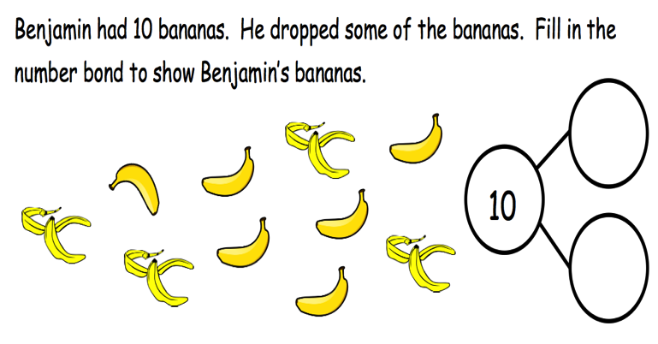
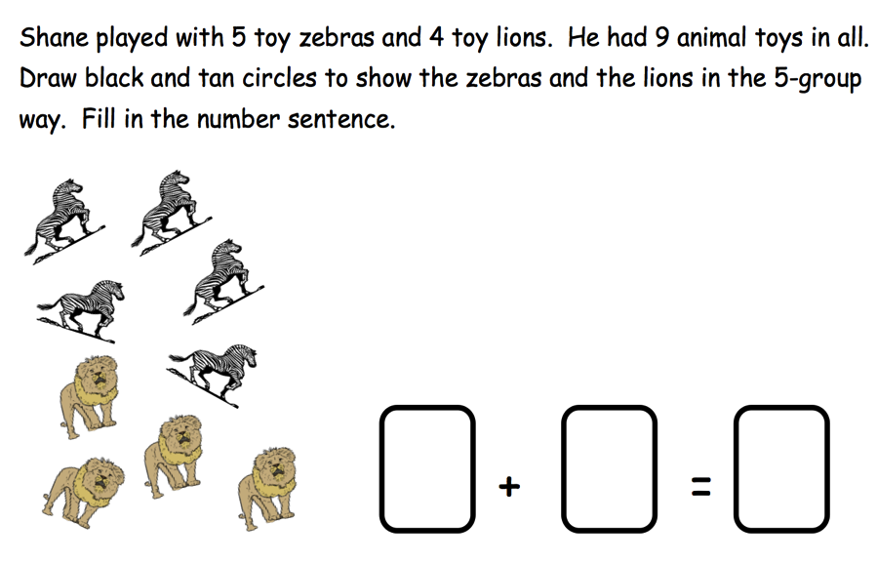
Kindergarten – Addition
Module 4 Lesson 27
Module 4 Lesson 31
Bill had 6 round crackers
and 3 square crackers.
How many crackers did
Bill have in all?
____ + ____ = ____
Module 4 Lesson 29
Notes:
Addition is putting together, combining, composing, finding a total. Counting on and counting all are ways to find the total. At this stage students will use both counting all and counting on strategies. Students explore addition and subtraction of numbers 1-10 using:
Number pairs – Students have explored number pairs with models and objects and use these skills to transition to representing them in a number bond.
Number bonds – Decomposing and composing numbers using number bonds help students understand the part-part-whole relationship and how addition and subtraction are related.
Expressions and Equations – Abstract representations of number pairs and bonds.
(CLICK to fade in the next three pictures)
Adding progression is as follows:
Decompose numbers to 10 using stories, objects, and number bonds (no equation)
Look at a picture, represent the picture in a 5-group, write the numbers in an equation with no unknown
Draw a picture and fill in the numbers for the equation
TIME ALLOTTED FOR THIS SLIDE: 4 minutes
MATERIALS NEEDED:
X

Slide 28
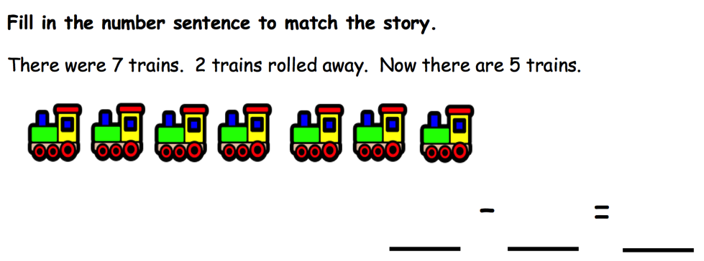
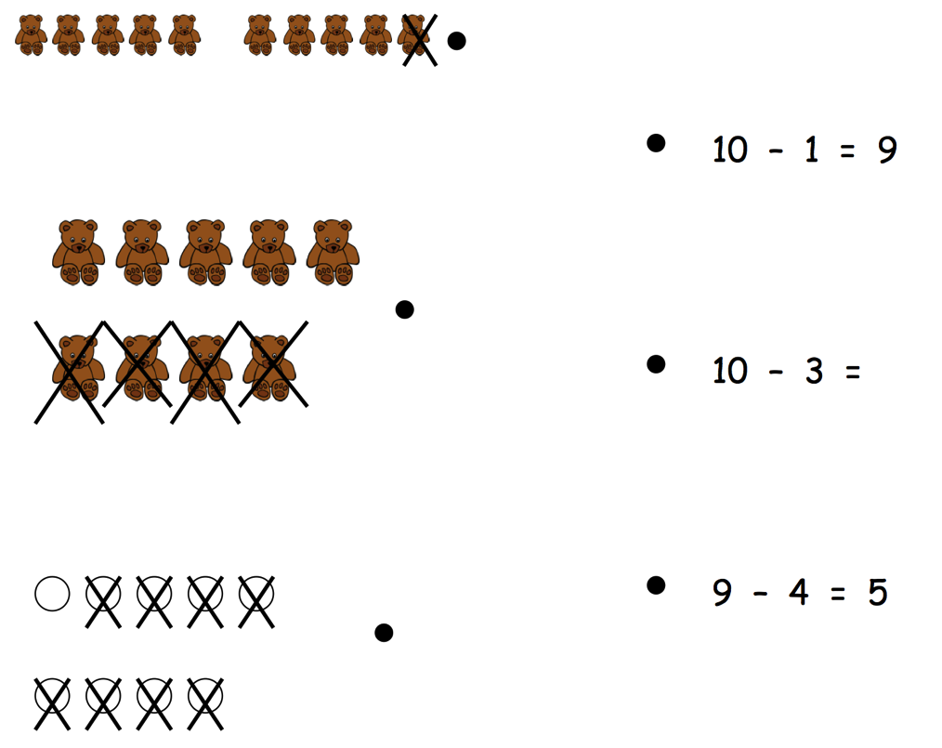
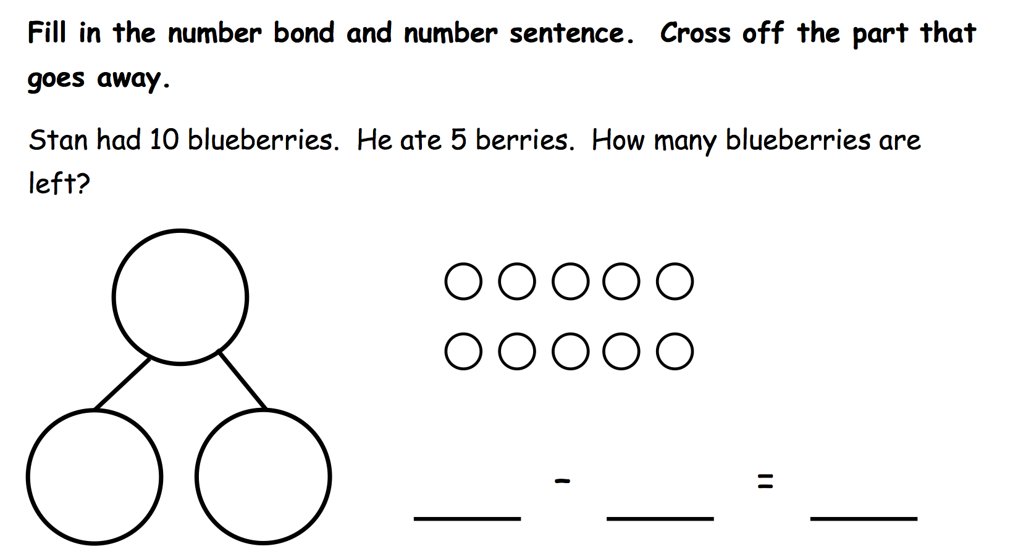
Kindergarten – Subtraction
Module 4 Lesson 33
Module 4 Lesson 33
Module 4 Lesson 36
Notes:
Subtraction progression is as follows:
(CLICK for each example)
Solve take from equations with no unknown using numbers to 10.
Represent subtraction story problems by breaking off, crossing out, and hiding a part.
Decompose the number 10 using 5-group drawings, and record each decomposition with a subtraction equation.
Note to presenter: The bear image is a section of a problem set therefore only 2 of the pictures match a correct equation.
TIME ALLOTTED FOR THIS SLIDE: 4 minutes
MATERIALS NEEDED:
X

Slide 29
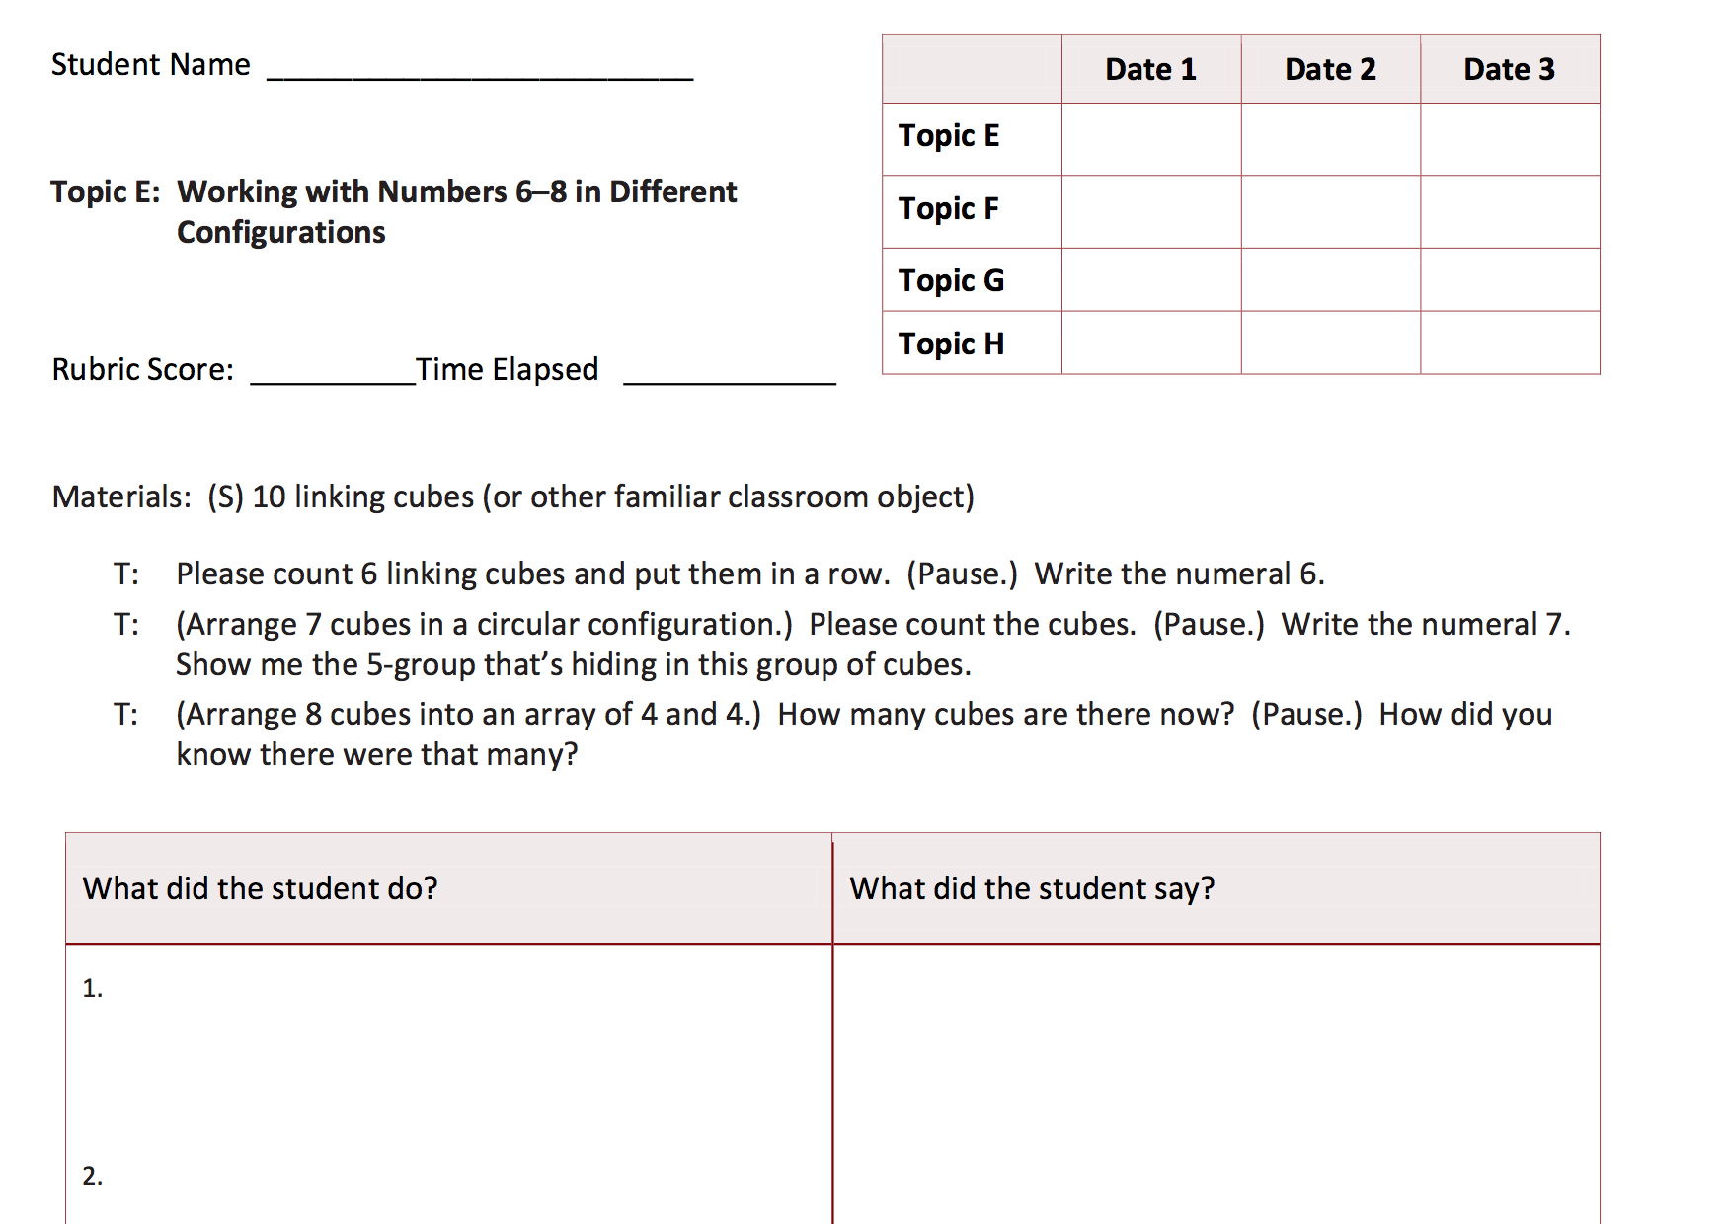
Kindergarten – Assessment
Kindergarten – Module 1 – Topic E
Notes:
Kindergarten assessments are one-on-one given interview style. The goal of the assessment is to establish a positive and collaborative attitude when analyzing progress. Each topic in a module is assessed with 3-5 questions based on the standards and what was learned over a 3-5 day period. In large modules there is typically a mid-module and an end-of-module assessment. The student's results are recorded in two ways:
The narrative documentation after each topic set
The overall score per topic using a 4-point rubric.
A stopwatch is used to document the elapsed time for each response, as response time in the primary years is an important indicator of learned skill or concept.
TIME ALLOTTED FOR THIS SLIDE: 5 minutes
MATERIALS NEEDED:
X

Slide 30
A Continuation of A Story of Units in Grade 1
By the end of Grade 1, students will:
Fluently add and subtract within 10 (1.OA.6)
Add and subtract within 20 (1.OA.6)
Use addition and subtraction within 20 to solve word problems (1.OA.1)
Add within 100 (1.NBT.4)
Subtract multiples of 10 in the range of 10 through 90 (1.NBT.6)
Notes:
Note to the presenter: During break, ask participants to prepare their personal boards by inserting the Number Bond Dash template, the Number Path template and the 5-group row template from the handouts. Also, ask them to cut out their 5-group cards.
For the next part of our presentation, we will be exploring how A Story of Units for Grade 1 unfolds in order to support our students into meeting their grade level standards in addition and subtraction and build a strong foundation towards their math understanding and work in the later grades.
By the end of Grade 1, students will:
Fluently add and subtract within 10, which is the only grade level fluency standard
Add and subtract within 20 using strategies such as counting on, making ten, taking from ten, using relationship between addition and subtraction (knowing that 8 + 4 = 12, one knows 12 – 8 = 4)
Use addition and subtraction within 20 to solve word problems
Add within 100
Subtract multiples of 10 from multiples of 10 in the range of 10 through 90 such as 90 – 20 = 70.
Materials Needed for G1 Portion of Presentation:
Presenter:
timer, die, 5 counting bears, mystery box (or dixie cup with ‘?’ on bottom), hide zero cards, linking cubes (9 red, 5 yellow, 5 blue, 2 orange), rekenrek, 5-group cards (and an extra “4”), templates (same as participants), paper and sharpies
Per pair of participants
scissors, linking cubes (2 sets of 20 cubes, different colors)
Handouts:
Target practice, Number bond dash, Number path, 5 groups row, Addition chart, Sprints, 5 group cards
Videos:
Happy Counting Say 10 Way, Tens and Ones
TIME ALLOTTED FOR THIS SLIDE: 2 minutes
MATERIALS NEEDED:
Number bond dash template
Number path template
5-group row template
5-group cards
scissors
Personal White Boards

Slide 31
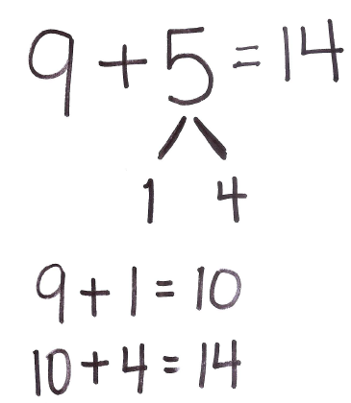
Foundational Skills for Grade 1
Partners to ten (K.OA.4)
Decompositions for all numbers within 10 (K.OA.3)
Representations of teen numbers as 10 + n (K.NBT.1 and 1.NBT.2b)
Notes:
As presented in the Kindergarten modules, the following are essential Kindergarten standards that are foundational to the work in first grade and beyond.
How much more a number needs to make ten (Partners to ten)
Decompositions of all numbers within 10
The ten plus facts (10+n)
In first grade, we are working hard to get students fluent with these skills in preparation for forming a unit of ten in M2, the foundation of place value strategies which are the basis of Level 3 strategies.
Let me show you how each of these K standards become integrated in Grade 1 as students to use the Make Ten strategy, a Level 3 strategy of converting a problem into an easier problem, by composing a unit of 10 first.
To solve 9 + 5, first, students must know 9 needs 1 more to make 10. (Partners to ten.)
We take 1 from 5 (CLICK) So 5 is now decompose into 1 and 4 (CLICK). (Decompositions to 5.)
Now, we have composed a new unit of ten by adding 9 and 1 (CLICK) and now can add the 4 extra ones to the ten. (10 + fact.) (CLICK) 10 + 4 = 14.
So 9 + 5 = (CLICK) 14.
We will explore the ways in which students continue to practice and strengthen these skills towards mastery in Module 1 and apply them in the later modules and grades as they work on Level 3 decomposition and composition methods and place value strategies.
TIME ALLOTTED FOR THIS SLIDE: 2 minutes
MATERIALS NEEDED:
X

Slide 32
Grade 1 – Level 2: Counting On
Use embedded numbers.
Find decompositions of 6, 7, 8, 9, and 10.
Solve addend unknown/change unknown problems.
Understand the meaning of subtraction as it relates to addition.
Notes:
The big idea of Grade 1 Module 1 is around bringing students from counting all to counting on in order to add and subtract numbers within 10. As you’ll recall from the Progressions Document, there are 3 Levels to the addition and subtraction strategies that the students employ. In GK, students practiced Level 1 counting strategies where each object was counted as 1 unit. They also worked on Level 2 counting strategies by seeing embedded numbers within a larger group.
For example, (hold up or show under doc cam) in a tower of 7, 5 are blue and 2 are orange. They see 5 as a unit and count on 2 more to get to 7.
Now, in G1, we work with students to independently use the Level 2 strategy of counting on as they continue to see 1 addend as a unit to which they add on or count on from. Students will develop this strategy by:
using embedded numbers in 5-group formations as well in varied configurations of dots
and use this strategy as the basis to:
find decompositions of numbers 6 through 10 in various combinations
solve addend unknown/change unknown problems and
understand the meaning of subtraction as it relates to addition.
Let’s look at each of these experiences to see how they support student understanding and use of counting on.
TIME ALLOTTED FOR THIS SLIDE: 2 minutes
MATERIALS NEEDED:
Presenter: Tower of 7: 5 blue, 2 orange

Slide 33
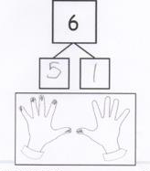

Grade 1 – Counting On:
Embedded Numbers
Seeing 5 as a Unit
Grade 1 – Module 1 – Lesson 1
Notes:
In Topic A, students count on from one embedded number to determine the total. Each time a student sees an embedded number, they are seeing a unit made of more than 1 object.
Their extensive work of 5 + n with the use of fingers, number towers and the Rekenrek with a color change at 5, and the 5-group formation allows students to easily identify 5 as a unit.
(CLICK) For example, in determining the number of nails painted, if students can see five as a unit and see 1 more, they know the total is 6. Five and 1 is 6.
(CLICK) Here, students can look at the set of dots and see 5 in the top row as a unit within the total number of dots. Once they have identified the 5, they can see the other part, 3. Now, we are able to guide students to count on from the 5 to determine the total. Students can count fiiiive, 6, 7, 8 and see that there are 8 dots. Number bonds are used here to show the two different parts composing the whole, building students’ understanding of addition.
If students can see five as a unit, they are going to be in a much better position to see ten as a unit in their later work.
Continue with 9.
TIME ALLOTTED FOR THIS SLIDE: 2 minutes
MATERIALS NEEDED:
X

Slide 34

Grade 1 – Foundations to Counting On:
Embedded Numbers and Decomposition
Seeing 5 as a Unit
5 + n
7
5
2
Grade 1 – Module 1 – Lesson 1
Notes:
Let’s try a few problems. How many dots are here? (7 dots.)
What numbers do you see inside 7?
I heard some people say they see 5. Are there 5 dots? (Yes.)
Where do you see the 5? (The top row.)
Let’s cover the 5. (CLICK) What is the other part to make 7? (2.)
(CLICK) So we saw two parts, 5 and 2 (point to the 2 parts). We can show that in the number bond.
(CLICK) Let’s count on from 5 to see how many dots are there in all. (With a pointer, gesture to the top row as you stretch out and say Fiiiiiive, then point to each individual dot as you model counting on 6, 7.)
5 and 2 make? (7.) (CLICK)
TIME ALLOTTED FOR THIS SLIDE: 1 minute
MATERIALS NEEDED:
X

Slide 35

Grade 1 – Foundations to Counting On:
Embedded Numbers and Decomposition
Seeing 5 as a Unit
5 + n
9
5
4
Grade 1 – Module 1 – Lesson 1
Notes:
How many dots are here? (9 dots.)
What numbers do you see inside 9?
I heard some people say they see 5. Are there 5 dots? (Yes.)
Let’s cover the 5. (CLICK) What is the other part to make 9? (4.)
(CLICK) So we saw two parts, 5 and 4 (point to the parts). We can show that in the number bond.
(CLICK) Let’s count on from 5 to see how many dots are there in all. (With a pointer, gesture to the top row as you stretch out and say Fiiiiiive, then point to each individual dot as you model counting 6, 7, 8, 9.)
5 and 4 make? (9.) (CLICK)
TIME ALLOTTED FOR THIS SLIDE: 1 minute
MATERIALS NEEDED:
X

Slide 36

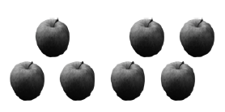




Grade 1 – Counting On:
Embedded Numbers
Grade 1 – Module 1 – Lesson 2
Notes:
In the following lesson, students are presented with objects or dots in varied configurations.
(CLICK) What 2 parts do you see here?
As students discuss the different parts they see within the total and the different ways they’re able to break the total apart, they begin to understand that a given quantity can be decomposed in a variety of ways. Again, the first number is a unit to which we can add on or count on by without counting all the apples. Starting with the first part they see, they continue to practice counting on to determine the total. Here, a student may see 4 and 3. They start with foouuuur, and count on, 5, 6, 7 to say that there are 7 apples in all.
Let’s practice counting on from an embedded number to find the total.
(CLICK to animate each dot cards. Have participants identify 2 sets in each configuration, practice counting on from an embedded number, and write out a number bond to match.)
As you can see, these lessons prepare the students to solve addition problems by counting on rather than counting all.
TIME ALLOTTED FOR THIS SLIDE: 3 minutes
MATERIALS NEEDED:
X

Slide 37
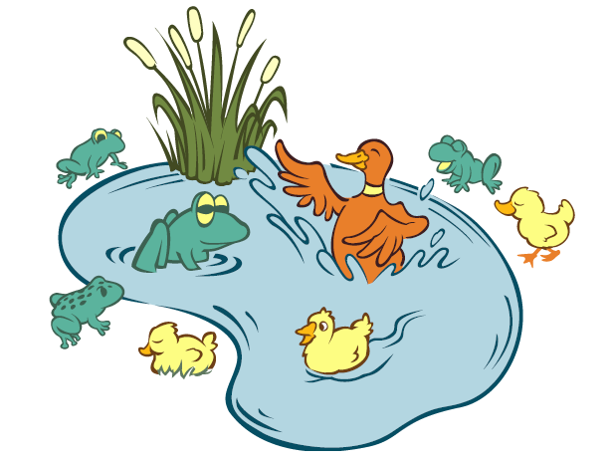
Grade 1 – Embedded Numbers and Decomposition Bridge to Counting On
Grade 1 – Module 1 – Lesson 6
Notes:
In Topic B, students use concrete and pictorial situations to describe all of the decompositions of 6, 7, 8, 9 and 10, as larger numbers can be decomposed into 2 smaller units. Students continue to see an embedded number which becomes an addend from which they count on to find the total. In the following lesson, students use 5-group cards to help count on from different embedded numbers to compose 8 and find all decompositions of 8. They then record their decompositions in number bonds and as expressions to total 8.
Demonstrate Lesson 6 Concept Development.
T: What 2 different animals do you see?
S: Frogs and ducks!
T: Partner A, show how many frogs there are with your 5-group cards, using the number side.
S: (Show the numeral 4.)
T: Partner B, show how many ducks there are with your 5-group cards, using the dot side.
S: (Show 4 dots.)
Note to the PRESENTER: SHOW THE CARDS UNDER THE DOCUMENT CAMERA.
T: Let’s count on to see how many animals there are altogether, starting with…
S: 4!
T/S: Foouuur, 5, 6, 7, 8. (Count, while pointing to the dots.)
T: Work with your partner to write a number sentence that matches our frogs and ducks on your personal white board.
S: (Write 4 + 4 = 8 or 8 = 4 + 4.)
T: How else are these animals different from one another?
Note to the PRESENTER: SWITCH BACK TO THE POWERPOINT AND SHOW PICTURE.
Have participants use the picture and come up with other ways to decompose 8. (Animals in the water, animals on land; adult animals, baby animals, etc.)
Some students may not need the dots to help use the counting on strategy. They may be able to look at, say 5 and 3, choose the greater number and count on from that larger unit in their head or by tracking with their fingers.
TIME ALLOTTED FOR THIS SLIDE: 4 minutes
MATERIALS NEEDED:
Presenter: 5-group cards plus an extra “4” card
Document camera
Participants: 5-group cards

Slide 38
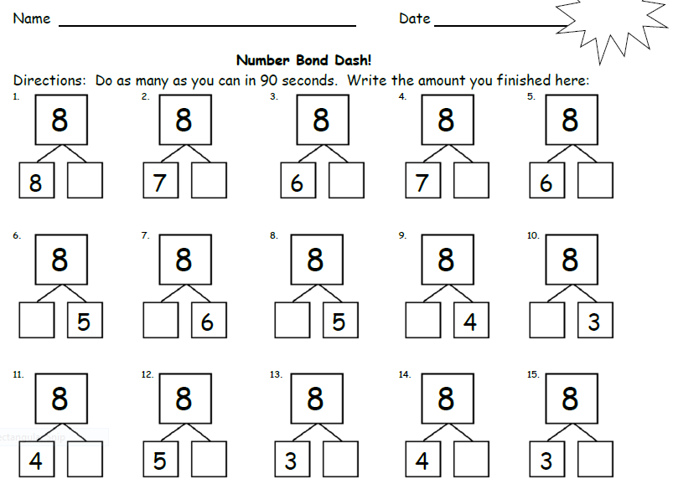
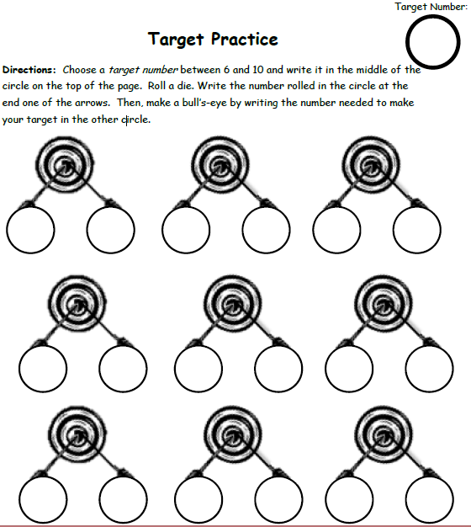
Grade 1 – Fluency: Decompositions
Notes:
After using 5-group cards to count on, the goal is for students move on to using the abstract number rather than relying on pictorial representation. Number Bond Dash and Target Practice are 2 fluency activities that provide continued practice for students to become fluent in decomposing numbers on an abstract level.
Please find an example of Number Bond Dash in your handout and insert it into your personal white boards, if you haven’t done so already.
In this particular Number Bond Dash, students are to complete as many number bonds for 8 as they can in 90 seconds. Students get many opportunities to work on decomposing numbers 5 through 10 using different versions of Number Bond Dashes and see themselves making improvements as they move on through the module.
Let’s have everyone do the Number Bond Dash. You’ll get 10 seconds, although the students will be getting 90. (Give 10 seconds for workshop participants. During this time, set up the document camera for “Target Practice”.)
You will also find a template for Target Practice in your handout. The teacher determines the target number, for instance, 7, which students write on top of their paper. The student rolls a die and writes the number as one of the parts in the number bond and determines and fills in the other part. For instance, if the target number is 7 and the student rolls 2, she writes 2 as one part and figures out and writes 5 to complete 7. (Demonstrate on the document camera and have the participants say what numbers to fill in for the number bond parts as the participant rolls the die.)
TIME ALLOTTED FOR THIS SLIDE: 4 minutes
MATERIALS NEEDED:
Presenter: timer, die, Target Practice template
Participants: Personal boards with Number Bond Template, Target Practice Template

Slide 39
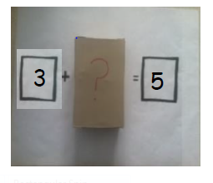
Grade 1 – Counting On: Add to with Change Unknown
Counting on to solve add to with change unknown math stories.
Once upon a time, 3 little bears went to play tag in the forest. Then some more bears came over. In the end, there were 5 little bears playing tag in the woods altogether. How many bears came to play?
Grade 1 – Module 1 – Lesson 11
Notes:
In Topic C, students are introduced to solving a new problem type: The add to change unknown problem type is used to encourage students to count on. Students physically add more to the first unit, the starting quantity, as they count on to determine the unknown part until they reach the total.
Let’s take a look at how the this problem type is introduced and encourages students to count on.
Demonstrate Lesson 11 Concept Development.
T: Once upon a time, 3 little bears went to play tag in the forest. (Place 3 bear counters under the document camera.)Then, some more bears came over. (Place the box with the question mark next to the bears.) In the end, there were 5 little bears playing tag in the woods altogether.
T: How many bears do you think came to play (point to the box)? Turn and talk to a partner.
S: (As students discuss, circulate and listen.)
T: How many bears joined the group to play tag? (Have students share ideas.) What strategy did you use to decide? (Ask a few students to share varying ideas.) Let’s use counting on to test our ideas.
S/T: (Gesture over the 3.) Threeeee, (Tap the box while drawing dots below the box for each count) 4, 5!
T: How many more bears came to play?
S: 2 bears!
T: Let’s find out if we were right. (Opens up the box and reveals 2 bears.) You were right! There were 2 more bears that came to play tag. (Closes the box and places the 2 bears on top of the box.)
T: Write the number sentence and number bond for the story.
Analyze the referents for each number ensuring that students understand what each number represents in the story. Emphasize the unknown in the number sentence and number bond as being the change.
TIME ALLOTTED FOR THIS SLIDE: 3 minutes
MATERIALS NEEDED:
Presenter: 5 Counting Bears, 2 of which are placed inside the mystery box or under the cup, Mystery Box (or paper cup from GK beans activity. Write a “?” on the bottom of the cup and place the cup upside down hiding the 2 bears), document camera

Slide 40
Grade 1 – Counting On: Relate Subtraction to Addition
Understanding the meaning of subtraction as it relates to addition
5
3 + ___ = 5
5 – 3 = ___
3
2
Grade 1 – Module 1 – Lesson 25
Notes:
Later in the module, students learn the meaning of subtraction as it relates to addition. Using the same lesson with the bears playing in the wood, students can see that subtraction can also be used to solve the problem. In the previous demonstration, we solved the mystery number by setting up an equation with a missing addend: 3 + ___ = 5. Let’s see how this problem can be solved using subtraction.
Demonstrate Lesson 25.
T: Once upon a time, 3 little bears went to play tag in the forest. Some more bears came over. In the end, there were 5 little bears playing tag in the woods. (Place 5 bear counters under the document camera.)
T: What does 5 stand for?
S: The number of bears playing at the end.
T: What does 3 stand for?
S: The number of bears playing in the beginning.
T: (Separate 3 bears slightly from the group.)
T: How many bears came over to play? Point to where you see them.
S: (Point to 2 bears.) 2 bears.
T: We can make an imaginary line with our finger to show the 2 parts. (Draw an imaginary line between 2 groups.) 3 bears were there first and then 2 more bears came. (Point to each part accordingly.)
T: Many of you used addition to figure out how many bears came over to play. When we checked our work just now, we separated the 3 bears from the total group of 5 bears. (Write 4 + __ = 6 on the board.) Since we know the whole and one part, we can use subtraction to find the other part. Turn and talk to your partner about how we could write this as a subtraction sentence.
T: (Choose a student to demonstrate her subtraction sentence using the bears.)
T: We can write 6 – 4 = 2 to show that we had 6 bears and separated 4 of them from the group, leaving us with 2 bears for the unknown part.
S/T: (Write 6 – 4 = 2 on the board.)
T: Circle the answer to our question in the number sentence.
T: What number bond matches the parts and the total for this story? Add that to your board.
S/T: (Draw number bond of 3 and 2 with the total of 5.)
T: Do both of your number sentences match the number bond?
S: Yes!
T: How are these number sentences the same? How are they different? Turn and talk to your partner.
S: Both number sentences gave us the answer. 2 more bears came to play. The first time, we used counting on and an addition sentence to solve. The second time, we used subtraction.
As students practice solving these add to with change unknown story problems, they write the number bond to match the parts and the total from the story and write both addition and subtraction number sentences. Representing the story as a number bond is a powerful method as students see the relationship between the parts and whole within the story and can relate it to both addition and subtraction sentences.
TIME ALLOTTED FOR THIS SLIDE: 3 minutes
MATERIALS NEEDED:
Presenter: 5 counting bears, Document camera

Slide 41

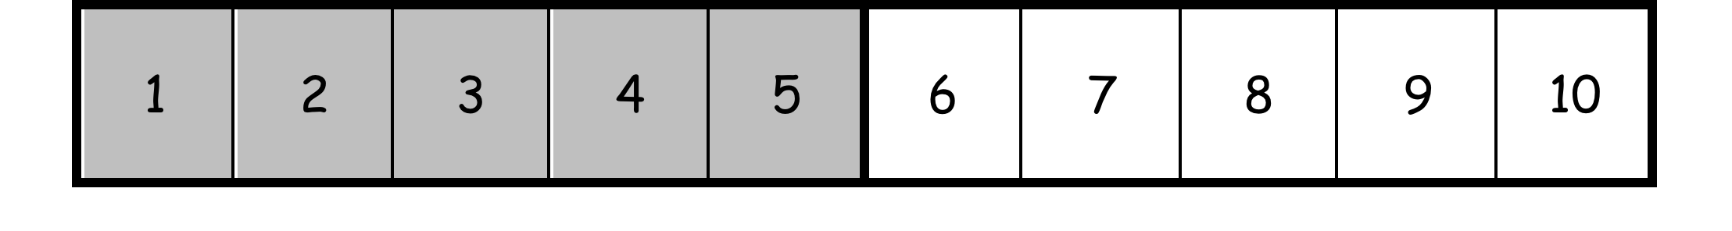
Grade 1 – Models
Number Path
7 + _____ = 8 8 – 7 = _____
2 + _____ = 9 9 – 2 = _____
8 + _____ = 9 9 – 8 = _____
Grade 1 – Module 1 – Lessons 26 and 27
Notes:
In M1, the number path is used for counting on to find the unknown part in an addition problem as well as its related subtraction problem. This model is reminiscent of the Rekenrek beads and the use of 5 groups. When counting on, students can start by circling the addend and hop forward one number at a time as they count on until they reach the total.
(Demonstrate on document camera.) First, when adding 2 numbers, 4 and 2 to find the total, we would circle the 4, and hop two places to add 2 and land on 6.
To solve the problem, (write) 4 + ___ = 6, students first ask themselves, “4 plus what number is the same as 6?” since the equal sign means “the same as.”
(Demonstrate.) They circle the 4 and hop as they count on until they reach the total of 6. They see that the unknown part, the missing addend, is 2.
(Continue demonstration under the document camera.) When solving a subtraction problem such as (write) 6 – 4, students can either use related addition method by starting with one part and hopping forward to the total as we just did. Or students may start at the total, circling 6 and hop backwards to take away the given part. To solve 6 – 4, students have the option of starting at 4 and counting their hops to get to 6, or staring at 6 and counting backwards 4 hops to get to 2.
(Switch back to the power point.) Use the number path and work with your partner to solve the problems on the slide. (Give 60 – 90 seconds.)
7 + ___ = 8, 8 – 7 = ___
2 + ___ = 9, 9 – 2 = ___
8 + ___ = 9, 9 – 8 = ___
As you use the number path to solve , think about the following question:
When is counting on more efficient and when is counting back more efficient? This is a discussion students have after having lots of experience solving related addition and subtraction problems.
TIME ALLOTTED FOR THIS SLIDE: 3 minutes
MATERIALS NEEDED:
Presenter: Number path on the white board, document camera
Participants: Number Path template inserted in the personal white board

Slide 42


Grade 1 – Models
Number Path
When solving 9 – 8 = ___ on the number path, which strategy is more efficient? Counting on or counting back?
8 + ___ = 9
9 – 8 = ___
Grade 1 – Module 1 – Lessons 26 and 27
Notes:
As we just discussed, sometimes, it’s more efficient to count on when the total and the part are close to each other. As the total gets larger and the part gets smaller, it can be more efficient to count back, as in 2 + ___ = 9. You would want to start from 9 and just count back 2 times.
TIME ALLOTTED FOR THIS SLIDE: 1 minute
MATERIALS NEEDED:
X

Slide 43
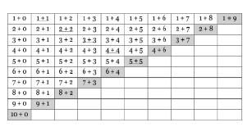
Grade 1 – Addition Chart
Notes:
At the end of Module 1, first graders use the addition chart (found in your handouts) and analyze their ones, twos, threes, and see patterns in the numbers.
Here are all the addition facts first graders are expected to be fluent with by the end of the year. At first glance, this seems like a lot of facts. As students analyze the chart, they realize that they know the first column. (CLICK)
They also realize that they know the second column. (CLICK) Students see the "Plus ones" are the same as the next number. “The answer is the next number. It’s like the number stairs we built in Kindergarten!”
(CLICK) They then see that 3+1, a fact from the 2nd column can be found in the first row, as 1 + 3. In fact, students can recognize the power of commutative property throughout the chart.
Students also notice that they know all the combinations to make 10 as seen in the staircase at the bottom of the chart. (CLICK)
Previous to looking at the addition chart, students also learn to use doubles to add near doubles, also known as doubles + 1. For instance, if the students know 4 + 4 = 8, they can add 4 + 5 by recognizing that the answer will be just 1 more than 4 + 4.
Looking at this chart, that means students who already know their doubles fact (CLICK) can also know to other diagonal stairs on this chart – the doubles + 1 facts. (CLICK)
What other patterns will students notice? Turn and talk to the person next to you.
As you move cross the row or down a column, the total increases by 1. One added remains the same but the other addend increases by 1.
As you move up diagonally, the totals remain the same (See the gray “stairs” on the bottom of the addition chart on the ppt. These are all decompositions of 10.) They make up the different decompositions of the same number.
TIME ALLOTTED FOR THIS SLIDE: 3 minutes
MATERIALS NEEDED:
Participants: Addition Chart from the handout

Slide 44
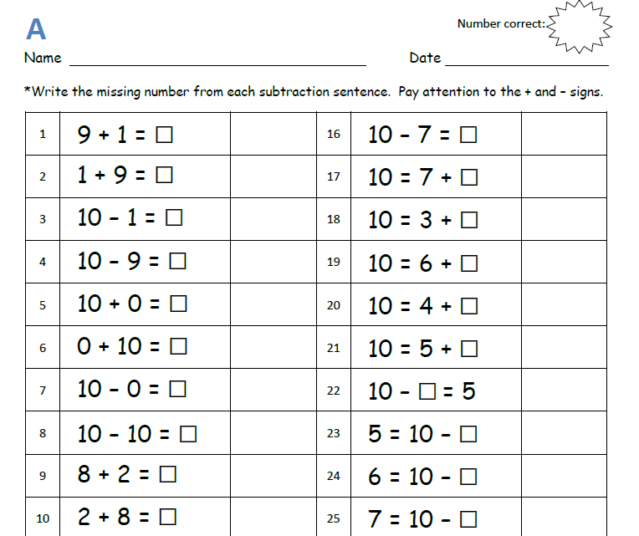
Grade 1 – Addition and Subtract within 10
Notes:
By the end of Module 1, students add and subtract within 10 at the abstract level. As you can see from this sprint, which you’ll find in your handouts, students are able to look at a number sentence, whether it be addition or subtraction and put their knowledge to work in finding the unknown number.
What skills or strategies have we shared until this point that you can imagine students employing to solve abstractly?
*Partners to 10
*Relationship between addition and subtraction
*Counting on to find the missing addend
*Understanding number sentences written in different order
TIME ALLOTTED FOR THIS SLIDE: 3 minutes
MATERIALS NEEDED:
Participants: Sprints from Handout

Slide 45
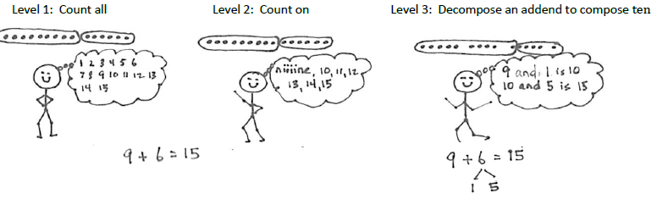
Grade 1 – Level 3: Convert to an Easier Problem
Notes:
Module 2 is a crucial time period in Grade 1 as student develop their use of Level 3 strategies where they convert a problem into an easier problem. Students are introduced to and are practicing the Make 10 strategy and Take from 10 strategy in order to add and subtract numbers within 20.
Let’s take a look at how students progress through Level 1, Level 2 and Level 3 strategies as they try to solve 9 + 6.
(CLICK) Students at Level 1 count all, starting with the first dot all the way to 15 dots. Here, each object is 1 unit.
(CLICK) Students at Level 2 understand that the first addend is a unit of 9 and therefore, count on from 9 to get to 15.
(CLICK) Finally, students at Level 3 see each addend as a unit, one of which can be manipulated to compose a new unit, a ten. At this point, students are reminded how easy it is for them to add when one of the units is 10. 9 needs 1 more to complete a new unit of 10. 1 is taken from 6 and 5 are now remaining. We now have 2 new units, 10 and 5, which equal 15. This strategy is called Making a Ten.
In M2, students will explore Level 3 strategies, the make 10 strategy to add (and take from 10 strategy to subtract) within 20, starting on concrete and pictorial levels and move towards working to solve abstractly using the notation you see on the last picture.
Up to the this point, students have been strengthening the 3 prerequisite skills necessary for solving problems such as 9 + 6 using this Level 3 strategy. Earlier in our presentation, we’ve looked at a number of K and G1 fluency activities and lessons to support making Partners to Ten and Decompositions of Numbers within 10 . Let’s looks at some fluency activities that will help students master their 10 plus facts.
TIME ALLOTTED FOR THIS SLIDE: 2 minutes
MATERIALS NEEDED:
X

Slide 46
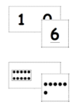
Grade 1 – Fluency
Focus on 10 + n
http://www.engageny.org/resource/nti-november-2012-rigor-breakdown-counting-exercises-for-k-1
Happy Counting: the Say Ten Way
Tens and Ones
Hide Zero Number Sentences
Rekenrek
Hide Zero Cards
Notes:
VIDEO – watch a demonstration of number glove counting (except that a glove isn’t being used) from 0:00–2:20. Tell participants that they can find this video on EngagyNY.org if they are interested in watching the rest of the video with additional counting exercises.
Here are some fluencies which will support students in decomposing numbers into tens and ones.
Happy Counting: the Say Ten Way SHOULD HAVE THE VIDEO SOON!! If not here’s the script:
(You may use the Rekenrek first. Then use your thumb to signal counting up and down.)
Let’s count up and down by 1s using the Say Ten Way. (i.e. 9, 10, ten 1, ten 2, ten 3, pause, ten 2, ten 1, pause, ten 2, ten 3, ten 4, etc.)
Now, let’s count up and down by 1’s alternating the Say Ten Way with the Regular Way. (i.e.,, ten 1, 12, ten 3, 14, pause, ten 3, 12, ten 1, pause, etc.)
Tens and Ones: SHOULD HAVE THE VIDEO SOON!! If not here’s the script: (Need Rekenrek.)
T: (Show 16, 6 on top, 10 in the second row, on the Rekenrek). How many tens do you see?
S: 1.
T: How many extra ones?
S: 6.
T: Say the number the Say Ten way.
S: Ten 6.
T: Good. 1 ten plus 6 ones is?
S: 16.
This time, we will be practicing the same concept but with Hide Zero Cards which will help student move on to the abstract or the pictorial level, depending on which side you use.
Hide Zero Number Sentences: (Use document camera.)
When I show you a number using my Hide Zero Cards, I want you to say the addition sentence starting with the tens as your first addend. For example, if I show you 14. You would say, 10 + 4 = 14. (Continue with other teen numbers.)
All of the hard work in achieving fluency in these skills will prepare students for their Level 3 strategy work of Making Ten to add.
TIME ALLOTTED FOR THIS SLIDE: 4 minutes
MATERIALS NEEDED:
Presenter: Rekenrek (or Video Clip), Hide Zero Cards, document camera

Slide 47
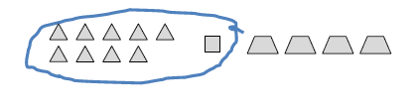
Grade 1 – Convert to an Easier Problem Make Ten
9 + 1 + 4 = 14
10
10
1 + 4 + 9 = ____
Grade 1 – Module 2 – Lessons 1 and 2
Notes:
Module 2 begins with 2 lessons that set students up for the Make Ten strategy . Students solve problems with 3 addends where each problem encourages students to use the associative and commutative properties to first compose a unit of 10 with 2 of the addends, then adding the 3rd addend using 10 plus facts. As students first compose a unit of 10, they begin to realize that 10 is a friendly number.
For example, in Lesson 1, students figure out how many pattern blocks there are when they are presented with 9 triangle blocks, 1 square blocks and 4 trapezoid blocks. This leads to a discussion that when you add 9 and 1, you make 10. Then you can add 10 and 4 to get 14.
(CLICK) If the problem was 1 + 4 + 9, students can still make 10 with 1 and 9, using the associative property (CLICK) and add on the 4 to get 14.
As you can see, knowing partners to 10, in this case, knowing that 9 needs 1 more to get to 10, and the ten plus fact, as in 10 + 4, helps students easily solve this problem.
TIME ALLOTTED FOR THIS SLIDE: 2 minutes
MATERIALS NEEDED:
X

Slide 48
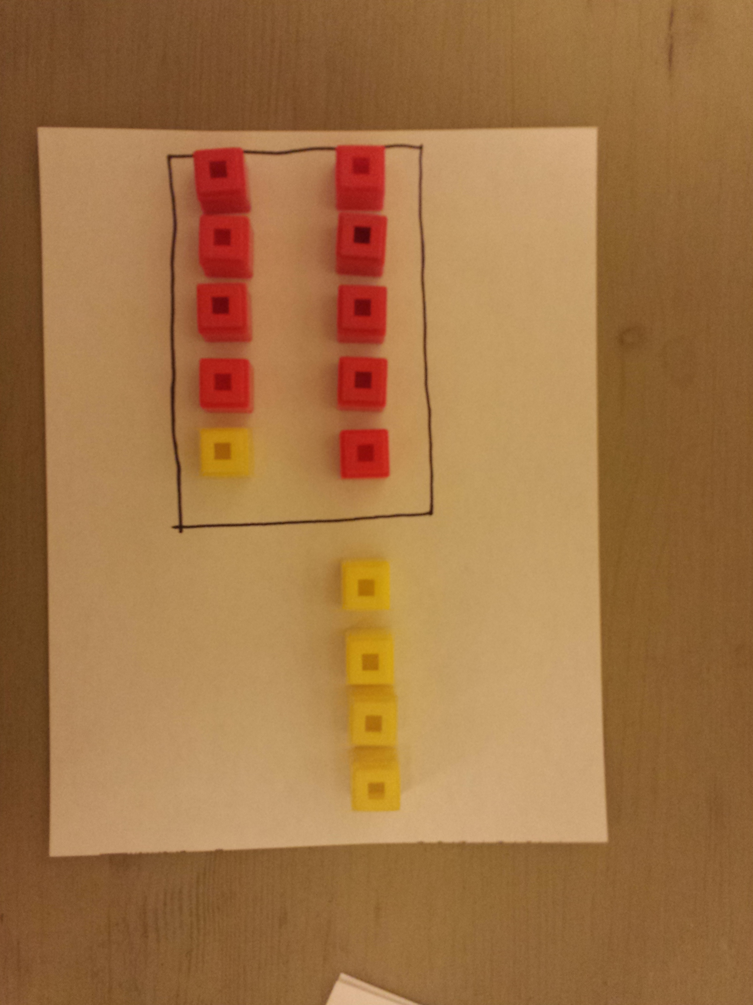
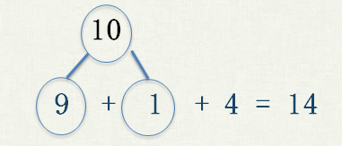
Grade 1 – Convert to an Easier Problem Make Ten
9 + 5 = ____
Grade 1 – Module 2 – Lessons 3-10
Notes:
How will knowing 9 + 1 + 4 help students prepare for the make 10 strategy? Let’s take a look at its related problem, 9 + 5.
(Demonstrate under document camera.)
(Lay out 9 red cubes and 5 yellow cubes in 5-group.)
How many does 9 need to get to 10? (1)
Let’s take 1 from 5. (Take 1 yellow cube and add to the 9 to make 10.)
We just made 10. To show we made 10, which is a friendly number, let’s put a frame around it.
Let’s look at our new piles. What new piles do you see? (10 and 4)
So, 9 + 5 is the same as? (10 and 4).
What is 10 + 4? (14)
What is 9 + 5? (14)
(Demonstrate.) Here is a pictorial representation of the Make 10 Strategy using o’s and x’s.
(Demonstrate.) Here is the abstract representation of solving 9 + 5. (Use the number bond to decompose 5 into 1 and 4 and emphasize the connection to the cubes and the math drawing. You can see that the 5 yellow cubes and the 5 x’s were broken apart into 1 and 4.)
As you can see, students compose a unit ten from the larger addend, the 9, by decomposing the second addend, the 5, into two smaller units, 1 and 4. 9 + 5 is composed to new units, 10 and 4. 10 + 4 = 14, so 9 + 5 = 14.
TIME ALLOTTED FOR THIS SLIDE: 3 minutes
MATERIALS NEEDED:
Presenter: 9 red and 5 yellow linking cubes, piece of paper, document camera

Slide 49
Grade 1 – Convert to an Easier Problem Make Ten
Now You Try!
9 + 3 = ____ 5 + 9 = ____
8 + 3 = ____ 7 + 8 = ____
Grade 1 – Module 2 – Lessons 3-10
Notes:
Now it’s your turn to solve these problems using the make 10 strategy. As you solve, we would like for you to represent your process using the concrete-pictorial-abstract progression for the first 2 problems. First, use the linking cubes and the ten frame to solve, then try making a math drawing using Os and Xs, and end with using a number bond to solve each problem. For the last 2 problems, solve using just the number bond. Ultimately, our goal is to have students move away from using concrete and pictorial representations and use just numbers to solve. (Give 2 minutes.)
Topic A progresses in a way that allows students to focus adding with 9 as an addend first, then 8 as an addend, and generalize this new making ten strategy to a new number, 7 and move on to solving a variety of problems involving a mixture of 7, 8, 9 as addends.
What patterns will students notice when 1 addend is a 9? 8? (In a Make Ten strategy, when an addend is 9, you take out 1 from the other addend. When an addend is 8, take out 2 from the other addend.)
TIME ALLOTTED FOR THIS SLIDE: 3 minutes
MATERIALS NEEDED:
linking cubes
personal white boards

Slide 50
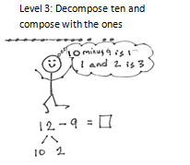
Grade 1 – Convert to an Easier Problem Take from Ten
Notes:
Module 2 Topic B is devoted to introducing the Take from Ten strategy and provides opportunities for students to explore and practice this Level 3 strategy.
TIME ALLOTTED FOR THIS SLIDE: 1 minute
MATERIALS NEEDED:
X

Slide 51
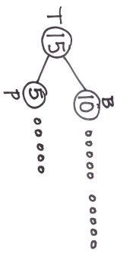

Grade 1 – Convert to an Easier Problem Take from Ten
Bailey Bunny has 15 carrots. 10 are in the basket and 5 are on the plate. She ate 9 carrots from the basket. How many carrots were left?
Grade 1 – Module 2 – Lesson 12
Notes:
Let’s take a look at how this strategy is introduced to the students. Similar to introducing the Making Ten strategy in Topic A, the first 2 lessons in Topic B serve as preparatory lessons for the Take from Ten strategy.
Here is a word problem.
Bailey Bunny has15 carrots. 10 are in a basket and 5 on a plate. She ate 9 carrots from the basket. How many carrots were left?
Here, the story problem explicitly asks the students to take away 9 from 10. (CLICK) When solving 15 – 9, students can see that 10 – 9 = 1 and 1 + 5 = 6. This allow students to begin using the take from ten strategy because the teen number is already separated into 2 smaller units for them, a unit of 10 and some ones and asks them to take 9 from 10 .
TIME ALLOTTED FOR THIS SLIDE: 2 minutes
MATERIALS NEEDED:
X

Slide 52

Grade 1 – Convert to an Easier Problem Take from Ten
12 – 9 = _____
Grade 1 – Module 2 – Lesson 13
Notes:
Now, we are ready to subtract 9 from a teen number. When solving 12 – 9 without the context of a story where students are explicitly asked to take 9 from 10, they should begin to decompose the teen number into 2 smaller units, a unit of 10 and some ones on their own and take 9 from Ten since we can’t take away 9 from 2. The next few lessons that follow focus on students modeling subtraction from teen numbers moving from concrete and pictorial representations to the abstract.
Here, we show 12 – 9 at the pictorial level.
(CLICK) This template, included in your handout, is provided for students in their personal white boards where 10 from a teen number is already drawn to help them make their pictorial representation more efficient. To solve 12 – 9, one must decompose 12 (CLICK) into 10 and…?
2 (CLICK) as a math drawing.
To subtract 9, students can simply cross off 9 from 10 (CLICK), leaving them to add 1 and 2 to get 3 as the answer.
(Use the document camera to demonstrate written notation.) It is crucial to always relate the pictorial representation to the abstract. Students show that 12 was decomposed as 10 and 2. We subtracted 9 from 10 and were left with 1 and 2 which equals 3. 12 – 9 = 3.
Let’s try one more. (Guide participants to solving 11 – 9 using the 5-group row template.)
TIME ALLOTTED FOR THIS SLIDE: 2 minutes
MATERIALS NEEDED:
Presenter: 5-group row template, document camera
Participants: 5-group row template inserted in personal white boards.

Slide 53
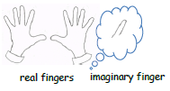
Grade 1 – Convert to an Easier Problem Take from Ten
11 – 9 = ____
Grade 1 – Module 2 – Lesson 16
Notes:
Students can also use real and imaginary fingers as a tool to subtract using Level 3.
T: Using your own fingers, show me 11 fingers.
(And students will say something like: We can’t! We only have 10 fingers!
T: You’re right. We’ll just have to use our imagination. First, put up your 10 fingers. (Show 10 fingers.)
S: (Show 10 fingers.)
T: How may more fingers do we need to imagine to have 11 fingers?
S: 1 finger.
T: Visualize or picture 1 more finger next to your 10 fingers.
T: We need to take away 9. Can we take away 9 from 1 imaginary finger?
S: No.
T: Can we subtract 9 from our 10 real fingers?
S: Yes.
T: Take away 9 all at once from the real fingers. (Take away 9, leaving 1.)
S: (Take away 9, leaving 1 finger.)
T: How many real fingers do you have up?
S: 1 finger.
T: How many imaginary fingers do you still have up?
S: 1 finger.
T: What is 1 and 1?
S: 2.
T: So what is 11- 9?
S: 2.
(Record written notation using the document camera.)
Let’s try one more. (Repeat the process for 13 – 8.)
TIME ALLOTTED FOR THIS SLIDE: 2 minutes
MATERIALS NEEDED:
X

Slide 54


Grade 1 – Convert to an Easier Problem: Make Ten to Subtract
13 – 8 = _____
8 + _____ = 13
Grade 1 – Module 2 – Lesson 19
Notes:
Earlier in the year, students used the number path to 10 to use related addition sentence to subtract. In Lesson 19, students apply the same idea as they use related addition sentence to subtract within 20 by using the number path that’s extended to 20. The number path invites students to count on. However, students are counting on with efficiency. This is a BIG step forward and a bridge to making ten to subtract.
For example, if students were to count on to solve 13 – 8 using the number path, they might do the following.
Starting from 8, they may count eiiight, 9, 10, 11, 12, 13 (use pointer and gesture hopping one number at a time) and count the number of arrows made.
But a more efficient way to count on is to make 10 first.
Start from 8
Get to 10 (Click to animate.) by adding 2.
Then get to 13 (Click to animate.) by adding 3 more.
Here, students must know their partners to 10 as well as knowing that a teen number is of the form10 + n. Eventually, students move away from having the actual number path and work on a problem such as this by using just the arrows:
(Click to animate.)
+2 +3
8 → 10 → 13
TIME ALLOTTED FOR THIS SLIDE: 2 minutes
MATERIALS NEEDED:
x

Slide 55
Grade 1 – Convert to an Easier Problem Take from Ten
14 – 8 = _____
Number path
5-group row drawing
Number bond
How do these models relate to one another?
Notes:
With the person sitting next to you, solve 14 – 8 using:
the number path
5-group row drawing
real and imaginary fingers and
number bond
Talk to your neighbor and compare how using the number path to 14 – 8 is related to using the 5-group row drawing, the real and imaginary fingers and number bond. How are these representations similar?
As you can see, each model we choose emphasizes the same concept, the completion of, or working with, the unit of (5 or )10, the relationship of one unit to another. All models are about making a story of units more simple.
TIME ALLOTTED FOR THIS SLIDE: 3 minutes
MATERIALS NEEDED:
Participants: Number Path and 5-group row template (from handout) in personal board

Slide 56
Grade 1 – Convert to an Easier Problem Take from Ten
Now you try!
13 – 9 = _____ 15 – 9 = _____
15 – 8 = _____ 13 – 7 = _____
Notes:
With your partner, now try these! You may use different models to practice, but always end with using the number bond to solve. This is because, ultimately, working at this abstract level will make the students’ work with double digit numbers in the future much easier.
13 – 9 =
15 – 9 =
15 – 8 =
13 – 7 =
TIME ALLOTTED FOR THIS SLIDE: 3 minutes
MATERIALS NEEDED:
Participants: Number Path and/or 5-group row template in personal board

Slide 57
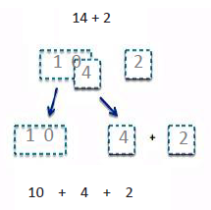


Grade 1 – Models
Hide Zero Cards and Magic Counting Sticks
Magic Counting Sticks
Hide Zero Cards
Grade 1 – Module 2 – Lesson 27
Notes:
Module 2 culminates with naming 10 as a unit of 1 ten. This is the very first time students are introduced to this language of ten as a unit. Up until now, they have used 10 as a friendly number but see it as 10 individual ones. Now they are introduced to ten as a unit so that these 10 linking cubes become 1 ten (show a ten stick) and this Rekenrek row becomes not only 10 individual beads but 1 ten (push 10 across all at once.)
Students go back to their work with their Hide Zero Cards and their Magic Counting Sticks, now rethinking their teen number as 1 ten and some more ones, as in 17 is the same as 1 ten and 7 ones.
Let’s see how this understanding will help students solve addition and subtraction problems within 20.
NOTE to presenter: Will need 2 volunteers to be Partner A and Partner B as the presenter projects the hide zero cards as scripted.
T: Using your magic counting sticks, show me 10 ones.
S: (Wiggle all 10 fingers.)
T: Show me 1 ten. (Clasp 1 both hands.)
S: (Clasp both hands.)
T: (Project 14 with Hide Zero Cards.) With your partner show me 14 as a ten and some ones.
S: (Partner A clasps hands, Partner B shows 4 fingers.)
T: How many tens are in 14?
S: 1 ten.
T: 14 is 1 ten and how many ones?
S: 4 ones.
T: Let’s add 2. (Project 2 with the Hide Zero Card and write 14 + 2.) How will you do this? Will you add 2 to the ten or to the ones? (Split the Hide Zero Cards into 10 and 4)
S: To the ones.
T: Add 2 more fingers.
S: (Partner B adds 2 more fingers.)
T: 4 and 2 is?
S: 6.
T: 10 and 6 is?
S: 16.
T: How many tens and ones make up 16?
S: 1 ten 6 ones.
Repeat with 15 + 3.
Let’s subtract. With your partner, show me 13 as a ten and some ones. (Write 13 – 2.) Let’s take away 2. Can I take from the ones? (Yes.) Partner B, take 2 from 3. What do you have? (1.) Partner A and B, put your fingers together. What is 13 – 2? (11.)
With your partner show me 12 as a ten and some ones. Let’s take away 9. Can I take from the ones? (No.) Can I take from the ten? (Yes.) Partner A, unbundle your ten. (Show all fingers.)
Take away 9 all at once. (Show 1 finger.) What is 1 and 2? (3) So what is 12-9? (3)
Say the number sentence. (12 – 9 = 3.) Let’s try some more: 13 – 9, 15 – 8.
TIME ALLOTTED FOR THIS SLIDE: 4 minutes
MATERIALS NEEDED:
Presenter: Hide Zero Cards, 2 volunteers

Slide 58
Grade 1 – Models
5-Groups
Evolution of 5-group formations:
K
G1-M1, M2
G1-M2
G1-M4
Notes:
In the next module, as students add and subtract numbers within 40, quick ten drawings are used to efficiently represent their numbers. The quick ten developed out of the five groups as they are first in two rows, either horizontally or vertically.
(CLICK) The formation transforms so the two rows are end to end, and then again with a line drawn through the dots. The way you saw the 5-group row or the way students build a stick of ten to show 10 ones can now be thought of and represented as 1 unit of ten.
(CLICK) Finally, the dots are taken away, leaving only a quick ten. Once the quick ten is in place, the idea of a unit of ten is firmly established. This one mark, a simple vertical line, proportionally represents 10 ones. 1 ten = 10 ones.
Again, point out how the quick ten develops out of the five groups as they are first side by side, then end to end and then drawn with a line through the five group dots and then the dots are taken away.
TIME ALLOTTED FOR THIS SLIDE: 2 minutes
MATERIALS NEEDED:
X

Slide 59



Grade 1 – Models
Quick Ten Drawing and Place Value Chart
Adding ones to ones, tens to tens
Grade 1 – Module 4 – Lesson 5
Notes:
Quick ten drawings helps students mentally add not only 1 more and 1 less, but also 10 more and 10 less.
(Using the document camera, demonstrate drawing 15 in quick tens and ones. Then show 1 more than 15 in a quick ten drawing and how it looks different when showing 10 more than 15.)
As students explore tens and ones through concrete objects (mainly through the use of ten sticks, 10 linking cubes put together like towers representing tens, as well as the individual cubes to represent ones) and make quick ten drawings to represent 2 digit numbers and reinforce the concept that 2 digit numbers are made of tens and ones, they are introduced to the place value chart. As you can see on the slide, using quick ten drawings and the place value chart side by side, students are able to solve +1, +10, -1 and -10 problems with efficiency.
TIME ALLOTTED FOR THIS SLIDE: 3 minutes
MATERIALS NEEDED:
Document camera

Slide 60


Grade 1 – Models
Dimes and Pennies
Adding ones to ones, tens to tens
Grade 1 – Module 4 – Lesson 6
Notes:
Here, dimes and pennies are used to represent and reinforce the concept of tens and ones. The dime is another representation of the unit of 10 and serves the same purpose as the quick ten. However, the proportionality is gone. When you draw a quick ten, it is proportional to drawing 10 ones , whereas the dime isn’t. But the idea is the same: one larger unit represents 10 smaller units.
As you can see in the first image, the places on the place value chart has been renamed from tens and ones to dimes and pennies. In the image below, students are asked to cross out the appropriate coin to show 1 less and 10 less, just like how they would cross out 1 one or 1 ten in a quick ten drawing.
TIME ALLOTTED FOR THIS SLIDE: 1 minute
MATERIALS NEEDED:
X

Slide 61


Grade 1 – Addition and Subtraction of Tens
Grade 1 – Module 4 – Lesson 11
Notes:
Early on in Module 4, students see that they can apply their knowledge of 2 + 1 to adding units of ten. Just as 2 + 1 = 3, 2 tens + 1 ten = 3 tens and 20 + 10 = 30, students use this understanding to add and subtract tens.
Students realize that when adding or subtracting tens only the unit changes (e.g., 2 bananas + 1 banana = 3 bananas, just as 2 tens + 1 ten = 3 tens) They also notice that when adding and subtracting ten the ones digit stays the same.
Later on, students move on to adding multiples of tens to any given number, such as 12 + 30 = 32 and subtract multiples of tens from tens, such as 30 – 10 = 20.
TIME ALLOTTED FOR THIS SLIDE: 2 minutes
MATERIALS NEEDED:
X

Slide 62


Grade 1 – Adding Ones to Ones, Tens to Tens
Do we add to the ones or to the tens?
16 + 2 = _____ 16 + 20 = _____
Grade 1 – Module 4 – Lesson 16
Notes:
The importance of adding like units is one of the key understandings in Module 4. Student pairs are asked to solve these two problems and discuss the difference in solving them. Students learn that it is important to ask, “Do I add ones to ones? Or, do I add tens to tens”:
(Demonstrate on document camera.)
When solving 16 + 2, students ask, “Do I add 2 to the ones or to the tens?”
When solving 16 + 20, students ask, “Do I add ones to the ones or tens to the tens?”
Using the quick ten drawings reinforces the concept of tens and ones and allows students to easily recognize that like units should be added together.
TIME ALLOTTED FOR THIS SLIDE: 2 minutes
MATERIALS NEEDED:
Document camera

Slide 63



Grade 1 – Convert to an Easier Problem Making the Next Ten
28 + 6 = _____
Grade 1 – Module 4 – Lesson 14
Notes:
Later in Module 4, students apply their work with the make ten strategy when adding to a two-digit number. Let’s look at 28 + 6.
(Point to the image with linking cubes.) Students may make a ten first. 28 needs 2 more to get to 30. Take 2 from 6 and we have 4 more yellow cubes. 28 and 2 make 30; 30 and 4 make 34.
(Talk through the quick ten and number bond/number sentences images.)
Again, using concrete, pictorial and abstract representations, students use their knowledge of the make ten strategy as they think about making the next ten by decomposing the addend with 1 digit, using the arrow way or the number bond as shown on this slide. Students also represent their thinking by writing 2 addition sentences to show how they made the next ten first.
Students must be able to use written notation to show how they solved 28 + 6. With every concrete and pictorial representation, the teacher must model the written notation and give students opportunities to do the same.
For students who know 8 + 6 mentally, they may choose to add the ones first and then add the 20 to find the total.
IF TIME ALLOWS:
Now You Try! 28 + 7; 27 + 5
TIME ALLOTTED FOR THIS SLIDE: 3 minutes
MATERIALS NEEDED:
x

Slide 64

Grade 1 – Working with “Ten”
Students use TEN in 2 different ways as they
decompose the second addend:
adding on the ten first
making the next ten first
19 + 15 = _____
Grade 1 – Module 4 – Lesson 26
Notes:
Module 4 culminates with students adding two of pairs of two-digit numbers in two distinct ways using ten.
To explore both of these methods, students will begin their work with their partner and use their ten sticks (linking cubes). Let’s take a closer look at “adding on the ten first” method.
(Demonstrate with linking cubes.) Partner A makes 19 with her ten sticks and Partner shows 15 with his ten sticks.
One way to add is to add on the ten first. (Add a ten stick from 15 to 19.)
We’ve added 10 to 19 which equals 29.
We now add the remaining ones, the 5, to 29 and get 34.
Let’s record how we added on the ten first. (Demonstrate.)
Another method is to make the next ten first. (Start with ten sticks representing 19 and 15.)
T: How many does 19 need to get to the next ten?
S: 1
T: Where should we take 1 from ?
S: 15.
T: (Take 1 from 15 and complete the ten stick with 9.)
T: 19 and 1 is?
S: 20.
T: What do we still have remaining from 15?
S: 14.
T: What is 20 and 14?
S: 34.
Let’s see how we can record how we used the making the next ten strategy. (Demonstrate.)
(Go right to the next slide. There are 2 animated images, but you’re already demonstrated under the doc cam.)
TIME ALLOTTED FOR THIS SLIDE: 4 minutes
MATERIALS NEEDED:
Presenter: Document camera, 19 red linking cubes, 15 yellow linking cubes
Participants: 20 linking cubes of the same color, partner with 20 cubes of different color

Slide 65

Grade 1 – Working with “Ten”
Now You Try!
adding on the ten first
making the next ten first
19 + 17 = _____
18 + 22 = _____
49 + 25 = _____
Notes:
Now you try! Solve these addition problems using both strategies. You may want to work with a partner and try using your ten sticks at first. However, using the written notation to connect what you did with concrete materials is crucial, and the goal for students is to move onto using abstract representation. (Give 2 minutes.)
19 + 17
18 + 22 (Note how compensation to make 20 + 20.)
49 + 25 (Module 6)
In the final module, Module 6, of Grade 1, students extend their learning from Module 4 and add and subtract within 100! As you can see, even though we are using bigger numbers to add, the strategies used are exactly the same as those from Module 4 and are deeply rooted in all the work of the Make Ten Strategy from Module 2.
TIME ALLOTTED FOR THIS SLIDE: 4 minutes
MATERIALS NEEDED:
linking cubes

Slide 66

Grade 1 – Tape Diagrams
Rose has a vase with 13 flowers. She puts 7 more flowers in the vase. How many flowers are in the vase?
Grade 1 – Module 4 – Lessons 19-22
Notes:
Throughout the year, students encounter all story problem types which you may recall from page 9 of the OA Progressions Document. When solving word problems, whether it may be from the concept development or working on their daily application problem, students use the RDW process. This process invites the students to Read the problem, Draw something, and Write a number sentence and a statement. In Modules 1, 2 and 3, students solve story problems using simple math drawings that represent each part of the story. In Module 4, students are formally introduced to representing the problem as a tape diagram.
Students continue to use their simple math drawings as they use circles or x’s to represent the parts or the total of the story, but now, they draw a rectangle around each part with a label and apply their part-whole thinking as they try to solve the story problems.
Let’s read the story problem. (Then use the document camera to demonstrate.) To solve this problem, students start by drawing 13 circles to represent the number of flowers already in the vase and draw a rectangle around it. Students then draw the other part, the number of flowers that were added, and put a rectangle around this second part. Inside each tape or part, the number is written so one can easily identify the amount for each. A label is also used represent the different parts of the story. The unknown of this problem, represented by the question mark, is the total, so students draw the arms, the lines which must hug or include all of the parts. To find the total, students add 7 and 13.
After completing the tape diagram with the labels, students read aloud each sentence and point to the part of their tape diagram that represent each sentence. For example, I would have students read this problem, stop them after every sentence and ask, “Point to the part of your tape diagram that represents: Rose has a vase with 13 flowers.”
(Go directly to the next slide. You can click to animate the image of the tape diagram, but you’ve just demonstrated the process under the doc cam. If it makes sense to, you can delete the image…. I thought it’d be nice to have it on the slide just in case.)
TIME ALLOTTED FOR THIS SLIDE: 2 minutes
MATERIALS NEEDED:
Document camera

Slide 67


Grade 1 – Tape Diagrams
Nine dogs were playing at the park. Some more dogs came to the park. Then there were 11 dogs. How many more dogs came to the park?
Grade 1 – Module 4 – Lessons 19-22
Notes:
Take about 2 minutes to read and solve the problem using the RDW process. (Give 2 minutes.)
Here, we have an add to change unknown problem.
(Demonstrate.) We draw 9 circles to represent the dogs that were playing at the park and put a rectangle around them. Some more dogs came but we don’t know how many. But we know that this part and the part with 9 dogs already in the park make up the total of 11 dogs. So we draw a rectangle representing the unknown part with a question mark. We know that there were 11 dogs by the end. (Draw arms and write 11 on top.) Students can solve this problem as an addition problem and look for the missing addend or they can solve as a subtraction problem. Students often make the connection that the tape diagram and its representation of the part-whole relationship is the same as that of the number bond.
TIME ALLOTTED FOR THIS SLIDE: 3 minutes
MATERIALS NEEDED:
Document camera
personal white boards

Slide 68


Grade 1 – Tape Diagrams
Ben solved 6 math problems. Robin solved 4 more problems than Ben. How many problems did Robin solve?
B
Grade 1 – Module 6 – Lesson 2
Notes:
In Module 6, students solve comparison word problems, the most challenging problem type. Students were informally introduced to comparison word problems in Module 3, the measurement module, where they used concrete objects such as centimeter cubes and paper clips to measure and compare the lengths of various classroom objects and determine their difference. Students also analyzed data and compared which category received more or fewer votes and by how many. In Module 6, students extend their previous learning and use the double tape diagram to solve various comparison story problems.
Let’s take a close look at how the compare with bigger unknown problem type is introduced. Students begin by using linking cubes and move onto representing their work using the double tape diagram.
Demonstrate M6 L2 Concept Development (Problem 2)
T: Who is this story about?
S: Ben and Robin.
T: (Write B and R to start a double tape diagram.)
T: They each solved math problems.
T: What do you notice about these two tapes?
S: They are the same size!
T: The same size tape means they solved the same amount of problems. Is this true?
S: No!
T: Who solved more problems?
S: Robin!
T: You are right! I’m going to add an extra part of tape next to Robin’s to show that she solved more problems than Ben. (Draw.) How many more problems did Robin solve?
S: Four more problems.
T: Let’s go back to our story. Read the first sentence.
S: Ben solved 6 math problems.
T: What information can I add to my double tape diagram?
S: Write 6 in Ben’s tape!
T: Where else can I write in the 6? Turn and talk to your partner and explain why.
S: Write 6 in the first part of Robin’s tape. → It’s the same size as Ben’s tape, so it makes sense to put 6 there, too. → It makes sense to put 6 in Robin’s first rectangle because the story says she solved 4 more than Ben. It has to show 4 more than 6 since 6 stands for how many problems Ben solved.
T: Great. (Write 6 in the first part of Robin’s tape.)
T: As I read each part of the story problem again, touch the part of the double tape model on your board that corresponds to what I’m saying.
T/S: (Read each sentence and have students point to the parts of their tape model.)
T: Write a number sentence that helped you find how many problems Robin solved.
S: 6 + 4 = 10.
T: How many problems did Robin solve?
S: Ten problems! (As students write 10 on the personal board next to their model, add 10 to the double tape diagram as shown.)
TIME ALLOTTED FOR THIS SLIDE: 3 minutes
MATERIALS NEEDED:
Document camera

Slide 69

Grade 1 – End-of-Module Assessment
MODULE 6 TOPIC
Notes:
These are the standards on which students are assessed at the end of Module 6, the end of the year.
Through 3 components of rigor, the concept development, fluency and application problems, provided by each lesson, students build their understanding and skills towards meeting these standards. Each concept is first introduced and practiced through concrete and pictorial representations and moves towards using abstract representations.
TIME ALLOTTED FOR THIS SLIDE: 2 minutes
MATERIALS NEEDED:
X

Slide 70


Grade 1 – End-of-Module Assessment
Notes:
Here is a portion of the End-of-the-Module Assessment for Module 6 that addresses the first grade standards for addition and subtraction. For each problem, students are asked to choose any strategy they prefer to solve. They must use quick ten drawings, the arrow way, or number bonds to show their thinking. Students may also use their ten sticks (linking cubes) and then use some written notation to represent their thinking.
Take about 2 minutes to answer some of these questions using the strategies from our presentation.
Our goal is to always move the students toward the most abstract level that stems from a strong conceptual understanding. And as you can see, each previous module and its lessons are foundational to the next module and its lessons. And all the learning that took place in Modules 1 through 6 prepares and enables students to solve complex problems such as the ones you see here in the End-of-the-Module assessment. Just like all the learning that occurred in Kindergarten was foundational to G1, you’ll see in our next part of the presentation how the learning in G1 prepares students for G2 and beyond.
TIME ALLOTTED FOR THIS SLIDE: 2 minutes
MATERIALS NEEDED:
Personal white boards

Slide 71
A Continuation of A Story of Units in Grade 2
By the end of Grade 2, students will:
Fluently add and subtract within 20 (2.OA.2)
Fluently add and subtract within 100 (2.NBT.5)
Add and subtract within 1,000
Notes:
You’ve seen the unfolding of the first part of the story, starting in Kindergarten and moving into First Grade.
Let’s explore how the story continues in G2, at the end of which students will:
Fluently add and subtract within 20, and know from memory all sums of two one-digit numbers (2.OA.2)
Fluently add and subtract within 100 (2.NBT.5)
Add and subtract within 1,000
That means taking into consideration the varying levels of readiness our students come to us with.
Materials Needed for G2 Portion of Presentation:
Presenter:
Large ten-frame cards
Linking cubes (10 yellow, 3 red, 2 green)
Place value disks
Per pair of participants:
Mini ten-frame cards
place value disks (5 hundreds, 12 tens, 14 ones)
Handouts:
Page 1 of G2-M5 End-of-Module Assessment
TIME ALLOTTED FOR THIS SLIDE: 1 minute
MATERIALS NEEDED:
X

Slide 72
Grade 2 – Considerations
Meeting students where they are:
  Counting All
  Counting On
  Convert to an Easier Problem
  The significance of understanding how addition and subtraction are introduced and developed across the primary grade span.
Notes:
It’s important to note that some students entering Grade 2 may still be at the Counting All stage. Understanding how addition and subtraction are introduced and developed across the primary grade span enables us to trace back through this developmental progression to support students and help them move forward. You know they need to know all decompositions of numbers within 10, so perhaps that’s where you need to begin. You may need to go back farther. What if a student isn’t able to count the numbers through 5? Begin with 1-3. Build to 1-5. Introduce the concept of 0. Move on to the numbers 6, 7, 8, 9, and 10 as 5 + n. Use multiple representations (fingers, counters, number towers, Rekenrek).
Are there gaps in knowledge:
1-3
1-5
0
5 + n
*Decompositions of numbers within 10
*Partners to 10
*Teen numbers as 10 and some ones
Once students have a solid understanding of these last three concepts, they are able to use the make a ten strategy and to extend it (e.g., 9 + 4 = 9 + 1 + 3, becomes 29 + 4 = 29 + 1 + 3, becomes 290 + 40 = 290 + 10 + 30.)
TIME ALLOTTED FOR THIS SLIDE: 2 minutes
MATERIALS NEEDED:
X

Slide 73
Grade 2 – Considerations
Meeting students where they are:
    Use of coherent models and strategies across grade levels
    Emphasis on the ten-structure
      Identify a unit of ten
      Make a unit of ten
      Take from a unit of ten
Notes:
The use of coherent models and strategies across grade levels enables teachers to support students at their current level of understanding and help them advance to Level 3 strategies, where they make an equivalent but easier problem. Remember in GK students worked to see the 5 group as a unit. This work makes seeing 10 as a unit a natural transition.
Because of the consistent reliance on the ten-structure and the continuous practice with identifying a unit of ten, making a unit of ten, and taking from a unit of 10, students’ conceptual understanding will rapidly and solidly develop. This will be even more true as students enter Grade 2 having used A Story of Units in Kindergarten and Grade 1.
TIME ALLOTTED FOR THIS SLIDE: 1 minute
MATERIALS NEEDED:
X

Slide 74

Grade 2 – Considerations
Meeting students where they are:
    Filling gaps
      Concrete representations
      Multiple representations
      Simple to complex
Notes:
There are multiple means of filling gaps in student understanding. For example, return to the concrete level; have students represent their thinking on multiple models, such as on their fingers, on the Rekenrek, and with ten-frame cards and counters; move from simple to complex so that students discover patterns, e.g., to solve 85 + 6, start at 5 + 6, then 15 + 6, and so on.
A word about working at the concrete level. We don’t want students lingering there very long. It’s important to move them along the concrete-pictorial-abstract path quickly in order to close gaps.
TIME ALLOTTED FOR THIS SLIDE: 2 minutes
MATERIALS NEEDED:
X

Slide 75
The Importance of Part–Whole Thinking
Building number sense/seeing relationships
Composition and decomposition require 2 key understandings
  Seeing embedded numbers
    A unit can always be decomposed into smaller units
  Properties of operations
    Commutative property (3 + 9 is the same as 9 + 3)
    Associative property (85 + 6 = 85 + 5 + 1)
Notes:
Now that we’ve considered where our students might be when they enter Grade 2 and ways to support them, let’s examine the major work of the grade.
Underlying this work is part-whole thinking. The ability to compose and decompose numbers (Level 3) depends upon the understanding that smaller numbers are inside of larger numbers – that smaller parts make up the larger whole.
It also requires an understanding of the properties of operations.
Let’s see what this looks like.
TIME ALLOTTED FOR THIS SLIDE: 2 minutes
MATERIALS NEEDED:
X

Slide 76
Grade 2 – Foundations
Sums and Differences to 20
2.OA.2 Fluently add and subtract within 20 using mental strategies. By the end of Grade 2, know from memory all sums of two one-digit numbers.
Notes:
Module 1 develops and strengthens this critical understanding of part-whole thinking to ensure that students advance from the counting all and counting on strategies of Kindergarten and Grade 1 to the Level 3 strategy of making a ten. Confidence with Level 3 strategies will enable students to work fluently with larger numbers within all four operations as they progress through later grades.
Success with addition and subtraction requires a deep understanding of the base ten place value system, the understanding of which, in turn, rests upon the knowledge of the bonds that make 10, the bonds within 10, and the understanding that teen numbers are composed of a ten and some ones.
For this reason, Module 1 is squarely focused on a review of sums and differences to 20 to ensure mastery of the grade level required fluency that supports the major work of the grade.
TIME ALLOTTED FOR THIS SLIDE: 1 minute
MATERIALS NEEDED:
X

Slide 77
Grade 2 – Convert to an Easier Problem Make a Ten
Ten-frame cards
Number bond
Grade 2 – Module 1 – Lesson 1
Notes:
Grade 2 begins with a review of partners to 10 and the decomposition of all numbers within 10. We are reactivating student learning from Kindergarten and Grade 1, as fluency in these areas forms the foundation upon which all subsequent work with addition and subtraction will rest.
Students work with ten-frame cards and number bonds to represent bonds within and of 10, as well as the part-whole relationship. (Discuss differences between the 5 group and ten-frame cards: spacing for subitizing on 5 group, 5 is the unit or embedded number that we count on from, whereas the ten-frame card focuses students on ten as the unit that they are building towards.)
Part 1
Arrange cards in descending order.
Move cards with 5 or fewer dots to make a ten.
Go through the bonds of 10 out loud.
Close your eyes and see if you can remember them without looking. Open your eyes and do it again. Who got better at their number bonds of 10?
Part 2
(Flash a ten-frame card.) Tell me the addition sentence to make 10.
(Flash a ten-frame card.) This time, tell me the subtraction sentence to get the number of dots shown.
Part 3
Turn your cards over and play with a partner. Partner A turns over the top card for two seconds. Partner B tells the addition and subtraction sentences.
Repeat the class ten-frame flash.
Part 4
Call out a number for students to show on their fingers. They show the missing part and say the number sentence.
Part 5
Record the bonds of 10.
TIME ALLOTTED FOR THIS SLIDE: 6 minutes
MATERIALS NEEDED:
Presenter: large ten-frame cards
Per pair of participants: mini ten-frame cards

Slide 78
Grade 2 – Fluency
Get the One Out
Get the Two Out
Partners to 10
Notes:
Let’s try some fluency activities that support fluency with bonds within 10.
I say, “6.” You say, “1 + 5.” Ready? (Run through 6, 4, 8, 5, 3, 9, 7, 2, 10.)
I say, “8.” You say “2 + 6.” Ready? (Run through 8, 5, 6, 4, 7, 3, 9, 10.)
Partners to 10 is a fluency that students will continue to revisit throughout the year.
Talk with a neighbor: How do these fluency activities and the models (ten-frame cards and number bonds) support students as they move towards mastery of the required grade level fluencies? (They build automaticity with prerequisite knowledge for using the make a ten strategy: partners to 10 and bonds within 10. These, when added to knowledge of teen numbers as 10 and some ones, enable students to simplify problems involving larger numbers.)
As we look at the progression of learning, note how these fluency activities support concept development.
TIME ALLOTTED FOR THIS SLIDE: 2 minutes
MATERIALS NEEDED:
X

Slide 79
Grade 2 – Convert to an Easier Problem Take from Ten
Decompose to subtract from a ten when subtracting within 100.
12 – 9 = ____
G1
G2
Grade 2 – Module 1 – Lesson 8
Notes:
Students revisit their addition and subtraction skills, practicing strategies with larger numbers up to 100. They use ten-frames and number bonds to add and subtract using the structure of ten (Mathematical Practice 7).
Look how the work of Grade 1 with take from ten supports students as they advance to larger numbers and extend the strategy.
Students subtract single-digit numbers from multiples of 10, (e.g., 10 – 3 can be used to solve 90 – 3). Since students know partners of ten with automaticity, adding some ones after taking from the ten should not be too challenging (e.g., 21 – 7 can be thought of as 11 + (10 – 7). Students learn to “get the ten out” when subtracting. Talk with a neighbor about what you understand from this picture.
***Model 35 – 8***
***You Try!*** 87 – 8
TIME ALLOTTED FOR THIS SLIDE: 3 minutes
MATERIALS NEEDED:
Personal white boards
document camera

Slide 80


Grade 2 – Fluency
Think 10 to Add 9
Related Facts Within 20
Notes:
The fluency activities of Grade 2 are designed to provide each student with enough practice to achieve mastery of the required fluencies (i.e., adding and subtracting within 20 and within 100) by the end of the year.
This fluency is essential to the work of later modules and future grade levels, where students must fluently recompose place value units to work adeptly with the four operations.
Let’s try a few fluency activities!
Think 10 to Add 9
I say, “9 + 5.” You say, “10 + 4.” (Continue with all the 9 + facts.)
Related Facts Within 20
I say, “15 - 8.” You write, “8+ 7 = 15.” (Continue with various facts within 20.)
TIME ALLOTTED FOR THIS SLIDE: 2 minutes
MATERIALS NEEDED:

Slide 81

Grade 2 – Measurement
Addition and Subtraction of Length Units
Metric units lead into place value units in Module 3 (10 tens inside 100 cm, 10 tens inside 1 hundred).
The unit is central to the addition and subtraction algorithms of Modules 4 and 5.
Rich context for word problems.
Notes:
Module 2 focuses on metric measurement. Its placement here in the instructional sequence serves several purposes:
The importance of the unit is emphasized as students learn to use measurement tools with the understanding that linear measure involves an iteration of units and that the smaller a unit, the more iterations are necessary to cover a given length. This reinforces the significance of the unit.
Work with metric units supports upcoming work in Module 3 with place value units of 1, 10, and 100, as students discover the relationship between 10s and 100s. Work on the centimeter ruler and meter stick gives students a concrete basis for seeing units within units. Students also construct a paper meter strip that emphasizes the units of 10 to add and subtract multiples of 10 to numbers within 100. Students are introduced to two fluency activities called Meter Strip Addition: Adding Multiples of 10 to a Number, and Meter Strip Subtraction: Subtracting Multiples of 10 from a Number.
Units play a central role in the addition and subtraction algorithms of Modules 4 and 5; the algorithms are manipulations of a different kind of unit, place value units
It provides a rich context for word problems that students can use throughout the year (the Application piece of rigor) and it provides the context for the introduction to the tape diagram in G2.
TIME ALLOTTED FOR THIS SLIDE: 2 minutes
MATERIALS NEEDED:
X

Slide 82
Grade 2 – Models
Tape Diagram
Relate Addition and Subtraction to Length.
Create tape diagrams to represent and compare lengths.
Apply conceptual understanding of measurement by solving two-step word problems.
G1 G2
Notes:
Module 2 ends with students relating addition and subtraction to length. They use measurement tools to find lengths, and then create tape diagrams to represent and compare lengths, and solve two-step word problems.
Notice the progression from G1, where students represented the amounts with dots. Now, they work with the more abstract representation of tapes and numbers.
TIME ALLOTTED FOR THIS SLIDE: 1 minute
MATERIALS NEEDED:
X

Slide 83







Grade 2 – Models
Tape Diagram
Maura’s ribbon is 26 cm long. Colleen’s ribbon is 14 cm shorter than Maura’s ribbon. What is the total length of both ribbons?
Grade 2 – Module 2 – Lesson 10 Homework
Notes:
Throughout Module 2, students solve problems involving a measurement context.
RDW stands for read, draw, write (both a number sentence and a statement to answer the question).
The comparison work of Kindergarten and Grade 1 now applies to numbers.
***Model the RDW process.*** We would begin by reading this problem and then asking, “Which ribbon is longer?” (Maura’s ribbon.)
(CLICK to advance for each step.)
TIME ALLOTTED FOR THIS SLIDE: 4 minutes
MATERIALS NEEDED:
X

Slide 84


Grade 2 – Models
Tape Diagram
Grade 2 – Module 2 – Lesson 10
Notes:
Now you try! Use the RDW process to solve this two-step word problem.
(CLICK twice to advance for student work.)
TIME ALLOTTED FOR THIS SLIDE: 2 minutes
MATERIALS NEEDED:
Personal white boards

Slide 85

Grade 2 – Place Value Understanding
Notes:
Place value understanding is the underpinning of the four operations. Success with the addition and subtraction algorithms in Modules 4 and 5 depends on it. Note that fluency with the algorithms is a Grade 4 standard.
In Grade 1, students worked with units of tens and ones. Now, they extend this work to include hundreds.
TIME ALLOTTED FOR THIS SLIDE: 1 minute
MATERIALS NEEDED:
X

Slide 86

Grade 2 – Models
Place Value Manipulatives
Bundles
Notes:
In Module 3, students gain extensive experience physically bundling units. We use the term “bundling” because it so perfectly describes the action being taken. The repeated bundling establishes the pattern that 10 of a smaller unit equals 1 of the next largest unit, here, 10 ones make 1 ten and 10 tens make 1 hundred.
Students bundle popsicle sticks in units of tens and hundreds to create a unit of 1000. Students will use these bundles for skip-counting throughout this module and in later topics, as needed, to support counting up and down by ones, tens, and hundreds.
Bundling can be called renaming, regrouping, changing, or exchanging. The terms are related to the action being taken. So when working with money or place value disks later on, students “change” or “exchange” 10 smaller units for 1 larger unit, or 1 larger unit for 10 smaller units. When relating place value disks to math drawings when working with the addition and subtraction algorithm, students “rename” or “regroup.” For example, 4 tens 3 ones can be renamed or regrouped as 3 tens 13 ones.
Models move from proportional, where size indicates value, to non-proportional, where value depends on placement, either on a place value chart or in a number.
Bundles are proportional models because their value can be determined by their size, i.e., a bundle of 100 is visibly larger than a bundle of 10. Ample practice with bundling provides the conceptual foundation students need to advance in later lessons to non-proportional models such as place value disks.
TIME ALLOTTED FOR THIS SLIDE: 2 minutes
MATERIALS NEEDED:
X

Slide 87

Grade 2 – Level 2: Counting On Benchmark Numbers
Kinnear decided that he would bike 100 miles this year. If he has biked 64 miles so far, how much farther does he have to bike?
Grade 2 – Module 3 – Lesson 3
Notes:
Students use the bundles to practice counting by ones and skip-counting by tens and hundreds. They learn about benchmark numbers, also called friendly numbers, and decide which unit helps them to count efficiently by thinking in terms of getting to a ten or a hundred.
Talk with a neighbor: Which units would help you count efficiently from 64 to 100?
(CLICK)
This is an example of how students apply their new counting strategies to word problems.
TIME ALLOTTED FOR THIS SLIDE: 2 minutes
MATERIALS NEEDED:
X

Slide 88
Grade 2 – Models
Place Value Chart
The Place Value Chart
Hide Zero Cards
Notes:
The place value chart is a graphic organizer that enables students to show the value of each digit within a number. This model was introduced in G1 to show tens and ones.
Students practice counting on a place value chart. They begin by building numbers with bundles, the proportional models.
Then they work with place value charts and Hide Zero cards simultaneously, relating the value of the digits in abstract form to the concrete form on their charts.
TIME ALLOTTED FOR THIS SLIDE: 2 minutes
MATERIALS NEEDED:
X

Slide 89
Terminology
Standard Form … 576
Expanded Form … 500 + 70 + 6
Unit Form … 5 hundreds 7 tens 6 ones
57 tens 6 ones
5 hundreds 76 ones
576 ones
Word Form … five hundred seventy-six
Notes:
This work on the place value chart enables students to read, write, and say numbers in all forms. It strengthens student understanding of place value, as students relate the value of each digit to its place on the chart.
Note that unit form counting differs from Say Ten counting. In unit form, all units are stated, e.g., 5 hundreds 7 tens 6 ones. Say Ten counting is used for counting two-digit numbers, and the ones unit is not named, e.g., 27 would be 2 tens 7, not 2 tens 7 ones.
Look at the example for unit form, and the various ways the units can be expressed. This shows once again how powerful the unit is because it can be manipulated in many ways, which translates into helping students solve problems.
Write Numbers in Expanded Form
I say, “135.” You write, “100 + 30 + 5.” (Continue with mixed order and form: 465, 300 + 20 + 6, 40 + 100 + 2, 10 + 7 + 100, etc.)
TIME ALLOTTED FOR THIS SLIDE: 3 minutes
MATERIALS NEEDED:
Personal white boards

Slide 90



Grade 2 – Models
Money
Notes:
Just as in G1 students worked with pennies and dimes to represent tens and ones, now students progress to the non-proportional model of dollar bills to represent ones, tens, and hundreds when modeling numbers. Dollar bills are a non-proportional model because the value is not proportionate to the size of the bill.
Students skip-count bills by ones, tens, and hundreds, and learn the equivalence of 10 ten dollar bills to a hundred dollar bill.
Note that money in Module 3 is used only as it relates to units of 1, 10, and 100.
TIME ALLOTTED FOR THIS SLIDE: 1 minute
MATERIALS NEEDED:
X

Slide 91


Grade 2 – Models
Place Value Disks
hundreds
tens
ones
Notes:
Students transition to another abstract, non-proportional model, place value disks, also known as number disks. This is a big advance, as this model will be used through Grade 5 for modeling very large and very small numbers.
This advance represents the culmination of all the foundational work that preceded this topic, and in turn, it lays the foundation for composition and decomposition in the standard addition and subtraction algorithm in Modules 4 and 5. Students are now ready to manipulate place value units: 10 ones for 1 ten, 10 tens for 1 hundred, and 10 hundreds for 1 thousand.
TIME ALLOTTED FOR THIS SLIDE: 1 minute
MATERIALS NEEDED:
X

Slide 92

Building Towards the Algorithm:
Base-Ten Structure
Conceptual understanding leading up to Modules 4 and 5
K
G1-M1, M2
G1-M2
G1-M4
G1-M4
G2-M3
Notes:
Student work leading up to this point is rooted in experiential learning to develop an understanding of base-ten structure and the meaning of place value.
Let’s look at how this work supports students as they compose and decompose tens and hundreds and relate it to the addition and subtraction algorithm.
TIME ALLOTTED FOR THIS SLIDE: 1 minute
MATERIALS NEEDED:
X

Slide 93


Building Towards the Algorithm:
Base-Ten Structure
Conceptual understanding leading up to Modules 4 and 5
G2-M4
G2-M5
Notes:
In Module 4, students extend and learn new place value strategies. They work within 200, building confidence with smaller numbers before their work within 1,000 begins. The standard addition and subtraction algorithms are introduced here.
Module 5 extends this work to numbers within 1,000. For this reason, we will examine the work of these two modules side by side. Both Modules 4 and 5 open with a topic on place value strategies.
Look at the images and talk with a neighbor:
What connections can you see reaching back to GK and G1? How does the work shown on this slide relate to the work of GK, G1, and the beginning of G2? (e.g., decomposition of numbers within 10, bonds of 10, the structure of 10)
What strategies are being used? (make a ten, make a hundred)
What understandings are necessary for students to be able to use number bonds to solve these two problems? (the decomposition of numbers into smaller units, and place value units of 1, 10, and 100.)
TIME ALLOTTED FOR THIS SLIDE: 3 minutes
MATERIALS NEEDED:
X

Slide 94

Grade 2 – Simplifying Strategies: Number Bonds and Arrow Notation
Notes:
In Topic A of Module 4, Sums and Differences to 100, students continue to use and learn simplifying strategies.
They add and subtract multiples of 10, using number bonds to decompose and create equivalent but easier problems.
They learn arrow notation, which we call the arrow way. This strategy highlights place value, as students record the addition and subtraction of multiples of 10 and 100. It encourages students to use units the way they see best. Maybe they want to add tens first and then hundreds, or perhaps they prefer to start with hundreds.
Look at the various strategies a student might use to solve 26 + 30.
TIME ALLOTTED FOR THIS SLIDE: 2 minutes
MATERIALS NEEDED:
X

Slide 95












Grade 2 – Simplifying Strategies:
Take from Ten
Notes:
Like making a ten, taking from ten relies on the the knowledge of the bonds of 10, and it extends to multiples of ten.
A powerful means of guiding students towards understanding is to silently record a progression of problems like these, and allow students to detect the pattern on their own. Then challenge them to solve a problem that extends the pattern a little bit more. (CLICK to advance problems on the left side.)
Talk with a neighbor: What pattern can you see?
(CLICK to advance 37 – 19.) How does that help you solve 37 – 19?
(CLICK to advance solution.)
Now you try! (CLICK to advance 48 – 29.) Solve 48 – 29 using the take from ten strategy.
TIME ALLOTTED FOR THIS SLIDE: 3 minutes
MATERIALS NEEDED:
Personal white boards

Slide 96


Grade 2 – Simplifying Strategies: Extend Make a Ten to Make a Hundred
590 + 240 =
You try! 280 + 640
Notes:
In Module 5 Topic A, Strategies for Adding and Subtracting Within 1,000, knowledge of place value and the make a ten strategy helps students solve problems such as 590 + 240.
Talk with a neighbor: What is it about 590 + 240 that poses a challenge for some students? (90 + 40) (CLICK twice to advance the number bond and arrow notation.)
In all of this work, notice how students continue to look for and make use of structure, building on their knowledge of partners to ten and applying it to make a hundred. This work relies on an understanding of the associative property. Arrow notation allows them to record the change in the numbers as they work with them.
(CLICK) Now you try! 280 + 640.
TIME ALLOTTED FOR THIS SLIDE: 4 minutes
MATERIALS NEEDED:
Personal white boards

Slide 97




Grade 2 – Simplifying Strategies: Decompose Numbers to Make Subtraction Easier
780 – 390 =
You try! 740 - 690
Notes:
Students learn to use this strategy for subtraction as well.
(CLICK twice to show number bond and arrow notation.)
(CLICK) You try! 740 – 690.
(CLICK twice to show number bond and arrow notation for the solution.)
Arrow notation avoids misconceptions which arise from using the equal sign to record such computation.
Talk with a partner: What is wrong with this statement? (Write 740 – 600 = 140 – 40 = 100 – 50 = 50. 140 ≠ 100 ≠ 50.)
TIME ALLOTTED FOR THIS SLIDE: 4 minutes
MATERIALS NEEDED:
Personal white boards

Slide 98
Grade 2 – Simplifying Strategies: Compensation
34 – 19 = 35 - 20
You try! 440 – 280
Notes:
Students work with another strategy that highlights place value and the ten structure, compensation. Progressing from a concrete model to work with small numbers and then larger numbers, students learn that they can add or subtract the same amount to or from both numbers to create an equivalent problem that involves no renaming.
***Model with linker cubes, then with the tape diagram.***
(CLICK) You try! 440 – 280. Then model using the tape diagram.
(On the document camera show 699 – 210.) What about 699 – 210? Why wouldn’t you add 1 to 699? (You can solve it mentally because no renaming is necessary.) This points out the importance of thinking about the relationship of the numbers before using strategies. Also, it’s subtracting a multiple of 100 from a number that’s easier, not subtracting from the multiple of 100.
Topic A of both Module 4 and Module 5 culminates with students sharing and critiquing strategies. Giving them ample time to share their work and explain their thinking using properties of operations and place value reasoning deepens their conceptual understanding of addition and subtraction.
The remainder of both modules shifts to conceptual understanding of the addition and subtraction algorithms, as students use manipulatives and math drawings to represent the composition and decomposition of tens and hundreds and relate them step by step to a written method.
TIME ALLOTTED FOR THIS SLIDE: 5 minutes
MATERIALS NEEDED:
Presenter: linking cubes in 3 different colors (10 yellow, 3 red, 2 green), document camera, paper and sharpie
Participants: Personal white boards

Slide 99






Grade 2 – Models
Place Value Disks and Drawings
Addition: Strategies for Composing Tens and Hundreds
26 + 35
Progression of understanding towards the addition algorithm
Notes:
Beginning at the concrete level, students start with their hands (Magic Counting Sticks) and then use place value disks to represent the composition of 10 ones as 1 ten and 10 tens as 1 hundred. Then they relate their models to a written vertical method.
Next they use math drawings, first of number disks and then chip models, to represent the composition of tens and hundreds. Again, relating the drawings to the algorithm.
Let’s walk through that progression. Have participants draw a place value chart on their whiteboards with no headings. Have them model on the personal board but write the algorithm on paper.
Guide participants through 183 + 319 with disks. > Discuss why we write horizontally, then vertically. Count as you model each addend.
For each place ask, “Did we make a new ___?” > Relate each step to the algorithm.
Now you try! 167 + 256 with disks
Guide participants through 304 + 298 with a labeled drawing . > Discuss vertical (ten-frame structure) vs. horizontal arrays (5 group structure). (Flexible thinking, space constraints.)
Labeled vs. unlabeled place value chart (Depends on whether the model shows the value.)
Now you try! 238 + 277 with a labeled drawing
Now you try! 387 + 534 with the chip model . > Discuss new groups below (write in usual order, proximity of digits suggests their origin, adding from the top down +1).
Relate to number bonds.
TIME ALLOTTED FOR THIS SLIDE: 15 minutes
MATERIALS NEEDED:
Participants: Personal white boards, blank paper, place value disks (5 hundreds, 12 tens, 13 ones)
Presenter: document camera, paper and sharpie, number disks

Slide 100



Grade 2 – Addition Strategies
Totals Below
Horizontal Notation
Left to Right Right to Left
You try! 125 + 75
Notes:
At the end of Module 4, students are exposed to an addition method that relates to their understanding of expanded notation and the concept of adding like units. First, they write the addends in expanded form horizontally. This then transitions to the vertical form, in which they record the totals below. The totals below method gives students the option of adding from left to right or from right to left.
Students represent and solve problems using both the new groups below and the totals below methods, they relate both methods to their math drawings of chip models and number bonds, and they discuss the differences and similarities between the two.
***Model 23 + 48 both ways and show the number bond of 11, 60, 71, and 23, 48, and 71.***
Now you try! 125 + 75 and show a number bond for both.
TIME ALLOTTED FOR THIS SLIDE: 5 minutes
MATERIALS NEEDED:
Personal white boards
document camera

Slide 101






Grade 2 – Models
Place Value Disks and Drawings
Subtraction: Strategies for Decomposing Tens and Hundreds
46 – 18
Progression of understanding towards the subtraction algorithm
Notes:
Students use the same models and again work from concrete to pictorial as they explore the subtraction algorithm. The magnifying glass presents a new element. It is a visual cue serving several purposes:
It reminds students to set the problem up for subtraction.
It reminds them that the minuend is the whole from which they are taking a part.
It short-circuits the habit of seeing numbers as columns of isolated, unrelated digits.
It prevents the common error of switching the top and bottom digits when the digit on top is too small.
It prevents the other common error of forgetting to show a change to the digits when regrouping has occurred.
Guide participants through 364 – 58 with disks. > Magnifying glass. Point out the connection to students understanding unit form, e.g., 364 can be seen as 3 H, 5 tens, 14 ones.
Guide participants through 316 – 127 with labeled disks. > Do we have enough ones, tens, hundreds? Relate each step.
Now you try! 584 – 147 with the chip model. > Write a number bond. Explain why the addition and subtraction methods work.
TIME ALLOTTED FOR THIS SLIDE: 15 minutes
MATERIALS NEEDED:
Participants: Personal white boards, blank paper, place value disks (3 hundreds, 6 tens, 14 ones)
Presenter: place value disks, document camera, paper and sharpie

Slide 102





Grade 2 – Simplifying Strategies
Subtraction: Subtract from Multiples of 100
300 – 159
Compensation
Arrow Notation
Notes:
Coming out of Modules 4 and 5, students have at their disposal a range of strategies based on place value, properties of operations, and the relationship between addition and subtraction. It’s important to note that there is no right answer to which strategy is the best or most efficient for a given problem type. Different students may find certain strategies easier than others. This is the reason we encourage sharing, reasoning, and critiquing solution strategies – to provide as many points of entry to the content as possible so that all students have access.
Here are two strategies students might use to subtract from a multiple of 100.
(CLICK to advance Compensation.)
(CLICK to advance Add to solve.)
Look at how these strategies build upon previous learning: compensation (what you do to one number you do to the other), benchmark numbers (friendly numbers that allow you to skip count), expanded notation and mixed order (1 + 40 + 100), partners to 10 ( 6 + 4, 60 + 40, 160 + 40).
Now you try! Use compensation to solve 800 – 543 (Subtract 1 to get 799 – 542). Use arrow notation and add to solve 400 – 278 (278 + 2 → 280 + 20 → 300 + 100 → 400).
TIME ALLOTTED FOR THIS SLIDE: 5 minutes
MATERIALS NEEDED:
Personal white boards

Slide 103




Grade 2 – Models
Place Value Disks and Drawings
Subtraction: Subtract from Multiples of 100
300 – 159
2 Step
1 Step
Notes:
That said, we are also leading students towards conceptual understanding of the standard algorithms for addition and subtraction. So let’s look at how students learn to subtract from multiples of 100.
(CLICK to advance the 2-step method) Rename 1 hundred as 10 tens then rename 1 ten as 10 ones.
(CLICK to advance the 1-step method) Rename 1 hundred as 9 tens and 10 ones
These methods are also used when subtracting from numbers with zero in the tens place.
***Model both 1- and 2-step methods for 700 – 463.***
Note that we return to that all-important understanding and manipulation of units – 100 can be grouped as 10 tens or as 9 tens 10 ones.
Now you try! Use the chip model to show both methods of solving 600 – 347.
TIME ALLOTTED FOR THIS SLIDE: 5 minutes
MATERIALS NEEDED:
Personal white boards
document camera

Slide 104
Grade 2 – Assessment
Grade 2 – Module 5 – End-of-Module Assessment
Notes:
These are the standards on which students are assessed at the end of Module 5.
As you can see, the conceptual understanding necessary for students to meet these standards has been developing in a coherent and sequential manner from the very beginning of Kindergarten, layer upon layer, right up to this point. Each step of the way, concept development has been supported by models and fluency practice, as well as daily opportunities to apply learning to real world problem solving.
Talk with a neighbor: What are some of the ways in which the sequence of lessons, including all lesson components and supporting models, prepare students to be successful at meeting these standards? (Concrete-pictorial-abstract, simple to complex, emphasis on the 5- and 10-structure, etc.)
TIME ALLOTTED FOR THIS SLIDE: 2 minutes
MATERIALS NEEDED:
X

Slide 105
Grade 2 – Assessment
Grade 2 – Module 5 – End-of-Module Assessment
Notes:
By the end of Module 5, students are brimming with place value strategies. The assessment purposefully allows students to make choices in order to show their thinking.
Take a moment to try out some of the strategies you learned today to solve Problem 1 a-f.
TIME ALLOTTED FOR THIS SLIDE: 2 minutes
MATERIALS NEEDED:
End of Module Assessment, page 1

Slide 106






The Story Continues
Grade 3
Grade 4
Grade 5
Notes:
And so ends the first part of addition and subtraction in of A Story of Units. The story continues with the work of Grades 3-5.
In 3rd grade (CLICK), students apply their Grade 2 understanding of regrouping or bundling to adding 3-digit numbers, which sometimes requires students to regroup or bundle more than once.
(CLICK) Students also solve 3-digit subtraction problems where they need to decompose twice in order to subtract.
(CLICK) Fluency with the algorithm for addition and subtraction is a Grade 4 standard (4.NBT.4). Students also use other solution strategies, such as the arrow method, to add mixed measurement units, extending the models used in the lower grades.
(CLICK) Students solve using the standard algorithm for subtraction from numbers up to 1 million, regrouping the entire minuend before solving. For the addition algorithm, students can add up to 1 million, regrouping on the line as taught in Grade 2.
(CLICK) In Grade 5 students continue their practice with fraction addition and subtraction, introduced in Grade 4. Students make like units numerically by finding equivalent fractions (5.NF.1).
(CLICK) Students apply fraction addition and subtraction to solve word problems (5.NF.2).
TIME ALLOTTED FOR THIS SLIDE: 2 minutes
MATERIALS NEEDED:
X

Slide 107
Reflection
What simple ideas have you learned about addition and subtraction?
Can you now manipulate units better than before?
What new strategies did you learn that use the structure of 10 to add and subtract?
Can you now help students see embedded numbers?
Notes:
Take a few moments to reflect on these questions. Share your thoughts with a partner.
Allow 2 minutes to discuss and 1 minute to share out.
TIME ALLOTTED FOR THIS SLIDE: 3 minutes
MATERIALS NEEDED:
X

Slide 108
Key Points for Addition and Subtraction
Addition and subtraction are about the manipulation of units.
Addition and subtraction are about seeing part/whole relationships.
Addition is putting together -- the composing of units to make a larger unit.
Subtraction is taking apart -- the decomposing of larger units into smaller units.
Subtraction is also the comparison of units.
Knowledge of bonds within 10, bonds that make 10, and teen numbers as 10 and some ones are key understandings necessary for the manipulation of units.
Conceptual understanding is developed and supported by learning, sharing, and reasoning about strategies based on place value, properties of operations, and the relationship between addition and subtraction.
Specifically chosen models and fluency activities support learning.
Notes:
Let’s take a final moment to review the key points from today’s presentation.
TIME ALLOTTED FOR THIS SLIDE: 1 minute
MATERIALS NEEDED:
X

