Slide 1

Eureka Math: A Story of Units
  Major Work of the Grade Band
  3-5: Multiplication and Division with
  Whole Numbers and Fractions
Notes:
This full-day session is intended to support a school-wide implementation of A Story of Units. This session highlights the progression of multiplication and division from 3rd grade through 5th grade. Educators teaching and supporting these grade levels will understand how the concepts and skills taught at each grade 3-5, fit together and ultimately play a key role in the profound understanding of multiplication and division.
Welcome participants and introduce presentation team.
Fist to Five:
- How familiar are you with A Story of Units?
Poll the participants:
Are you using the lessons on a daily basis? Or to supplement your instruction?
Are you a 3rd grade classroom teacher? 4th grade? 5th grade?
Are you a math coach? Coordinator? Resource teacher?
Are you a school-level administrator? District-level administrator?
TIME ALLOTTED FOR THIS SLIDE: 5 minutes
MATERIALS NEEDED:
Session PowerPoint

Slide 2
This PowerPoint presentation is provided to individuals who participated in a live training by professional developers certified by, or affiliated with, the copyright holder, Common Core, Inc. It may be not be altered in any way. The presentation may be shared for non-commercial purposes only. However, Common Core makes no representations or warranties about the effectiveness of training provided by non-certified/non-affiliated presenters of the material. Any commercial use of this presentation is illegal and violates the copyrights of Common Core, Inc.

Slide 3
Session Objectives
Discover that multiplication and division are, respectively, composing and decomposing equal units.
Understand how the part to whole and whole to part relationships apply to multiplication and division.
Notes:
Our objectives for this session are to:
Just like addition and subtraction, multiplication and division are, respectively, composing and decomposing units; however, unlike addition and subtraction, multiplication and division are all about EQUAL units!
Understand how the part to whole and whole to part relationships apply to multiplication and division.
TIME ALLOTTED FOR THIS SLIDE:
2 minutes
MATERIALS NEEDED:
x

Slide 4
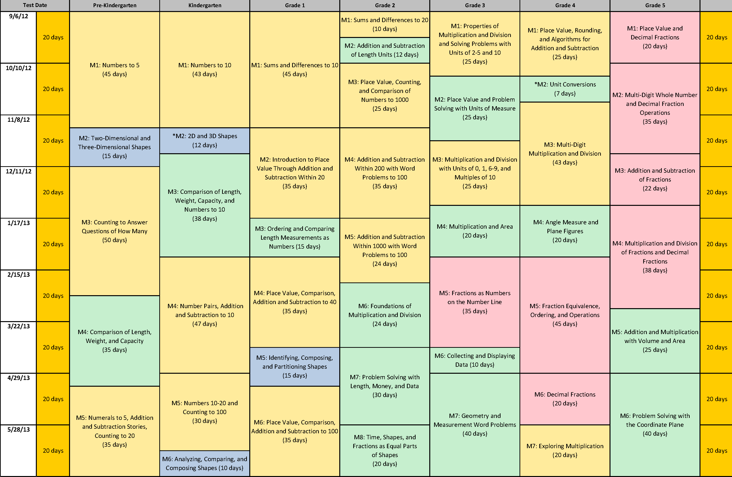
Curriculum Map for A Story of Units
Notes:
This is the curriculum map for A Story of Units. It shows the sequence of five to eight modules for each grade, PK through Grade 5.
(CLICK) Today we are focusing on the skills and concepts of multiplication and division in 3rd, 4th, and 5th grades.
(CLICK) The sections (modules) highlighted in blue are the modules where our work today will focus. As we explore these modules, you will understand the important role of the lessons and topics within your grade level and how they connect with the entire grade band. Knowing the work across the grade band will give you insight into the specific lesson you are teaching.
TIME ALLOTTED FOR THIS SLIDE: 2 minutes
MATERIALS NEEDED:
X

Slide 5
Agenda
Foundations of Multiplication and Division
Grade 3 Progression of Multiplication and Division
Grade 4 Progression of Multiplication and Division
Grade 5 Progression of Multiplication and Division
Continuation of Multiplication and Division in the Middle Grades
Notes:
Today we will see where the foundations for multiplication and division are laid in the lower elementary grades. Then we will progress grade by grade to show the development of whole number and fraction multiplication and division in Grades 3-5. We will conclude with an insight into how these concepts will continue in the middle grades.
(CLICK) Let’s get started by taking a look at how Grades K-2 prepare students for multiplication and division.
TIME ALLOTTED FOR THIS SLIDE: 1 minute
MATERIALS NEEDED:
X

Slide 6
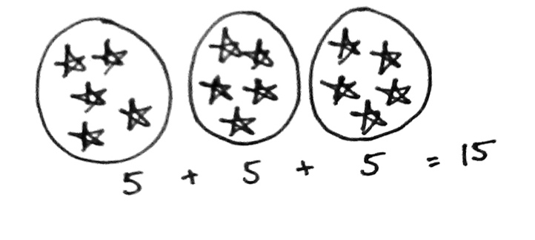
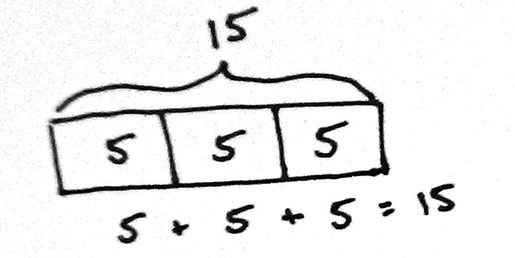
Grade 2 Module 6: Foundations of Multiplication and Division
Equal groups and repeated addition
Tape diagrams and repeated addition
Grade 2 – Module 6 – Overview
Notes:
Grade 2 Module 6 lays the conceptual foundation for multiplication and division in Grade 3 and for the idea that numbers other than 1, 10, and 100 can serve as units.
(CLICK) Students make equal groups using concrete materials, learning to manipulate a given number of objects to create equal groups, and progress to pictorial representations.
(CLICK) They determine the total and relate their drawings to the corresponding repeated addition number sentence.
(CLICK) Students progress to drawing abstract tape diagrams to represent the total and to show the number in each group as a new unit. Hence, they begin their experience towards understanding that any unit may be counted, e.g., 3 dogs, 3 tens, or even 3 fives. This is the bridge between Grades 2 and 3: Grade 2 focuses on the manipulation of place value units, whereas Grade 3 focuses on the manipulation of numbers 1 through 10 as units.
TIME ALLOTTED FOR THIS SLIDE: 2 minutes
MATERIALS NEEDED:
X

Slide 7
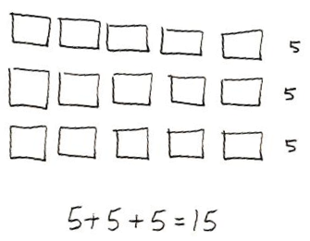
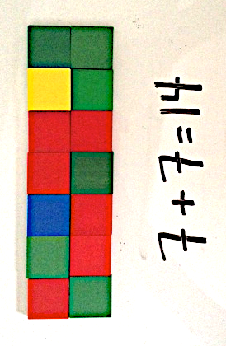
Grade 2 Module 6: Foundations of Multiplication and Division
Arrays and repeated addition
Tiled rectangular arrays
Grade 2 – Module 6 – Lessons 7 and 11
Notes:
(CLICK) Students organize the equal groups into arrays. They use manipulatives to compose up to 5 by 5 arrays, and express the total via repeated addition number sentences.
(CLICK) Students build upon their work with arrays to develop the spatial reasoning skills they will need in preparation for Grade 3’s area content. They use same-size squares to tile a rectangle with no gaps or overlaps and then count to find the total number of squares. Students relate repeated addition to the rectangular array model.
TIME ALLOTTED FOR THIS SLIDE: 2 minutes
MATERIALS NEEDED:
X

Slide 8
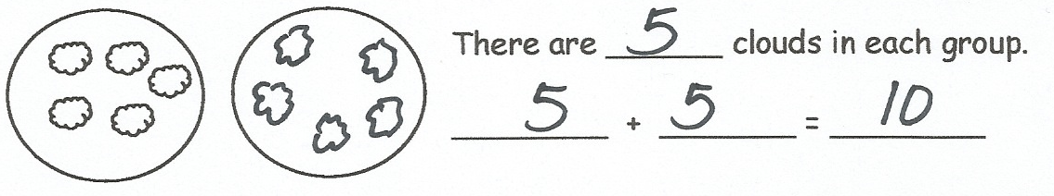
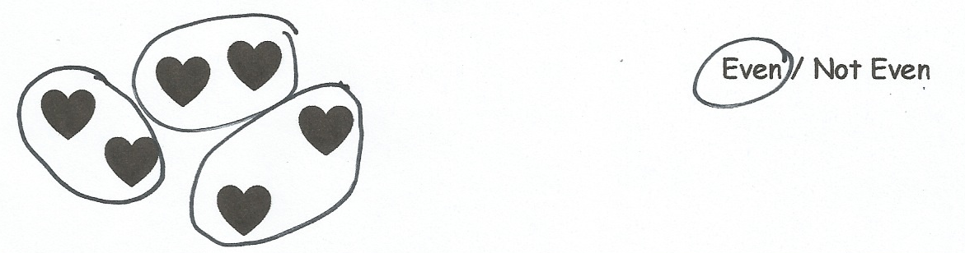
Grade 2 Module 6: Foundations of Multiplication and Division
Doubles
Even and Odd
Grade 2 – Module 6 – Lessons 17 and 18
Notes:
(CLICK) The final topic in Grade 2, Module 6 focuses on doubles and even numbers, thus setting the stage for the multiplication table of two in Grade 3. In their exploration of odd and even numbers, students pair objects to make groups of two with none left over. This particular example lays the foundation for students to think about how many units of 2 are in 6, which sets the stage for dividing in 3rd grade.
As we examine the progression of multiplication and division in 3rd grade, you will see how these models and topics that the students explore in 2nd grade set the foundation for student understanding.
TIME ALLOTTED FOR THIS SLIDE: 2 minutes
MATERIALS NEEDED:
X

Slide 9



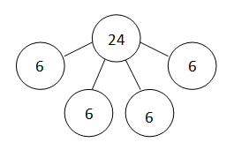
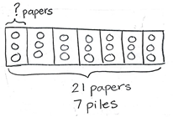


Models
Concrete → Pictorial → Abstract
Equal groups pictures
Array
Number Bond
Tape diagram
Notes:
Before we begin our in-depth look at the progression of multiplication and division in 3rd grade, I would like to take a few minutes to differentiate between the models and the strategies we’ll be exploring.
(CLICK) The models that support multiplication and division in 3rd grade move from concrete to pictorial to abstract. We tend to emphasize pictorial and abstract models because concrete models can be time consuming to use and they often distract from the math.
(CLICK) The concrete and pictorial models that the students use are equal groups pictures and arrays. In the equal groups picture, we see 3 fives. In the array, we see 3 fours.
(CLICK) From there, students progress to number bonds and tape diagrams, which are more abstract models. The number bond shows 4 sixes and the tape diagram shows 7 units of 3, or 7 threes.
With each model that we use, the ultimate goal is to use the model to move the students to the abstract number sentence that represents the model.
We will see more about these models and their progression in a few minutes.
TIME ALLOTTED FOR THIS SLIDE: 2 minutes
MATERIALS NEEDED:
X

Slide 10
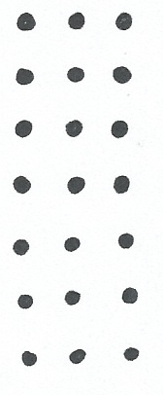
Strategies
Simple → Complex
Level 1: One object is one unit.
Level 2: A group is a unit.
Level 3: Multiple groups are units.
Notes:
The progressions documents, which give a narrative description of what the instruction at each level should look like, break strategies for multiplication and division down into 3 levels.
(CLICK) These 3 levels move from simple to complex.
(CLICK) Level 1 is of course the most basic; that’s where we’re hoping our students come in from Grade 2. As a result, we don’t spend too much time in that land, although it is a path for remediation in the event that its necessary for some of your students. (CLICK) In this example, a Level 1 strategy would be to count all the objects in the array to find the total.
(CLICK) Module 1 starts at Level 2, with the Group Counting fluency and these Level 2 strategies make their appearance in many lessons throughout the module. (CLICK) In our example, a Level 2 strategy would be to count the rows as groups of units: 1 three, 2 threes, 3 threes, 4 threes, 5 threes, 6 threes, 7 threes, which gives the total, 7 x 3 = 21. Or, students could use skip-counting to find the total, 3, 6, 9, 12, 15, 18, 21.
(CLICK) The first Level 3 strategy isn’t introduced until Lesson 7. At that point, the students:
Have been introduced to multiplication and division
Are starting to get comfortable with the vocabulary associated with those new concepts
And are becoming more proficient in their understanding of the meaning of factors
(CLICK) A Level 3 strategy in our example, would be looking at groups as units, so here we have 5 threes and 2 threes, which is 7 threes, or 21. This Level 3 strategy demonstrates the distributive property.
Level 3 strategies grow slowly over the course of the modules because students need a very strong foundation in the models in order to access the properties. Models themselves are entry points and then they’re tools for teaching the properties, or Level 3 strategies, pictorially. As you can see, the Level 2 and 3 strategies require an understanding of the unit and how to manipulate the unit.
TIME ALLOTTED FOR THIS SLIDE: 2 minutes
MATERIALS NEEDED:
X

Slide 11
Agenda
Foundations of Multiplication and Division
Grade 3 Progression of Multiplication and Division
Grade 4 Progression of Multiplication and Division
Grade 5 Progression of Multiplication and Division
Continuation of Multiplication and Division in the Middle Grades
Notes:
So let’s begin A Story of Units for multiplication and division in Grade 3.
Materials needed for the G3 portion of the presentation:
problem set
personal white boards
TIME ALLOTTED FOR THIS SLIDE: 1 minute
MATERIALS NEEDED:
X

Slide 12
Grade 3: Multiplication and Division in A Story of Units
By the end of Grade 3, students will:
Use multiplication and division within 100 to solve word problems. (3.OA.3)
Find the unknown number in a multiplication or division equation. (3.OA.4)
Apply properties of operations as strategies to multiply and divide. (3.OA.5)
Fluently multiply within 100. (3.OA.7)
Identify and explain patterns in the multiplication table. (3.OA.9)
Multiply one-digit whole numbers by multiples of 10. (3.NBT.3)
Relate area to multiplication. (3.MD.7)
Notes:
The major work of Grade 3 with multiplication and division occurs in Modules 1, 3, and 4.
Third grade begins the year with multiplication and division with units of 2-5 and 10. The reasoning behind starting the year with multiplication and division lies in the fluency standard for 3rd grade.
(CLICK) Since multiplying and dividing within 100 is an expected fluency for 3rd grade, starting the year working on these skills provides ample time for the students to build fluency with these facts. Module 1 also provides a coherence link to the work the students did in 2nd grade by building upon their work with equal groups, repeated addition, and arrays.
Furthermore, multiplication in particular gives an important perspective on the place value chart. It is easier for students to comprehend 5 twos and 3 twos than 5 tens and 3 tens. We work in Module 2 with place value and now students will have a new way of seeing place value units from Module 1 as repetitions of units, as multiplicative. It really strengthens their understanding of both place value and multiplication.
TIME ALLOTTED FOR THIS SLIDE: 2 minutes
MATERIALS NEEDED:
X

Slide 13
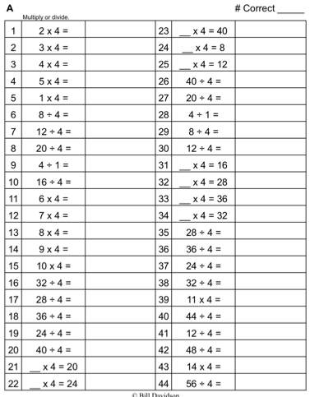
Grade 3 Fluency
Group Counting
Use the Commutative Property
Find the Common Products
“Multiply By” Pattern Sheets
Multiply by Different Units
Sprints
Notes:
The fluency activities of Grade 3 are designed to provide each student with enough practice to achieve mastery of the required fluency by the end of the year.
(CLICK) This is just a small list of fluency activities that students engage in to build their multiplication and division skills.
(CLICK) Activities such as Group Counting, Multiply By Pattern Sheets, and Sprints help students gain automaticity with their facts in a fast-paced and engaging way.
TIME ALLOTTED FOR THIS SLIDE: 1 minute
MATERIALS NEEDED:
X

Slide 14
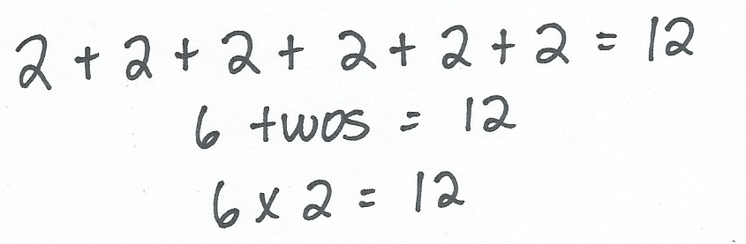
Multiplication
Repeated addition
Equal groups pictures
4 + 4 = 8
2 fours = 8
2 × 4 = 8
Grade 3 – Module 1 – Lesson 1
Notes:
In the first topic of Module 1, students are introduced to the concept of multiplication and they gain an understanding of what each factor means (number of groups vs. group size).
(CLICK) The topic begins with repeated addition and unit form as tools to introduce the multiplication number sentence.
(CLICK) This example from Lesson 1 shows 2 being added 6 times, which can be written in unit form as 6 twos. As mentioned earlier, this unit form is the bridge between grades 2 and 3. Grade 2 focuses on the manipulation of place value units, but here you can see that Grade 3 focuses on the manipulation of numbers 1 through 10 as units. The unit form is then represented as a multiplication number sentence.
(CLICK) Lesson 1 also utilizes the equal groups pictures that students are familiar with from second grade. The added complexity for third graders is that they learn how to represent these pictures as multiplication number sentences.
(CLICK) In this example, we have 2 equal groups of 4, which can be written as a repeated addition number sentence. (CLICK to show addition number sentence.)
(CLICK) This picture can also be represented in unit form as 2 fours equals 8.
(CLICK) And finally, the students can represent this picture as a multiplication number sentence.
TIME ALLOTTED FOR THIS SLIDE: 3 minutes
MATERIALS NEEDED:
X

Slide 15
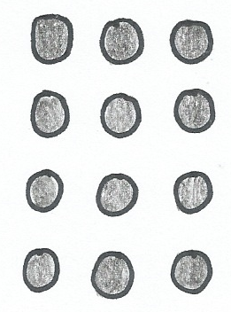
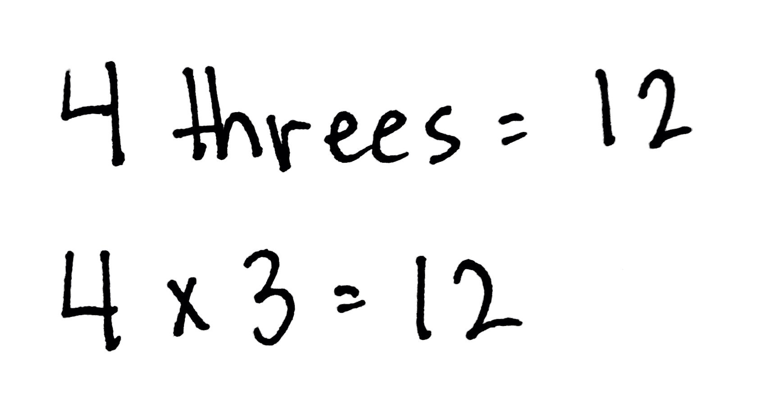
Relate Multiplication to the Array Model.
Equal Groups Pictures
Multiplication Number Sentence
Array
Grade 3 – Module 1 – Lesson 2
Notes:
In Lesson 2, students discover that an array is a more efficient organization of an equal groups picture. Students are familiar with arrays, as they have been working with them since Kindergarten.
(CLICK) Students are already comfortable with equal groups pictures, having been reintroduced to them as a way to represent a multiplication number sentence.
(CLICK) Students relate the equal groups pictures to the array model, seeing the array as a more organized and efficient way to group objects. They also explore the correspondence between 1 equal group and 1 row. They begin to distinguish between the number of groups and the size of groups as they count rows and how many in 1 row to write multiplication facts.
(CLICK) Students are able to identify the corresponding number sentences (both unit form and standard form) for their array.
By the end of Lesson 2 students use the following vocabulary: row, array, number of groups, and size of groups.
The array is one of the most important models that students will use for exploring multiplication, division, and the arithmetic properties, which is why there’s so much emphasis placed on getting students comfortable manipulating the array. Arrays keep appearing for students as an old friend that helps them access new material and make content connections.
TIME ALLOTTED FOR THIS SLIDE: 3 minutes
MATERIALS NEEDED:
X

Slide 16
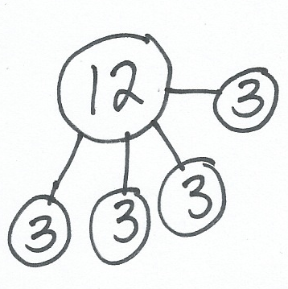

Relate Multiplication to Number Bonds.
Number Bond
Grade 3 – Module 1 – Lesson 3
Notes:
Lesson 3 provides students with an opportunity to use another familiar model, the number bond, and apply it to multiplication. The number bond is more abstract than the equal groups pictures and arrays because the representations in number bonds are primarily numerical. Thinking about multiplication as a part-whole relationship requires the students to make a slight step in their thinking.
(CLICK) In this example, the number bond is showing 4 threes being combined to make a total of 12.
(CLICK) Students can then use the number bond to write the multiplication number sentence, 4 x 3 = 12.
TIME ALLOTTED FOR THIS SLIDE: 2 minutes
MATERIALS NEEDED:
X

Slide 17
RDW Process
Read, Draw, Write
Read the problem.
Draw a picture representing the problem.
Write a number sentence to solve a problem and a statement answering the problem.
Notes:
Before moving forward, let’s review the RDW process, which is a series of steps the students are asked to follow when solving problems.
(CLICK)
Explain all 3 steps for participants.
TIME ALLOTTED FOR THIS SLIDE: 2 minutes
MATERIALS NEEDED:
X

Slide 18
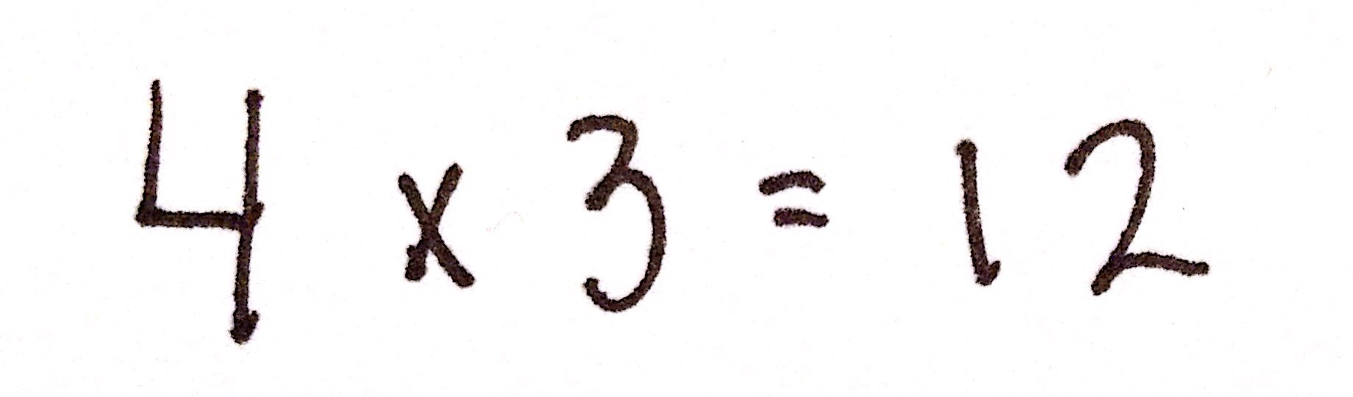
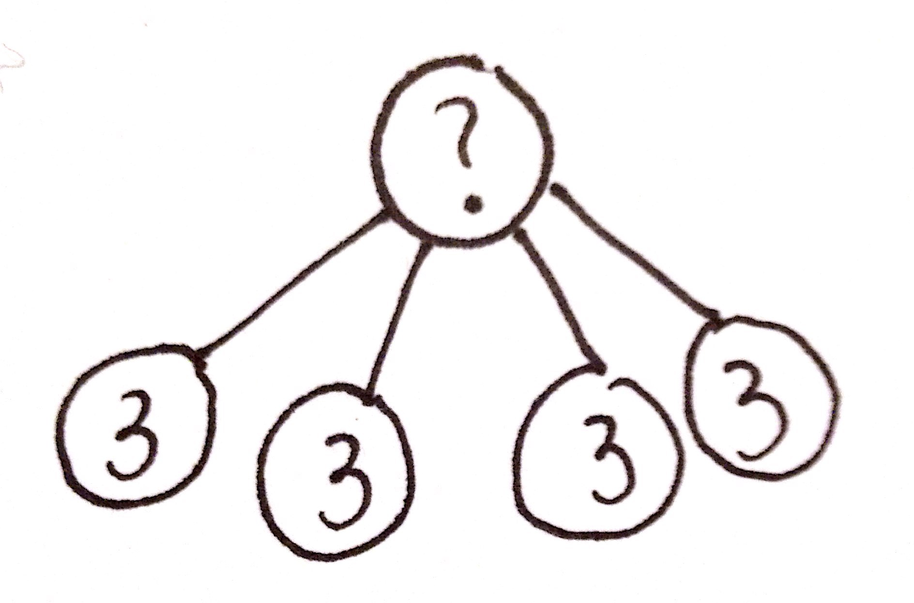
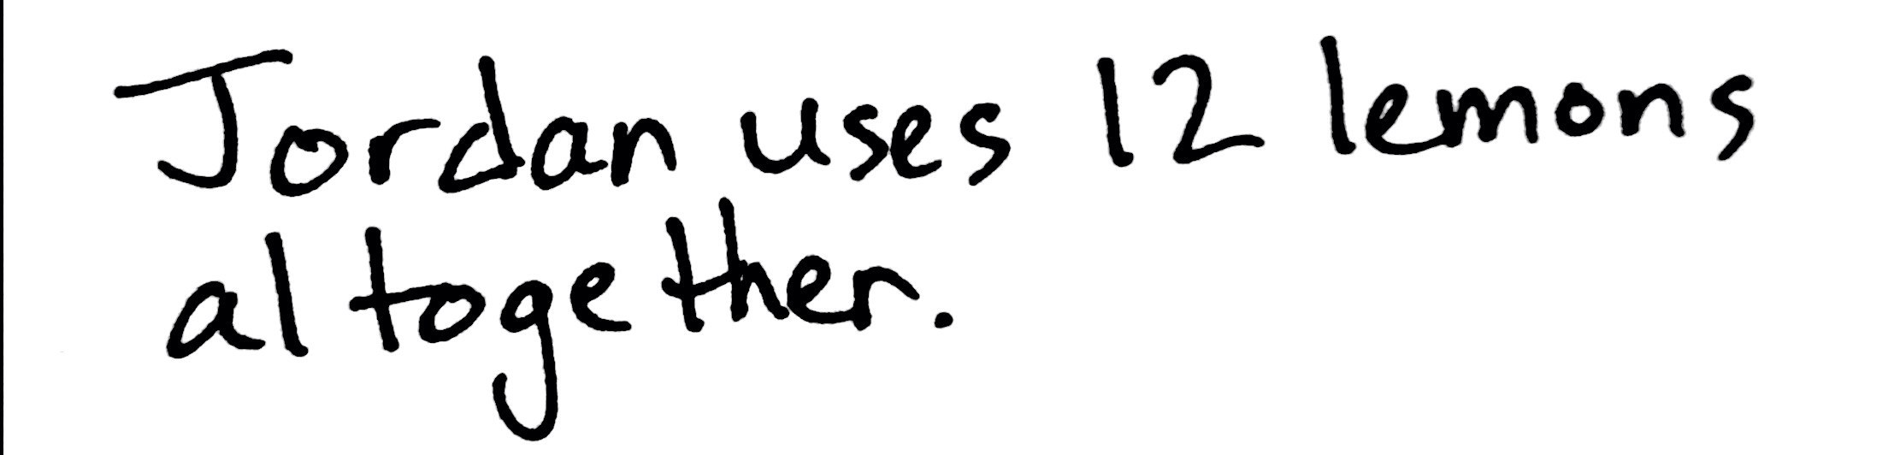
RDW Process
Jordan uses 3 lemons to make 1 pitcher of lemonade. He makes 4 pitchers. How many lemons does he use altogether? Use the RDW process to show your solution.
Notes:
Let’s take a look at how a student might apply the RDW process to a word problem.
First, the students read the problem.
(CLICK) Next, they draw a picture to represent the problem.
(CLICK) Last, they write a number sentence and a statement to answer the question.
(CLICK) This last sentence reminding students to use the RDW process appears frequently throughout the first half of Module 1, but is left out thereafter (although students are still expected to use the process anytime they are solving word problems).
TIME ALLOTTED FOR THIS SLIDE: 2 minutes
MATERIALS NEEDED:
personal white boards

Slide 19
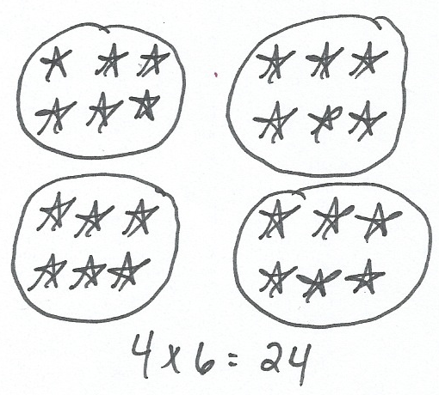
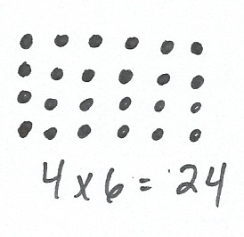
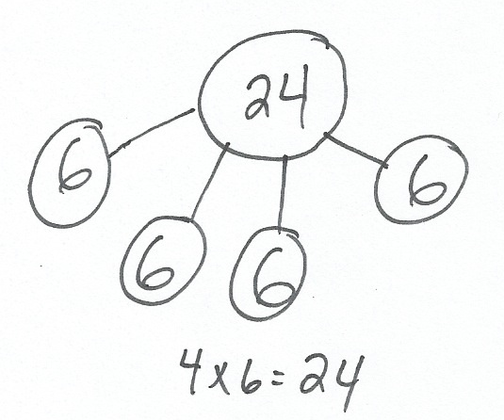
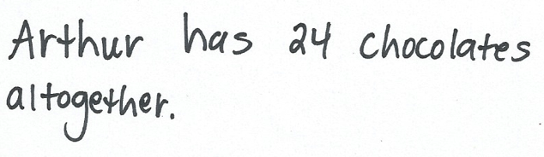


Try Problem # 1.
Use the RDW process to solve this problem.
Arthur has 4 boxes of chocolates. Each box has 6 chocolates inside. How many chocolates does Arthur have altogether?
Equal Groups Pictures
Array
Number Bond
Notes:
Try problem 1 on your Problem Set to practice using the models introduced to the students in the first three lessons of Module 1. Encourage participants to use the RDW process to solve, review the steps in RDW if necessary.
After allowing participants time to work, click to advance animation to show possible solutions for this problem. Clarify that students will choose the model they wish to use, and then share their strategy with another student. As they share, students can make connections between the strategies that they used. It is not necessary for one student to solve with multiple strategies.
TIME ALLOTTED FOR THIS SLIDE: 5 minutes
MATERIALS NEEDED:
Problem Set

Slide 20
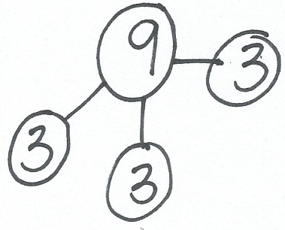
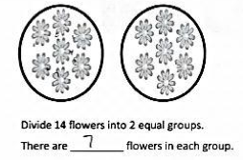


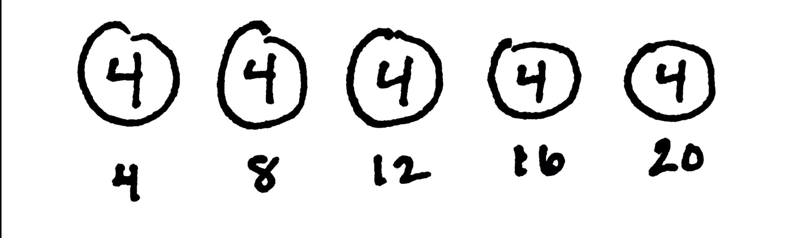
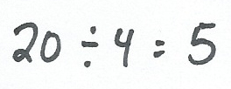
Division
Number
Bond
Equal Groups Pictures
Skip-counting
Grade 3 – Module 1 – Lessons 4 and 5
Notes:
The next few lessons use the models that students learned for multiplication and extend them to division. The emphasis in these lessons rests on conceptually understanding division and learning to interpret problems by writing division expressions. Students use equal groups pictures, number bonds, and count-bys to understand the meaning of the unknown in division as the size of groups or the number of groups.
(CLICK) This equal groups picture shows 14 flowers divided into 2 equal groups of 7.
(CLICK) The number bond represents 9 decomposed into 3 equal groups of 3. Students draw parts of 3 until they reach the whole, 9. The number of parts shows that 9 is equal to 3 threes.
(CLICK) The count-by shows 20 wheels divided into groups of 4. Students track the number of fours they count to determine that 20 divided by 4 equals 5.
In each of these examples, the groups can also be referred to as units. So, in the equal groups pictures, there are 2 groups of 7, or 2 units of 7, which is the same as 2 sevens. In the number bond, there are 3 groups of 3, or 3 units of 3, which is the same as 3 threes. And finally, in the skip-counting example, there are 5 groups of 4, or 5 units of 4, which is the same as 5 fours.
Note to presenter: Invite participants to solve 15 divided by 3 using all 3 methods on their whiteboards.
TIME ALLOTTED FOR THIS SLIDE: 4 minutes
MATERIALS NEEDED:
personal white board

Slide 21
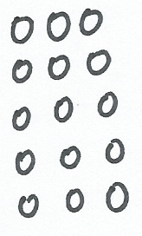
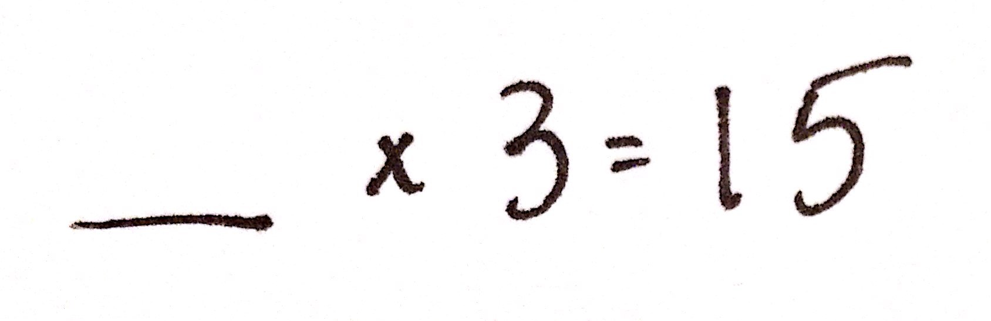
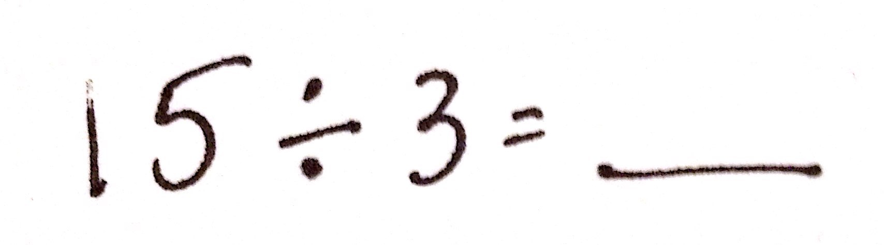
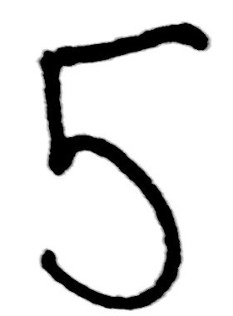
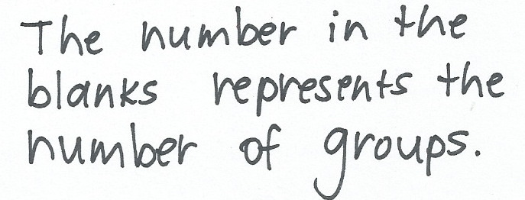
Arrays Used to Relate Multiplication and Division
Rick puts 15 tennis balls into cans. Each can has 3 tennis balls. How many cans does Rick use?
Grade 3 – Module 1 – Lesson 6
Notes:
In Lesson 6, students explore division in the context of the array model, interpreting arrays by writing division sentences.
(CLICK) In this example, students start by drawing an array and writing a multiplication number sentence with an unknown factor.
(CLICK) This multiplication number sentence can then be rewritten as a division number sentence, where the quotient is the same as the unknown factor.
(CLICK) Students can use the array to solve each equation.
(CLICK) Students also interpret the unknown and see that, in this case, the unknown represents the number of groups.
TIME ALLOTTED FOR THIS SLIDE: 2 minutes
MATERIALS NEEDED:
X

Slide 22
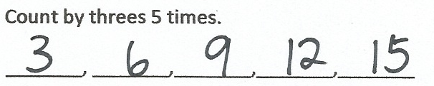
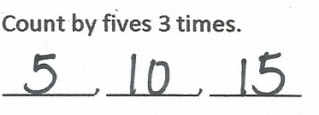
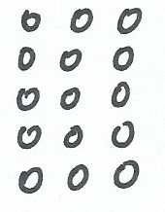
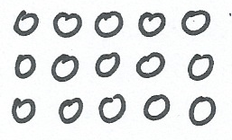
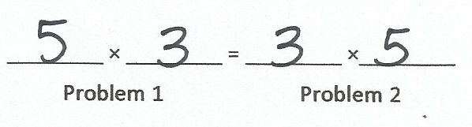
Arrays and the Commutative Property
Grade 3 – Module 1 – Lesson 8
Notes:
As students become more familiar modeling with arrays, they are introduced to the new complexity of manipulating arrays to apply Level 3 strategies when solving multiplication and division problems.
Let’s look at some sample work from Lesson 8’s Problem Set.
(CLICK) First, students skip-count 5 threes and draw the matching array.
(CLICK) Next, they do the same for 3 fives. They notice that the second array is identical to the first, but it is rotated 90 degrees.
(CLICK) Last, they realize that, because the 2 arrays are showing the same amount, the multiplication sentences are equal
This sample work from Lesson 8’s Problem Set shows how students use arrays to demonstrate the commutativity of multiplication. Students learn to distinguish rows from columns as they rotate arrays 90 degrees, noticing that the meaning of the factors changes depending on the orientation of the array.
Note to presenter: Invite participants to solve 4 times 6 by drawing an array on their whiteboards. Then have participants rotate their boards and say the new multiplication number sentence.
TIME ALLOTTED FOR THIS SLIDE: 4 minutes
MATERIALS NEEDED:
personal white board

Slide 23
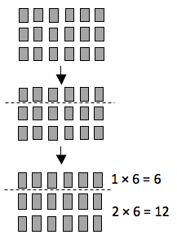




Arrays and the Distributive Property
Grade 3 – Module 1 – Lesson 10
Notes:
Students also manipulate arrays to model the distributive property as they decompose units to multiply.
(CLICK) In this example, students decompose a 3 by 6 array into a 1 by 6 array and a 2 by 6 array.
(CLICK) The decomposition of the array can be represented in unit form as 1 six plus 2 sixes.
(CLICK) Students can rewrite the unit form as multiplication facts, using parentheses to show how the array is decomposed.
(CLICK) Then students solve the multiplication facts and add to find that 3 sixes is equal to 18.
(CLICK)
Turn and Talk: Why is the distributive property be a valuable strategy for the students to learn?
TIME ALLOTTED FOR THIS SLIDE: 2 minutes
MATERIALS NEEDED:
X

Slide 24
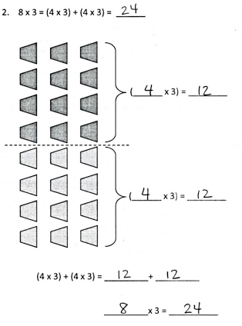
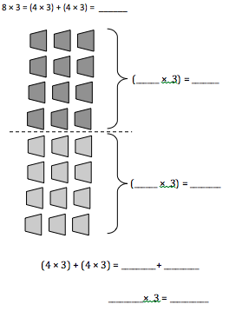
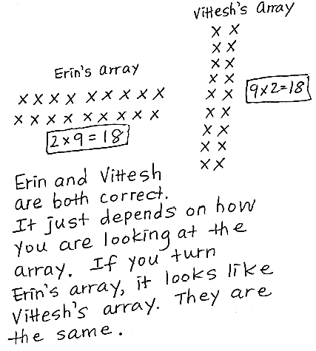
Try Problems # 2 and # 3.
Hint: Draw 2 arrays to model Erin’s and Vittesh’s thinking.
Children sit in 2 rows of 9 on the carpet for math time. Erin says, “We make 2 equal groups.” Vittesh says, “We make 9 equal groups.” Who is correct? Explain how you know using models, numbers, and words.
Grade 3 – Module 1 – Lessons 8 and 10
Notes:
Try problems 2 and 3 on your Problem Set to practice using arrays with the commutative and distributive properties.
(CLICK to show possible solutions for these problems.)
TIME ALLOTTED FOR THIS SLIDE: 5 minutes
MATERIALS NEEDED:
Problem Set

Slide 25

Types of Division: Measurement
12 ÷ 4 = ?
Notes:
As students continue to explore division, they start to understand that there are 2 different types of division situations: one in which the size of each group is known and the other in which the number of groups is known.
In measurement division, we know the measure, or size of each group. Let’s look at 12 divided by 4 as measurement division.
(CLICK) Here we have 12 pencils and the 4 is telling us that there are 4 pencils in each group.
(CLICK, CLICK, CLICK) Now we have divided our 12 pencils into equal groups of 4.
(CLICK, CLICK, CLICK) The number of equal groups we have gives us the quotient. So, 12 divided by 4 equals 3.
TIME ALLOTTED FOR THIS SLIDE: 2 minutes
MATERIALS NEEDED:
X

Slide 26
Types of Division: Partitive
12 ÷ 4 = ?
Notes:
Let’s use 12 divided by 4 again, but this time let’s show how this problem can model partitive division, which is when we know the number of parts, or the number of groups.
(CLICK) We’ll start with our 12 pencils again.
(CLICK, CLICK, CLICK, CLICK) But this time, we know that the 4 represents the number of groups, so here we have 4 groups.
(CLICK, CLICK, CLICK, CLICK) After sharing the pencils equally among the 4 groups, we find that there are 3 pencils in each group, which is the quotient for 12 divided by 4.
Note to presenter:
Clarify for participants: the terms “measurement” and “partitive” are not vocabulary words used with students. They’re used with teachers to distinguish between the 2 types of division situations.
Invite participants to discuss the fact that each division situation gave us the same quotient, 3, but that 3 means something different in each case.
TIME ALLOTTED FOR THIS SLIDE: 2 minutes
MATERIALS NEEDED:
X

Slide 27
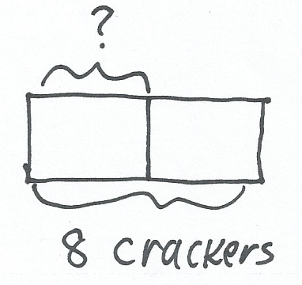
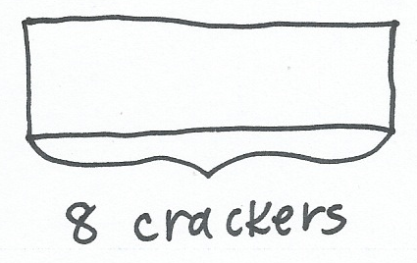
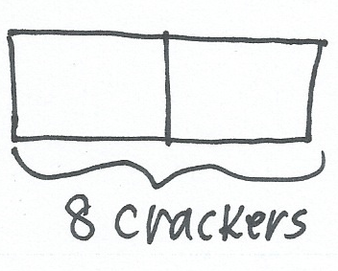

Tape Diagrams and Types of Division
2 students equally share 8 crackers. How many crackers does each student get?
Partitive Division: number of groups is known
Grade 3 – Module 1 – Lesson 12
Notes:
Tape diagrams are used to help students model the 2 types of division.
(CLICK) In this problem, the number of groups is known (partitive) and the size of the groups is unknown, so students start by drawing a tape diagram and labeling the whole.
(CLICK) Then the tape diagram is partitioned into 2 equal groups, or 2 units, to represent the 2 students in the problem.
(CLICK) Finally, the unknown is labeled with a question mark and students write a division number sentence to solve the problem. Tape diagrams are used as tools to help students solve problems and we’ll see some examples in a few minutes that show the flexibility of labeling tape diagrams. Not all students will label the tape diagram as indicated in this picture.
(CLICK) This is an example of partitive division, where the number of groups is known, but the size of each group is unknown.
TIME ALLOTTED FOR THIS SLIDE: 2 minutes
MATERIALS NEEDED:
X

Slide 28
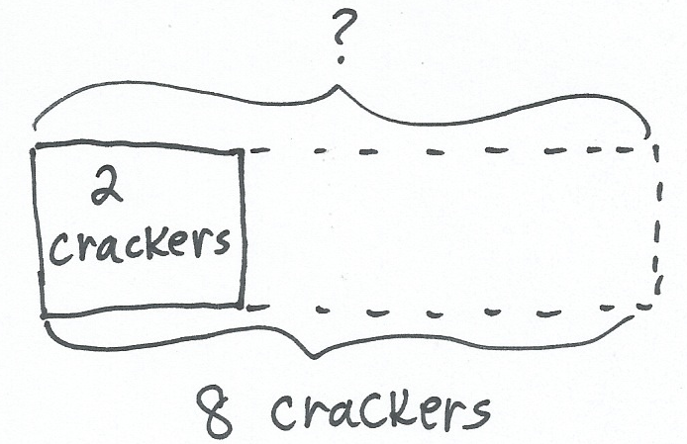
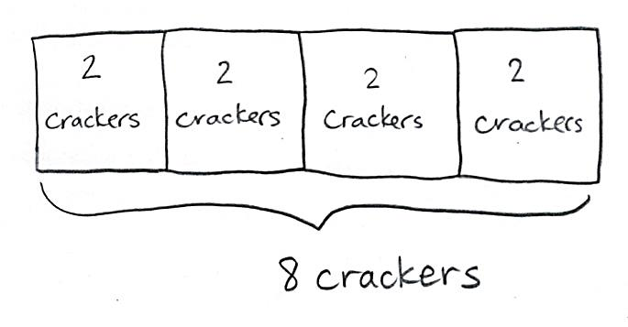
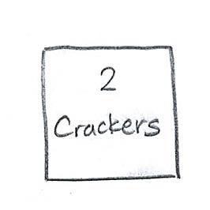
Tape Diagrams and Types of Division
There are 8 crackers, but this time each student gets 2. How many students get crackers?
Measurement Division: size of each group is known
Grade 3 – Module 1 – Lesson 12
Notes:
In this problem, the students know the size of each group (measurement) and are trying to find how many groups there are.
(CLICK) When the number of groups is unknown, students start by drawing and labeling 1 unit, according to the information in the problem.
(CLICK) The total of the tape diagram is also labeled and the unknown is indicated with a question mark.
(CLICK) Students continue to draw units of 2 until they have a total of 8 crackers. Then they write a division number sentence to match the tape diagram.
(CLICK) This is an example of measurement division, where the size of each group is known, but the number of groups is unknown.
TIME ALLOTTED FOR THIS SLIDE: 2 minutes
MATERIALS NEEDED:
X

Slide 29
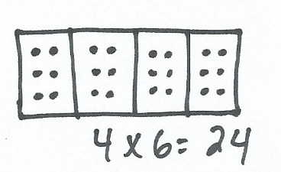
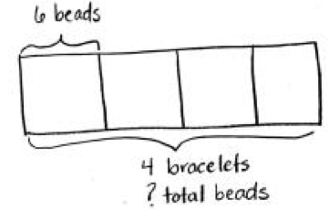
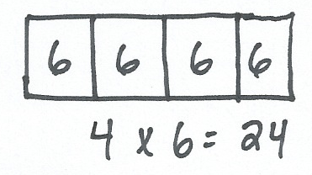
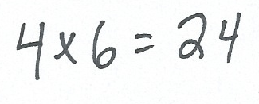
Use a Tape Diagram to Model and Solve Multiplication.
Grade 3 – Module 1 – Lessons 14 and 15
Notes:
Students also use tape diagrams to model multiplication. They draw and partition a tape into equal groups, or units. Each unit in a multiplication tape diagram has the same value.
(CLICK) Here are 3 different tape diagrams that all model the same multiplication fact, 4 x 6.
Invite participants to discuss the differences and similarities in the tape diagrams.
These different representations of tape diagrams used to solve 4 x 6 demonstrate the flexibility of the tape diagram. As mentioned earlier, you can see that not all students will label their tape diagrams the same way. However, in each example, students recognize that 1 unit equals 6, so 4 units equals 24.
It’s also important to note that students use tape diagrams with division before they are used with multiplication. The idea of sharing equally, or dividing, is intuitive for students, as it is something that they have a lot of experience doing. Dealing cards in equal groups, sharing candy, making equal groups of students for games, etc. are familiar to students, which is why the tape diagram is modeled with division first.
TIME ALLOTTED FOR THIS SLIDE: 3 minutes
MATERIALS NEEDED:
X

Slide 30


Try Problems # 4 and # 5.
How are the tape diagrams similar? Different?
Sarah and Esther equally share the cost of a present. The present costs $18. How much does Sarah pay?
Grace picks 4 flowers from her garden. Each flower has 8 petals. Draw and label a tape diagram to show how many petals there are in total.
Grade 3 – Module 1 – Lessons 12 and 15
Notes:
Try problems 4 and 5 on your Problem Set to practice using tape diagrams to solve multiplication and division problems.
(CLICK to show possible solutions for these problems.)
Invite participants to answer the question in the box.
Possible answers:
The tape diagram for #4 shows the total and the number of units, but not the size of each unit.
The tape diagram for #5 shows the number of units and the size of each unit, but not the total.
Both tape diagrams show the number of units.
TIME ALLOTTED FOR THIS SLIDE: 5 minutes
MATERIALS NEEDED:
Problem Set

Slide 31



Model the 5 + n Pattern as a Strategy for Multiplying.
8 fours = 5 fours + 3 fours
8 x 4 = (5 x 4) + (3 x 4)
= (5 + 3) x 4
Grade 3 – Module 1 – Lesson 16
Notes:
Students return to arrays to model the 5 + n pattern as a strategy for multiplying.
(CLICK) To solve 8 x 4, students start by drawing an 8 by 4 array. Encourage participants to do the problem with you on their whiteboards.
(CLICK) Then they decompose the array by shading in part of the array to show 5 times 4, which is a fact that they know or can figure out quickly by counting by fives. (CLICK to show 5 x 4 = 20.)
(CLICK) The unshaded part of the array is solved by multiplying 3 times 4.
(CLICK) Number bonds are used to show the decomposition of 8 fours into 5 fours and 3 fours. The equations show how the groups of 4 are distributed. Students begin to use the word “distribute” to describe what is happening to the equal groups.
Note to presenter: Invite participants to solve 9 x 4 on their whiteboards using the 5 + n strategy. Model the solutions on the document camera.
TIME ALLOTTED FOR THIS SLIDE: 4 minutes
MATERIALS NEEDED:
personal white board
document camera

Slide 32




Apply the Distributive Property to Decompose Units to Divide.
28 ÷ 4 = _____
Grade 3 – Module 1 – Lesson 19
Notes:
Module 1 wraps up with using arrays to model the distributive property with division. Students break apart an array, solve 2 smaller division problems, and add the quotients of these problems together to solve the original division problem.
(CLICK) To solve 28 divided by 4, the 7 by 4 array is broken apart into a 5 by 4 array and a 2 by 4 array. So, how many fours is 28? It’s 5 fours plus 2 fours, which is 7 fours.
(CLICK) Then a division number sentence is completed for each smaller array.
The quotients of these 2 smaller arrays are added together to to get 7, which is the solution of the original problem, 28 divided by 4.
(CLICK) This problem can also be modeled with a number bond. The whole, 28 divided by 4 is decomposed into the parts 20 divided by 4 and 8 divided by 4.
(CLICK) This work shows how both the array and number bond are decomposed and the distributive property is applied.
Note to presenter: Clarify the following for participants:
The 5 + n strategy is used to break apart the dividend in the number bond (28 is broken apart into 20 and 8 because 5 x 4 = 20)
While this might be a fact that students know, we are using it here to get at the properties of arithmetic, while also tying together various basic facts.
TIME ALLOTTED FOR THIS SLIDE: 3 minutes
MATERIALS NEEDED:
X

Slide 33



Try Problem # 6.
Why is the array decomposed this way?
Grade 3 – Module 1 – Lesson 19
Notes:
Try problem 6 on your Problem Set to practice using an array to model the distributive property with division.
(CLICK to show possible solutions for these problems.)
Invite participants to answer the question in the box.
Possible answers:
It allows students to use smaller facts to solve a larger fact.
It uses an easy fact, 5, to help solve a harder fact.
Note how this solution is related to the 5 + n strategy.
TIME ALLOTTED FOR THIS SLIDE: 5 minutes
MATERIALS NEEDED:
Problem Set

Slide 34


Multiply and Divide with Familiar Facts Using a Letter to Represent the Unknown.
Twenty-four people line up to use the canoes at the park. Three people are assigned to each canoe.
How many canoes are used for all 24 people?
Grade 3 – Module 3 – Lesson 3
Notes:
Lesson 3 in Module 3 introduces using a letter to represent the unknown in various positions within multiplication and division problems. In Module 1 students represented the unknown on tape diagrams, and occasionally in equations, using a question mark. This lesson uses familiar facts to introduce the new abstraction of a letter as a placeholder.
Note to presenter: Encourage participants to solve the problem with a tape diagram on their whiteboards. Then show how the letter is introduced to represent the unknown.
(CLICK) Here is an example solution. So far, students have been using a question mark to represent the unknown.
(CLICK) Here, students learn to instead use a letter to represent the unknown. The question marks have been replaced with the letter “c”.
TIME ALLOTTED FOR THIS SLIDE: 2 minutes
MATERIALS NEEDED:
personal white board

Slide 35



Count by Units of 6 and 7 to Multiply and Divide.
Grade 3 – Module 3 – Lesson 4
Notes:
Level 2 skip-counting strategies are used with units of 6 and 7 to solve both multiplication and division problems. When counting by sixes and sevens, students compose up to and then over the next decade.
(CLICK) For example, students might count, 6, 12, 18, and then mentally add 18 + 2 + 4 to make 24. This skip-counting method utilizes make ten strategies from Grades 1 and 2. Initially, students use number bonds to decompose and identify appropriate number pairs. Eventually students are able to use mental math as they manipulate numbers and skip-count to multiply.
(CLICK) This count by can be used to solve 7 times 6 because it represents 7 sixes.
(CLICK) Or, it can be used to solve 42 divided by 6 because it shows that you have to count by six 7 times to reach 42.
TIME ALLOTTED FOR THIS SLIDE: 2 minutes
MATERIALS NEEDED:
X

Slide 36


Model the Distributive Property with Tape Diagrams and Number Bonds.
Tape Diagram
Number Bond
Grade 3 – Module 3 – Lesson 6
Notes:
Lesson 6 is a formal re-introduction of the distributive property using the 5 + n pattern to multiply and divide, with the added complexity of using tape diagrams and number bonds, rather than arrays, to model this Level 3 strategy.
(CLICK) This tape diagram represents 9 times 7 and can be decomposed into 5 sevens and 4 sevens. The products of these smaller multiplication facts, 35 and 28, are added to solve 9 times 7, which is 63.
(CLICK) In division, students decompose the dividend using a multiple of 5, and then add the quotients of the smaller division facts to find the quotient of the larger unknown division fact. In this example, 48 divided by 6 is decomposed using a number bond into 30 divided by 6 and 18 divided by 6. The quotients of these smaller division facts, 5 and 3, are added to get 8, which is the quotient of 48 divided by 6.
TIME ALLOTTED FOR THIS SLIDE: 3 minutes
MATERIALS NEEDED:
X

Slide 37





Model the Associative Property as a Strategy to Multiply.
Grade 3 – Module 3 – Lesson 9
Notes:
The associative property is another Level 3 strategy that students use to multiply. The array is used as a familiar model to introduce this new property of multiplication.
(CLICK) A student is presented with a difficult multiplication problem, 16 x 2. An array can be used to represent this large multiplication fact.
(CLICK) To solve 16 times 2, 16 is rewritten as a multiplication problem with two easier factors, 8 x 2. The array is now broken apart into 2 separate 8 x 2 arrays.
(CLICK) Next, the parentheses shift so that the 2 x 2 is the first multiplication fact to be solved. The array now shows 8 separate arrays.
(CLICK) By moving the parentheses and regrouping the factors, students change a difficult problem like 16 times 2 into 8 times 4, which is an easier problem to solve. They see that the array, which is the same as the original 16 x 2 array, is broken apart into 8 units of 4, or 8 fours.
(CLICK) Students see that 32, the solution to 8 times 4, is also the solution to 16 times 2.
TIME ALLOTTED FOR THIS SLIDE: 4 minutes
MATERIALS NEEDED:
X

Slide 38

Try Problem # 7.
Is there a different way to use the associative property to solve this problem?
3 × 12 = _____
b) (3 × 3) × 4
= _____ × 4
= _____
Grade 3 – Module 3 – Lesson 9
Notes:
Try problem 7 on your Problem Set to practice using an array to model the associative property.
(CLICK to show possible solutions for these problems.)
Invite participants to answer the question in the box.
Possible answer:
12 can be rewritten as 2 x 6, and then when the parentheses are moved, the problem becomes 6 x 6. (Model on document camera)
Note to presenter: Participants might want/need additional practice with the associative property. They can solve the following problems on their whiteboards, as you model with the document camera: 3 x 14, 3 x 15, and 3 x 16.
TIME ALLOTTED FOR THIS SLIDE: 4 minutes
MATERIALS NEEDED:
Problem Set
Optional: personal white boards and document camera for extra practice

Slide 39


Apply 9 = 10 – 1 as a Strategy to Multiply by 9.
9 = 10 - 1
Grade 3 – Module 3 – Lesson 12
Notes:
Students explore a variety of arithmetic patterns that become engaging strategies for quickly learning nines facts with automaticity. Nines are placed late in the module so that students have enough experience with multiplication and division to recognize, analyze, and apply the rich patterns found in the manipulation of these facts. In Lesson 12, students use the distributive property to establish the 9 = 10 – 1 pattern for multiplication.
(CLICK) To solve 9 times four, students draw a tape diagram with 10 units of four. They shade in 9 fours and realize that 9 fours is equal to 10 fours minus 1 four.
Note to presenter: If available, use a Rekenrek to model this problem.
Conceptual understanding of this pattern enables students to see this method of multiplication as a tool rather than a trick. This lesson lays the foundation for exploring other patterns that emerge with multiplication using units of 9 in the subsequent lessons.
Note to presenter: Encourage participants to solve 9 x 6 on their whiteboards using this strategy. Model the solution with the document camera.
TIME ALLOTTED FOR THIS SLIDE: 4 minutes
MATERIALS NEEDED:
personal white board
document camera
Optional: rekenrek

Slide 40


Identify and Use Arithmetic Patterns to Multiply.
3 x 9 = ____
9 = 10 – 1
3 nines = 3 tens – 3 ones
3 x 9 = 30 – 3
3 x 9 = 27
Grade 3 – Module 3 – Lesson 14
Notes:
The 9 equals 10 minus 1 pattern is extended to demonstrate the nines finger strategy. Before they are introduced to the finger strategy, students model how this strategy works with arrays.
(CLICK) To solve 3 times 9, students draw a 3 by 10 array.
(CLICK) Then using the 9 equals 10 minus 1 pattern, students realize that 3 nines is equal to 3 tens minus 3 ones.
(CLICK) Relating this to the array, students cross off 3 ones from the 3 tens, which leaves 2 tens 7 ones.
(CLICK) This can be written in a number sentence as 3 times 9 equals 30 minus 3.
This gives the answer to 3 times 9, 27.
(CLICK) Students are then introduced to the nines finger strategy, which utilizes the 9 equals 10 minus 1 pattern.
Turn and Talk: How does the 9 = 10 – 1 strategy relate to the nines “finger” strategy?
TIME ALLOTTED FOR THIS SLIDE: 3 minutes
MATERIALS NEEDED:
X

Slide 41






Multiply and Divide Using Units of 1 and 0.
Grade 3 – Module 3 – Lesson 16
Notes:
Working with facts using units of 0 and 1 wraps up the sequence of factors in Module 3. From a procedural standpoint, these are simple facts that require little time for students to master; however, understanding the concept of nothing (zero) is among the more complex, particularly as it relates to division. This unique combination of simple and complex explains the late introduction of 0 and 1 in the sequence of factors.
(CLICK) Students draw equal groups pictures to understand that 1 times any number equals that number.
(CLICK) Then they write the related division number sentence, n divided by 1 equals n, to discover that any number divided by 1 equals that number.
(CLICK) Students also use equal groups pictures to learn that any number multiplied by 0 equals 0.
(CLICK) Once it’s established that any number times 0 equals 0, students can write the related division fact to see that 0 divided by any number equals 0. Students draw an equal groups picture to verify this concept.
(CLICK) To explore dividing by 0, students write a new division equation to show 7 items divided into 0 groups equals n. If 7 divided by 0 made sense, then it would be equivalent to the multiplication number sentence, 0 times n equals 7. But, there is no value for n that makes this multiplication number sentence true. Students know that any number times 0 equals 0, so it’s not possible to multiply a number by 0 and get 7. This also means that there isn’t a value for n that makes the division equation true.
(CLICK) Finally, students see a special case of dividing by zero. They write the equation, 0 divided by 0 equals a number, n. If 0 divided by 0 equals n, then it would be equivalent to the multiplication number sentence, 0 times a number, n, equals 0 . Students realize that this multiplication equation is true for many different values of n. Which means that 0 divided by 0 doesn’t specify a number.
TIME ALLOTTED FOR THIS SLIDE: 5 minutes
MATERIALS NEEDED:
X

Slide 42


Multiply by Multiples of 10 Using Place Value Disks.
Grade 3 – Module 3 – Lesson 19
Notes:
Module 3 ends with students multiplying by multiples of 10.
(CLICK) To solve a fact like 2 × 30, they first model the basic fact 2 × 3 with place value disks. Notice the use of unit language, 2 times 3 ones equals 6 ones.
(CLICK) Then they transfer this knowledge to multiply 2 x 30 with place value disks, again using unit language. 2 times 3 tens equals 6 tens, which is 60.
TIME ALLOTTED FOR THIS SLIDE: 2 minutes
MATERIALS NEEDED:
X

Slide 43


Multiply by Multiples of 10 Using a Place Value Chart.
Grade 3 – Module 3 – Lesson 19
Notes:
This work of multiplying by multiples of 10 is then transferred to the place value chart.
(CLICK) Once again, students begin by modeling 2 × 3 in the ones place.
(CLICK) Students relate this to multiplying 2 × 3 tens, locating the same basic fact in the tens column. They see that when multiplied by 10, the product shifts one place value to the left.
Note to presenter: Invite participants to solve 2 x 4 and 2 x 40 on a place value chart (have them draw the place value chart on their whiteboards). Demonstrate the solution with the document camera.
TIME ALLOTTED FOR THIS SLIDE: 4 minutes
MATERIALS NEEDED:
personal white boards

Slide 44


Use Place Value Strategies & the Associative Property to Multiply Multiples of 10.
Grade 3 – Module 3 – Lesson 20
Notes:
Place value understanding becomes more abstract as students model place value strategies using the associative property.
(CLICK) In this example, students solve 3 times 5 first, then multiply by 10 to get 150.
(CLICK) This problem can also be solved using the associative property, which results in multiplying 5 times 10 first, then multiplying by 3. Both strategies result in the same solution.
Note to presenter: Invite participants to solve 2 x 90 on a place value chart (have them draw the place value chart on their whiteboards), using the associative property. Demonstrate the solution with the document camera.
TIME ALLOTTED FOR THIS SLIDE: 3 minutes
MATERIALS NEEDED:
personal white boards

Slide 45

Grade 3 Module 4: Multiplication and Area
Tiled Rectangular Array
Area Model
Array
Grade 3 – Module 4 – Overview
Notes:
In Module 4, students explore area as an attribute of two-dimensional figures and relate it to their prior understandings of multiplication.
(CLICK) This image shows the progression from arrays to rectangular tiling to the area model.
TIME ALLOTTED FOR THIS SLIDE: 1 minute
MATERIALS NEEDED:
X

Slide 46


Multiplying and Dividing With the Area Model
Grade 3 – Module 4 – Lesson 8
Notes:
Students use the area model for both multiplication and division.
(CLICK) Given the side lengths of a rectangle, students multiply to find the area.
(CLICK) Given the area and one side length of a rectangle, students can find the other side length by solving either a missing factor multiplication number sentence or a division number sentence.
Note to presenter: Invite participants to find the area of a rectangle with side lengths of 6 inches and 7 inches. Demonstrate the solution with the document camera.
TIME ALLOTTED FOR THIS SLIDE: 4 minutes
MATERIALS NEEDED:
Personal white boards
document camera

Slide 47

Apply the Distributive Property as a Strategy to Find Area.
Distributive Property
Grade 3 – Module 4 – Lessons 10 and 11
Notes:
Students apply knowledge of the distributive property and the associative property from Modules 1 and 3 to find area.
(CLICK) Students connect their experience of decomposing arrays to using the distributive property to find the area of a rectangle. In this example, the side length 8 is decomposed into 5 and 3. Then students use the other side length, 3 to find the areas of the smaller rectangles. These areas are added to find the total area of the large rectangle.
Note to presenter: Have participants try this strategy with a rectangle that has side lengths of 9 and 6. Model a possible solution with the document camera.
This Level 3 strategy prepares students for the work they will do in 4th grade with multiplication and the area model.
TIME ALLOTTED FOR THIS SLIDE: 4 minutes
MATERIALS NEEDED:
personal white boards
document camera

Slide 48
Agenda
Foundations of Multiplication and Division
Grade 3 Progression of Multiplication and Division
Grade 4 Progression of Multiplication and Division
Grade 5 Progression of Multiplication and Division
Continuation of Multiplication and Division in the Middle Grades
Notes:
Now let’s see where Grade 4 picks up in the Story of Units for multiplication and division.
Note to presenter: During the transition, have participants place their “Ones to Ten Thousands Place Value Chart” into the back side of their personal white boards. It is untraditional to place templates into the back side, but this will allow participants to flip between their work on the chart and on the white side of the board as needed.
Materials needed for the G4 portion of the presentation:
Participants:
problem set
personal white boards
Ones to Ten Thousands place value chart
place value disks (1 set per pair)
graph paper
Presenter:
place value chart (ones to ten thousands)
place value disks (1 set per pair)
graph paper
paper and sharpies
TIME ALLOTTED FOR THIS SLIDE: 1 minute
MATERIALS NEEDED:
Personal white boards
Ones to Ten Thousands Place Value Chart template

Slide 49
A Continuation of a Story of Units in Grade 4
By the end of Grade 4 students will:
  Multiply up to a four-digit number by a one-digit number. (4.NBT.5)
  Multiply two two-digit numbers. (4.NBT.5)
  Multiply a fraction by a whole number (4.NF.4)
  Divide up to four-digit numbers by one digit divisors finding whole number quotients with remainders. (4.NBT.6)
  Interpret multiplication as comparison. (4.OA.1)
  Solve word problems using multiplication and division. (4.OA.2,3)
Notes:
Grade 4’s work with multiplication and division continues with whole numbers and introduces fraction multiplication. An important step in whole number multiplication and division in Grade 4 is seeing multiplication as comparison, relating how each unit on the place value chart is 10 times the value as the unit to the right, so can we say 6 is 3 times as much as 2.
Several standards support this learning in Grade 4, as seen here. As we progress through Grade 4, take note of the familiar models that were used in Grade 3 multiplication and division and see how they are connected to the work done in this grade, as well as the next.
We begin with whole number work in Module 3 and connect whole number understanding to fraction operations in Module 5 of Grade 4.
TIME ALLOTTED FOR THIS SLIDE: 2 minutes
MATERIALS NEEDED:

Slide 50



Multiplication Models
Array → Area Model
A = l × w
Grade 4 – Module 3 – Lesson 1
Notes:
Students begin their practice with multiplication and division in Grade 4 using the area formula. Formally defined and used in Lesson 1, students now see that 1 square unit is composed of a length of 1 unit and a width of 1 unit. From here students can use their Grade 3 multiplication skills to solve a variety of area problems, those including missing side lengths, in order to use division to solve.
Students are introduced to area in Grade 3 after work with arrays, seen here, then to connected rectangular areas to open areas. We continue that bridge of connecting those models with the use of graph paper.
(Use graph paper with participants. Draw an area model with a width of 5 units and a length of 4 units. Solve for area. Now draw to find the length when the area is 20 sq. units and the width is 2 units.)
(CLICK) Quickly use of graph paper ends so that students can practice drawing areas to scale, for example, the width of 7 units is longer than the length of 4 units. Later in the module, students will draw area models to solve multiplication and division problems with multi-digit numbers. The area models will consist of composite areas for each unit in the numbers.
TIME ALLOTTED FOR THIS SLIDE: 6 minutes
MATERIALS NEEDED:
Graph paper
document camera

Slide 51


Multiplicative Comparison Word Problems
Area Model
Grade 4 – Module 3 – Lesson 2
Notes:
In Grade 3, as was just explained, the emphasis for multiplication and division is put into a context, always asking how many in each group or how many groups there are.
Here we see 1 group of 2.
(CLICK) We have 3 groups of 2.
(CLICK) Now Grade 4 extends that notion to interpret multiplication equations as comparison. 3 times as many as 2 is 6.
(CLICK) We can now apply the phrase “times as many as” in word problems, and again use the area model as a model for visualizing and solving multiplication problems.
What is the area of a rectangle if it has a width of 2 meters and the length is 3 times as long as the width?
The width is 2 meters, so each part of the width is 2 meters, and there are 3 parts, equaling a length of 6 meters. Multiply the length and width to find the area of 12 square meters.
Practicing this in context of smaller numbers makes these problems visual and appealing for students. Use of square tiles in your classroom would take this pictorial model 1 step back to a concrete model. Eventually this type of context will be applied to solve problems with much larger numbers.
“Times as many as” and multiplicative comparison set the stage for Grade 5 scaling and Grade 6 proportional reasoning.
TIME ALLOTTED FOR THIS SLIDE: 3 minutes
MATERIALS NEEDED:
X

Slide 52





Multiplication by 10, 100, and 1000
Place Value Chart
Number Disks
Unit Language
Grade 4 – Module 3 – Topic B
Notes:
Grade 3 students practiced multiplying by 10. 2 times 10, 3 times 10, etc, doing so using unit language and on the place value chart. Now students extend this by multiplying by 10, 100 and 1000, again using pictorial models of number disks to model how, for example 3 ones times 10 is 3 tens, and 3 times 100 is really 3 times 10 times 10. We also think of 3 hundreds as 100 times as many as 3 ones, relating back to multiplicative comparison.
Model: Show using number disks how to introduce this concept concretely. Following the top left image, place 30 ones to show ten times, regrouping to 3 tens.
(CLICK) Then students practice multiplying by multiples of 10, 100 and 1000. Seen here students reinforce their understanding by using pictorial models and unit language to make sense of the written numerical work.
TIME ALLOTTED FOR THIS SLIDE: 5 minutes
MATERIALS NEEDED:
Presenter: place value disks, place value chart, document camera

Slide 53






Multiplication by 10, 100, and 1000
Grade 4 – Module 3 – Topic B
Notes:
Think back to Grade 3’s learning of the associative property for multiplication. Students can use what they know about multiples of 10, 100, and 1000 to make a problem more accessible to them. For example, 4 times 20. A students knows 20 is composed of 2 tens, or 2 times 10. This model now shows 2 rows of 4 ones multiplied by 10. As students use this reasoning, they become more comfortable by thinking of 4 times 20 as 4 times 2 tens. If I know 4 times 2 is 8, 4 times 2 tens is 8 tens.
(CLICK) Practicing this unit language here while there is support with the number disks will prepare students for using unit language when multiplying using the algorithm.
TIME ALLOTTED FOR THIS SLIDE: 2 minutes
MATERIALS NEEDED:
X

Slide 54



Multiplication by 10, 100, and 1000
40 × 20
Grade 4 – Module 3 – Topic B
Notes:
Using their reasoning for how to solve 4 times 20, students are now able to reason about multiplying a multiple of 10 times a multiple of 10. This prepares students for multiplication of a 2 digit number times a 2 digit number, which has far more complexities than multiplying by a 1 digit number. We introduce this concept now, so that students have ample time to practice this unit language of 1 ten times 1 ten equals 1 hundred during fluency activities.
(CLICK) Using number disks, students know how to represent 40 times 2 or 20 times 4. Then they can multiply times 10. They can practice the “break apart and distribute” strategy and the associative property they learned in Grade 3. Using what we know about the composition of numbers, we reorganize the way in which we solve a multiplication problem.
(CLICK) Visually through the area model students see 1 ten times 1 ten is 1 hundred. Therefore 4 tens times 2 tens is 8 hundreds. Just as with the area model, soon students remove the inner grid and reason numerically that 40 times 20 is 800.
TIME ALLOTTED FOR THIS SLIDE: 2 minutes
MATERIALS NEEDED:
X

Slide 55






Multiplication of Up to 4 Digits by Single-Digit Whole Numbers
Place Value Chart & Number Disks → Partial Products
Grade 4 – Module 3 – Lesson 7
Notes:
Students use distributive property, number disks, partial products, standard algorithm, and area model to multiple 2, 3, and 4 digit numbers times a single digit.
Fluency with the standard algorithm for multiplication is not expected until Grade 5 – 5.NBT.5. Students are introduced to the algorithm, being supported by place value strategies as stated in 4.NBT.4, to prepare them for Grade 5 multiplication. Therefore students are not assessed in Grade 4 on using simply the algorithm.
Number disks model the multiplication and are used to support the algorithmic work. The algorithm shows the recording. Grade 4 students are allowed and encouraged to explain their calculations using equations, array and area models. We use place value charts slid into personal white boards. This activity can be shown concretely initially, but advance students to the pictorial stage as soon as possible. We want to focus not on manipulating objects, but rather seeing the actions of the numbers with focus on the algorithm.
Let’s start with a form of the array, number disks.
Here we see 1 group of 23.
(CLICK) Now 4 groups of 23. This makes 8 tens and 12 ones.
(CLICK) We record the partial products under the algorithm. 4 times 3 ones is 12 ones. Working right to left, just as with addition. 4 times 2 tens is 8 tens.
(CLICK) 12 ones can be renamed as 1 ten 2 ones. And the answer is 92.
(Give participants the chance to solve 34 x 4 using disks and white boards with you.)
TIME ALLOTTED FOR THIS SLIDE: 5 minutes
MATERIALS NEEDED:
Personal white boards
Place value disks
document camera

Slide 56
Multiplication of Up to 4 Digits by Single-Digit Whole Numbers
Place Value Chart
Number Disks
Algorithm
Grade 4 – Module 3 – Lessons 8-10
Notes:
Using number disks as concrete tools or drawing disks as a pictorial model, students multiply 3 and 4-digit numbers with regrouping. As seen in the hundreds column, students grouped 10 hundreds and renamed it for 1 thousand. In the algorithm, shown to the right, regrouping in multiplication happens on the line.
As their comfort with the algorithm grows, students rely on unit language to multiply abstractly.
TIME ALLOTTED FOR THIS SLIDE: 4 minutes
MATERIALS NEEDED:
X

Slide 57





Multiplication of Up to 4 Digits by Single-Digit Whole Numbers
Algorithm
Grade 4 – Module 3 – Lessons 9-10
Notes:
Let’s see how the algorithm works using unit language and regrouping on the line with a 4-digit number times a 1 digit number.
5 times 4 ones is 20 ones. 20 ones is the same as 2 tens 0 ones. So we record 2 tens “on the line” and a 0 in the ones column below the line. The 2 is recorded before the 0 because this is the number twenty, not the number “zero-two”. The proximity of the 2 and 0 remind us of the number 20.
(CLICK) Next, 5 times 7 tens is 35 tens, plus 2 tens is 37 tens. 37 tens is the same as 3 hundreds 7 tens. Record the 3 “on the line” in the hundreds column and then record the 7 in the tens column.
(CLICK twice to advance the remaining slides) Continue on until the problem is solved. This is the standard algorithm used in a Story of Units.
(Have participants solve along with you 3,186 x 4.)
TIME ALLOTTED FOR THIS SLIDE: 4 minutes
MATERIALS NEEDED:
Personal white boards
Place value chart
document camera

Slide 58




Multiplication of Up to 4 Digits by Single-Digit Whole Numbers
Area Model
Distributive Property
Partial Products
Grade 4 – Module 3 – Lesson 11
Notes:
Just as multiplication was introduced in Grade 4 with the area model, we close it out with the area model, going full cycle connecting pictorial to abstract and then explaining the abstract pictorially. However, the area model can be used pictorially first, to support the algorithm.
(Guide participants in drawing an area model, clicking to advance the slide.)
To multiply 234 by 8, we think of 234 as 200 + 30 + 8, because 238 is composed of 2 hundreds, 3 tens, and 8 ones.
Draw a rectangle with a width of 8 and a length of 200. (CLICK)
Imagine a rectangle with a width of 8 and a length of 30. Imagine connecting this area to the rectangle you just drew. Go. (CLICK)
Finally, imagine a rectangle with a width of 8 and a length of 4. Imagine connecting this area to the rectangles you just drew. Go. (CLICK)
This area model represents what students would draw when faced with the problem 234 times 8, as it decomposed 234 into 2 hundreds, 3 tens and 4 ones. 3 individual rectangles representing the multiplication of 8 times each unit, now connected together as composite rectangles, representing a large rectangular area model of 234 times 8.
We support this model using unit language. 8 times 2 hundreds is 16 hundreds. 8 times 3 tens is 24 tens. 8 times 4 ones is 32 ones. This unit language connects the model to the algorithm.
(Have participants try solving 486 x 4 using the area model with you, record with unit language.)
TIME ALLOTTED FOR THIS SLIDE: 6 minutes
MATERIALS NEEDED:
Personal white boards
document camera

Slide 59



Try Problem # 8.
Hint: This is a 2-step problem. Try solving using a variety of methods: algorithm, area model, distributive property, partial products, or number disks.
Use RDW to solve.
The Turner family uses 548 liters of water each day. The Hill family uses 3 times as much water as the Turner family per day. How much water does the Hill family use each week?
Grade 4 – Module 3 – Lesson 12
Notes:
(Follow the RDW process with participants.)
CLICK to advance the:
tape diagram
algorithms to solve
written answer
TIME ALLOTTED FOR THIS SLIDE: 5 minutes
MATERIALS NEEDED:
Problem Set

Slide 60



Division of Tens and Ones with Successive Remainders
There are 12 students in PE class separated into 4 teams. How many students are on each team?
There are 12 students in PE class. The teacher makes teams of 3 students each. How many teams are there?
Grade 4 – Module 3 – Lesson 14
Array
Notes:
Division is introduced and sequenced nearly identically as multiplication was. We start with the area model using smaller numbers and the factors students learned in Grade 3. From there, you will see a pictorial model, number disks, to support the algorithm, then abstractly to the algorithm, and finally returning pictorially to the area model for larger dividends.
For now, let’s ground ourselves with our Grade 3 facts and the study of measurement and partitive division.
(CLICK) Read this problem, draw an array, and write an equation to solve. Is this measurement or partitive? (Partitive.) (CLICK to advance the slide, showing the answer.) Yes, we know the number of groups.
(CLICK) Try this one now. Read this problem, draw an array, and write an equation to solve. Is this measurement or partitive? (Measurement.) (CLICK to advance the slide, showing the answer.) Yes, we know the number in each group.
Did the arrays change? (No, not in my examples, and maybe not in yours. Turn your array on its side. Does it now look like mine?) So an array can represent both types of division, and an area model can also do the same. The divisor can be represented as the length or the width in an area model for division.
TIME ALLOTTED FOR THIS SLIDE: 3 minutes
MATERIALS NEEDED:
X

Slide 61





Division of Tens and Ones with Successive Remainders
There are 13 students in PE class separated into 4 teams. How many students are on each team?
Array → Area Model
13 ÷ 4 = 3R1
13 ÷ 4 ≠ 7 ÷ 2
Tape Diagram
Grade 4 – Module 3 – Lesson 14
Notes:
Let’s consider remainders.
Read this problem, draw an array, and write an equation to solve.
(CLICK) Now we have an extra student. Can we divide up that student among equal groups? (No.) Here, the concept of a remainder is introduced, and done so within a context, as we cannot further subdivide the remaining student.
(CLICK) Let us look at a mathematical error commonly made with division equations with remainders. As shown, we write out “The quotient is 3. The remainder is 1.” as it helps to interpret the remainder. We also do that because the answer “3R1” can be a quotient and remainder for other division problems as well.
(CLICK) 7 divided by 2 equals 3 remainder 1. Therefore we cannot write “3-R-1” after the equal sign because we would be equating that 13÷4 is equivalent to 7÷2, which we know it is not. 13 fourths is not the same as 7 halves. Also writing “13÷4=3R1” is invalid. The R is invalid in an equation. Therefore we write them as statements as shown. We can write “3-R-1” in the algorithm because there is no equal sign.
(CLICK) On the right, we can see how the array can advance students into seeing the area model, shown with and without the grid, including the 1 square unit remainder. Remember this work’s foundation, of moving from the array to the area model, was laid at the end of Grade 3. We are reviewing it and taking it one step further with the remainder.
(CLICK) A tape diagram model, representing the 4 equal groups including the remainder, is introduced here so students may model word problems. Students will not know there is a remainder when drawing tape diagrams with larger dividends, so encourage them to erase and redraw their model as more information presents itself as they solve.
TIME ALLOTTED FOR THIS SLIDE: 2 minutes
MATERIALS NEEDED:
X

Slide 62



Division of Tens and Ones with Successive Remainders
36 ÷ 3
6 ÷ 3
Place Value Chart
Number Disks
Algorithm
Grade 4 – Module 3 – Lesson 16
Notes:
The algorithm for division is introduced here alongside place value disks. The use of unit language is heard throughout every step, supporting the place value chart model and the algorithm. We discuss how the each disk is divided up into the groups below as distributing cards when playing a card game.
The division algorithm is introduced in the following sequence for the first time in the curriculum. Although students are not expected to show fluency with the division algorithm until Grade 6 (6.NS.2), we introduce it now so students have ample time to practice it. Therefore students are never assessed by solely showing the division algorithm.
We see on the left that 6 ones divided by 3 is 2 ones.
On the right, 3 tens is divided by 3 is 1 ten. 6 ones divided by 3 is 2 ones. 1 ten 2 ones equals 12. We have divided all tens and ones evenly for both problems.
The number disks show exactly what is happening in the algorithm, and gives meaning to each step, instead of memorizing the 4-step process with an acronym like DMSB – “Does McDonalds Sell Burger?” or “Dad Mom Sister Brother”.
TIME ALLOTTED FOR THIS SLIDE: 4 minutes
MATERIALS NEEDED:

Slide 63


Division of Tens and Ones with Successive Remainders
45 ÷ 4
5 ÷ 4
Place Value Chart
Number Disks
Algorithm
Grade 4 – Module 3 – Lesson 16
Notes:
Allowing students to practice a few sample problems, we increase the difficulty by introducing successive remainders. First remainders are only seen in the ones.
5 ones divided by 4 is 1 one. There is 1 one remaining. 1 remainder 1.
4 tens divided by 4 is 1 ten. 5 ones by 4 is 1 one. There is 1 one remaining. 11 remainder 1.
TIME ALLOTTED FOR THIS SLIDE: 4 minutes
MATERIALS NEEDED:

Slide 64





Division of Tens and Ones with Successive Remainders
4 ÷ 3
42 ÷ 3
44 ÷ 3
Grade 4 – Module 3 – Lesson 17
Notes:
Next students find remainders in the tens, and finally the tens and ones combined.
4 ones divided by 3 is 1 one. I one remains. 1 remainder 1.
4 tens divided by 3 is 1 ten. 1 ten remains. Rename 1 ten as 10 ones. 10 ones and 2 ones is 12 ones. 12 ones divided by 3 is 4 ones. 1 ten 4 ones is 14. Unlike the student context from earlier, we can subdivide a ten.
4 tens divided by 3 is 1 ten. 1 ten remains. Rename 1 ten as 10 ones. 10 ones and 4 ones is 14 ones. 14 ones divided by 3 is 4 ones. 2 ones remain. 1 ten 4 ones is 14. 14 remainder 2.
Additionally, students discuss the relationship of multiplication and division. They come to realize that the quotient times the divisor, and a remainder added, equals the dividend. Therefore students are asked to check their work using multiplication and division.
Another way students bring meaning to the quotient and its relationship to the whole, or dividend, is to draw number bonds. The top number bond shows how much of the whole is divided equally and any remaining parts. The bottom number bond shows the 3 equal groups and the remainder make up the whole.
(Model using the place value chart how students can draw the “groups below”.)
(Allow participants to try 58 ÷ 3.)
TIME ALLOTTED FOR THIS SLIDE: 4 minutes
MATERIALS NEEDED:
Personal white boards
Place value chart
document camera

Slide 65





Try Problem # 9.
Try modeling with number disks to support the algorithm.
Use RDW to solve:
The Grand Market sells 3 pounds of oranges for 87 cents. How much does 1 pound of oranges cost at Grand Market?
Grade 4 – Module 3 – Lesson 18
Notes:
(Follow the RDW process with participants.)
CLICK to advance the:
tape diagram
algorithms to solve
written answer.
TIME ALLOTTED FOR THIS SLIDE: 5 minutes
MATERIALS NEEDED:
Problem Set
place value disks

Slide 66



Division of Thousands, Hundreds, Tens, and Ones
Number Disks Algorithm Checking Work
with Multiplication
Grade 4- Module 3 – Lesson 29
Notes:
Student apply their understanding of 2-digit dividend division to 3- and 4-digit dividends, again modeling with disks and recording in the algorithm. Students are encouraged to check their work as well.
TIME ALLOTTED FOR THIS SLIDE: 1 minutes
MATERIALS NEEDED:
X

Slide 67


Try Problem #10.
Try modeling with number disks to support the algorithm.
There are twice as many cows as goats on a farm. All the cows and goats have a total of 1,116 legs. How many goats are there?
Tape Diagram
Algorithm
Grade 4 – Module 3 – Lesson 29
Notes:
Try solving Problem #10 using RDW to apply the division algorithm. Feel free to practice again drawing number disks to support your algorithmic work.
(CLICK)
Solution A solves first for the number of animals in each unit.
Solution B solves first for the number of total legs on the farm.
TIME ALLOTTED FOR THIS SLIDE: 5 minutes
MATERIALS NEEDED:
Problem Set

Slide 68


Try Problem # 11.
Try solving using number disks and the standard algorithm at the same time.
Solve 1,584 ÷ 2:
a) Using number disks. b) Use the algorithm.
Grade 4 – Module 3 – Lesson 33
Notes:
CLICK to advance the:
number disks
algorithm
TIME ALLOTTED FOR THIS SLIDE: 5 minutes
MATERIALS NEEDED:
Problem Set

Slide 69


The Area Model for Division
A = l × w
A ÷ w = l
1,344 ÷ 6
Grade 4 – Module 3 – Lesson 33
Notes:
Division has come full circle back to the area model.
1,344 is the area and 6 is the width. Students solve for the length by thinking 6 times how many thousands is about 1 thousand? Zero thousands. So 6 times how many hundreds is about 13 hundreds? 6 times 2 hundreds is 12 hundreds, which is almost 13 hundreds.
(CLICK)
A new area model drawn below shows how one might decompose the area, showing the 12 hundreds and a remaining 144. Then we can ask 6 times how many tens is about 14 tens? 2 tens. That leaves a remaining 24 ones. 6 times 4 ones is 24 ones.
A number bond represents the 3 parts to the area model, and the number sentence below shows the distributive property as we divided up the total area into smaller parts.
Remember how this is similar to how we decomposed 1 division problem into 2 division problems in Grade 3 using the distributive property, such as 48 ÷ 3 as 30÷3 and 18÷3.
Remember the area model breaks down for remainders, so the remaining part of an area would get tacked on as 1 square unit to the end of the model, as we showed a few slides back.
(Solve 1,214 ÷ 4 with participants.)
TIME ALLOTTED FOR THIS SLIDE: 4 minutes
MATERIALS NEEDED:
personal white boards
document camera

Slide 70


Multiplication of 2-Digit by 2-Digit Numbers
Area Model
Grade 4 – Module 3 – Lesson 35
Notes:
Let’s switch gears back to multiplication. Why would we separate this type of multiplication and teach it after division? (Let participants think and possibly respond.) We multiplied by 1-digit numbers first, and just completed dividing by 1-digit divisors. We want to show that linkage and now break up that flow with 2 digit multiplication, which adds several new complexities.
We used number disks on the place value chart at the onset of this module to allow students time to practice during fluency multiplying multiples of 10 times 2 digit numbers. Now we will use the area model to support the conceptual understanding of multiplying 2-digit numbers by 2-digit numbers.
Imagine an area model for 3 times 25. (CLICK)
Now imagine solving an area model for 30 times 25. (CLICK) Notice the solution is 10 times as much because we multiplied by 10.
Note the unit language that drives the understanding of the multiplication.
Then let’s connect that to what we already know about partial products using the algorithm.
TIME ALLOTTED FOR THIS SLIDE: 2 minutes
MATERIALS NEEDED:
X

Slide 71

Multiplication of 2-Digit by 2-Digit Numbers
Area Model
Grade 4 – Module 3 – Lesson 35
Notes:
Students record the 2 partial products under the algorithm, paying close attention to what was being multiplied and again, focusing on the units multiplied.
TIME ALLOTTED FOR THIS SLIDE: 1 minutes
MATERIALS NEEDED:
X

Slide 72

Multiplication of 2-Digit by 2-Digit Numbers
Area Model
Distributive Property
4 Partial Products
Grade 4 – Module 3 – Lesson 36
Notes:
Build on complexity of multiplying a 2 digit number times a multiple of 10, now students multiply 2 two-digit numbers.
Students complete each individual smaller rectangle of the whole area, solving for 4 partial products, thus using the distributive property to simplify this problem into more manageable parts.
TIME ALLOTTED FOR THIS SLIDE: 1 minutes
MATERIALS NEEDED:
X

Slide 73

Multiplication of 2-Digit by 2-Digit Numbers
Area Model
Distributive Property
4 Partial Products
Grade 4 – Module 3 – Lesson 36
Notes:
As students solve for each individual smaller rectangle of the whole area, solving for 4 partial products, they record them under the algorithm.
TIME ALLOTTED FOR THIS SLIDE: 1 minutes
MATERIALS NEEDED:
X

Slide 74




Multiplication of 2-Digit by 2-Digit Numbers
Grade 4 – Module 3 – Lesson 37
Notes:
Soon we start to see the multiplication of 43 and 67 as 3 times 67, and 40 times 67, moving us to the recording of 2 partial products, more formally as the algorithm.
Hide zero cards can be helpful for introducing this next step towards the algorithm.
TIME ALLOTTED FOR THIS SLIDE: 2 minutes
MATERIALS NEEDED:
X

Slide 75






Multiplication of 2-Digit by 2-Digit Numbers
Algorithm
Grade 4 – Module 3 – Lesson 38
Notes:
(Animated to show each step in 2 digit multiplication. Click through each step, use unit language, pointing out regrouping on the line and between the lines.)
(Solve 48 x 74 with participants if needed.)
TIME ALLOTTED FOR THIS SLIDE: 2 minutes
MATERIALS NEEDED:
X

Slide 76

Try Problem #12.
Try using an area model, 4 partial products, and the standard algorithm to solve.
Solve: 84 × 73.
Grade 4 – Module 3 – Lesson 38
Notes:
(Click to animate the solution.)
TIME ALLOTTED FOR THIS SLIDE: 6 minutes
MATERIALS NEEDED:
Problem Set

Slide 77




Multiplication of Fractions
= 3 apples
= 3 ones
= 3 fourths
1 fourth + 1 fourth + 1 fourth = 3 fourths
3 × (1 fourth) = 3 fourths
(3 × 1) fourths = 3 fourths
Grade 4 – Module 5 – Topic A
Notes:
Let’s think about how we can apply what we know about multiplication of whole numbers for multiplication of fractions.
I know that 1 apple + 1 apple + 1 apple = 3 apples.
So, 1 one + 1 one + 1 one = 3 ones.
Therefore, 1 fourth + 1 fourth + 1 fourth = 3 fourths.
We can say there are 3 copies of 1 fourth. And just as we learned repeated addition for whole numbers is multiplication, the same is found true for fractions.
The associative property allows the components of this number sentence to associate with different parts, shown on the bottom left in unit form, and on the bottom right, with the numerical form.
TIME ALLOTTED FOR THIS SLIDE: 3 minutes
MATERIALS NEEDED:
X

Slide 78


Multiplication of Fractions
Tape Diagram
Grade 4 – Module 5 – Topic E
Notes:
Students practice with decomposing fractions and strengthening their number sense with fractions by first practicing with fractions with sums and products less than 2. Think about how that connects to students first learning to add whole numbers. Students in Grades K-2 start with numbers within 5, then numbers within 10, 20 and then 100. Think about how that connects to students learning to multiply whole numbers in Grade 3. They start with smaller, easier factors. We want to follow that same model as students become comfortable multiplying fractions by whole numbers in Grade 4.
Here we see a student decomposing 5 thirds using multiplication. They multiply by the unit fraction, 1 third, 2 different ways.
(CLICK) Next, using the associative property, as it works well with fractions less than one or improper fractions, students compose 4 groups of 3 fifths. This can easily be applied to a word problem context, right? Sally’s ribbon is 3 fifths meters long. Marcus’s ribbon is 4 times as long as Sally’s ribbon. How long is Marcus’s ribbon?
TIME ALLOTTED FOR THIS SLIDE: 4 minutes
MATERIALS NEEDED:
X

Slide 79



Multiplication of Fractions
Number Line
Grade 4 – Module 5 – Topic E
Notes:
In the 2nd half of the module, the value of the fraction increases working with larger numbers. We again work with the tape diagram, but also use the number line, shown here how we can quickly slide along the number line which may more efficient than drawing tape diagrams.
Just as we can slide along the number line when multiplying 6 times 2, we can also do the same for fractions, making 6 1-half slides.
(CLICK) Or we can make 3 1-whole slides, since we now have the fraction number sense that tells me 2 halves make a whole.
TIME ALLOTTED FOR THIS SLIDE: 4 minutes
MATERIALS NEEDED:
X

Slide 80







Multiplication of Fractions
Tape Diagram Distributive Property
Grade 4 – Module 5 – Lessons 37 & 38
Notes:
Alternatively, students can use the distributive property to multiply a whole number times a fraction. This tape diagram shows this pictorially, and works really great with mixed number multiplication. I start with 3 and 1 fifth.
(CLICK) I represent 2 copies because I am multiplying times 2. I can see how I have 2 copies of 3 and 2 copies of 1 fifth.
(CLICK) I can multiply those separately, multiplying the whole number 3, and then multiplying the fraction 1 fifth, and then add them back together. This last image shows how I distributed the parts of my tape diagram to more clearly shows this.
TIME ALLOTTED FOR THIS SLIDE: 3 minutes
MATERIALS NEEDED:
X

Slide 81




Try Problem #13.
Try using the associative property to solve.
Use RDW to solve.
A bricklayer places 12 bricks along an outside wall of a shed. Each brick is ¾ foot long. How many feet long is that wall of the shed?
Grade 4 – Module 5 – Lesson 36
Notes:
(Follow the RDW process with participants.)
CLICK to advance the:
tape diagram
algorithms to solve
written answer
TIME ALLOTTED FOR THIS SLIDE: 5 minutes
MATERIALS NEEDED:
Problem Set

Slide 82



Try Problem #14.
Try using the distributive property to solve.
Use RDW to solve.
Kelly’s new puppy weighed 4 7/10 pounds when she brought him home. Now the puppy weighs six times as much as he did when he came home. How much does the dog weigh now?
Grade 4 – Module 5 – Lesson 37
Notes:
(Follow the RDW process with participants.)
CLICK to advance the:
tape diagram
algorithms to solve
written answer
TIME ALLOTTED FOR THIS SLIDE: 5 minutes
MATERIALS NEEDED:
problem set

Slide 83
Agenda
Foundations of Multiplication and Division
Grade 3 Progression of Multiplication and Division
Grade 4 Progression of Multiplication and Division
Grade 5 Progression of Multiplication and Division
Continuation of Multiplication and Division in the Middle Grades
Notes:
Now let’s take a look at how we continue developing the Story of Units in Grade 5.
Materials needed for the G5 portion of the presentation:
problem set
personal white boards
Ones to Thousandths Place Value chart
counters (use number disks turned face down)
3 straws/pencils (presenter only)
TIME ALLOTTED FOR THIS SLIDE: 1 minute
MATERIALS NEEDED:
X

Slide 84
A Continuation of a Story of Units in Grade 5
By the end of Grade 5 students will:
  Use whole-number exponents to denote power of 10. (5.NBT.2)
  Fluently multiply multi-digit whole numbers. (5.NBT.5)
  Find whole-number quotients of whole numbers with up to four-digit dividends and two-digit divisors. (5.NBT.6)
  Multiply and divide decimals to hundredths. (5.NBT.7)
  Interpret a fraction as division of the numerator by the denominator. (5.NF.3)
  Multiply a fraction or whole number by a fraction. (5.NF.4)
  Solve real world problems involving multiplication of fractions and mixed numbers. (5.NF.6)
  Divide unit fractions by whole numbers and whole numbers by unit fractions. (5.NF.7)
Notes:
The work of multiplying and dividing whole numbers continues in grade 5, with of course some increased complexity. Therefore students will multiply up to 4-digit by 3-digit numbers and divide with 2-digit divisors.
What really sets G5 apart though are the standards found in the final 5 bullets of this slide. Students will spend a great deal of time learning to multiply and divide decimals, fractions, and mixed numbers in fifth grade.
The big idea that we need to reiterate often for students is that fractions can be manipulated and operated on in the same fashion as whole numbers. There are NOT different rules for the multiplication and division of fractions. They act just like whole numbers do!
TIME ALLOTTED FOR THIS SLIDE: 1 minutes
MATERIALS NEEDED:
X

Slide 85
Patterns on the Place Value Chart: Multiplication
Place Value Chart
2.16 × 10³ =
2.16 × 10 × 10 × 10 =
2,160.
2
1
6
× 10
× 10
× 10
× 10
× 10
× 10
× 10
× 10
× 10
2
1
6
0
Unit Language
2.16 × 10³ =
216 hundredths × 10³ =
216,000 hundredths =
2,160.
Grade 5 – Module 1 – Lessons 5 & 6
Notes:
In the first Module of G5, students continue to work on the place value mat (using discs, the chip model, and ultimately digits, as we see here) to show how adjacent place value units are related.
In G5, the only added complexity is the addition of a new place value, called the “thousandths” place and this new more efficient recording method we use when multiplying by 10 multiple times.
Here students are introduced to exponential notation where they learn to recognize that multiplying by 10 to the 3rd power is equivalent to multiplying 10 x 10 x 10. Of course, each multiplication by 10 results in the movement of the DIGIT, one place to the left.
This work mirrors very closely the math you’ve seen previously in grades 3 and 4.
TIME ALLOTTED FOR THIS SLIDE: 2 minutes
MATERIALS NEEDED:
X

Slide 86
Patterns on the Place Value Chart: Division
Place Value Chart
754 ÷ 10³ =
754 ÷ 10 ÷ 10 ÷ 10 =
.754
7
5
4
÷ 10
÷ 10
÷ 10
÷ 10
÷ 10
÷ 10
÷ 10
÷ 10
÷ 10
0
7
5
4
Grade 5 – Module 1 – Lessons 5 & 6
Notes:
Furthermore, students also use exponential notation when showing division by a power of ten.
Previously, students learned that when moving to the left on the place value chart, the units become 10 times greater than those to the right. Here, students recognize that places to the right on the place value chart are 1/10 the size of the place to the immediate left.
It is very important for students to realize, and for teachers to reiterate, that the digits are doing the shifting… (As you can see, the digit 7, in the hundreds place, shifts 3 places to the right, when being divided by 10 to the 3rd power)… the DECIMAL POINT DOES NOT SHIFT! The decimal is ALWAYS between the ones place and the tenths place… it does not move.
TIME ALLOTTED FOR THIS SLIDE: 2 minutes
MATERIALS NEEDED:
X

Slide 87

Decimal Multiplication
Grade 5 – Module 1 - Lesson 11
Notes:
After students multiply decimals by powers of 10, we move to the multiplication of multi-digit decimal numbers by one-digit whole numbers. As always, though the complexity of content may be changing, the models remain the same.
In this example, we’re using the chip model and a place value chart to show the multiplication and connecting it to the standard algorithm.
This student has shown 4 copies of 0.423.
Of course, 4 copies of 3 thousandths, results in 12 thousandths, which is then grouped to show 10 thousandths and 2 remaining thousandths. Those 10 thousandths are renamed as 1 hundredth and a chip is added to the hundredths column in the place value chart.
The 1 hundredth is also recorded in the algorithm (point), so we show both the 1 hundredth and the 2 thousandths.
The process continues with the rest of the computation, so that the work on the place value mat matches the recording in the algorithm.
TIME ALLOTTED FOR THIS SLIDE: 2 minutes
MATERIALS NEEDED:
X

Slide 88

Decimal Multiplication
Area Model & Unit Language
Grade 5 – Module 1 - Lesson 11
Notes:
The Area Model, another old friend from previous grades can be used to support learning with decimal multiplication.
Model this problem and highlight the use of unit language when solving.
TIME ALLOTTED FOR THIS SLIDE: 4 minutes
MATERIALS NEEDED:
personal white boards
document camera

Slide 89


Dividing Decimals
Place Value Chart → Standard Algorithm
Grade 5 – Module 1 - Lesson 14
Notes:
Students also divide a decimal dividend using a place value chart and the standard algorithm.
You’ve already seen how the place value chart and algorithm connect in 4th grade, but let’s take a look at how we can use the same models when dividing with decimals.
Model: if necessary, check vignette of L14 CD to model appropriate language. It might begin like this…
“Let’s begin by dividing or sharing our largest units.”
Can we share 1 one with 2 groups?” → “No, we must change 1 one for 10 tenths.”
(Draw change using chip model)
“10 tenths plus the original 3 tenths in our whole makes… 13 tenths.”
“Can we share 13 tenths with 2 groups?”
“How many tenths in each group?” → “6 tenths” (Record 6 tenths in both groups using chip model and record 6 tenths in algorithm)
“When we shared 6 tenths with 2 groups, how many tenths were shared?” → “12 tenths” (Record in algorithm.)
“How many tenths remain?” → “1 tenth” → “Can we share 1 tenth with 2 groups?” → “No, we must change 1 tenth for 10 hundredths” etc.
TIME ALLOTTED FOR THIS SLIDE: 5 minutes
MATERIALS NEEDED:
Ones to Thousandths Place Value Chart
document camera

Slide 90
Try Problem # 15.
Hint: When completing the division algorithm, use language that connects it to the work shown on the place value chart.
The total weight of 5 pieces of butter is 3.445 kg. What is the weight of each piece of butter?
Use the place value chart and algorithm to solve.
Grade 5 – Module 1 – Lesson 14
Notes:
Give participants an opportunity to complete problem 15. Go over correct answer if necessary.
Answer: 0.689
TIME ALLOTTED FOR THIS SLIDE: 5 minutes
MATERIALS NEEDED:
Problem Set

Slide 91


Multi-Digit Whole Number Multiplication
4509 x 326
Area Model → Standard Algorithm
Grade 5 - Module 2 – Lesson 7
Notes:
In the second module of G5, students begin multiplying with larger numbers, initially using the area model as they’ve done in previous grades. Let’s take a look at how we can use the area model to show 4509 x 326. Listen for the use of unit language as we solve.
Model: use unit language when completing area model.
Note: Though this is a 4-digit by 3-digit problem, the area model is a 3-by-3 model due to the zero in the tens place of the first factor.
TIME ALLOTTED FOR THIS SLIDE: 5 minutes
MATERIALS NEEDED:
personal white boards
document camera

Slide 92


Multi-Digit Multiplication with Decimals
41 x 7.38
Area Model → Algorithm
Compensation Strategy
Grade 5 – Module 2 – Lesson 11
Notes:
The same models and strategies are used to show decimal multiplication as well. However, in order to make this problem much more friendly to students, we rename 7.38 using only the units hundredths. So this problem becomes 41 times 738 hundredths. In doing so, the work resembles that of whole number multiplication much more closely.
Also, students can demonstrate an understanding of “compensation” here. In essence, students use the standard algorithm as they always have, but mentally they know they are multiplying 7.38 by 100 before multiplying. So in order to find the actual product, they must divide by 100.
TIME ALLOTTED FOR THIS SLIDE: 2 minutes
MATERIALS NEEDED:
X

Slide 93

Division with 2-digit Divisors
590 divided by 17
Unit Language for Estimation → Standard Algorithms
Grade 5 – Module 2 – Lesson 22
Notes:
Dividing by 2-digit divisors is new to Grade 5 students. So we’re going to round the divisor in order to know where to put the first digit in the quotient of the standard algorithm. Notice how unit language helps students estimate.
Model:
This problem should be modeled step-by-step so that participants can see how we estimate first using unit language. It is probably easier to calculate how many groups of 20 are in 60 tens, compared with deciding how many groups of 20 are in 600. Once we decide to start with 3 tens, the digit “3” is place in the algorithm in the tens place
TIME ALLOTTED FOR THIS SLIDE: 4 minutes
MATERIALS NEEDED:
personal white boards
document camera

Slide 94



Multi-Digit Decimal Division
Decompose the divisor.
Grade 5 – Module 2 – Lesson 24
Notes:
Also in G5, students solve multi-digit decimal division, by focusing on basic facts and multiples of 10. In these three examples, students are decomposing the divisors so that the problems all become mental math.
For example, 54 divided by 90 can be expressed as 54 divided by 10, divided by 9, because the dividend 90 is being decomposed.
From there, our friendly stick figure shows 54 divided by 10, which results in 5.4 or 54 tenths. And of course 54 tenths divided by 9 is 6 tenths.
Have participants examine the remaining 2 examples.
TIME ALLOTTED FOR THIS SLIDE: 2 minutes
MATERIALS NEEDED:
X

Slide 95


Try Problem # 16.
Hint: Decompose the divisor so these problems become “mental math”.
54 ÷ 900 5.4 ÷ 900
Grade 5 – Module 2 – Lesson 24
Notes:
Ask participants to solve these problems in a way that was similar to the previous slide. After giving them time to work, advance the answers.
TIME ALLOTTED FOR THIS SLIDE: 5 minutes
MATERIALS NEEDED:
Problem Set

Slide 96


Fractions as Division
Grade 5 – Module 4 – Lesson 2
Notes:
And now we begin to move towards a focus on fractions and decimals. The second lesson of Module 4, gets really interesting for 5th graders as they begin to realize that fractions are really just another way to write a division expression. In fact, they realize that every fraction they’ve ever seen can be interpreted as a division problem and every division problem they’ve ever solved could be expressed as a fraction.
In other words, the fraction ½ can be interpreted as the result of taking 1 thing (for example, 1 cracker) and sharing it equally with 2 people. When 1 cracker is shared equally by 2 people, each person gets ½ cracker. This same scenario can be used to explain any fraction. This is really an interesting turning point for many 5th graders.
So in this lesson, students are given a number of square pieces of paper. And similar to the lesson you saw in G3, students are using the paper to represent crackers. Teachers ask students to show what happens when you take 2 crackers and share them equally with 2 people, and then the teacher draws what the students show… this is the picture on the left. Of course 2 divided by 2 is 1, so each person gets one cracker. Students are then asked to represent how 1 cracker can be shared with 2 people, as in the middle graphic. Of course this is an exercise that students have most likely done many times in their life, at lunch or snack time, but may not have recognized its correlation to math and/or fractions. The 3rd graphic shows how the students might represent the sharing of 1 cracker with 3 students.
Notice the use of unit language in the 2nd and 3rd illustrations. You will see it’s importance in one moment.
TIME ALLOTTED FOR THIS SLIDE: 3 minutes
MATERIALS NEEDED:
X

Slide 97


Fractions as Division
Grade 5 – Module 4 – Lesson 2
Notes:
Things get more interesting when students are asked to share 3 crackers equally with 2 people. Most students will easily recognize that there are enough crackers for each person to get 1 whole and then the 3rd cracker must be split in half to share equally. Therefore, each person gets 1 and 1 half crackers and 3 divided by 2 equals 1 and 1 half.
Students are then asked to consider this problem in a different way, and consider how the sharing would work if each cracker was a unique flavor and both people wanted to taste each flavor equally. In this context, we could not give a whole cracker to each person, but instead (CLICK) we must split each cracker in half before sharing. When doing so, 3 crackers becomes 6 half crackers, and when written in unit language, students are able to see the imbedded basic fact 6 divided by 2. Of course, 6 divided by 2 is 3 and since we are counting halves, 6 halves divided by 2 is 3 halves. Both the unit language and the illustration support this understanding.
TIME ALLOTTED FOR THIS SLIDE: 2 minutes
MATERIALS NEEDED:
X

Slide 98


Fractions as Division
Grade 5 – Module 3 – Lesson 3
Notes:
Students spend 2 lessons interpreting fractions as division within the context of sharing crackers equally and on the second day we begin to make the connection to the standard algorithm and expressing the remainder as a fraction, which is new territory for 5th graders. However the pictorial model is going to support this complexity perfectly.
Let’s see how the standard algorithm can be recorded to match the work we’ve done concretely and pictorially.
Model:
How many crackers do we have? → 8 crackers (show 8 as the whole in the algorithm)
How many people are equally sharing the 8 crackers? → 3 people (show 3 as the divisor in the algorithm)
How many whole crackers can each person get? → 2 whole crackers (show 2 in the quotient)
When each person gets 2 whole crackers, how many crackers were shared? → 6 crackers (record in algorithm)
How many crackers remain? → 2 crackers (record)
Can we share 2 crackers with 3 people? → Not without partitioning them into thirds.
And when we partitioned the 2 remaining crackers in thirds, how many thirds did each person get? → 2 thirds (record)
Check using repeated addition.
TIME ALLOTTED FOR THIS SLIDE: 5 minutes
MATERIALS NEEDED:
personal white boards
document camera

Slide 99


Fractions as Division
Tape Diagrams
Grade 5 – Module 4 – Lesson 4
Notes:
In the 4th lesson of M4, students continue to interpret fractions as division but now we move to a more abstract pictorial model, the tape diagram.
The tape diagram is slightly more abstract because students must represent the 3 crackers using one contiguous unit, and no longer show each individual cracker. This is appropriate however because at this point students have recognized that the number of whole crackers can be expressed as the numerator, and the number of equal shares or the number of people sharing can be expressed in the denominator.
Model:
Show tape diagram and connection to standard algorithm and check.
Here we see 3 crackers being shared by 4 people, or 3 divided by 4. Since the model shows 4 units being equal to 3, we can find the value of 1 unit by dividing 3 by 4. Therefore, 3 divided by 4 equals ¾.
TIME ALLOTTED FOR THIS SLIDE: 3 minutes
MATERIALS NEEDED:
personal white boards
document camera

Slide 100



Fraction of a Set
Array
(Similar to Area Model)
Tape Diagram
Grade 5 – Module 4 – Lessons 6 & 7
Notes:
From there students begin to multiply fractions by whole numbers, but we begin with the context of “fraction of a set”. So ¼ x 12 is interpreted as ¼ of 12.
Model:
(Use counters and straws to model the array.)
Since we are finding a fraction of 12, we’ll use 12 counters and arrange them in an array.
And since we’re finding ¼ of 12, we’ll use 4 counters as our length.
Note to Presenter: If counters are available, this exercise can be done with participants. If not, modeling is okay. If straws unavailable, use pencils or colored strips of paper. Participants can model drawing lines.
TIME ALLOTTED FOR THIS SLIDE: 4 minutes
MATERIALS NEEDED:
Counters (upside-down number disks)
Straws (presenter)

Slide 101
Fraction x Whole Number
2 x 6
6 + 6 → 2 + 2 + 2 + 2 + 2 + 2
6 copies of 2
6 times as much as 2
Grade 5 – Module 4 – Lessons 6 & 7
Notes:
Then, we begin to multiply a fraction by a whole number.
But before doing so, we have students think back on how they’ve learned to interpret multiplication of whole numbers.
Using the familiar expression, 2 times 6, students recall the different ways they’ve learned what this expression means.
(CLICK) Students began interpreting 2 times 6 as a repeated addition statement. As in 6 + 6, or 2 + 2 + 2 + 2 + 2 + 2
(CLICK) Or as 6 copies of 2.
(CLICK) Or as in G4, as 6 times as much as 2.
TIME ALLOTTED FOR THIS SLIDE: 1 minutes
MATERIALS NEEDED:
X

Slide 102



Fraction x Whole Number
Fraction of a Set:
2-thirds of 6
Repeated Addition 6 copies of 2/3
Grade 5 – Module 4 – Lesson 8
Notes:
These same interpretations can be used to conceptualize 2/3 times 6.
(CLICK) Students can use a tape diagram to model this multiplication as fraction of a set and find 2/3 of 6.
(CLICK) Or they can think of this expression as a repeated addition sentence, or as 6 copies of 2/3.
In this case, the addition sentence that matches the multiplication expression is 2 thirds plus 2 thirds etc.
Adding 2 thirds, 6 times is of course, equivalent to multiplying 6 times 2, and since we’re counting thirds this becomes (6 x 2) thirds.
6 times 2 is 12 and so 6 times 2 thirds is 12 thirds, which is equal to 4.
TIME ALLOTTED FOR THIS SLIDE: 2 minutes
MATERIALS NEEDED:
X

Slide 103
Fraction x Whole Number
Simplification Strategy
Grade 5 – Module 4 – Lesson 8 – Concept Development
Notes:
Students also learn to multiply a fraction by a whole number algorithmically.
And also, as seen in the 2nd thought bubble, students learn to rename the fraction using the largest units possible by finding common factors in the numerators and denominators. Here they’ve found a common factor of 3.
TIME ALLOTTED FOR THIS SLIDE: 1 minutes
MATERIALS NEEDED:
X

Slide 104


Fraction x Fraction: Pictorial
Area Models
Area Models
Unit Fraction x Unit Fraction
Non-unit Fraction x Non-unit Fraction
Grade 5 – Module 4 – Lessons 13 & 15
Notes:
We then move to multiplying fractions by fractions.
We begin by multiplying unit fractions by unit fractions (as you see in the first model). Remember that a unit fraction is any fraction with a denominator of 1, like 1 half, or 1 eighth or 1 twentieth.
Then we move to multiplying a unit fraction by a non-unit fraction and finish in the 3rd lesson by multiplying non-unit fractions by non-unit fractions (as you see in the 2nd image).
This work can be, if you choose, supported by concrete models using paper to show the folds represented in the area model drawings.
Let’s take a look at how this can be represented with area models.
Model:
½ of ¼
½ of 3 /4
TIME ALLOTTED FOR THIS SLIDE: 4 minutes
MATERIALS NEEDED:
personal white boards
document camera

Slide 105
Try Problem # 17.
Hint: Draw an area model to solve. As you solve, use the language you’d use in your classroom while modeling.
    1/2 of 1/3
    2/3 x 3/4
Grade 5 – Module 2 – Lesson 24
Notes:
Ask participants to solve these problems in a way that was similar to the previous slide.
TIME ALLOTTED FOR THIS SLIDE: 5 minutes
MATERIALS NEEDED:
Problem Set

Slide 106


Fraction x Fraction
7/9 x 3/7
Standard Algorithms
Grade 5 – Module 4 – Lesson 15 – Concept Development
Notes:
Ultimately though, our goal is to move to the abstract as soon as possible. That is, as soon as students can understand and articulate why a third times a fourth will result in a twelfth, they are ready to move away from the pictorial model.
So visualize for a moment how we could show 7/9 times 3/7 using the area model. We’d first have to partition a whole into ninths vertically and then partition each 7th into nine equal units horizontally, to make 63rds. Most students will be frustrated by this exercise and will therefore appreciate the opportunity to just show abstractly the pattern they’ve been noticing. That is, that when multiplying fractions, they can simply multiply the numerators and multiply the denominators to find the product. So at this point, that is what we encourage the students to do.
(CLICK) Some students may multiply first and then choose to simplify at the end.
(CLICK) While others may choose to find common factors before multiplying. Either way, we find that 7/9 x 3/7 = 1/3.
TIME ALLOTTED FOR THIS SLIDE: 2 minutes
MATERIALS NEEDED:
X

Slide 107


Fraction Multiplication
Mrs. Onusko made 60 cookies for a bake sale. She sold 2/3 of them and gave ¾ of the remaining cookies to the students working at the table. How many cookies did she have left?
Grade 5 – Module 4 – Lesson 16 – Concept Development
Notes:
Students also solve multi-step word problems like this involving fraction multiplication.
Model:
Show tape diagram.
Then (CLICK) explain how the abstract can be used to solve as well.
TIME ALLOTTED FOR THIS SLIDE: 5 minutes
MATERIALS NEEDED:
personal white boards
document camera

Slide 108


Fraction x Fraction with Decimal Notation
Fraction Notation → Decimal Notation
Grade 5 – Module 4 – Lesson 17
Notes:
The same concepts and models can be used to show unit fractions by unit fractions using decimal notation and a hundreds chart.
Here we see that a tenth of a tenth is in fact a hundredth, which can be represented as a fraction or a decimal.
TIME ALLOTTED FOR THIS SLIDE: 1 minutes
MATERIALS NEEDED:
X

Slide 109



Fraction x Fraction with Decimal Notation
Fraction Notation → Decimal Notation
Grade 5 – Module 4 – Lesson 17
Notes:
The same work can be done to represent a non-unit fraction by non-unit fractions using decimal notation.
So, 7 tenths times 2 tenths is 14 hundredths.
TIME ALLOTTED FOR THIS SLIDE: 1 minutes
MATERIALS NEEDED:
X

Slide 110


Fraction x Fraction with Decimal Notation
2.3 x 1.8
Fraction Notation
Decimal Notation with Unit Language
Grade 5 – Module 4 – Lesson 18
Notes:
Furthermore, students can multiply fractions greater than 1 by fractions greater than 1 using decimal notation.
The 2nd image shows unit language or the compensation strategy we saw earlier to multiply 2 decimal values.
TIME ALLOTTED FOR THIS SLIDE: 1 minutes
MATERIALS NEEDED:
X

Slide 111




Area with Fractional Side Lengths
Tiling with Patty Paper
Grade 5 – Module 5 – Lesson 12
Notes:
Once students are comfortable multiplying fractions, they are then ready to find the area of rectangles with fractional side lengths. But in order to progress to a mixed number times a mixed number, we can start with a simpler problem.
For this exercise, students will be using what we call “mystery rectangles” and patty paper (or something like it). (Patty paper is translucent paper used to separate hamburger patties. They’re sold in boxes of 1000, very cheaply, and they are typically 5.5 inches by 5.5 inches.) Patty paper does not have to be used but since we are finding area, it is important to use units that are square in shape, since area is measured in square units. Post-it notes would also work but they are far more expensive. The translucent nature of patty paper is also nice, so that students can still see the shape that they are covering.
Students begin by finding the area of their mystery rectangle by seeing how many whole units (or whole pieces of patty paper) it takes to completely cover the rectangle without any spaces between square units and without any overlap.
(CLICK) In this case it takes 6 square units to cover this rectangle so we say it has an area of 6 square units.
(CLICK) From this concrete experience students can draw an area model to represent what they just did, to find that a rectangle with a length of 3 units and width of 2 units has an area of 6 square units. This can be done by showing each of the six units.
(CLICK) Or more abstractly, just using a multiplication expression to find the area of 6 square units.
TIME ALLOTTED FOR THIS SLIDE: 2 minutes
MATERIALS NEEDED:
X

Slide 112




Area with Fractional Side Lengths
Tiling with Patty Paper
Tiling with Patty Paper
Grade 5 – Module 5 – Lesson 12
Notes:
Then students practice with several other “mystery rectangles”, like the one we see here.
In this case, only 4 whole units can be used, but there is still part of the rectangle that is not yet covered.
Of course, students will realize that they must cut or fold pieces of patty paper to cover the remaining area of the rectangle. (CLICK)
This mystery rectangle, therefore, has a length of 2 ½ units and width of 2 units.
Again, students are asked to draw an area model to represent the concrete experience they’ve just had and calculate the area.
(CLICK) This can be done by drawing each individual piece of patty paper.
(CLICK) Or ultimately using the area model with multiplication to find the area.
TIME ALLOTTED FOR THIS SLIDE: 2 minutes
MATERIALS NEEDED:
X

Slide 113


Area with Fractional Side Lengths
Tiling with Patty Paper
Grade 5 – Module 5 – Lesson 13
Notes:
Students also, in the next lesson, use a ruler to find the side lengths of a rectangle. Here, we have a rectangle measuring 2 ½ in x 1 ¼ in.
(CLICK) Then students decompose those side lengths into whole number and fractional parts and use the distributive property to multiply and find the area.
Explain multiplication of partial products.
TIME ALLOTTED FOR THIS SLIDE: 2 minutes
MATERIALS NEEDED:
X

Slide 114



Area with Fractional Side Lengths
Grade 5 – Module 5 – Lesson 13
Notes:
Students also spend time solving using multiple solution strategies.
As we see here on the left, they may either rename each side length as fraction greater than 1, and then multiply.
Or, on the right, students may continue to decompose the dimensions into whole number and fractional lengths, and use the Distributive Property when finding the area.
Ultimately students should reason about which method is most efficient depending on the side lengths given.
In this example, either method could be considered a viable option and perhaps the method on the left might be more straightforward. However, when considering a rectangle with side lengths of 4 1/3 yd by 3 ¾ yds, the distributive property might be a better method considering the size of the improper fractions that would be necessary with these side lengths.
TIME ALLOTTED FOR THIS SLIDE: 2 minutes
MATERIALS NEEDED:
X

Slide 115


Whole Number ÷ Unit Fraction
Jenny has 2 pounds of pecans. If she puts ½ pound in each bag, how many bags can she make?
Measurement Division
&
Tape Diagrams
Grade 5 – Module 4 – Lesson 25
Notes:
The final few lessons of Module 4 are dedicated to division with unit fractions. The G5 standard limits fractional division to the use of just unit fractions, so again we’ll be looking at fractions with 1 as the denominator.
As is usually the case, when discovering a new concept we want to provide students with a context for them to solve through. So here, we have a word problem that states that Jenny has 2 pounds of pecans. If she puts ½ pound in each bag, how many bags can she make?
Just as with whole numbers there are two ways to interpret any division problem. As we learned earlier, there is measurement division and partitive division or more simply, number of groups unknown or group size unknown. In this case, the context tells us size of the groups (they’re ½ pound groups) and we are trying to find the number of groups (or how many halves are in 2). Since it’s a number of groups unknown problem this is the measurement division interpretation.
Model:
We can use a tape diagram and a number line to help support our solution. And since we’re being asked to find the number of halves in 2, it might be helpful for us to first think of how many halves are in 1. So let’s take a look at how we might model this division sentence.
TIME ALLOTTED FOR THIS SLIDE: 4 minutes
MATERIALS NEEDED:
personal white boards
document camera

Slide 116

Whole Number ÷ Unit Fraction
Jenny has 2 pounds of pecans. If this is ½ the number she needs to make pecan pies, how many pounds will she need?
Partitive Division & Number Line
Grade 5 – Module 4 – Lesson 25
Notes:
Let’s take a look at this context, and see how it’s related to the previous problem. It says, Jenny has 2 pounds of pecans. If this is ½ the number she needs to make pecan pies, how many pounds will she need?
In this case, the context tells us the number of groups (the pecans that Jenny has is ½ of a group) and we are trying to find the size of the group (or we’re trying to answer, 2 is half of what?). Since it’s a size of groups unknown problem, this is the partitive division interpretation.
(CLICK)
Again, we can use a tape diagram and a number line to help support our solution. In this model, we show the 2 pounds of pecans being equal to half the amount needed. Therefore, if each of 2 units is equal to 2 lbs, then the whole must be 4 lbs. So, Jenny will need 4 pounds of pecans to make her pies.
TIME ALLOTTED FOR THIS SLIDE: 2 minutes
MATERIALS NEEDED:
X

Slide 117


Try Problem # 18.
Hint: Use both a tape diagram and a number line to support your answer to each question.
a) 2 ÷ ¼ = __ There are __ fourths in 1 whole.
There are __ fourths in 2 wholes.
b) If 2 is ¼, what is the whole?
Grade 5 – Module 4 – Lesson 25
Notes:
Ask participants to solve these problems in a way that was similar to the previous slides.
(CLICK for answers). Explain them if necessary.
TIME ALLOTTED FOR THIS SLIDE: 5 minutes
MATERIALS NEEDED:
Problem Set

Slide 118

Unit Fraction ÷ Whole Number
Nolan gives some pans of brownies to his 3 friends to share equally. If he has ½ a pan of brownies, how much of a pan will each friend get?
Grade 5 – Module 4 – Lesson 26
Notes:
In prior lessons, students divided a whole number by a unit fraction. Now students move into dividing a unit fraction by a whole number.
And again, in the lesson we provide students with a context to solve through. Here, Nolan gives some pans of brownies to his 3 friends to share equally. If he has ½ a pan of brownies, how much of a pan will each friend get?
Model:
Let’s take a look at how me might represent this problem pictorially.
TIME ALLOTTED FOR THIS SLIDE: 4 minutes
MATERIALS NEEDED:
personal white boards
document camera

Slide 119
Agenda
Foundations of Multiplication and Division
Grade 3 Progression of Multiplication and Division
Grade 4 Progression of Multiplication and Division
Grade 5 Progression of Multiplication and Division
Continuation of Multiplication and Division in the Middle Grades
Notes:
That concludes the presentation for multiplication and division of whole numbers and fractions in Grades 3-5 for A Story of Units. But let’s take a brief look at how this story continues in the middle grades in A Story of Ratios.
TIME ALLOTTED FOR THIS SLIDE: 1 minute
MATERIALS NEEDED:
X

Slide 120


Continuation of Multiplication and Division in the Middle Grades
The students will complete their work with fraction operations in Grade 6 by dividing fractions by fractions. (6.NS.1)
Grade 6 – Module 2 – Lesson 4
Notes:
In Grade 6 Module 2, students divide fractions by fractions through visual models, such as, tape diagrams, area models, and number line diagrams.
(CLICK) This example shows how a tape diagram, which is used in grades 3 – 5 to divide, is used to divide 8 ninths by 2 ninths.
TIME ALLOTTED FOR THIS SLIDE: 1 minutes
MATERIALS NEEDED:
X

Slide 121

Continuation of Multiplication and Division in the Middle Grades
Grade 6 – Module 2 – Lesson 5
Notes:
This example shows how another familiar model, the number line, is used to divide 3 fourths by 1 fourth.
This understanding of dividing fractions by fractions serves to complete the students’ study of the four operations with positive rational numbers.
Students will continue to multiply and divide in all grades in increasingly more difficult scenarios.
TIME ALLOTTED FOR THIS SLIDE: 1 minutes
MATERIALS NEEDED:
X

Slide 122
Key Points
Extends the work of K-2.
Use of unit language.
Familiar models support understanding.
Fractions operate as whole numbers.
Supports “Story of Ratios”.
Notes:
Some key points to remember today, as we wrap up are…
All of the work involving multiplication and division, is built upon and stems from the important work with addition and subtraction that occurs in Kindergarten through 2nd grade. As you recall, multiplication begins as repeated addition and equal groups.
Secondly, unit language drives the experience for understanding multiplication and division. The use of unit language is prevalent throughout a SOU and it makes so much of this content accessible and simple for students. USE IT OFTEN AND CONSISTENTLY!
Similarly, the use of only a few, familiar models throughout this curriculum allows students to conceptualize new content with the help of some recognizable friends. Place value charts, the area model, and tape diagrams serve as support for understanding whole number multiplication and division algorithmic work.
Also, and very importantly, we must, in order to remove much of the anxiety surrounding fraction work, help students realize that fractions operate in exactly the same way as whole numbers do. Multiplication and division of fractions is really just an extension of whole number multiplication and division.
And lastly, remember that the work you are doing now is preparing students for success in the future, namely the 6-8 curriculum, A Story of Ratios.
TIME ALLOTTED FOR THIS SLIDE: 2 minutes
MATERIALS NEEDED:
X

