Slide 1

Eureka Math: A Story of Units
  K-5 Focus on Fluency
Notes:
This full-day session is intended to support a school-wide implementation of a systematic fluency program. This session highlights the progression and coherence of the key types of fluency activities that you’ll find woven across A Story of Units.
Welcome participants and introduce presentation team.
Fist to Five:
- How familiar are you with A Story of Units?
Poll the participants:
Are you using the lessons on a daily basis? Or to supplement your instruction?
Are you a Kindergarten classroom teacher? 1st grade? 2nd? 3rd? 4th? 5th? Beyond 5th grade?
Are you a math coach? Coordinator? Resource teacher?
Are you a school-level administrator? District-level administrator?
TIME ALLOTTED FOR THIS SLIDE: 8 minutes
MATERIALS NEEDED:
Session PowerPoint

Slide 2
This PowerPoint presentation is provided to individuals who participated in a live training by professional developers certified by, or affiliated with, the copyright holder, Common Core, Inc. It may be not be altered in any way. The presentation may be shared for non-commercial purposes only. However, Common Core makes no representations or warranties about the effectiveness of training provided by non-certified/non-affiliated presenters of the material. Any commercial use of this presentation is illegal and violates the copyrights of Common Core, Inc.

Slide 3
Focus on Fluency
Session Objectives:
Understand the fluency component of rigor called for in the Standards, as defined by guiding documents
Examine Sprints, counting exercises, choral and whiteboard exchanges, and other fluency activities
Analyze the implementation considerations and differentiation abilities of each fluency activity
Recognize and appreciate the coherence of K-5 fluency
Notes:
Let’s look at the objectives.
TIME ALLOTTED FOR THIS SLIDE: 2 minutes

Slide 4
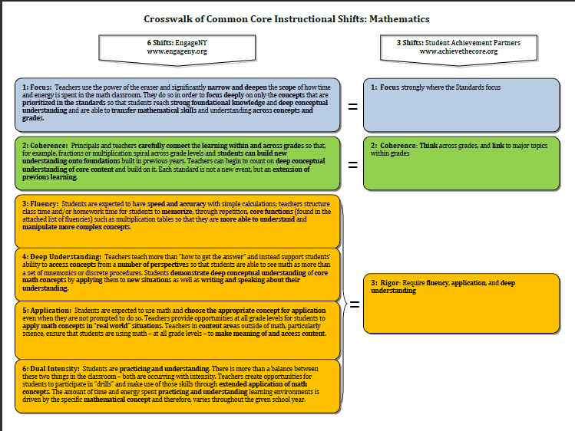
Fluency as Defined by the
Instructional Shifts
“Students are expected to have speed and accuracy with simple calculations; teachers structure class time and/or homework time for students to memorize through repetition, core functions.”
Notes:
What is Fluency?
TIME ALLOTTED FOR THIS SLIDE: 2 minutes

Slide 5
Required Fluencies
K | K.OA.5 | Add/Subtract within 5
1 | 1.OA.6 | Add/Subtract within 10
2 | 2.OA.2 2.NBT.5 | Add/Subtract within 20 (know single-digit sums from memory Add/Subtract within 100
3 | 3.OA.7 3.NBT.2 | Multiply/Divide within 100 Add/Subtract within 1000
4 | 4.NBT.4 | Add/Subtract within 1,000,000
5 | 5.NBT.5 | Multi-digit multiplication
Notes:
Here are the fluency standards for grades K-5. These are the major focus fluency of the year but students are not expected to master these fluencies until the end of the year. The daily fluency drills build to meeting such mastery.
Please note that not all fluency drills address the grade level standard. Some will give skills in preparation for the lesson or in anticipation for future lessons, as well as reviewing previously taught material.
TIME ALLOTTED FOR THIS SLIDE: 4 minutes

Slide 6
Fluency Activities in A Story of Units
Promote automaticity – allows students to reserve their cognitive energy for higher-level thinking
Daily, substantial, sustained, and supported by the lesson structure
10-20 minutes of easy-to-administer activities
Energetic activities that allow students to see measureable progress
Support conceptual understanding and application as well as the mathematical practices
Notes:
Fluency is designed to promote automaticity by engaging students in practice in ways that get their adrenaline flowing. Automaticity is critical so that students avoid using up too many of their attention resources with lower-level skills when they are addressing higher-level problems. The automaticity prepares students with the computational foundation to enable deep understanding in flexible ways.
TIME ALLOTTED FOR THIS SLIDE: 6 minutes

Slide 7
Lesson Study: Fluency Practice
Fluency activities serve a variety of purposes:
    Maintenance: Staying sharp on previously learned skills
    Preparation: Targeted practice for the current lesson
    Anticipation: Building skills to prepare students for the in-depth work of future lessons
In fluency work, all students are actively engaged with familiar content. This provides a daily opportunity for continuous improvement and individual success.
Notes:
Fluency activities serve a variety of purposes. In general, there are three main categories of fluency work:
Maintenance: Staying sharp on previously learned skills
Preparation: Targeted practice for the current lesson
Anticipation: Building foundational skills to prepare students for the in-depth work of future lessons
It is important to recognize that fluency work is always an extension of familiar content. It provides a daily opportunity for continuous improvement and individual success toward acquiring speed and accuracy.
Never new material, always something previously taught.
Fluencies are a bank of activities, change as needed for your class
Purposeful selection, not random
Careful planning to prepare students for what they will see in future lessons.
TIME ALLOTTED FOR THIS SLIDE: 8 minutes

Slide 8
AGENDA
Fluency Work – Sprints
Fluency Work – Counting Exercises
Fluency Work – White Board Exchanges
Fluency Work – Choral Exercises
Fluency Work – Other Fluency Activities
Notes:
Let’s look at Sprints.
TIME ALLOTTED FOR THIS SLIDE: 1 minute

Slide 9
Sprint: Take the Challenge!!
Grade 5 Sprint
Write the Missing Factor
You try!
Notes:
Delivery of a Sprint on Finding the Missing Factor from Grade 5, Module 3, Lesson 1.
TIME ALLOTTED FOR THIS SLIDE: 15 minutes
MATERIALS NEEDED:
Grade 5, Module 3, Lesson 1 Sprints

Slide 10
Sprint Directions
Read through the Directions for Administration of Sprints
Located in the overview of first module of every grade,1st through 5th
Notes:
Participants will have 4 minutes to read through the Directions for Administration of Sprints.
TIME ALLOTTED FOR THIS SLIDE: 4 minutes
MATERIALS NEEDED:
Module 1 Overview

Slide 11
Sprint Steps
Side A “On your mark, get set, GO!”
“Stop” and review answers
Continue to work, practice for the next sprint
Review answers again
Exercise and Counting
Side B “On your mark, get set, GO!”
“Stop” and review answers
Improvement
Notes:
Review each step of the Sprint routine with the participants.
TIME ALLOTTED FOR THIS SLIDE: 2 minutes

Slide 12
Fluency – Sprints
  A fast pace is essential. With practice the routine takes about 8-10 minutes.
  While administering Sprints, teachers assume the role of athletic coaches.
    Teacher = Coach
    Students = Players
    Sprint = Contest
    A rousing routine fuels students’ motivation to do their personal best.
  Student recognition of increasing success is critical, and so every improvement is celebrated.
Notes:
Dr. Yorham Sagher, inventor of the Sprints, designed sprints to promote automaticity by engaging students in practice that gets their adrenaline flowing. Adrenaline produces long term memory. Automaticity is critical so that students avoid using up too many of their attention resources with lower-level skills when they are addressing higher-level problems. The automaticity prepares students with the computational foundation to enable deep understanding in flexible ways.
Now let’s review the basics of Sprint design. Sprints have two parts. The problems on Sprint A should be almost identical to the problems on Sprint B without actually being identical. Sprint B should be neither harder nor easier than Sprint A.
Students are given 60 seconds for each Sprint: 60 seconds for Sprint A and 60 seconds for Sprint B. Your goal in writing the Sprint is that every student should get at least 25% correct, and ideally, no student will finish within the 60 seconds. A typical 4th or 5th grade Sprint has about 44 problems. Younger students need fewer problems.
You don’t want students skipping around while working a Sprint in hopes of finding the easiest problems to work – that only slows them down and takes their concentration off doing the problems and on finding easy ones. Therefore, problems on the Sprint should start easy and get progressively more complex, perhaps in quadrants. For example, the first 11 should be the simplest form, a complexity is added to the next 11, then an additional complexity is added to the next 11, and finally the last 11 problems are the most complex.
Problems should be designed with a pattern or rhythm in mind that encourages students to “Look for and express regularity in repeated reasoning.” This is MP.8.
If you are not familiar with the delivery of a Sprint, please refer to the How to Implement A Story of Units document and read about the Sprint routine. It is the combination of the design and the delivery that make Sprints far, far superior to traditional worksheets.
TIME ALLOTTED FOR THIS SLIDE: 2 minutes

Slide 13
Fluency – Sprints
  One Sprint (side A & B) with closely related problems.
  Students complete the two parts of the Sprint in quick succession with the goal of improving on the second part, even if only by one more.
  Round B of the Sprint consolidates student progress, and builds confidence, especially for lower performing students.
Notes:
Refer to the slide’s information.
TIME ALLOTTED FOR THIS SLIDE: 2 minutes

Slide 14
Fluency – Sprints
Intelligent design and sequence of delivery makes the Sprint superior to computer-generated worksheets.
Sprints have been written to account for a large range of skill levels.
Teachers are encouraged to study the sequence of problems in the Sprints from A Story of Units and create their own Sprints.
Sprints do not have to be administered daily, but certainly can be done at least 2-3 times per week.
Notes:
Refer to the slide’s information.
TIME ALLOTTED FOR THIS SLIDE: 2 minutes

Slide 15

Sprints - Fluency in Action:
Notes:
Participants will watch a video clip.
Scott Baldridge, PhD: Sprints - Fluency in Action
http://www.engageny.org/resource/nti-november-2012-rigor-breakdown-sprints-fluency-in-action
TIME ALLOTTED FOR THIS SLIDE: 10 minutes
MATERIALS NEEDED:
Video Clip

Slide 16
Introducing…Sprints to K!
Sprints are introduced in the second half of Module 3.
What are the steps of the Sprint routine?
What skills will students need for success with Sprints?
What social-emotional considerations
are necessary for Kindergarten
students?
Notes:
NOTE THAT THIS SLIDE IS “HIDDEN” AND WILL NOT AUTOMATICALLY BE PART OF THE PRESENTATION. IF YOU’D LIKE TO INCLUDE THIS SLIDE IN YOUR PRESENTATION, YOU CAN SIMPLY “UNHIDE” THE SLIDE.
To Kindergarten students, the Sprint routine at first appears to be a rather complicated procedure, and to their teachers, an overwhelming and daunting task. To have success in introducing Sprints in the lower grades, teachers must break down the procedure into a series of steps, and teach each part separately before combining them. By investing a substantial amount of time in teaching procedure, it will soon become automatic, allowing students to focus on the tangible signs of progress in Math, and pride in exceeding one’s personal best.
Allow 3 minutes for participants to think and jot down their responses to the above questions.
TIME ALLOTTED FOR THIS SLIDE: 2 minutes

Slide 17
K Sprint: Breaking it down
Rather than teach the Sprint procedure in its entirety, the procedure is broken down.
Step 1: Each component is practiced individually.
Step 2: Students observe the teacher take a Sprint.
Step 3: Students debrief the procedure.
Step 4: Students try a Sprint.
Notes:
Sprints are timed, skill based exercises that are a set of intentionally laid out problems intended to improve students abilities to carry out procedures such as addition and subtraction.
Think of how you would teach any classroom procedure in Kindergarten: walking in line, unpacking in the morning, taking out materials. Effective teachers should model the process and the expected behavior, using an “I do, we do, you do” scaffolded approach to teach each part. Encourage students to reflect.
Ask questions such as:
What went well? What was hard for you? What was easy for you? How can we do better next time? Have high expectations, and insist that every student meet them, before proceeding to the next part.
TIME ALLOTTED FOR THIS SLIDE: 2 minutes

Slide 18
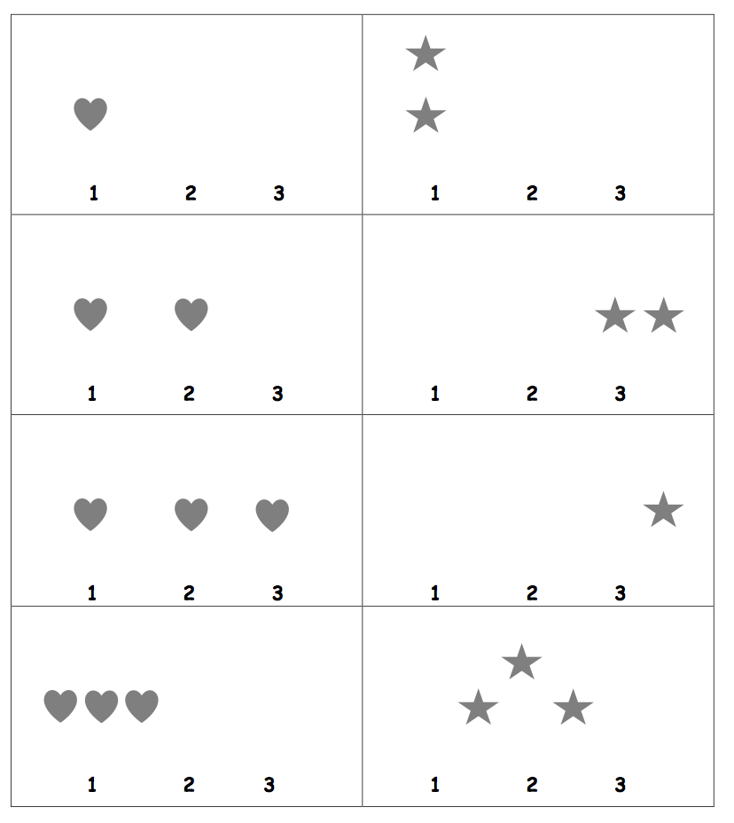
How do students build up to the Sprint Routine in A Story of Units?
Lesson 16: Starting and stopping at a signal, while writing numbers 1-10.
Lesson 19: Same as Lesson 16, but counting down.
Lesson 20: Observing and Noticing
Lesson 21: My First Sprint
Lesson 25: Beat Your Score
Lessons 28 and 31: We Can Do Sprints
Notes:
Sprints are used throughout A Story of Units K-5 and beyond. They are first introduced in Kindergarten Module 3 Lesson 16.
Hearts and stars to show the students to do the columns first, do all the hearts first then the stars.
In Lesson 16, students practice starting and stopping at the signal, while writing numbers quickly.
In Lesson 19, a slight layer of complexity is added. Students repeat the same activity, but now, counting down, challenging them to remain alert to their teacher’s signal while concentrating more heavily on an academic task.
In Lesson 20 not only do they observe the teacher, or other students taking a Sprint, but more importantly they engage, reflect, and have a dialogue about the process before they do it themselves.
In Lesson 21, students take only one Sprint, the same Sprint they observed just the day before. The focus is on the successful completion of a very complicated procedure, and putting forth a strong effort. Note that 2 different shapes are used in each column, as a scaffold that assists students in working down, instead of across, the 2 columns.
In Lesson 25, the concept of “beating your score” is introduced. Continue to emphasize improvement over completion, by reminding students that they are racing against themselves.
In Lessons 28 and 31, new Sprints are delivered. The content is still very familiar, although slightly more difficult than before. Scaffolds remain in place in Lesson 28 to ensure that students complete problems in the intended sequence, down the columns, rather than across, but are then removed by Lesson 31. As always, problems move from simple to complex, and the pattern drives students closer to the finish line.
With the right classroom culture, and careful attention to social and emotional needs Kindergarten students will grow to love Sprints and look forward to seeing themselves making progress.
TIME ALLOTTED FOR THIS SLIDE: 2 minutes

Slide 19
Variations for Kindergarten
Complete example problem(s) on the board.
If using single sided Sprints, have students write numbers to 10 on the back while they wait, so that no time is wasted.
Warm up: Have students “finger-write” the answers, so that they can practice before the real race.
Instead of teacher role play, take students to observe a 1st grade class taking a Sprint, or watch a video, pausing periodically to ask questions about what students noticed.
Notes:
Completing a few examples together on the board ensures that students won’t be caught off-guard when the Math race begins. It puts them at ease with the academic task and builds confidence. Sprints are intended to develop fluency, that is, speed and accuracy. Therefore, the academic content should be familiar.
TIME ALLOTTED FOR THIS SLIDE: 2 minutes

Slide 20
Troubleshooting in Kindergarten
If motor skills haven’t caught up to cognitive ability…
    try having the student use a highlighter to “swipe” the correct answer, rather than write it.
If the student is still working across the columns, instead of down…
    try making a green stripe along the left side, and a red stripe down the right to lead the eye down the columns.
Notes:
Refer to the slide’s information.
TIME ALLOTTED FOR THIS SLIDE: 2 minutes

Slide 21
Troubleshooting in Kindergarten
If a student is slow to get started…
    Check to see that they are holding the pencil “ready to write” , that is, in the writing grip position, not by the eraser, or in the middle.
    Fumbling to orient the pencil when the signal is given leads to valuable seconds lost!
Notes:
Refer to the slide’s information.
TIME ALLOTTED FOR THIS SLIDE: 2 minutes

Slide 22
Sprints in Action – 2nd Grade
Notes:
Participants will watch a video clip.
2nd Grade: Sprints
http://commoncore.org/maps/math/video-gallery/implementing-a-sprint-in-a-classroom
TIME ALLOTTED FOR THIS SLIDE: 10 minutes
MATERIALS NEEDED:
Video Clip

Slide 23
Implementation Consideration
Consistent Routine
Focus on Improving Personal Best
Student Recognition
Teacher Engagement
Variety of Sprint Topics
Notes:
Refer to the slide’s information.
TIME ALLOTTED FOR THIS SLIDE: 2 minutes

Slide 24
Summary of Differentiation Techniques
Provide students with the Sprint the night before
Use Sprints as morning work, classwork, or homework
Create differentiated Sprints
Create Sprints to address student needs
Notes:
Refer to the slide’s information.
TIME ALLOTTED FOR THIS SLIDE: 2 minutes

Slide 25
How to Create a Sprint?
Select a topic:
Multiplication/Times table
Sprint progression of 4 quadrants:
1st: Very easy 1-11 (every student
feels successful)
2nd: Easy 12-22
3rd: Moderate 23-33
4th: Challenge 34-44 (strongest student
couldn’t finish)
You try!
Notes:
Participants will have 5 minutes to create a Multiplication/Times tables Sprint.
TIME ALLOTTED FOR THIS SLIDE: 5 minutes
MATERIALS NEEDED:
Blank Sprints

Slide 26
Sprints: Reflections
In what ways are Sprints advantageous in meeting the demands of fluency?
Notes:
Participants will reflect on the question.
TIME ALLOTTED FOR THIS SLIDE: 4 minutes

Slide 27
Sprints: Key Points
Sprints allow for rapid completion of multiple practice problems.
Sprints create intensity in student practice.
Sprints give students quick feedback.
Sprints motivate students with a near-term goal for improvement.
Notes:
Refer to the slide’s information.
TIME ALLOTTED FOR THIS SLIDE: 2 minutes

Slide 28
AGENDA
Fluency Work – Sprints
Fluency Work – Counting Exercises
Fluency Work – White Board Exchanges
Fluency Work – Choral Exercises
Fluency Work – Other Fluency Activities
Notes:
Let’s look at Counting Exercises.
There are many fluency drills throughout the curriculum. Today we will go through a few samples of each category.
TIME ALLOTTED FOR THIS SLIDE: 1 minute

Slide 29
Counting Exercises
Appropriate for all grade levels, K-5
Counting forward and backwards allows students to develop a mental number line
Counting forward and backwards supports addition and subtraction
Skip-counting supports multiplication
Notes:
Refer to the slide’s information.
TIME ALLOTTED FOR THIS SLIDE: 2 minutes

Slide 30
K-5 Progression of Finger Counting
What did you notice?
How do lower grade level counting exercises support the work of the upper grades?
Notes:
Presenters will demonstrate K-5 Finger Counting.
Participants will then reflect on the questions.
TIME ALLOTTED FOR THIS SLIDE: 7 minutes

Slide 31
Kindergarten Counting Exercises
Green Light, Red Light
Rekenrek Roller Coaster
Pop Up
Finger Counting
Rekenrek Say Ten counting
Say Ten Push Ups
Notes:
Students need to be fluent and automatic with counting strategies to be able to contend with higher level addition and subtraction problem types.
Green Light, Red Light (3 minutes)
Draw a green dot with a 1 underneath and a red dot with a 3 underneath on the board. Explain to students that they will start counting and stop counting on the number as indicated by the color code.
T: Look at your numbers (pointing to the number 1 written below the green dot, and 3 below the red dot), think, ready… green light!
S: 1, 2, 3.
T: Very good! (Erase numbers 1 and 3, and write the new numbers.) New numbers (green is 1, red is 5). Look, think, ready… green light!
S: 1, 2, 3, 4, 5.
A recommended sequence to follow these problems: (2, 3); (2, 3, 4); (3, 4); (3, 4, 5); (3, 2, 1); (5, 4, 3, 2, 1); (5, 4); (5, 4, 3); (4, 3); (4, 3, 2).
Rekenrek Roller Coaster (4 minutes)
Materials: (T) 20 Rekenrek
Direct the students to gradually raise their hands as the numbers increase, and lower their hands as the numbers decrease, mimicking the motion of a wave. Refer to the Rekenrek fluency activity in Lesson 4 for a recommended sequence.
Pop Up Number (5 minutes)
T: Come sit in a circle on the rug. We’re going to play Pop Up Number! The Pop Up Number is 3. What number?
S: 3.
T: We’ll count around the circle to 5. If you say the Pop Up Number, you have to….
S: Pop up (Stand up.)!
T: Let’s begin. 1.
S: 2.
S: 3 (Stands up.).
S: 4.
S: 5.
The next student begins again at 1. Continue until some or all students are standing. For a variation, try counting down from 5.
NOTES CONTINUE ON NEXT PAGE…
TIME ALLOTTED FOR THIS SLIDE: 5 minutes
MATERIALS NEEDED:
Rekenrek

Slide 32
Kindergarten Counting Exercises
Green Light, Red Light
Rekenrek Roller Coaster
Pop Up
Finger Counting
Rekenrek Say Ten counting
Say Ten Push Ups
Notes:
NOTES FROM PREVIOUS SLIDE CONTINUED…
Finger Counting (3 Minutes)
T: Count with me. Ready? (Show pinky on the right hand.)
S: 1. (Show pinky on the left hand).
T: (Show pinky and ring fingers on the right hand.)
S: 2. (Show pinky and ring fingers on the left hand.)
T: (Show pinky on the right hand.)
S: 3. (Show pinky, ring, and middle fingers on the left hand.)
T: (Show pinky and ring fingers on the right hand.)
Remain consistent in finger counting, moving from pinky to thumb, so that students can see their hands as a number line from left to right. (The teacher begins on the right so that the students do not see the reverse.) Here is a recommended sequence: 1, 2, 1, 2, 3, 2, 3, 2, 3, 4, 3, 4, 3, 4, 5.
Notice that the teacher does not say the numbers with the students, but rather, listens intently for hesitations or errors. Return to a simpler sequence (within 3) if students begin to struggle.
TIME ALLOTTED FOR THIS SLIDE: 5 minutes
MATERIALS NEEDED:
Rekenrek

Slide 33
1st Grade Counting Exercises
Red Light, Green Light
Beep Counting
Sparkle: Say Ten Way
Happy Counting
Coin Drop
Notes:
Red Light/Green Light: Counting by Ones (5 minutes)
Note: By providing students with ongoing practice with counting throughout the year, they build and maintain their counting skills. This counting work is also foundational for later first grade work with adding and subtracting within 100.
Say a number between 1 and 100. When you say “green light,” students begin running in place and counting aloud together, beginning with the number you said. When you say “red light,” they stop counting and freeze. Any students who are still moving or counting after you say “red light” sit down until the next game. Continue playing with a new starting number every time you say “green light.” Play until only a few students are standing, or when you see fit. Then instruct the whole class to stand and start the game again. A suggested sequence of start numbers would be: 15, 28, 35, 48, 55, 68, etc.
Beep Counting (2 minutes)
Note: This activity reviews counting and reading numbers to 120.
Write number sequences on the board with missing numbers. Students read the sequence aloud, saying “beep” for the missing number. Then, students say the missing number on your signal.
Suggested sequence, as time permits:
a. 10, 11, 12, ___ b. 110, 111, 112, ___ c. 20, 19, 18, ___ d. 120, 119, 118, ___
e. 17, 18, __, 20 f. 117, 118, ___, 120 h. 8, 9, ___, 11 i. 108, 109, ___, 111
j. 12, 11, ___, 9 k. 112, 111, ___, 109 l. ___, 7, 8, 9 m. ___, 107, 108, 109
Sparkle: The Say Ten Way (7 minutes)
Note: By providing students with ongoing practice with counting throughout the year, they build and maintain their counting skills. This activity also prepares students for work in later modules, as they explore place value and the importance of 10.
Students stand in a circle. Introduce the counting pattern, start number and end number (“Today we will count the Say Ten way from 8 to 13.”). You may adjust the number range to fit the size of your class. Before the game, practice the counting sequence as a group and say, “Sparkle!” after the ending number is said aloud (“Let’s practice. Eight, nine, ten, ten-1, ten-2, ten-3, Sparkle!”).
Begin the game. Students count around the circle, each student saying one number in the counting sequence. After the ending number is said (ten-3), the next student says, "Sparkle!" and the following player sits. Begin again with the start number and continue counting in the same direction around the circle until only one player is standing.
Coin Drop (3 minutes) (L28)
Materials: (T) 4 dimes, 10 pennies
Note: In this activity, students practice adding and subtracting ones and tens.
T: (Hold up a penny.) Name my coin.
S: A penny.
T: How much is it worth?
S: 1 cent.
T: Listen carefully as I drop coins in my can. Count along in your minds.
Drop in some pennies and ask how much money is in the can. Take out some pennies and show them. Ask how much money is still in the can. Continue adding and subtracting pennies for a minute or so. Then repeat the activity with dimes.
TIME ALLOTTED FOR THIS SLIDE: 5 minutes
MATERIALS NEEDED:
Rekenrek-20

Slide 34
2nd Grade Counting Exercises
Say Ten Counting, Say Ten to the Next Ten
Counting by 1, 2, 5, 10, 100
Counting by 2’s by end of year
Counting length units, with coins, on a clock
Rekenrek
Hide Zero cards
Notes:
Module 1-2: Say Ten Counting Move from Rekenrek to Hide Zero cards. (See Lesson 2 script)
Count from 5 to 25: 5, 6, 7, 8, 9, 10, ten 1, ten 2, … 2 tens, 2 tens 1, etc.
Talk with a partner: What patterns did you notice as you counted the numbers 11-19? How does this relate to counting numbers 20-29?
Then you can repeat using Hide Zero cards.
Counting by 1’s, 5’s, and 10’s (Module 3-Focus on PV)
Happy Counting starts simple by ones, in modules 1 and 2, then by 5’s and 10’s in module 3.
Happy Counting: Up and Down by Ones from 95 to 121 (2 minutes) (M3 L1)
T: We’re going to play Happy Counting!
T: Watch my fingers to know whether to count up or down. A closed hand means stop. (Show signals as you explain.)
T: Let’s count by ones, starting at 95. Ready? (Teacher rhythmically points up until a change is desired. Show a closed hand then point down. Continue, mixing it up.)
S: 95, 96, 97, 98, 99, 100, 101, 102 (switch). 101, 100 (switch). 101, 102, 103, 104, 105, 106, 107, 108, 109, 110, 111, 112 (switch). 111, 110, 109 (switch). 110, 111, 112, 113, 114, 115, 116, 117 (switch). 116, 115, 114, (switch), etc.
Skip-Count by Tens: Up and Down Crossing 100 (2 minutes)
T: This time let’s play Happy Counting, but skip-counting by tens!
T: Watch my fingers to know whether to count up or down. A closed hand means stop. (Show signals as you explain.)
T: Let’s count by tens, starting at 60. Ready? (Teacher rhythmically points up until a change is desired. Show a closed hand then point down. Continue, mixing it up.)
S: 60, 70, 80, 90, 100, 110, 120, 130, 140 (switch). 130, 120, 110, 100, 90 (switch). 100, 110, 120, 130, 140, 150, 160, 170, 180, 190, 200, 210, 220 (switch). 210, 200, 190, 180, (switch), etc.
NOTES CONTINUE ON NEXT PAGE…
TIME ALLOTTED FOR THIS SLIDE: 5 minutes
MATERIALS NEEDED:
Rekenrek-100
Clock

Slide 35
2nd Grade Counting Exercises
Say Ten Counting, Say Ten to the Next Ten
Counting by 1, 2, 5, 10, 100
Counting by 2’s by end of year
Counting length units, with coins, on a clock
Rekenrek
Hide Zero cards
Notes:
NOTES FROM PREVIOUS SLIDE CONTINUED…
Counting with Ones, Tens, and Hundreds: 0 to 1,000 (4 minutes) (M3L2)
Materials: (T) Bundle of one hundred, 1 ten, and a single straw from Lesson 1
T: Let’s play a game using what we know about counting by ones, tens, and hundreds. I’ll hold bundles to show you what to count by. A bundle of 100 means count by hundreds, a bundle of 10 means count by tens, and a single straw means count by ones. (Create visual support by writing the numbers on the board as students count.)
T: Let’s start at 0. Ready? (Hold up a bundle of 10 until students count to 130.)
S: 10, 20, 30, 40, 50, 60, 70, 80, 90, 100, 110, 120, 130.
T: (Hold up a bundle of 100 until students count to 630.)
S: 230, 330, 430, 530, 630.
T: (Hold up a bundle of 10 until students count to 690.)
S: 640, 650, 660, 670, 680, 690.
T: (Hold up a single one until students count to 702.)
S: 691, 692, 693, 694, 695, 696, 697, 698, 699, 700, 701, 702.
T: (Isolate the numbers 698–702 by drawing a box around them.) Partner A, count these numbers up and down as fast as you can to Partner B. Then switch. If you both finish before one minute is up, try it again and see if you get faster!
Count by Ten or One with Dimes and Pennies (3 minutes) (M5 L15)
Materials: (T) 10 dimes and 10 pennies
Note: This activity uses dimes and pennies as abstract representations of tens and ones to help students become familiar with coins, while simultaneously providing practice with counting forward and back by ten or one.
First minute: Place and take away dimes in a 5-group formation as students count along by ten.
Second minute: Begin with 2 pennies. Ask how many ones there are. Instruct students to start at 2 and add and subtract 10 as you place and take away dimes.
Third minute: Begin with 2 dimes. Ask how many tens there are. Instruct students to begin at 20 and add and subtract 1 as you place and take away pennies.
Skip-Counting by Twos (4 minutes) (M6 L18)
Note: Students practice counting by twos in preparation for their work with even and odd numbers in the lesson.
T: Let’s skip-count by twos. On my signal, count by ones from 0 to 20 in a whisper. Ready? (Tap the desk while the students are counting, knocking on the twos. For example, tap, knock, tap, knock, etc.)
T: Did anyone notice what I was doing while you were counting? I was tapping by ones, but I knocked on every other number. Let’s count again, and this time you can try knocking and tapping with me.
S: 1 (tap), 2 (knock), 3 (tap), 4 (knock), 5 (tap), 6 (knock), etc.
Continue this routine up to 20.
TIME ALLOTTED FOR THIS SLIDE: 5 minutes
MATERIALS NEEDED:
Rekenrek-100
Clock

Slide 36
Counting Exercises in Action: K-2
Notes:
Participants will watch a video clip.
Kindergarten: Finger Counting
http://www.engageny.org/resource/nti-november-2012-rigor-breakdown-counting-exercises-for-k-1
2nd Grade: Skip Counting by Ones, Tens, and Hundreds
http://www.engageny.org/resource/nti-november-2012-session-2-a-story-of-units-skip-counting-by-ones-tens-and-hundreds
2nd Grade: Counting with Bundles
http://www.engageny.org/resource/nti-november-2012-rigor-breakdown-counting-with-bundles
2nd Grade: Happy Counting by 2’s
http://commoncore.org/maps/math/video-gallery/happy-counting
2nd Grade: Hop and Count by 10’s, Arm Circles by 5’s
http://commoncore.org/maps/math/video-gallery/motion-fluency
TIME ALLOTTED FOR THIS SLIDE: 5 minutes
MATERIALS NEEDED:
Video Clip

Slide 37
3rd Grade Counting Exercises
Group Counting by 3, 4, 6, 7, 8, 9
Minute Counting
Gram Counting
Skip Counting by Halves and Fourths on the Clock
Counting by Unit Fractions
Notes:
Group Counting (3 minutes)
Note: Group counting reviews interpreting multiplication as repeated addition. Counting by sevens, eights, and nines in this activity anticipates multiplication using those units in Module 3.
Direct students to count forward and backward using the following suggested sequences, occasionally changing the direction of the count:
Sevens to 28
Eights to 32
Nines to 36
Minute Counting (6 minutes)
Note: This activity reviews the Grade 2 standard of telling and writing time to the nearest 5 minutes. It prepares students to count by 5-minute intervals on the number line and clock in Lesson 2. Students also practice group counting strategies for multiplication in the context of time.
T: There are 60 minutes in 1 hour. Count by 5 minutes to 1 hour.
S: 5 minutes, 10 minutes, 15 minutes, 20 minutes, 25 minutes, 30 minutes, 35 minutes, 40 minutes, 45 minutes, 50 minutes, 55 minutes, 60 minutes. (Underneath 60 minutes, write 1 hour.)
T: How many minutes are in a half-hour?
S: 30 minutes.
T: Count by 5 minutes to 1 hour. This time, say half-hour when you get to 30 minutes.
Repeat the process using the following suggested sequences:
Count by 10 minutes and 6 minutes to 1 hour.
Count by 3 minutes to a half hour.
NOTES CONTINUE ON NEXT PAGE…
TIME ALLOTTED FOR THIS SLIDE: 5 minutes
MATERIALS NEEDED:
Clock

Slide 38
3rd Grade Counting Exercises
Group Counting by 3, 4, 6, 7, 8, 9
Minute Counting
Gram Counting
Skip Counting by Halves and Fourths on the Clock
Counting by Unit Fractions
Notes:
NOTES FROM PREVIOUS SLIDE CONTINUED…
Gram Counting (2 minutes)
Note: This activity reviews Lesson 6 and lays a foundation for Grade 4 when students compose compound units of kilograms and grams.
T: There are 1,000 grams in 1 kilogram. Count by 100 grams to 1 kilogram.
S: 100 grams, 200 grams, 300 grams, 400 grams, 500 grams, 600 grams, 700 grams, 800 grams, 900 grams, 1 kilogram.
Skip-Count by Halves on the Clock (2 minutes)
T: (Hold or project a clock.) Let’s skip-count by halves on the clock starting with 1.
S: 1 o’clock, half past 1, 2, half past 2, 3, half past 3, 4, (Switch direction.) half past 3, 3, half past 2, 2, half past 1, 1.
Continue counting up and down.
Skip-Counting by Fourths on the Clock (2 minutes)
T: (Hold or project a clock.) Let’s skip-count by fourths on the clock starting with 1.
S: 1, 1:15, 1:30, 1:45, 2, 2:15, 2:30, 2:45, 3.
Continue with possible sequences:
1, 1:15, half past 1, 1:45, 2, 2:15, half past 2, 2:45, 3.
1, quarter past 1, half past 1, quarter ‘til 2, 2, quarter past 2, half past 2, quarter ‘til 3, 3.
Counting by Unit Fractions (2 minutes)
T: (Project a number line.) Count by halves from 1 half to 6 halves and back to 0.
S: $\frac{1}{2}, \frac{2}{2}, \frac{3}{2}, \frac{4}{2}, \frac{5}{2}, \frac{6}{2}, \frac{5}{2}, \frac{4}{2}, \frac{3}{2}, \frac{2}{2}, \frac{1}{2}, 0.$
Continue with possible sequence for: thirds, fifths, and fourths.
TIME ALLOTTED FOR THIS SLIDE: 5 minutes
MATERIALS NEEDED:
Clock

Slide 39
4th Grade Counting Exercises
Unit Counting (grams, liters, meters, minutes, etc.)
Fraction Counting
Notes:
Unit Counting (5 minutes) : This fluency will deepen student understanding of the composition and decomposition of units, laying a foundation for adding and subtracting grams and kilograms. Numbers are bolded to show change in direction of counting.
Direct students to count by grams in the following sequence:
500 g, 1,000 g, 1,500 g, 2,000 g, 2,500 g, 3,000 g, 2,500 g, 2,000 g, 1,500 g, 1,000 g, 500 g
500 g, 1 kg, 1,500 g, 2 kg, 2,500 g, 3 kg, 2,500 g, 2 kg, 1,500 g, 1 kg, 500 g
500 g, 1 kg, 1 kg 500 g, 2 kg, 2 kg 500 g, 3 kg, 2 kg 500 g, 2 kg, 1 kg 500 g, 1 kg, 500 g
200 g, 400 g, 600 g, 800 g, 1 kg, 1 kg 200 g, 1 kg 400 g, 1 kg 600 g, 1 kg 800 g, 2 kg.
600 g, 1,200 g, 1,800 g, 2,400 g, 3 kg, 2,400 g, 1,800 g, 1,200 g, 600 g.
600 g, 1 kg 200 g, 1 kg 800 g, 2 kg 400 g, 3 kg, 2 kg 400 g, 1 kg 800 g, 1 kg 200 g, 600 g.
Unit Counting (4 minutes)
Note: This fluency will deepen student understanding of the composition and decomposition of unit conversions, laying a foundation for adding and subtracting meters and centimeters.
Direct students to count by 50 cm in the following sequence, letting them know with gestures when to change direction in counting:
50 cm, 100 cm, 150 cm, 200 cm, 250 cm, 300 cm, 250 cm, 200 cm, 150 cm, 100 cm, 50 cm.
50 cm, 1 m, 150 cm, 2 m, 250 cm, 3 m, 250 cm, 2 m, 150 cm, 1 m, 50 cm.
50 cm, 1 m, 1 m 50 cm, 2 m, 2 m 50 cm, 3 m, 2 m 50 cm, 2 m, 1 m 50 cm, 1 m, 50 cm.
Count by Equivalent Fractions (5 minutes)
Materials: (S) Personal white boards
Note: This fluency activity prepares students for G4–M5–Lesson 4.
T: Count by ones to 6.
S: 1, 2, 3, 4, 5, 6.
T: Count by sixths to 6 sixths. Start at 0 sixths. (Write as students count.) S: $\frac{0}{6}\frac{1}{6}\frac{2}{6}\frac{3}{6}\frac{4}{6}\frac{5}{6}\frac{6}{6}.$
T: 6 sixths is the same as one of what unit?
S: 1 whole.
T: (Beneath $\frac{6}{6}$, write 1.) Count by sixths again. This time, say “1 whole” when you arrive at 6 sixths. Start at zero.
S: $\frac{1}{6}\frac{2}{6}\text{, }\frac{3}{6}\text{, }\frac{4}{6}\text{, }\frac{5}{6},$1 whole.
T: Let’s count by thirds to 6 thirds. Start at 0 thirds. (Write as students count.) S: $\frac{0}{3}\text{, }\frac{1}{3}\text{, }\frac{2}{3}\text{, }\frac{3}{3}\text{, }\frac{4}{3}\text{, }\frac{5}{3}\text{, }\frac{6}{3}$.
T: How many thirds are in 1?
S: 3 thirds.
T: (Beneath $\frac{3}{3}$, write 1.) How many thirds are in 2?
S: 6 thirds.
T: (Beneath $\frac{\text{6}}{\text{3}}$ , write 2.) Let’s count by thirds again. This time, when you arrive at 3 thirds and 6 thirds, say the whole number. Start at zero.
S: $\frac{1}{3}\frac{2}{3}\text{,1, }\frac{4}{3}\frac{5}{3}$, 2.
Repeat the process, counting by halves to 6 halves.
TIME ALLOTTED FOR THIS SLIDE: 5 minutes

Slide 40
5th Grade Counting Exercises
Skip count by 12’s, 12 tens
Happy Counting with Mixed Numbers
Count by Fractions
Notes:
G5 standard calls for students to be fluent multiplying multi-digit numbers by the end of G5. That being said, it would not be reasonable or even advisable to expect students to multiply 5,247 by 389 in a matter of seconds. However, there are a number of skills and strategies that we can practice to help students be more successful when using the multiplication algorithm. Our goal today is to look at a number of these type of fluency activities.
Keep in mind that the following fluency exercises would NOT be administered in one day, but represent a progression of activities that might be implemented over a series of days/weeks to build success and confidence.
*The following are excerpts from Fluency scripts found in M1-L2, & M2-L16/17/18. Refer to them for further support*
Suggested sequence of G5 Counting Exercises:
Skip count by 12s (emphasize 60, 108, 132 and 144… they’re always the hardest)
Skip count by 12 tens or 12 hundreds (stop periodically to have participants say the number in standard form)
Happy Counting with Mixed Numbers (3 minutes)
T: Let’s count by 1/2 with mixed numbers. Ready? (Teacher rhythmically points up until a change is desired. Show a closed hand, then point down. Continue, mixing it up).
S: 1/2, 1, 1 1/2, 2 (stop), 1 1/2, 1, 1/2, 0 (stop), 1/2, 1, 1 1/2, 2, 2 1/2, 3, 3 1/2, 4 (stop), 3 1/2, 3, 2 1/2, 2, 1 1/2, 1 (stop), 1 1/2, 2, 2 1/2, 3, 3 1/2, 4, 4 1/2, 5.
T: Excellent. Try it for 30 seconds with your partner. Partner A, you are the teacher today.
Count by Fractions (3 minutes)
Note: This fluency prepares students for G5–M4–Lesson 21.
T: Count by ones to 10. (Write as students count.)
S: 1, 2, 3, 4, 5, 6, 7, 8, 9, 10.
T: Count by halves to 10 halves. (Write as students count.)
S: 1 half, 2 halves, 3 halves, 4 halves, 5 halves, 6 halves, 7 halves, 8 halves, 9 halves, 10 halves.
T: Let’s count by halves again. This time, when we arrive at a whole number, say the whole number. (Write as students count.)
S: 1 half, 1 whole, 3 halves, 2 wholes, 5 halves, 3 wholes, 7 halves, 4 wholes, 9 halves, 5 wholes.
T: Let’s count by halves again. This time, change improper fractions to mixed numbers. (Write as students count.)
S: 1 half, 1, 1 and 1 half, 2, 2 and 1 half, 3, 3 and 1 half, 4, 4 and 1 half, 5.
TIME ALLOTTED FOR THIS SLIDE: 5 minutes

Slide 41
Implementation Considerations
Consistent routine
Engagement and Pacing
Varied student ability levels
Notes:
Keeping hand signals consistent throughout the year, practice daily for no more than 4-5 minutes, otherwise students will lose enthusiasm for the experience.
Keep the counting challenging and exciting.
Use differentiation techniques to alter for your class.
TIME ALLOTTED FOR THIS SLIDE: 1 minute

Slide 42
Ways to Differentiate Counting
Tapping on desk, lap
Whisper, Hum counting
Think/talk counting
Visuals such as number bonds, hundreds chart, number line
Increase/decrease speed
Manipulatives such as Rekenrek and linking cubes
Turn and counts
Notes:
Refer to the slide’s information.
TIME ALLOTTED FOR THIS SLIDE: 1 minute

Slide 43
Counting Exercises in Action: 3-5
Notes:
Participants will watch a video clip.
5th Grade: Addition Fractions to make 1 Whole (part 1); Happy Counting by Fractions (part 2)
http://www.engageny.org/resource/common-core-video-series-fraction-fluency-in-grade-5
TIME ALLOTTED FOR THIS SLIDE: 5 minutes
MATERIALS NEEDED:
Video Clip

Slide 44
Let’s Practice!
Study the progression of counting exercises in grades K-5.
Select a few exercises and practice with a partner.
You try!
Notes:
Participants will have 5 minutes to read and practice.
TIME ALLOTTED FOR THIS SLIDE: 5 minutes
MATERIALS NEEDED:
K-5 Counting Handout

Slide 45
Counting Exercises: Reflections
  How could counting exercises have an impact or a benefit in your classes, school or district?
  How might counting exercises address trouble areas that your students experience?
Notes:
Participants will reflect on the questions.
TIME ALLOTTED FOR THIS SLIDE: 2 minutes

Slide 46
Counting Exercises: Key Points
Appropriate for all grade levels, K-5
Counting forward and backwards allows students to develop a mental number line
Counting forward and backwards supports addition and subtraction
Skip-counting supports multiplication
Notes:
Refer to the slide’s information.
TIME ALLOTTED FOR THIS SLIDE: 1 minute

Slide 47
AGENDA
Fluency Work – Sprints
Fluency Work – Counting Exercises
Fluency Work – White Board Exchanges
Fluency Work – Choral Exercises
Fluency Work – Other Fluency Activities
Notes:
Let’s look at White Board Exchanges.
TIME ALLOTTED FOR THIS SLIDE: 1 minute

Slide 48
Fluency – White Board Exchanges
Quick, efficient interactive drills and games
Applies to a wide range of skills
Notes:
Chunk it, Check it technique
Students feel safe, no judgment
Quick check for understanding, can change your questioning based on responses
Choral engages all students, raise your hand when ready gives more thinking time.
Have simple to complex sequence in mind, be prepared to alter based on student responses
TIME ALLOTTED FOR THIS SLIDE: 1 minute

Slide 49
Kindergarten Whiteboard Exercises
5 Group Cards
Rekenrek
Triangle Mat
Left Hand Mat
Notes:
Five Frame Peek-a-Boo (4 minutes)
Materials: (T) 5‐group cards
T: I’m going to show you my 5--‐group cards, but only for a second! Like this… (hold up the card briefly, and then quickly take it out of view). Quickly count the dots, and raise your hand when you know how many. Remember to wait for the snap. (Wait for all students to raise hands, and then give the signal.)
S: 1!
Work within numbers to 3 at first, and as students demonstrate mastery, introduce 4 and 5. Here is a possible sequence: 1, 2, 1, 2, 3, 2, 3, 4, 3, 2, 3, 2, 3, 4, 5, 4, 5, 4, 3, then random.
Making 3 with Triangles and Beans (6 minutes)
Materials: (S) 3 beans, paper or foam triangle
T: Touch and count the corners of the triangle.
S: 1, 2, 3.
T: Touch and count your beans.
S: 1, 2, 3.
T: Our job is to make 3. Put your 2 beans on the corners of your triangle. Keep the other one in your hand. How many beans on your triangle?
S: 2.
T: How many beans in your hand?
S: 1.
T: We can tell how to make 3 like this: 2 and 1 makes 3. Echo me, please.
S: 2 and 1 makes 3.
T: Show me 1 bean on your triangle. Keep the rest in your hand. How many beans on your triangle?
S: 1.
T: How many beans in your hand?
S: 2.
T: Raise your hand when you can say the sentence, start with 1. (Wait until all hands are raised and then give the signal.)
S: 1 and 2 makes 3.
NOTES CONTINUED ON NEXT SLIDE…
TIME ALLOTTED FOR THIS SLIDE: 5 minutes
MATERIALS NEEDED:
5 Group Cards
Rekenrek-20
Triangle Mat
Left Hand Mat

Slide 50
Kindergarten Whiteboard Exercises
5 Group Cards
Rekenrek
Triangle Mat
Left Hand Mat
Notes:
NOTES FROM PREVIOUS SLIDE CONTINUED…
Counting Beans and Fingers to 3 (5 minutes GK-M1)
Materials: (S) Left hand mat, bag of beans (painted red on one side)
Note: This fluency was selected in anticipation of future lessons. Although students will not be working with numbers in this lesson, they will need to develop fluency for upcoming lessons in which students will work with numbers in depth.
T: Take 1 bean out of your bag and put it on your mat. Count how many beans are on your mat.
S: 1.
T: Take another bean out of your bag and put it on your mat. Count how many beans are on your mat now.
S: 1, 2.
T: Yes. Take another bean out of your bag and put it on your mat. Count how many beans are on your mat now.
S: 1, 2, 3.
T: yes. Let’s touch and count them one at a time like this, 1, 2, 3.
S: 1, 2, 3 (as they touch each bean).
T: Move 1 bean to the pinky fingernail. How many fingers have a bean?
S: 1.
T: How many fingernails are under the bean?
S: 1.
T: Is that exactly the same number?
S: Yes!
Continue to 3 in this manner. Give time for students to touch and count, but take notice of which students must recount each time.
TIME ALLOTTED FOR THIS SLIDE: 5 minutes
MATERIALS NEEDED:
5 Group Cards
Rekenrek-20
Triangle Mat
Left Hand Mat

Slide 51
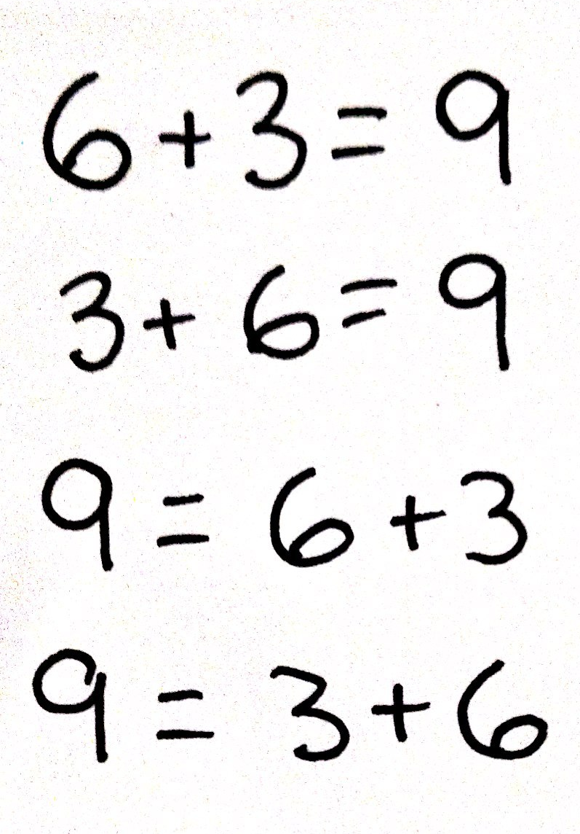
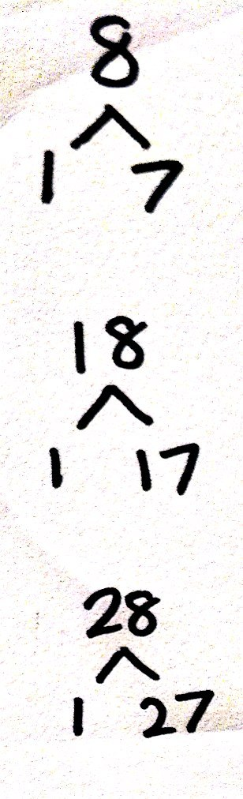
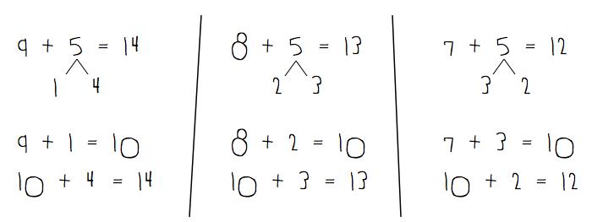
1st Grade Whiteboard Exercises
Dice Game with Partners
Take Out Ones
Make Ten Addition with Partners
Notes:
Standards Check: Commutative Property (5 minutes)
Materials: (S) 2 dice, personal whiteboard
Note: In the remaining lessons, there will be a variety of fluency activities that can be used to monitor students’ mastery of grade level standards. Take note of any students who may need additional support or particular standards-based activities that may be useful to include in summer practice.
This activity reviews the Commutative Property of Addition (e.g., if 6 + 3 = 9 is known, then 3 + 6 = 9 is also known) (1.OA.3) and requires students to understand the meaning of the equal sign (1.OA.7).
Assign partners.
Both partners roll their dice to determine the addends and write 4 equations with the sum.
Partners exchange whiteboards and check each other’s work.
Take Out Ones (5 minutes)
Materials: (S) Personal whiteboards
Note: Taking out some ones from a two-digit number strengthens students ability to apply the make ten strategy when adding two, two-digit numbers. Give students a sequence of three related numbers at a time and have them write number bonds on their personal whiteboards. Challenge early finishers to think of additional related number bonds for each sequence. Suggested sequence:
Take out 1: 8, 18, 28; 6, 56, 86;
Take out 2: 5, 15, 25; 7, 37, 97;
Take out 3: 6, 36, 76; 9, 69, 99, 109
Take out 4: 8, 48, 88, 108; 7, 77, 107, 117
Make Ten Addition with Partners (6 minutes)
Materials: (S) Personal white board
Note: This fluency activity reviews how to use the Level 3 strategy of making ten to add two single-digit numbers. Students will learn how to apply this strategy when adding a 1-digit number to a 2-digit number in today’s lesson.
Assign partners of equal ability.
Partners choose an addend for each other from 1-10.
On their personal boards, students add their number to 9, 8 and 7. Remind students to write the two addition sentences they learned in Module 2.
Partners then exchange boards and check each other’s work.
TIME ALLOTTED FOR THIS SLIDE: 5 minutes
MATERIALS NEEDED:
Dice

Slide 52
2nd Grade Whiteboard Exercises
Take From 10, Take From 20
10 More/Less, 100 More/Less
Rename the Units
Compensation
Notes:
The fluency activities of Grade 2 are designed to provide each student with enough practice to achieve mastery of the required fluencies (i.e., adding and subtracting within 20 and within 100) by the end of the year. Activities such as Say Ten counting and Think 10 to Add 9, and the use of tools and models like the Rekenrek and Hide Zero cards, solidify student fluency.
This fluency is essential to the work of later modules and future grade levels, where students must fluently recompose place value units to work adeptly with the four operations.
Say Ten Counting Move from Rekenrek to Hide Zero cards. (See Lesson 2 script)
Count from 5 to 25: 5, 6, 7, 8, 9, 10, ten 1, ten 2, … 2 tens, 2 tens 1, etc.
Talk with a partner: What patterns did you notice as you counted the numbers 11-19? How does this relate to counting numbers 20-29?
Then you can repeat using Hide Zero cards.
Think 10 to Add 9 (See Lesson 6 script)
I say, “9 + 5.” You say, “10 + 4.” (Continue with all the 9 + facts.)
Related Facts Within 20 (See Lesson 8 script)
I say, “10 - 6.” You write, “6 + 4 = 10.” (Continue with various facts.)
TIME ALLOTTED FOR THIS SLIDE: 6 minutes
MATERIALS NEEDED:
Rekenrek-100
Hide Zero Cards

Slide 53
Whiteboard Exercises in Action: K-2
Notes:
Participants will watch a video clip.
TIME ALLOTTED FOR THIS SLIDE: 5 minutes
MATERIALS NEEDED:
Video Clip

Slide 54
3rd Grade Whiteboard Exercises
Rekenrek: Multiplication and Division
Rename Tens
Halfway on the Number Line
Number Bonds: Decompose 60 minutes
Unit and Non-Unit Fractions of 1 Whole
Notes:
Multiply Using the Distributive Property (4 minutes:G3-M3)
Materials: (S) Personal white boards
Note: This fluency reviews the n + 1 strategy from Lesson 2.
T: (Project a 5 × 6 array, covering a sixth row of 6.) How many groups of 6 are there?
S: 5.
T: Let’s find how many are in the array counting by fives. (Point as students count.)
S: 5, 10, 15, 20, 25, 30.
T: Let’s find how many are in the array counting by sixes. (Point as students count.)
S: 6, 12, 18, 24, 30.
T: Write two multiplication sentences for this array.
S: (Write 6 × 5 = 30 and 5 × 6 = 30.)
T: (Reveal the sixth row of 6.) How many groups of 6 are there now?
S: 6.
T: Add 1 more group of 6 to 30. (Write 30 + 6 = .) On your white boards, write the addition sentence.
S: (Write 30 + 6 = 36.)
T: On your white boards, write a multiplication sentence for this array.
S: (Write 6 × 6 = 36.)
Continue with the following suggested sequence: 5 × 8 → 6 × 8, 5 × 7 → 6 × 7, and 5 × 9 → 6 × 9.
Rename Tens (3 minutes: G3-M2)
Materials: (T) Hide Zero Cards (S) Personal white boards
Note: This activity anticipates rounding in Lessons 13 and 14. You may want to use Hide Zero cards to quickly review place value with students if necessary.
T: (Write 7 tens = ____.) Say the number.
S: 70.
Continue with the following possible sequence: 8 tens, 9 tens, and 10 tens.
T: (Write 11 tens = ____.) On your boards, fill in the number sentence.
S: (Write 11 tens = 110.)
Continue with the following possible sequence: 12 tens, 16 tens, 19 tens, and 15 tens.
NOTES CONTINUED ON NEXT SLIDE…
TIME ALLOTTED FOR THIS SLIDE: 7 minutes
MATERIALS NEEDED:
Rekenrek-100

Slide 55
3rd Grade Whiteboard Exercises
Rekenrek: Multiplication and Division
Rename Tens
Halfway on the Number Line
Number Bonds: Decompose 60 minutes
Unit and Non-Unit Fractions of 1 Whole
Notes:
NOTES FROM PREVIOUS SLIDE CONTINUED…
Halfway on the Number Line (4 minutes)
Materials: (S) Personal white boards
Note: This activity anticipates rounding in the next topic. Practicing this skill in isolation lays a foundation for conceptually understanding rounding on a vertical number line.
T: (Project a vertical line with ends labeled 0 and 10.) What’s halfway between 0 tens and 1 ten?
S: 5.
T: (Write 5 halfway between 0 and 10.)
Repeat process with ends labeled 10 and 20.
T: Draw a vertical number line on your personal boards and make tick marks at each end and one for a halfway point.
S: (Draw number line.)
T: (Write 3 tens and 4 tens.) Label the ends and write the halfway point.
S: (Label 30 as the bottom point, 40 as the top point, and 35 as the halfway point.)
Continue with the following possible sequence: 60 and 70, 80 and 90, 40 and 50, and 50 and 60.
Decompose 60 Minutes (6 minutes)
Materials: (S) Personal white boards
Note: Decomposing 60 minutes using a number bond helps students relate part–whole thinking to telling time.
T: (Project a number bond with 60 minutes written as the whole.) There are 60 minutes in 1 hour.
T: (Write 50 minutes as one of the parts.) On your boards, draw my number bond and complete the missing part.
S: (Draw number bond with 10 minutes completing the missing part.)
Repeat the process for 30 minutes, 40 minutes, 45 minutes, and 35 minutes.
Unit and Non-Unit Fractions of 1 Whole (2 minutes)
Materials: (S) Personal white boards
T: (Draw a shape partitioned in halves with 1 half shaded.) Write the fraction that is shaded.
S: (Students write 1/2.)
T: Write the fraction that is not shaded.
S: (Students write 1/2.)
TIME ALLOTTED FOR THIS SLIDE: 7 minutes
MATERIALS NEEDED:
Rekenrek-100

Slide 56
4th Grade Whiteboard Exercises
Place Value
Rename the Units
Find the Missing Part
Find Equivalent Fractions
Notes:
Place Value (4 minutes G4-M1)
Materials: (S) Personal white boards with a place value chart to thousands
Note: Reviewing and practicing place value skills in isolation will prepare students for success in multiplying different place value units during the lesson.
T: (Project place value chart to the thousands place.) Show 5 tens in number disks and write the number below it.
Students draw 5 ten disks, write 5 below it and 0 in the ones column. (Draw to correct student misunderstanding.)
T: Say the number in unit form.
S: 5 tens.
T: Say the number in standard form.
S: 50.
Continue for the following possible sequence: 3 tens 2 ones, 4 hundreds 3 ones, 1 thousand 2 hundreds, 4 thousands 2 tens, 4 thousands 2 hundreds 3 tens and 5 ones.
Place Value (2 minutes)
Note: Reviewing and practicing place value skills in isolation will prepare students for success in comparing numbers during the lesson.
T: (Write 3,487.) Say the number.
S: 3,487.
T: What digit is in the tens place?
S: 8.
T: (Underline 8.) What’s the value of the 8?
S: 80.
T: State the value of the 3.
S: 3,000.
T: 4?
S: 400.
Repeat for the following possible sequence: 59,607; 287,493; and 7,142,952.
NOTES CONTINUED ON NEXT PAGE…
TIME ALLOTTED FOR THIS SLIDE: 7 minutes
MATERIALS NEEDED:
Hide Zero Cards

Slide 57
4th Grade Whiteboard Exercises
Place Value
Rename the Units
Find the Missing Part
Find Equivalent Fractions
Notes:
NOTES FROM PREVIOUS SLIDE CONTINUED…
Rename the Units (3 minutes)
Materials: (S) Personal white boards
Note: This fluency applies students’ place value skills in a new context that will help them better access the lesson’s content.
T: (Write 357,468.) Say the number.
S: 357,468.
T: (Write 357,468 = ____ thousands 468 ones.) On your personal white boards, fill in the number sentence.
S: (Students write 357,468 = 357 thousands 468 ones.)
Repeat process for 357,468 = ____ ten thousands 7468 ones; 357,468 = ____ hundreds 6 tens 8 ones; 357,468 = ____ tens 8 ones.
Find the Missing Part (2 minutes)
Materials: (T) Blank number bond
T: (Project number bond with 3/3 as the whole and 2/3 as a part.) Say the whole.
S: 3 thirds.
T: Say the given part.
S: 2 thirds.
T: Say the missing part.
S: 1 third.
T: (Writes in the missing part space.)
Find Equivalent Fractions (4 minutes G4-M5)
Materials: (S) Personal white boards
Note: This fluency activity reviews G4–M5–Lesson 8.
T: (Write 3/4 =_/8. Point to 3/4.) Say the fraction.
S: 3/4.
T: On your boards, complete the number sentence.
S: (Write 3/4 =6/8.) (times 2 on top and bottom)
TIME ALLOTTED FOR THIS SLIDE: 7 minutes
MATERIALS NEEDED:
Hide Zero Cards

Slide 58
5th Grade Whiteboard Exercises
Bundle Ten and Change Units
Multiply and Divide by 10
Write the Unit as Decimal
Multiplying Metric Units
Fractions Number Bonds
Notes:
Bundle Ten and Change Units (2 minutesG5-M1)
Note: Reviewing this fluency will help students work towards mastery of changing place value units in the base ten system.
T: (Write 10 hundreds = 1 ____.) Say the sentence, filling in the blank.
S: 10 hundreds = 1 thousand.
Repeat the process for 10 tens = 1 ____, 10 ones = 1 ____, 10 tenths = 1 ____, 10 thousandths = 1 ____, and 10 hundredths = 1 ____.
Multiply and Divide by 10 (5 minutes)
Materials: (S) Personal white boards
Note: Reviewing this skill from Lesson 1 will help students work towards mastery.
T: (Project place value chart from millions to thousandths.) Write three ones disks and the number below it.
S: (Write 3 ones disks in the ones column. Below it, write 3.)
T: Multiply by 10. Cross out each disk and the number 3 to show that you’re changing its value.
S: (Students cross out each ones disk and the 3. They draw arrows to the tens column and write 3 tens disks. Below it, they write 3 in the tens column and 0 in the ones column.)
Repeat the process for 2 hundredths, 3 tenths 2 hundredths, 3 tenths 2 hundredths 4 thousandths, 2 tenths 4 hundredths 5 thousandths, and 1 tenth 3 thousandths. Repeat the process for dividing by 10 for this possible sequence: 2 ones, 3 tenths, 2 ones 3 tenths, 2 ones 3 tenths 5 hundredths, 5 tenths 2 hundredths, and 1 ten 5 thousandths.
NOTES CONTINUED ON NEXT PAGE…
TIME ALLOTTED FOR THIS SLIDE: 6 minutes
MATERIALS NEEDED:
Place Value Chart (million)

Slide 59
5th Grade Whiteboard Exercises
Bundle Ten and Change Units
Multiply and Divide by 10
Write the Unit as Decimal
Multiplying Metric Units
Fractions Number Bonds
Notes:
NOTES FROM PREVIOUS SLIDE CONTINUED…
Write the Unit as a Decimal (2 minutes)
Materials: (S) Personal white boards
Note: Reviewing these skills will help students work towards mastery of decimal place value, which will in turn help them apply their place value skills to more difficult concepts.
T: 9 tenths.
S: 0.9
T: 10 tenths.
S: 1.0
Repeat the process for 20 tenths, 30 tenths, 70 tenths, 9 hundredths, 10 hundredths, 11 hundredths, 17 hundredths, 57 hundredths, 42 hundredths, 9 thousandths, 10 thousandths, 20 thousandths, 60 thousandths, 64 thousandths, and 83 thousandths.
Write in Exponential Form (3 minutes)
Materials: (S) Personal white boards
Note: Reviewing this skill in isolation will lay a foundation for students to apply the skill in multiplication during the lesson.
T: (Write 100 = 10?.) Write 100 in exponential form.
S: (Students write 100 = 102.)
Repeat the process for 1000, 10,000, and 1,000,000.
Multiplying Metric Units (2 minutes)
Materials: (S) Personal white boards
Note: This fluency will help students work towards mastery on the concept that was introduced in Lesson 4.
T: (Write 3 m = ___ cm.) Show 3 in your place value chart.
S: (Students write 3 in the ones column.)
T: How many centimeters are in 1 meter?
S: 100 centimeters.
T: Show how many centimeters are in 3 meters on your place value chart.
S: (Students cross out the 3 and shift it 2 place values to the left to show 300.)
T: How many centimeters are in 3 meters?
S: 300 centimeters.
Repeat the process and procedure for 7 kg = ____ g, 7000 ml = ____ l, 7500 m = ____ km ____ m, and 8350 g = ____ kg ____ g.
TIME ALLOTTED FOR THIS SLIDE: 6 minutes
MATERIALS NEEDED:
Place Value Chart (million)

Slide 60
Whiteboard Exercises in Action: 3-5
Notes:
Participants will watch a video clip.
5th Grade: Write the quotient as a fraction and put in simplest form
http://www.engageny.org/resource/nti-november-2012-rigor-breakdown-white-board-exchange
TIME ALLOTTED FOR THIS SLIDE: 5 minutes
MATERIALS NEEDED:
Video Clip

Slide 61
Scaffolding Exercise
Create a sequence to rename 3,426
* Reminder: simple to complex
You try!
Notes:
Participants will have 5 minutes to practice creating a sequence to rename 3,426.
TIME ALLOTTED FOR THIS SLIDE: 5 minutes

Slide 62
Whiteboard Exercises: Reflections
What are the benefits of using personal whiteboards?
Notes:
Participants will reflect on the question.
TIME ALLOTTED FOR THIS SLIDE: 4 minutes

Slide 63
Whiteboard Exercises: Key Points
Quick, efficient interactive drills and games
Applies to a wide range of skills
Notes:
Refer to the slide’s information.
TIME ALLOTTED FOR THIS SLIDE: 1 minute

Slide 64
AGENDA
Fluency Work – Sprints
Fluency Work – Counting Exercises
Fluency Work – White Board Exchanges
Fluency Work – Choral Exercises
Fluency Work – Other Fluency Activities
Notes:
Let’s look at Choral Exercises.
All choral response exercises can be used with the whiteboard.
TIME ALLOTTED FOR THIS SLIDE: 1 minute

Slide 65
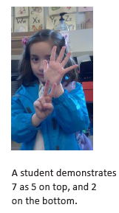
Kindergarten Choral Response
5 Groups Hands
Say Ten Push Ups
Dot Cards
Show Me Part or Whole
1 More/Less
Notes:
5-Group Hands (3 minutes)
Materials: (T) Large 5-group cards (5–7)
T: (Show the 6 dot card.) Raise your hand when you know how many dots are on top. (Wait until all hands are raised, then signal.) Ready?
S: 5.
T: Bottom?
S: 1.
T: We can show this 5-group on our hands. 5 on top, 1 on the bottom, like this. (Demonstrate on hands, one above the other.)
S: (Show 5 and 1 on hands, one above the other.)
T: Push your hands out as you count on from 5, like this. 5 (extend the top hand forward), 6 (extend the bottom hand forward). Try it with me.
S: 5 (extend the top hand forward), 6 (extend the bottom hand forward).
Continue with 5, 6, 7, steadily decreasing guidance from the teacher, until students can show the 5-groups on their hands with ease.
Say Ten Push-Ups (4 minutes)
Note: This activity reviews students’ understanding of numbers to 10 for the work of this module and extends to teen numbers in anticipation of Module 5.
T: We are going to do Say Ten Push-Ups. First, let’s get ready to push up by counting to 10 the Math Way.
S: 1, 2, 3, 4, 5, 6, 7, 8, 9, 10. (Students should start counting with 1 on the left pinky and continue to 10 on the right pinky.)
T: Great! Now that we have 10, we can continue counting with ten (push out both hands as if doing a push-up exercise in the air, then pause with closed fists close to body), 1 (push out the left hand, pinky finger). Repeat please.
S: Ten (push out both hands as if doing a push-up exercise in the air, then pause with closed fists close to body), 1 (push out the left hand, pinky finger).
T: Keep going with me. Ten (repeating push-up), 2 (push out the left hand pinky and ring finger).
Continue to 20 (2 ten or 10 and 10).
NOTES CONTINUED ON NEXT PAGE…
TIME ALLOTTED FOR THIS SLIDE: 5 minutes
MATERIALS NEEDED:
5 Group Cards
Dot Cards

Slide 66
Kindergarten Choral Response
5 Groups Hands
Say Ten Push Ups
Dot Cards
Show Me Part or Whole
1 More/Less
Notes:
NOTES FROM PREVIOUS SLIDE CONTINUED…
Dot Cards of 6 (3 minutes)
Materials: (T/S) Varied dot cards of 6 (card template from GK–M3–Lesson 13)
Note: This activity deepens students’ knowledge of embedded numbers and develops part–whole thinking.
T: (Show card.) How many do you see?
S: 6.
T: How did you see them in two parts?
S: (Possible answers.) 5 on this side and 1 on that side. → 2 down and 4 up. → 3 up and 3 down.
Show Me Part or Whole (3 minutes)
Materials: (T) Familiar objects that exemplify the part–whole relationship such as a whole apple and an apple slice or a whole banana and a banana peel
T: Show me the sign for whole. (Model two hands clasped together).
S: (Hold two hands clasped together.)
T: Let’s use our math muscles and take it apart (exaggerate with facial expression, as if straining to pull the two hands apart).
S: (Pull two hands apart.)
T: Show me whole.
S: (Hold two hands clasped together.)
T: Show me parts.
S: (Pull two hands apart.)
T: Whole, part, whole, part, part, part, whole, whole, part….
S: (Show hand gestures as indicated.)
T: Now, I’ll show you some objects, and I want you to decide if it’s the whole thing (reinforce with hand gestures), or just part of something (emphasize with gesture). (Hold up an apple slice.) Is this the whole apple, or part of the apple? Think (pause). Now show me.
S: (Hold hands apart, as before.)
T: Now tell me. Is it whole (gesture) or part (gesture)?
S: Part!
T: Very good. Look at what I have now (show a whole apple). Whole or part? Think (pause). Now show me.
S: (Hands clasped together to indicate whole.)
T: Raise your hand when you know the math word. (Wait for all hands to go up, then signal.)
S: Whole!
TIME ALLOTTED FOR THIS SLIDE: 5 minutes
MATERIALS NEEDED:
5 Group Cards
Dot Cards

Slide 67
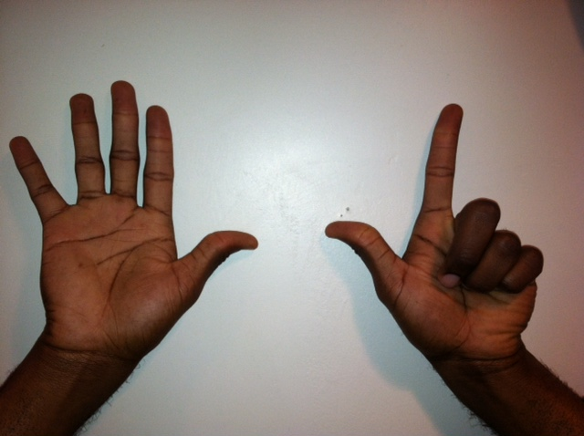
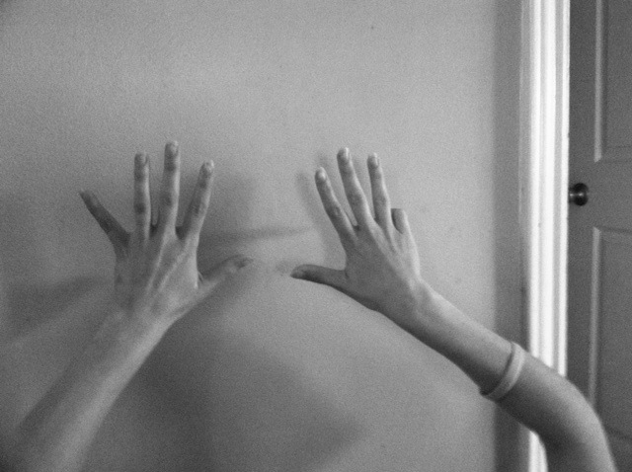
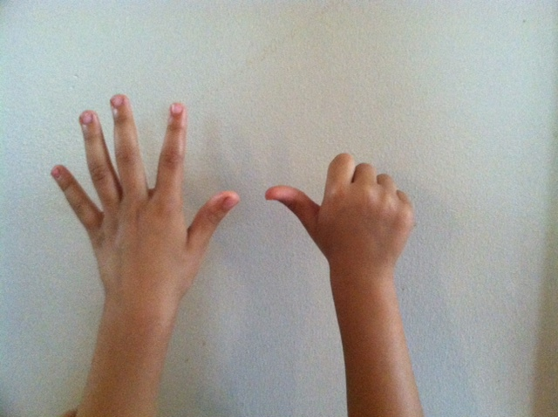
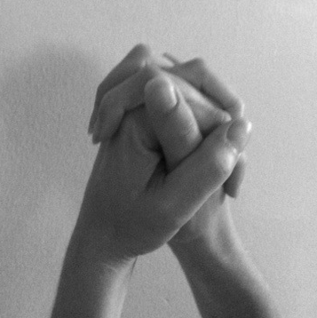
1st Grade Choral Response
Math Fingers Flash
5 Group Flash
Ten and Tuck
Tens and Ones
1 More/Less, 10 More/Less
Addition Strategies
Subtraction from Teens
9 + 6 = 10 + 5
Notes:
Math Fingers Flash (3 minutes)
Note: Visually recognizing (perceptually subitizing) sets of objects, particularly fingers, allows students to move toward seeing two sets of objects together (conceptually subitizing), thus preparing them for the fluency objective of Grade 1.
Teacher flashes fingers the Math Way for numbers 0–10 (teacher’s raised fingers should begin with the right pinky and end with the left pinky so students see fingers from left to right).
T: I’m going to hold up some fingers the Math Way and then hide them. Look carefully and say the number you saw when I snap.
T: (Flash 3 fingers for 2–3 seconds and then hides them). Ready, (snap).
S: 3!
Repeat process for numbers within 5.
T: (Flash 7 fingers). Ready, (snap).
5-Group Flash (3 minutes)
Materials: (T) 5-group cards (the dot cards from the 1 More game in this lesson maybe used, as long as they have been enlarged on the copier)
Note: This activity relates to the core fluency objective of Grade 1 of adding and subtracting within 10.
Teacher flashes 5-group cards for 2–3 seconds and instructs students to say the number when teacher snaps. After flashing all the numbers from 0–10 (in a random order), flash the cards again and count on from the number flashed, up to 10.
T: (Flash 4 fingers, hides them, then snaps.)
S: 4 .
T: Now use four in an adding sentence to make 5.
S: 4 + 1 = 5.
NOTES CONTINUED ON NEXT PAGE…
TIME ALLOTTED FOR THIS SLIDE: 5 minutes
MATERIALS NEEDED:
5 Group Cards
Rekenrek

Slide 68
1st Grade Choral Response
Math Fingers Flash
5 Group Flash
Ten and Tuck
Tens and Ones
1 More/Less, 10 More/Less
Addition Strategies
Subtraction from Teens
9 + 6 = 10 + 5
Notes:
NOTES FROM PREVIOUS SLIDE CONTINUED…
Ten and Tuck (5 minutes)
Note: This activity addresses the core fluency objective for Grade 1.
Tell students to show 10 fingers. Instruct them to tuck 3 (students put down the pinky, ring finger and middle finger on their right hands). Ask them how many fingers are up (7) and how many are tucked (3). Then ask them to say the number sentence aloud, beginning with the larger part (7 + 3 = 10), beginning with the smaller part (3 + 7 = 10) and beginning with the whole (10 = 3 + 7 or 10 = 7 + 3).
Tens and Ones (3 minutes)
Materials: (T) 100-bead Rekenrek
Note: This activity addresses the grade level standard requiring students to understand that two-digit numbers represent amounts of tens and ones.
Practice decomposing numbers into tens and ones using the Rekenrek.
(Show 16 on the Rekenrek). How many tens do you see?
S: 1.
T: How many ones?
S: 6.
T: Say the number the Say Ten way.
S: Ten 6.
T: Good. 1 ten plus 6 ones is?
S: 16.
T: (Slide over 10 from the next row.) How many tens to you see?
S: 2.
T: How many ones?
S: 6.
T: Say the number the Say Ten way.
S: 2 tens 6.
T: Good. 2 tens plus 6 ones is?
S: 26.
Slide over the next row and repeat. Continue with the following suggested sequence within 40: 15, 25, 35; 17, 27, 37; 19, 29, 39.
TIME ALLOTTED FOR THIS SLIDE: 5 minutes
MATERIALS NEEDED:
5 Group Cards
Rekenrek

Slide 69
2nd Grade Choral Response
Make Ten/ Take From Ten
Make Ten to Add
Place Value/Renaming Units
Zap to Zero
Take From Tens or Ones
Related Facts within 20
Notes:
Make Ten to Add (6 minutes)
T: Let’s make 10 to add. If I say 9 + 2, you say 9 + 2 = 10 + 1. Ready? 9 + 3.
S: 9 + 3 = 10 + 2.
T: Answer?
S: 12.
T: 9 + 5.
S: 9 + 5 = 10 + 4.
T: Answer?
S: 14.
Continue with possible sequence: 9 + 7, 9 + 6, 9 + 8, 8 + 3, 8 + 5, 7 + 4, and 7 + 6.
Take From Ten (3 minutes)
Note: Students revisit this activity from Module 1 in preparation for more practice of subtraction in Module 3. Draw a number bond for the first example to model student thinking to solve.
(Draw on board)
12 – 3 =
/\
2 1
T: For every number sentence I say, you will give a subtraction number sentence that takes from the ten first. When I say 12 - 3, you say 12 – 2 – 1. Ready? T: 12 – 3.
S: 12 – 2 – 1.
T: Answer.
S: 9.
Continue with the possible sequences: 12 – 4, 12 – 5, 14 – 5, 14 – 6, 14 – 7, 15 – 7, 15 – 8, 15 – 9, 16 – 9, and 16 – 8.
NOTES CONTINUED ON NEXT PAGE…
TIME ALLOTTED FOR THIS SLIDE: 5 minutes
MATERIALS NEEDED:

Slide 70
2nd Grade Choral Response
Make Ten/ Take From Ten
Make Ten to Add
Place Value/Renaming Units
Zap to Zero
Take From Tens or Ones
Related Facts within 20
Notes:
NOTES FROM PREVIOUS SLIDE CONTINUED…
Rename the Units: Choral Response (5 minutes)
Note: This fluency will review foundations that will lead into today’s lesson.
T: (Write 10 ones = ____ ten.) Say the number sentence.
S: 10 ones = 1 ten.
T: (Write 20 ones = 1ten ____ ones.) Say the number sentence.
S: 20 ones = 1 ten 10 ones.
T: (Write 24 ones = 1 ten ____ ones.) Say the number sentence.
S: 24 ones = 1 ten 14 ones.
T: (30 ones = 2 tens ____ ones.) Say the number sentence.
S: 30 ones = 2 tens 10 ones.
Repeat the process for 30, 32, 38, 40, 41, 46, 50, 63, 88.
Take from the Tens or Ones (2 minutes)
Note: This fluency helps students to know when to unbundle a ten to subtract and when not to. This is a foundational skill for the lesson.
T: For every number sentence I say you tell me if I take from the tens or the ones. When I say 46 – 5, you say take from the ones, but If I say 46 – 7, you say take from the tens. Ready?
T: 46 – 6.
S: Take from the ones.
T: 46 – 9.
S: Take from the tens.
Continue with the following possible sequence: 52 – 1, 52 – 4, 63 – 6, 64 – 5, 65 – 4, 68 – 8, 70 – 3.
TIME ALLOTTED FOR THIS SLIDE: 5 minutes
MATERIALS NEEDED:

Slide 71
Choral Response in Action: K-2
Notes:
Participants will watch a video clip.
Kindergarten: Double 10-frames
http://www.engageny.org/resource/common-core-video-series-kindergarten-mathematics-double-10-frames
2nd Grade: 10-Frame Flash
http://www.engageny.org/resource/nti-november-2012-rigor-breakdown-ten-rame-flash
2nd Grade: Simple Additions
http://commoncore.org/maps/math/video-gallery/choral-response
TIME ALLOTTED FOR THIS SLIDE: 5 minutes
MATERIALS NEEDED:
Video Clip

Slide 72
Let’s Practice!
Study the progression of choral response exercises for grades K-2.
Select a few exercises and practice with a partner.
You try!
Notes:
Participants will have 5 minutes to read and practice.
TIME ALLOTTED FOR THIS SLIDE: 5 minutes
MATERIALS NEEDED:
K-5 Choral Response Handout

Slide 73
3rd Grade Choral Response
Add to Multiply
Commutative Multiplying
Rename Tens
Rounding Three- and Four-Digit Numbers
Find the Area
Find the Whole/Missing Part
Notes:
Add to Multiply (3 minutes)
Materials: (S) Personal white boards
Note: This activity reviews Lesson 2. Students directly relate repeated addition to multiplication. They interpret products using the array.
T: (Project a picture array with 3 groups of 5 circled.) How many groups are circled?
S: 3.
T: How many are in each group?
S: 5.
T: Write it as an addition sentence.
S: (Write 5 + 5 + 5 = 15.)
T: Write a multiplication sentence representing 3 fives equals 15.
S: 3 × 5 = 15.
Continue with possible sequence: 3 groups of 10, 3 groups of 4, and 7 groups of 2.
Commutative Multiplying (3 minutes)
Note: This activity reviews the commutativity of multiplication, learned in Lessons 7, 8, and 15.
T: (Write 3 x 2 = ___.) Say the multiplication sentence.
S: 3 x 2 = 6.
T: Flip it.
S: 2 x 3 = 6.
Repeat process for 5 x 2, 5 x 3, 3 x 4, 2 x 8, and 3 x 7.
Rename the Tens (4 minutes)
Note: This activity prepares students for rounding in this lesson and anticipates the work in Lesson 14, where students round numbers to the nearest hundred on the number line.
T: (Write 9 tens = ____.) Say the number.
S: 90.
Continue with the following possible sequence: 10 tens, 20 tens, 80 tens, 63 tens, 52 tens.
NOTES CONTINUED ON NEXT PAGE…
TIME ALLOTTED FOR THIS SLIDE: 5 minutes
MATERIALS NEEDED:

Slide 74
3rd Grade Choral Response
Add to Multiply
Commutative Multiplying
Rename Tens
Rounding Three- and Four-Digit Numbers
Find the Area
Find the Whole/Missing Part
Notes:
NOTES FROM PREVIOUS SLIDE CONTINUED…
Find the Area (4 minutes)
Note: This fluency reviews strategies for finding the area of a rectangle.
T: (Project a rectangular array with 2 rows of 4 units. Write 1 tile = 1 square meter.) What does 1 tile equal?
S: 1 square meter.
T: (Point to the side length of 4 units.) This is the length of the rectangle. What is its value?
S: 4 meters.
T: (Point to the side length of 2 units.) This is the width of the rectangle. What is its value?
S: 2 meters.
T: Write a multiplication sentence to represent the area of the rectangle.
S: (Write 2 m × 4 m = 8 sq m or 4 m × 2 m = 8 sq m.)
Find the Missing Part (2 minutes)
Materials: (T) Blank number bond
T: (Project number bond with $\frac{3}{3 }$ as the whole and $\frac{2}{3}$ as a part.) Say the whole.
S: 3 thirds.
T: Say the given part.
S: 2 thirds.
T: Say the missing part.
S: 1 third.
T: (Writes $\frac{1}{3}$ in the missing part space.)
Continue with whole and part sequence: $\frac{6}{6}$ and $\frac{1}{6}, \frac{8}{8}$ and $\frac{3}{8},1$whole and $\frac{3}{10},1$ whole and $\frac{7}{12}$.
TIME ALLOTTED FOR THIS SLIDE: 5 minutes
MATERIALS NEEDED:

Slide 75
4th Grade Choral Response
Place Value
Base Ten Units
Renaming Units (Capacity, Length, Weight, Time, Money, Fractions, etc.)
Round to Different Place Values
Fraction Parts to Make a Whole
Notes:
Base Ten Units (2 minutes)
Note: This fluency will bolster students’ place value proficiency while reviewing multiplication concepts learned in Lessons 1 and 2.
T: (Project 2 tens =____.) Say the number in standard form.
S: 2 tens = 20.
Repeat for possible sequence: 3 tens, 9 tens, 10 tens, 11, tens, 12 tens, 19 tens, 20 tens, 30, tens, 40 tens, 80 tens, 84 tens, and 65 tens.
Convert Units (2 minutes)
Note: Reviewing these conversions in isolation will help students apply their operations in word problems.
T: (Write 100 cm = ____ m.) 100 centimeters is the same as how many meters?
S: 1 meter.
Repeat process using the following possible sequence: 200 cm, 300 cm, 800 cm, and 500 cm.
T: (Write 1 m = ____ cm.) How many centimeters are in 1 meter?
S: 100 centimeters.
Repeat process using the following possible sequence: 2 m, 3 m, 7 m, 4 m, 9 m.
Adding Fractions to Make One Whole (4 minutes)
T: I will name a fraction. You say a fraction with the same denominator so that together our fractions add up to 1 whole. For example, if I say 1 third, you say 2 thirds.
1/3 + 2/3 = 3/3 or 1 whole. Say your answer at the signal.
T: 1 fourth? (Signal)
S: 3 fourths.
T: 1 fifth? (Signal)
S: 4 fifths.
T: 2 tenths? (Signal)
S: 8 tenths.
Continue with possible sequence: 1/3, 3/5, 1/2, 5/10, 6/7, 3/8.
TIME ALLOTTED FOR THIS SLIDE: 6 minutes
MATERIALS NEEDED:
Hide Zero Cards (Thousands)
Clock

Slide 76
5th Grade Choral Response
Rename the Units
Rename the Decimal
Multiply by 10, 100 & 1,000
Equivalent Fractions
Decimal Parts to Make a Whole
Finding the Exponent
Notes:
Let’s take a look at how some choral response activities might be used in G5 to prepare students to multiply multi-digit numbers fluently.
Rename the Units (adapted from M1-L1/2/7/8)
10 ones = __ ten “Say the complete equation and fill in the blank.”… Repeat with 30 ones; 80 ones; 100 ones; 120 ones; 170; 270; 640
10 tens = __ hundred “Say the complete equation and fill in the blank”… Repeat with 40 tens; 90 tens; 180 tens; 540 tens
90 = __ tens “Say the complete equation and fill in the blank”… Repeat with 110; 420; 750; 1,280
19 tens = ___ “Say the complete equation say the equivalent expression in standard form” →190… Repeat with 24 tens, 62 tens, 12 hundreds, 36 hundreds, 72 hundreds
Rename the Decimal (2 minutes)
Materials: (S) Personal white board, place value chart
Note: This fluency activity reviews G4–M6–Lesson 8.
T: (Write 3.1.) Write the decimal as a mixed number.
S: (Write $\text{3}\frac{1}{10}$.)
T: (Write 3.1 = $\text{3}\frac{1}{10}$ = $\frac{}{10}$.) Complete the number sentence.
S: (Write 3.1 = $\text{3}\frac{1}{10}$ = $\frac{31}{10}$.)
T: (Write 3.1 = $\text{3}\frac{1}{10}$ = $\frac{31}{10}$ = $\frac{}{100}$.) Complete the number sentence.
S: (Write 3.1 = $\text{3}\frac{1}{10}$ = $\frac{31}{10}$ = $\frac{310}{100}$.)
Continue this process for the following possible suggestions: 9.8, 10.4, and 64.3.
Multiply by 10, 100, & 1,000 (M2-L1)
3 x 10 “Say the product”→30… Repeat with 3 x 100; 3 x 1000; 5 x 100; 5 x 1000; 14 x 100; 14 x 1000; 20 x 100; 200 x 10; 20 x 1000; 370 x 10; 100 x 370; 1000 x 370
Find Equivalent Fractions (4 minutes)
Materials: (S) Personal white boards
Note: This fluency activity reviews G4–M5–Lesson 7.
T: (Write $\frac{1}{2} = \frac{}{} \frac{×}{×} \frac{}{}\text{ = }\frac{2}{}$ . Point to $\frac{1}{2}$.) Say the unit fraction.
S: $\frac{1}{2}$.
T: On your boards, complete the number sentence to make an equivalent fraction.
S: (Write $\frac{1}{2}$ = $\frac{\text{1 }}{× 22 × 2}$ = $\frac{2}{4}$.)
Continue the process for the following possible suggestions: $\frac{1}{2}\frac{4}{8}$ , $\frac{1}{3}$ = $\frac{2}{6}$ , $\frac{1}{3}\text{ = }\frac{3}{9}$ , $\frac{1}{4}$ = $\frac{4}{16}$ , and $\frac{1}{5}$ = $\frac{3}{15}$.
Decimal Parts to make a whole: Give the missing part to make 1 whole: 3 tenths, Give the number sentence. 3 tenths + 7 tenths = 1.
TIME ALLOTTED FOR THIS SLIDE: 6 minutes
MATERIALS NEEDED:
Hide Zero Cards (Decimals)

Slide 77
Implementation Considerations
Keep exercises short and fast paced.
Use review material only.
Establish signal for student response.
“Raise your hand when you know…”
Scaffold questioning.
Use break it down.
“I say, you say”
Make a whiteboard exercise.
Notes:
Keep exercises short and fast paced-after asking a question, wait a few seconds to signal for choral response. If you wait too long students will forget the initial question as well as their answer.
Use review material only
Establish signal for student response
“Raise your hand when you know…”
Scaffold questioning
Use break it down
TIME ALLOTTED FOR THIS SLIDE: 2 minutes

Slide 78
Choral Response in Action: 3-5
Notes:
Participants will watch a video clip.
5th Grade: Addition Fractions to make 1 Whole (part 1); Happy Counting by Fractions (part 2)
http://www.engageny.org/resource/common-core-video-series-fraction-fluency-in-grade-5
5th Grade: Skip Counting by Fractions
http://www.engageny.org/resource/nti-november-2012-rigor-breakdown-skip-counting-by-fractions
TIME ALLOTTED FOR THIS SLIDE: 5 minutes
MATERIALS NEEDED:
Video Clip

Slide 79
Let’s Practice!
Study the progression of choral response exercises for grades 3-5.
Select a few exercises and practice with a partner.
You try!
Notes:
Participants will have 5 minutes to read and practice.
TIME ALLOTTED FOR THIS SLIDE: 5 minutes
MATERIALS NEEDED:
K-5 Choral Response handout

Slide 80
Choral Response: Reflections
What are some benefits of using a choral response in a classroom?
Notes:
Participants will reflect on the question.
TIME ALLOTTED FOR THIS SLIDE: 4 minutes

Slide 81
Choral Response: Key Points
Exchanges can be used as a quick form of assessment.
Exchanges allow for rapid completion of multiple practice problems.
Exchanges create intensity in student practice.
Exchanges give students immediate feedback.
Notes:
Refer to the slide’s information.
TIME ALLOTTED FOR THIS SLIDE: 1 minute

Slide 82
AGENDA
Fluency Work – Sprints
Fluency Work – Counting Exercises
Fluency Work – White Board Exchanges
Fluency Work – Choral Exercises
Fluency Work – Other Fluency Activities
Notes:
Let’s look at Other Fluency Activities.
TIME ALLOTTED FOR THIS SLIDE: 2 minutes

Slide 83
Kindergarten Fluency Activities
Tower Flip
1, 2, 3 Sit on 10
Make 10 Memory Game
5 Group Fill Up
Core Fluency Differentiated Practice Sets
Notes:
Tower Flip (5 minutes)
Materials: (S) 5 linking cubes
T: Touch and count your cubes.
S: 1, 2, 3, 4, 5.
T: How many cubes do you have?
S: 5.
T: Set them down on your table, like a tower.
T: Take 1 cube off the top of your tower and place it on the table, next to the tower. Do you still have 5 cubes?
S: Yes.
T: How many cubes are on the first tower?
S: 4.
T: On the other tower?
S: 1.
T: We can tell about it like this: 4 and 1 make 5. Echo me, please.
S: 4 and 1 make 5. T: Good. Take another cube off the top of the first tower, and stick it on to the top of the other tower. Do you still have 5 cubes?
S: Yes.
T: How many cubes are on the first tower?
S: 3.
T: On the other tower?
S: 2.
T: Give me the and…make statement.
S: 3 and 2 make 5.
Continue transferring cubes from one tower to the other to work through all of the combinations of 5. Then, reverse the procedure and cycle back through the flipped combinations. Students should progress through the combinations in this order: 5 and 0, 4 and 1, 3 and 2, 2 and 3, 1 and 4, 0 and 5. Invite students to tell what they noticed about the towers as they did this exercise (one tower got taller while the other got shorter).
Note: At this point in the year, many students will have already mastered compositions of 3, 4, and 5. This activity seeks to build on their understanding of comparison in order to see the relationship between partner numbers, essential to the work of the next module.
1, 2, 3 Sit on 10
Make 10 Memory Game
5-Group Fill-Up (4 minutes)
Materials: (S) Dice with 6 dot side covered, personal white boards
Partner A rolls the dice and draws a corresponding 5-group with O’s.
Partner B completes the ten by drawing X’s.
Both Partners engage in math talk: “ I have 7. You drew 3 more to make ten.”
Note: This activity gives students a head start in learning their partners to ten, anticipating the work of the next module.
Core Fluency Differentiated Practice Sets
TIME ALLOTTED FOR THIS SLIDE: 6 minutes
MATERIALS NEEDED:
Linking Cubes
Dice

Slide 84
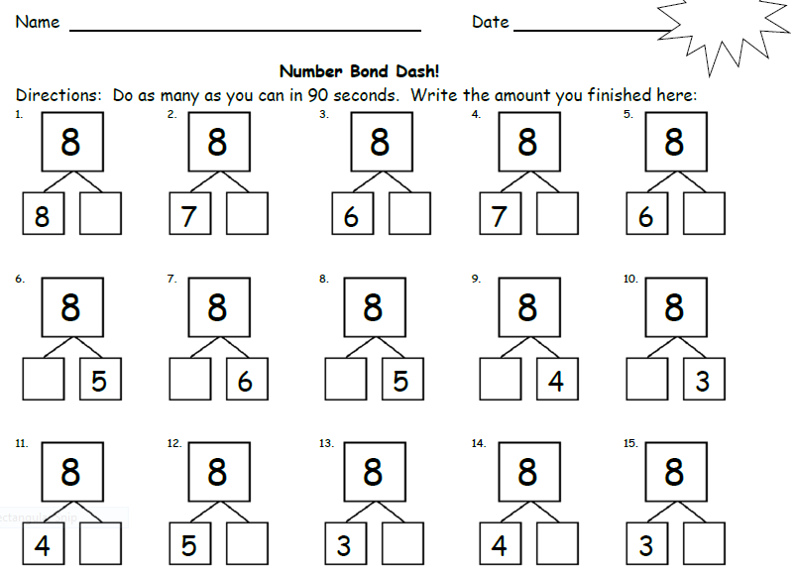

1st Grade – Fluency: Decompositions
Notes:
Number Bond Dash- 90 seconds to complete.
After using 5-group cards to count on, the goal is for students move on to using the abstract number rather than relying on pictorial representation. Number Bond Dash and Target Practice are 2 fluency activities that provide continued practice for students to become fluent in decomposing numbers on an abstract level.
Target Practice: 6 & 7 (8 minutes)
Materials: (S) 7 counters and a die per partner
Note: This activity addresses the core fluency objective for Grade 1 of adding and subtracting within 10. Break students into partners. Give each set of partners 6 counters. Instruct them to take turns as the Roller and the Target Finder. The Roller rolls the dice. The Target Finder determines the partner to 6. Students may use counters as needed. First, play with 6 as the target number and then distribute another counter to each set of partners and practice making finding to 7.
TIME ALLOTTED FOR THIS SLIDE: 6 minutes
MATERIALS NEEDED:

Slide 85
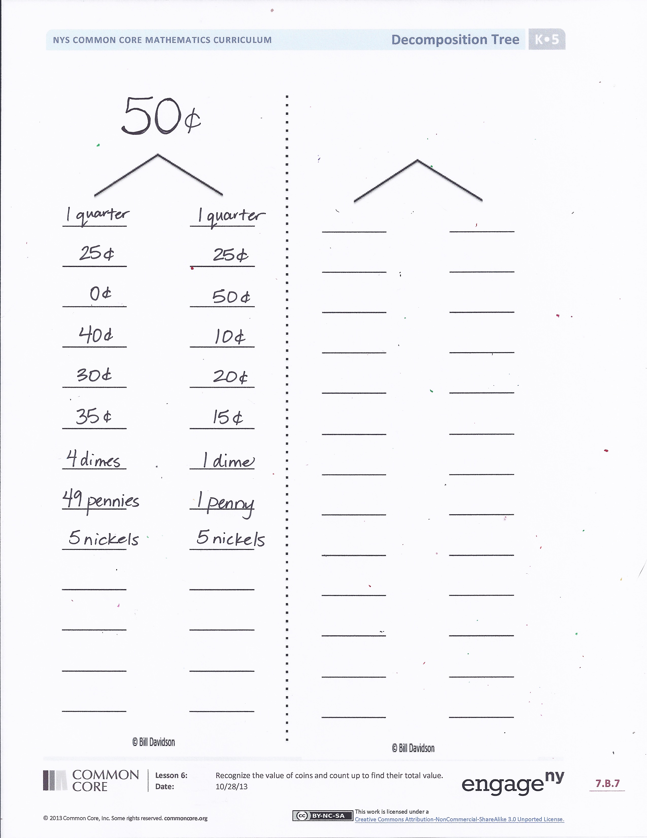
2nd Grade Fluency Activities
Differentiated Core Fluency Sheets
Decomposition Tree
3rd Grade Fluency Activities
Pattern Sheets
Notes:
Do a decomposition tree activity with the participants.
Decomposition Tree (6 minutes)
Materials: (S) Decomposition Tree Template
Note: Students are given 90 seconds to decompose a specified amount in as many ways as they can. This fluency allows students to work at their own skill level and decompose amounts in a multitude of ways in a short amount of time.
T: (Post a blank Deco Tree.) I’m going to think of a way to break 50 cents into two parts. I know 2 quarters make 50 cents and each quarter is worth 25 cents.
T: Watch me as I track our thinking on this Deco Tree. It is called a Deco Tree because we are decomposing the number at the top. The tree is like a number bond because the sum of the two parts is equal to the whole.
T: Raise your hand when you have another way to break 50 cents into two parts.
S: 0¢ and 50¢. → 40¢ and 10¢. → 30¢ and 20¢. → 35¢ and 15¢. → 4 dimes and 1 dime. → 49 pennies and 1 penny. → 5 nickels and 5 nickels.
T: (Write each correct student response on the posted Deco Tree.)
T: Great! You are on a roll! Now let’s see what you can do on your own. (Distribute tree template.)
T: You are going to break apart 60¢ on your own tree for 90 seconds. Make as many pairs as you can. GO!
S: (Work for 90 seconds.)
T: Now exchange your tree with your partner and check each other’s work. (Allow students 30–45 seconds to check.)
T: Return each other’s papers. Did you see another way to make 60¢ on your partner’s paper? (Allow students to share for another 30 seconds.)
T: Turn your paper over. Let’s break apart 60¢ for another minute.
Explain how the Core fluency sheets and pattern sheets work.
TIME ALLOTTED FOR THIS SLIDE: 6 minutes
MATERIALS NEEDED:
Decomposition Tree

Slide 86
4th/5th Grade Fluency Activities
Physiometry
  Points, Rays, Segments, Lines
  Angles and Angle Measure
  Turns
  Parallel and Perpendicular
  Symmetry
Notes:
Physiometry is a fluency activity that blends kinesthetic movements with geometry. Kinetic Memory is very strong, so these fluency activities are an outstanding way to solidify memory of geometric terms and concepts. Use them often!
Suggested sequence of activities: (all adapted from G4-M4-L2/4/6/9/14 & G5-M5-L14/G5-M6-L1)
Stand up…
Show closed fist, “My hand represents a point”… show me a point
Show open hand, “This hand represents an arrow”… show me an arrow
Show 2 extended arms with 2 closed fists, “Do my arms and hands represent a line, ray, or segment? Tell your neighbor how you know”
“Show me a ray.”
“Show me a line.”
“Show me an angle… a different angle… a third angle made up of 2 segments”
Point to ceiling and one wall, “What type of angle do my arms represent?” → Right angle
“How many degrees in a right angle?” → 90
“Show me different right angle”
“Show me an acute angle… a different one” “Your angle must measure less than… but more than …”
“Show me an obtuse angle… a different one” “Your angle must measure more than … but less than…”
“Show me a 180 degree angle… the name for this angle is a …”
“Show me an angle of approximately 30, 60, 90, 120, 150, 170, 70, 180”
“Put your arms at your sides… turn 90 to right, turn 90 to right, turn 90 to right, turn 180, turn 90 left, turn 180”
Point to ceiling… “Point to surface that is parallel to where I am pointing.”
“Point to surface that is perpendicular to where I am pointing… a different surface”
“Use both of your arms to point to parallel surfaces… perpendicular surface”
Participants sit
“I am trying to model a position of symmetry” … Point one arm… “Am I?” … change position… “Now” … continue with various positions
Participants stand
“Model a position of symmetry… model an asymmetrical position… symmetrical… asymmetrical”
TIME ALLOTTED FOR THIS SLIDE: 10 minutes

Slide 87
Gallery Walk
Sprints
Counting
Whiteboard Exercises
Choral Response
Other Fluency Activities
Notes:
We will set up 5 stations (Sprints, Counting, Whiteboard Exercises, Choral Response, and Other Fluency Activities) with prompts on poster boards in the room. Participants will do a gallery walk and spend 5 minutes to response and discuss at each station.
TIME ALLOTTED FOR THIS SLIDE: 35 minutes

Slide 88
Fluency Key Points
Fluency standards exist for each grade.
Fluency can be promoted in a variety of ways.
Fluency work is usually included as a warm-up at the beginning of a lesson for approximately 10-20 minutes.
A Story of Units provides frequent, rich opportunities for students to work toward achieving fluency.
Notes:
Refer to the slide’s information.
TIME ALLOTTED FOR THIS SLIDE: 5 minutes

Slide 89
Next Steps
What type of fluency activity are you most eager to incorporate into your current teaching?
How can you help your colleagues implement the fluency component of rigor?
Notes:
Participants will reflect on the questions.
TIME ALLOTTED FOR THIS SLIDE: 5 minutes

