Slide 1
A Story of Units
Grade 2 – Module 1 and Module 2
Notes:
This full-day session is intended to support successful implementation of this module. Using this module as a platform for understanding our instructional approach and lesson structure, you will have the tools needed to tackle the remaining modules of the year.
Welcome participants and introduce presentation team.
Fist to Five:
- How familiar are you with Eureka Math and A Story of Units?
Poll the participants:
Are you using the lessons on a daily basis? Or to supplement your instruction?
Are you a classroom teacher? For this grade? A different grade?
Are you a math coach? Coordinator? Resource teacher?
Are you a school-level administrator? District-level administrator?
Quickly orient participants to the day’s materials:
Full module – provided by Wiley; additional modules are available for purchase through our website, commoncore.org
Handout packet – describe the nature and purpose of both the stapled packet and the loose handouts
Materials – any announcements needed regarding materials on the tables?
TIME ALLOTTED FOR THIS SLIDE:
6 minutes
MATERIALS NEEDED:
X

Slide 2
This PowerPoint presentation is provided to individuals who participated in a live training by professional developers certified by, or affiliated with, the copyright holder, Common Core, Inc. It may not be altered in any way. The presentation may be shared for non-commercial purposes only. However, Common Core makes no representations or warranties about the effectiveness of training provided by non-certified/non-affiliated presenters of the material. Any commercial use of this presentation is illegal and violates the copyrights of Common Core, Inc.

Slide 3
Agenda
Lesson Structure
Instructional Sequence
Module Review
Preparation for Implementation
Notes:
(Click 1x to advance animation.)
We will begin by exploring the lesson structure and how it is fundamental to supporting rigorous instruction. Then we will dig in to the math of the module, examining the intentional instructional sequence that leads students toward mastery of the focus standards. Afterwards, we’ll take a look back at the module, reflecting on all the parts as one cohesive whole. Finally, we’ll talk about strategies for implementation in preparation for the beginning of the school year.
Let’s get started with the lesson structure.
TIME ALLOTTED FOR THIS SLIDE:
1 minute
MATERIALS NEEDED:
X

Slide 4
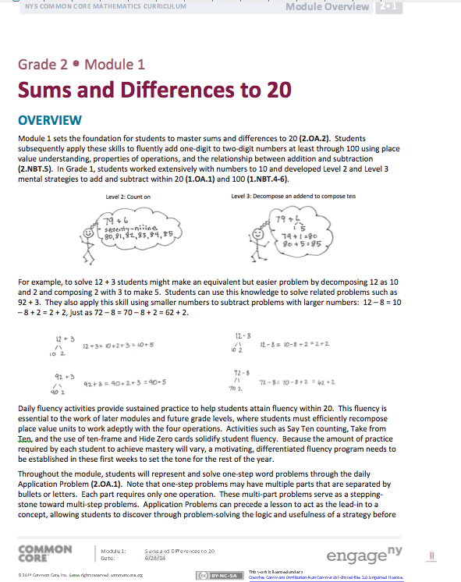
Module 1 Overview
Read the narrative.
* key concepts
Models and tools
Important vocabulary
Why did we begin the Grade 2 curriculum with a focus on sums and differences to 20?
Notes:
Take about 8 minutes to read the Module Overview. As you read, think about why we begin the Grade 2 curriculum with a focus on sums and differences to 20?
Foundational for Level 3 counting strategies (make a 10)
Enables assessment that can drive instruction/differentiation
Foundational for addition and subtraction up to 1,000 and solving word problems

Slide 5
Introduction to the Lesson Structure
Happy Counting
Break Ten in 2 Parts
Sprint: Add Tens and Some Ones
Lesson 1, Fluency Practice
Notes:
Materials: 10 linking cubes per participant, Add Tens and Some Ones, sprint directions sheet
Model all three fluencies.
TIME ALLOTTED FOR THIS SLIDE:
X minutes
MATERIALS NEEDED:
X

Slide 6
The Role of Fluency
Maintenance staying sharp on previously learned skills
Preparation targeted practice for the current lesson
Anticipation skills that ensure that students will be ready for the in-depth work of upcoming lessons
Notes:
Review the 3 functions of fluency. Note that the information on this slide can be found as a text box in the fluency section of the revised version of G2-M1-L1.
Point out about fluency in SOU in general, regardless of the activity’s function:
Fluency is designed to promote automaticity.
Just about every lesson has a fluency component to it.
Most lessons start with fluency to immediately engage students in the math in an exciting and fast-paced way.
Activities are meant to be fast-paced, accessible, and exciting, and almost never include completely new learning in order to make that possible.
This is a high-energy point in the lesson in which students celebrate improvement and recognize patterns and connections between material.
Most lessons have more than 1 fluency choice per day. (Talk about how teachers might use these depending on student needs. E.g., choose one, some, all, write your own.)
Stress the importance of including fluency with each lesson to maintain a balance of components that achieves the rigor specified by the shifts.
Let’s move on to the next component of the lesson.

Slide 7
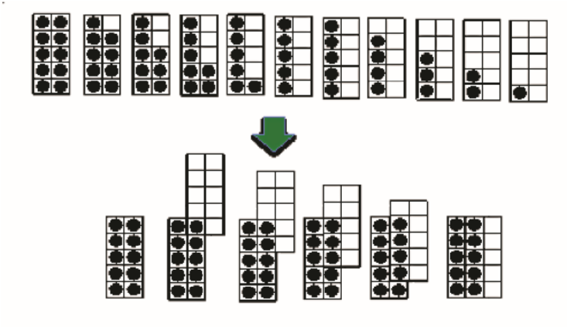
Introduction to the Lesson Structure
Ten-frame cards
Number bond
Lesson 1, Concept Development
Notes:
Materials: (T) Large set of ten-frame cards in the following suggested order: 5, 9, 1, 8, 2, 7, 3, 6, 4, 5, 10
S) Mini ten-frame cards that show the numbers 1–10, with an extra card that shows 5 (Template 1), number bond recording sheet (Template 2), RDW poster, Problem Set
Once you have taught the Concept Development, have participants complete the Problem Set.
Complete the Problem Set. As you work, think about what parts of the lesson support student success.
TIME ALLOTTED FOR THIS SLIDE:
X minutes
MATERIALS NEEDED:
X

Slide 8
Concept Development
New material
Timing includes 10 minutes for Problem Set
Moves from simple to complex
Problem Set
Time frame rather than task frame
Closely related to the other lesson components
A good place to begin lesson planning
Notes:
The Concept Development is the part of the lesson where new material is taught. It almost always ends with a Problem Set, which offers immediate practice with the new learning.
Discuss/ask participants the following questions about the work they just did:
What do you notice about the relationship between the CD and PS?
How did the CD prepare you for the PS?/Was anything on the PS surprising?
In a moment we’ll spend some time talking just about the PS, and how you might make adjustments for different students and also for lesson pacing.
Point out/discuss the following about CDs in SOU:
Is generally the component allotted the most time within the hour long lesson.
(Click 1x to advance animation.) The time allotment for the CD includes 10 minutes for the PS.
Very few lessons don’t have any CD at all. (Might be a lesson focused on fluency, for example.)
Some CDs use the PS, which makes the 10 minutes for it at the end unnecessary.
(Click 1x to advance animation.) The CD moves from simple to complex, usually mirroring that same development on the PS.
CDs take different formats. For example: teacher directed, stations, problem solving, group work, etc.
The vignettes throughout the lesson are meant to sample what the instruction looks, sounds, and feels like. They’re definitely not meant to be followed verbatim.

Slide 9
Concept Development
New material
Timing includes 10 minutes for Problem Set
Moves from simple to complex
Problem Set
Time frame rather than task frame
Closely related to the other lesson components
A good place to begin lesson planning
Notes:
Point out/discuss the following about Problem Sets:
Simple to complex sequence.
Draw attention to the Problem Set directions in the lesson.
The Problem Set reinforces the day’s Concept Development, and is an opportunity for students to apply their learning independently. PS is meant to be done as a time frame rather than a task frame, meaning that students have 10 minutes to do their personal best. (Click 1x to advance animation.)
Every student may not be assigned every problem (but ensure they get a balance of word problems and other types)
Suggestion for implementation: Take 8 minutes to get as far as possible on PS, last 2 minutes all work on a particular problem. (Ensures everyone’s done at least 1 ‘meaty’ problem to discuss in the Debrief.)
Discuss the relationship between PS and HW and PS and Exit ticket. (Click 1x to advance animation.)
Problems mirror development in CD
May want to talk about how writers wrote PS first, then CD. Suggestion for planning: start with the PS and plan the path that will get your students there. (Click 1x to advance animation.)
This is a time period when you can work with a small group or one-to-one to remediate.

Slide 10
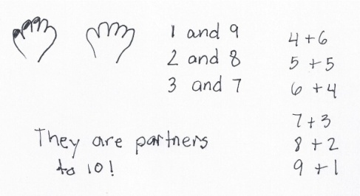
Introduction to the Lesson Structure
Problem 1
Mrs. Potter paints her fingernails one at a time from left to right. She paints 1 fingernail first. How many fingernails does she have unpainted? If she keeps painting 1 fingernail at a time, how many other combinations of painted and unpainted nails can she have?
Lesson 1, Application Problem
Notes:
Materials: RDW poster, blank paper for each participant
Take a moment to read and solve the Application Problem.
TIME ALLOTTED FOR THIS SLIDE:
X minutes
MATERIALS NEEDED:
X

Slide 11
Introduction to the Lesson Structure
Problem 2
The cashier wants each envelope to have exactly 10 bills. How many more bills does he need to put in each of the following envelopes?
An envelope with 9 bills.
An envelope with 5 bills.
An envelope with 1 bill.
Find other numbers of bills that might be in an envelope and tell how many more bills the cashier needs to put to make 10 bills.
Lesson 1, Application Problem
Notes:
Materials: RDW poster, blank paper for each participant
Take a moment to read and solve the second Application Problem.
To provide differentiation opportunities, an extension to Problem 2 calls for envelopes to have 30 bills. A) an envelope with 28 bills, etc. This calls on students to make the next ten.
TIME ALLOTTED FOR THIS SLIDE:
X minutes
MATERIALS NEEDED:
X

Slide 12
The Role of Application Problems
Real world problem solving
Placement in lesson depends on function
Opportunity for informal assessment
Problem-solving process:
Read the problem
Draw and label a model to represent the problem
Write an equation and a complete word sentence
Notes:
We just solved two word problems that make up the Application Problem component of G2-M1-L1. The Application Problem can precede a lesson as a lead-in to the concept, or they can follow a lesson, allowing students to make connections between math and real-world situations. In this module, the Application Problems follow the lessons.
Point out/discuss the following about Application Problems:
(Click to advance animation.) These are often word problems, but occasionally take other forms. They typically offer real word applications (like the example).
The number of Application Problems may vary from lesson to lesson (usually 0 if the CD is a problem solving lesson, and 1 or more for a more typical lesson).
(Click to advance animation.) Placement in the lesson depends on function.
Point out/discuss the following about the function of APs:
Those that come before the CD often:
Make an application of the new learning from the day before.
Relate to the CD by providing context or point of comparison for a later problem, or by having students solve a problem that they’ll use again in some way in the CD.
Those that come after the CD often:
Provide an immediate application of new learning before the Problem Set, (or at the end of the lesson if the PS is used during the CD).
Provide a quick opportunity for informal assessment of new learning before independent practice in the PS.
Usually, Application Problems don’t specify a model to use or way of solving. This encourages students to think quantitatively and creatively, and to give them practice with understanding how to choose and apply the correct mathematics concept to solve real world problems, as called for by the Standards for Mathematical Practice.

Slide 13
The Role of Application Problems
Real world problem solving
Placement in lesson depends on function
Opportunity for informal assessment
Problem-solving process:
Read the problem
Draw and label a model to represent the problem
Write an equation and a complete word sentence
Notes:
(Click to advance animation.) Because of this, APs present a good opportunity for informal assessment. Noticing how students represent problems using models and equations will provide you with lots of information about their level of comfort with recently taught material, as well as how they’re thinking through solution paths.
Think back on the problem-solving process we just went through.
What was our first step? (Read.) (Click 1x to advance animation.)
What came next? (Draw.) (Click 1x to advance animation.)
And then? (Write an equation/word sentence.) (Click 1x to advance animation.)
Throughout SOU we refer to these steps as the RDW process. (Click 1x to advance animation.)
Point out/discuss the following about the RDW process:
Usually this is the process that students use to solve word problems in SOU, including Application Problems.
We hope students internalize the process with practice over time so that it becomes a tool for problem solving.
Don’t let RDW become the focus of problem solving, but rather teach RDW as a tool for approaching problem solving.
Discuss/Point out the following tips for implementation:
If students need encouragement to draw: Provide just the stem of the problem at first. (This removes the temptation to ‘just solve’.)
Ask them to share their drawing with a neighbor.
You might present your own model to help students distinguish between a drawing and a math drawing (for example, in the G3 AP problem we’d rather not see detailed pictures of 159 boys and girls).
Once students have drawn and before they’ve seen the question, ask, “What questions could we ask based on the information we’ve been given?”
This emphasis on the drawing encourages students to use it as a tool for solving rather than as an afterthought.

Slide 14
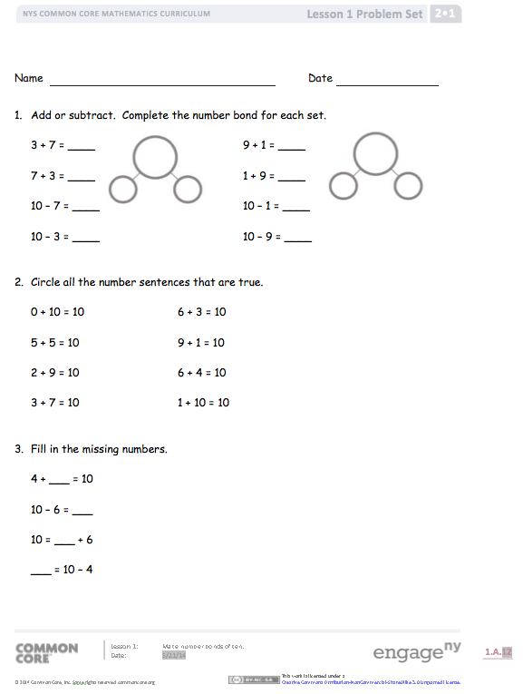
Introduction to the Lesson Structure
Compare the envelope problem to the fingernail problem. What is different about the problems? What is the same?
Why do you think I chose to use the ten-frame cards today?
How did the first envelope problem help you solve the second one? How does 6 + 4 help you solve 26 + 4?
Lesson 1, Student Debrief
Notes:
Materials: Exit Ticket
Conduct the Debrief, beginning with: What connections are we trying to elicit with the fingernail and envelope problems? Then continue with the actual questions from the lesson as shown on the slide.
Have participants complete the Exit Ticket.
Complete the Exit Ticket.
TIME ALLOTTED FOR THIS SLIDE:
X minutes
MATERIALS NEEDED:
X

Slide 15
Student Debrief and Problem Set
Class conversation to reflect on the day’s learning
Make connections between parts of the lesson, concepts, strategies, and tools
Students ultimately articulate the learning objective
Exit Ticket
Daily formative assessment to drive instruction
Time frame rather than task frame
Tool for lesson planning
Notes:
Discuss/Point out about Student Debrief in SOU:
Students bring PS to the carpet and gather around for a conversation about the lesson.
Check PS with a partner/correct as a class.
Invite students to share work.
Students see and hear multiple perspectives from classmates.
Students reflect back on the lesson to analyze the learning that occurred. (Lesson doesn’t start by naming objective.)
(Click 1x to advance animation.) Students make connections between the lesson concepts, strategies and tools. The debrief is not to be missed!
The suggested list of questions invite reflection and connection-making. They guide teachers’ planning for eliciting the level of student thinking necessary to achieve this. Use those questions that will best support your students, or create questions of your own that target your students’ needs.
(Click 1x to advance animation.) Students ultimately articulate the objective/day’s learning.
Teacher reviews key vocabulary and help students name the learning they describe.
(Click 1x to advance animation.) The time allotment for the Debrief includes 3 minutes for the Exit Ticket.
Tip for implementation:
If initially your students need help learning how to have these conversations (or accountable partner talk): They can share work, but also, you might present 1-2 different solutions and have them practice explaining the model, labels, equation, and solution path to their partner.
Discuss/Point out the following about the Exit Ticket:
(Click 1x to advance animation.) Daily formative assessment to drive daily instruction (use it to plan!)
Use it to close the lesson, or some people use as morning work the next day (can be used in different ways)
(Click 1x to advance animation.) Time frame, not task frame
(Click 1x to advance animation.) Can be a tool for lesson planning because it’s a glimpse of the student outcome for each day.

Slide 16
Agenda
Lesson Structure
Instructional Sequence
Module Review
Preparation for Implementation
Notes:
As you’ve seen, each lesson component has a very different purpose. Consequently, each lesson component has a different pace, so the experience feels different for students. It is important to honor each component in order to do justice both to the mathematical practices and to the balance of rigor that is expected.
Moving forward, we’ll explore the instructional sequence. In doing this, we’ll lead you through the rest of Module 1 and all of Module 2, modeling instruction for each objective. Along the way, we’ll also revisit the other lesson components and experience how they function in collaboration with the concept development. As we work through these Modules, you may want to jot down or highlight key ideas or questions to emphasize in the lesson that will lead to deeper conceptual understanding.
TIME ALLOTTED FOR THIS SLIDE:
1 minute
MATERIALS NEEDED:
X

Slide 17

Objective: Make number bonds through ten with a subtraction focus and apply to one-step word problems.
Module 1, Lesson 2
Notes:
Materials: 10 two-sided counters, a blank ten-frame template, a die, and a blank piece of paper to hide the counters.
Model Fluency: Say Ten counting (introduce Hide Zero cards and Rekenrek)
Give them time to practice (30 seconds each)
Explain rationale for Say Ten counting
Model CD.
Then have participants do Problem Set page 1 and discuss the third bullet in the debrief with their table. (Next slide.)
TIME ALLOTTED FOR THIS SLIDE:
X minutes
MATERIALS NEEDED:
X

Slide 18
Objective: Make number bonds through ten with a subtraction focus and apply to one-step word problems.
Look at the first and second columns of Problem 2 on the Problem Set. What connections do you see between the problems in each row?
Module 1, Lesson 2, Student Debrief
Notes:
Have participants discuss the Debrief question and share out.
TIME ALLOTTED FOR THIS SLIDE:
X minutes
MATERIALS NEEDED:
X

Slide 19
Scaffolds
Continue providing visual support of the ten-frame cards.
Extensions
Give numbers appropriate to student ability level.
Module 1, Lesson 2
Notes:
Scaffolds:
Visual support of the ten-frame cards
Allow both partners to see the counters.
Extensions:
Start students who are proficient with decompositions of 7 at 8, 9, or 10.
Add another ten so that students are working within teen numbers.
Allow time for participants to brainstorm other differentiation ideas and chart them.

Slide 20
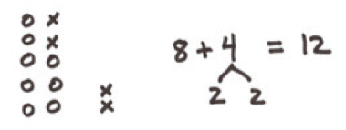
Topic Openers
Read the Topic A and Topic B Openers.
How does Topic B build on student understanding from Topic A?
Notes:
Discuss structure of the Module: Overview, Openers, Lessons.
Discuss usefulness of Topic Openers as planning tools (to be more thoroughly discussed during the implementation portion of today’s session).
Read Topic A and Topic B. Then discuss the progression of the instructional sequence. (For example, in order to make ten to add within 20, which is the focus of Topic B, students need to be confident decomposing numbers within 10 and they need to know all partners to 10.)

Slide 21
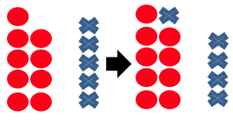
Objective: Make a ten to add within 20.
Turn and talk, how does Part 2 of the Concept Development reinforce what the students learned in part 1?
Module 1, Lesson 3
Notes:
Materials: (T) Two-sided counters (S) Personal white boards, blank paper, ten-frame cards for numbers 8, 9, and 10 (Template), small bag of two-sided counters
Model Part 1: Larger addend in common, i.e., 8 + 4, 8 + 5; 9 + 4, 9 + 5.
Partner A and Partner B read Part 2: Smaller addend in common, i.e., 8 + 4, 9 + 4. Partner A, teach Part 2.
Complete Problem Set page 1.
Turn and talk to discuss the Debrief question.
Application Problem (next slide).
TIME ALLOTTED FOR THIS SLIDE:
X minutes
MATERIALS NEEDED:
X

Slide 22
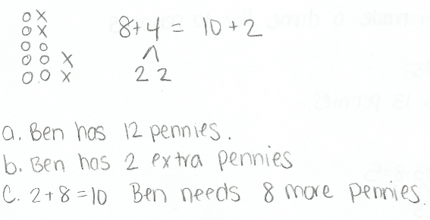
Objective: Make a ten to add within 20.
Ben collects dimes. He does it by first collecting pennies and then trading his parents 10 pennies for 1 dime. Ben has 8 pennies. He finds 4 more pennies.
How many pennies does Ben have before he trades?
How many pennies does Ben have after he trades?
How many more pennies will Ben need before he can trade for another dime?
Module 1, Lesson 3, Application Problem
Notes:
Take a few minutes to complete the Application Problem.

Slide 23
Scaffolds
Use the ten-frame cards with counters so that students can touch and count for Part 1 as well as Part 2.
Extensions
Add more tens.
Module 1, Lesson 3
Notes:
Scaffolds:
Move sequentially beginning at 9 + 1 and continue with 9 + 2, 9 + 3, etc., so that students can discover the pattern.
Show on the Rekenrek. (Make student Rekenreks.)
Allow students to use 2-color counters before moving to the pictorial level.
Extensions:
Start with 6.
Allow time for participants to brainstorm other differentiation ideas and chart them.

Slide 24
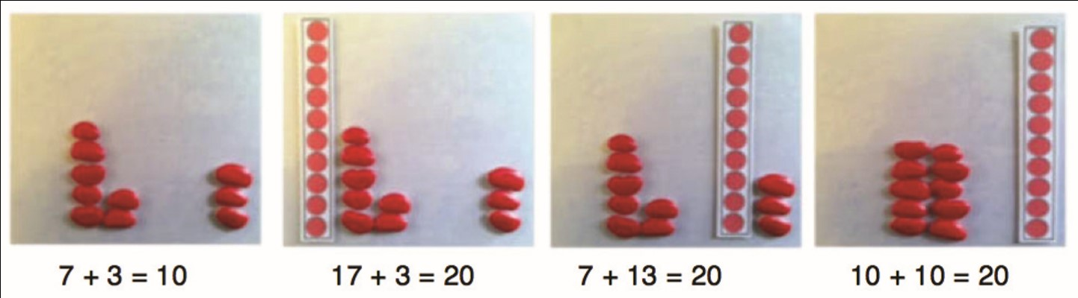
Objective: Make a ten to add and subtract within 20.
Module 1, Lesson 4
Notes:
Materials: (T) Two-sided counters and a ten-frame card showing 10 (Lesson 3 Template)
(S) 1-ten-strip (Template) and 10 two-sided counters per participant
Model Fluency: Make a ten to add.
Demo use of whiteboard. Start with whiteboard and then have them do it orally. (Draw attention to the UDL box which suggests this scaffold.)
Note the statement below this image in the lesson: Write at least one set of similar problems. The lesson focus is on the use of the basic fact to help students solve other problems. Note how the responses may not all make a ten, as the example showed, and when they don’t, the teacher guides students to defend and justify their reasoning.
Model Parts 1 and 2.
Partner B, teach Part 3.
TIME ALLOTTED FOR THIS SLIDE:
X minutes
MATERIALS NEEDED:
X

Slide 25
Scaffolds
Allow students to use 2-color counters before moving to the pictorial level.
Extensions
Apply the same concept to larger numbers, e.g., 45 + 2 and 42 + 5.
Module 1, Lesson 4
Notes:
Scaffolds:
Say Ten counting supported with the Rekenrek for teen numbers to help them understand 10 and some ones
Basic Fact practice using fingers the Math Way
Extensions:
Model and write a related pair of addition and subtraction problems where there are enough ones in the ones place to subtract from the ones, e.g., 12 + 3 = 15 and 15 – 3 = 12. What are the related basic facts? 2 + 3 = 5 and 5 – 3 = 2.
Allow time for participants to brainstorm other differentiation ideas and chart them.

Slide 26
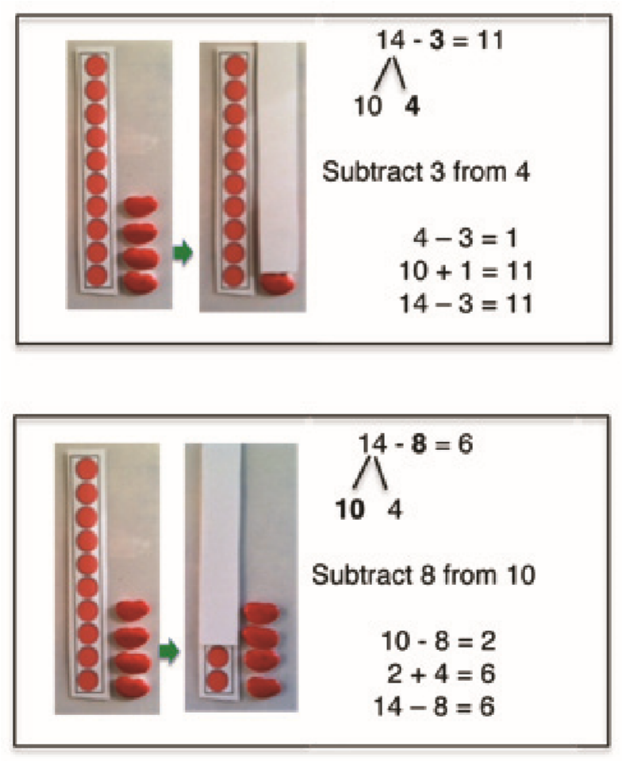
Objective: Decompose to subtract from a ten when subtracting within 20 and apply to one-step word problems.
Module 1, Lesson 5
Notes:
Materials: (T) Two-sided counters (S) Personal white board, ten-strip (Lesson 4 Template), bag of two-sided counters, a subtracting strip (this is simply a white strip of paper, pictured in the photograph in Part 2)
Model Part 1.
Partner A, teach Part 2.
Complete Problem Set page 2. (Debrief on next slide.)
TIME ALLOTTED FOR THIS SLIDE:
X minutes
MATERIALS NEEDED:
X

Slide 27
Objective: Decompose to subtract from a ten when subtracting within 20 and apply to one-step word problems.
In Problem 2, where did the 2 come from in 11 – 8 = 2 + ___ ?
Module 1, Lesson 5, Student Debrief
Notes:
Have participants use their work from the Problem Set to discuss the Debrief question.
The concepts taught in L5, and all of Module 1, are a review of concepts learned in Grade 1. Some students may not show mastery by the end of this lesson, however, and that is ok. Taking from the ten is used repeatedly throughout all of Grade 2, reinforcing the concept over and over. If your students do not show mastery, that does not mean you need to repeat the lesson.

Slide 28
Scaffolds
Give students a ten-frame and 2-color counters to show the whole. As they take from 10, either have them remove or flip the counters to see how many remain.
Extensions
See Part 3 of the Concept Development.
Module 1, Lesson 5
Notes:
Scaffolds:
Say Ten counting supported with the Rekenrek for teen numbers to help them understand 10 and some ones
Basic Fact practice using fingers the Math Way
Extensions:
Model and write a related pair of addition and subtraction problems where there are enough ones in the ones place to subtract from the ones, e.g., 12 + 3 = 15 and 15 – 3 = 12. What are the related basic facts? 2 + 3 = 5 and 5 – 3 = 2.
Allow time for participants to brainstorm other differentiation ideas and chart them.

Slide 29
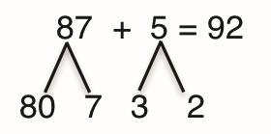
Topic Openers
Read the Topic C Opener.
How does Topic C build on student understanding from Topics A and B?
Notes:
Read Topic C and discuss the progression of the instructional sequence.

Slide 30
Objective: Add and subtract within multiples of ten based on understanding place value and basic facts.
37 + 3 = 40
How do structures and patterns make math easier?
Module 1, Lesson 6
Notes:
Materials: (T) Two-sided counters, 3 ten-frame cards for the number 10, a set of ten-frame cards (Lesson 3 Template), linking cubes
Model Part 1.
Partner B, teach Part 2.
Partners A and B read Part 3 and discuss the sequence of the lesson.
Discuss Debrief question.
Complete Exit Ticket. Discuss how the Exit Ticket connects to the lesson objective and how student performance can be used to guide instruction.
TIME ALLOTTED FOR THIS SLIDE:
X minutes
MATERIALS NEEDED:
X

Slide 31
Scaffolds
Use popsicle sticks as a concrete representation of tens and ones.
Extensions
Extend the pattern up to 100.
Module 1, Lesson 6
Notes:
Scaffolds:
Work within teen numbers using the Rekenrek to reinforce basic facts. With a partner, go up to 40.
Extensions:
Create word problems that could be solved using the strategy of using basic facts and/or making a ten.
Allow time for participants to brainstorm other differentiation ideas and chart them.
At this point, if time allows, unhide the Scaffolds/Extensions slides. Have participants work in table groups to come up with scaffolds and extensions per topic. Post a chart per topic that they can add their post-its to.

Slide 32
Objective: Add within 100 using properties of addition to make a ten.
One box fits exactly 10 cans. On Monday, Maria packed 18 cans into boxes, making sure to fill a box before beginning a new one. On Tuesday she added 6 more cans.
a. How many boxes were completely filled then?
b. How many cans did Maria pack in all?
c. Extension: How many more cans did Maria need to fill another box?
Module 1, Lesson 7, Application Problem
Notes:
Materials: blank paper for each participant
In Lesson 6, students made a ten within multiples of ten, e.g., 37 + 3. Analyze the scaffolding of Lesson 7 to see what next level of complexity is introduced. (In Lesson 7, students learn to “cross a ten.” For example, 87 + 5 is shown to be the same as 87 + 3 + 2 using a number bond to decompose 5.)
Complete the Application Problem.
TIME ALLOTTED FOR THIS SLIDE:
X minutes
MATERIALS NEEDED:
X

Slide 33
Objective: Decompose to subtract from a ten when subtracting within 100 and apply to one-step word problems.
11 – 5 = 6
21 – 5 =16
31 – 5 = 26
41 – 5 = 36
Module 1, Lesson 8
Notes:
Materials: (T) Two-sided counters, ten-frame cards showing 10 (Lesson 3 Template)
(S) Personal white boards, blank paper for the AP, Problem Set page 1
Model Part 1.
Partner A, teach Part 2.
Allow 5 minutes for participants to work on Problem Set page 1.
TIME ALLOTTED FOR THIS SLIDE:
X minutes
MATERIALS NEEDED:
X

Slide 34
Objective: Decompose to subtract from a ten when subtracting within 100 and apply to one-step word problems.
Kayla has 21 stickers. She gives Sergio 7 stickers. How many stickers does she have left?
Module 1, Lesson 8, Application Problem
Notes:
Take participants through the RDW process to solve the Application Problem for this lesson.
Discuss Debrief question: How do number bonds help you solve subtraction problems?
TIME ALLOTTED FOR THIS SLIDE:
X minutes
MATERIALS NEEDED:
X

Slide 35
End of Module Assessment
Trevor’s mom gave him 6 stickers to start his collection. He received 85 more for his birthday.
  Use words, pictures, or numbers to show how many stickers Trevor has now.
  James has 95 stickers and gives away 7. How many stickers does James have now?
  Who has more stickers now, James or Trevor?
Module 1, End of Module Assessment
Notes:
Materials: blank paper
Please note that, while we certainly have a systematic approach to assessment, we do not provide a complete assessment program. At this point, a primary goal of the project has been to create a curriculum that is free and accessible to anyone, anywhere. By default, that means that the assessments are also free and accessible to anyone, anywhere. The assessments that we provide are worthy assessments, regardless of how much help individual students might have gotten at home. If a student can perform in class, getting the correct answer and demonstrating understanding through models and explanation, then that should be acknowledged and praised. However, these assessments are obviously not sufficient.
Take a moment to complete End of Module Assessment Problem 3.
As a teacher, what strategies would you be looking for a student to use when completing this problem? (Make a ten, take from ten, using a number bond)
How can you help a student who is making 85 circles to find a more efficient strategy? (encourage them to make a number bond)
TIME ALLOTTED FOR THIS SLIDE:
X minutes
MATERIALS NEEDED:
X

Slide 36
Agenda
Lesson Structure
Instructional Sequence
Module Review
Preparation for Implementation
Notes:
As you’ve seen, the sequence of objectives is very intentional. Each one is critical in preparing students for what comes next. We think of these objectives as rungs on a ladder that lead to success with the module’s focus. Collectively, they play a significant role in the students achieving mastery of the grade’s expectations.
Keep in mind that we only sampled a small part of each objective. When looking at the daily lesson, you’ll find that each plan is thoroughly detailed… as you experienced with Lesson 1 at the beginning of this session.
Now, we are going to examine the module in its entirety.

Slide 37
Progression Study
What are the Progressions?
Explore: K-5, Operations and Algebraic Thinking Progression
      Read pages 14-16
      Read pages 18-19
      Scan pages 36-39
  Highlight the information relevant to the content of this module.
Notes:
PPT Developers: On the slide, state the appropriate progression document(s) and identify the most relevant passage(s).
What are the Progressions?
Poll participants using the fist-to-five protocol to gauge how well (if at all) they know the progression documents. Participants show zero fingers/fist if they have never heard of or seen the progressions, show 5 fingers if they have read a majority of the progressions, or some number of fingers if they are relatively familiar or have read some portion of them.
Explain what the progressions are:
The Common Core State Standards for mathematics were built from the progressions. They are a narrative document describing the progression of a topic across a number of grade levels. The progressions were guided by a child’s cognitive development and the logical structure of math when written. These documents were used to create the grade level standards, and therefore can explain why the standards are sequenced the way they are. The progressions also highlight cognitive difficulties and provide pedagogical solutions, and give greater detail on some of the particularly challenging areas of mathematics. As writers, we referred to the progressions often to guide our thinking when sequencing lesson objectives and problems within each lesson.
Progression Exploration:
To continue our study of Module 1, we’re going to first take some time to examine a portion of the Progression document (K-5, Operations and Algebraic Thinking) that serves as the foundation for this module. You’ll have about 10 minutes to read through the document independently or with a partner. As you read, highlight the information that is relevant to the content of this module.
Allow participants time to read independently. Encourage them to highlight and make notes.
TIME ALLOTTED FOR THIS SLIDE:
10 minutes
MATERIALS NEEDED:
X progression document
Highlighters( optional)

Slide 38
Progression Study
Study Lessons 1, 3, 5, and 7 from Module 1.
Then, turn and talk:
    How do these lessons engage students in the work described in the Progression?
Notes:
PPT Developers: On the slide, list a few lessons that closely tie to the progression document(s).
Allow participants time to study Lessons 1, 3, 5, and 7.
Then, allow participants time to turn and talk about how these lessons engage students in the work described in the Progressions.
Consider providing sentence frames for the turn and talk.
Facilitate a whole group discussion.
TIME ALLOTTED FOR THIS SLIDE:
5 minutes
MATERIALS NEEDED:
X

Slide 39
Coherence Within the Module
Analyze the progression of each lesson component across the Module.
  What does the sequence of Fluency Practices
  accomplish as a whole?
  How does the sequence of Application
  Problems connect to topic/module?
  How does the sequence of Concept
  Development and Student Debrief build
  toward mastery of the topic/module?
Notes:
Earlier, we examined Lesson 1 in great detail and recognized the coherence within the lesson. Now that you’ve had an opportunity to see the development of the mathematical concepts outlined in the Progression document, let’s take some time to return to Module 1 and take a look at how the module is coherent on a larger scale. Specifically, let’s look for examples of the same scaffolding that we have mentioned all day today: simple to complex and concrete to abstract.
You might each want to divide the Topics amongst your tablemates and each select a Topic to closely examine.
Be prepared to share your observations with the group.
Allow 15 minutes for participants to complete this analysis. Then advance to the next slide.
TIME ALLOTTED FOR THIS SLIDE:
15 minutes
MATERIALS NEEDED:
X

Slide 40
Coherence Within the Module
Analyze the progression of each lesson component across the Module.
  What does the sequence of Fluency Practices
  accomplish as a whole?
  How does the sequence of Application
  Problems connect to topic/module?
  How does the sequence of Concept
  Development and Student Debrief build
  toward mastery of the topic/module?
Notes:
Allow time for turn and talk, then facilitate a discussion. Be sure to include answers to the provided questions, specifically addressing the progression of mathematics in Module 1.
What does the sequence of Fluency Practices accomplish as a whole? (2.OA.2 focus: emphasis on the structure of ten, making ten, taking from ten to add and subtract fluently, as well as ten plus facts – show that those facts are easy, thus motivating students to use the make a ten strategy.)
How does the sequence of Application Problems connect to topic/module? (they often build on the previous lesson objective, they provide a variety of problem types (from the OA Progression), they provide continued practice with solution strategies, progress from simple (smaller numbers) to complex (larger numbers, linguistic expectations, and extensions), they allow for practice of simple math drawings (number bonds, equal groups drawings, arrays etc.)
How does the sequence of Concept Development and Student Debrief build
toward mastery of the topic/module? (built on the progression of learning, highlight transition from concrete → abstract, and simple → complex; the debrief gives them the chance to summarize their understanding from the lesson; also a type of formative assessment so teacher can know students’ levels of understanding. Also a good time for students to get feedback, from partner and teacher on their thinking. Individual feedback is one of the top tools that students use to learn and summarizing deepens understanding by helping students internalize their knowledge.)
TIME ALLOTTED FOR THIS SLIDE:
5minutes
MATERIALS NEEDED:
X

Slide 41
Agenda
Lesson Structure
Instructional Sequence
Module Review
Preparation for Implementation
Notes:
Now you’ve had a chance to examine this module at several levels. We looked at the lesson components, we explored the instructional sequence from objective to objective, and we’ve thought about what this module accomplishes in the larger scope of mathematical understanding.
Let’s spend some time now discussing strategies for implementation and preparing for the beginning of the upcoming school year.
TIME ALLOTTED FOR THIS SLIDE:
1 minute
MATERIALS NEEDED:
X

Slide 42
Practice a Planning Protocol
With any topic from A Story of Units, read the module overview and the topic opener.
Study the module assessment, paying particular attention to the sample responses provided.
Notes:
Click to advance the first bullet. Allow time for participants to look back at the module overview and the topic opener for the pre-selected topic.
Click to advance second bullet. Allow time for participants to study the sample work provided for the module assessment(s).
NOTE TO FACILITATORS: It is likely that participants will have already studied these documents during Session 1 of this NTI. If this is the case, there is no need to spend additional time on this slide at this point.
TIME ALLOTTED FOR THIS SLIDE:
5 minutes
MATERIALS NEEDED:
The module overview, topic opener, and applicable module assessment(s) for any topic from any module at any grade level

Slide 43
Practice a Planning Protocol
Read through the first lesson of the topic.
Then, take note of the lesson objective and re-examine the exit ticket with the objective in mind. What major concept is necessary to successfully complete the exit ticket?
Study the concept development and problem set. How do the CD/PS develop the major concept that is required in the exit ticket? What parts of the CD/PS go beyond this major concept?
Notes:
Click to advance the first bullet. Allow time for participants to read the first lesson of the pre-selected topic.
Click to advance second bullet. Read aloud the objective of the first lesson. Allow time for participants to re-read the exit ticket. Facilitate a discussion about the major concept required by the exit ticket.
Click to advance the third bullet. Allow time for participants to study the concept development and problem set. If participants have paper copies of the lessons, encourage them to highlight the portions of the CD/PS that are critical in preparation for the exit ticket. Facilitate a discussion about those portions of the lesson that are necessary in preparation for the exit ticket and those that go beyond the major concept needed for the exit ticket.
TIME ALLOTTED FOR THIS SLIDE:
5 minutes
MATERIALS NEEDED:
The preselected topic
Highlighters (optional)

Slide 44
Practice a Planning Protocol
How will this knowledge empower teachers to support specific groups of learners?
Turn to the subsequent lesson, and examine the exit ticket. How does this exit ticket build on the last? How are the two exit tickets similar and how are they different?
Will students have an opportunity in the second lesson to continue development of the first lesson’s objective? What level of mastery of the first lesson’s objective is necessary in preparation for the second lesson?
Notes:
Click to advance the first bullet. Facilitate a discussion about how participants’ previous observations might be further impacted as they consider the needs of a specific group of students. As appropriate, draw attention to any relevant notes boxes in the margins of the lesson.
Click to advance second bullet. Allow time for participants to read the exit ticket for the next lesson. Facilitate a discussion about the relationship between the two exit tickets.
Click to advance the third bullet. Facilitate discussion about how these new observations might further impact their decisions regarding implementation of the first lesson.
TIME ALLOTTED FOR THIS SLIDE:
5 minutes
MATERIALS NEEDED:
The preselected topic

Slide 45
Practice a Planning Protocol
How does the new plan for implementation impact the student debrief?
Are any adjustments needed to the fluency and/or application components of the lesson?
Notes:
Click to advance the first bullet. Facilitate a discussion about how the student debrief is impacted by the implementation decisions made thus far.
Click to advance second bullet. Facilitate a discussion about the other lesson components and the need to ensure that the balance of rigor is maintained.
TIME ALLOTTED FOR THIS SLIDE:
5 minutes
MATERIALS NEEDED:
The preselected topic

Slide 46
Practice a Planning Protocol
Repeat this process for each lesson.
    Read lesson.
    Study Exit Ticket. Identify critical portions of Concept Development and Problem Set.
    Consider needs of specific students.
    Refer to subsequent Exit Ticket. Revise implementation plan as needed.
    Make adjustments to the Student Debrief as needed.
    Consider the other lesson components, ensuring a balance of rigor.
Notes:
Review the planning protocol.
TIME ALLOTTED FOR THIS SLIDE:
5 minutes
MATERIALS NEEDED:
The preselected topic

Slide 47
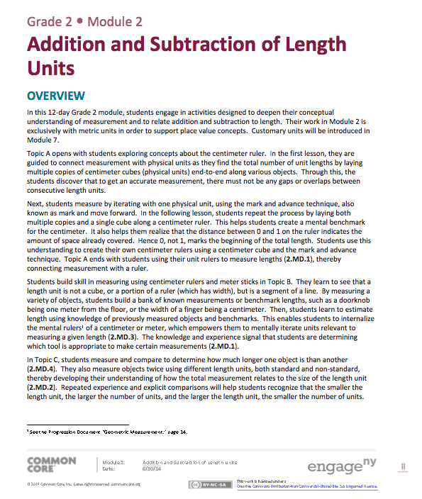
Module 2 Overview
Read the narrative.
* key concepts
Models and tools
Important vocabulary
How will students be able to apply their understanding of measurement units to place value units in later modules?
Notes:
Module 2 focuses on metric measurement. Its placement here in the instructional sequence serves several purposes:
The importance of the unit is emphasized as students learn to use measurement tools with the understanding that linear measure involves an iteration of units and that the smaller a unit, the more iterations are necessary to cover a given length. This reinforces the significance of the unit.
Work with metric units supports upcoming work in Module 3 with place value units of 1, 10, and 100, as students discover the relationship between 10s and 100s. Work on the centimeter ruler and meter stick gives students a concrete basis for seeing units within units. Students also construct a paper meter strip that emphasizes the units of 10 to add and subtract multiples of 10 to numbers within 100. Students are introduced to two fluency activities called Meter Strip Addition: Adding Multiples of 10 to a Number, and Meter Strip Subtraction: Subtracting Multiples of 10 from a Number.
Units play a central role in the addition and subtraction algorithms of Modules 4 and 5; the algorithms are manipulations of a different kind of unit, place value units.
It provides a rich context for word problems that students can use throughout the year (the Application piece of rigor) and it provides the context for the introduction to the tape diagram in G2.

Slide 48
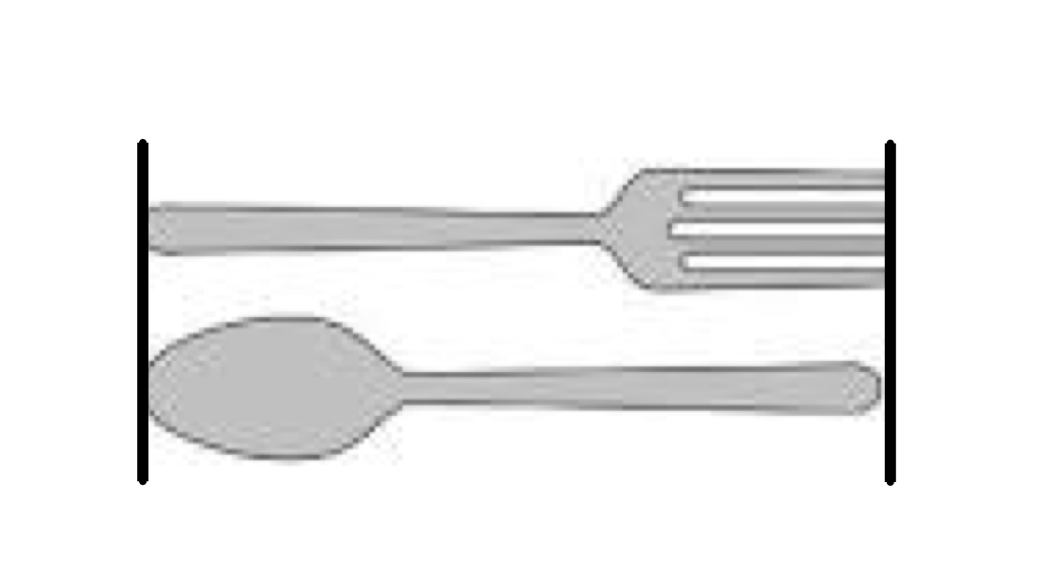
Objective: Connect measurement with physical units by using multiple copies of the same physical unit to measure.
Module 2, Lesson 1
Notes:
Materials: (T) 2 post-it notes, cm cubes, used crayon, Problem Set page 1 and Exit Ticket for each participant
In Lesson 1 of Module 2, students begin building concepts about measurement. In this lesson students are introduced to the terms estimate and about.
Model CD.
Complete Problem Set page 1 and the Exit Ticket.
TIME ALLOTTED FOR THIS SLIDE:
X minutes
MATERIALS NEEDED:
X

Slide 49
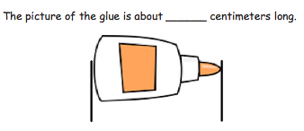
Objective: Use iteration with one physical unit to measure.
Module 2, Lesson 2
Notes:
Materials: Exit Ticket
Model CD and take Exit Ticket. Discuss the conceptual understanding needed to measure the card. (Student started at 1 instead of at 0.)
TIME ALLOTTED FOR THIS SLIDE:
X minutes
MATERIALS NEEDED:
X

Slide 50
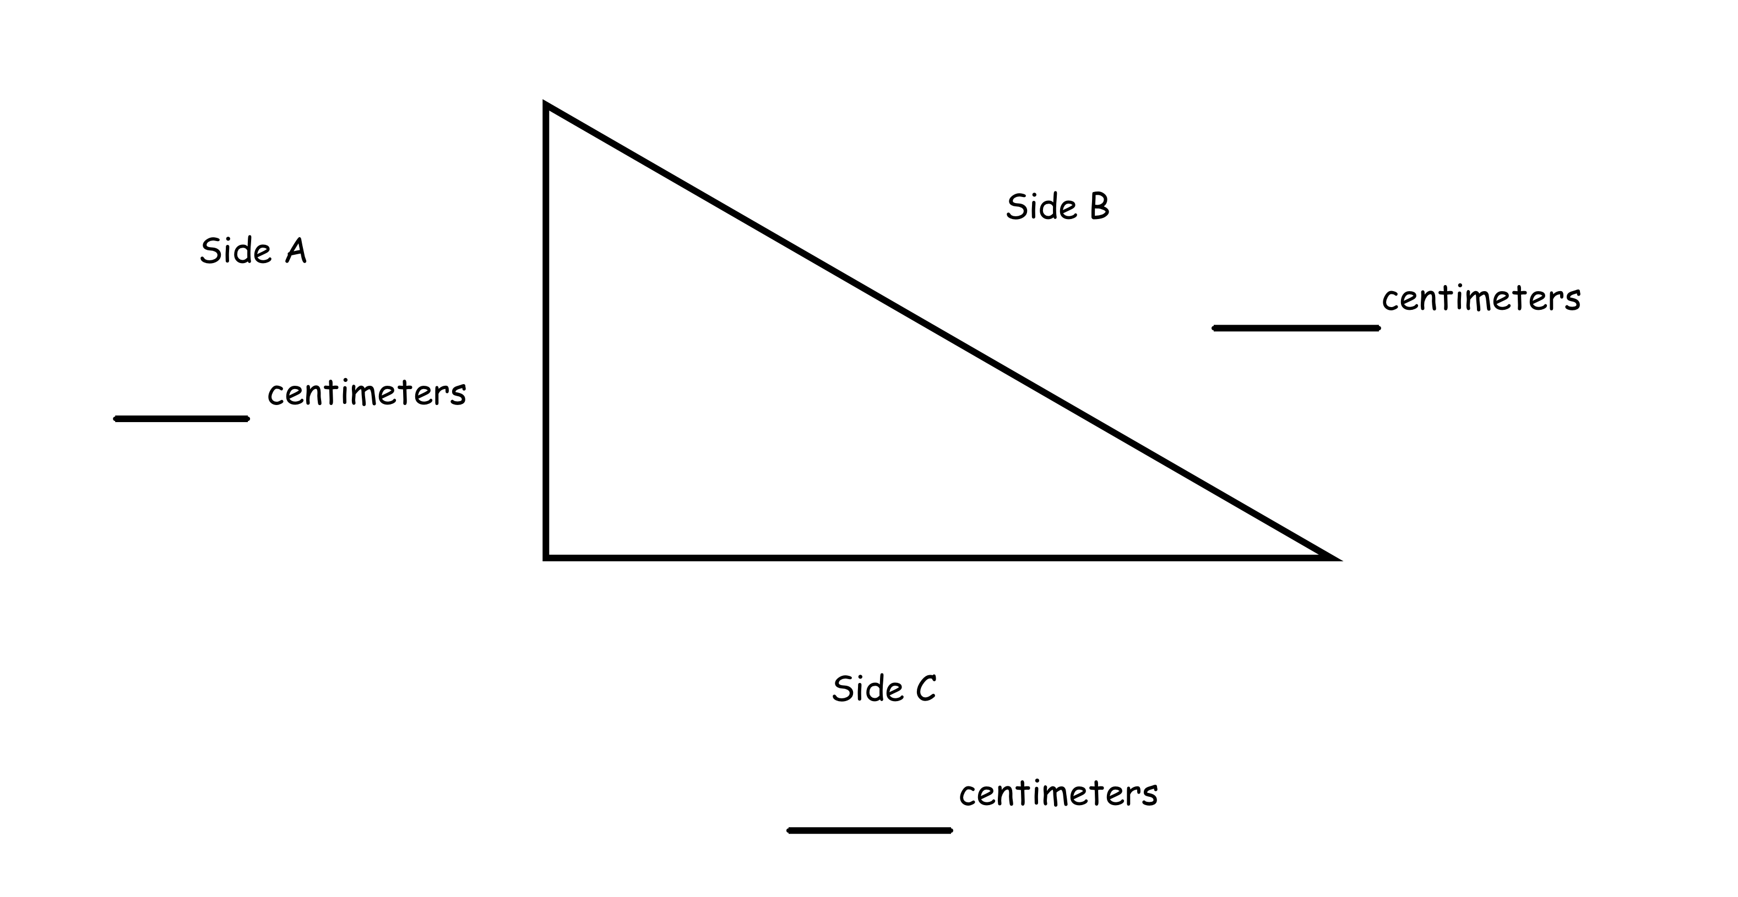
Objective: Apply concepts to create unit rulers and measure lengths using unit rulers.
Module 2, Lesson 3
Notes:
Materials: (S) 1 30 cm × 5 cm strip of tag board or sentence strip, 1 centimeter cube, CD
In Lesson 3, students apply understanding about measurement to create centimeter rulers. Read the lesson and make the rulers.
Discuss the issue of accuracy. The rulers will not be perfect for many reasons: small hands, poor fine motor skills, human error. That’s okay!
The purpose of creating the centimeter ruler is to give students a first-hand experience with the centimeter cube so that they internalize the meaning of a centimeter.
This helps them remember and visualize the size of a centimeter, helpful for later work with benchmarks and estimation.
This helps students understand the length unit is from the beginning of the cube to the end of it.
This helps them understand the numbers on the ruler as the number of length units so far, or the distance covered.
Using the centimeter cube helps them see the usefulness of a commercially made ruler (it’s easier). Also, students measure the rulers they made with a store-bought ruler and see that the lengths vary, pointing out the need for a standard measurement tool.
See next slide to discuss Debrief questions.

Slide 51
Objective: Apply concepts to create unit rulers and measure lengths using unit rulers.
Tell your partner how you made your ruler. What steps did you take to make it an accurate tool for measurement?
What was different about using the mark and move forward strategy from using the ruler? Why is using the ruler more efficient than counting hash marks?
What are some objects that are longer than our centimeter rulers? How can we measure objects that are longer than our rulers?
How do you think giving students a chance to create their own rulers will build a strong foundation for understanding measurement?
Module 2, Lesson 3, Student Debrief
Notes:
Have participants discuss debrief questions with a partner. Note to participants that question 3 helps set up the discovery in Lesson 4.

Slide 52
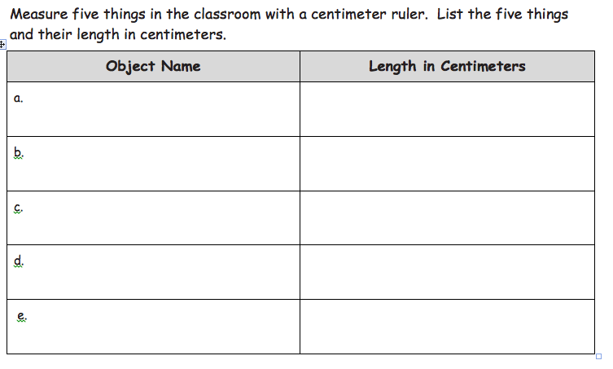
Objective: Measure various objects using centimeter rulers and meter sticks.
Complete page 1 of the Problem Set
Read through the Concept Development
Module 2, Lesson 4
Notes:
Materials: CD, Problem Set page 1
Have participants read the lesson and look at the Problem Set.
See next slide for Debrief questions.

Slide 53
Objective: Measure various objects using centimeter rulers and meter sticks.
How does the teacher facilitate the discovery of the meter stick in the beginning of the lesson?
How does the Concept Development bring MP.5 (students choose appropriate tools to measure) to life?
Module 2, Lesson 4, Student Debrief
Notes:
Now that you have completed the PS and reading the CD, take the next 4 minutes to discuss these questions in your table groups.
Question 1: Students learn that there is a larger unit that they can use to measure. They also learn that the iteration of the ruler makes a meter. 3 rulers is about the length of the meter stick.
Question 2: Students learn the shorter the length, the shorter the unit they should use. They learn that it is inefficient to measure longer distances with small units (i.e., measuring the carpet in centimeters leaves a lot of room for error and takes too long). They learn when to use a meter tape and when to use a meter stick.

Slide 54
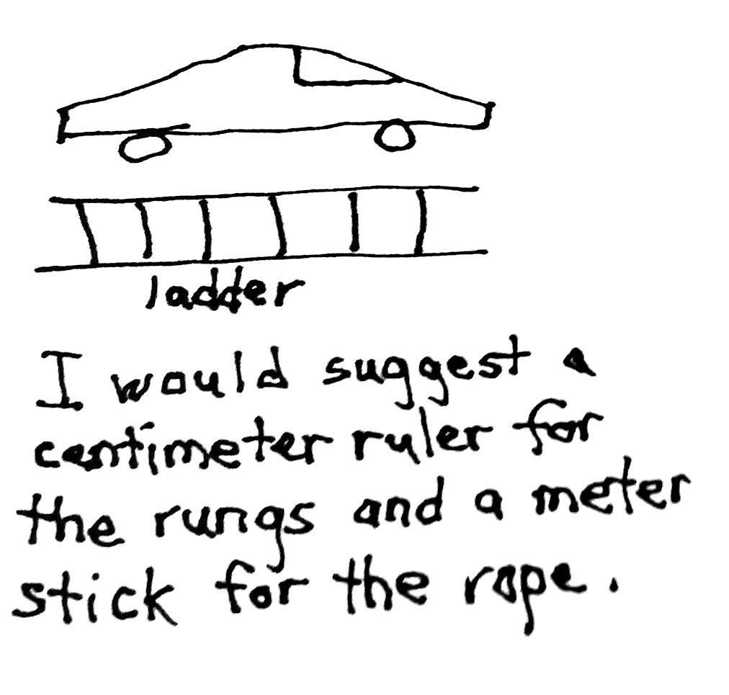
Objective: Develop estimation strategies by applying prior knowledge of length and using mental benchmarks.
Module 2, Lesson 5
Notes:
Summarize the lesson without naming any benchmarks.
See next slide to discuss the second and third bullets from the Debrief.

Slide 55
Objective: Develop estimation strategies by applying prior knowledge of length and using mental benchmarks.
How many mental benchmarks can you name?
How do mental benchmarks help us? When is a good time to use them?
Module 2, Lesson 5, Student Debrief
Notes:
Materials: CD
Think of as many benchmarks as you can. If you’re stumped, scan the lesson for ideas.
Width of a pinky is about 1 cm
A unsharpened pencil is about 20 cm
A meter is about the height from a doorknob to the floor

Slide 56
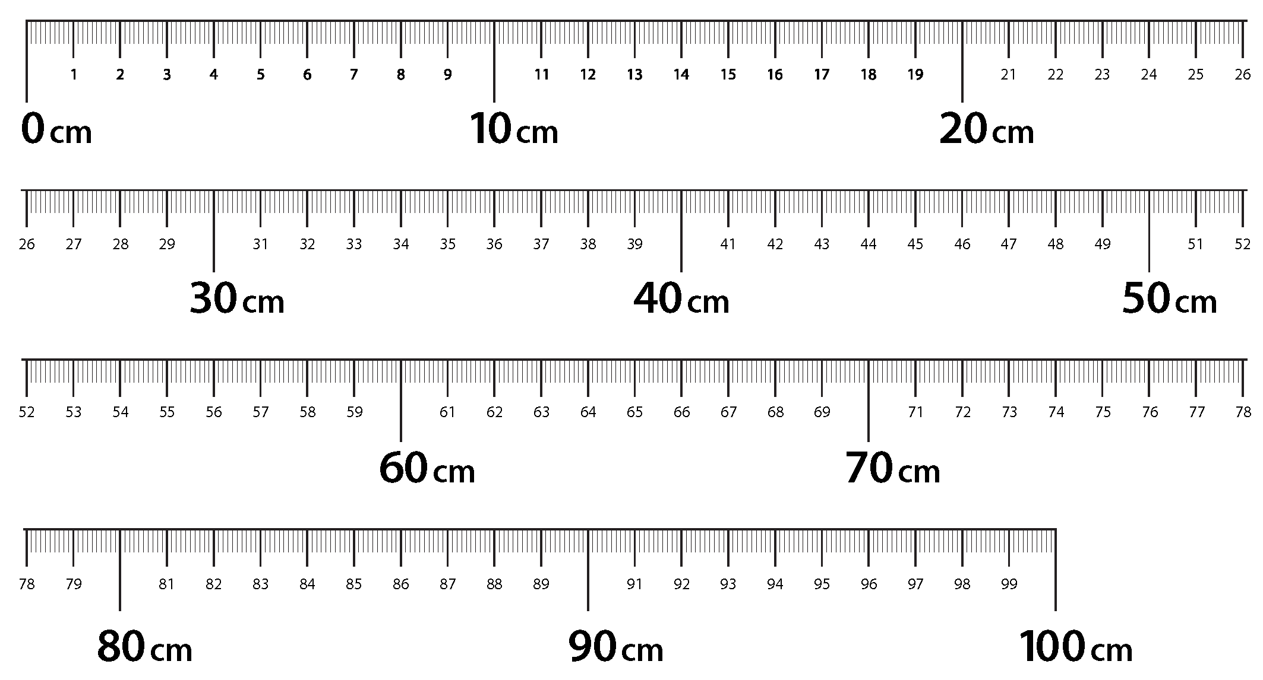
Objective: Measure and compare lengths using centimeters and meters.
Module 2, Lesson 6
Notes:
Materials: Lesson 6 Template (meter strip)
Summarize the lesson: Students create the meter strip and use it to measure the length and width of a piece of paper. Then they find the difference between the two measurements and share their strategies.

Slide 57
Objective: Measure and compare lengths using centimeters and meters.
Eve builds a block tower that reaches the height of her bedroom doorknob, which is 1 meter high. Her little sister knocks some blocks down. Eve measures her new tower, and it is 48 centimeters tall.
How does Eve’s new tower compare to when it was first built? Draw a picture on your personal board and use numbers or words to explain your thinking.
Module 2, Lesson 6, Application Problem
Notes:
Take the next 3 minutes to complete the Application Problem. Just as we ask the students to do, go through the Read, Draw, Write process. Begin by reading the problem. Draw a picture to show your thinking. Include a number sentence and a statement to show your answer. This process is called out specifically in Module 3, but you will want to encourage your students to go through this process even in module 1.
See sample work on the next slide.

Slide 58
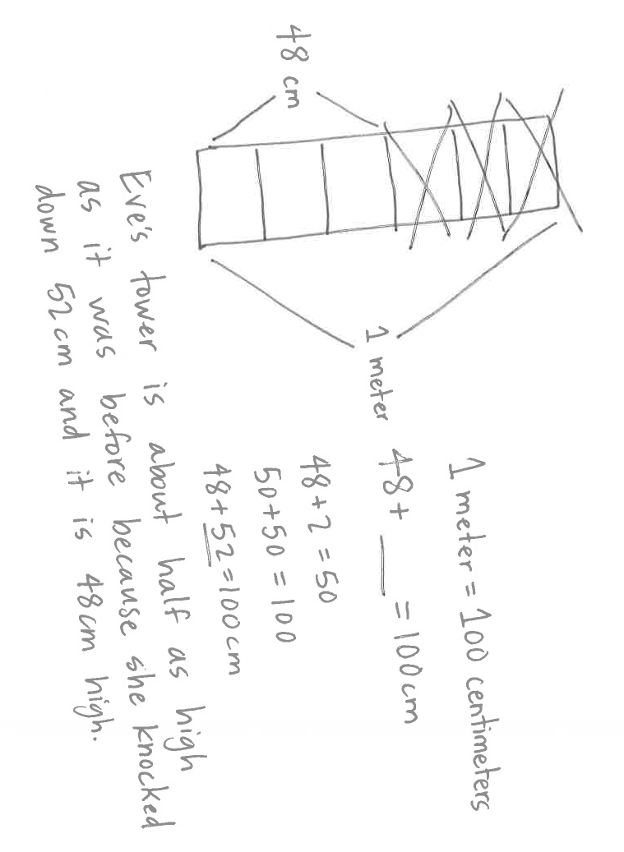
Objective: Measure and compare lengths using centimeters and meters.
Module 2, Lesson 6, Application Problem

Slide 59
Objective: Measure and compare lengths using standard metric length units and non-standard length units; relate measurement to unit size.
How does this lesson help students understand the relationship between the size of a unit of length and the number of units required to cover a specific length?
Module 2, Lesson 7, Student Debrief
Notes:
Materials: (S) Personal white board, 1 baggie per pair (containing 1 straw, 1 new crayon, 1 wedge eraser, 1 square sticky note, 30 paper clips), chart paper to record measurements
Model CD (not the very last part), then discuss the Debrief question.

Slide 60
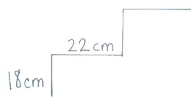
Objective: Solve addition and subtraction word problems using the ruler as a number line.
Module 2, Lesson 8
Notes:
Materials: (created Meter strip (Lesson 6 Template), CD, Problem Set page 1
In Lesson 8, students learn to use the meter strip as a number line. The teacher tells the students she is decorating her house. She is decorating her front steps with lights. In order to find the total length of lights needed the students decide to add the height and depth of each step using the meter strip.
Read through this lesson, then complete Problem Set page 1, Problem 2.
This lesson also introduces the idea of a torn meter strip, i.e., what do you do when you can’t start the measurement at zero.
See next slide to discuss Debrief questions.

Slide 61
Objective: Solve addition and subtraction word problems using the ruler as a number line.
How can you solve a problem with a ruler that does not start at zero?
How is a ruler similar to a number line?
Module 2, Lesson 8, Student Debrief
Notes:
Question 2: You could start at any number on the ruler because the distance between the length units never changes.
Question 3: You can use it to count up and back. Both show numbers that are equal distance to each other.

Slide 62
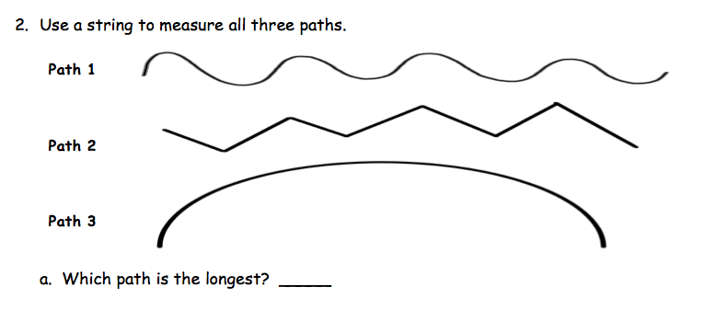
Objective: Measure lengths of string using measurement tools, and use tape diagrams to represent and compare lengths.
Module 2, Lesson 9
Notes:
Materials: chart paper to create the tape diagram from Problem 1 of the CD, 1 3-meter length of ribbon and 1 5-meter length of ribbon for presenter, 50 cm string per pair, Exit Ticket
In Lesson 9, students are formally introduced to Tape Diagrams. They are taught tape diagrams in Kindergarten and First Grade, but this is the first time they will see it in Grade 2.
Model CD (the lead into the tape diagram with the string).
Complete the Exit Ticket.

Slide 63
Objective: Apply conceptual understanding of measurement by solving two-step word problems.
Mr. Peterson decorated with 15 meters of ribbon in the morning. He decorated with 8 more meters in the afternoon than in the morning. How many meters of ribbon did Mr. Peterson use to decorate in the morning and afternoon in all?
Module 2, Lesson 10
Notes:
Materials: CD
In Lesson 10, students build their tape diagram skills when they solve 2-step word problems.
Model Problem 1.
Complete Problem 2.
What pitfalls do you anticipate in your classroom and what can you do to successfully navigate around them? How can you help your students master this content?
See next slide to discuss the Debrief questions.

Slide 64
Objective: Apply conceptual understanding of measurement by solving two-step word problems.
What must you do when drawing tape diagrams and comparing lengths in order to be accurate?
How could we arrive at the same answer to today’s problems but in a different way? What other math strategies can you connect with this (e.g., part–whole, number bond figures)?
How do tape diagrams help you to solve problems with more than one step?
Module 2, Lesson 10, Student Debrief

Slide 65
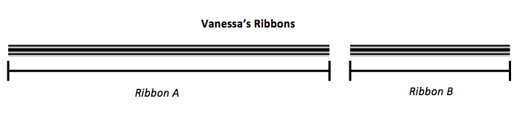
End of Module Assessment
Module 2, End of Module Assessment
Notes:
Materials: Problem 4 from the M2 EOM Assessment
Complete Problem 4 from the EOM Assessment.
For Problem 4 b, how do you want your students to respond?
For Problem 4 d, which model or strategy would you like to see your students use to solve this problem? (Number bond, tape diagram)
What other connections can you make to the lessons we studied today?

Slide 66
Agenda
Lesson Structure
Instructional Sequence
Module Review
Preparation for Implementation
Notes:
Now that we’ve had a chance to work through Module 2, let’s talk about strategies for implementation.
What challenges you foresee? Let’s brainstorm solutions.
TIME ALLOTTED FOR THIS SLIDE:
1 minute
MATERIALS NEEDED:
X

Slide 67
Practice a Planning Protocol
Repeat this process for each lesson.
    Read lesson.
    Study Exit Ticket. Identify critical portions of Concept Development and Problem Set.
    Consider needs of specific students.
    Refer to subsequent Exit Ticket. Revise implementation plan as needed.
    Make adjustments to the Student Debrief as needed.
    Consider the other lesson components, ensuring a balance of rigor.
Notes:
Review the planning protocol.
TIME ALLOTTED FOR THIS SLIDE:
5 minutes
MATERIALS NEEDED:
The preselected topic

Slide 68
Biggest Takeaway
I now know…
I need to figure out…
Notes:
Take two minutes to turn and talk with others at your table. During this session, what information was particularly helpful and/or insightful? What new questions do you have?
Allow 2 minutes for participants to turn and talk. Bring the group to order and advance to the next slide.
TIME ALLOTTED FOR THIS SLIDE:
3 minutes
MATERIALS NEEDED:
X

Slide 69
Key Points
When making instructional decisions in order to meet the needs of specific students, there are only two rules:
  Honor the objective!
  Honor the balance of rigor!
Addition and subtraction within 20 is the Grade 2 fluency standard and will be reviewed and built upon throughout the year.
The work of Module 1 is the foundation for the major work of the grade, which is addition and subtraction.
Notes:
PPT Developers: On this slide, add some key points regarding the mathematical content of M1.
Let’s review some key points of this session.
TIME ALLOTTED FOR THIS SLIDE:
2 minutes
MATERIALS NEEDED:
X

Slide 70
Next Step
The first thing I’ll do to prepare is…
Notes:
For your Exit Ticket for today’s session, please take these last few minutes to write your thoughts on an index card. ☺
TIME ALLOTTED FOR THIS SLIDE:
5 minutes
MATERIALS NEEDED:
Index cards

