Slide 1
A Story of Units
Curriculum Overview
Notes:
This full-day session is intended to support a school-wide implementation of A Story of Units. This session highlights the progression of mathematics in Grade 4 – Module 1, including steps for implementation. Educators teaching and supporting this grade level will understand the sequence of conceptual understanding for place value, addition, and subtraction, along with the models that support this learning.
Welcome participants and introduce presentation team.
Fist to Five:
- How familiar are you with A Story of Units?
Poll the participants:
Are you using the lessons on a daily basis? Or to supplement your instruction?
Are you a 4th grade classroom teacher? Do you teach a different grade-level?
Are you a math coach? Coordinator? Resource teacher?
Are you a school-level administrator? District-level administrator?
TIME ALLOTTED FOR THIS SLIDE:
5 minutes

Slide 2
This PowerPoint presentation is provided to individuals who participated in a live training by professional developers certified by, or affiliated with, the copyright holder, Common Core, Inc. It may not be altered in any way. The presentation may be shared for non-commercial purposes only. However, Common Core makes no representations or warranties about the effectiveness of training provided by non-certified/non-affiliated presenters of the material. Any commercial use of this presentation is illegal and violates the copyrights of Common Core, Inc.

Slide 3
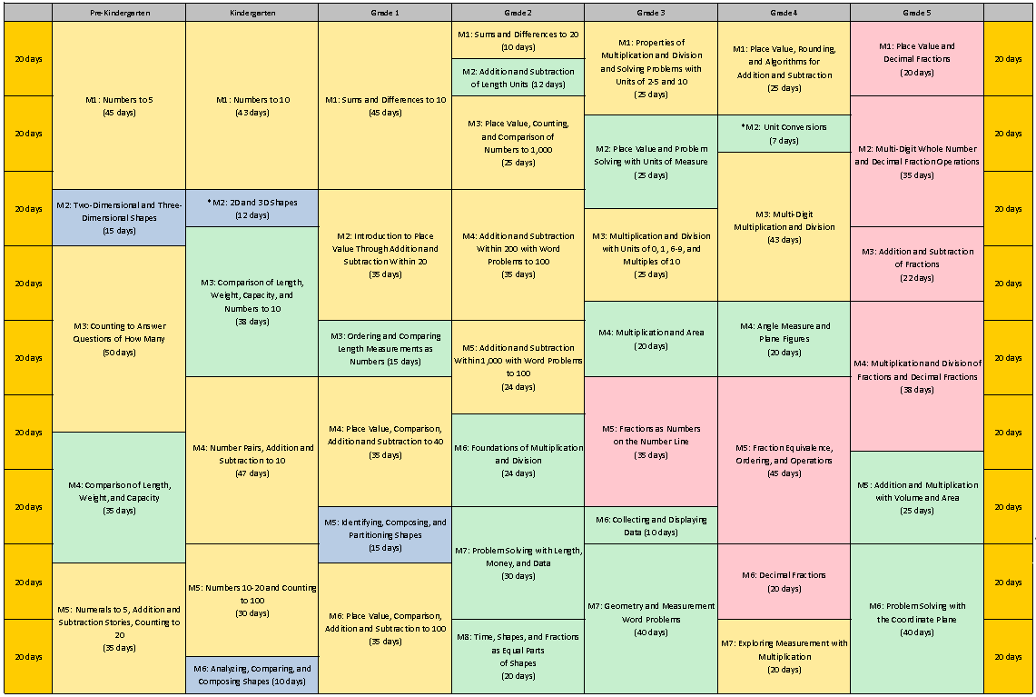
Curriculum Overview of A Story of Units
Notes:
Let’s start by looking at the curriculum map, found on page 3 of A Story of Units: A Curriculum Overview for Grades P-5. What information do you already know from this map? (Encourage participants to share their observations.)
NOTE TO FACILITATOR: If participants have not previously explored the Curriculum Overview and examined this map, it may be helpful to prompt them with the following questions. Make sure the following points are addressed, even if you need to state them directly.
Title?
Place Value, Rounding, and Algorithms for Addition and Subtraction
How many days?
25 instructional days, 19 lessons, 2 assessments
Prep modules?
Builds on Place Value concepts in previous grades, especially G2-M6 with the addition and subtraction algorithm introduction
Following modules?
M2, M3 and M7
TIME ALLOTTED FOR THIS SLIDE:
1 minute
MATERIALS NEEDED:
X

Slide 4
Session Objectives
Examine the development of mathematical understanding across the module, focusing on the Concept Development within the lessons.
Introduction to mathematical models and instructional strategies to support implementation of A Story of Units.
Plan for implementation of this module and subsequent modules.
Notes:
NOTE TO FACILITATOR: During this session, encourage participants to make note of any concerns they have as they prepare to implement this module. Sticky notes are provided in the table baskets, and parking lots are designated on the wall for this purpose.
Our objectives for this session are to:
Examine the development of mathematical understanding across the module, focusing on the Concept Development within the lessons.
Introduction to mathematical models and instructional strategies to support implementation of A Story of Units.
Plan for implementation of this module and subsequent modules.
In order to accomplish these objectives, we will take an in-depth look at the structure of the modules and will look for the coherence and progression from one lesson to the next.
You will first experience one lesson, Lesson 1, from the perspective of a student. Then, we will focus on the Concept Development of the subsequent lessons.
TIME ALLOTTED FOR THIS SLIDE:
2 minutes
MATERIALS NEEDED:
X

Slide 5
Agenda
Lesson Structure
Instructional Sequence
Module Review
Preparation for Implementation
Notes:
We will begin by guiding you through all the parts of Lesson 1 of Module 1. This will help us in exploring the lesson structure and how it is fundamental to supporting rigorous instruction. We’ll talk about strategies for implementation in preparation for the beginning of the school year. Then, we will dig into the math of the whole module, examining the intentional instructional sequence that leads students toward mastery of the Focus Standards. Afterwards, we’ll take a look back at the module, reflecting on all the parts as one cohesive whole.
TIME ALLOTTED FOR THIS SLIDE:
1 minute
MATERIALS NEEDED:
X

Slide 6
Introduction of Module Structure
Module Overview
Topic
L1
Topic
L5
Topic
L6
L2
L3
L7
L8
L9
Topic
Topic
L11
Topic
L13
L4
L10
L12
L14
L15
L16
L17
L18
L19
Notes:
Module Structure
A Story of Units: A Curriculum Overview for Grades P-5 provides a curriculum map and grade-level overview. The curriculum map provides an at-a-glance view of the entire story, making clear the coherence of the curriculum and the role that each module plays in that progression.
5-8 modules per grade level
Modules are comprised of Topics. The number of Topics varies by module.
Topics break into concepts, and concepts become lessons. Topics vary in the number of lessons.
Lessons are designed for 60 minute instructional periods.
(Point to “L1”) Here is where we are going to begin.
TIME ALLOTTED FOR THIS SLIDE:
2 minutes
MATERIALS NEEDED:
X

Slide 7
Topic A Place Value of Multi-Digit Whole Numbers
Focus Standards:
4.NBT.1: Recognize that in a multi-digit whole number, a digit in one place represents ten times what it represents in the place to its right.
4.NBT.2: Read and write multi-digit whole numbers using base-ten numerals, number names, and expanded form. Compare two multi-digit numbers based on meanings of the digits in each place, using >, =, and < symbols to record the results of comparisons.
Notes:
Each module is divided into topics. Within a given topic, the lessons work together to build strong understanding of a set of related concepts.
The Module Overview and Topic Openers each list Focus Standards and Foundational Standards.
The Progressions documents (see University of Arizona website) are helpful in explaining and showing representations of what the Standards mean.
Read the Standards and discuss. What do students need to know in G4?
See notes below for links to prior learning.
Prior Learning:
In G3, students multiply by multiples of 10 (3.NBT.3).
In G2, students read and write numbers to 1,000 using base-ten numerals, number names, and expanded form (2.NBT.2) and compare two three-digit numbers based on the meanings of the digits in each place and symbols of <,>, and = (2.NBT.4).
TIME ALLOTTED FOR THIS SLIDE:
4 minutes
MATERIALS NEEDED:
X

Slide 8
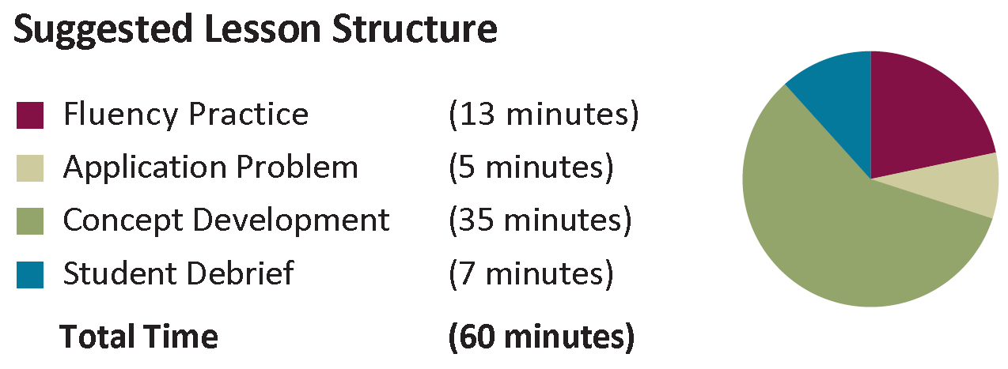
Lesson 1 Objective: Interpret a multiplication equation as a comparison.
Notes:
Grade 4, Module 1 has 6 topics and 19 lessons.
Every lesson is 60 minutes in length and has 4 parts: Fluency, Application, Concept Development, and Student Debrief.
Ask participants to take note of the structure of the lesson; They will see this familiar image at the beginning of each lesson.
Fluency Practice helps students to get their math minds ready for the lesson. The Application Problem affords students the opportunity to ‘show what they know’. The Concept Development (typically the longest component of the lesson) includes the new learning. The Debrief gives students the opportunity to discuss what they’ve learned and to make new discoveries.
Let’s start by walking through the components of Lesson 1 as the students might experience the lesson. It is the first lesson of Topic A: Place Value of Multi-Digit Whole Numbers.
Turn and Talk: Look at the objective. Make a prediction about why we start with this lesson. Prompt participants to think about the Focus Standards and the jump from numbers within 1,000 to numbers up to 1,000,000. So… why do we start Lesson 1 with this objective?
Students compose numbers from one place value to the next; we are building from the familiar of Grade 3 (numbers to 1,000) to larger place values up to the 1 million (a G4 standard); Students see the connection of one place value to another and recognize that this is how our number system works.
TIME ALLOTTED FOR THIS SLIDE:
4 minutes
MATERIALS NEEDED:
X

Slide 9
Lesson 1 Objective: Interpret a multiplication equation as a comparison.
Lesson 1: Fluency
Notes:
Fluency is:
10 – 20 minutes of daily work strategically designed to be easily administered and assessed.
high paced and energetic and gets students’ adrenaline flowing while creating daily opportunities to celebrate improvement.
promoting automaticity so that students can reserve their cognitive resources for higher-level thinking.
focusing on previously taught information.
MODEL delivery of Lesson 1 Sprint: Multiply and Divide by 10
Distribute Sprint A.
Give instructions.
Complete Sprint A and B in the spirit of delivery in the classroom.
MODEL delivery of Place Value.
Use document camera with unlabeled place value chart to the thousands:
Teaching Sequence
Have participants draw 4 ones and write ‘4’ underneath.
Then draw 4 ten disks and write ‘4’ underneath.
Ask them to say the number in unit form. (4 tens 4 ones)
Ask them to say the number in standard form. (44)
Point out the suggested sequence for the remainder of this fluency found in G4-M1 book on page 1.A.4.
TIME ALLOTTED FOR THIS SLIDE:
17 minutes
MATERIALS NEEDED:
Sprint
Unlabeled thousands place value chart
Place value disks

Slide 10
The Role of Fluency
Maintenance staying sharp on previously learned skills
Preparation targeted practice for the current lesson
Anticipation skills that ensure that students will be ready for the in-depth work of upcoming lessons
Notes:
Review the 3 functions of fluency.
Point out regarding fluency in SOU, in general, regardless of the activity’s function:
Fluency is designed to promote automaticity.
Just about every lesson has a fluency component to it.
Most lessons start with fluency to immediately engage students in the math in an exciting and fast-paced way.
Activities are meant to be fast-paced, accessible, and exciting, and they almost never include completely new learning in order to make that possible.
This is a high-energy point in the lesson in which students celebrate improvement and recognize patterns and connections between material.
Most lessons have more than 1 fluency choice per day. (Talk about how teachers might use these depending on student needs. E.g., choose one, some, all, write your own.)
Stress the importance of including fluency with each lesson to maintain a balance of components that achieves the rigor specified by the shifts.
Turn and Talk:
How might the three roles of fluency support the students in your school and classroom? (dynamic; engaging; differentiated, etc.)
What types of fluencies were these? (maintenance; preparation)
TIME ALLOTTED FOR THIS SLIDE:
3 minutes
MATERIALS NEEDED:
X

Slide 11
Lesson 1 Objective: Interpret a multiplication equation as a comparison.
Lesson 1: Application Problem
Notes:
Lead participants through solving the Application Problem in the spirit of classroom-style.
As you go through each step of the process, model the teacher language of using the steps of the RDW Approach without actually calling out what each part is. This leads up to the next slide where participants will think back to the structure used.
Read: Let’s read this together; What do we know? What do we need to know?
Draw: How can we represent this pictorially? What can we draw?
Share drawings under document camera.
Ask participants to analyze other pictures and then have them solve and write their answer as a statement.
Write: Record a number and written sentence.
Share solutions under document camera.
TIME ALLOTTED FOR THIS SLIDE:
4 minutes
MATERIALS NEEDED:
X

Slide 12
Application Problems
Real world problem solving
Placement in lesson depends on function
Opportunity for informal assessment
Problem-solving process:
Read the problem
Draw and label a model to represent the problem
Write an equation and a complete word sentence
Notes:
We just solved the word problem that makes up the Application Problem component of G4-M1-L1.
(CLICK.) These are often word problems, but occasionally take other forms. They typically offer real-world applications (like the example).
The number of Application Problems may vary from lesson to lesson (usually 0 if the CD is a problem solving lesson, and 1 or more for a more typical lesson).
(CLICK.) Placement in the lesson depends on function.
Those that come before the CD often:
Make an application of the new learning from the day before.
Relate to the CD by providing context or point of comparison for a later problem or by having students solve a problem that they’ll use again in some way in the CD.
Those that come after the CD often:
Provide an immediate application of new learning before the Problem Set (or at the end of the lesson if the PS is used during the CD).
Provide a quick opportunity for informal assessment of new learning before independent practice in the PS.
Usually Application Problems don’t specify a model to use or a way of solving. The reason for this is to encourage students to think quantitatively and creatively and to give them practice with understanding how to choose and apply the correct mathematics concept to solve real-world problems.
(CLICK.) Because of this, APs present a good opportunity for informal assessment. Noticing how students represent problems using models and equations will provide you with lots of information about their level of comfort with recently taught material, as well as how they’re thinking through solution paths.
Think back on the problem-solving process we just went through. (CLICK to advance each step: Read, Draw, Write.)
Throughout SOU we refer to these steps as the RDW process. (CLICK.)
Point out/discuss the following about the RDW process:
Usually this is the process that students use to solve word problems in SOU, including Application Problems.
We hope students internalize the process with practice over time so that it becomes a tool for problem solving.
Don’t let RDW become the focus of problem solving, but rather teach RDW as a tool for approaching problem solving.
Discuss/Point out the following tips for implementation:
If students need encouragement to draw, provide just the stem of the problem at first. (This removes the temptation to ‘just solve’.)
Ask them to share their drawing with a neighbor.
You might present your own model to help students distinguish between a drawing and a math drawing (for example, we’d rather not see detailed pictures of a fence and grass sod).
Once students have drawn and before they’ve seen the question, ask, “What questions could we ask based on the information we’ve been given?”
This emphasis on the drawing encourages students to use it as a tool for solving rather than as an afterthought.
TIME ALLOTTED FOR THIS SLIDE:
5 minutes
MATERIALS NEEDED:
X

Slide 13
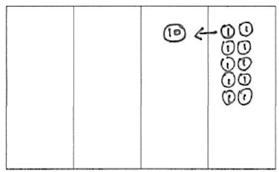
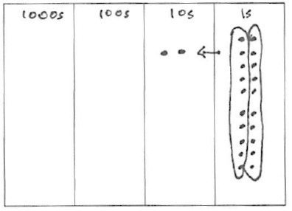
Lesson 1 Objective: Interpret a multiplication equation as a comparison.
1 ten = 10 × 1 one (Say, “1 ten is 10 times as much as 1 one.”)
1 hundred = 10 × 1 ten (Say, “1 hundred is 10 times as much as 1 ten.”)
1 thousand = 10 × 1 hundred (Say, “1 thousand is 10 times as much as 1 hundred.”)
Lesson 1: Concept Development
Notes:
Teaching Sequence (in the spirit of classroom delivery)
Insert unlabeled thousands place value chart into the personal white boards
Problem 1:
T: (Place 1 one.) How many units do I have?
S: 1.
T: What is the name of this unit?
S: A one.
T: Count the ones with me. (Place ones as counting.)
S: 1 one, 2 ones, 3 ones…10 ones.
T: What larger unit can I make?
S: 1 ten.
T: I changed 10 ones for 1 ten. We say, “1 ten is 10 times as much as 1 one.” Tell your partner what we say and what it means. Use the model to help you.
Problem 2: Repeat Problem 1 with 10 times as much as 1 ten.
Problem 3: Discuss Problem 1 with 10 times as much as 1 hundred.
T: Record 2 multiplication sentences that model the phrase “1 thousand is 10 times as much as 1 hundred” on your board, one using numbers and the other using unit language.
T: Repeat for 1 hundred and 1 ten.
Problem 4: Model 10 times as much as 2 tens using the chip model. Record a multiplication sentence.
Problem Set: Give participants 5-8 minutes to complete the Lesson 1 Problem Set in the Participant Problem Set handout.
CLICK to display images from the lesson.
TIME ALLOTTED FOR THIS SLIDE:
25 minutes
MATERIALS NEEDED:
Lesson 1 Template: Unlabeled thousands place value chart
Personal white boards
Place value disks
Participant Problem Set – Lesson 1

Slide 14
Concept Development
New material
Timing includes 10 minutes for Problem Set
Moves from simple to complex
Problem Set
Time frame rather than task frame
Closely related to the other lesson components
A good place to begin lesson planning
Notes:
The Concept Development is the part of the lesson where new material is taught. It almost always ends with a Problem Set which offers immediate practice with the new learning.
Discuss/ask participants the following questions about the work they just did.
What do you notice about the relationship between the CD and PS?
How did the CD prepare you for the PS? Was anything on the PS surprising?
Later today, we’ll spend some time talking just about the PS and how you might make adjustments for different students and also for lesson pacing.
Point out/discuss the following about CDs in SOU.
Generally the component allotted the most time within the hour long lesson.
(CLICK.) The time allotment for the CD includes 10 minutes for the PS.
Very few lessons don’t have any CD at all. (Might be a lesson focused on fluency, for example.)
Some CDs use the PS, which makes the 10 minutes for it at the end unnecessary.
(CLICK.) The CD moves from simple to complex, usually mirroring that same development on the PS.
CDs take different formats. For example: teacher directed, stations, problem solving, group work, etc.
The vignettes throughout the lesson are meant to sample what the instruction looks, sounds, and feels like. They’re definitely not meant to be followed verbatim.
Point out/discuss the following about Problem Sets: (CLICK.)
Simple to complex sequence.
Draw attention to the Problem Set directions in the lesson.
(CLICK.) PS is meant to be done as a time frame rather than a task frame.
Every student may not be assigned every problem (but ensure they get a balance of word problems and other types).
Suggestion for implementation: Take 8 minutes to get as far as possible on PS, last 2 minutes all work on a particular problem. (Ensures everyone’s done at least 1 ‘meaty’ problem to discuss in the Debrief.)
(CLICK.) Discuss the relationship between PS and HW and PS and Exit ticket.
Problems mirror development in CD .
(CLICK.) May want to talk about how writers wrote PS first, then CD.
Suggestion for planning: start with the PS and plan the path that will get your students there.
TIME ALLOTTED FOR THIS SLIDE:
6 minutes
MATERIALS NEEDED:
X

Slide 15
Lesson 1 Objective: Interpret a multiplication equation as a comparison.
Take 2 minutes to explain to your partner what we learned about the value of each unit as it moves from right to left on the place value chart.
Lesson 1: Student Debrief
Notes:
Debrief (in the spirit of classroom delivery):
Direct participants to get together with a partner to discuss their answers to the Problem Set; use document camera to show student work; model a classroom discussion to review the answers.
Choose 1-2 questions to debrief with the group as a whole; show ‘student’ work; discuss solutions; use appropriate Debrief questions to analyze ‘student’ work such as:
How did Problem 1(c) help you to solve Problem 4?
In Problem 5, which solution proved most difficult to find? Why?
How does the answer about Sarah’s age and her grandfather’s age relate to our lesson’s objective?
CLICK to advance a Debrief question about the lesson objective.
Turn and talk to answer the question. Then share out.
<Have participants complete the Lesson 1 Exit Ticket, located after the Participant Problem Set.>
TIME ALLOTTED FOR THIS SLIDE:
7 minutes
MATERIALS NEEDED:
Lesson 1 Exit Ticket

Slide 16
Student Debrief
Class conversation to reflect on the day’s learning
Make connections between parts of the lesson, concepts, strategies, and tools
Students ultimately articulate the learning objective
Exit Ticket
The lesson ends with a daily informal assessment known as an Exit Ticket.
Daily formative assessment to drive instruction
Time frame rather than task frame
Tool for lesson planning
Notes:
Discuss/Point out about Student Debrief in SOU:
Students bring PS to the carpet and gather around for a conversation about the lesson.
Check PS with a partner/correct as a class.
Invite students to share work.
Students see and hear multiple perspectives from classmates.
Students reflect back on the lesson to analyze the learning that occurred. (Lesson doesn’t start by naming objective.)
(CLICK.) Students make connections between parts of the lesson, concepts, strategies, and tools. The student debrief is not to be missed!
(CLICK.) Students ultimately articulate the objective/day’s learning.
Teacher reviews key vocabulary and helps students name the learning they describe.
The time allotment for the Debrief includes 3 minutes for the Exit Ticket.
Tip for implementation:
If initially your students need help learning how to have these conversations (or accountable partner talk), they can share work, but also, you might present 1-2 different solutions and have them practice explaining the model, labels, equation, and solution path to their partners.
Exit Ticket (CLICK.)
Teachers get valuable feedback.
Teachers can use the Exit Ticket to plan.
Exit Ticket can be used as a refresher the next morning if not enough time, or repeat exact question again to see what students retained.
Did you learn what we meant for you to?
You can change numbers and repeat questions.
“Exit Tickets” close the Student Debrief component of each lesson. These short, formative assessments are meant to provide quick glimpses of the day’s major learning for students and teachers. Through this routine, students grow accustomed to showing accountability for each day’s learning and produce valuable data for the teacher that becomes an indispensable planning tool.
Discuss/Point out the following about the Exit Ticket:
(CLICK.) Daily formative assessment to drive daily instruction (Use it to plan!)
Use it to close the lesson, or some people use as morning work the next day (Teachers use it in lots of ways; the point is that it can be useful for planning your instruction.)
(CLICK.) Time frame, not task frame
(CLICK.) Can be a tool for lesson planning because it’s a glimpse of the student outcome for each day.
Homework
<Have participants analyze the Lesson 1 Problem Set and Homework.>
TURN and TALK: Compare the alignment of problems on the Problem Set to the Homework. What do you notice? (Similar sequencing, problem types, and directions; familiar language that was used in the Concept Development)
TIME ALLOTTED FOR THIS SLIDE:
10 minutes
MATERIALS NEEDED:
G4-M1 Book
Lesson 1 Homework

Slide 17
Agenda
Lesson Structure
Instructional Sequence
Module Review
Preparation for Implementation
Notes:
As you’ve seen, each lesson component has a very different purpose. Consequently, each lesson component has a different pace, so the experience feels different for students. It is important to honor each component in order to do justice both to the mathematical practices and to the balance of rigor that is expected.
Moving forward, we’ll explore the instructional sequence. In doing this, we’ll lead you through the module, modeling instruction for each objective. Along the way, we’ll also revisit the other lesson components and experience how they function in collaboration with the Concept Development.
TIME ALLOTTED FOR THIS SLIDE:
1 minute
MATERIALS NEEDED:
X

Slide 18
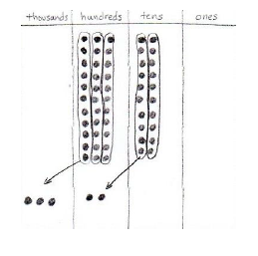
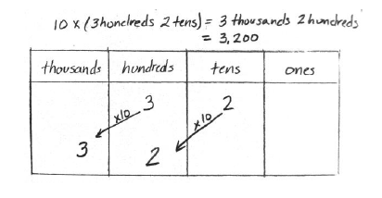
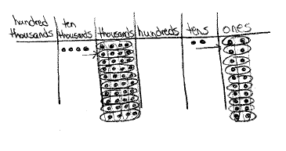
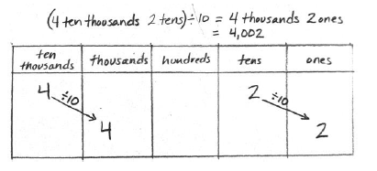
Lesson 2 Recognize a digit represents 10 times the value to the right.
Notes:
LINK:
Lesson 1 taught students ‘10 times as much as’, building from ones to tens to hundreds to thousands.
Began with 10 times as much as 1 unit and then extended the learning to 10 times as much as more than 1 unit.
Lesson 2:
Extends the learning to the unfamiliar place values of ten thousands, hundred thousands, and millions.
Students see the relationship that each digit represents 10 times the value of what it represents in the place to its right.
When moving from left to right, the opposite occurs. → We move one place value to the right when dividing by 10.
Students multiply and divide 1 unit and then multiples of 1 unit by 10.
Finally, as seen on the slide from the Concept Development, students multiply and divide multiple copies of two different units by 10. In other words, they learn that each digit shifts.
Unit language is used throughout the lesson.
<Have participants work on Lesson 2 examples in Participant Problem Set.>
TIME ALLOTTED FOR THIS SLIDE:
5 minutes
MATERIALS NEEDED:
Participant Problem Set Lesson 2

Slide 19
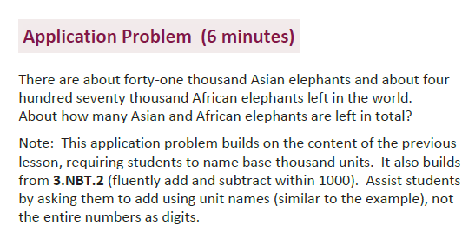
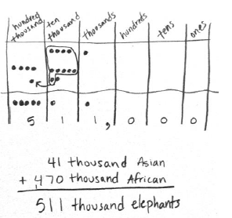
Lesson 4 Application Problem (Reviewing Lesson 3)
Notes:
LINK:
With a deeper understanding of the relationship from one place value to another, students use this understanding to see other relationships in the place value chart.
There is a repeating pattern of ones, tens, and hundreds within each grouping of units.
Lesson 3:
Note: Lesson 3 goes beyond the Standards to the ten millions and hundred millions places in order to show that the pattern continues to repeat. Students are not assessed on numbers past 1,000,000. Any time a lesson extends beyond the scope of a grade level standard, a note is placed in the lesson. Review the note on page 1.A.28.
They learn that we separate these groupings with commas and that the commas help us to name the number.
Students practice naming numbers and come to appreciate the comma within numbers.
Develop a pattern for every third place value (i.e. each period- thousands, millions, billions)
<Have participants work on Lesson 3 examples in Problem Set.>
Turn and Talk: Notice Problem 3: Why is it important to have experience adding numbers such as 24 ten thousands + 11 thousands? (Students see that numbers can be expressed using different units but that they represent the same amount; further, we can compose groups of ten for one unit of the next place value; this prepares students for later work with the algorithm for addition.)
TIME ALLOTTED FOR THIS SLIDE:
5 minutes
MATERIALS NEEDED:
Participant Problem Set Lesson 3

Slide 20
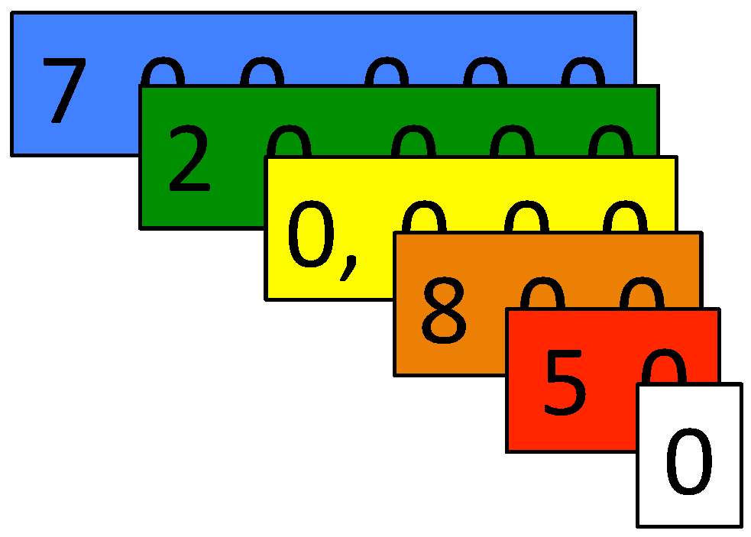
Lesson 4 Read and write multi-digit numbers using base 10, number names and expanded form.
Notes:
LINK from Lesson 3:
Represented numbers in unit form and standard form up to 1 million.
Applied multiplicative comparison (10 times as many) to numbers up to 1 million.
Lesson 4:
Read multi-digit numbers.
Write multi-digit numbers in standard form, as words, and in expanded form.
Extend knowledge of comma usage to writing numbers as words.
Place value cards (aka Hide Zero cards) show the value of each digit (e.g. 8 is worth 800).
Place value cards are introduced in Kindergarten and used throughout grades, including Grades 4-5 for whole numbers, and will introduce place value cards for decimal numbers as well.
During the CD, students read the number 720,850 and write it in word and expanded forms.
<Have participants work on Lesson 4 problems on the Participant Problem Set.>
Turn and Talk:
How has Topic A, Place Value of Multi-Digit Whole Numbers, set students up for success for the rest of the module?
Consider the strengths and weaknesses your incoming students may face during these first 4 lessons. Jot down these thoughts. We will refer to them later in this presentation as we discuss implementing these lessons.
TIME ALLOTTED FOR THIS SLIDE:
8 minutes
MATERIALS NEEDED:
Participant Problem Set Lesson 4

Slide 21
Topic B Comparing Multi-Digit Whole Numbers
Focus Standard:
4.NBT.2: Read and write multi-digit whole numbers using base-ten numerals, number names, and expanded form. Compare two multi-digit numbers based on meanings of the digits in each place, using >, =, and < symbols to record the results of comparisons.
Notes:
Invite participants to view page 1.B.1.
Review the components of a Topic Opener:
Topic Title
Standards (bolded for focus, unbolded for supporting)
Focus standard spelled out
Number of instructional days
Coherence (‘links from’ and ‘links to’ modules with foundational or future standards of similar content)
Narrative and images to support and explain the learning of the sequence of lessons
Objectives for the topic to show sequence of mastery
Turn and Talk: What skills are needed from Topic A for students to be successful in Topic B? (knowledge of place value up to millions, understand the value of each unit is 10 times as much as the unit to its right, read and write numbers to 1 million)
TIME ALLOTTED FOR THIS SLIDE:
4 minutes
MATERIALS NEEDED:
G4-M1 Book
Topic Opener B page 1.B.1

Slide 22
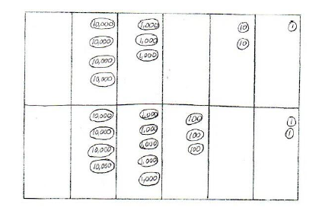
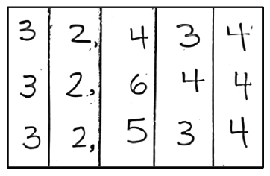
Lesson 5 Compare numbers based on meanings of the digits, using >, <, or = to record the comparison.
Notes:
LINK
Familiar use of place value disks to represent numbers in the place value chart.
Continued practice of saying multi-digit numbers and recognizing the value of each digit.
Lesson 5:
Teaching sequence:
Draw an unlabeled ten thousands place value chart on your personal white board.
Place chips in your place value chart to represent both numbers.
What is the largest unit for each number? (ten thousands)
What is the value of the ten thousands for each number? (4)
What is the next largest unit? (thousands)
What is the value of the thousands for each number? (3 and 5)
What is greater? 3 thousands or 5 thousands? (5 thousands)
Tell your partner a statement that compares these two numbers using the phrase “greater than”. (45,302 is greater than 43,021.)
Now, tell your partner a statement that compares these two numbers using the phrase “less than.” (43,021 is less than 45,302.)
Students may draw disks, use manipulatives, or draw using the chip model as was shown from Lesson 1. (CLICK to show image of drawn disks.)
(CLICK to show image of digits in place value chart.) Showing the digits in the place value chart is a more abstract way for students to compare the value of the larger units.
Using verbal comparison statements places the focus on the units and the size of the numbers, instead of on the comparison symbol.
Avoiding the comparison symbol initially reinforces the comparison understanding, and avoids a lesson that focuses on the symbols and drawing alligators.
<Have participants work on Lesson 5 problems on the Participant Problem Set.>
TIME ALLOTTED FOR THIS SLIDE:
7 minutes
MATERIALS NEEDED:
Personal white board
Place value disks
Participant Problem Set Lesson 5

Slide 23
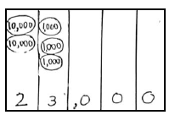
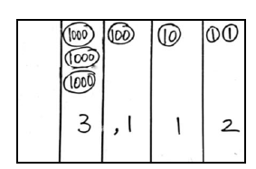
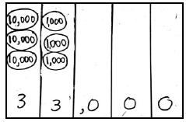
Lesson 6 Find 1, 10, and 100 thousand more and less than a given number.
Notes:
LINK
Students have been adding and subtracting 1, 10 and 100 since Kindergarten and up.
Now the application is not to the ones period, but rather the newly-learned thousands period.
Lesson 6:
Teaching sequence:
Draw an unlabeled ten thousands place value chart on your personal white board.
Draw disks to show 3,112. (CLICK to verify answer.)
Draw 1 more unit of 1 thousand. What number is 1 thousand more than 3,112? (4,112)
Show and tell your partner what is 1 thousand less than 3,112. (2,112)
Draw 1 ten thousand disk. What number do you have? (14,112)
Show what is 1 thousand less than 14,112. Say the number. (13,112)
Show and tell your partner what is 1 thousand more than 14,112. (15,112)
The sequence continues using various numbers by adding or subtracting units of 10 thousand and 100 thousand. (CLICK to show example of adding 10 thousand.)
<Have participants work on Lesson 6 problems on the Participant Problem Set.>
TIME ALLOTTED FOR THIS SLIDE:
6 minutes
MATERIALS NEEDED:
Personal white board
Participant Problem Set Lesson 6

Slide 24
Topic C Rounding Multi-Digit Whole Numbers
Focus Standard:
4.NBT.3: Use place value understanding to round multi-digit whole numbers to any place.
Notes:
Have participants read the narrative for Topic C on page 1.C.1.
Note that:
The students round numbers up to 1 million.
Place value understanding is at the core of this skill.
Students no longer round to just 2 places, but to any place value for multi-digit numbers.
Turn and Talk:
What skills do Grade 4 students need to bring with them to this topic to be successful? (Rounding to the nearest ten and hundred, use of [vertical] number line, identifying the largest unit in a number.)
What skills do you know your Grade 4 students will have (or not have) to prepare them for this topic? (Answers will vary at each school site. Relate concerns about gaps to the last portion of today’s session which focuses on implementation.)
TIME ALLOTTED FOR THIS SLIDE:
5 minutes
MATERIALS NEEDED:
G4-M1 Book
Topic Opener C page 1.C.1

Slide 25
Lesson 7 Round multi-digit numbers to the thousands place using the vertical number line.
Notes:
LINK
Students round to the nearest ten and hundred in Grade 3.
Fluency in Lesson 7 reviews this skill using the vertical number line and finding the halfway point of a ten or hundred.
This fluency prepares students for Lesson 7 as they extend to the thousands place.
Lesson 7:
Teaching sequence:
Draw a vertical number line with the endpoints 10 and 20.
What is halfway between 10 and 20. (15). (CLICK to show line.)
Draw another number line next to it with endpoints 1,000 and 2,000.
How many hundreds are in 1,000? (10 hundreds)
How many hundreds are in 2,000? (20 hundreds.)
What is halfway between 10 hundreds and 20 hundreds? (15 hundreds) (CLICK to show line.)
Draw a new number line with endpoints 31,000 and 32,000.
Tell your partner how many hundreds are in each endpoint. (310 hundreds and 320 hundreds)
Then determine the halfway point. (31,500 or 315 hundreds)
This fluency activity prepares students for the Concept Development where they round to the nearest thousand. To do so, they must find the number of thousands in a number as well as the number of hundreds to find a midpoint. For example, 1 thousand and 2 thousands has a midpoint of 1 thousand 5 hundred. If I am rounding the number 1,234, it has 1 thousand 2 hundreds. Now I know where it lies on the number line and that it rounds to 1 thousand.
TIME ALLOTTED FOR THIS SLIDE:
5 minutes
MATERIALS NEEDED:
Personal white board

Slide 26
Lesson 8 Round multi-digit numbers to any place using the vertical number line.
Notes:
LINK
With experience of rounding multi-digit numbers to the nearest ten, hundred, or thousand, now students apply reasoning to round to any place value for any number up to 1 million.
Lesson 8:
Teaching sequence:
Compare and contrast both images with your partner.
Explain to which place each number line is being rounded. (ten thousands)
Explain how unit language supports rounding using place value understanding.
<Have participants work on Lesson 7 and 8 problems on the Participant Problem Set.>
TIME ALLOTTED FOR THIS SLIDE:
8 minutes
MATERIALS NEEDED:
Participant Problem Set Lessons 7 and 8

Slide 27
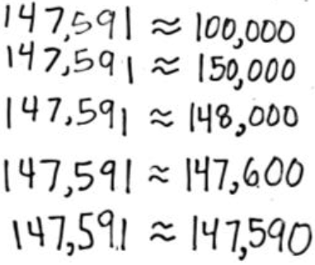
Lesson 9 Use place value understanding to round multi-digit numbers to any place value.
Notes:
LINK
Supported with pictorial model (vertical number line) to round to any unit/place.
Lesson 9:
Teaching sequence:
Students are asked to round the number 147,591 to all places, as shown here.
What does this skill allow students to do in the real world? (apply rounding to fit a context, round to get an approximate guess that fits a situation)
Note Lesson 9 moves away from the pictorial support of the number line, applying place value understanding for rounding numbers to a selected unit.
TIME ALLOTTED FOR THIS SLIDE:
2 minutes
MATERIALS NEEDED:
X

Slide 28
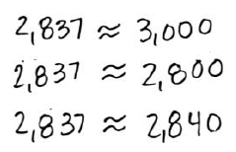
Lesson 10 Use place value understanding to round multi-digit numbers to any place value using real world applications.
2,837 students attend Lincoln Elementary School.
Discuss with your partner how you would estimate the number of chairs needed in the school.
Notes:
LINK
Apply abstract rounding to any place value.
Lesson 10:
Teaching sequence:
Work with a partner to estimate the number of chairs needed.
Allow time for partners to work.
Turn and Talk:
Rounding to which places allows for an appropriate estimate? (thousands and tens)
How can you elect the best possible answer? What circumstances make you think rounding to the thousands or rounding to the tens is more advantageous? (If the school is short on money, rounding to the nearest 10 is best; In case there are new students or visitors or chairs required for teachers, rounding to the nearest thousand is a safe bet for this context.)
What if 5 of these 2,837 students decided to attend Washington Elementary School? How does rounding effect this problem now? (Rounding to the nearest tens would not allow for enough chairs for each student.)
<Have participants work on Lesson 9 and 10 problems on the Participant Problem Set.>
Note the Mid-Module Assessment takes place at this point in the module.
TIME ALLOTTED FOR THIS SLIDE:
10 minutes
MATERIALS NEEDED:
Personal white boards
Participant Problem Set Lessons 9 and 10

Slide 29
Topic D, Topic E, Topic F Multi-Digit Whole Number Addition, Multi-Digit Whole Number Subtraction, Addition and Subtraction Word Problems
Focus Standards:
4.OA.3: Solve multi-step word problems posed with whole numbers and having whole-number answers using the four operations, including problems in which remainders must be interpreted. Represent these problems using equations with a letter standing for the unknown quantity. Assess the reasonableness of answers using mental computation and estimation strategies including rounding.
4.NBT.4: Fluently add and subtract multi-digit whole numbers using the standard algorithm.
Notes:
Focus of the 2nd half of the module:
Fluently add and subtract multi-digit whole numbers using the standard algorithm.
Apply the addition and subtraction algorithm for solving word problems.
Assess the reasonableness of answers using mental math or estimation.
Topic D focuses on addition.
Topic E focuses on subtraction.
Topic F is mixed practice of addition and subtraction.
Students come from Grade 2 learning about place value understanding for addition and subtraction and setting up a problem to use the algorithm for addition and subtraction.
Use of the standard algorithm is a fluency of Grade 4 and is to be mastered by the end of the year.
Practice Sets, similar to a Sprint, are delivered in the final module, Module 7 of Grade 4, to assess this skill.
Again, Topic Openers allow for further insight and detail about a collection of lessons. Reading each Topic Opener before each set of lessons is helpful in planning and teaching with an end goal in mind, instead of achieving day by day objectives.
TIME ALLOTTED FOR THIS SLIDE:
3 minutes
MATERIALS NEEDED:
X

Slide 30
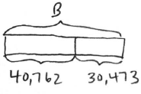
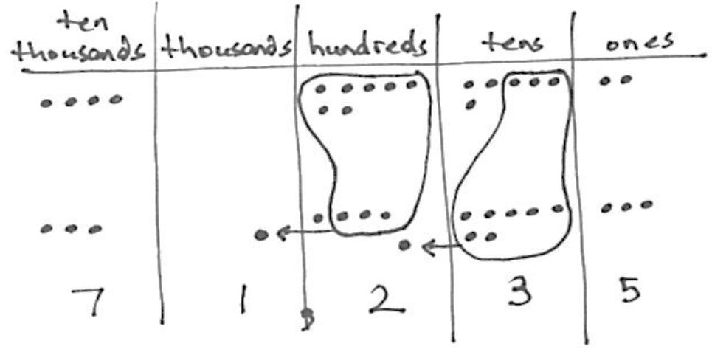
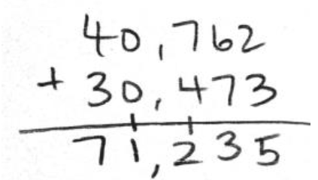
Lesson 11 Use place value understanding to fluently add multi-digit whole numbers using the standard algorithm and apply the algorithm to solve word problems using tape diagrams.
Notes:
LINK
Observe the Application Problem in Lesson 11 on page 1.D.4.
Note how this problem sets students up for assessing the reasonableness of their answer.
The actual answer is 37,901. Students come to realize that rounding to a smaller unit will provide a more accurate estimate.
Lesson 11:
Teaching sequence:
(Switch to document camera.) On the bottom of the millions place value chart template, set up the problem 3,134 + 2,492.
Using disks, represent 3,134 in your millions place value chart. Under 3,134 represent 2,492.
What operation am I doing to these numbers? (addition)
I’m going to draw a rectangle/bar that looks like a piece of tape. (Draw and label 3,134.)
Now help me figure out how long my next piece of tape should be. I’m adding these two numbers together, so it is like combining 2 lengths of tape together into one. I’ll draw this tape right next to the first one. (Draw, having participants tell you when to stop. It should be shorter than the first tape. Label as 2,492.)
Great. Now we are finding the total length of this tape. Let’s label what we are finding with a letter, such as ‘a’ to represent the unknown. ‘a’ is a variable.
Tell me an addition number sentence for how many ones are in the ones column. (4 ones + 3 ones = 7 ones) (Point to the problem and record 7; record 7 in the ones column.)
Tell me an addition number sentence for how many tens are in the tens column. (3 tens plus 9 tens is 12 tens.) (Point to the problem and record 12 tens.)
(Refer to the chart.) What can we do with 12 tens? (Regroup 10 tens as 1 hundred.) (Show by circling 10 tens.)
(Refer to problem.) 12 tens (erase) is the same as 1 hundred (record on line) 2 tens (record).
Continue to solve the problem.
(CLICK to show tape diagram.) Observe this drawing and tell your partner what you see. (2 parts of 40,762 and 30,473 that add to the whole of B.)
(CLICK to show chip model.) Observe this model and tell your partner what you notice. (The 2 parts are represented. When 10 disks are in a unit, they are bundled and moved to the left as the next larger unit. The total value of each unit is written below as the sum.)
(CLICK to show the problem.) Let me know what you see in this problem. (13 tens are regrouped as 1 hundred, on the line, and 3 tens. 12 hundreds are represented as 1 thousand, on the line, and 2 hundreds.)
Place value understanding drives the work of solving an addition problem using the standard algorithm.
Concrete (place value disks) to pictorial (chip model) to abstract (algorithm).
TIME ALLOTTED FOR THIS SLIDE:
10 minutes
MATERIALS NEEDED:
G4-M1 Book
Lesson 11 AP page 1.D.4
Lesson 11 Template: millions place value chart
Place value disks
Personal white boards
Document camera

Slide 31
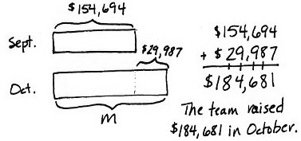
Lesson 12 Solve multi-step word problems using the standard algorithm modeled with tape diagrams and assess the reasonableness of answers using rounding.
The basketball team raised a total of $154,694 in September and $29,987 more in October than in September. How much money did they raise in October? Draw a tape diagram and write your answer in a complete sentence.
Notes:
LINK
Lesson 11 established using the algorithm as a method for solving multi-digit addition problems.
Tape diagrams for addition were reintroduced.
Lesson 12:
Teaching sequence:
Review this problem. How can you assess the reasonableness of this answer?
Estimate the sum by rounding each addend. (Participants should round to the nearest thousand to get $185,000.)
(CLICK to show student work.) Is this student work reasonable? Tell your partner why or why not.
Lesson 12 includes multi-step problems which increases the complexity of drawing a tape diagram.
Lesson 12 is the first ‘word problem lesson’ in which the word problems are solved together as a class with student input for solving.
There is not one right way to draw a tape diagram, as long as it accurately represents the problem and accurately shows the relationship of the numbers.
Examples of tape diagrams are given for each problem in the module.
Tape diagrams are not a model used to solve, but rather a model used to show the relationships of the numbers. This will lead to solving complex problems more efficiently.
Tape diagrams are introduced in Kindergarten and used in Middle School to solve ratios.
<Have participants work on Lesson 11 and 12 problems on the Participant Problem Set.>
TIME ALLOTTED FOR THIS SLIDE:
10 minutes
MATERIALS NEEDED:
Personal white boards
Participant Problem Set Lessons 11 and 12

Slide 32
Lesson 13 and Lesson 14 Use place value understanding to decompose to smaller units once/up to 3 times using the standard algorithm, and apply the algorithm to solve word problems using tape diagrams.
Notes:
LINK
Subtraction is introduced in Kindergarten and use of the algorithm, supported by place value models like place value disks, is introduced in Grade 2. It is further practiced in Grade 3 during the measurement modules.
Lesson 13:
Teaching sequence:
(Switch to document camera. Follow a similar sequence as found in Lesson 11 for solving 4,259 – 2,171. Refer to the problem first, then unbundle units as needed.)
Lesson 14:
(CLICK to show tape diagram.) Observe this tape diagram and tell your partner what you see. (A whole of 22,397 and two parts (one is 3,745, the other unknown, represented by ‘A’).)
(CLICK to show the problem.) Let me know what you see in this problem. (All units are unbundled and regrouped before solving.)
(CLICK to show chip model and the solved problem.) Observe this model and tell your partner what you notice. (The whole is represented. When not enough of a unit is there to subtract from, the problem unbundles from the left column, just as shown using the chips.)
Place value understanding drives the work of solving a subtraction problem using the standard algorithm.
Concrete (place value disks) to pictorial (chip model) to abstract (algorithm).
The entire problem is regrouped before using the algorithm to solve. This allows subtraction from any unit, in any order, but the modules support subtraction from right to left.
We ask: Are you ready to subtract?
TIME ALLOTTED FOR THIS SLIDE:
10 minutes
MATERIALS NEEDED:
Lesson 11 Template: millions place value chart
Place value disks
Personal white boards
Document camera

Slide 33
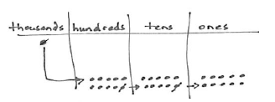
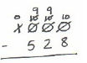
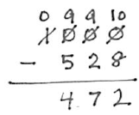
Lesson 15 Use place value understanding to fluently decompose to smaller units multiple times using the standard algorithm, and apply the algorithm to solve word problems using tape diagrams.
Notes:
LINK
Subtraction is being further developed, mostly abstractly. Students who still need pictorial support may use disks until they feel supported with the steps of the algorithm, a more efficient solving method.
Lesson 15:
Students are prepared to subtract across a multi-digit number, regrouping multiple times, as needed.
Students rely on using the abstract algorithm as they solidify this fluency.
This lesson has a focus on zeros in the minuend with a pictorial aspect allowing students to see a shortcut for recording regroupings.
Observe the images on the slide to see how the shortcut of regrouping across several zeros as nines is shown through place value understanding.
<Have participants work on Lesson 13, 14, and 15 problems on the Participant Problem Set.>
TIME ALLOTTED FOR THIS SLIDE:
8 minutes
MATERIALS NEEDED:
Lesson 11 Template: millions place value chart
Personal white boards
Participant Problem Set Lessons 13, 14, and 15

Slide 34
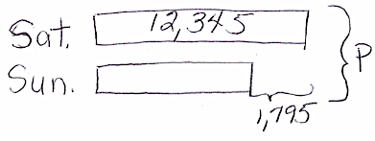
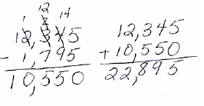
Lesson 16 Solve two-step word problems using the standard subtraction algorithm fluently modeled with tape diagrams and assess the reasonableness of answers using rounding.
There were 12,345 people at a concert on Saturday night. On Sunday night, there were 1,795 fewer people at the concert than on Saturday night. How many people attended the concert on both nights?
Notes:
LINK
To make use of the 4.OA.3 standard of solving multi-step word problems using a variety of operations, students practice their addition and subtraction algorithm in the final few lessons.
Lesson 16:
Teaching sequence:
Read this word problem and draw a tape diagram that models this problem.
(Share some possible tape diagrams from the participants.)
Optional: Work with participants to draw, depending on their skill level with tape diagrams.
(CLICK to advance tape diagram.) Compare and contrast this tape diagram with the one you drew.
What are the advantages to drawing 2 tapes, one on top of the other? (Allows for comparing information.)
From this diagram, describe how to solve this problem. (Subtract then add.)
Estimate the solution so we can check for a reasonable answer. (12,000 - 2,000 = 10,000. 12,000 + 10,000 = 22,000.)
(CLICK to advance solution.) Our solution models the regrouping for the subtraction algorithm and a second step with addition.
Is this answer reasonable? Why or why not? (Yes, the answer is relatively close to our estimate.)
<Have participants work on Lesson 16 problems on the Participant Problem Set.>
TIME ALLOTTED FOR THIS SLIDE:
8 minutes
MATERIALS NEEDED:
Personal white boards
Participant Problem Set Lesson 16

Slide 35
Lesson 17 Solve additive compare word problems modeled with tape diagrams.
A pair of hippos weighed 5,301 kilograms together. The female weighed 2,038 kilograms.
How much more did the male weigh than the female?
Lesson 18 Solve multi-step word problems modeled with tape diagrams and assess the reasonableness of answers using rounding.
In one year, a factory used 11,650 meters of cotton, 4,950 fewer meters of silk than cotton, and 3,500 fewer meters of wool than silk. How many meters in all were used of the three fabrics?
Notes:
LINK
For the last Topic of the module, students use the addition and subtraction algorithm to solve word problems.
Lesson 17: Additive compare word problems
Read the directions for word problem lessons found on page 1.F.4 and 1.F.5.
(CLICK to display problem.)
Solve for the problem posted on the slide per directions in Lesson 17.
Model the problem.
Participants draw. Two participants share solutions on chart paper or document camera.
Peers provide feedback.
Calculate to solve and write a statement.
Solve independently.
Share solutions with partners and class.
Peers provide feedback for two participants.
Assess the solution for reasonableness.
Explain if their solutions are reasonable.
Lesson 18: Multi-step word problems
CLICK to advance the next problem.
Solve with participants using the same process as above.
<Have partners solve the Problem Set Problems from Lessons 17 and 18 as partners or teams. Each person/team takes a problem, solves, and shares answer at table.>
TIME ALLOTTED FOR THIS SLIDE:
15 minutes
MATERIALS NEEDED:
G4-M1 Book
Lesson 17 page 1.F.4-5
Personal white boards
Participant Problem Set Lessons 17 and 18

Slide 36
Lesson 19 Create and solve multi-step word problems from given tape diagrams and equations.
Notes:
LINK
The final lesson challenges students to analyze tape diagrams to create a word problem and solve for an unknown.
Lesson 19:
For this tape diagram, students see that there are 3 parts to the whole. One of the parts is unknown.
Now, we think of a context where these numbers make sense. Obviously weight of 3 humans doesn’t work. But maybe groups of humans, such as men, women, and children. The context could be attendance at a sporting event.
Students would write a word problem and then solve.
(CLICK to show the image on the right.)
Your turn. With a partner, analyze this tape diagram and create your own word problem to share with the group/table.
Allow time for participants to write a word problem and solve. Share.
<Have participants work on the Lesson 19 problem on the Participant Problem Set.>
TIME ALLOTTED FOR THIS SLIDE:
10 minutes
MATERIALS NEEDED:
Personal white boards
Participant Problem Set Lesson 19

Slide 37
End-of-Module Assessment
Notes:
The Mid-Module Assessment is administered after Topic C (Lesson 10) and the End-of-Module Assessment after Topic F (Lesson 19).
Assessments were created prior to writing any lessons, therefore keeping the end in mind.
In planning lessons and implementing, keep the assessment in mind as an end goal.
The final problem of an assessment is cumulative of all focus standards in a module.
Looking at this last question in the End-Module Assessment, you will notice that there are many concepts addressed from the entire module. You can find it towards the back of your book on page 1.S.8.
Turn and Talk: What are the different skills addressed in this question?
addition and subtraction
multi-step word problems
rounding
writing numbers in various forms (digits, words, expanded)
comparing numbers
explaining place value of numbers to 1 million
(If necessary:) We have a systematic approach to assessment. A primary goal of the project has been to create a curriculum that is free and accessible to anyone, anywhere. By default, that means that the assessments are also free and accessible to anyone, anywhere. The assessments that we provide are worthy assessments, regardless of how much help individual students might have gotten at home. If a student can perform in class, getting the correct answer and demonstrating understanding through models and explanation, then that should be acknowledged and praised.
TIME ALLOTTED FOR THIS SLIDE:
6 minutes
MATERIALS NEEDED:
X

Slide 38
Agenda
Lesson Structure
Instructional Sequence
Module Review
Preparation for Implementation
Notes:
As you’ve seen, the sequence of objectives is very intentional. Each one is critical in preparing students for what comes next. We think of these objectives as rungs on a ladder that lead to success of the module’s focus. Collectively, they play a significant role in the students achieving mastery of the grade’s expectations.
Keep in mind that we only sampled a small part of each objective. When looking at the daily lesson, you’ll find that each plan is thoroughly detailed… as you experienced with Lesson 1 at the beginning of this session.
Now, we are going to examine the module in its entirety.
TIME ALLOTTED FOR THIS SLIDE:
1 minute
MATERIALS NEEDED:
X

Slide 39
Progression Study
What are the Progressions?
Explore: K-5, Numbers and Operations in Base 10
Read pages 2 – 4 and 12 – 13.
Highlight the information relevant to the content of this module.
Notes:
What are the Progressions?
Poll participants using the fist-to-five protocol to gauge how well (if at all) they know the Progression documents. Participants show zero fingers/fist if they have never heard of or seen the Progressions, show 5 fingers if they have read a majority of the Progressions, or some number of fingers if they are relatively familiar or have read some portion of them.
Explain what the Progressions are:
The Common Core State Standards for mathematics were built from the Progressions. They are a narrative document describing the progression of a topic across a number of grade levels. The Progressions were guided by a child’s cognitive development and the logical structure of math when written. These documents were used to create the grade level standards and, therefore, can explain why the standards are sequenced the way they are. The Progressions also highlight cognitive difficulties and provide pedagogical solutions and give greater detail on some of the particularly challenging areas of mathematics. As writers, we referred to the Progressions often to guide our thinking when sequencing lesson objectives and problems within each lesson.
Progression Exploration:
To continue our study of Module 1, we’re going to first take some time to examine a portion of the Progression document (K-5, Numbers and Operations in Base 10, pages 2-4 and 12-13) that serves as the foundation for this module. You’ll have about 10 minutes to read through the document independently or with a partner. As you read, highlight the information that is relevant to the content of this module.
Allow participants time to read independently. Encourage them to highlight and make notes.
TIME ALLOTTED FOR THIS SLIDE:
12 minutes
MATERIALS NEEDED:
Progression: Numbers and Operations, pages 2-4 and 12-13.

Slide 40
Progression Study
Study Lessons 2, 3, 5, 8, and 13.
Turn and Talk:
How do these lessons engage students in the work described in the Progressions?
Notes:
Allow participants time to study Lessons 2, 3, 5, 8, and 13. Also refer to Lesson 1.
Then, allow participants time to turn and talk about how these lessons engage students in the work described in the Progressions.
Consider providing sentence frames for the Turn and Talk.
The base ten system is helpful for rounding and comparing numbers because _____________.
Visual representations are useful for __________________.
We are able to use the place value chart for addition and multiplication or subtraction and division because ____.
Facilitate a whole-group discussion.
TIME ALLOTTED FOR THIS SLIDE:
20 minutes
MATERIALS NEEDED:
G4-M1 Book
Lessons 1, 2, 3, 5, 8 and 13.

Slide 41
Coherence Within the Module
Analyze the progression of each lesson component across the module.
What does the sequence of Fluency Practices accomplish as a whole?
How does the sequence of Application Problems connect to the topic? To the module?
How does the sequence of Concept Development and Student Debrief build toward mastery of the topic/module?
Notes:
Earlier, we examined Lesson 1 in detail and recognized the coherence within the lesson. Now that you’ve had an opportunity to see the development of the mathematical concepts outlined in the Progressions document, let’s take some time to return to Module 1 and take a look at how the module is coherent on a larger scale. Specifically, let’s look for examples of scaffolding: simple to complex and concrete to abstract.
You might each want to divide the 6 Topics to closely examine:
Amongst tablemates and each select a Topic.
Amongst tables so each table is responsible for a Topic and sharing out.
Amongst sections of the room.
Be prepared to share your observations with the group.
Allow 15 minutes for participants to complete this analysis. Then advance to the next slide.
TIME ALLOTTED FOR THIS SLIDE:
15 minutes
MATERIALS NEEDED:
X

Slide 42
Coherence Within the Module
Analyze the progression of each lesson component across the module.
What does the sequence of Fluency Practices accomplish as a whole?
How does the sequence of Application Problems connect to the topic? To the module?
How does the sequence of Concept Development and Student Debrief build toward mastery of the topic/module?
Notes:
Allow time for turn and talk, then facilitate a discussion.
What does the sequence of Fluency Practices accomplish as a whole?
(It reviews skills from the lower grades with easier numbers and applies it to larger G4 numbers, maintaining and building upon skills to move students forward in this and the coming modules. Skip-Counting supports the development of multiplication facts; Place Value strengthens the understanding of the value a number has; Naming Units provides flexible thinking for mental math calculations; etc.)
How does the sequence of Application Problems connect to the module?
(They often build on the previous lesson objective; they provide a variety of problem types (from the OA Progression); they provide continued practice with solution strategies; progress from simple (smaller numbers) to complex (larger numbers, linguistic expectations, and extensions); they allow for practice of simple math drawings (number bonds, equal groups drawings, arrays etc.)
How does the sequence of Concept Development and Student Debrief build toward mastery of the module?
(highlight transition from concrete → abstract and simple → complex)
TIME ALLOTTED FOR THIS SLIDE:
5 minutes
MATERIALS NEEDED:
X

Slide 43
Agenda
Lesson Structure
Instructional Sequence
Module Review
Preparation for Implementation
Notes:
Now you’ve had a chance to examine this module at several levels. We looked at the lesson components, we explored the instructional sequence from objective to objective, and we’ve thought about what this module accomplishes in the larger scope of mathematical understanding.
Let’s spend some time now discussing strategies for implementation and preparing for the beginning of the upcoming school year.
TIME ALLOTTED FOR THIS SLIDE:
1 minute
MATERIALS NEEDED:
X

Slide 44
Practice a Planning Protocol
With any topic from A Story of Units, read the Module Overview and the Topic Opener.
Study the Module Assessments, paying particular attention to the sample responses provided.
Notes:
CLICK. Allow time for participants to read the Module Overview and Topic Opener C.
CLICK. Allow time for participants to study the End-of-Module Assessment sample work.
NOTE TO FACILITATORS: It is likely that participants may have already studied these. If this is the case, there is no need to spend additional time on this slide at this point.
TIME ALLOTTED FOR THIS SLIDE:
5 minutes
MATERIALS NEEDED:
G4-M1 Book
Module Overview
End-of-Module Assessment
Topic Opener C

Slide 45
Practice a Planning Protocol
Read through the first lesson of the topic.
Take note of the lesson objective and re-examine the Exit Ticket with the objective in mind. What major concept is necessary to successfully complete the Exit Ticket?
Study the Concept Development and Problem Set. How do the CD/PS develop the major concept that is required in the Exit Ticket? What parts of the CD/PS go beyond this major concept?
Notes:
CLICK. Allow time for participants to read Lesson 7 of Topic C.
CLICK. Read aloud the objective of the lesson. Allow time for participants to re-read the Exit Ticket. Facilitate a discussion about the major concept required by the Exit Ticket.
CLICK. Allow time for participants to study the Concept Development and Problem Set. If participants have paper copies of the lessons, encourage them to highlight or use post-its in the portions of the CD/PS that are critical in preparation for the Exit Ticket. Facilitate a discussion about those portions of the lesson that are necessary in preparation for the Exit Ticket and those that go beyond the major concept needed for the Exit Ticket.
TIME ALLOTTED FOR THIS SLIDE:
5 minutes
MATERIALS NEEDED:
G4-M1 book
Lesson 7
Post-Its

Slide 46
Practice a Planning Protocol
How will this knowledge empower teachers to support specific groups of learners?
Turn to the subsequent lesson and examine the Exit Ticket. How does this Exit Ticket build on the last? How are the two Exit Tickets similar? How are they different?
Will students have an opportunity in the second lesson to continue development of the first lesson’s objective? What level of mastery of the first lesson’s objective is necessary in preparation for the second lesson?
Notes:
CLICK. Facilitate a discussion about how participants’ previous observations might be further impacted as they consider the needs of a specific group of students. As appropriate, draw attention to any relevant notes boxes in the margins of the lesson.
CLICK. Allow time for participants to read the Exit Ticket for the next lesson, Lesson 8. Facilitate a discussion about the relationship between the two Exit Tickets.
CLICK. Facilitate discussion about how these new observations might further impact their decisions regarding implementation of the first lesson, Lesson 7.
TIME ALLOTTED FOR THIS SLIDE:
8 minutes
MATERIALS NEEDED:
X

Slide 47
Practice a Planning Protocol
How does the new plan for implementation impact the Student Debrief?
Are any adjustments needed to the Fluency and/or the Application Problem of the lesson?
Notes:
CLICK. Facilitate a discussion about how the Student Debrief is impacted by the implementation decisions made thus far.
CLICK. Facilitate a discussion about the other lesson components and the need to ensure that the balance of rigor is maintained.
TIME ALLOTTED FOR THIS SLIDE:
3 minutes
MATERIALS NEEDED:
X

Slide 48
Practice a Planning Protocol
Repeat this process for each lesson.
Read lesson.
Study the Exit Ticket. Identify critical portions of Concept Development and Problem Set.
Consider needs of specific students.
Refer to subsequent Exit Ticket. Revise implementation plan as needed.
Make adjustments to the Student Debrief as needed.
Consider the other lesson components, ensuring a balance of rigor.
Notes:
Review the planning protocol. If time allows, have participants go through the cycle again for the third lesson of the topic.
TIME ALLOTTED FOR THIS SLIDE:
5 minutes
MATERIALS NEEDED:
X

Slide 49
Biggest Takeaway
I now know…
I need to figure out…
Notes:
Take two minutes to turn and talk with others at your table. During this session, what information was particularly helpful and/or insightful? What new questions do you have?
Allow 2 minutes for participants to turn and talk. Bring the group to order and advance to the next slide.
TIME ALLOTTED FOR THIS SLIDE:
3 minutes
MATERIALS NEEDED:
X

Slide 50
Key Points
When making instructional decisions in order to meet the needs of specific students, there are two rules:
Honor the objective!
Honor the balance of rigor!
During Module 1, students will:
Gain a deeper understanding of the Base Ten System.
Record numbers in various forms.
Gain fluency with addition and subtraction algorithms.
Compare numbers.
Round numbers and check for reasonable answers.
Use RDW as a process for solving word problems.
Use information to create their own word problems.
Notes:
Let’s review some key points of this session.
CLICK to advance the bullets.
TIME ALLOTTED FOR THIS SLIDE:
3 minutes
MATERIALS NEEDED:
X

Slide 51
Next Step
The first thing I’ll do to prepare is…
Notes:
Participants write their answers on an index card, which will be their Exit Tickets.
TIME ALLOTTED FOR THIS SLIDE:
4 minutes
MATERIALS NEEDED:
Index cards

