Slide 1
A Story of Units
Grade 5 – Module 1
Notes:
This full-day session is intended to support successful implementation of this module.
Using this module as a platform for understanding our instructional approach and lesson structure, you will have the tools needed to tackle the remaining modules of the year.
MATERIALS:
Document camera, personal white boards, markers, eraswers
Decimal and whole number disks
Slide 3
Sticky notes for parking lot issues
Poster Paper labeled “Parking Lot Issues”
Slide 10
For the fluency activity, you’ll need the personal white board, or the printed version of the fluency.
TIME ALLOTTED FOR THIS SLIDE:
1 minute
MATERIALS NEEDED:
X

Slide 2
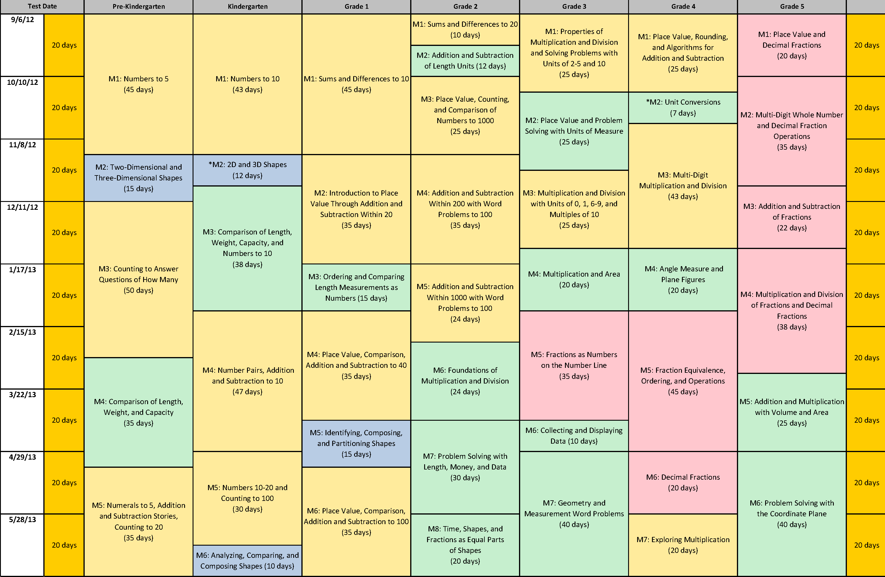
Curriculum Overview of A Story of Units
Notes:
Note to presenter: Be sure to include this in handouts if no Curriculum Overview included in presentation!
Let’s start by looking at the curriculum map, found on page 3 of A Story of Units: A Curriculum Overview for Grades P-5. What information do you already know from this map? (Encourage participants to share their observations.)
NOTE TO FACILITATOR: If participants have not previously explored the Curriculum Overview and examined this map, it may be helpful to prompt them with the following questions. Make sure the following points are addressed, even if you need to state them directly.
What is the title of this module? (Place Value & Decimal Fractions)
How many instructional days are allotted for this module? (20)
What modules, beyond this one, might build on the concepts of this module? (M2 - 4)
Title?
Place Value & Decimal Fractions
How many days?
20 Instructional, 16 lessons, 2 assessments
Prep mods?
Builds on Place Value concepts in previous grades, especially G4
Following mods?
M2 through M4
TIME ALLOTTED FOR THIS SLIDE:
2 minutes
MATERIALS NEEDED:
X

Slide 3
Session Objectives
Examine the development of mathematical understanding across the module using a focus on Concept Development within the lessons.
Introduction to mathematical models and instructional strategies to support implementation of A Story of Units.
Plan for implementation of this module and subsequent modules.
Notes:
STICKY NOTES!
In basket
NOTE TO FACILITATOR: During this session, encourage participants to make note of any concerns they have as they prepare to implement this module. Sticky notes are provided in the table baskets, and parking lots are designated on the wall for this purpose.
Our objectives for this session are to:
Examination of the development of mathematical understanding across the module using a focus on Concept Development within the lessons.
Introduction to mathematical models and instructional strategies to support implementation of A Story of Units.
TIME ALLOTTED FOR THIS SLIDE:
2 minutes
MATERIALS NEEDED:
X

Slide 4
Agenda
Lesson Structure
Instructional Sequence
Module Review
Preparation for Implementation
Notes:
Agenda
We will begin by exploring the lesson structure and how it is fundamental to supporting rigorous instruction.
Then we will dig in to the math of the module, examining the intentional instructional sequence that leads students toward mastery of the focus standards.
Afterwards, we’ll take a look back at the module, reflecting on all the parts as one cohesive whole.
Finally, we’ll talk about strategies for implementation in preparation for the beginning of the school year.
TIME ALLOTTED FOR THIS SLIDE:
1 minute
MATERIALS NEEDED:
X

Slide 5
Introduction of Module Structure
Module Overview
Topic
L1
Topic
L4
Topic
L5
L2
L3
L6
L7
L8
Notes:
Module Structure
A Story of Units: A Curriculum Overview for Grades P-5 provides a curriculum map and grade-level overview. The curriculum map provides an at-a-glance view of the entire story, making clear the coherence of the curriculum and the role that each module plays in that progression.
5-8 mods per grade level
Modules are comprised of Topics. The number of Topics vary by module.
Topics vary in the number of lessons.
Lesson designed for 60 minute instructional periods. Modules are comprised of topics, topics break into concepts, and concepts become lessons.
TIME ALLOTTED FOR THIS SLIDE:
2 minutes
MATERIALS NEEDED:
X

Slide 6
Topic A
Focus Standards:
5.NBT.1: Recognize that in a multi-digit number, a digit in the one place represents 10 times as much as it represents in the place to its right and 1/10 of what it represents in the place to its left.
5.NBT.2: Explain patterns in the number of zeros of the products when multiplying a number by powers of 10, and explain patterns in the placement of the decimal point when a decimal is multiplied or divided by a power of 10. Use whole-number exponents to denote powers of 10.
5.MD.1: Convert among different-sized standard measurement units within a given measurement system (e.g., convert 5 cm to 0.05 m), and use these conversions in solving multi-step, real world problems.
Notes:
Each module is divided into topics. Within a given topic, the lessons work together to build strong understanding of a set of related concepts.
Quickly divide the large group into 3 smaller groups. Assign each group one standard to read and discuss. (More than one group can discuss a standard.)
After 3 minutes, ask participants to paraphrase each standard.
TIME ALLOTTED FOR THIS SLIDE:
8 minutes
MATERIALS NEEDED:
X

Slide 7
Fluency Practice
Rename the Units
Composing and decomposing numbers is a critical part of mathematical literacy.
120 ones = 12 tens
2,700 ones = 27 hundreds = 270 tens
Lesson 1, Fluency, Page 1.A.3.
Notes:
This is the first fluency in grade 5.
Some participants will not be familiar with renaming 120 ones as 12 tens, so this is a learning opportunity as well as an introduction to unit language.
Use the document camera to facilitate this fluency activity.
Although you can write this on a personal white board, there is a printed version all ready with the materials.
T: (Write 10 ones = ___ ten.) Say the number sentence.
S: 10 ones = 1 ten.
T: (Write 20 ones = ___ tens.) Say the number sentence.
S: 20 ones = 2 tens.
T: 100 ones.
S: 10 tens.
T: 110 tens.
S: 11 tens.
T: 120 ones.
S: 12 tens.
T: 640 ones.
S: 64 tens.
T: 830 ones.
S: 83 tens.
**If I were teaching this with limited time for fluency, I would choose this activity out of the three in this lesson to do, and skip the others, bc this gets to the heart of the skills in this lesson in the most efficient way…”
If time, participants practice leading each other through other fluency exercise.
(COMPARE DECIMAL FRACTIONS.)
TIME ALLOTTED FOR THIS SLIDE:
10 minutes
MATERIALS NEEDED:
Personal marker boards

Slide 8
Fluency Practice
Daily, substantial, sustained, and supported by the lesson structure
8-12 minutes of easy-to-administer activities
Energetic activities that allow students to see measureable progress
Promotes automaticity – allows students to reserve their cognitive energy for higher-level thinking
Support conceptual understanding and application as well as the mathematical practices
Notes:
Every lesson starts w/ fluency
Time to practice & review – daily basis (we all know that students who don’t have their basic facts down use a lot of their energy before they’ve even gotten to the heart of a problem – we want to free up their brains. )
(CLICK TO ADVANCE THIRD BULLET) The fluency activities in A Story of Units are generally daily, high-paced and energetic, getting students’ adrenaline flowing, and creating daily opportunities to celebrate improvement. From the beginning of the year, students see their accuracy and speed measurably increase both as individuals and as a class. Like opening a basketball practice with team drills and exercises, both personal and group improvements are exciting and prepare the players for the application in the game setting.
(CLICK TO ADVANCE FOURTH BULLET) Fluency promotes automaticity, a critical capacity that allows students to reserve their cognitive resources for higher-level thinking.
(CLICK TO ADVANCE FIFTH BULLET) By encouraging students to recognize patterns and make connections within the lessons, the fluency exercises in A Story of Units support the other two components of rigor as well as the Standards for Mathematical Practice.
TIME ALLOTTED FOR THIS SLIDE:
2 minutes
MATERIALS NEEDED:
X

Slide 9
Fluency Practice
Fluency activities serve a variety of purposes:
Maintenance: Staying sharp on previously learned skills
Preparation: Targeted practice for the current lesson
Anticipation: Building skills to prepare students for the in-depth work of future lessons
In fluency work, all students are actively engaged with familiar content. This provides a daily opportunity for continuous improvement and individual success.
Notes:
Fluency activities serve a variety of purposes. In general, there are three main categories of fluency work:
Maintenance: Staying sharp on previously learned skills
Preparation: Targeted practice for familiar skills to support the current lesson
Anticipation: Building foundational skills to prepare students for the in-depth work of future lessons (for ex, 3 days from now, we are going to be rounding decimals, so we need to spend the next few days practicing renaming – a skill they already have mastered but need to practice to be on autopilot)
It is important to recognize that fluency work is always an extension of familiar content. It provides a daily opportunity for continuous improvement and individual success toward acquiring speed and accuracy.
TIME ALLOTTED FOR THIS SLIDE:
2 minutes
MATERIALS NEEDED:
X

Slide 10
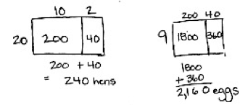
Application Problem
Farmer Jim keeps 12 hens in every coop. If Farmer Jim has 20 coops, how many hens does he have in all? If every hen lays 9 eggs on Monday, how many eggs will Farmer Jim collect on Monday? Explain your reasoning using words, numbers or pictures.
Lesson 1, Application Problem, Page 1.A.4.
Notes:
Allow participants time to solve this problem on their personal white boards. Encourage them to do a drawing.
You may choose to have a participant show his / her work. You may model this on your white board with the document camera.
Click to show the solution in the module.
What evidence can you find that this question was deliberately written?
Multiple entry points – built in differentiation
Informal assessment -- There’s a ton of information to be gained from watching students solve this problem:
Relevance of this problem in the lesson..
related to concept development? Sometimes it’s a really juicy problem, and sometimes just about the routine, getting your students into math time…
TIME ALLOTTED FOR THIS SLIDE:
12 minutes
MATERIALS NEEDED:
X

Slide 11
Application Problems
In Grade 5 Module 1 lessons, Application Problems are after the fluency exercises and before the conceptual development.
Application problems are commonly 7-12 minutes.
The Read, Draw, Write (RDW) process is modeled and encouraged through daily problem solving.
Application Problems can be powerful formative assessments.
Students problem solve independently, choosing appropriate strategies and skills, even when not prompted by their teachers.
Notes:
The Application Problems are word problems that connect to the content currently be taught, or that reach back to previously taught concepts. The Application Problem usually takes between 5 and 10 minutes.
RDW This is introduced in Kindergarten, and used through middle school. “Can you draw something?”
“What does your drawing tell you?”
RDW is a strategy that helps students comprehend the problem. It may or may not give them the actual answer.
Formative assessments
There is usually more than one right way to represent a problem, and multiple paths to solve it.
Short on time? Students work on post-it notes, and leave on your desk so you can check it later.
or use as journal opportunity
components of the lesson do not need to be taught within 60 consecutive minutes.
Independent problem solving – students working, doing best they can, without teacher showing them how to do each step.
Lots of choice – indep or collaborate -- pairs, small groups debrief after, have stdts present, stdts turn in work
Notice: note provided, but no explicit instructions accompany app problem.
TIME ALLOTTED FOR THIS SLIDE:
2 minutes
MATERIALS NEEDED:
X

Slide 12
Introduction to Lesson Structure
Concept Development 30 minutes
Includes the Problem Set (10 min.)
Student Debrief 10 minutes
Includes the Exit Ticket (3 min.)
Lesson 1, Concept Development
Notes:
Lesson Structure
We are going to study each component of the lessons, by examining all aspects of Lesson 1.
After that, we will be concentrating on the math of each lesson, rather than each part.
In your preparation to teach each specific lesson, you will study each component for each lesson.
TIME ALLOTTED FOR THIS SLIDE:
2 minutes
MATERIALS NEEDED:
X

Slide 13
Concept Development
Constitutes the major portion of instruction.
Generally comprises about 30 minutes of the total lesson time.
Builds toward new learning through intentional sequencing.
Often utilizes the deliberate progression from concrete to pictorial to abstract, which compliments and supports an increasingly complex understanding of concepts.
Accompanied by thoughtfully sequenced problem sets and reproducible student sheets.
Notes:
In grade 5, the Concept Development is the teacher directed portion of the lesson, and usually takes about 30 minutes.
It is written as vignettes. The format is merely the best way to communicate how a teacher might lead the lessons. The vignette also gives teachers the possible ways students might respond.
Concept development moves from Concrete → Abstract. There are usually several problems in the Concept Development. Teachers need to decide which problems are appropriate for their students. It is not intended that each problem in the Concept Development will be used with each student. The problems go from simple to complex.
The Problem Set is the opportunity for students to work with the concepts taught in the Concept Development. The Problem Set is limited to 10 minutes. There are more problems in the Problem Set than most students can complete. Again, teacher need to be judicious about which questions to assign.
Teachers can use debrief Qs to guide your focus, and even as guiding Qs to set students up before they do problem set (worksheet). The exit ticket can also guide teachers in their choices of the problems in the CD or the PS.
TIME ALLOTTED FOR THIS SLIDE:
2 minutes
MATERIALS NEEDED:
X

Slide 14
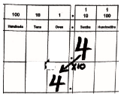
Concept Development
0.4 × 10
0.04 × 10
0.004 × 10
Lesson 1, Concept Development, Page 1.A.6.
Notes:
Materials: place value charts, white boards, place value disks
Change to document camera.
Model these problems with participants as they work along on their white boards.
Have participants draw the place value charts in the personal white boards.
Use 0.1 x 10 as a model for all three models (disks, drawn chips, digits.)
Do the first problem using the place value disks on the chart.
Do the second problem by drawing the disks.
Do the third problem as shown on this slide – using the digits only,
TIME ALLOTTED FOR THIS SLIDE:
18 minutes
MATERIALS NEEDED:
X

Slide 15
Problem Set
In the Modified Problem Set, complete Problems 1 - 3.
Draw arrows to show how the value of each digit changes as you multiply or divide.
3.452 × 100
345 ÷ 1,000
Lesson 1, Problem Set, Page 1.A.12 & 13.
Notes:
Materials: white boards, place value disks
Model these two problems, as participants do them with you. Model as follows.
Draw the place value chart.
Use digits.
Show the shifting of the digits.
Stress that we shift the digits, not the decimal point. The decimal point stays between the ones and tenths.
TIME ALLOTTED FOR THIS SLIDE:
18 minutes
MATERIALS NEEDED:
X

Slide 16
Student Debrief
What do you notice about the number of zeros in your products when multiplying by 10, 100, and 1000 relative to the number of places the digits shift on the place value chart?
What patterns do you notice?
Lesson 1, Debrief, Page 1.A.8.
Notes:
TIME ALLOTTED FOR THIS SLIDE:
2 minutes
MATERIALS NEEDED:
X

Slide 17
Student Debrief
Includes sample dialogue or suggested lists of questions to invite the reflection and active processing of the totality of the lesson experience.
Encourages students to articulate the focus of the lesson and the learning that has occurred.
Promotes mathematical conversation with and among students.
Allows student work to be shared and analyzed.
Closes the lesson with daily informal assessment known as Exit Tickets.
Notes:
Like the other lesson components, the Student Debrief section includes sample dialogue or suggested lists of questions to invite the reflection and active processing of the totality of the lesson experience. The purpose of these talking points is to guide teachers’ planning for eliciting the level of student thinking necessary to achieve this. Rather than ask all of the questions provided, teachers should use those that resonate most as they consider what will best support students in reaching self-articulation of the focus from the lesson’s multiple perspectives.
Rather than stating the objective of the lesson at its beginning, we wait until the dynamic action of the lesson has taken place. Students then reflect back on it to analyze the learning that occurred, articulate the focus of the lesson, and make connections between parts of the lesson, concepts, strategies, and tools on their own. We recognize or introduce key vocabulary by helping students appropriately name the learning they describe.
Sharing and analyzing high quality work gives teachers the opportunity to model and then demand authentic student work and dialogue. Conversation constitutes a primary medium through which learning occurs in the Student Debrief. Teachers can prepare students by establishing routines for talking early in the year. For example, “pair-sharing” is an invaluable structure to build for this and other components of the lesson. During the debrief, teachers should circulate as students share, noting which partnerships are bearing fruit, and which need support. They might join struggling communicators for a moment to give them sentence stems. Regardless of the scaffolding techniques that a teacher decides to use, all students should emerge clear enough on the lesson’s focus to either give a good example or make a statement about it.
TIME ALLOTTED FOR THIS SLIDE:
3 minutes
MATERIALS NEEDED:
X

Slide 18
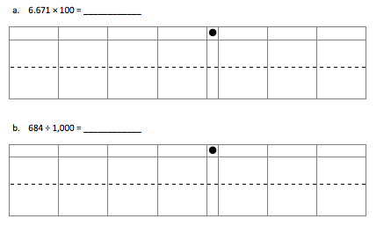
Exit Ticket
Lesson 1, Exit Ticket, Page 1.A.15.
Notes:
This is the exit ticket for Lesson 1.
It can guide teachers’ planning.
Is this exit ticket reflective of what was taught and practiced?
Give participants an opportunity to review the homework for Lesson 1.
TIME ALLOTTED FOR THIS SLIDE:
2 minutes
MATERIALS NEEDED:
X

Slide 19
Exit Ticket & Homework
The lesson ends with a daily informal assessment opportunity known as the Exit Ticket.
Each lesson has a Homework assignment included.
Notes:
Language
Journal entry
Exit ticket
Teachers get valuable feedback
Teachers can use the exit ticket to plan
Exit ticket can be used as a refresher the next morning if not enough time, or repeat exact question again to see what students retained.
Did you learn what we meant for you to?
You can change numbers and repeat questions…
“Exit Tickets” close the Student Debrief component of each lesson. These short, formative assessments are meant to provide quick glimpses of the day’s major learning for students and teachers. Through this routine, students grow accustomed to showing accountability for each day’s learning and produce valuable data for the teacher that becomes an indispensable planning tool.
TIME ALLOTTED FOR THIS SLIDE:
2 minutes
MATERIALS NEEDED:
X

Slide 20
Debrief
Problem Set
Concept
Development
Exit Ticket
Application
Fluency
Homework
Notes:
Debrief like pinnacle of lesson: Top of slope
Left side builds to it and added to the debrief, all the components make the exit tickets and homework assignments a “down-hill slope” – Students are given all they need to “ski out”…

Slide 21
Agenda
Lesson Structure
Instructional Sequence
Module Review
Preparation for Implementation
Notes:
As you’ve seen, each lesson component has a very different purpose.
Consequently, each lesson component has a different pace, so the experience feels different for students.
It is important to honor each component in order to do justice both to the mathematical practices and to the balance of rigor that is expected.
Moving forward, we’ll explore the instructional sequence. In doing this, we’ll lead you through the module, modeling instruction for each objective.
Along the way, we’ll also revisit the other lesson components and experience how they function in collaboration with the concept development.
TIME ALLOTTED FOR THIS SLIDE:
2 minutes
MATERIALS NEEDED:
X
Module Focus

Slide 22
Use Exponents
In the Modified Problem Set, complete Problem 4.
Complete this chart.
1,000,000 | 100,000 | 10,000 | 1,000 | 100 | 10
10 x 10 x 10
10 x 1
10³
10¹
Lesson 3, Concept Development, Page 1.A.33.
Notes:
Lesson 2 has the same objective as lesson 1.
Students are introduced to exponents in Lesson 3. They complete this chart during the Lesson Concept.
Use the dialogue to fill in the two cells on the right. Click the animation, and the cells will fill.
T: How many factors of tens do we need to get 100?
S: 2
T: Write the expression.
S: 10 x 10
T: We can use an exponent to represent how many times we use 10 as a factor. We say, “Ten to the second power.” 2 is the exponent and it tells us how many times to use 10 as a factor.
Let the participants finish the chart in the modified Problem Set.
Advance to the next slide to show the completed chart.
TIME ALLOTTED FOR THIS SLIDE:
4 minutes
MATERIALS NEEDED:
X

Slide 23
Use Exponents
In the Modified Problem Set, complete Problem 4.
Complete this chart.
1,000,000 | 100,000 | 10,000 | 1,000 | 100 | 10
(10x10x10) x (10 x10x10) | (10x10x10)x(10x10) | (10x10)x(10x10) | 10x10x10 | 10x10 | 10x1
10⁶ | 10⁵ | 10⁴ | 10³ | 10² | 10¹
Lesson 3, Concept Development, Page 1.A.33.
Notes:
Show the completed chart and discuss how it relates to exponential notation.
T: We can write 10 x 10 x 10 as 10³. We say, “Ten to the third power.” The 3 is the exponent. It tells how many times to use 10 as a factor.
Let the participants finish the chart in the modified Problem Set.
TIME ALLOTTED FOR THIS SLIDE:
2 minutes
MATERIALS NEEDED:
X

Slide 24
Solve 247 ÷ 10² and 247 x 10².
What is different about the two answers? Use words, numbers or pictures to explain how the digits shift.
247 ÷ 10² = 2.47 247 x 10² = 24,700
The first problem is a division problem. The digits shift two places to the right.
The second problem is a multiplication problem. The Digits shift two places to the left.
Lesson 3, Homework, Page 1.A.43.
Notes:
Give participants a few minutes to answer the questions before clicking to show a possible answer.
TIME ALLOTTED FOR THIS SLIDE:
2 minutes
MATERIALS NEEDED:
X

Slide 25
1.37 m = _____ cm
1.37 x (1 m) = _____ cm
1.37 x (10² cm) = _____ cm
1.37 m = 137 cm
Lesson 4, Concept Development.
Notes:
Use the document camera to explain how we convert from meters to centimeters. Note that conversions are covered in Grade 4.

Slide 26
In the Modified Problem Set, complete Problem 5.
1.37 m = _____ mm
1.37 x (1 m) = _____ mm
1.37 x (10³ mm) = _____ mm
1.37 m = 1,370 mm
Lesson 4, Concept Development.
Notes:
This slide is the problem in the problem set.
Advance the animation. It asks participants to do Problem 5. Leave this slide up as a model.

Slide 27
Eric and YiTing commute to school every day. Eric walks 0.81 km, and YiTing walks 0.65 km. How far does each of them walk in meters? Explain your answer using an equation that includes an exponent.
Lesson 4, Homework, Page 1.A.55.
Notes:
Story or word problems continue to be an important aspect of the problem sets. This is one example.
Give participants a few minutes to solve on their white boards.
Model the solution with the document camera, have a participant model his or her solution, or advance the animation to show the solution in the module.
TIME ALLOTTED FOR THIS SLIDE:
3 minutes
MATERIALS NEEDED:
X

Slide 28
Topic B: Decimal Fractions & Place Value Patterns
Focus Standard
5.NBT.3: Read, write & compare decimals to thousandths.
Read and write decimals to thousandths using base-ten numerals, number names, and expanded form, e.g.,
347.392 = 3 x 100 + 4 x 10 + 7 x 1 + 3 x 0.1 + 9 x 0.01 + 2 x 0.001
b) Compare two decimals to thousandths based on meanings of the digits in each place, using >, =, and < symbols to record the results of comparisons.
Notes:
Give participants time to review this focus standard for Topic B.
TIME ALLOTTED FOR THIS SLIDE:
2 minutes
MATERIALS NEEDED:
X

Slide 29
Thirteen thousandths =
0.013 = 13/1000
0.013 = 1 x 1/100 + 3 x 1/1000
One hundredth 3 thousandths
13 thousandths
Lesson 5, Concept Development, Page 1.B.5.
Notes:
Advance the animation to show how students are taught to see this number (0.013) in a variety of ways.
TIME ALLOTTED FOR THIS SLIDE:
2 minutes
MATERIALS NEEDED:
X

Slide 30
In the Modified Problem Set, complete Problems 6 & 7.
Compose this expression.
7 x 10 + 4 x 1 + 6 x 1/10 + 9 x 1/100 + 2 x 1/1000
= 74.692
Lesson 5, Problem Set, Page 1.B.12.
Notes:
Give participants time to compose the expression in the Modified Problem Set.
Ask: How might this be different from how we might have written a fraction as expanded in the past? (Without the multiplication.)
TIME ALLOTTED FOR THIS SLIDE:
2 minutes
MATERIALS NEEDED:
X

Slide 31
Mr. Pham wrote 2.619 on the board. Christy says it’s two and six hundred nineteen thousandths. Amy says it’s 2 ones 6 tenths 1 hundredth 9 thousandths. Who is right? Use words and numbers to explain your answer.
Lesson 5, Problem Set, Page 1.B.12.
Notes:
Give participants time to discuss the word problem with their partners. Advance the animation to show the answer that is printed in the module.
TIME ALLOTTED FOR THIS SLIDE:
3 minutes
MATERIALS NEEDED:
X

Slide 32
Talk with your table partners.
What do you notice about the progression of problems?
16.3 |  | 16.4
0.83 |  | 83/100
205/1000 |  | 0.205
95.580 |  | 95.58
9.1 |  | 9.099
8.3 |  | 83 tenths
5.8 |  | Fifty-eight hundredths
Thirty-six and nine thousandths |  | 4 tens
202 hundredths |  | 2 hundreds and 2 thousandths
One hundred fifty-eight thousandths |  | 58,000
4.15 |  | 415 tenths
<
=
=
=
>
=
>
<
<
<
<
Lesson 6, Problem Set, Page 1.B.22.
Notes:
Give participants time to study this chart. The unit language may be new to them.
Participants should notice how the problems get increasingly more complex.
TIME ALLOTTED FOR THIS SLIDE:
3 minutes
MATERIALS NEEDED:
X

Slide 33
Topic C: Place Value & Rounding Decimal Fractions
Focus Standard:
5.NBT.4: Use place value understanding to round decimals to any place.
Notes:
The skill of rounding is taught starting in Grade 3. The skill and approach is similar, but the numbers in Grade 5 include decimals.
TIME ALLOTTED FOR THIS SLIDE:
1 minute
MATERIALS NEEDED:
X

Slide 34
Round 155 to the nearest 10.
How many tens in 155?
160
16 tens
How much is one more ten?
Say 15 tens in standard form.
155
155
Say 16 tens in standard form.
What is the midpoint between 150 and 160?
150
15 tens
Lesson 7, Concept Development, Page 1.C.3.
Notes:
This should be modeled with the document camera.
After modeling you can click through the animation.
Ask, “Why do we use a vertical number line?” (It allows students to compare place values.)
How will unit language help students round? (It makes the process less procedural. It helps students identify the place to which they are rounding. Rounding up from 9 is simplified. This is shown in the next slide.)

Slide 35
Round 9.975 to the nearest tenth.
9 ones | 9 tenths | 7 hundredths | 5 thousandths
 | 99 tenths | 7 hundredths | 5 thousandths
 |  | 997 hundredths | 5 thousandths
 |  |  | 9975 thousandths
10.0
100 tenths
9.975
9.95
What questions could we ask?
9.9
99 tenths
Lesson 7, Concept Development, Page 1.C.5.
Notes:
Participants just heard the questioning you modeled in the previous slide.
This time, ask participants what they could say to guide students’ thinking.
It should go something like this:
T: How many tenths in nine and nine hundred seventy-five thousandths?
S: 99 tenths. (Click animation.)
T: If I had one more tenth, how many would I have?
S: 100 tenths. (Click animation.)
T: How do we say 99 tenths in standard form?
S: Nine and 9 tenths. (Click.)
T: How do we say 100 tenths in the standard way?
S: Ten. (click)
T: What’s the midpoint between 9.9 and 10?
S: 9.95. (click.)
T: Where should we place 9.975? (Click)
T: What is 9.975 rounded t the nearest tenth?
S: 10. (Click)
TIME ALLOTTED FOR THIS SLIDE:
3 minutes
MATERIALS NEEDED:
X

Slide 36
In the Modified Problem Set, complete Problem 8.
Work with a partner.
Do problem 8.
Take turns being the teacher, and being the student.
Notes:
Circulate. Listen for how teachers are using unit language and guiding their “students” though this process.
If requested, answer these problems using the document camera. You can click to show the answers on the next slide.
TIME ALLOTTED FOR THIS SLIDE:
3 minutes
MATERIALS NEEDED:
X

Slide 37
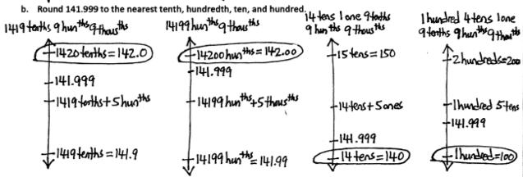
Lesson 8, Problem Set, Page 1.C.21.
Notes:
TIME ALLOTTED FOR THIS SLIDE:
1 minute
MATERIALS NEEDED:
X

Slide 38
Topic D: Adding & Subtracting Decimals
Focus Standards:
5.NBT.2: Explain patterns in the number of zeros of the product when multiplying a number by powers of 10, and explain patterns in the placement of the decimal point when a decimal is multiplied or divided by a power of 10. Use whole-number exponents to denote powers of 10.
5.NBT.3: Read, write, and compare decimals to thousandths.
a. Read and write decimals to thousandths using base-ten numerals, number names, and expanded form, e.g., 347.392 = 3 x 100 + 4 x 10 + 7 x 1 + 3 x
(1 x 1/10) + 9 x (1/100) + 2 x (1/1000).
b. Compare two decimals to thousandths based o meanings of the digits in each place, using >, =, and < symbols to record the results of comparisons.
5.NBT.7: Add, subtract, multiply and divide decimals to hundredths, using concrete models or drawings and strategies based on place value, properties of operations, and / or the relationship between addition and subtraction; relate the strategy to a written method and explain the reasoning used.
Notes:
Give participants a little time to read the standards. Topic D focuses on adding and subtracting decimals.
TIME ALLOTTED FOR THIS SLIDE:
2 minutes
MATERIALS NEEDED:
X

Slide 39
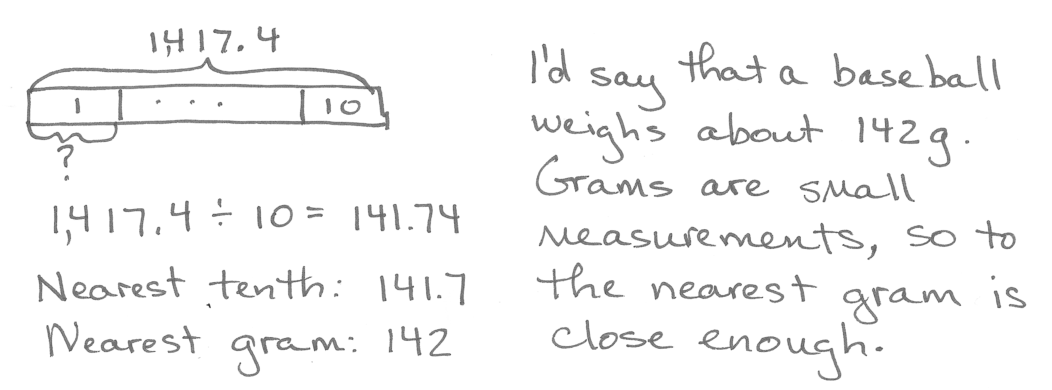
Ten baseballs weigh 1,417.4 grams. About how much does 1 baseball weigh? Round your answer to the nearest tenth of a gram. Then round your answer to the nearest gram. If someone asked about how much a baseball weights, what would you say? Why?
In the Modified Problem Set, complete Problem 9.
Lesson 9, Application Problem, Page 1.D.4.
Notes:
Ask participants to complete the question. Then click the animation for one possible answer.
This Application Problem requires students to use skills learned in the first part of the module which was dividing by powers of 10 and rounding.
TIME ALLOTTED FOR THIS SLIDE:
4 minutes
MATERIALS NEEDED:
X

Slide 40
Sample Problems from Lesson 9
Analyze these problems with your partner.
2 tenths + 6 tenths
1.8 + 13 tenths
148 thousandths + 7 ones 13 thousandths
7.44 + 0.774
Lesson 9, Concept Development, Page 1.D.4 - 6.
Notes:
TIME ALLOTTED FOR THIS SLIDE:
2 minutes
MATERIALS NEEDED:
X

Slide 41
The process is similar to earlier grades. Students use place value charts.
1.8 + 13 tenths
ones | tenths
1 . 8
+ 1 . 3
Show each addend in the chart.
We add ones with ones, and tenths with tenths.
3 1
3
. 1
How many tenths in all?
If we regroup 11 tenths, what do we get?
How many ones?
Lesson 9, Concept Development, Page 1.D.6.
Notes:
Model this problem using a place value chart. Draw the dots, and record the work in the algorithm.
TIME ALLOTTED FOR THIS SLIDE:
2 minutes
MATERIALS NEEDED:
X

Slide 42
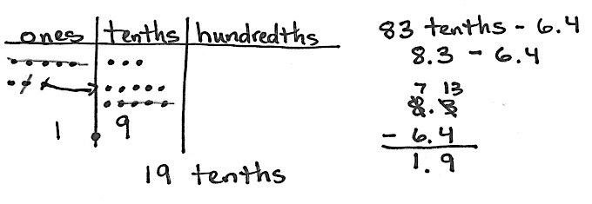
The subtraction process is similar to the addition process.
83 tenths – 6.4
Lesson 10, Concept Development, Page 1.D.18.
Notes:
Use a place value chart and the document camera to model this subtraction problem.
Use the algorithm to record the process.
Click on the animation afterwards.
TIME ALLOTTED FOR THIS SLIDE:
2 minutes
MATERIALS NEEDED:
X

Slide 43
In the Modified Problem Set, complete Problems 10 & 11 .
Work with a partner.
Take turns playing the role of the teacher and student.
Notes:
Circulate. Listen for how teachers are using unit language and guiding their “students” though this process.
Advance the slides to show the solutions that are in the modules. This could be modeled with the document camera by either you or a participant.
TIME ALLOTTED FOR THIS SLIDE:
3 minutes
MATERIALS NEEDED:
X

Slide 44
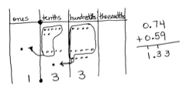
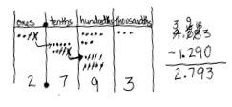
0.74 + 0.59 = 1.33
4.083 – 1.29 = 2.793
Lesson 9, CD, Page 1.D.7 and Lesson 10, CD, Page 1.D.18.
Notes:
These are the solutions found in the module.
TIME ALLOTTED FOR THIS SLIDE:
1 minute
MATERIALS NEEDED:
X

Slide 45
Topic E: Multiplying Decimals
Focus Standards:
5.NBT.2: Explain patterns in the number of zeros of the product when multiplying a number by powers of 10, and explain patterns in the placement of the decimal point when a decimal is multiplied or divided by a power of 10. Use whole-number exponents to dente powers of 10.
5.NBT.3: Read, write, and compare decimals to thousandths.
a. Read and write decimals to thousandths using base-ten numerals, number names, and expanded form, e.g., 347.392 = 3 x 100 + 4 x 10 + 7 x 1 + 3 x (1 x 1/10) + 9 x (1/100) + 2 x (1/1000).
b. Compare two decimals to thousandths based o meanings of the digits in each place, using >, =, and < symbols to record the results of comparisons.
5.NBT.7: Add, subtract, multiply and divide decimals to hundredths, using concrete models or drawings and strategies based on place value, properties of operations, and / or the relationship between addition and subtraction; relate the strategy to a written method and explain the reasoning used.
Notes:
These are the same focus standards as Topic D. In this Topic we will focus on Multiplication rather than addition and subtraction.
TIME ALLOTTED FOR THIS SLIDE:
1 minute
MATERIALS NEEDED:
X

Slide 46
The first model used is an array on the place value chart.
4 x 0.3
Four copies of 3 tenths
ones | tenths
0 . 3
x 4
1 . 2
Lesson 11, Concept Development, Page 1.E.4.
Notes:
Model this problem using the document camera.
Click the animation to show the process.
TIME ALLOTTED FOR THIS SLIDE:
2 minutes
MATERIALS NEEDED:
X

Slide 47
Another model used is the area model.
2 x 0.423
Two copies of 0.423
Lesson 11, Concept Development, Page 1.E.5.
Notes:
Use the document camera to show how we teach multiplication in this module. The work on this slide can be shown after the demonstration with the document camera.
Use a place value chart to show 2 x 0.423. Draw on the chart, using the chip model.
As you draw the chip model on the place value chart, record your work in the standard algorithm.
Finally show the same problem using the area model. Make sure you use unit language as you solve with the area model.
TIME ALLOTTED FOR THIS SLIDE:
2 minutes
MATERIALS NEEDED:
X

Slide 48
In the Modified Problem Set, complete Problems 12 & 13.
Solve, then check your work with a partner.
Lesson 11, Problem Set, Page 1.E.10.
Notes:
Display the previous slide as a model for participants as they work on these 2 problems.
TIME ALLOTTED FOR THIS SLIDE:
3 minutes
MATERIALS NEEDED:
X

Slide 49
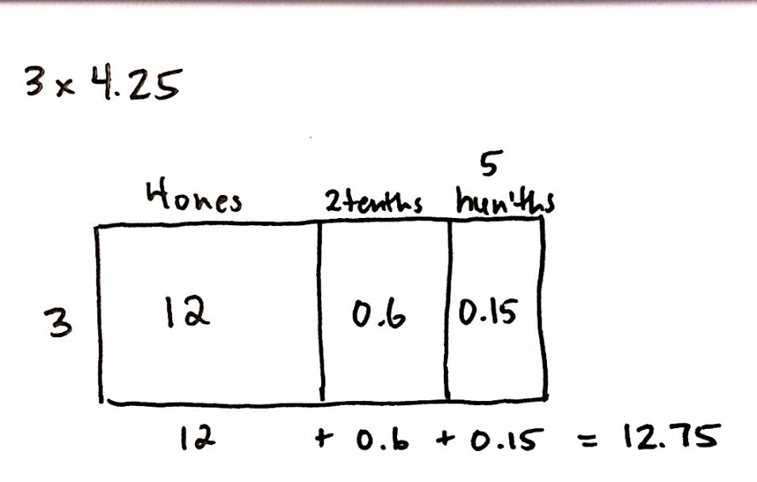
Lesson 11, Problem Set, Page 1.E.10.
Notes:
These are the solutions found in the module.
TIME ALLOTTED FOR THIS SLIDE:
1 minute
MATERIALS NEEDED:
X

Slide 50
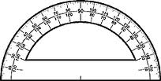
In the Modified Problem Set, complete Problem 14.
Word problems are embedded within the entire module. Use a tape diagram and an area model to solve this problem.
Mrs. Zamir wants to buy 8 protractors and some erasers for her classroom. She has $30. If protractors cost $2.65 each, how much money will Mrs. Zamir have left to buy erasers?
Lesson 11, Problem Set, Page 1.E.11.
Notes:
Give participants time to answer this question. Encourage use of tape diagrams.
Make sure that participants understand that tape diagrams won’t always give the numerical answer. They will, however, help students understand what to do with the numbers.
In this case, the students must first multiply to find the cost of 8 protractors, and then subtract that amount from $30. One possible tape diagram is shown on the next slide.
TIME ALLOTTED FOR THIS SLIDE:
3 minutes
MATERIALS NEEDED:
X

Slide 51
Mrs. Zamir wants to buy 8 protractors and some erasers for her classroom. She has $30. If protractors cost $2.65 each, how much money will Mrs. Zamir have left to buy erasers?
$30
2 ones
6 tenths
5 hundredths
?
8
16 ones
48 tenths
40 hundredths
$2.65
remaining
money
16 + 4.8 + .40 = 21.20
$30.00 – $21.20 = $8.80
Mrs. Zamir has $8.80 left to buy erasers.
Lesson 11, Problem Set, Page 1.E.11.
Notes:
You can model the problem using the document camera, or have a participant model his or her work. You can use this slide to show the answer.
TIME ALLOTTED FOR THIS SLIDE:
2 minutes
MATERIALS NEEDED:
X

Slide 52
Students also use unit language to multiply decimals.
5.1 x 6
= 30.6
5 1 tenths
x 6
3 0 6 tenths
Express 306 tenths in standard form?
30.6
Lesson 12, Concept Development, Page 1.E.17.
Notes:
We can use the standard algorithm to solve multiplication of decimals. Click through the animation on this slide to show how this is taught.
TIME ALLOTTED FOR THIS SLIDE:
2 minutes
MATERIALS NEEDED:
X

Slide 53
Topic F: Dividing Decimals
Focus Standards:
5.NBT.3: Read, write, and compare decimals to thousandths.
a. Read and write decimals to thousandths using base-ten numerals, number names, and expanded form, e.g., 347.392 = 3 x 100 + 4 x 10 + 7 x 1 + 3 x (1 x 1/10) + 9 x (1/100) + 2 x (1/1000).
b. Compare two decimals to thousandths based o meanings of the digits in each place, using >, =, and < symbols to record the results of comparisons.
5.NBT.7: Add, subtract, multiply and divide decimals to hundredths, using concrete models or drawings and strategies based on place value, properties of operations, and / or the relationship between addition and subtraction; relate the strategy to a written method and explain the reasoning used.
Notes:
These standards are in Topics D & E.
TIME ALLOTTED FOR THIS SLIDE:
1 minute
MATERIALS NEEDED:
X

Slide 54
How can we rename the whole, so this problem is easier to solve? Discuss this at your table.
1.5 ÷ 5
15 tenths ÷ 5
3 What?
15 tenths ÷ 5 =
3
tenths
= 0.3
1.5 ÷ 5 = 0.3
Lesson 13, Concept Development, Page 1.F.5.
Notes:
After participants read the problem, give them time to talk with their partners in order to think of another way to name One and five tenths.
After they have a few minutes, click the animation that shows that we can rename “One and five tenths” as “15 tenths.”
T: 15 divided by 5 is…
S: 3
T: (Click the animation to show 3.) What’s the unit?
S: Tenths.
T: Read the division problem with the answer; read the equation.
S: 15 tenths divided by 5 equals 3 tenths.
TIME ALLOTTED FOR THIS SLIDE:
1 minute
MATERIALS NEEDED:
X

Slide 55
4 groups of ___ tenths is 16 tenths
1.6 ÷ 4 = _____
4.2 ÷ 7 = ______ tenths ÷ 7
= ______ tenths
= __________
4
In the Modified Problem Set, complete Problems 15 & 16.
0.4
42
6
0.6
Lesson 13, Problem Set, Page 1.E.10.
Notes:
Talk through these two examples. Click the animation as you go. You can choose to use the document camera instead.
Then give participants time to finish the Modified Problem Set.
TIME ALLOTTED FOR THIS SLIDE:
3 minutes
MATERIALS NEEDED:
X

Slide 56
8 groups of ______hundredths is 0.32. 0.32 ÷ 8 = ______
7 groups of ______ thousandths is 0.084 0.084 ÷ 7 = _______
2.64 ÷ 2 = ___________ ones ÷ 2 + __________hundredths ÷ 2
= _____ ones + __________hundredths
= __________
12.64 ÷ 2 = ___________ ones ÷ 2 + __________hundredths ÷ 2
= _____ ones + _____hundredths
= __________
4
0.04
12
0.012
2
64
1
32
1.32
12
64
6
.32
6.32
Lesson 13, Problem Set, Page 1.E.10.
Notes:
This is a copy of the modified Problem Set for Lesson 13.
After participants have time to solve the 4 problems, you can…
ask for volunteers to show how they solved, or
you can also use the document camera to model your thinking and the answers,
or click the animation to show the answers.
TIME ALLOTTED FOR THIS SLIDE:
3 minutes
MATERIALS NEEDED:
X

Slide 57
6.72 ÷ 3
ones | tenths | hundredths
Show the total with your disks.
2 . 3 4
Lesson 14, Problem Set, Page 1.F.19.
Notes:
Use the document camera, a hand-drawn place value chart, and the disks to model this problem. As you work, record the process in the standard algorithm. Below is the dialogue used in the vignette. The slide is animated to show the same process.
T: (Write 6.72 ÷ 3 = on the board, and draw a place value chart with 3 groups at bottom.) Show 6.72 on your place value chart using your place value disks. I’ll draw on my chart.
S: (Students represent their work with the place value disks. For the first problem, the students will show their work with the place value disks. The teacher will represent the work in a drawing, and in the algorithm. In Problems 2 and 3 of the Concept Development, students may draw instead of using the disks.)
T: Let’s begin with our largest units. We will share 6 ones equally with 3 groups. How many ones are in each group?
S: 2 ones. (Students move the place value disks to show the distribution.)
T: (Draw 2 place value disks in each group, and cross off in the dividend as they are shared.) We gave each group 2 ones. (In the algorithm, record 2 in the ones place in the quotient.) How many ones did we share in all?
S: 6 ones.
T: (Show the subtraction in the algorithm.) How many ones are left to share?
S: 0 ones.
T: Let’s share our tenths. 7 tenths divided by 3. How many tenths can we share with each group?
S: 2 tenths.
T: Using your place value disks, share your tenths. I’ll show what we did on my place value chart, and in my written work. (Draw to share, cross off in dividend. Record in the algorithm.)
S: (Students move the place value disks.)
T: (Record 2 in tenths place in the quotient.) How many tenths did we share in all?
S: 6 tenths.
T: (Record subtraction.) Let’s stop here a moment. Why are we subtracting the 6 tenths?
S: We have to take away the tenths we have already shared. → We distributed the 6 tenths into 3 groups, so we have to subtract them.
T: Since we shared 6 tenths in all, how many tenths are left to share?
TIME ALLOTTED FOR THIS SLIDE:
3 minutes
MATERIALS NEEDED:
X

Slide 58
In the Modified Problem Set, complete Problem 17 .
5.7 ÷ 4
Lesson 15, Problem Set, Page 1.F.36.
Notes:
This problem is listed in the modified Problem Set. The participants need to draw a place value chart, and use the standard algorithm, as modeled with the last problem.
When they have had enough time to finish, model this problem using the document camera, or have a participant show his / her work.
TIME ALLOTTED FOR THIS SLIDE:
2 minutes
MATERIALS NEEDED:
X

Slide 59
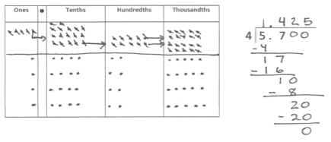
5.7 ÷ 4
Lesson 15, Problem Set, Page 1.F.36.
Notes:
This is the solution in the module.
Work with a partner to analyze this solution.
TIME ALLOTTED FOR THIS SLIDE:
1 minute
MATERIALS NEEDED:
X

Slide 60
Mr. Frye distributed $216 equally among his 4 children for their weekly allowance.
a. How much money did each child receive?
In the Modified Problem Set, complete Problem 18a.
Use a tape diagram.
RDW
$216
4 units = 216
1 unit = 216 ÷ 4 = 54
$ ?
Each child received $54.
Lesson 16, Problem Set, Page 1.F.50.
Notes:
Ask participants to solve this problem using a tape diagram.
Advance the animation to show one possible solution strategy.
TIME ALLOTTED FOR THIS SLIDE:
2 minutes
MATERIALS NEEDED:
X

Slide 61
John, the oldest child, paid his siblings to do his chores. If John pays his allowance equally to his brother and two sisters, how much money will each of his siblings have received in all?
In the Modified Problem Set, complete Lesson 18b.
$54
3 units = 54
1 unit = 54 ÷ 3 = 18
54 + 18 = 72
$ ?
Each of John’s sibling will get $72.
Lesson 16, Problem Set, Page 1.F.50.
Notes:
This is the second part of the problem. Again, give participants time to complete, and then advance the animation to show one possible solution strategy.
TIME ALLOTTED FOR THIS SLIDE:
3 minutes
MATERIALS NEEDED:
X

Slide 62
Agenda
Lesson Structure
Instructional Sequence
Module Review
Preparation for Implementation
Notes:
As you’ve seen, the sequence of objectives is very intentional. Each one is critical in preparing students for what comes next. We think of these objectives as rungs on a ladder that lead to success of the module’s focus. Collectively, they play a significant role in the students achieving mastery of the grade’s expectations.
Keep in mind that we only sampled a small part of each objective. When looking at the daily lesson, you’ll find that each plan is thoroughly detailed… as you experienced with Lesson 1 at the beginning of this session.
Now, we are going to examine the module in its entirety.
TIME ALLOTTED FOR THIS SLIDE:
1 minute
MATERIALS NEEDED:
X

Slide 63
Progression Study
What are the Progressions?
Read Progression on Number and Operations in Base Ten:
Overview pages 1 – 4
Grades 4 & 5, pages 12-19
If time allows, Grades K – 3, pages 5 – 11.
Notes:
To continue our study of Module 1, we’re going to first take some time to examine a portion of the Progression document that serves as the foundation for this module. You’ll have about 10 minutes to read through the document independently or with a partner. As you read, highlight the information that is relevant to the content of this module.
Allow participants 10 minutes to read independently. Encourage them to highlight and make notes.
.
TIME ALLOTTED FOR THIS SLIDE:
10 minutes
MATERIALS NEEDED:
X

Slide 64
Progression Study
How do the lessons fulfill the expectations described in the Progression?
Turn and talk to your partner.
Then we’ll discuss as a large group.
Notes:
Allow 2 minutes for participants to turn and talk about their reflections. Then, facilitate a discussion.
TIME ALLOTTED FOR THIS SLIDE:
5 minutes
MATERIALS NEEDED:
X

Slide 65
Coherence Within the Module
Analyze the progression of Fluency Activities across Module
What does the sequence of Fluency Practices accomplish as a whole?
Read the fluency activities in Lessons 5, 7, 9, 11, 13.
Look for Maintenance, Preparation &
Anticipation Fluencies.
Notes:
Give about 10 minutes for participants to read (skim) these fluency activities.
Discuss the focus question.
Participants should say that they recognize the three types of fluency activities:
Maintenance: Staying sharp on previously learned skills
Preparation: Targeted practice for the current lesson
Anticipation: Building skills to prepare students for the in-depth work of future lessons
TIME ALLOTTED FOR THIS SLIDE:
10 minutes
MATERIALS NEEDED:
X

Slide 66
Coherence Within the Module
Analyze the Problem Sets.
In what ways were the writers intentional in the design of these Problem Sets?
Notes:
Work in pairs to complete every Problem Set. With your partner, analyze the sequence of each Problem Set and the sequence of material across the Problem Sets.
If time is short, you can have participants review the completed problem sets found within the modules.
TIME ALLOTTED FOR THIS SLIDE:
20 minutes
MATERIALS NEEDED:
X

Slide 67
Agenda
Lesson Structure
Instructional Sequence
Module Review
Preparation for Implementation
Notes:
Now you’ve had a chance to examine this module at several levels. We looked at the lesson components, we explored the instructional sequence from objective to objective, and we’ve thought about what this module accomplishes in the larger scope of mathematical understanding.
Let’s spend some time now discussing strategies for implementation and preparing for the beginning of the upcoming school year.
TIME ALLOTTED FOR THIS SLIDE:
1 minutes
MATERIALS NEEDED:
X

Slide 68
Practice a Planning Protocol
With any topic from A Story of Units, read the module overview and the topic opener.
Study the module assessment, paying particular attention to the sample responses provided.
Notes:
Click to advance the first bullet. Allow time for participants to read the module overview and the topic opener for the pre-selected topic.
Click to advance second bullet. Allow time for participants to study the sample work provided for the module assessment(s).
NOTE TO FACILITATORS: It is likely that participants will have already studied these documents during Session 1 of this NTI. If this is the case, there is no need to spend additional time on this slide at this point.
TIME ALLOTTED FOR THIS SLIDE:
5 minutes
MATERIALS NEEDED:
The module overview, topic opener, and applicable module assessment(s) for any topic from any module at any grade level

Slide 69
Practice a Planning Protocol
Read through the first lesson of the topic.
Then, take note of the lesson objective and re-examine the Exit Ticket with the objective in mind. What major concept is necessary to successfully complete the Exit Ticket?
Study the Concept Development (CD) and Problem Set (PS). How do the CD/PS develop the major concept that is required in the exit ticket? What parts of the CD/PS go beyond this major concept?
Notes:
Click to advance the first bullet. Allow time for participants to read the first lesson of the pre-selected topic.
Click to advance second bullet. Read aloud the objective of the first lesson. Allow time for participants to re-read the exit ticket. Facilitate a discussion about the major concept required by the exit ticket.
Click to advance the third bullet. Allow time for participants to study the concept development and problem set. If participants have paper copies of the lessons, encourage them to highlight the portions of the CD/PS that are critical in preparation for the exit ticket. Facilitate a discussion about those portions of the lesson that are necessary in preparation for the exit ticket and those that go beyond the major concept needed for the exit ticket.
TIME ALLOTTED FOR THIS SLIDE:
5 minutes
MATERIALS NEEDED:
The preselected topic
Highlighters (optional)

Slide 70
Practice a Planning Protocol
How will this knowledge empower teachers to support specific groups of learners?
Turn to the subsequent lesson, and examine the Exit Ticket. How does this Exit Ticket build on the last? How are the two Exit Tickets similar and how are they different?
Will students have an opportunity in the second lesson to continue development of the first lesson’s objective? What level of mastery of the first lesson’s objective is necessary in preparation for the second lesson?
Notes:
Click to advance the first bullet. Facilitate a discussion about how participants’ previous observations might be further impacted as they consider the needs of a specific group of students. As appropriate, draw attention to any relevant notes boxes in the margins of the lesson.
Click to advance second bullet. Allow time for participants to read the exit ticket for the next lesson. Facilitate a discussion about the relationship between the two exit tickets.
Click to advance the third bullet. Facilitate discussion about how these new observations might further impact their decisions regarding implementation of the first lesson.
TIME ALLOTTED FOR THIS SLIDE:
5 minutes
MATERIALS NEEDED:
The preselected topic

Slide 71
Practice a Planning Protocol
How does the new plan for implementation impact the student debrief?
Are any adjustments needed to the fluency and/or application components of the lesson?
Notes:
Click to advance the first bullet. Facilitate a discussion about how the student debrief is impacted by the implementation decisions made thus far.
Click to advance second bullet. Facilitate a discussion about the other lesson components and the need to ensure that the balance of rigor is maintained.
TIME ALLOTTED FOR THIS SLIDE:
5 minutes
MATERIALS NEEDED:
The preselected topic

Slide 72
Practice a Planning Protocol
Repeat this process for each lesson.
Read lesson.
Study Exit Ticket. Identify critical portions of Concept Development and Problem Set.
Consider needs of specific students.
Refer to subsequent Exit Tickets. Revise implementation plan as needed.
Make adjustments to the Student Debrief as needed.
Consider the other lesson components, ensuring a balance of rigor.
Notes:
Review the planning protocol. If time allows, have participants go through the cycle again for the second lesson of the topic.
TIME ALLOTTED FOR THIS SLIDE:
5 minutes
MATERIALS NEEDED:
The preselected topic

Slide 73
Biggest Takeaway
Turn and Talk:
What questions were answered for you?
What new questions have surfaced?
Notes:
Take two minutes to turn and talk with others at your table. During this session, what information was particularly helpful and/or insightful? What new questions do you have?
Allow 2 minutes for participants to turn and talk. Bring the group to order and advance to the next slide.
TIME ALLOTTED FOR THIS SLIDE:
3 minutes
MATERIALS NEEDED:
X

Slide 74
Key Points
Each of the lesson components are necessary in order to achieve balanced, rigorous instruction and to bring the Standards to life.
Opportunities to nurture the Standards for Mathematical Practice are embedded throughout the lesson.
Multiple exposures over time allow students to learn abstract concepts.
Notes:
While each component is essential piece,
As teacher you have choice about timing and placement.
TIME ALLOTTED FOR THIS SLIDE:
1 minutes
MATERIALS NEEDED:
X

Slide 75
Key Points
This module is a decimal study. Be prepared to scaffold!
The concepts are introduced concretely and move to the abstract. Teachers should use manipulatives until no longer needed.
Students use visual models (place value charts & number disks, vertical number lines, and area models) to support their place value understanding.
Review, extend, recognize, generate, apply.
Notes:
READ THE PROGRESSIONS!
Let’s summarize the key points that you have identified as a group during this session:
NOTE TO FACILITATOR: As you prepare the previous slides examining the Progression document and coherence within the module, articulate the key points from your study of Module 1 on this slide.
TIME ALLOTTED FOR THIS SLIDE:
1 minutes
MATERIALS NEEDED:
X

Slide 76
Next Steps
What will you need to do between now and the beginning of school to better prepare for the implementation of A Story of Units?
Notes:
Participants write their answers on an index card, which will be their exit tickets.
TIME ALLOTTED FOR THIS SLIDE:
5 minutes
MATERIALS NEEDED:
X

Slide 77
Next Steps
Use the provided index card to answer this question:
What further support do you anticipate needing in order to implement the work of Modules?
Thank you!
Notes:
Participants write their answers on an index card, which will be their exit tickets.
TIME ALLOTTED FOR THIS SLIDE:
5 minutes
MATERIALS NEEDED:
X

