Slide 1
A Story of Ratios
Grade 6 – Module 1
Notes:
This full-day session is intended to support successful implementation of this module. Using this module as a platform for understanding our instructional approach and lesson structure, you will have the tools needed to tackle the remaining modules of the year.
Welcome participants and introduce presentation team.
Fist to Five:
- How familiar are you with Eureka Math and A Story of Units?
Poll the participants:
Are you using the lessons on a daily basis? Or to supplement your instruction?
Are you a classroom teacher? For this grade? A different grade?
Are you a math coach? Coordinator? Resource teacher?
Are you a school-level administrator? District-level administrator?
Quickly orient participants to the day’s materials:
Full module – provided by Wiley; additional modules are available for purchase through our website, commoncore.org
Handout packet – describe the nature and purpose of both the stapled packet and the loose handouts
Materials – any announcements needed regarding materials on the tables?
TIME ALLOTTED FOR THIS SLIDE:
6 minutes
MATERIALS NEEDED:
X

Slide 2
This PowerPoint presentation is provided to individuals who participated in a live training by professional developers certified by, or affiliated with, the copyright holder, Common Core, Inc. It may not be altered in any way. The presentation may be shared for non-commercial purposes only. However, Common Core makes no representations or warranties about the effectiveness of training provided by non-certified/non-affiliated presenters of the material. Any commercial use of this presentation is illegal and violates the copyrights of Common Core, Inc.

Slide 3
Agenda
Lesson Structure
Instructional Sequence
Module Review
Preparation for Implementation
Notes:
We will begin by exploring the lesson structure and how it is fundamental to supporting rigorous instruction. Then we will dig in to the math of the module, examining the intentional instructional sequence that leads students toward mastery of the focus standards. Afterwards, we’ll take a look back at the module, reflecting on all the parts as one cohesive whole. Finally, we’ll talk about strategies for implementation in preparation for the beginning of the school year.
Let’s get started with the lesson structure.
TIME ALLOTTED FOR THIS SLIDE:
1 minute
MATERIALS NEEDED:
X

Slide 4
Introduction to the Lesson Structure
Examine the development and function of each lesson component.
      Lesson Type (Socratic, Modeling Cycle, Exploration, Problem Set)
      Lesson Title
      Student Outcomes
      Optional Lesson Notes
      Classwork: Examples and Exercises
      Application Problems
      Concept Development
      Student Debrief/Exit Ticket
      Problem Set
Notes:
Please turn to the first lesson of the Module. (CLICK TO ADVANCE FIRST BULLET)Before we get into the meat of the lesson, lets take a look at how these lessons are designed. Note the blue conversation bubble prior to the lesson title. This graphic means that this is a Socratic lesson. There will be four different lesson types within the module: Socratic, Modeling Cycle, Exploration and Problem Set.
(DIRECT ATTENTION TO CHART PAPER)Teachers lead students in a conversation with the aim of developing a specific concept or proof in a Socratic lesson. Teachers ask guiding questions to pull information from the students and draw them into the discussion. In the remaining minutes of the lesson, other activities are likely to occur, like a debrief or application problem.
Modeling Cycle Lesson – Teacher and students work through a sequence of examples and exercises to develop or reinforce a concept. This is mostly teacher directed. Students work on exercises individually or in pairs but not for long periods at a time. The majority of the class period is spent alternating between the teacher working through examples with the students and the students completing exercises.
Exploration Lesson – Students are given 20 – 30 minutes to work independently or in small groups on one or more exploratory challenges followed by a debrief with the goal of clarifying, expanding upon or developing a concept, definition, theorem or proof. This is typically going to be a challenging problem or question that requires students to collaborate (in pairs or groups) but can be done individually. The class comes back together to discuss the problem for a period of time to draw conclusions and consolidate understandings.
Problem Set Lesson –Students are involved in practicing all or part of the problem set lesson. The problem students are working on is ill-defined and has a real world context. Students are likely to work in groups on these types of problems, but teachers may want students to work for a period of time individually before collaborating with their group members.
(CLICK TO ADVANCE FOR EACH BULLET)Each lesson is titled with a general description of the lesson. This is followed by student outcomes. Sometimes the lesson will include lesson notes that are optional narratives containing critical pre-instructional guidance. Classwork : Note that there are examples and exercises. If the lesson denotes an example, you will notice that this is teacher-led instruction. Exercises are student-led with teacher guidance. You will note that the lessons include application problems, and of course logical concept development.
Each lesson ends with a debriefing/closure with student response. This includes an exit ticket. The exit ticket is a daily assessment performance that must be observed and/or collected through an artifact. Exit tickets, debrief questions, or artifacts will enable teacher to assess each student individually.
There is a problem set that is available for each lesson. Directions on how to use these have not been included in the teacher’s notes, but each problem set is provided for the teacher’s discretion on how to use the problems. These problems can be used for additional practice if the timing of the lesson allows. They can also be given as homework.
TIME ALLOTTED FOR THIS SLIDE:
X minutes
MATERIALS NEEDED:
X

Slide 5




Lesson Types
Problem Set
  Teacher and/or students work through a series of examples.
Exploratory
  Students are presented exploratory challenge(s) in the form of activities and/or exercises.
Socratic
  Teacher engages students in a discussion leading to a big idea or proof.
Modeling
  Application problem ill/well defined task that students complete. Real world application of mathematics. (Reserved mainly for high school, but there will be at least 3 modeling tasks throughout the grade 6 curriculum.)
Notes:
The 6 – 8 curriculum has 4 types of lessons students will experience. The first type is a problem set. In this lesson, the teacher generally introduces a series of examples and students work through a series of exercises based on the discussion of the example and the modeling of the concept. The next is an exploratory lesson where students are presented with exploratory challenges in the form of activities and/or exercises. The third type of lesson is the socratic lesson where teachers engage students in a discussion leading into a big idea or a proof. The final lesson type is a modeling lesson which involves an application problem that is ill defined. Students will complete the task which is presented as real life application of mathematics. The modeling cycle is reserved, of course, for ninth grade, however we have included at least three examples in the 6 – 8 curriculum for students to be introduced to the process.

Slide 6
Agenda
Lesson Structure
Instructional Sequence
Module Review
Preparation for Implementation
Notes:
As you’ve seen, each lesson component has a very different purpose. Consequently, each lesson component has a different pace, so the experience feels different for students. It is important to honor each component in order to do justice both to the mathematical practices and to the balance of rigor that is expected.
Moving forward, we’ll explore the instructional sequence. In doing this, we’ll lead you through the module, modeling instruction for each objective. Along the way, we’ll also revisit the other lesson components and experience how they function in collaboration with the concept development.
TIME ALLOTTED FOR THIS SLIDE:
1 minute
MATERIALS NEEDED:
X

Slide 7
Lesson 1 - Ratios
Student Outcomes
Students understand that a ratio is an ordered pair of non-negative numbers, which are not both zero. Students understand that a ratio is often used in lieu of describing the first number as a multiple of the second.
Students use the precise language and notation of ratios (3: 2,
3 to 2). Students understand that the order of the pair of numbers in a ratio matters, and that the description of the ratio relationship determines the correct order of the numbers. Students conceive of real-world contextual situations to match a given ratio.
Notes:
(CLICK TO ADVANCE FIRST BULLET) Read the student outcome.
(CLICK TO ADVANCE SECOND BULLET) Read the student outcome.
TIME ALLOTTED FOR THIS SLIDE:
X minutes
MATERIALS NEEDED:
X

Slide 8
Lesson 1 - Ratios
Lesson Notes:
The first two lessons of this module will develop the students understanding and definition of the term ratio.
A ratio is always a pair of numbers, like 2:3, and never a pair of quantities like 2 cm : 3 sec. Keeping this straight for students will require consistently correct use of the term ratio. It will require keeping track of the units in a word problem separately.
To help distinguish between ratios and statements about quantities that define ratios, we use the term ratio relationship to describe an English phrase in a word problem that indicates a ratio.
Typical examples of ratio relationship descriptions include, “3 cups to 4 cups,” “5 miles in 4 hours,” etc. The ratios for these ratio relationships are 3:4 and 5:4, respectively.
Notes:
(CLICK TO ADVANCE FIRST BULLET) Read the note.
(CLICK TO ADVANCE SECOND BULLET) Read the note.
(CLICK TO ADVANCE THIRD BULLET) Read the note.
(CLICK TO ADVANCE FOURTH BULLET) Read the note.
TIME ALLOTTED FOR THIS SLIDE:
X minutes
MATERIALS NEEDED:
X

Slide 9
Lesson 1- Ratios – Example
The coed soccer team has four times as many boys on it as it has girls. We say the ratio of the number of boys to the number of girls on the team is 4:1, we read this as “four to one.”
Let’s create a table to show how many boys and how many girls are on the team.
# of Boys | # of Girls | Total # of Players
4 | 1 | 5
8
2
10
12
3
15
Notes:
Read through the problem. CLICK to advance the task: Let’s create a table to show how many boys and how many girls are on the team. CLICK to advance the table. If the ratio of the number of boys to the number of girls on the team is 4:1, we can show this in the table. We have 4 boys, 1 girl, and a total of 5 players. What might be the next set of data on this table? If we are speaking to the ratio 4:1, then the next set would be (CLICK to advance the boys) 8 boys, (CLICK to advance the girls) 2 girls, and (CLICK to advance the total number of players) together there are 10 total players. What do we notice about the relationship of the first row of data, and the second row of data? We can tell that they represent a multiplicative comparison. Let’s take a look at the next row in the table. Notice that in the first row, there are 4 boys, in the second row, when we doubled the quantity, we had 8 boys, now if we triple the original amount of boys, we will have (CLICK to advance the boys)12 boys. Notice the pattern in the girls column. We had 1, then 2, and three times the original amount of girls will give us (CLICK to advance the girls) 3 girls. When added together, 12+3= (CLICK to advance the total number of players) 15. Let’s look at the comparison of the data in the total number of players column. We see that the multiplicative comparison remains constant throughout the table.
TIME ALLOTTED FOR THIS SLIDE:
X minutes
MATERIALS NEEDED:
X

Slide 10
Lesson 1- Ratios - Example
Suppose the ratio of boys to girls on a different soccer team is 3:2
Create a table like the one shown below to show possibilities of the number of boys and girls on the soccer team.
# of Boys | # of Girls | Total # of Players
3 | 2 | 5
6 4 10
9 6 15
Notes:
Let’s take a look at a different ratio. Here we see that the ratio between the number of boys on the team to the number of girls on the team is 3:2.
(CLICK TO ADVANCE TABLE) What values can I place in the second row of the table?
(CLICK TO ADVANCE SECOND ROW) What is another set of values for the third row?
(CLICK TO ADVANCE THIRD ROW)
I can’t say there are 3 times as many boys as girls. What would my multiplicative value have to be? There are how many more boys as girls? Can this be easily determined?
Here we lead students into finding the fractional representation of 3/2. Students may not come to this conclusion, but based on the previous ratio of 4:1, they notice that there are four times as many boys as girls, so in this example there are 3/2 as many boys as girls.
Can you visualize 3/2 as many boys as girls? Students are anticipated to share all thoughts.
TIME ALLOTTED FOR THIS SLIDE:
X minutes
MATERIALS NEEDED:
X

Slide 11
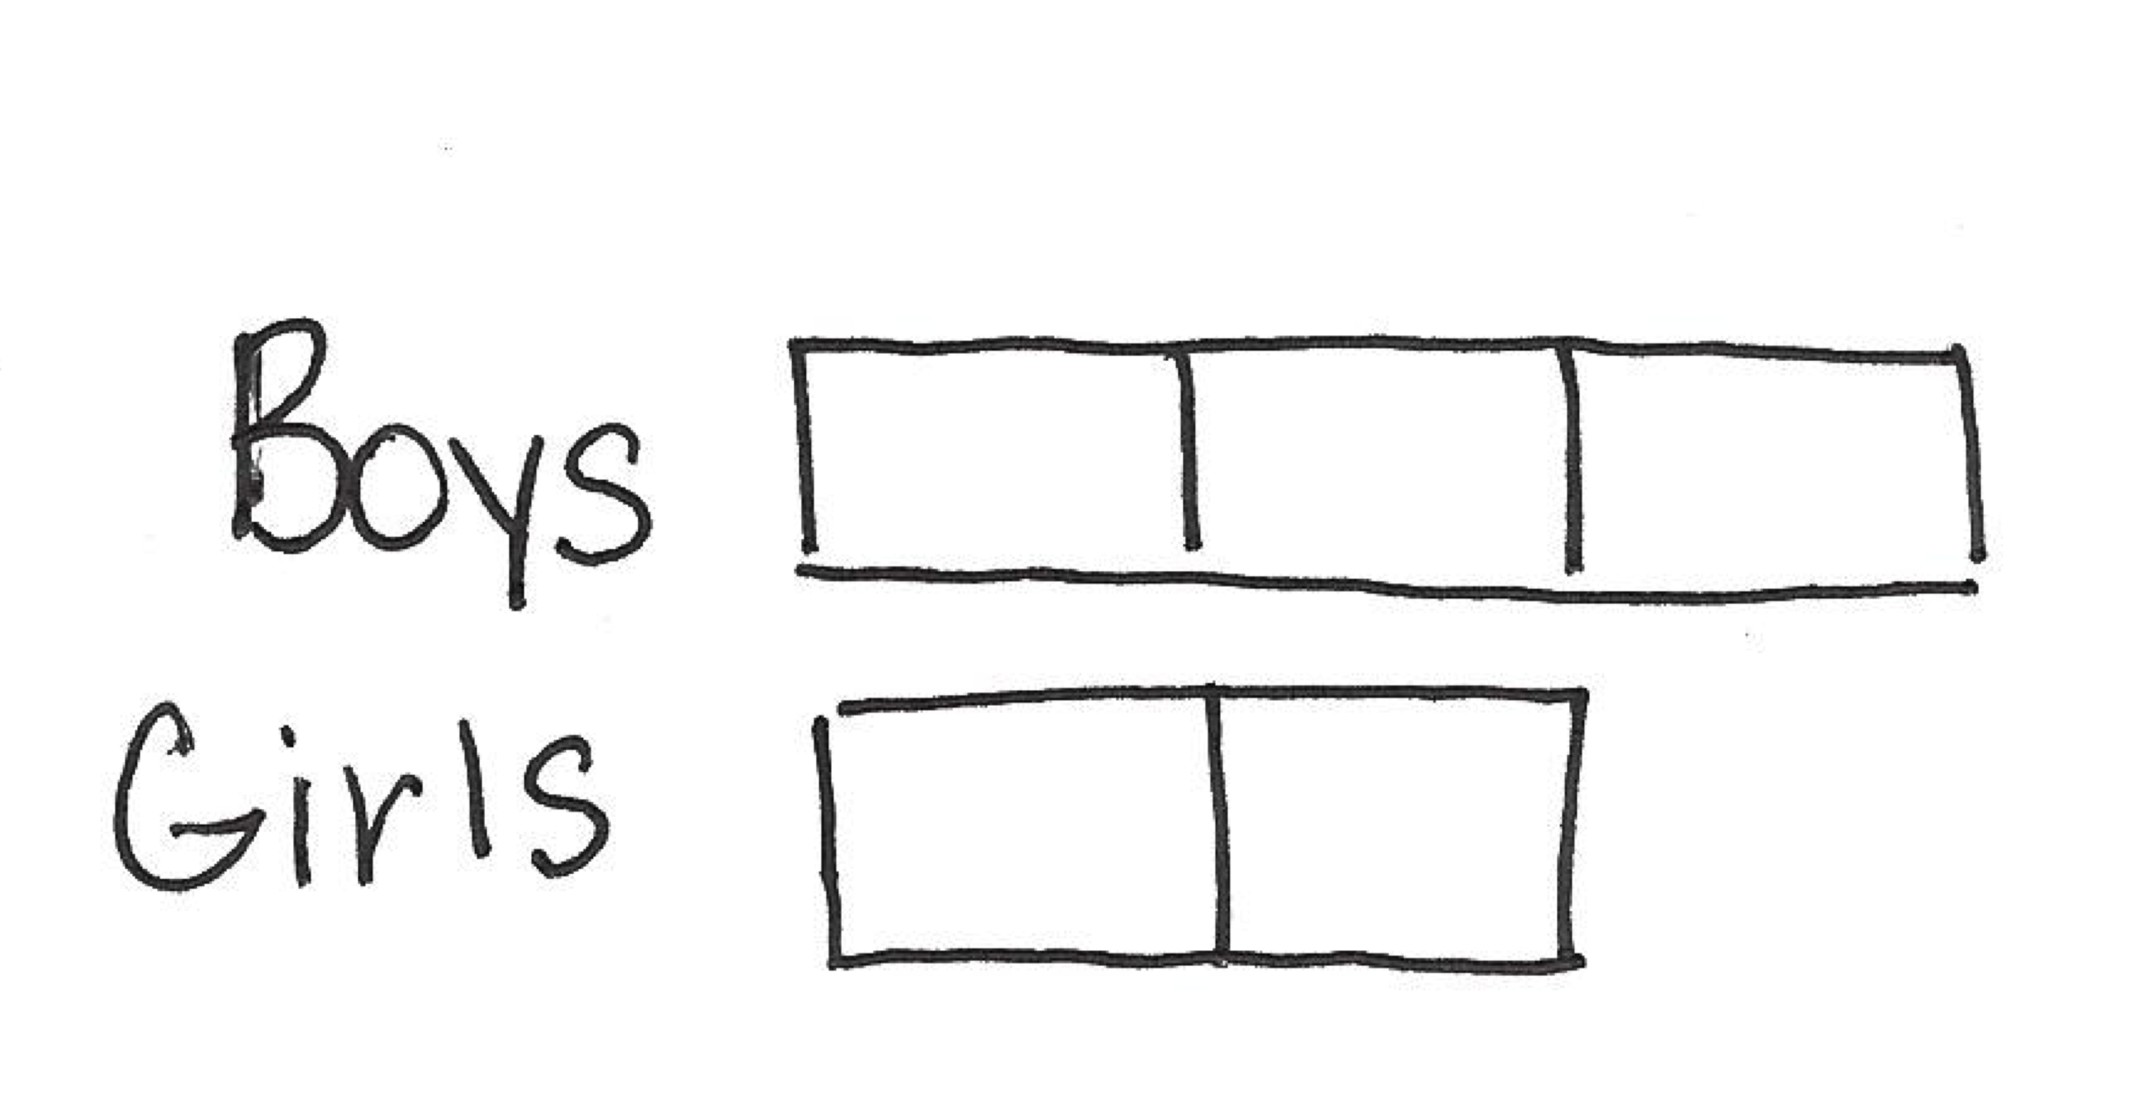
Lesson 1- Ratios - Example
Can we make a tape diagram (or bar model) that shows that there are 3/2 as many boys as girls?
Which description makes the relationship easier to visualize? Saying the ratio is 3 to 2 or saying there are 3 halves as many boys as girls?
There is no right or wrong answer, have students explain why they picked their choice.
Notes:
Can we make a tape diagram (or bar model) that shows that there are 3/2 as many boys as girls? Students have been exposed to tape/bar diagrams in previous grades, but if students need further instruction, here is where it is appropriate.
(CLICK TO ADVANCE TAPE DIAGRAM) Note that there are three units to represent the boys and two units to represent the girls.
(CLICK TO ADVANCE DISCUSSION) Which description makes the relationship easier to visualize? Saying the ratio is 3 to 2 or saying there are 3 halves as many boys as girls?
(CLICK TO ADVANCE DISCUSSION) There is no right or wrong answer, have students explain why they picked their choice.
TIME ALLOTTED FOR THIS SLIDE:
X minutes
MATERIALS NEEDED:
X

Slide 12
Lesson 1 – Ratios - Discussion
Find the ratio of the number of men to the number of women in our session. Use your whiteboards to show the ratio.
Show on your whiteboards how you can write this ratio as a multiplicative comparison without using ratios.
Compare your answer with your neighbor. Does everyone’s look exactly the same?
Write the ratio of the number of women to the number of men in our session on your whiteboard.
Is the ratio of the number of women to the number of men the same as the ratio of the number of men to the number of
women?
Notes:
Continually click through the slide and elicit responses from the group using whiteboards.
TIME ALLOTTED FOR THIS SLIDE:
X minutes
MATERIALS NEEDED:
X

Slide 13
Lesson 1 – Ratios – Example 2
Students record a ratio for each of the examples you provide
You traveled out of state this summer.
You did not travel out of state this summer.
You have at least one sibling.
You are an only child.
Your favorite class is math.
Your favorite class is not math.
Notes:
Discuss the Example 2 where students collect the data in a discussion, and then create ratios based on the data collected. First, they create a ratio depicting the number of students who traveled out of state over the summer to the number of students who did not travel out of the state over the summer. Then they create a ratio describing the number of students who did not travel out of state to the number of students that did travel out of state. They will see that for example if the ratio of students who traveled out of state to the number of students that did not is 12:10, that it only makes sense that the ratio of students who did not travel out of states to the number of students that did would be 10:12. The same thing goes for the next two discussions: Let’s say the ratio of students who have at least one sibling to the number of students that are an only child is 7:15. It is only natural that the ratio of the number of students who are an only child to the number of students who have at least one sibling is 15:7. And the same thing goes for the last two discussions between favorite math classes. Let’s say the ratio of the number of students whose favorite class is math to the number of students whose favorite class is not math is 10:11, then the ratio of the number of students whose favorite class is not math to the number of students whose favorite class is math would be 11:10.
What this is leading up to is seeing some associated ratios, specifically how the ratio of A:B is related to the ratio of B:A.
When might this be a problem for students? Maybe if the numbers in the ratio are the same.
TIME ALLOTTED FOR THIS SLIDE:
X minutes
MATERIALS NEEDED:
X

Slide 14
Lesson 1 - Exercises
Students look around the classroom to think of their own ratios. They create written ratio statements that represent their ratios in one of the summary forms.
Using words, describe a ratio that represents each ratio below.
  1 to 12
  12:1
  2 to 5
  5 to 2
  10:2
  2:10
Notes:
Have participants participate in the activity, providing descriptions of each of the ratios using their whiteboards. Motivate participants to create descriptions that are specific to the ratio. Some specific examples would include 1 to 12 “for every one year, there are twelve months;” 12:1 “for every twelve months there is one year;” 2 to 5 “for every 2 days of non-school days in a week, there are five school days;” 5 to 2 “for every 5 school days in a week, there are 2 non-school days;” 10:2 “for every 10 toes, there are 2 feet;” and 2:10 “for every 2 feet there are 10 toes.”
TIME ALLOTTED FOR THIS SLIDE:
X minutes
MATERIALS NEEDED:
X

Slide 15
Lesson 1 – Exit Ticket
Write a ratio for the following description: Kaleel made three times as many baskets as John during basketball practice.
Describe a situation that could be modeled with the ratio 4:1.
Write a ratio for the following description: For every 6 cups of flour in a bread recipe, there are 2 cups of milk.
Notes:
Discuss the exit ticket. Switch to the document camera and model the responses for each problem.
TIME ALLOTTED FOR THIS SLIDE:
X minutes
MATERIALS NEEDED:
X

Slide 16
Lesson 1 – Problem Set
1. At the 6th grade school dance, there are 132 boys, 89 girls, and 14 adults.
  Write the ratio of the number of boys to the number of girls.
  Write the same ratio using another form (A: B vs. A to B).
  Write the ratio of the number of boys to the number of adults.
  Write the same ratio using another form.
2. In the cafeteria, 100 milk cartons were put out for breakfast. At the end of breakfast, 27 remained.
  What is the ratio of the number of milk cartons taken to total number of milk cartons?
  What is the ratio of the number of milk cartons remaining to the number of milk cartons taken?
3. Choose a situation that could be described by the following ratios, and write a sentence to describe the ratio in the context of the situation you chose. For example: 3:2. When making pink paint, the art teacher uses the ratio 3:2. For every 3 cups of white paint she uses in the mixture, she needs to use 2 cups of red paint.
  1 to 2
  29 to 30
  52:12
Notes:
Have participants use their whiteboards to answer each problem.
TIME ALLOTTED FOR THIS SLIDE:
X minutes
MATERIALS NEEDED:
X

Slide 17
Lesson 2 - Ratios
Students reinforce their understanding that a ratio is an ordered pair of non-negative numbers, which are not both zero. Students continue to learn and use the precise language and notation of ratios (3: 2, 3 to 2). Students demonstrate their understanding that the order of the pair of numbers in a ratio matters.
Students create multiple ratios from a context in which more than two quantities are given. Students conceive of real-world contextual situations to match a given ratio.
Notes:
Let’s move on to the second half of the Ratios Lesson – Lesson 2.
(CLICK TO ADVANCE EACH OUTCOME) Read each outcome as they appear.
TIME ALLOTTED FOR THIS SLIDE:
X minutes
MATERIALS NEEDED:
X

Slide 18
Lesson 2 - Ratios
Notes:
Notice that students share and write the examples on the board, being careful to include some of the verbal clues that indicate a ratio relationship: ‘to’, ‘for each’, ‘for every’, which is reinforced by the teacher prompting, “What are the verbal cues that tell us someone is talking about a ratio relationship?”
(CLICK TO ADVANCE LINE PLOT)
(CLICK TO ADVANCE DESCRIPTION OF RATIO RELATIONSHIP TABLE 2)
(Switch to document camera and model at least 2 from each of the tables)
TIME ALLOTTED FOR THIS SLIDE:
X minutes
MATERIALS NEEDED:
X

Slide 19
Lesson 3 – Equivalent Ratios
Students develop an intuitive understanding of equivalent ratios by using tape diagrams to explore possible quantities of each part given the part to part ratio. Students use tape diagrams to solve problems where the part to part ratio is given and the value of one of the quantities is given.
Students formalize a definition of equivalent ratios: Two ratios 𝐴:𝐵 and 𝐶:𝐷 are equivalent ratios if there is a positive number, 𝑐, such that 𝐶=𝑐𝐴 and 𝐷=𝑐𝐵.
Notes:
Now that students have a good foundational understanding of what a ratio is, and how it is represented, let’s move on to the third lesson, which is the introduction to equivalent ratios.
(CLICK TO ADVANCE EACH OUTCOME) Read each outcome as they appear.
TIME ALLOTTED FOR THIS SLIDE:
X minutes
MATERIALS NEEDED:
X

Slide 20
Lesson 3 – Equivalent Ratios
Shanni and Mel are using ribbon to decorate a project in their art class. The ratio of the length of Shanni’s ribbon to the length of Mel’s ribbon is 7:3.
Create a table.
Draw a tape diagram to represent this ratio.
Shanni
Mel
21 inches
9 inches
21:9
21 to 9
2 m
2 m
2 m
2 m
2 m
2 m
2 m
7 inches
3 inches
7:3
7 to 3
14 meters
6 meters
14:6
14 to 6
2 m
2 m
2 m
What ratios can we say are equivalent to 7:3?
Notes:
In this lesson, students examine and create tape diagrams in order to determine equivalent ratios.
(CLICK TO ADVANCE THE EXAMPLE PROBLEM) Shanni and Mel are using ribbon to decorate a project in their art class. The ratio of the length of Shanni’s ribbon to the length of Mel’s ribbon is 7:3.
(CLICK TO ADVANCE THE FIRST BULLET) Here, students will refer back to previous lessons and create a table to represent other ratios based on 7:3
(CLICK TO ADVANCE THE SECOND BULLET) Let’s closely examine the construction and interpretation of tape diagrams.
(CLICK TO ADVANCE SHANNI) How many units of our tape diagram should we draw for Shanni?
(CLICK TO ADVANCE THE TAPE DIAGRAM) (CLICK TO ADVANCE MEL) How many units of our tape diagram should we draw for Mel?
(CLICK TO ADVANCE THE TAPE DIAGRAM) What does this mean? What does each unit represent?
(CLICK TO ADVANCE MEANING) So Shanni’s ribbon is 7 inches and Mel’s is 3 inches. The ratio of Shanni’s ribbon length in inches to Mel’s ribbon length in inches is 7:3 or 7 to 3
(CLICK TO HIDE BOX) What if each unit were to represent 2 meters? What would the length of Shanni’s ribbon be? What would we do to find out?
(CLICK TO ADVANCE THE LABELING OF EACH UNIT FOR SHANNI’S RIBBON) What would we do to find out the length of Mel’s ribbon? Can we do the same thing? We must!
(CLICK TO ADVANCE THE LABELING OF EACH UNIT FOR MEL’S RIBBON) Now, what does this mean?
(CLICK TO ADVANCE MEANING) So Shanni’s ribbon is 14 meters and Mel’s ribbon is 6 meters. The ratio of Shanni’s ribbon length in meters to Mel’s ribbon length in meters is 7:3 or 7 to 3.
(CLICK THREE TIMES TO HIDE THE MEANING AND THE LABELS IN THE TAPE DIAGRAM) What if the each unit represents 3 inches?
(CLICK TO SHOW RATIOS)
TIME ALLOTTED FOR THIS SLIDE:
X minutes
MATERIALS NEEDED:
X

Slide 21
Lesson 3 – Equivalent Ratios
Take 5 minutes to work through Exercise 4 with your neighbor.
Share your thoughts!
Notes:
TIME ALLOTTED FOR THIS SLIDE:
X minutes
MATERIALS NEEDED:
X

Slide 22
Lesson 4 – Equivalent Ratios
Given a ratio, students will identify equivalent ratios. Students use tape diagrams and the description of equivalent ratios to determine if two ratios are equivalent.
Students relate the common factor, c, in the description of equivalent ratios to the tape diagrams they’ve been using to find equivalent ratios.
Notes:
Now that students have a good foundational understanding of determining equivalent ratios, let’s move on to the fourth lesson, which is the second part to equivalent ratios.
(CLICK TO ADVANCE EACH OUTCOME) Read each outcome as they appear.
Note that the outcomes build upon each other, yet not omitting outcomes from previous lessons.
TIME ALLOTTED FOR THIS SLIDE:
X minutes
MATERIALS NEEDED:
X

Slide 23
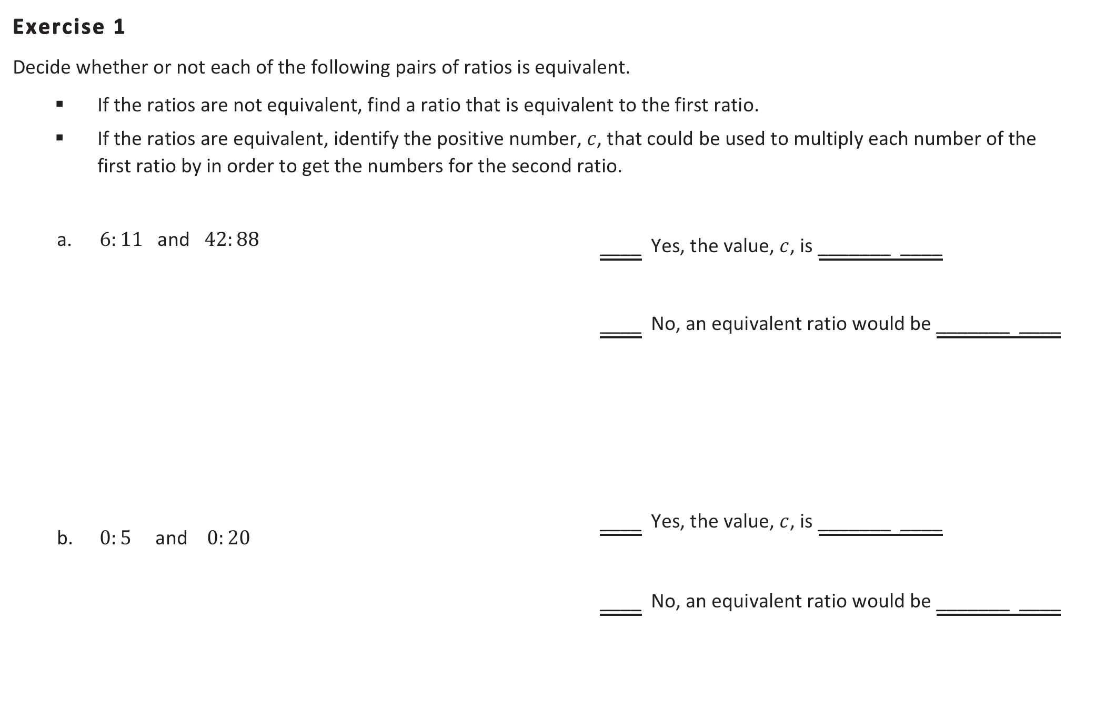
Lesson 4 – Equivalent Ratios
Notes:
Exercise 1 is a recursive exercise to practice outcomes developed in the first 3 lessons. Here for exercise 2, you will see that students bridge their knowledge to the constant, or noted here, the value c. Students are determining if ratios are equivalent. If they are they equivalent, they denoting the constant, which is also referenced as the value of the unit in the tape diagram. If they are not equivalent, students create a situation where the ratios would be equivalent.
(SWITCH to document camera to model)
Note number two in this exercise. What are your thoughts on this? How can we explain to students why this is a ratio if we can’t necessarily determine that the constant is 4? Can’t we make the argument that the product of zero and any number will result in zero? This includes 4.
TIME ALLOTTED FOR THIS SLIDE:
X minutes
MATERIALS NEEDED:
X

Slide 24
Lesson 4- Equivalent Ratios
Exercise 3:
In a bag of mixed walnuts and cashews, the ratio of the number of walnuts to the number of cashews is 5:6. Determine the amount of walnuts that are in the bag if there are 54 cashews. Use a tape diagram to support your work. Justify your answer by determining equivalent ratios.
walnuts
cashews
54
Notes:
Read the problem to participants.
Students will have to determine that six equal parts of 54 is 9. The constant is 9. Then they will multiply the units for the walnuts by the constant 9. 5 times 9 is 45. There would be 45 walnuts.
Use your whiteboards to show the multiplicative relationship between the values, highlighting the constant, 9.
TIME ALLOTTED FOR THIS SLIDE:
X minutes
MATERIALS NEEDED:
X

Slide 25
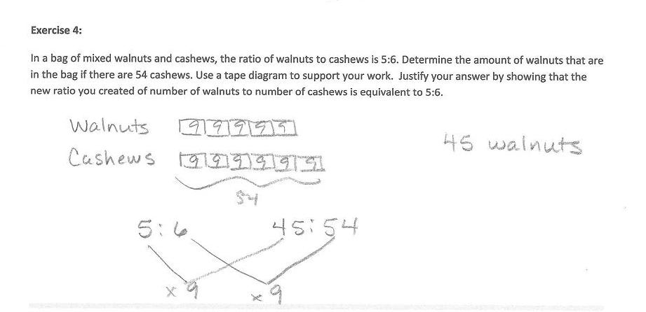
Lesson 4- Equivalent Ratios
Exercise 3:
In a bag of mixed walnuts and cashews, the ratio of the number of walnuts to the number of cashews is 5:6. Determine the amount of walnuts that are in the bag if there are 54 cashews. Use a tape diagram to support your work. Justify your answer by determining equivalent ratios.
Notes:
Share with group.
(CLICK TO ADVANCE THE EXEMPLAR)
TIME ALLOTTED FOR THIS SLIDE:
X minutes
MATERIALS NEEDED:
X

Slide 26
Lesson 5 – Solving Problems by Finding Equivalent Ratios
Students use tape diagrams to find an equivalent ratio given the part to part ratio and the total of those quantities. Students use tape diagrams to find an equivalent ratio given the part-to-part ratio and the difference between those two quantities.
Students make the connection between the common factor, c, in definition of equivalent ratios and the value of the unit in the tape diagram used to solve ratio problems.
Notes:
Now that students have experience with recognizing and creating equivalent ratios, they will use their knowledge to solve problems by finding equivalent ratios.
(CLICK TO ADVANCE EACH OUTCOME) Read each outcome as they appear.
TIME ALLOTTED FOR THIS SLIDE:
X minutes
MATERIALS NEEDED:
X

Slide 27
Lesson 5 – Solving Problems by Finding Equivalent Ratios
A County Superintendent of Highways is interested in the numbers of different types of vehicles that regularly travel within his county. In the month of August a total of 192 registrations were purchased for passenger cars and pickup trucks at the local Department of Motor Vehicles. They reported that in the month of August, for every 5 passenger cars registered there were 7 pickup trucks registered. How many of each type of vehicle were registered there in the month of August?
5:7 part-to-part
7:5 part-to-part
5 to 12 part-to-whole
7 to12 part-to-whole
192 vehicles
12 equal parts
192 divided by 12 = 16
7 x 16 = 112 pickup trucks
Passenger Cars
Pickup Trucks
Notes:
What ratios can we determine from this problem? Describe the ratios (CLICK TO ADVANCE EACH RATIO)
(Answer: 5:7 part-to-part, 7:5 part-to-part, 5 to 12 part-to-whole, 7 to12 part-to-whole)
Let’s use a tape-diagram to represent the situation. (CLICK TO ADVANCE THE TAPE DIAGRAM)
How many total units (or equal parts) are there? (CLICK TO ADVANCE, THEN HIDE) How many total registered vehicles are there? (CLICK TO ADVANCE, THEN HIDE)
How can we determine the unit value? (CLICK TO ADVANCE, THEN HIDE)
How do we determine the amount of passenger cars? (CLICK TO ADVANCE, THEN HIDE)
How do we determine the amount of pickup trucks? (CLICK TO ADVANCE)
How many equal sized parts does the tape diagram consist of? 12
What total quantity does the tape diagram represents? 192 vehicles
What value does each individual part of the tape diagram represent?
Divide the total quantity into 12 equal sized parts:
192/12=16
How many of each type of vehicle were registered in August?
5∙16=80 passenger cars and 7∙16=112 pickup trucks
TIME ALLOTTED FOR THIS SLIDE:
X minutes
MATERIALS NEEDED:
X

Slide 28
Lesson 6 – Exercise 1
The Business Direct Hotel caters to people who travel for different types of business trips. On Saturday night, there is not a lot of business travel, so the ratio of the number of occupied rooms to the number of unoccupied rooms is 2:5. However, on Sunday night the ratio of the number of occupied rooms to the number of unoccupied rooms is 6:1 due to the number of business people attending a large conference in the area. If the Business Direct Hotel has 432 occupied rooms on Sunday night, how many unoccupied rooms does it have on Saturday night?
Notes:
Model problem with document camera and tape diagrams.
TIME ALLOTTED FOR THIS SLIDE:
X minutes
MATERIALS NEEDED:
X

Slide 29
Lesson 6 – Solving Problems by Finding Equivalent Ratios
Students use tape diagrams to solve problems given a ratio between two quantities, and a change to those quantities that changes the ratio.
Gallery Walk!
Spend 2 minutes at each station to determine the answers to each question.
Share with the group the rigor you find
in the problems provided in the examples.
Notes:
Lesson 6 furthers students problem solving by finding equivalent ratios.
(CLICK TO ADVANCE THE OUTCOME)
Because there are many exercises in this lesson, let’s participate in a gallery walk in order for us all to visit each exercise and collaborate with our peers. You will choose a station to begin. We will spend 2 minutes at each station. When time is up you will move to the station to the right. Please record your work on a separate sheet of paper.
Once time is up, we will return to our seats and share with the group our thoughts on the rigor you found in the problems.
Allow 10 minutes for the gallery walk. After two minute intervals, have participants move to the next station.
Once seated, (CLICK TO ADVANCE) have participants discuss the rigor of the exercises/stations.
TIME ALLOTTED FOR THIS SLIDE:
X minutes
MATERIALS NEEDED:
X

Slide 30
Lesson 7 – Associated Ratios and the Value of a Ratio
Students understand the relationship between ratio and fractions. Students describe the fraction A / B associated with the ratio A : B as the value of the ratio A to B.
Students understand that when given a ratio A : B, different ratios can be formed from the numbers A and B. For example, B : A, A : (A + B), and B : (A + B) are associated with the same ratio relationship.
Notes:
Now that students have experience with recognizing, creating and solving problems by using equivalent ratios, they will use their knowledge to understand the relationship between ratios and fractions, associated ratios and the value of a ratio.
(CLICK TO ADVANCE EACH OUTCOME) Read each outcome as they appear.
TIME ALLOTTED FOR THIS SLIDE:
X minutes
MATERIALS NEEDED:
X

Slide 31
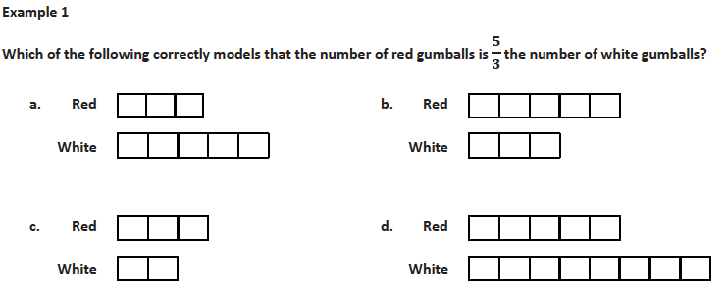
Lesson 7 – Associated Ratios and the Value
of a Ratio
Notes:
Read through Example 1 and solve.
TIME ALLOTTED FOR THIS SLIDE:
X minutes
MATERIALS NEEDED:
X

Slide 32
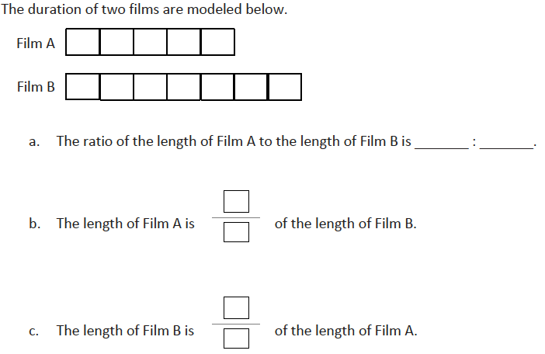


Lesson 7 – Associated Ratios and the Value of a Ratio
Notes:
Now take a look at how Example 2 extends Example 1. Take 1 minute to complete the example.
Take 2 minutes to discuss with your table why students would need to understand associated ratios. Where later will they need this a prerequisite skill?
TIME ALLOTTED FOR THIS SLIDE:
X minutes
MATERIALS NEEDED:
X

Slide 33
Lesson 8 - Equivalent Ratios Defined Through Value of a Ratio
Students understand the value of a ratio A:B is A/B. They understand that if two ratios are equivalent they have the same value. Students use the value of a ratio to solve ratio problems in a real-world context.
Students use the value of a ratio in determining whether two ratios are equivalent.
Notes:
TIME ALLOTTED FOR THIS SLIDE:
X minutes
MATERIALS NEEDED:
X

Slide 34
Lesson 8 - Equivalent Ratios Defined Through Value
of a Ratio
Recall that given a ratio A : B, where B ≠ 0, we call the quotient, A / B, the value of the ratio.
Circle any equivalent ratios from the list below.
Ratio: 1 : 2 Value of the Ratio:
Ratio: 5 : 10 Value of the Ratio:
Ratio: 6 : 16 Value of the Ratio:
Ratio: 12 : 32 Value of the Ratio:
What do you notice about the value of the equivalent ratios?
Note that 1:2 is not the same ratio as 5:10, we don’t say they are equal. The ratios are not the same, but their values are equal. Would this always be the case? Would the values of equivalent fractions always be equal?
1/2
1/2
3/8
3/8
Notes:
Read the outcomes.
(CLICK TO ADVANCE RATIOS AND VALUES OF RATIOS) Let’s circle the equivalent ratios. (CLICK TO ADVANCE CIRCLES)
What would be the value of the ratio 1:2? The value of 5:10?
How about the value of the ratio 6:16? The value of 12:32?
(CLICK TO ADVANCE BULLET)
What do you notice about the value of the equivalent ratios?
(CLICK TO ADVANCE BULLET)
Read bullet and allow 1-2 minute for participant sharing.
TIME ALLOTTED FOR THIS SLIDE:
X minutes
MATERIALS NEEDED:
X

Slide 35
Lesson 8 - Equivalent Ratios Defined Through Value
of a Ratio
Exercise 2:
Here is a theorem: If two ratios are equivalent, then they have the same value.
Can you provide any counter-examples to the theorem above?
Allow students to try this in pairs. Observe the progress of students and question student’s counter-examples. Ask for further clarification or proof that the two ratios are equivalent, but do not have the same value. If students still think they have discovered a counter-example, share the example with the class and discuss why it is not a counter-example.
Ask entire class if anyone thought of a counter-example. If students share examples, have others explain why they are not counter-examples. Then discuss why there are not possible counter-examples to the given theorem. It is important for students to understand that the theorem is always true so it is not possible to come up with a counter-example.
Notes:
TIME ALLOTTED FOR THIS SLIDE:
X minutes
MATERIALS NEEDED:
X

Slide 36
Lesson 9 – Tables of Equivalent Ratios
Students understand that a ratio is often used to describe the relationship between the amount of one quantity and the amount of another quantity as in the cases of mixtures or constant rates.
Students understand that a ratio table is a table of equivalent ratios. Students use ratio tables to solve problems.
The approach of this lesson and those that follow is for the teacher to model the use of tables in problem solving. There is no need to engage in an explanation of why or how they are useful; simply modeling their use in this lesson, examining their structure in the next lesson, and repeated use for problem solving in the remaining lessons of the topic should sufficiently promote tables as a tool for problem solving with collections of equivalent ratios.
Notes:
TIME ALLOTTED FOR THIS SLIDE:
X minutes
MATERIALS NEEDED:
X

Slide 37
Lesson 9 – Examples
Example 1:
To make Paper Mache, the art teacher mixes water and flour. For every two cups of water, she needs to mix in three cups of flour to make the paste.
Find equivalent ratios for the ratio relationship 2 cups of water to 3 cups of flour. Represent the equivalent ratios in the table below.
Example 2:
Spraying plants with “cornmeal juice” is a natural way to prevent fungal growth on the plants. It is made by soaking cornmeal in water, using two cups of cornmeal for every nine gallons of water. Complete the ratio table to answer the questions that follow.
Notes:
Model each example using the document camera.
TIME ALLOTTED FOR THIS SLIDE:
X minutes
MATERIALS NEEDED:
X

Slide 38
Lesson 10 – The Structure of Ratio Tables
Students identify both the additive and multiplicative structure of a ratio table and use the structure to make additional entries in the table.
Students use ratio tables to solve problems.
Exploratory Challenge
Imagine that you are making a fruit salad. For every quart of blueberries you add, you would like to put in 3 quarts of strawberries. Create three ratio tables that show the amounts of blueberries and strawberries you would use if you needed to make fruit salad for greater numbers of people.
Table 1 should contain amounts where you have added fewer than 10 quarts of blueberries to the salad.
Table 2 should contain amounts of blueberries between 10 and 50 quarts.
Table 3 should contain amounts of blueberries greater than 100 quarts.
Notes:
Use the document camera to model the exploratory challenge.
TIME ALLOTTED FOR THIS SLIDE:
X minutes
MATERIALS NEEDED:
X

Slide 39
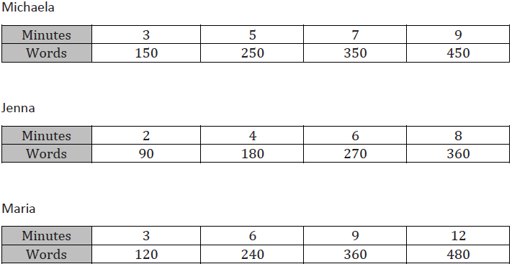
Lesson 11 – The Structure of Ratio Tables
Students solve problems by comparing different ratios using two or more ratio tables.
The following tables show how many words each person can text in a given amount of time. Compare the rates of texting for each person using the ratio table.
Notes:
What might be problematic for students to compare the rates of texting for each person? Comparing the rates using the table can be a struggle because there is not a common time for all three tables. We could compare the first and third table by comparing the words at 3 and 9 and we could compare the second and third tables by comparing the words at 6 minutes. If we use the ratios to compare, what do the ratios mean in the context of this problem? The ratios show how many words each person can text in 1 minute. Knowing this, how can we use the ratios to help compare the texting rates of the three girls? We can find the values of the ratios an then put them in order to see who is the fastest and the slowest. Why can’t students just pick the student that has the largest number of words at the end of the table?
TIME ALLOTTED FOR THIS SLIDE:
X minutes
MATERIALS NEEDED:
X

Slide 40
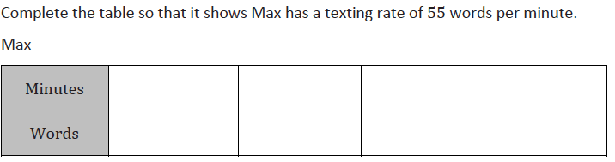
Lesson 11 – Example 1
1
2
3
4
55
110
165
220
Notes:
Now that we know that for every minute (CLICK to advance the 1 minute), there are 55 words (CLICK to advance the 55 words), we can use this information, as well as our knowledge of multiplicative comparisons and patterns to determine the values for the rest of the table. If we doubled 1 minute (CLICK to advance the 2) we would have 2 minutes. Since we doubled the 1, we have to double 55, or multiply it by two to determine the amount of texted words in 2 minutes which is (CLICK to advance the 110) 110. If we multiply the 1 minute by 3 to find the words text in 3 minutes (CLICK to advance), then we multiply 55 by three to find the number of words, which is (CLICK to advance 165) 165. Same goes for finding the number of words text in 4 minutes. We multiply 1 by 4, so we must multiply 55 by 4 to determine the amount of words text in 4 minutes to be (CLICK to advance 220) 220 words.
TIME ALLOTTED FOR THIS SLIDE:
X minutes
MATERIALS NEEDED:
X

Slide 41
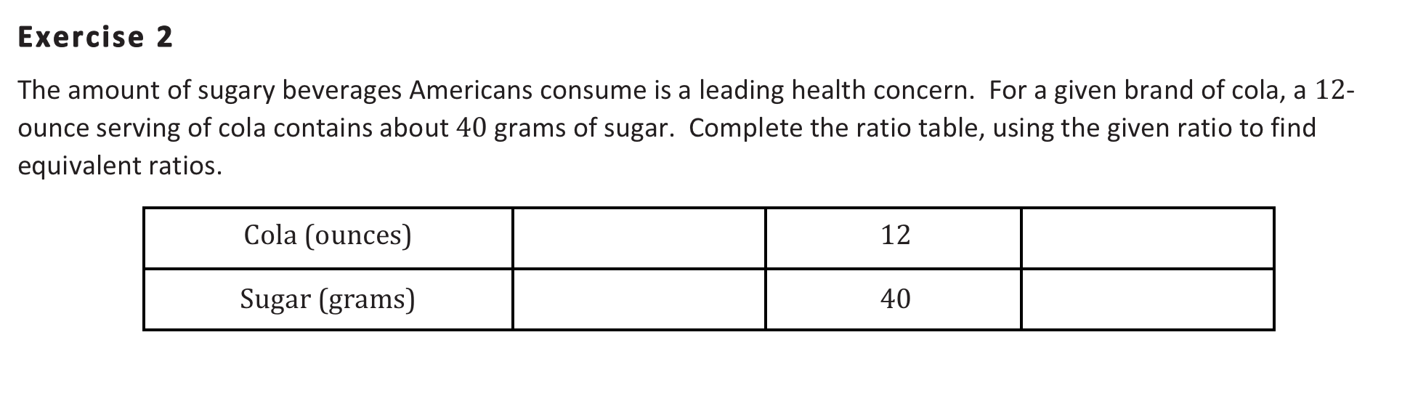
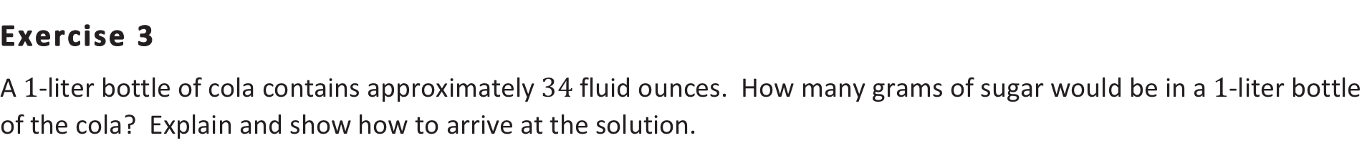
Lesson 12- From Ratio Tables to Double Number Line Diagrams
Students create equivalent ratios using a ratio table and represent these ratios on a double number line diagram.
Students extend and use a double number line diagram to solve ratio problems related to the real world.
6
18
20
60
Notes:
Click to advance through slide, reading the outcomes and solving Exercise 2. From there, present exercise 3 and switch to document camera to model solution.
TIME ALLOTTED FOR THIS SLIDE:
X minutes
MATERIALS NEEDED:
X

Slide 42
Lesson 12- From Ratio Tables to Double Number Line Diagrams
Each participant is given a card with a ratio on it.
Move around the room in search of other participants who have ratios that are equivalent to theirs.
Those with equivalent ratios will form a group and create a ratio table, which contains all of the equivalent ratios.
Notes:
Allow 5 minutes for the activity.
TIME ALLOTTED FOR THIS SLIDE:
X minutes
MATERIALS NEEDED:
X

Slide 43
Lesson 13 - From Ratio Tables to Equations Using
the Value of a Ratio
Students restate a ratio in terms of its value; e.g., if the ratio of the length A to the length B is 3:5 (in the same units), students state that “length A is 3/5 of length B”, “length B is 5/3 of length A”, “length A is 3/8 of the total length”, and “length B is 5/8 of the total length.”
Students use the value of the ratio to problem-solve by writing and solving equations.
Notes:
TIME ALLOTTED FOR THIS SLIDE:
X minutes
MATERIALS NEEDED:
X

Slide 44
Lesson 13 - From Ratio Tables to Equations Using
the Value of a Ratio
Jorge is mixing a special shade of orange. He has mixed 1 gallon of red paint with three gallons of yellow paint.
Based on the ratio of gallons of yellow paint to gallons of red paint, which of the following statements are true?
3/4 of a 4-gallon mix would be yellow. Every 1 gallon of yellow requires 1/3 gallon of red.
Every 1 gallon of red requires 3 gallons of yellow.
There is 1 gallon of red in a 4-gallon mix of orange paint.
There are 2 gallons of yellow paint in an 8-gallon mix of orange paint.
Notes:
Each participant is given a pre-made Unifix cube model consisting of 1 red and 3 yellow cubes to be used as a model for the scenario below.
Allow participants to discuss each question with a partner or group. As a whole group, participants explain one of the statements, and whether their groups feels the statement is true or false, and why. (The first 4 statements are true, while the 5th statement is false.)
How can we make the last statement true? To be made true, it should read “There are 6 gallons of yellow paint in an 8 gallon mix of orange paint.
TIME ALLOTTED FOR THIS SLIDE:
X minutes
MATERIALS NEEDED:
X

Slide 45
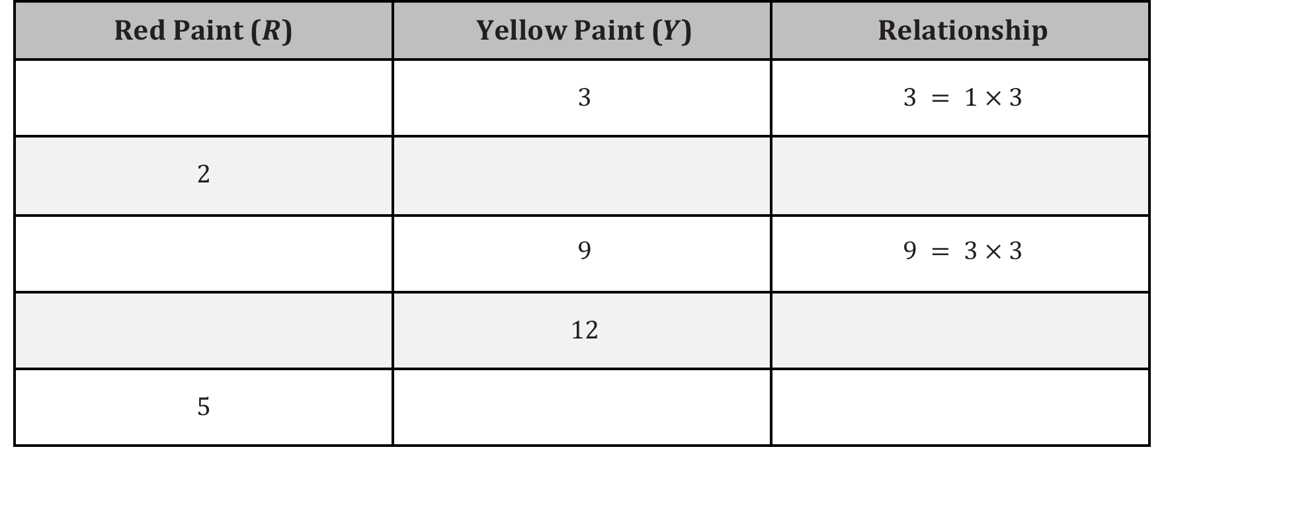
Lesson 13 - From Ratio Tables to Equations Using
the Value of a Ratio
Based on the information on red and yellow paint given in Exercise 1, complete the table below.
1
6
6 = 2 x 3
3
4
12 = 4 x 3
15
15 = 5 x 3
Notes:
Continually advance through slide and reinforce the relationship between the red paint and the yellow paint as multiplicative relationships.
TIME ALLOTTED FOR THIS SLIDE:
X minutes
MATERIALS NEEDED:
X

Slide 46
Lesson 14 - From Ratio Tables, Equations,
and Double Number Line Diagrams to Plots
on the Coordinate Plane
Students associate with each ratio A : B the ordered pair (A, B) and plot it in the x-y coordinate plane.
Students represent ratios in ratio tables, equations, and double number line diagrams and then represent those ratios in the coordinate plane.
Notes:
TIME ALLOTTED FOR THIS SLIDE:
X minutes
MATERIALS NEEDED:
X

Slide 47
Lesson 14 - From Ratio Tables, Equations,
and Double Number Line Diagrams to Plots
on the Coordinate Plane
Based on their previous knowledge from earlier lessons in this module, and with predetermined groups, students complete tables to satisfy missing values, create double line diagrams to support the values, and develop an equation to support the values.
From there, a Socratic approach is used in order to guide students to build a graph on the coordinate plane.
Read through the questioning in Lesson 14 and discuss with your table partner(s). What do you notice about the questioning?
Notes:
(CLICK TO ADVANCE EACH BULLET)
Based on their previous knowledge from earlier lessons in this module, and with predetermined groups, students complete tables to satisfy missing values, create double line diagrams to support the values, and develop an equation to support the values.
From there, a Socratic approach is used in order to guide students to build a graph on the coordinate plane.
Read through the questioning in Lesson 14 and discuss with your table partner(s). What do you notice about the questioning? Allow 2 minutes for reading, 2 minutes for sharing with table.
Model examples from Lesson on Document Camera
TIME ALLOTTED FOR THIS SLIDE:
X minutes
MATERIALS NEEDED:
X

Slide 48
Lesson 15 - From Ratio Tables, Equations,
and Double Number Line Diagrams to Plots
on the Coordinate Plane
Students associate with each ratio A:B the ordered pair (A, B) and plot it in the x–y coordinate plane.
Given a ratio table, students plot the ratios in the plane and observe that they lie on a line through the origin. Students conclude that the coordinates in the line satisfy y=kx, where k is the value of an associated ratio.
At the end of this morning’s news segment, the local television station highlighted area pets that need to be adopted. The station posted a specific website on the screen for viewers to find more information on the pets shown and the adoption process. The station producer checked the website two hours after the end of the broadcast and saw that the website had 24 views. One hour after that, the website had 36 views.
Notes:
SWITCH to document camera and model the progression of the exercises.
TIME ALLOTTED FOR THIS SLIDE:
X minutes
MATERIALS NEEDED:
X

Slide 49
Lesson 16: From Ratios to Rates
Student Outcomes
Students recognize that they can associate a ratio of two quantities, such as “the ratio of miles per hour is 5:2,” to another quantity called the rate.
Given a ratio, students precisely identify the associated rate. They identify the unit rate and the rate unit.
Notes:
TIME ALLOTTED FOR THIS SLIDE:
X minutes
MATERIALS NEEDED:
X

Slide 50
Lesson 16: From Ratios to Rates
Lesson Notes:
To define the most general form of a rate precisely requires calculus, a concept that is well beyond middle school. While teachers in 6th and 7th grade should describe and speak about the idea of rates and how rates can vary over time, rate should be left undefined for students. Even a precise definition of average rate requires that students know the definition of a function.
We will describe a rate as a ratio of two quantities.
Unit rate is the value of the ratio.
Rate unit is the label.
Notes:
(CLICK TO ADVANCE FIRST BULLET) Read the note.
(CLICK TO ADVANCE SECOND BULLET) Read the note.
(CLICK TO ADVANCE THIRD BULLET) Read the note.
(CLICK TO ADVANCE FOURTH BULLET) Read the note.
We are going to focus on these terms in lesson 16.
TIME ALLOTTED FOR THIS SLIDE:
X minutes
MATERIALS NEEDED:
X

Slide 51
Lesson 16: From Ratios to Rates
Take a look at Example 1.
Notice students are called upon to use their prior knowledge of equivalent ratios from the first half of the module.
Diet cola was on sale last week. It cost $10 for every 4 packs of diet cola.
  How much does 2 packs of diet cola cost?
  How much does 1 pack of diet cola cost?
Packs of Cola | 4 | 2
Total Cost | 10 | 5
Packs of Cola | 2 | 1
Total Cost | 5 | 2.50
Notes:
Thinking about the outcomes and the lesson notes, we are going to dive into the first lesson of the second half of lessons. For these next few lessons, we will examine various portions to detail the progression of learning. Please follow along in the lesson documents in front of you.
Read the problem to the group.
(CLICK TO ADVANCE FIRST BULLET) Notice students are called upon to use their prior knowledge of equivalent ratios from the first half of the module.
(CLICK TO ADVANCE SECOND BULLET) Diet cola was on sale last week. It cost $10 for every 4 packs of diet cola.
(CLICK TO ADVANCE THE THIRD BULLET) Notice that now there are eight boys on the team. How many girls would be on the team now, if there are 8 boys? What do the students know from the first half of the module in order for them to find this answer? Students know how to find equivalent ratios using tape diagrams, tables, equations, graphs, etc. Here, we provide an example using a table.
(CLICK TO ADVANCE TABLE) if 4 packs of cola cost 10 dollars, students can determine that 2 packs of cola costs 5 dollars.
(CLICK TO ADVANCE FIFTH BULLET) How much does 1 pack of diet cola cost?
(CLICK TO ADVANCE) From the table, we can see that one pack of cola costs $2.50
TIME ALLOTTED FOR THIS SLIDE:
X minutes
MATERIALS NEEDED:
X

Slide 52
Lesson 16: From Ratios to Rates
After ratios have been discussed, students use the previous example to identify the new terms.
Rate
  $10 for every 4 packs of diet cola is a rate because it is a ratio of two quantities.
Unit Rate
  The unit rate is 2.5 because it is the value of the ratio, meaning for every 1 pack of diet cola, the cost is 2.5.
Rate Unit
  The rate unit is dollars/packs of cola (dollars per packs of cola) because it costs 2.5 dollars for every 1 pack of cola.
Notes:
CLICK TO ADVANCE BULLET) Let’s determine rate from this exercise.
(CLICK TO ADVANCE BULLET) $10 for every 4 packs of diet cola is the rate because it is a ratio of the two quantities.
(CLICK TO ADVANCE BULLET) So, what about the unit rate?
(CLICK TO ADVANCE BULLET) The unit rate is 2.5 because it is the value of the ratio, meaning for every 1 pack of diet cola, the cost is 2.5.
(CLICK TO ADVANCE BULLET) Well, then, with those descriptions, what would the rate unit be?
(CLICK TO ADVANCE BULLET) The rate unit is dollars/packs of cola (or, dollars per packs of cola) because it costs 2.5 dollars for every 1 pack of cola.
Do you see the connection between each of these? Students will explore various real-life situations in order to become proficient in determining rate, unit rate and rate unit.

Slide 53
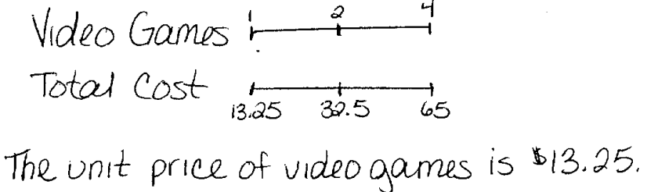
Lesson 16: From Ratios to Rates
Teagan went to Gamer Realm to buy new video games. Gamer Realm was having a sale: $65 for 4 video games. He bought 3 games for himself and one game for his friend, Diego, but Teagan does not know how much Diego owes him for the one game. What is the unit price of the video games? What is the rate unit?
Students are encouraged to use all representations they have learned from the first half of the module.
Note the students using a double number line diagram to find the answer to question 1 in the exploration problems.
Here, students determine the unit price of the video game is $13.25.
The unit rate is 13.25.
The rate unit is dollars/video games.
Notes:
Let’s take a look at the language in the problem. We see a ratio relationship of 64 dollars for every 4 video games. Notice, too, where students may misinterpret the amount of video games because Teagan is buying three for himself but he is also buying one for his Diego. Students are encouraged to use all representations they have learned from the first half of the module.
(CLICK TO ADVANCE BULLET) Note that below the students using a double number line diagram to find the answer to question 1 in the exploration problems because we are comparing different units.
(CLICK TO ADVANCE DOUBLE NUMBER LINE DIAGRAM) This is not to say that this is the only representation they can use, it is solely an example of one they can use. We begin at 4 since that has been given to us, and we compare it to 65 dollars. If we take half of 4, we can find the price for 2 video games and that is half of 65 dollars, which is 32.5. If we take half once more, we can find the cost of 1 video game which is half of 32.5. The cost for 1 video game is $13.25.
(CLICK TO ADVANCE BULLET) Here, students determine that the unit price of the video game is $13.25.
(CLICK TO ADVANCE BULLET) The unit rate is 13.25, while the rate unit is (CLICK TO ADVANCE BULLET) dollars/video games. Together we can state the entire rate as 13.25 dollars/video games.

Slide 54
Lesson 17: From Rates to Ratios
Student Outcomes
Given a rate, students find ratios associated to the rate, including a ratio where the second term is one and a ratio where both terms are whole numbers.
Students recognize that all ratios associated to a given rate are equivalent because they have the same value.
Notes:
With a firm understanding of rates, we are going to examine how students maneuver from rates back to ratios.
(CLICK TO ADVANCE EACH OUTCOME) Read each outcome as they appear.

Slide 55
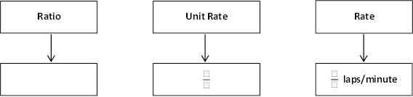
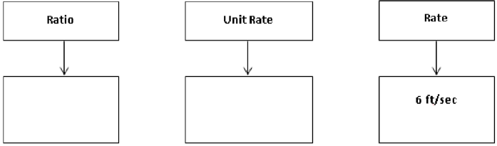
Lesson 17: From Rates to Ratios
Notes:
(CLICK TO ADVANCE FLOW CHART) Notice how students will use the flow chart to find the rate for question 2 in the first exercise. They break down the ratio, determine the unit rate, then determine the rate.
(CLICK TO ADVANCE FLOW CHART) In order for students to determine ratios from rates, they will simply move backward along the flow chart. Here, the rate is provided at 6 ft/sec. Students will identify the unit rate as 6 feet for every 1 minute, and from there determine a ratio. Notice all ratios can be acceptable if it is equivalent to the unit rate.

Slide 56
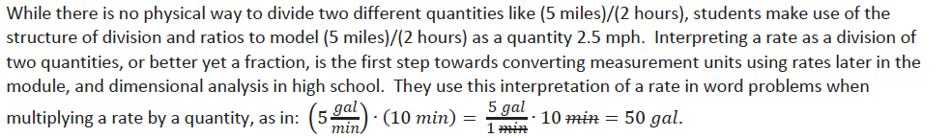
Lesson 18: Finding a Rate by Dividing Two Quantities

Slide 57
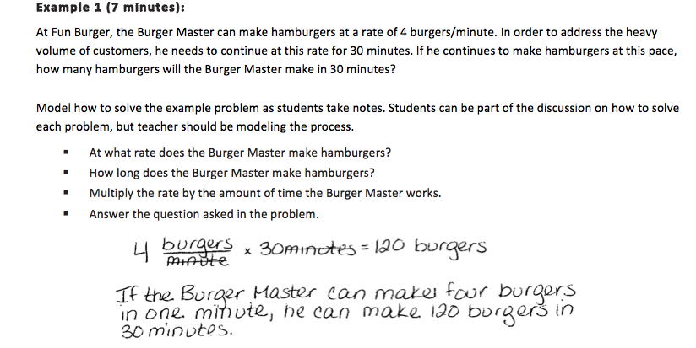
Lesson 18: Finding a Rate by Dividing Two Quantities
Notes:
Let’s take a minute to read Example 1.
Note the guiding questions. Students are guided through the solution to this problem. You will have to discuss why the minute labels “cancel out” You can describe the product of 4 burgers/ minute x 30 minutes as 120 burger minutes/minute first. That way you can explain that the minutes/minutes will equal 1, and can be omitted.

Slide 58
Lesson 18: Finding a Rate by Dividing Two Quantities
Gallery Walk!
Spend 2 minutes at each station to determine the answers to each question.
Share with the group the rigor you find
in the problems provided in the examples.
Notes:
Because there are many exercises in this lesson, let’s participate in a gallery walk in order for us all to visit each exercise and collaborate with our peers. You will choose a station to begin. We will spend 2 minutes at each station. When time is up you will move to the station to the right. Please record your work on a separate sheet of paper.
Once time is up, we will return to our seats and share with the group our thoughts on the rigor you found in the problems.
Allow 12 minutes for the gallery walk. After two minute intervals, have participants move to the next station.
Once seated, (CLICK TO ADVANCE) have participants discuss the rigor of the exercises/stations.

Slide 59
Lesson 19: Comparison Shopping – Unit Price and Related Measurement Conversions
Students solve problems by analyzing different unit rates given in tables, equations and graphs.
The ratio of the number of cups of blue paint to the number of cups of red paint is 1:2, which means for every cup of blue paint, there are two cups of red paint. In this case, the equation would be red = 2 x blue or r = 2b, where b represents the amount of blue paint and r represents the amount of red paint. Make a table of values.
Cups Blue | 1 | 2 | 3 | 4
Cups Red | 2 | 4 | 6 | 8
Notes:
(CLICK TO ADVANCE EACH OUTCOME) Read the outcome.
(CLICK TO ADVANCE STUDENT EXAMPLE) The ratio of cups of blue paint to cups of red paint is 1:2, which means for every cup of blue paint, there are two cups of red paint. In this case, the equation would be red = 2 x blue or r = 2b, where b represents the amount of blue paint and r represents the amount of red paint. Make a table of values.
(CLICK TO ADVANCE TABLE) Here, students are using the equation to build the table.

Slide 60
Lesson 19: Comparison Shopping – Unit Price and Related Measurement Conversions
Matching Activity!
Spend 5 minutes matching the graphs, equations and tables!
Notes:
This activity is provided for students to master the correlation between equation, tables and graphs. Let’s spend 5 minutes trying to figure out which cards match up with which.
Let’s spend the next 5 minutes collaborating with your tables as you examine the rest of this lesson. How is the second half of the module building off of the first half, so far? How are the lessons building in succession?

Slide 61
Lesson 20: Comparison Shopping – Unit Price and Related Measurement Conversions
Student Outcomes
Students solve problems by analyzing different unit rates given in words, tables, equations and graphs.

Slide 62
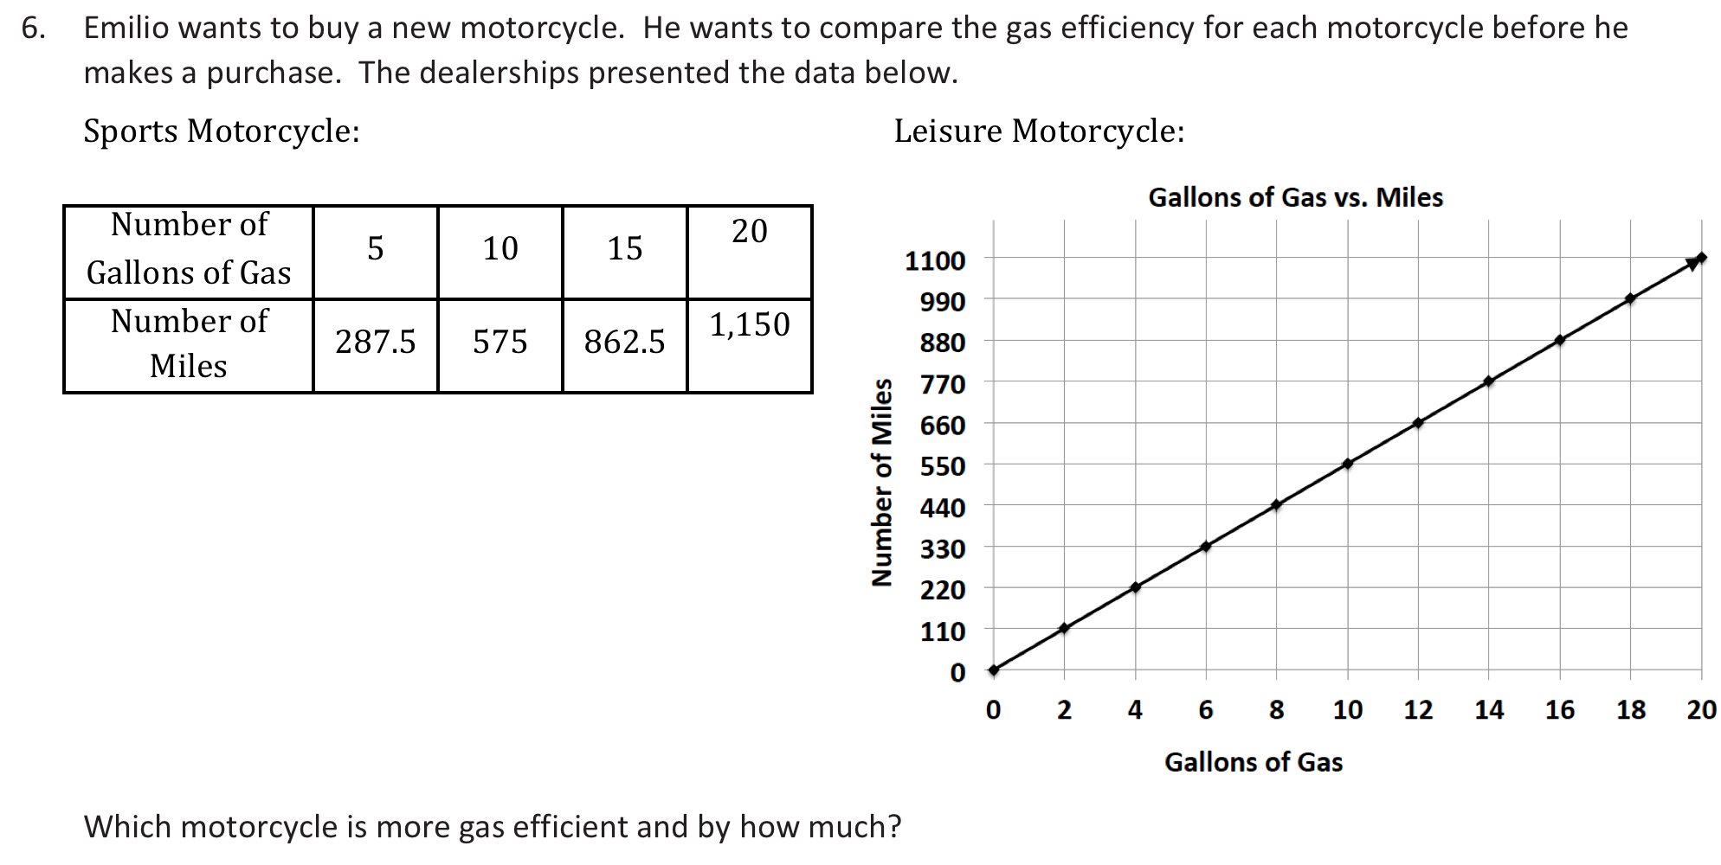
Lesson 20: Comparison Shopping – Unit Price
and Related Measurement Conversions
Notes:
SWITCH to document camera and model example.

Slide 63
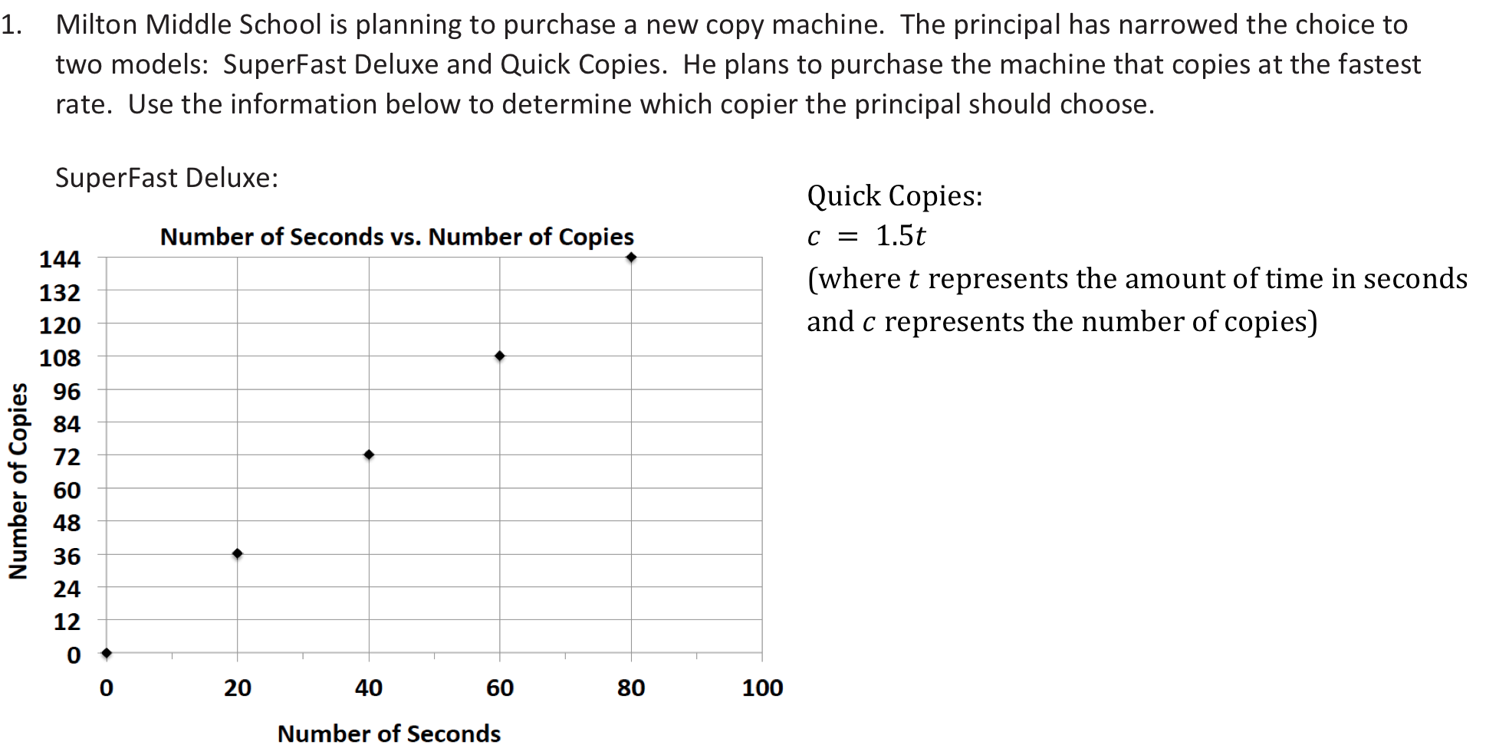
Lesson 20: Comparison Shopping – Unit Price
and Related Measurement Conversions
Notes:
SWITCH to document camera and model example.

Slide 64
Lesson 21: Getting the Job Done – Speed, Work,
and Measurement Units
Opening Exercise
Identify the ratios that are associated with conversions between feet, inches, and yards.
12 inches = foot; the ratio of inches to feet is .
1 foot = inches; the ratio of feet to inches is .
3 feet = yard; the ratio of feet to yards is .
1 yard = feet; the ratio of yards to feet is .
Example 1
Work with your partner to find out how many feet are in 48 inches. Make a ratio table that compares feet and inches. Use the conversion rate of 12 inches per foot or 112 foot per inch.
Notes:
Discuss the opening activity and have participants answer the problems using their whiteboards.
(ADVANCE SLIDE) Read the problem to participants.

Slide 65
Lesson 21: Getting the Job Done – Speed, Work,
and Measurement Units
How many feet are in 48 inches?
Make a ratio table that compares feet and inches. Use the conversion rate of 12 inches per foot, or 1/12 foot per inch.
Inches | 12 | 24 | 36 | 48
Feet | 1 | 2 | 3 | 4
Using knowledge from previous lessons, determine another method we could use to determine how many feet are in 48 inches.

Slide 66
Lesson 22: Getting the Job Done – Speed, Work,
and Measurement Units
Student Outcome
Students decontextualize a given speed situation, representing symbolically the quantities involved with the formula, distance = rate • time
Part 1: Chris Johnson ran the 40 yard dash in 4.24 seconds. What is the rate of speed? Round any answer to the nearest hundredth of a second.
Notes:
Model using the document camera.

Slide 67
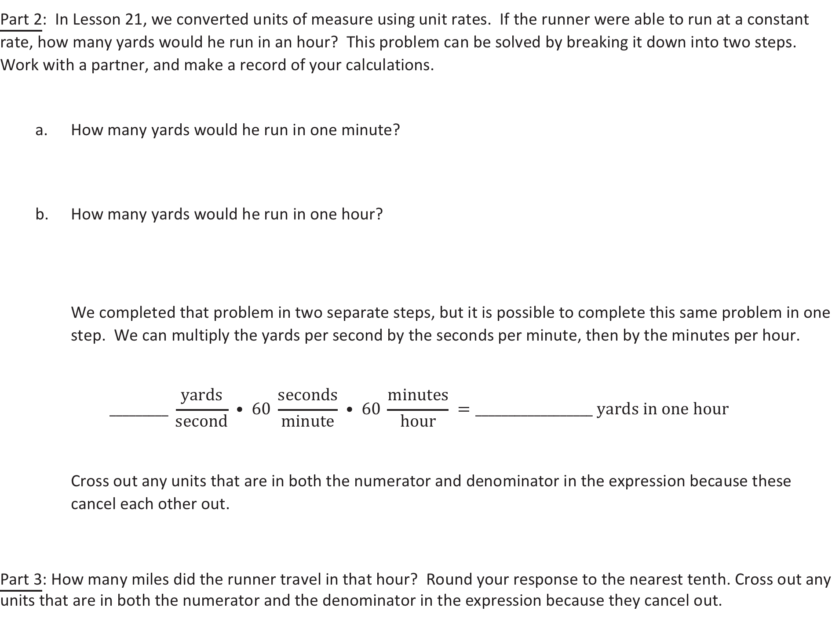
Lesson 22: Getting the Job Done – Speed, Work,
and Measurement Units
Notes:
Model Parts 2 and 3 using the document camera.

Slide 68
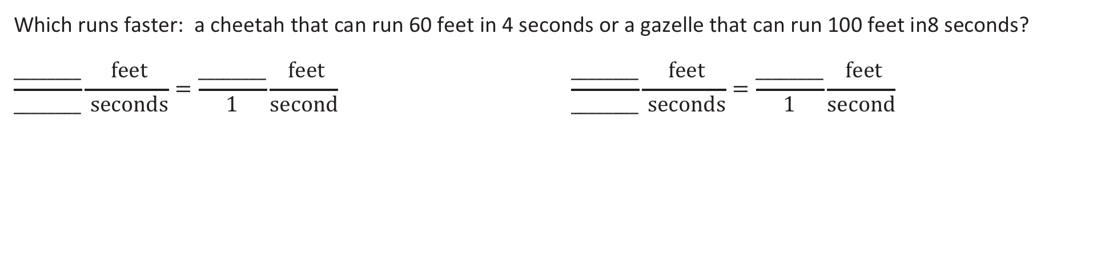
Lesson 23: Problem Solving Using Rates, Unit Rates,
and Conversions
Student Outcome
Students solve constant rate work problems by calculating and comparing unit rates.
Notes:
Have participants answer this using their whiteboards.

Slide 69
Lesson 24: Percents and Rates per 100
Student Outcomes
Students understand that percentages are related to part-to-whole ratios and rates where the whole is 100.
Students model percents and write a percent as a fraction over 100 or a decimal to the hundredths place.

Slide 70
Lesson 24: Percents and Rates per 100
http://nlvm.usu.edu/en/nav/frames_asid_333_g_3_t_1.html?from category_g_3_t_1.html
Notes:
If internet connection is available, share this link as it is referenced in Lesson 24 as a visual representation.

Slide 71
Lesson 24: Percents and Rates per 100
Exercise 1
Robb’s Fruit Farm consists of 100 acres, on which three different types of apples grow. On 25 acres, the farm grows Empire apples. McIntosh apples grow on 30% of the farm. The remainder of the farm grows Fuji apples. Shade in the grid below to represent the portion of the farm each type of apple occupies. Use a different color for each type of apple. Create a key to identify which color represents each type of apple.
Notes:
Model using document camera.

Slide 72




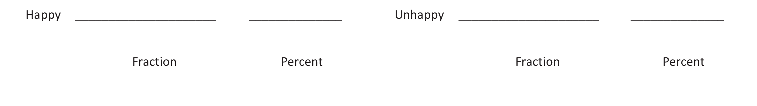
Lesson 25: A Fraction as a Percent
Student Outcome
Students write a fraction and a decimal as a percent of a whole quantity and write a percent of a whole quantity as a fraction or a decimal.
A survey was taken that asked participants whether or not they were happy with their job. An overall score was given. 300 of the participants were unhappy while 700 of the participants were happy with their job. Give a part-to-whole fraction for comparing happy participants to the whole. Then write a part-to-whole fraction of the unhappy participants to the whole. What percent were happy with their job, and what percent were unhappy with their job? Create a model to justify your answer.
Notes:
CLICK to advance problem and again to advance the organizer. Let’s move from a fraction to a percent using the information from the problem. Note that 700 people were unhappy and 300 were happy. That gives us a total of 1,000 people surveyed. To represent the happy people as a fraction, we simply compare the quantities using a fraction bar. 700 is in the numerator and 1,000 is in the denominator. CLICK to advance 700/1000. From there students can calculate the percent through equivalent fractions. They will determine that 700/1000 is equivalent to 70/100. Since there are 70 out of 100, the percent is 70%. Similarly, the fraction for unhappy people can be represented with the part over the whole, CLICK to advance: 300/1000. Using equivalent fractions, student will see that the percentage of unhappy people surveyed is 30%.

Slide 73
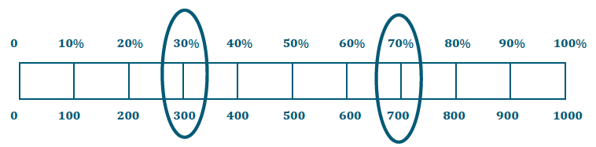
Lesson 25: A Fraction as a Percent
A survey was taken that asked participants whether or not they were happy with their job. An overall score was given. 300 of the participants were unhappy while 700 of the participants were happy with their job. Give a part-to-whole fraction for comparing happy participants to the whole. Then write a part-to-whole fraction of the unhappy participants to the whole. What percent were happy with their job, and what percent were unhappy with their job? Create a model to justify your answer.
Notes:
From there, students can use a visual representation to support their answer.

Slide 74
Lesson 26: Percent of a Quantity
Student Outcome
Students find the percent of a quantity. Given a part and the percent, students solve problems involving finding the whole.
Five of the 25 girls on Alden Middle School’s soccer team are 7th grade students. Find the percentage of 7th graders on the team. Show two different ways of solving for the answer. One of the methods must include a diagram or picture model.
Of the 25 girls on the Alden Middle School soccer team, 40% also play on a travel team. How many of the girls on the middle school team also play on a travel team?
Notes:
Model each using the document camera.

Slide 75
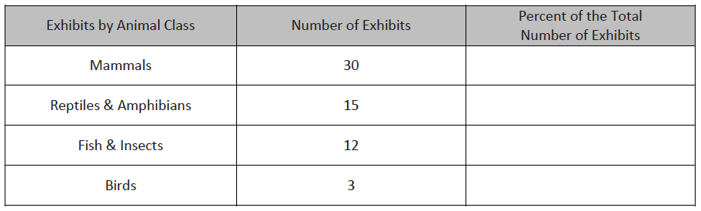




Lesson 26: Percent of a Quantity
There are 60 animal exhibits at the local zoo. What percent of the zoo’s exhibits does each animal class represent?
Notes:
Here, students are using the part and the whole to find the percent of the zoo’s exhibits that each animal class represents. We see that there are 60 total animal exhibits. Students use fractions, again, to determine the percent since they are given the part and the whole. So for 30 mammal exhibits, that is 30 out of 60. Students find equivalent fractions that will enable them to determine the percent. Students can scale 30/60 down to 5 tenths and then scale 5/10 up to 50/100 to determine that the amount of mammal exhibits represents 50% of the zoo. Similarly, knowing that there are 15 reptile and amphibian exhibits, students create a fraction using the part and the whole, which is 15/60, determine that that is equivalent to ¼ and ¼ is equivalent to 25/100 which determines that it is 25 percent. They continue in this fashion to determine the rest of the exhibits’ percentages.

Slide 76
Lesson 27: Solving Percent Problems
Student Outcome
Students find the percent of a quantity. Given a part and the percent, students solve problems involving finding the whole.
Solve the following three problems.
Write the words PERCENT, WHOLE, PART under each problem to show which piece you were solving for.
60% of 300 = _________________
60% of ______________ = 300
60 out of 300 = ______________%
How did your solving method differ with each problem?
Notes:
What are we determining when given certain problems? If we are looking for 60% of 300, we are given the percent and the whole, so we must be looking for the CLICK to advance” part.” When we are looking for 60% of a number and that results in 300, we have the percent and the part, so we are looking for the CLICK to advance “whole.” If we are given 60 out of 300, 60 represents the part, 300 represents the whole, so what we are looking for is the CLICK to advance “percent.” If we were to solve these problems, how do our solving methods differ with each problem?

Slide 77
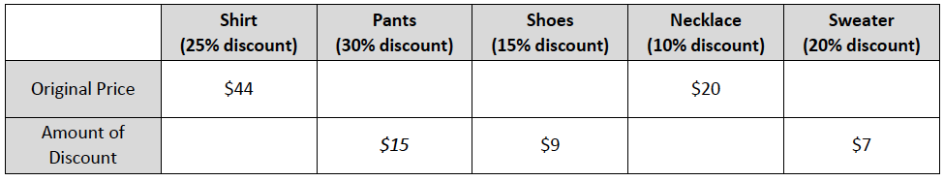





Lesson 27: Solving Percent Problems
Use models, such as 10×10 grids, ratio tables, tape diagrams, or double number line diagrams, to solve the following situation.
Priya is doing her back-to-school shopping. Calculate all of the missing values in the table below, rounding to the nearest penny, and calculate the total amount Priya will spend on her outfit after she received the indicated discounts.
Notes:
Depending on time:
Option 1: Model this problem with the document camera showing the work needed for each missing value.
Option 2: Have participants complete the table and have time to share in groups.
Option 3: Use the power point progression of the table to discuss how each of the missing values were determined.

Slide 78




Lesson 28: Solving Percent Problems
Student Outcome
Given a part and a percent, students find the percent of a quantity and solve problems involving finding the whole.
If an item is discounted 20%, the sale price is what percent of the original price?
If the original price of the item is $400, what is the dollar amount of the discount?
How much is the sale price?

Slide 79
Lesson 29: Solving Percent Problems
Student Outcome
Students find the percent of a quantity.
Given a part and the percent, students solve problems involving finding the whole.
Claim: If an item is already on sale and then there is another discount taken off the new price, this is the same as taking the sum of the two discounts off the original price.
Use at least one model to solve each problem (e.g., tape diagram, table, double number line diagram, 10×10 grid).

Slide 80
Lesson 29: Solving Percent Problems
  Make a prediction. Do you think the claim is true or false? Explain.
  Sam purchased 3 games for $140 after a discount of 30%. What was the original price?
  If Sam had used a 20% off coupon and opened a frequent shopper discount membership to save 10%, would the games still have a total of $140?
  Do you agree with the claim? Explain why or why not. Create a new example to help support your claim.
Notes:
Model using the document camera.

Slide 81
Module Review
Modules Overviews and Topic Openers provide essential information about the instructional path of the module and are key tools in planning for successful implementation.
Each of the lesson components are necessary in order to achieve balanced, rigorous instruction and to bring the Standards to life.
The Exit Ticket is an essential piece of the Student Debrief and provides daily formative assessment.
Opportunities to nurture the Standards for Mathematical Practice are embedded throughout the lesson.
Notes:
TIME ALLOTTED FOR THIS SLIDE:
1 minute
MATERIALS NEEDED:
X

Slide 82
Preparation for Implementation
Notes:
TIME ALLOTTED FOR THIS SLIDE:
1 minute
MATERIALS NEEDED:
X

