Slide 1
A Story of Ratios
  Grade 7 Module 1
  Lesson Study and Instructional Sequence
Notes:
NOTE THAT THIS SESSION IS DESIGNED TO BE 360 MINUTES IN LENGTH
Script…
FACILITATOR NOTES…
TIME ALLOTTED FOR THIS SLIDE:
8 minutes
MATERIALS NEEDED:
X

Slide 2
Session Objectives
  Examine the sequence of concepts across the module.
  Study mathematical models and instructional strategies from A Story of Ratios.
  Prepare to implement this and subsequent modules of A Story of Ratios.
Notes:
Read through the agenda.

Slide 3
Agenda
Lesson Structure
Instructional Sequence
Module Review
Preparation for Implementation

Slide 4
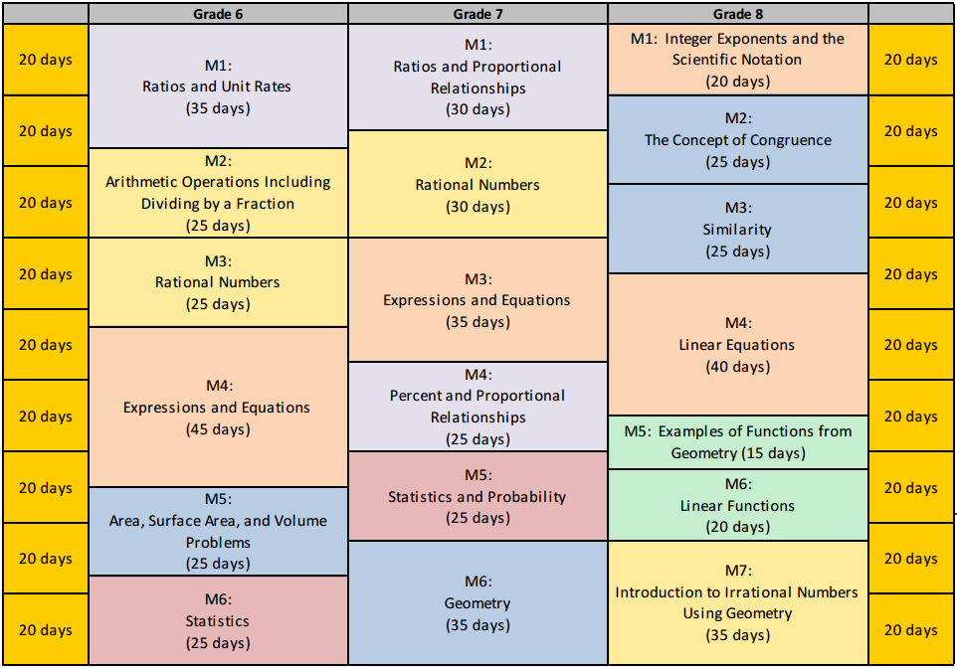
A Story of Ratios
Curriculum Overview
Notes:
Say: This module is 30 days long. It includes 22 lessons, 2 days for assessments, 2 days for review of assessments, and 4 days for remediation, if needed.

Slide 5
Progression Study
What are the Progressions?
Explore: 6-7, Ratios and Proportional Relationships
  Read pages 2-4
  Read last paragraph of page 8
  Read second paragraph of page 10
  Scan pages 11-15
Highlight the information relevant to the
content of this module.
Notes:
The 6-7 Ratios and Proportions Progression document is reviewed prior to the module focus to frontload participant knowledge of how the domain progresses across the grade band. Participants can then have the document available with some familiarity for reference throughout the session. The document will be revisited prior to implementation discussions.
What are the Progressions?
Poll participants using the fist-to-five protocol to gauge how well (if at all) they know the progression documents. Participants show zero fingers/fist if they have never heard of or seen the progressions, show 5 fingers if they have read a majority of the progressions, or some number of fingers if they are relatively familiar or have read some portion of them.
Explain what the progressions are:
The Common Core State Standards for mathematics were built from the progressions. They are a narrative document describing the progression of a topic across a number of grade levels. The progressions were guided by a child’s cognitive development and the logical structure of math when written. These documents were used to create the grade level standards, and therefore can explain why the standards are sequenced the way they are. The progressions also highlight cognitive difficulties and provide pedagogical solutions, and give greater detail on some of the particularly challenging areas of mathematics. As writers, we referred to the progressions often to guide our thinking when sequencing lesson objectives and problems within each lesson.
Progression Exploration:
To continue our study of Module 1, we’re going to first take some time to examine a portion of the Progression document (6-7, Ratios and Proportional Relationships) that serves as the foundation for this module. You’ll have about 10 minutes to read through the document independently or with a partner. As you read, highlight the information that is relevant to the content of this module.
Allow participants time to read independently. Encourage them to highlight and make notes.

Slide 6
Module Structure
Module Overview
Topic A
L1
Topic B
L7
Topic C
L8-L9
L2
L3-L4
L11-L12
L13
L14
L5-L6
L10
L15
Topic D
L16
L17
L18
L19
L20
L21-L22
Notes:
Explain the Module Overview
ADVANCE SLIDE – Explain the importance of the different topics.
ADVANCE SLIDE – Show how each topic includes a section of the 22 lessons.

Slide 7
Module Overview Structure
Table of Contents
Narrative
Focus Standards
Foundational Standards
Focus Standards for Mathematical Practice
Terminology
Suggested Tools and Representations
Assessment Summary
Module Overview
Notes:
Say: This are the items that are included throughout the Module Overview.

Slide 8
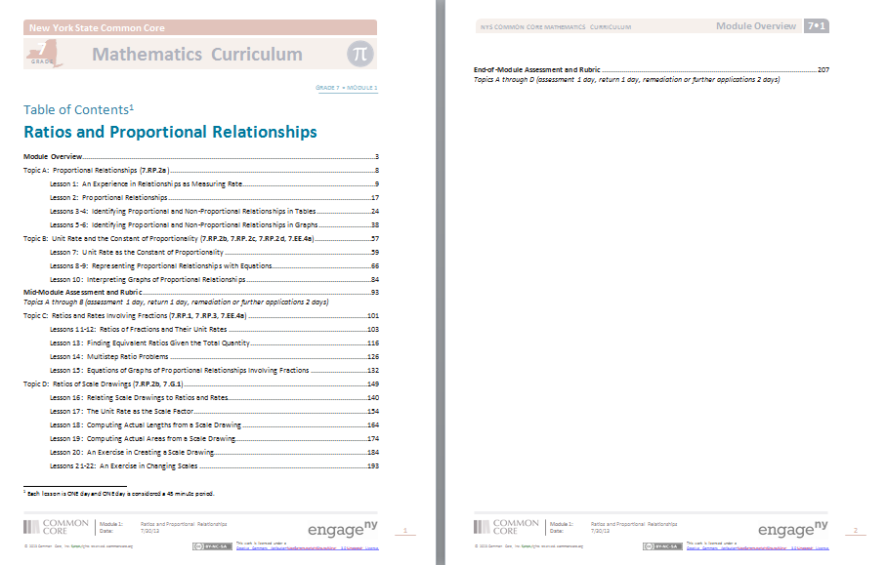
Table of Contents
How does Module 1 break down Ratios and Proportional Relationships?
Module Overview / Pages 1-2
Notes:
Say: The table of contents shows the titles of each lesson, shows where each topic begins and ends. The table of contents also shows when to give each assessment during the module.

Slide 9
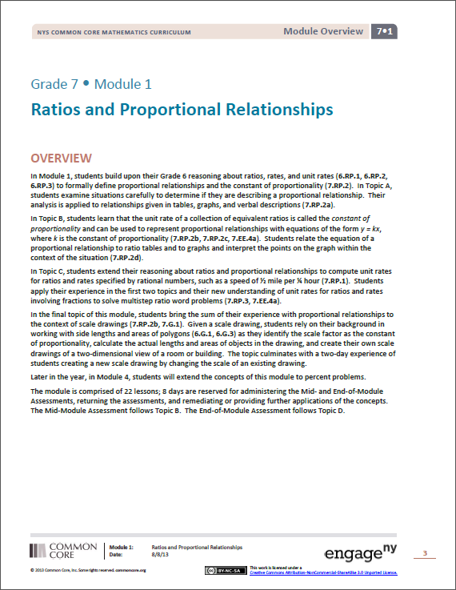
Overview Narrative
Examine the overview narrative to uncover how Module 1 unfolds. Highlight any major concepts and/or questions for discussion.
Module Overview / Page 3
Notes:
Say: The overview narrative discusses different topics lessons will cover. The narrative is more specific than the table of contents.

Slide 10
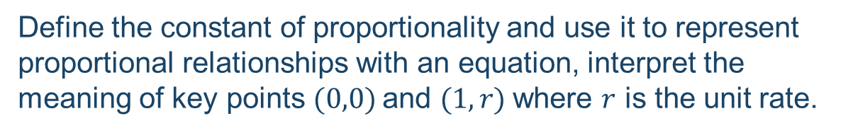
Overview Narrative
Topic A:
Topic B:
Topic C:
Topic D:
Explore what it means to be proportional to and how to determine if two types of quantities are in a proportional relationship, examining both tables and graphs.
Define the constant of proportionality and use it to represent proportional relationships with an equation, interpret the meaning of key points $(0,0)$and $(1,r)$where $r$ is the unit rate.
Compute unit rates involving fractions, find equivalent ratios of two partial quantities given a part-to-part ratio and the total of the quantities, solve multi-step ratio problems including markup, markdown, and commission.
Explore scale drawings and recognize the term scale factor as the constant of proportionality.
Module Overview / Page 3
Notes:
Say: The narrative also provides teachers more information about each topic throughout the module.

Slide 11
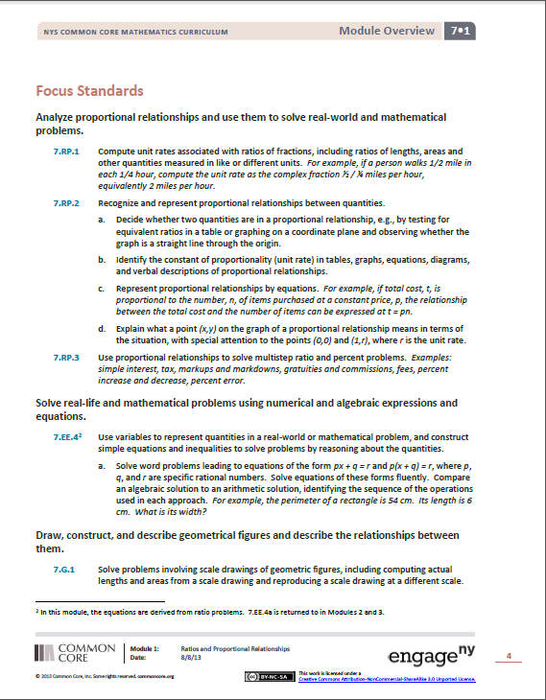
Focus Standards
Which Common Core State Standards will be covered in Module 1?
Module Overview / Page 4
Notes:
Say: The focus standards lists all of the 7th grade standards that will be covered throughout this first module.

Slide 12
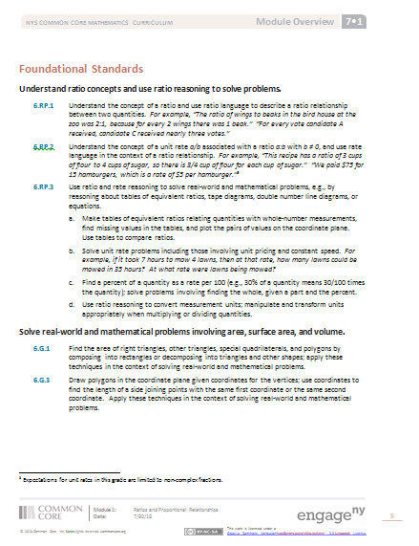
Foundational Standards
What are students expected to know under the Common Core Standards as they enter Grade 7 Module 1?
Module Overview / Page 5
Notes:
Say: The foundational standards section lists the standards they have learned in previous grades, but will apply throughout module 1.

Slide 13
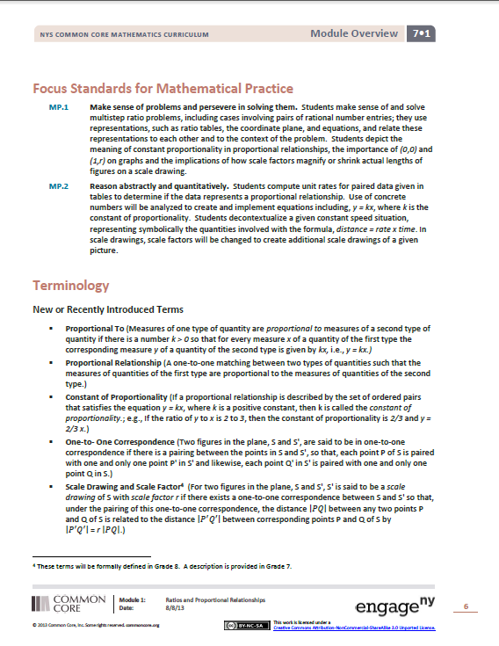
Focus Standards for Mathematical Practice
What specific mathematical practices will be evident in Module 1?
Module Overview / Page 6
Notes:
Say: The module overview also provides an insight to the Standards for Mathematical Practice that will be implemented throughout the module. Although there may be other Standards for Mathematical Practice throughout the module, this are the ones that were chosen to be the focus.

Slide 14
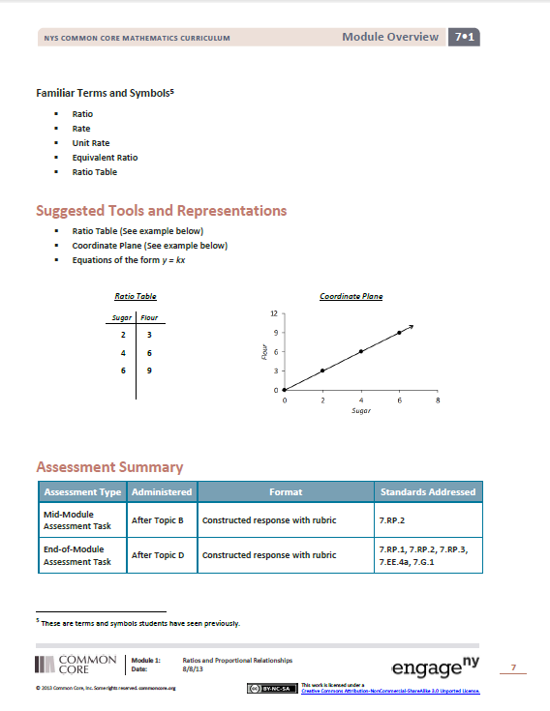
Familiar Terminology
What terminology are students expected to know under the Common Core State Standards as they enter Grade 7 Module 1?
We’ll look at these terms in more detail as we examine Lesson 1.
Module Overview / Page 7
Notes:
Say: Terminology students have previously learned is listed in the familiar terminology section.

Slide 15
New Terminology
What new mathematical language will be introduced in Module 1?
Module Overview / Page 6
Notes:
Say: Any new terminology, and the definitions, are listed in the new terminology section.

Slide 16
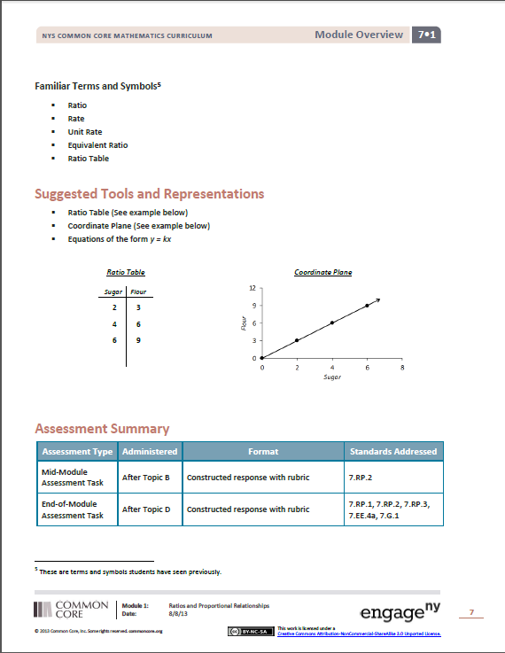
Suggested Tools and Representations
What types of tools and mathematical representations will be seen in Module 1?
Module Overview / Page 7
Notes:
Say: The module overview also lists different tools and visual representations that may be used throughout the module.

Slide 17
Assessment Summary
Mid-Module and End-of-Module Assessments
Module Overview / Page 7
Notes:
Say: The final component of the module overview is the assessment summary. This shows when to assess students and what common core standards will be assessed.

Slide 18
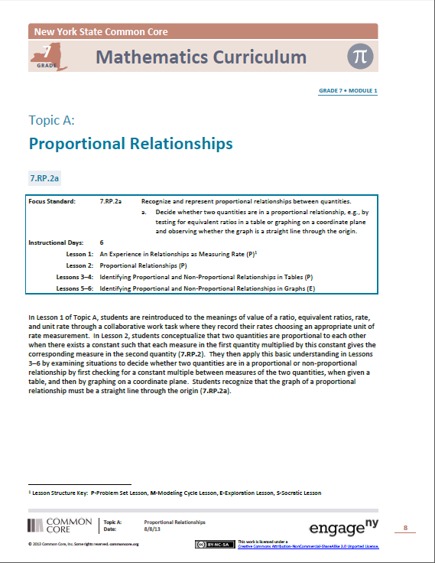

Topic Openers
Read the concept chart and the descriptive narrative.
Make note of the important information that will help teachers implement these lessons.
Topic A Opener / Page 8
Notes:
Discuss the first Topic Opener

Slide 19




Types of Lessons
Problem Set
    Students and teachers work through examples and complete exercises to develop or reinforce a concept or procedure.
Socratic
    Teacher leads students in a conversation to develop a specific concept or proof.
Exploration
    Independent or small group work on a challenging problem followed by debrief to clarify, expand or develop math knowledge
Modeling
    Students and teacher practice part of the modeling cycle with problems that are ill-defined and have a real world context.
Topic A Opener / Page 8
Notes:
Read and explain each type of lesson included in the curriculum.

Slide 20
Lesson Structure
Teacher Materials
Student Outcomes
Lesson Notes (in select lessons)
Classwork
  General directions and guidance, including timing guidance
  Discussion points with expected student responses
  Student classwork with solutions
  Scaffolding Boxes
Closing
Exit Ticket
Problem Set (with solutions)
Student Materials
Classwork
  Space provided for student work
Problem Set
  Without solutions
Lesson Structure
Notes:
Explain each part of the lesson structure. Make sure the emphasize the importance of each lesson structure.

Slide 21
Agenda
Lesson Structure
Instructional Sequence
Module Review
Preparation for Implementation
Notes:
Each lesson component has a very different purpose and consequently, each lesson component has a different pace, so the experience feels different for students. It is important to honor each component in order to do justice both to the mathematical practices and to the balance of rigor that is expected.
Moving forward, we’ll explore the instructional sequence. In doing this, we’ll lead you through the module, modeling and examining instruction for each objective. Along the way, we’ll also revisit the other lesson components and experience how they function in collaboration with the concept development.
*PPT Developers: This section is essentially a montage of [Concept Developments (PK-5) or Class Works (6-12)] (and possibly other components as relevant) from Module 1 that show the sequence of how material unfolds beyond L1. The idea is that at the end, teachers trust that the sequence grows sequentially from simple to complex, allowing time for students to master concepts over the course of a topic or module. Add slides as necessary… essentially one slide for each lesson. (Of course, this isn’t an absolute rule.) All material included on the slides should come directly from the lessons and the appropriate lesson number and lesson component should be cited in the text box at the bottom of the slide.

Slide 22
An Experience in Relationships as Measuring Rate
Paper Passing Directions
One participant at each table, remove the stack of papers from the large envelope labeled A.
On my command, take one and pass the remaining stack to the left. Continue passing the stack until all participants at your table have a paper.
If you are the last person to receive a paper, raise your hand to indicate that all participants at your table have a paper. Please leave your hand in the air and await further instructions.
Lesson 1 / Example 1
Notes:
Read through the directions and make sure every participants understands the directions.
*Presenter should be prepared to modify the instructions as necessary per the room setup and participant group size.
When you say “go”, secretly start a stopwatch to record how long it takes to get every person to receive a piece of paper. When the papers are all distributed, inform the group that they were timed, then record and provide their time. Ask participants to return the papers to their original location using the reverse process. Upon saying “go”, start the stopwatch again and stop when all papers are returned to the original location. Record the time, then encourage the participants to beat their times on their next attempt. Repeat this experiment at least 3 times (5 if needed) and then complete the first two columns of the table with participants using the document camera.
Presenter may choose to have participants complete the remaining table independently using their knowledge about ratios and rate. In doing so, the presenter should have prepared a sample for comparison and discussion, emphasizing the specificity of language in the curriculum. The relevant terminology is the focus of the next 2 slides.

Slide 23
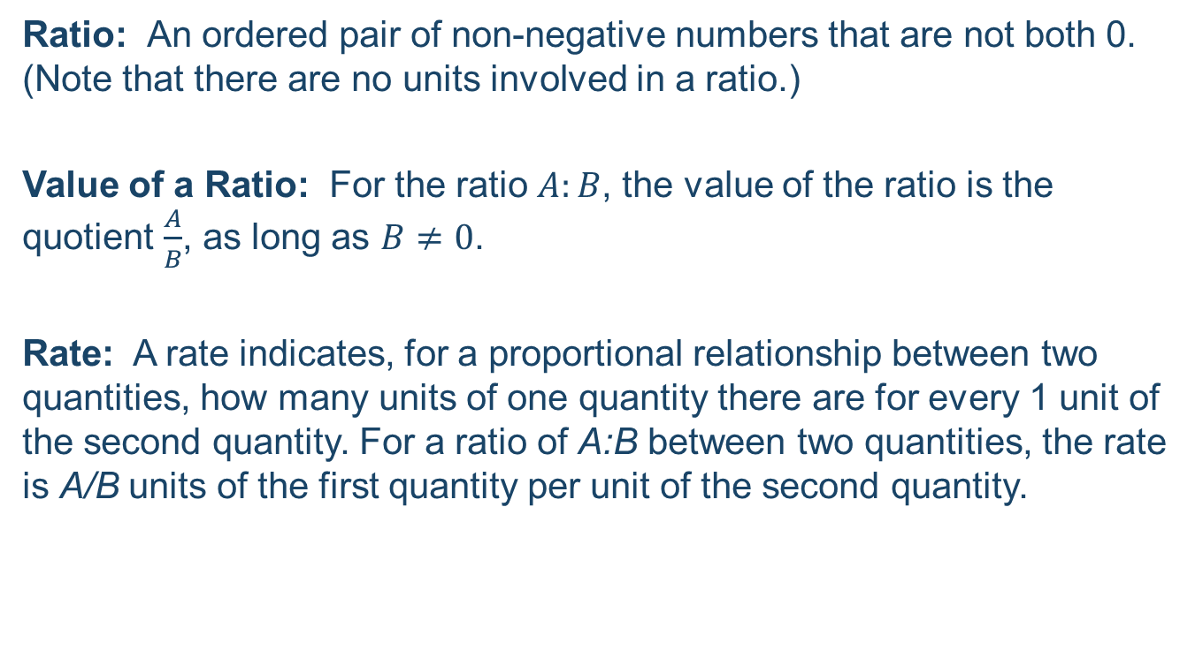
Ratio and Rate from Grade 6
Ratio: An ordered pair of non-negative numbers that are not both 0. (Note that there are no units involved in a ratio.)
Value of a Ratio: For the ratio $A:B$, the value of the ratio is the quotient $\frac{A}{B}$, as long as $B≠0$.
Rate: A rate indicates, for a proportional relationship between two quantities, how many units of one quantity there are for every 1 unit of the second quantity. For a ratio of A:B between two quantities, the rate is A/B units of the first quantity per unit of the second quantity.
Lesson 1 / Example 1
Notes:
Read and discuss definitions that were introduced in 6th grade (module 1). Compare these definitions (or descriptions) to the data recorded in the table from the paper passing activity.

Slide 24
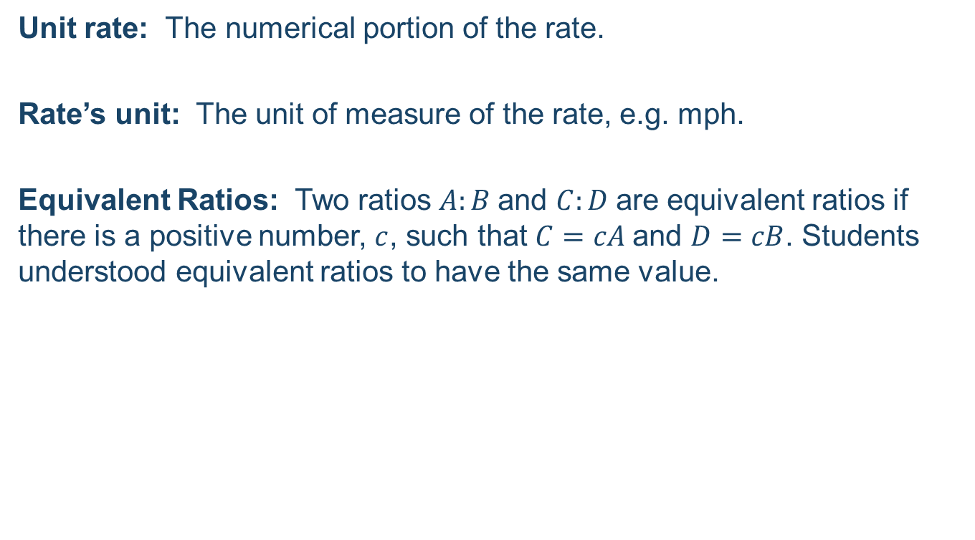
Ratio and Rate from Grade 6
Unit rate: The numerical portion of the rate.
Rate’s unit: The unit of measure of the rate, e.g. mph.
Equivalent Ratios: Two ratios $A:B$and $C:D$are equivalent ratios if there is a positive number, $c$, such that $C=cA$and $D=cB$. Students understood equivalent ratios to have the same value.
Lesson 1 / Example 1
Notes:
Read and discuss definitions that were introduced in 6th grade (module 1).
[After participants understand the definitions, if necessary, complete the remaining cells in the table.]

Slide 25

An Experience in Relationships as Measuring Rate
Paper Passing
Why this problem?
R
T
A
E
Lesson 1 / Example 1
Notes:
Discuss the benefits of this problem with participants. Some responses might include:
Active and relevant to the lesson
Establishes a classroom routine
Not an artificial problem
Reviews G6 terminology
After this discussion, switch to document camera and go through the rest of the classwork for Lesson 1 including Example 2 and Exercise 1 (provided in participant materials).

Slide 26
An Experience in Relationships as Measuring Rate
Tillman the English Bulldog
At the conclusion of the video, your classmate takes out his or her calculator and says, “Wow that was amazing! That means the dog went about 5 meters in 1 second!” Is your classmate correct, and how do you know?
Lesson 1 / Exit Ticket
Notes:
Read the problem and then show the video on the next slide.
Allow time for participants to solve the problem, and then discuss the answer.
Yes, the classmate is correct. The dog traveled at an average rate of $100$ meters in $19.678$ seconds, or an associated rate of $\frac{100}{19.678}$ meters per second, giving a unit rate of approximately $5.08$.

Slide 27


Slide 28
An Experience in Relationships as Measuring Rate
After seeing this video, another dog owner trained his dog, Lightning, to try to break Tillman’s skateboarding record. Lightning’s fastest recorded time was on a 75-meter stretch where it took him 15.5 seconds. Based on this data, did Lightning break Tillman’s record for fastest dog on a skateboard? Explain how you know.
Lesson 1 / Exit Ticket
Notes:
Read the problem, and allow time for participants to solve the problem.
Discuss the answer.
No, Lightning did not break Tillman’s record. Tillman traveled at an average rate of $5.08$ meters per second (calculated from an associated rate of $\frac{75}{15.5}$meters per second), and Lightning traveled at an average rate of $4.84$ meters per second (about $\frac{1}{4}$ of a meter slower per second), making Tillman the faster skateboarder.

Slide 29
Exit Ticket Reflection
What do you notice about the exit ticket?
How does it compare to what you have seen teachers use in the past?
Take 2 minutes to talk about this at your table.
Lesson 1 / Exit Ticket
Notes:
Pose the questions, provide two minutes to discuss at tables, then discuss groups’ answers to the questions whole group.
Following the Exit Ticket (in the participant materials) is the Problem Set for lesson 1. Take a moment to read through these problems and note what they “are” and what they “are not”.

Slide 30
Proportional Relationships
This lesson introduces the notion of Proportional Relationship
Serves as the connecting piece from Grade 6 to Grade 8
Grade 6
Equivalent Ratios
Rate and Unit Rate
Grade 7
Proportional Relationship
Unit Rate as Constant of Proportionality
Grade 8
and up
Linear Relationships
Study of Functions
Ratios
Concept Development
Notes:
Discuss the progression of proportional relationships between 6th, 7th, and 8th grades.

Slide 31

Proportional Relationships
Pay by the Ounce Frozen Yogurt!
A new self-serve frozen yogurt store opened this summer that sells its yogurt at a price based upon the total weight of the yogurt and its toppings in a dish. Each member of Isabelle’s family weighed their dish and this is what they found. Determine if the cost is proportional to the weight.
The cost ______________________________ the weight.
Lesson 2 / Example 1
Notes:
Participants read the problem.
Say: Does everyone pay the same cost per ounce? How do you know?
Allow for group discussion. Each ounce costs $0.40.
Say: Since this is true, we say “the cost is proportional to the weight.”
Isabelle’s brother paid for his yogurt after the rest of the family. His yogurt weighed 15 ounces, how much does his yogurt cost? How did you calculate the cost?
$6. Multiply the weight by the cost per ounce.

Slide 32
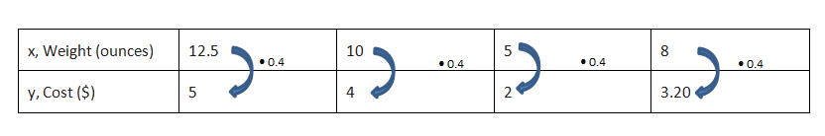
Proportional Relationships
Pay by the Ounce Frozen Yogurt!
Lesson 2 / Example 1
Notes:
Say: For any value of x, how to we find y?
Multiply by the cost per ounce ($0.40)
Say: Write an equation to represent the proportional relationship.
y=0.4x

Slide 33
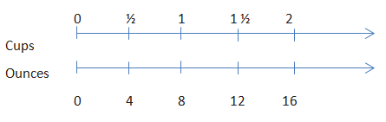
Proportional Relationships
A Cooking Cheat Sheet!
In the back of a recipe book, a diagram provides easy conversions to use while cooking.
The ounces ______________________________ the cups.
Lesson 2 / Example 2
Notes:
Participants read the problem.
Say: The diagram is showing us the number of ounces in a given number of cups. Is the number of ounces proportional to the number of cups? Why or why not?
The ounces is proportional to the cups because you can multiply the number of cups by 8 to get the number of ounces.
Say: If a recipe called for 4 cups, how many ounces would be needed?
32 ounces.
Say: Let x represent the number of cups and y represent the number of ounces. How could we write an equation to represent the proportional relationship.
y=8x

Slide 34
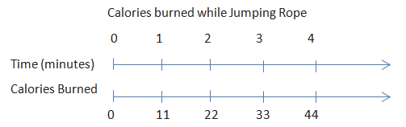
Proportional Relationships
During Jose’s physical education class today, students visited activity stations. Next to each station was a chart depicting how many calories (on average) would be burned by completing the activity.
a. Is the number of Calories burned proportional to time? How do you know?
b. If Jose jumped rope for 6.5 minutes, how many calories would he expect to burn?
Lesson 2 / Exercise 1
Notes:
Participants read the problem.
ADVANCE SLIDE
Participants answer part (a)
Discuss as a group
Yes, the time is always multiplied by the same number, 11, to find the calories burned.
ADVANCE SLIDE
Participants answer part (b)
Discuss as a group
Jose would expect to burn 71.5 calories since 6.5 times 11 is 71.5.

Slide 35
Proportional Relationships
How do we know if two quantities are proportional to each other?
How can we recognize a proportional relationship when looking at a table or a set of ratios?
Two quantities are proportional to each other if there is one constant number that is multiplied by each measure in the first quantity to give the corresponding measure in the second quantity.
If each of the measures in the second quantity is divided by its corresponding measure in the first quantity and it produces the same number, called a constant, then the two quantities are proportional to each other.
Lesson 2 / Closing
Notes:
Participants read question. Discuss as a whole group
ADVANCE SLIDE – Add anything that was not discussed
ADVANCE SLIDE – Participants read question. Discuss as a whole group.
ADVANCE SLIDE – Add anything that was not discussed

Slide 36
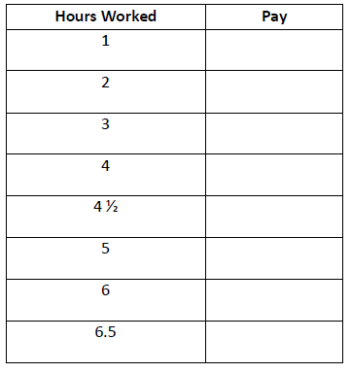
Identifying Proportional and Non-Proportional Relationships in Tables
You have been hired by your neighbor to babysit their children on Friday night. You are paid $8 per hour. Complete the table relating your pay to the number of hours you worked.
Based on the table, is pay proportional to hours worked? How do you know?
Lesson 3 / Example
Notes:
Participants read the problem and complete the table.
Discuss results from table.
Say: How did you determine the pay for 4 ½ hours?
Multiplied 4 ½ by 8 or knowing an extra half hour would be $4, added $32+$4=$36
Say: If the table was graphed, would the point (0,0) be on the graph?
Yes
Say: What would this point represent?
If I worked 0 hours, I would get paid $0.
ADVANCE SLIDE – Discuss the question as a group.
Yes, the pay is proportional to the hours worked because every ratio of the amount of pay to the number of hours worked is the same. The ratio is 8:1 and every measure of hours multiplied by 8 will result in the corresponding measure of pay.

Slide 37
Identifying Proportional and Non-Proportional Relationships in Tables
Read through Exercises 1 and 2.
Compare and Contrast the two Exercises.
Share your observations with a neighbor.
Lesson 3 / Exercises 1 and 2
Notes:
Allow time for participants to read Exercises 1 and 2.
ADVANCE SLIDE – Allow time for group discussion
Groups share their similarities and differences
Similarity – Comparing two variables
Difference – Exercise 1 is not proportional and Exercise 2 is

Slide 38
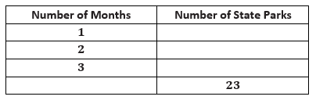
Identifying Proportional and Non-Proportional Relationships in Tables
Mark recently moved to a new state. During the first month he visited 5 state parks. Each month after he visited two more. Complete the table below.
5
7
9
10
Lesson 4 / Exercise 2
Notes:
Participants read the problem and complete the table.
ADVANCE SLIDE – to reveal the numbers in the table
Say: Examine the table. Determine if the number of parks visited is proportional to the number of months.

Slide 39
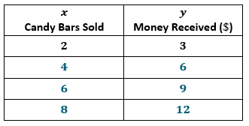
Identifying Proportional and Non-Proportional Relationships in Graphs
From a Table to Graph
Use the ratio provide, create a table that shows money received is proportional to the number of candy bars sold.
x | y
2 | 3
Lesson 5 / Example 1
Notes:
Participants read problem and complete the table.
Say: Answers may vary, but the ratio must remain the same.
ADVANCE SLIDE – show possible answers
Say: We are going to create a graph from this table.
On you graph, what is the origin and where is it located?
The origin is the intersection of the x-axis and y-axis and is located at (0,0).
Say: What should we label the x-axis and y-axis?
The x-axis should be labeled the number of candy bars sold and the y-axis should be labeled money received (in dollars).
Say: How do we plot the first ratio pair?
We moved 3 units right and 2 units up.
Say: Plot the ratio pairs on the graph.

Slide 40
Identifying Proportional and Non-Proportional Relationships in Graphs
Lesson 5 / Example 1
Notes:
Say: What observations can you make about the graph.
The points form at straight line.
Say: Would all proportional graphs touch the origin?
Yes, the origin is always included in proportional graphs.
Say: What can you infer about graphs of two quantities that are proportional to each other?
The points will appear to be on a line that goes through the origin.

Slide 41
Identifying Proportional and Non-Proportional Relationships in Graphs
How are proportional quantities represented on a graph?
What is a common mistake a student might make when deciding whether a graph of two quantities shows that they are proportional to each other?
Lesson 5 / Closing
Notes:
ADVANCE SLIDE – Discuss that a proportional graph must create a straight line AND touch the origin.
ADVANCE SLIDE – Allow participants to provide some misconceptions.
Possible misconceptions: Students may say a graph is proportional if:
Straight line but does not touch origin
Touches origin but does not create a straight line
Incorrect scale makes the line look straight

Slide 42
Groups Exploration
Problem | Table
Graph | Proportional or Not Explain.
What are some benefits of group exploration?
Lesson 6 / Exploratory Challenge
Notes:
Discuss Benefits of the Exploratory Challenges throughout the Lessons.
Execute the Exploratory Challenge
Each group should set up a piece of poster paper like the one above.
Each group receives a Station from the lesson and complete the poster using the ratios provided.
When posters are completed, hang them around the room and provide time for a gallery walk.
Discuss observations.

Slide 43
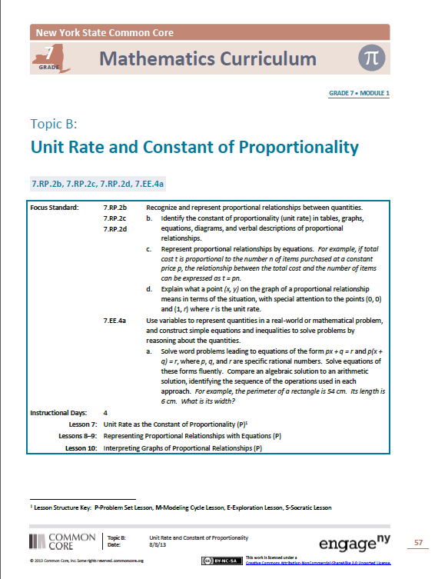
Topic B
Read the concept chart and the descriptive narrative.
Make note of the important information that will help teachers implement these lessons.
Topic B Opener / Pages 57-58

Slide 44
Unit Rate as the Constant of Proportionality
Haven’t we already learned about the constant of proportionality?
Why is this lesson here?
Notes:
Present these questions to the participants.
Say: The term Constant of Proportionality has not been used in this module or previous grades. However, students do know how to recognize the unit rate, which is the same value of the Constant of Proportionality. This lesson is here to show students the connection between these two terms.

Slide 45
Unit Rate as the Constant of Proportionality
Brandon came home from school and informed his mother that he had volunteered to make cookies for the entire grade level. He needs 3 cookies for each of the 96 students in 7th grade. Unfortunately, he needs to cookies the very next day! Brandon and his mother determined that they can fit 36 cookies on two cookie sheets.
Is the number of cookies proportional to the number of cookie sheets used in baking? Create a table that shows data for the number of sheets needed for the total number of cookies baked.
Lesson 7 / Example 2
Notes:
Participants read the problem.
ADVANCE SLIDE – Provide time for participants to create a table.
Say: What is the unit rate?
18
Say: Therefore, the constant of proportionality is k=18. Explain the meaning of the constant of proportionality.
There are 18 cookies per 1 cookie sheet.
Say: It takes 2 hours to bake 8 sheets of cookies. If Brandon and his mom begin at 4:00 pm, when will they finish baking cookies?
288 cookies means 16 sheets of cookies. Therefore, it will take 4 hours, so Brandon and his mom will be finished baking cookies at 8:00 pm.

Slide 46
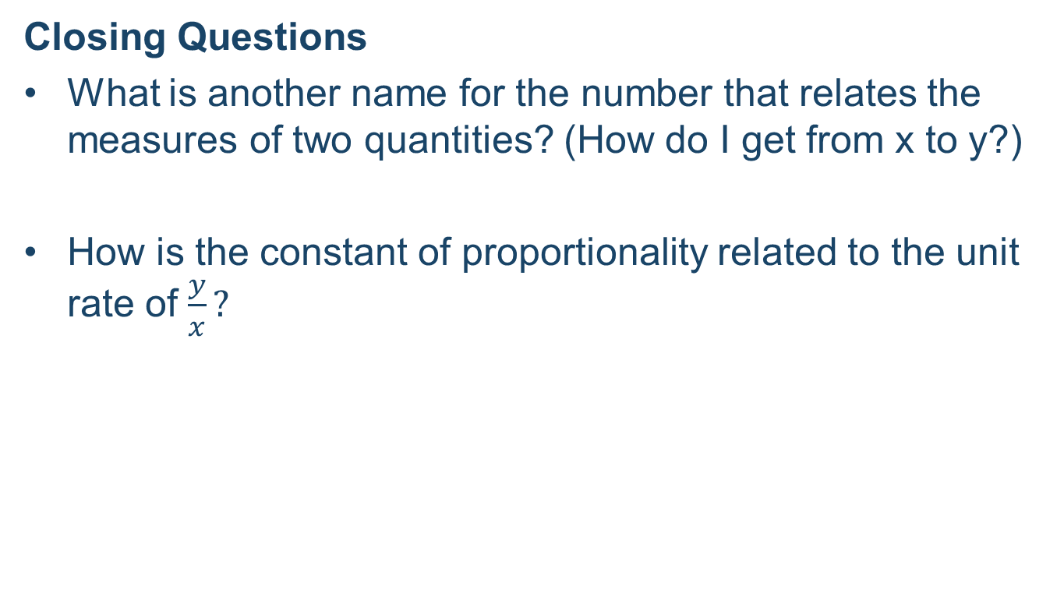
Unit Rate as the Constant of Proportionality
Closing Questions
What is another name for the number that relates the measures of two quantities? (How do I get from x to y?)
How is the constant of proportionality related to the unit rate of $\frac{y}{x}?$
Lesson 7 / Closing
Notes:
ADVANCE SLIDE – Discuss possible answers: constant, unit rate, constant of proportionality
ADVANCE SLIDE – Discuss answers: they represent the value of the ratio y:x

Slide 47
Representing Proportional Relationships with Equations
Look at the Student Materials for Lesson 8
Complete Examples 1 and 2
Compare your answers with your neighbor
Lesson 8
Notes:
Say: Remember that these are Examples and, therefore, will be teacher lead throughout the lesson.
Discuss possible student struggles.
Some possible student struggles:
Writing the equation – identifying the independent and dependent variables
Using the equation to solve different types of problems
Starting with a graph
Understanding the fractional constant of proportionality and what it means

Slide 48
Representing Proportional Relationships with Equations
Discuss at your table:
What is the main idea of this lesson?
How do the Examples prepare students for success with the Problem Set?
Lesson 8
Notes:
ADVANCE SLIDE – allow time for participants to discuss with their groups
The main idea is to represent proportional relationships with equations.
ADVANCE SLIDE – allow time for participants to discuss with their groups
The examples provide real-world connections to help students write equations. This type of practice prepares them for the problem set.

Slide 49
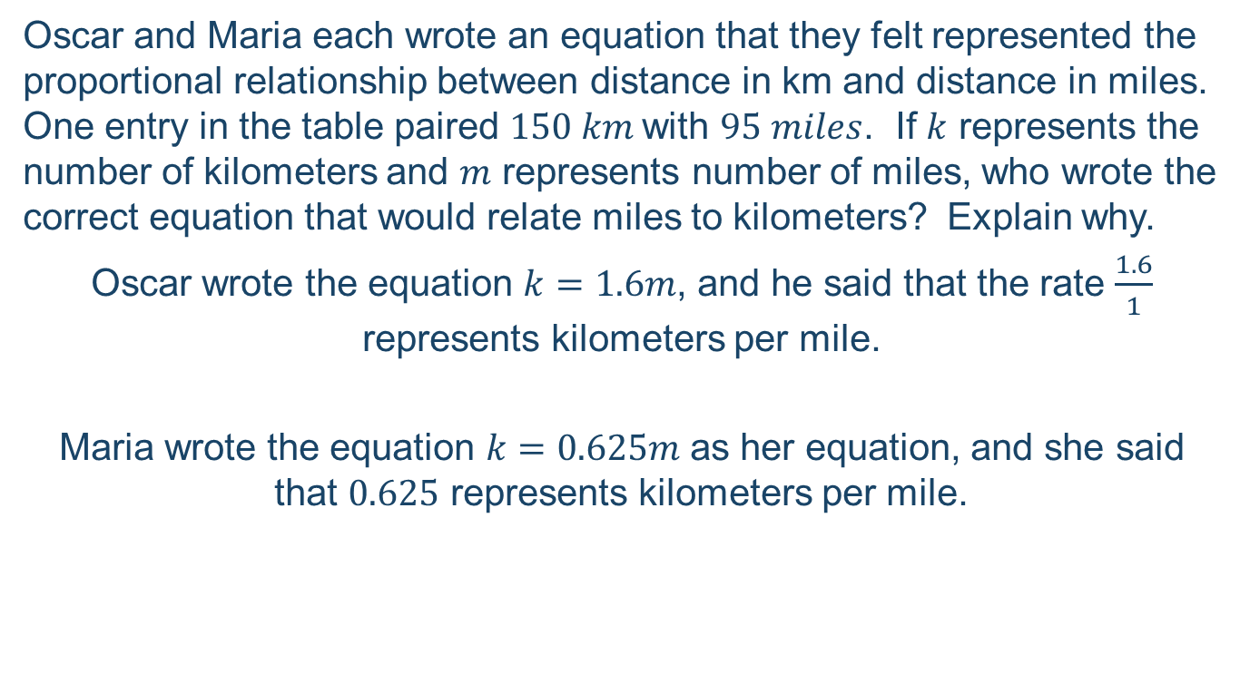
Representing Proportional Relationships with Equations
Oscar and Maria each wrote an equation that they felt represented the proportional relationship between distance in km and distance in miles. One entry in the table paired $150 km$with $95 miles$. If $k$ represents the number of kilometers and $m$ represents number of miles, who wrote the correct equation that would relate miles to kilometers? Explain why.
Oscar wrote the equation $k=1.6m$, and he said that the rate $\frac{1.6}{1}$ represents kilometers per mile.
Maria wrote the equation $k=0.625m$as her equation, and she said that $0.625$ represents kilometers per mile.
Lesson 9 / Exit Ticket
Notes:
Say: Lesson 9 is a continuation of Lesson 8. Students continue to write equations to represent proportional relationships. Complete the Exit Ticket that students will see at the end of Lesson 9.
Provide time for participants to complete the exit ticket.
Oscar is correct. Oscar found the unit rate to be $1.6$ by dividing kilometers by miles. The rate that Oscar used represents the number of kilometers per the number of miles.
Mention to participants that each equation would be more precise if the variables were better defined.

Slide 50
Interpreting Graphs of Proportional Relationships
Look at the Student Pages for Lesson 10
Complete Examples 1 and 2
How do you anticipate students will respond to this lesson?
Lesson 10 / Example 1 and 2
Notes:
Say: This is a culmination of all the material learned in the first half of the module.
ADVANCE SLIDE - Discuss possible student responses to the lesson.

Slide 51
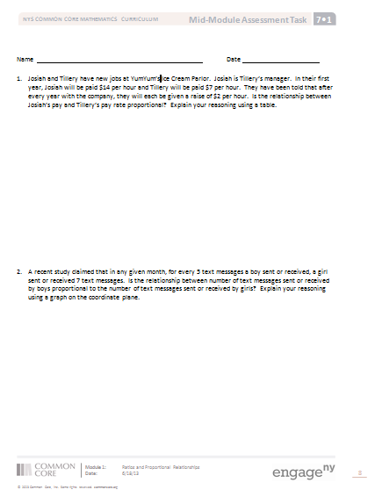
Understanding the Mid-Module Assessment
Assessments are developed directly from the CCSS.
Developed prior to the corresponding lessons.
Mid-Module Assessment
Notes:
Discuss the Mid Module Assessment
If time allows, participants read through the entire assessment and discuss it with their groups.

Slide 52
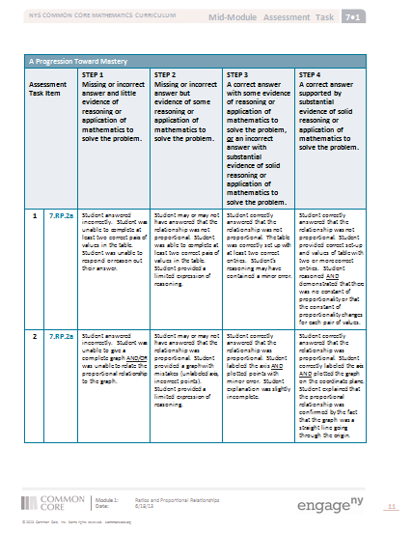
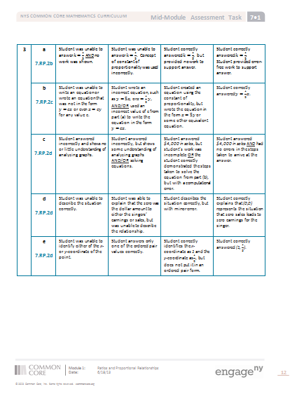
A Progression Toward Mastery
The rubric is not a “grading” rubric.
What are the levels?
Notes:
Allow time for participants to examine the rubric.
Discuss rubric.

Slide 53
Remainder of G7-M1
Topic C: Compute unit rates involving fractions, find equivalent ratios of two partial quantities given a part-to-part ratio and the total of the quantities, solve multi-step ratio problems including markup, markdown, and commission
Topic D: Explore scale drawings and recognize the term scale factor as the constant of proportionality

Slide 54
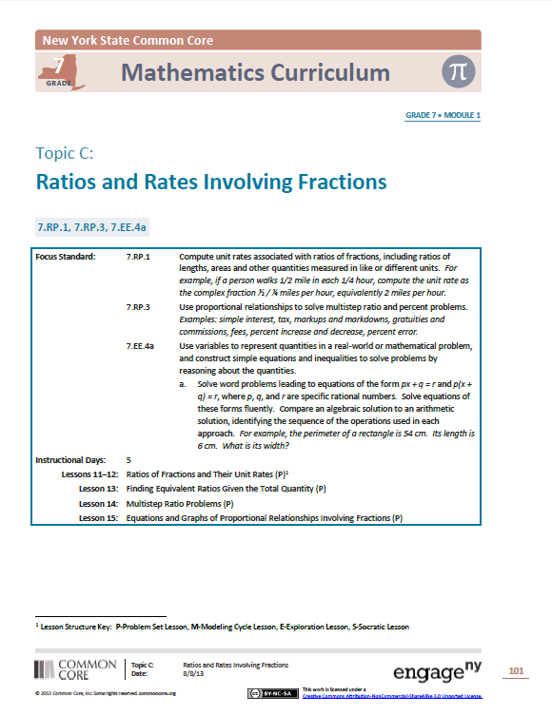
Topic C
Read the concept chart and the descriptive narrative.
Make note of the important information that will help teachers implement these lessons.
Topic C Opener / Page 101

Slide 55
Ratios of Fractions and Their Unit Rates
Student Outcomes
Students use ratio tables and ratio reasoning to compute unit rates associated with ratios of fractions in the context of measured quantities such as recipes, lengths, areas, and speed.
Students work collaboratively to solve a problem while sharing their thinking process, strategies, and solutions with the class.
Lesson 11 / Student Outcomes

Slide 56
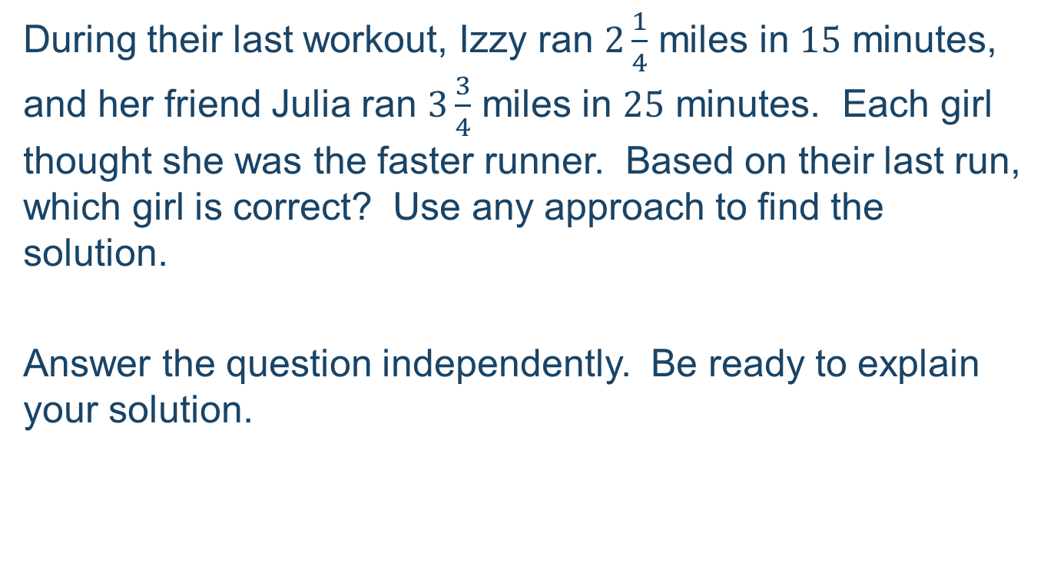
Ratios of Fractions and Their Unit Rates
During their last workout, Izzy ran $2\frac{1}{4}$ miles in $15$ minutes, and her friend Julia ran $3\frac{3}{4}$ miles in $25$ minutes. Each girl thought she was the faster runner. Based on their last run, which girl is correct? Use any approach to find the solution.
Answer the question independently. Be ready to explain your solution.
Lesson 11 / Example 1
Notes:
Participants read the problem.
Say: Think of different ways 7th graders may solve this problem. If you complete the problem quickly using one method, try using another method to solve.
Discuss different methods of solving.

Slide 57
Ratios of Fractions and Their Unit Rates
Solution:
Both girls ran 9 miles per hour so they ran the same speed.
Possible Approaches:
- Complete a table
- Equation or formula substitution
- Visual (clock, double number line)
- Other?
Lesson 11 / Example 1 (cont’d)

Slide 58
Become an Expert
Examine the student and teacher materials with your group.
Read through the lesson at least once
Complete the Examples/Exercises
Complete the Exit Ticket
Complete the Problem Set
Become an Expert! You and your group will create a poster that summarizes your group’s lesson and present your summation to the whole group. YOU select which discussion(s), examples, exercises to present.
Lessons 13-15

Slide 59
Gallery Walk
Walk around the room and examine the posters that summarize Lessons 13 – 15.
What stands out to you?
Where might students struggle?
Did you notice anything different about different posters that represent the same lesson?
Notes:
Allow time for participants to walk around and examine posters.
Discuss their observations. Point out any differences between the same lesson but different groups.

Slide 60
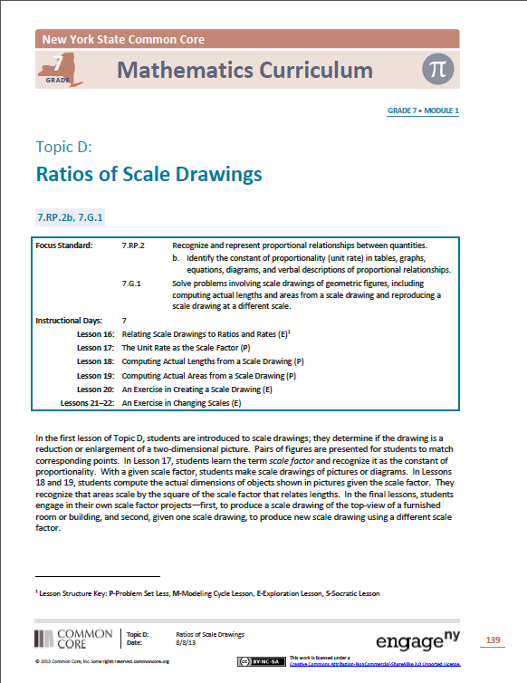
Topic D
Read the concept chart and the descriptive narrative.
Make note of the important information that will help teachers implement these lessons.
Topic D Opener / Page 139

Slide 61
Modeling Lessons 16-19
Put your student hat back on…

Slide 62
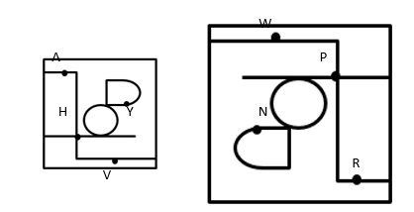
Relating Scale Drawings to Ratios and Rates
Derek’s family took a day trip to a modern public garden. Derek looked at his map of the park that was a reduction of the map located at the garden entrance. The dots represent the placement of rare plants. The diagram below is the top-view as Derek held his map while looking at the posted map.
Lesson 16 / Example 2
Notes:
Ask: What are the corresponding points of the scale drawings of the maps?
What is the corresponding point to Point A?
Point R
Say: What is the corresponding point to Point V?
Point W
Say: What is the corresponding point to Point H?
Point P

Slide 63
Terminology
Scale Drawing: Refers to a reduced-size or enlarged-sized 2-dimensional picture of another 2-dimensional picture.
One-to-One Correspondence: A pairing between the points in one picture/drawing and the points in a scale drawing so that each point is paired with one and only one point in the scale drawing.
Notes:
Read and discuss the explanation of new terminology.

Slide 64
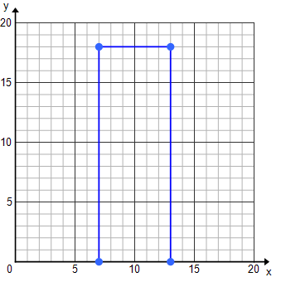
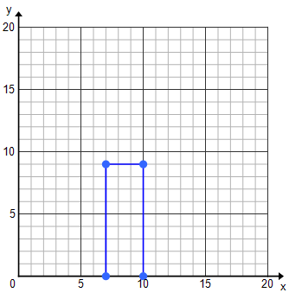
Relating Scale Drawings to Ratios and Rates
Lengths of the original drawing (in units)
Lengths of the second drawing (in units)
Lesson 16 / Example 3
Notes:
Say: Is the second drawing an enlargement or a reduction of the original drawing?
Reduction because it is smaller than the original drawing.
Say: Complete the table.
Say: What do you notice about the values on the table?
The pairs of corresponding lengths are proportional.
Say: Does a constant of proportionality exist? If so, what is it?
Yes, because the corresponding lengths are proportional, there is a constant of proportionality. It is 1/3.
Say: If two drawings did not have a constant of proportionality then the drawings would not be a scaled up or scaled down version of the original image.

Slide 65


The Unit Rate as the Scale Factor
Use a scale factor of $3$ to draw a scale drawing of the Columbian Flag.
Lesson 17 / Examples 2 and 3
Notes:
Participants read the problem.
ADVANCE SLIDE – next slide shows flag measurements

Slide 66





The Unit Rate as the Scale Factor
1$\frac{1}{2} in.$
$\frac{1}{2} in.$
$1 in.$
$\frac{1}{4} in.$
$\frac{1}{4} in.$
Notes:
Participants create a scale drawing of the Columbian Flag.

Slide 67
Computing Actual Lengths from a Scale Drawing
Student Outcomes:
Given a scale drawing, students compute the lengths in the actual picture using the scale. Students identify the scale factor in order to make intuitive comparisons of size, and then devise a strategy for efficiently finding actual lengths using the scale.
Lesson 18 / Student Outcomes

Slide 68

Computing Actual Lengths from a Scale Drawing
A drawing of a surfboard in a catalog shows its length as $8$ $\frac{4}{9}$ inches. Find the actual length of the surfboard if $\frac{1}{2}$ inch length on the drawing corresponds to $\frac{3}{8}$ foot of actual length.
Lesson 18 / Exit Ticket
Notes:
Participants read the problem.
Say: There are a variety of methods to solve this problem. Use the knowledge gained throughout the module to solve the Exit Ticket.
Allow participants time to complete the problem.
Discuss answers and different methods to get to the answer.
The actual surfboard is measures 6 1/3 feet long.

Slide 69
Computing Actual Areas from a Scale Drawing
Take 5 minutes to complete Examples 1-3 from Lesson 19.
The big moment of the lesson…
Reflect upon how we arrived at this “big moment”. What do students gain from this type of approach?
Lesson 19 / Examples 1-3
Notes:
Allow 5 minutes for participants to complete Examples 1-3.
ADVANCE SLIDE
Say: What is the big moment of the lesson?
Students determine the ratio of the areas is the scale factor multiplied by itself or squared.
ADVANCE SLIDE
Say: By allowing students to discover this big moment, what do students gain?

Slide 70
What’s in Store for Lessons 20-22?
Students create their own scale drawing of the top-view of a furnished room of building.
Students reproduce a scale drawing using a different scale.
Students recognize that a scale drawing drawn with a different scale is actually a scale drawing of the scale drawing using the first scale.
For the scale factor of a different scale, students compute the scale factor for the original scale drawing.
Notes:
Discuss the main ideas of each of the last 3 lessons.
If time allows, have participants read through the lessons and discuss their questions or comments.

Slide 71
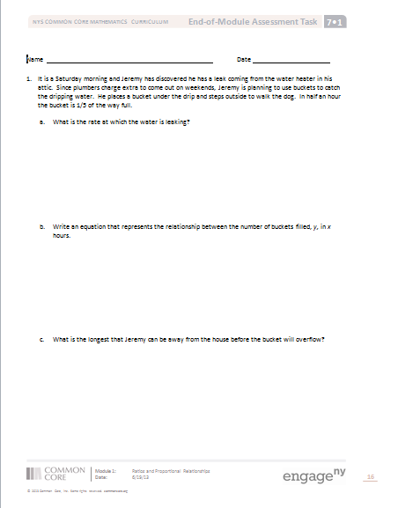
End of Module Assessment
Spend a few moments examining the problems on the End-of-Module Assessment.
Choose 1 problem to complete from a student’s perspective.
End-of-Module Assessment
Notes:
Allow time for participants to read through the End of Module Assessment.
Discuss any questions or comments.

Slide 72
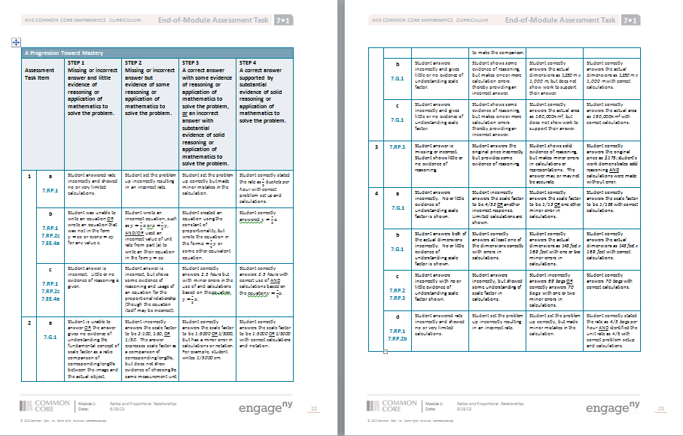
A Progression Toward Mastery
End-of-Module Assessment
Notes:
Remind participants that the rubric is NOT a grading scale, but shows the progression towards Mastery.
Step 1: Doesn’t understand
Step 2: Starting to understand
Step 3: Understands
Step 4: Can teach it

Slide 73
Standards for Mathematical Practice
What Standards for Mathematical Practice are evident in the End-of-Module Assessment? Provide your evidence.
End-of-Module Assessment
Notes:
Discuss the Standards for Mathematical Practice that exist throughout the End of Module Assessment.
Possible Answers:

Slide 74
Agenda
Lesson Structure
Instructional Sequence
Module Review
Preparation for Implementation

Slide 75
Progression Study
Study Lessons 8 through 10 and Lessons 11 & 12.
Then, turn and talk:
  How do these lessons engage students in the work described in the Progression?
Notes:
PPT Developers: On the slide, list a few lessons that closely tie to the progression document(s).
Allow participants time to study relevant Lessons.
Then, allow participants time to turn and talk about how these lessons engage students in the work described in the Progressions.
Consider providing sentence frames for the turn and talk.
Facilitate a whole group discussion.

Slide 76
Agenda
Lesson Structure
Instructional Sequence
Module Review
Preparation for Implementation

Slide 77
Practice a Planning Protocol
With any topic from A Story of Ratios, read the module overview and the topic opener.
Study the module assessment, paying particular attention to the sample responses provided.
Notes:
Click to advance the first bullet. Allow time for participants to read the module overview and the topic opener for the pre-selected topic.
Click to advance second bullet. Allow time for participants to study the sample work provided for the module assessment(s).
NOTE TO FACILITATORS: It is likely that participants will have already studied these documents during Session 1 of this NTI. If this is the case, there is no need to spend additional time on this slide at this point.

Slide 78
Practice a Planning Protocol
Read through the first lesson of the topic.
Then, take note of the lesson objective and re-examine the exit ticket with the objective in mind. What major concept is necessary to successfully complete the exit ticket?
Study the concept development and problem set. How do the CD/PS develop the major concept that is required in the exit ticket? What parts of the CD/PS go beyond this major concept?
Notes:
Click to advance the first bullet. Allow time for participants to read the first lesson of the pre-selected topic.
Click to advance second bullet. Read aloud the objective of the first lesson. Allow time for participants to re-read the exit ticket. Facilitate a discussion about the major concept required by the exit ticket.
Click to advance the third bullet. Allow time for participants to study the concept development and problem set. If participants have paper copies of the lessons, encourage them to highlight the portions of the CD/PS that are critical in preparation for the exit ticket. Facilitate a discussion about those portions of the lesson that are necessary in preparation for the exit ticket and those that go beyond the major concept needed for the exit ticket.

Slide 79
Practice a Planning Protocol
How will this knowledge empower teachers to support specific groups of learners?
Turn to the subsequent lesson, and examine the exit ticket. How does this exit ticket build on the last? How are the two exit tickets similar and how are they different?
Will students have an opportunity in the second lesson to continue development of the first lesson’s objective? What level of mastery of the first lesson’s objective is necessary in preparation for the second lesson?
Notes:
Click to advance the first bullet. Facilitate a discussion about how participants’ previous observations might be further impacted as they consider the needs of a specific group of students. As appropriate, draw attention to any relevant notes boxes in the margins of the lesson.
Click to advance second bullet. Allow time for participants to read the exit ticket for the next lesson. Facilitate a discussion about the relationship between the two exit tickets.
Click to advance the third bullet. Facilitate discussion about how these new observations might further impact their decisions regarding implementation of the first lesson.

Slide 80
Practice a Planning Protocol
How does the new plan for implementation impact the student debrief?
Are any adjustments needed to the fluency and/or application components of the lesson?
Notes:
Click to advance the first bullet. Facilitate a discussion about how the student debrief is impacted by the implementation decisions made thus far.
Click to advance second bullet. Facilitate a discussion about the other lesson components and the need to ensure that the balance of rigor is maintained.

Slide 81
Practice a Planning Protocol
Repeat this process for each lesson.
    Read lesson.
    Study exit ticket. Identify critical portions of concept development and problem set.
    Consider needs of specific students.
    Refer to subsequent exit ticket. Revise implementation plan as needed.
    Make adjustments to the student debrief as needed.
    Consider the other lesson components, ensuring a balance of rigor.
Notes:
Review the planning protocol. If time allows, have participants go through the cycle again for the second lesson of the topic.

Slide 82
Biggest Takeaway
What was your biggest takeaway from today’s session?
What questions or concerns do you still have?
Notes:
Allow time to discuss takeaways, questions, comments.
If there is time, another question that could be asked: What hesitations do you have about implementation?

Slide 83
Key Points
Lessons designed for students to be active learners.
Teacher questioning guides students to explore ideas, investigate natural questions, and develop the big ideas that are the focus of the module.
Students use the study of Ratios in Grade 6 as a foundation to examine the characteristics of a Proportional Relationship in Grade 7.
Students make connections between multiple representations of proportional relationships (verbal, diagram, table, graph) to develop a deeper understanding of a proportional relationship.
Notes:
DiLet’s review some key points of this session:
Lessons designed for students to be active learners.
Teacher questioning guides students to explore ideas, investigate natural questions, and develop the big ideas that are the focus of the module.
scuss key points

Slide 84
Key Points
Students use the study of Ratios in Grade 6 as a foundation to examine the characteristics of a Proportional Relationship in Grade 7.
Students make connections between multiple representations of proportional relationships (verbal, diagram, table, graph) to develop a deeper understanding of a proportional relationship.
The second half of lessons focuses on applying proportional reasoning to solve real-world and mathematical problems.
Lessons are designed to guide students to ask natural next questions and discover different approaches to solving problems, analyzing what they learned in earlier grades along with the first half of the module to find the approach that makes the most sense.
Notes:
Discuss key points

Slide 85
Key Points – Assessments
Assessments:
Directly from the CCSSM standards
Assess deeper conceptual understanding
Address multiple learning standards and practice standards simultaneously
Assessment Rubrics
Assess student progress toward mastery of standards
Do not focus on deficiencies
Notes:
Discuss key points

Slide 86
Next Step
The first thing I’ll do to prepare is…
Notes:
Participants write their answers on an index card, which will be their exit tickets.

Slide 87
Questions?
Notes:
Answer any remaining questions.
Check parking lot for more questions.

