Slide 1
A Story of Ratios
Grade 8 – Module 1
Integer Exponents and Scientific Notation
Notes:
NOTE THAT THIS SESSION IS DESIGNED TO BE ? MINUTES IN LENGTH
Script…
FACILITATOR NOTES…
TIME ALLOTTED FOR THIS SLIDE:
8 minutes
MATERIALS NEEDED:
X

Slide 2
Session Objectives
Articulate and model the instructional approaches to teaching the content of Module 1.
Examine how the topics and lessons promote mastery of the focus standards and address the major work of the grade.
Articulate connections from the content of previous grade levels to the content of this module.

Slide 3
Icebreaker!
Each table needs a poster paper and no more than two markers.
A vocabulary word/phrase will be given. Once you see/hear it, write down as many words as possible related to the vocabulary word.
The table with the most words wins!
You have 2 minutes to work.
Anyone can write, but only with the two markers provided.
Ready, Set, Go!
LAWS OF EXPONENTS

Slide 4
Agenda
Lesson Review 1
Module Overview
Lesson Review 2 – 6
Mid Module Assessment
Lesson Review 7 – 13
End of Module Assessment
Preparation for Implementation
Summary and Closure

Slide 5
Lesson 1: Exponential Notation
Students know what it means for a number to be raised to a power and how to represent the repeated multiplication symbolically.
Students know the reason for some bases requiring parentheses.

Slide 6
Discussion
When we add 5 copies of 3, we devise an abbreviation–a new notation, for this purpose:
If we multiply the same number, 3, with itself 5 times, how should we abbreviate this?

Slide 7
Discussion
When we add 5 copies of 3, we devise an abbreviation–a new notation, for this purpose:
If we multiply the same number, 3, with itself 5 times, how should we abbreviate this?
Students prior experience with this: The square of a number and powers of 10.

Slide 8
Examples 1–5
How should we write:

Slide 9
Examples 1–5
What does it mean:

Slide 10
Examples 1–5
Notice the use of parentheses in some problems:
Why are they used in examples 2, 3 and 4?

Slide 11
Examples 1–5
If n is a fixed positive integer, then by definition,

Slide 12
Definition
Complete Exercises 1-14 in your handout.
What’s the point of Exercises 11-13?
What’s the point of Exercise 14?

Slide 13
Closing
Why bother with exponential notation? Why not just write out the multiplication?
Exponential notation saves writing!
It’s good for recording very small and very large scientific measurements.
It makes clear the magnitude of a number.

Slide 14
Overview of the Year
Module 1: Integer Exponents and Scientific Notation
20 days, 13 lessons (1 optional)
Module 2: The Concept of Congruence
25 days, 16 lessons (2 optional)
Module 3: Similarity
25 days, 14 lessons (2 optional)
Module 4: Linear Equations
40 days, 31 lessons (1 optional)

Slide 15
Overview of the Year
Module 5: Examples of Functions from Geometry
15 days, 11 lessons
Module 6: Linear Functions
20 days, 14 lessons (1 optional)
Module 7: Introduction to Irrational Numbers Using Geometry
35 days, 23 lessons (2 optional)

Slide 16
Introduction to the Lesson Structure
Examine the development and function of each lesson component.
Lesson Type (Socratic, Modeling Cycle, Exploration, Problem Set)
Lesson Title
Student Outcomes
Optional Lesson Notes
Classwork: Examples and Exercises, Discussions and Concept Development
Student Debrief/Exit Ticket
Problem Set

Slide 17
Lesson Types
Problem Set
Teacher and/or students work through a series of examples.
Exploratory
Students are presented exploratory challenge(s) in the form of activities and/or exercises. Exploratory challenges comprise the majority of the lesson.
Socratic
Teacher engages students in a discussion leading to a big idea or proof.
Modeling
Application problem ill/well defined task that students complete. Real world application of mathematics. (Reserved mainly for high school, but there will be at least 3 modeling tasks throughout the grade 8 curriculum.)

Slide 18
Agenda
Lesson Review 1
Module Overview
Lesson Review 2 – 6
Mid Module Assessment
Lesson Review 7 – 13
End of Module Assessment
Preparation for Implementation
Summary and Closure

Slide 19
Module Overview (8 minutes)
Overview
Focus Standards
Foundational Standards
Mathematical Practices
Terminology
Suggested Tools
Assessment Summary
Topic Overviews

Slide 20
Table Talk
How might this document be used?
Think specifically about your role as a teacher, coach, or administrator.

Slide 21
Agenda
Lesson Review 1
Module Overview
Lesson Review 2 – 6
Mid Module Assessment
Lesson Review 7 – 13
End of Module Assessment
Preparation for Implementation
Summary and Closure

Slide 22
Topic A: Exponential Notation and Properties of Integer Exponents
Students learn notation related to exponential notation.
Progression of learning laws: counting numbers, whole numbers, integers.
Proofs of Laws of Exponents (optional).

Slide 23
Lesson 2: Multiplication and Division of Numbers in Exponential Form
Students use the definition of exponential notation to make sense of the first property of exponents.
Students know that the rule for division is merely a consequence of the first law.

Slide 24
Discussion
Let students work:

Slide 25
Discussion
In general, if x is any number and m, n are positive integers, then
because

Slide 26
Discussion: MP 7 Structure
What is the analog of in the context of repeated addition of a number x?
This is in line with our understanding of the notation regarding repeated multiplication of a number using exponents.

Slide 27
Exercises
Complete Exercises 1-20.
Which problems should all students be able to do? On grade level students? Challenge students?

Slide 28
Discussion
We now apply our learning to a new situation.
What is: How students will likely respond.
How we want them to respond.

Slide 29
Discussion
In general, if x is nonzero and m, n are positive integers, then:
Why m > n?

Slide 30
Proof
Since then there is a positive integer so that Then,

Slide 31
Exercises
Complete Exercises 21-32.
Which problems should all students be able to do? On grade level students? Challenge students?

Slide 32
Lesson 3: Numbers in Exponential Form Raised to a Power
Students take powers of powers and know that when a product is raised to a power, each factor of the product is raised to that power.

Slide 33
Discussion
Apply definition of exponential notation to develop another property of exponents:
Suppose we add 4 copies of 3, thereby getting (3+3+3+3), and then add 5 copies of the sum. We get:

Slide 34
Discussion
Apply definition of exponential notation to develop another property of exponents:
Replace addition by multiplication and we have

Slide 35
Discussion
Apply definition of exponential notation to develop another property of exponents:
This is correct because

Slide 36
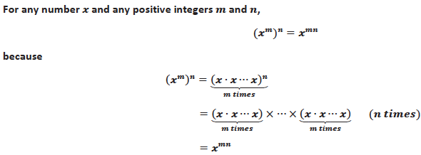
Definition

Slide 37
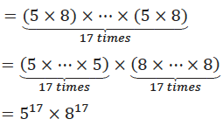
Discussion
Allow time for discussion:

Slide 38
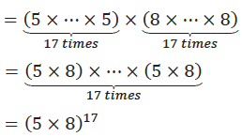
Discussion
Allow time for discussion:

Slide 39
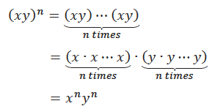
Definition
Complete Exercises 1-12.
because

Slide 40
Exercise 13
Why the restriction y ≠ 0?

Slide 41
Lesson 4: Numbers Raised to the Zeroth Power
Students know that a number raised to the zeroth power is equal to one.
Students recognize the need to define a number raised to the zeroth power in this manner to preserve the properties of exponents learned thus far.

Slide 42
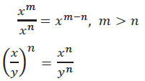
Discussion
If we assume x > 0 in (4) and y > 0 in (5) then:

Slide 43
Exploratory Challenge/Discussion
Our goal is to extend these existing properties of exponents for positive integers to all whole numbers. That is, we need to know that these properties still hold when m and/or n is zero.
What should something like be equal to?
What would kids say?

Slide 44
Keeping our goal in mind (preserve the existing properties of exponents) let’s see what happens using equation (1) with
(1)
We will let x = 3, and m = 0 (and recall n > 0). Then:

Slide 45
Keeping our goal in mind (preserve the existing properties of exponents) let’s see what happens using equation (1) with
(1)
We will let x = 3, and m = 0 (and recall n > 0). Then:
but

Slide 46
Since and what could it be?
Definition. For any positive number x, we define
Write the definition in your handout.
Now that we have a definition for let’s check to see if it works with our properties of exponents. Namely equations (1)-(3).
Complete Exercise 1.

Slide 47
Exercise 1: List all the possible cases of whole numbers m and n for identity (1). More precisely, when m > 0 and n > 0, we already know that (1) is correct. What are the other possible cases of m and n for which (1) is yet to be verified?
Case A:
Case B:
Case C:
Now that we know what we need to check. Let’s begin that process.

Slide 48
Exercise 2: Check that equation (1) is correct for each of the cases listed in exercise 1.
(1)
Case A:
Yes! It’s true.
Case B:
Yes! It’s true.
Case C:
Yes! It’s true.

Slide 49
Fluency Exercise
Sprint (10 minutes)
Designed to be fun, adrenaline-rich activity
Fast pace is essential
Students complete two sets of exercises
Goal is for students to improve their score
Low stakes activity: no grade, no name

Slide 50
Lesson 5: Negative Exponents and the Laws of Exponents
Students know the definition of a number raised to a negative exponent.
Students simplify and write equivalent expressions that contain negative exponents.

Slide 51
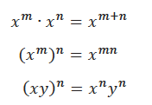
Discussion
We have now extended the properties of exponents to whole numbers (Lesson 4):
We now want to extend these properties for when m
and n are integers.

Slide 52
Discussion
Ask students:
Guide their thinking with:
Then, and must be?

Slide 53
Definition
For any positive number x and for any positive integer n, we define
Then , which explains why we must say that x ≠ 0.
Now we claim that for a positive x and all integers b:

Slide 54
Proof
There are three possibilities for b: b > 0, b = 0, or b < 0 (Trichotomy Law).
When b > 0, we use the definition.
When b = 0, both sides of the equation equal 1.
When b < 0, we’ve got some work to do.

Slide 55
Proof
We have to show that both sides of the equation are equal when b < 0.
Let b be negative, then b = -n for some positive integer n.
The left side of the equation is:

Slide 56
Proof
We have to show that both sides of the equation are equal when b < 0.
Let b be negative, then b = -n for some positive integer n.
The right side of the equation is:
Since both sides were equal, the proof is finished.

Slide 57
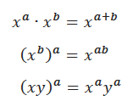
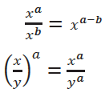
Laws of Exponents

Slide 58
Lesson 6: Proofs of Laws of Exponents
Students know the Laws of Exponents for integer exponents.
Students base symbolic proofs on concrete examples to show that the second law is valid for all integer exponents.

Slide 59
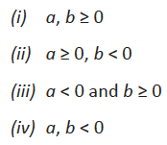
Prove one of the Laws of Exponents
There are four cases to consider:
Which, if any, have we already proven?

Slide 60
Prove
Demonstrate for students:

Slide 61
Prove
Imitate the argument for a, and b = -c (c is a positive integer). Because we are using symbols we have to show the left side equals the right side. L.S.:

Slide 62
Prove
Imitate the argument for a, and b = -c (c is a positive integer). Because we are using symbols we have to show the left side equals the right side. R.S.:
Since the left side is the same as the right side, case (ii) is proven.

Slide 63
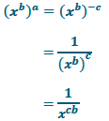
Prove
Complete Exercise 4: Proof of Case (iii)

Slide 64
Prove
Proof of Case (iv), start with the concrete:

Slide 65
Prove
Proof of Case (iv). Let a = -c and b = -d (c, c are positive integers). Show that L.S. = R.S.
L.S.:

Slide 66
Prove
Proof of Case (iv). Let a = -c and b = -d (c, c are positive integers). Show that L.S. = R.S.
R.S.:
Putting all four cases together, we have finished the proof of (11).

Slide 67
Problem Set #7
Use the properties of exponents to write an equivalent expression that is a product of distinct primes, each raised to an integer power.

Slide 68
Key Points
The Laws of Exponents are dependent upon a clear definition of exponential notation.
The “rule” for dividing exponential expressions is a consequence of the first.
There exists a logical sequence that illustrates the coherence of all concepts in Topic A.
Begin with positive integer exponents, move to whole numbers, then extend to integer exponents.
Definitions, definitions, definitions.

Slide 69
Agenda
Lesson Review 1
Module Overview
Lesson Review 2 – 6
Mid Module Assessment
Lesson Review 7 – 13
End of Module Assessment
Preparation for Implementation
Summary and Closure

Slide 70
Mid-Module Assessment
Briefly review the content of the Mid-Module Assessment and Exemplars.
Which problems/vocabulary will be challenging for students?
Which problems do you expect all students to be able to complete successfully?
Rubric Scoring

Slide 71
Agenda
Lesson Review 1
Module Overview
Lesson Review 2 – 6
Mid Module Assessment
Lesson Review 7 – 13
End of Module Assessment
Preparation for Implementation
Summary and Closure

Slide 72
Topic B: Magnitude and Scientific Notation
Students estimate very large and very small quantities expressed as a single digit times an integer power of 10.
Students perform operations with numbers written in scientific notation.

Slide 73
Lesson 7: Magnitude
Students know that positive powers of 10 are very large numbers and negative powers of 10 are very small numbers.
Students know that the exponent of an expression provides information about the magnitude of the number.

Slide 74
Discussion
Exponential notation is indispensable in science because it is used to clearly display the magnitude of a measurement.
That is, it provides a sense of how big or how small a number is.
Understanding magnitude comes down to understanding integer powers of 10.

Slide 75
Discussion
Fact 1: The numbers for arbitrarily large positive integers n are big numbers, in the sense that given a number M (no matter how big M is) there is a power of 10 that exceeds M.
Fact 2: The numbers for arbitrarily large positive integers n are small numbers, in the sense that given a positive number S (no matter how small S is), there is a (negative) power of 10 that is smaller than S.
We will look at two special cases of Fact 1.

Slide 76
Example1
Let M be the world population as of March 23, 2013. Approximately, M = 7,093,981,143.
We want to find the smallest power of 10 that exceeds the world population.
The number, M, has 10 digits and is therefore smaller than any whole number with 11 digits, such as 10,000,000,000. Agree?
So, Therefore, the 10th power of 10 exceeds M.

Slide 77
Example 2
Let M be the US national debt on March 23, 2013. M = 16,755,133,009,522 to the nearest dollar.
We want to find the smallest power of 10 that exceeds the US national debt.
The number, M, has 14 digits. The largest 14 digit number is 99,999,999,999,999. Agree?
So, Therefore, the 14th power of 10 exceeds M.
Complete Exercises 1 and 2.

Slide 78
Example 3
We prove what we have observed for all numbers.
We have two cases to consider:
Case 1: When the number M is a whole number, like in Exercise 1 that you just completed.
Case 2: When the number M is not a whole number, like in Exercise 2 that you just completed.

Slide 79
Example 3: Case 1
Let M be a positive integer with m digits.
Then,
So for an m-digit positive integer M, the m-th power of 10 exceeds M. Symbolically,

Slide 80
Example 3: Case 2
Let M be a non-integer. That is, M is a number that lies between two consecutive points on a number line.
That means that there is some integer N so that M lies between N and N + 1. N < M < N + 1.
By Case 1 we know there is a positive integer n so that
Since then

Slide 81
What’s the point?
Powers of 10 give us a sense of a numbers size, i.e., magnitude.
Consider:
Which is bigger, or ?
We can get a sense of the size of but not the other number.
This is why we want to learn about magnitude and the powers of 10!

Slide 82
Lesson 8: Estimating Quantities
Students compare and estimate quantities in the form of a single digit times a power of 10.
Students simplify expressions using knowledge of ratios, fractions and the Laws of Exponents.

Slide 83
Example 1

Slide 84
Example 1

Slide 85
Discussion

Slide 86
Discussion

Slide 87
Example 3

Slide 88
Example 3

Slide 89
Example 4

Slide 90
Exercises
Complete Exercises 2, 3 and 5.
There’s another sprint in this lesson that covers all Laws of Integer Exponents.

Slide 91
Lesson 9: Scientific Notation
Students write, add and subtract numbers in scientific notation.

Slide 92
Discussion
Knowing powers of 10 helps in understanding scientific notation, notation that scientists use because they work with very large and very small numbers.
Consider the estimated number of stars in the universe: This is a 23-digit whole number with the leading digit (leftmost digit) 6 followed by 22 zeroes.
When the number is written as , we say the number is written in scientific notation.

Slide 93
Definition
Complete Exercises 1 – 6.

Slide 94
Example 2

Slide 95
Example 2
To compute easily we will make the order of magnitude of each number the same:

Slide 96
Example 3

Slide 97
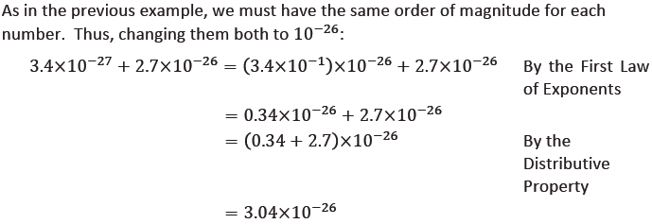
Example 3
Complete Exercises 7 and 8.

Slide 98
Lesson 10: Operations with Numbers in Scientific Notation
Students practice operations with numbers expressed in scientific notation and standard notation.

Slide 99
Example 1

Slide 100
Example 2

Slide 101
Example 3

Slide 102
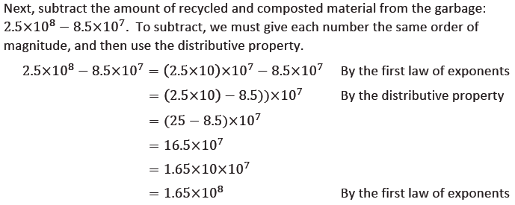
Example 3

Slide 103
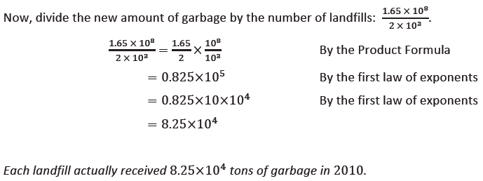
Example 3
Complete Exercises 2 – 4.

Slide 104
Lesson 11: Efficacy of Scientific Notation
Students continue working with very large and very small numbers expressed in scientific notation.
Students read, write and operate with numbers expressed in scientific notation.
http://www.youtube.com/watch?v=0fKBhvDjuy0

Slide 105
Example 1
The advantage of scientific notation becomes clear when we have to compute how many times heavier a proton is than an electron. The value of the ratio, r, of proton mass : electron mass is
isn’t it easier to look at the following?

Slide 106
Example 1
To compute, we use what we know about equivalent fractions:
Using the first law of exponents, we get:

Slide 107
Example 1
We can approximate the value of the fraction:
Then the value of the ratio, r, is approximately
A proton is about 2,000 times heavier than an electron.
Complete Exercises 5 and 6.

Slide 108
Lesson 12: Choice of Unit
Students understand how the choice of unit effects how easy or difficult it is to understand an expression of measurement.
Students determine appropriate units for various measurements and rewrite measurements based on new unit.

Slide 109
Discussion
The reason we use scientific notation is to sensibly and efficiently record and convey the results of measurements.
Consider the dimensions of a dining table. Which unit do you prefer to see the dimensions in?
Complete Exercise 1.

Slide 110
Example 1
Consider the mass of the proton and the electron in kilograms:
Wouldn’t a unit other than kg make these numbers easier to read and understand?
For this reason, scientists use the gigaelectronvolt as a unit of mass:

Slide 111
Exploratory Challenge 1
Consider the masses of the planets in our solar system. Mercury’s mass is:
Earth is used as a reference point for masses when expressed in the unit M_{E}. Then
We now want to express the mass of Mercury in this new unit.

Slide 112
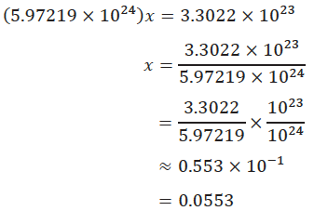
Exploratory Challenge 1
Let x represent the mass of Mercury in a new unit, M_{E}.

Slide 113
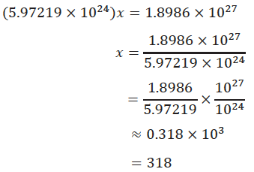
Exploratory Challenge 1
Students compute the mass of Jupiter in this new unit.
Complete the Exit Ticket.

Slide 114
Lesson 13: Comparison of Numbers Written in Scientific Notation and Interpreting Scientific Notation Using Technology
Students compare numbers expressed in scientific notation.
Students apply the Laws of Exponents to interpret data and use technology to compute with very large numbers.

Slide 115
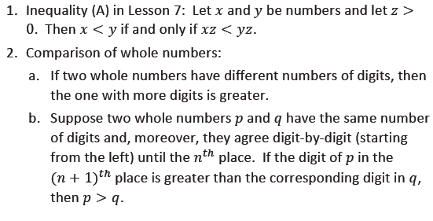
Discussion
There is a general principle that underlies the comparison of two numbers in scientific notation: Reduce everything to whole numbers if possible. To this end, we recall two basic facts.

Slide 116
Example 1

Slide 117
Example 3
Complete Exercise 1 and 6.

Slide 118
Fluency: Rapid White Board Exchange
Grab a white board, marker and eraser.
You will have one minute to complete each problem.
All answers must be expressed in scientific notation.

Slide 119
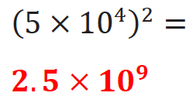
Problem 1

Slide 120
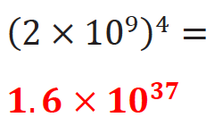
Problem 2

Slide 121
Problem 3

Slide 122
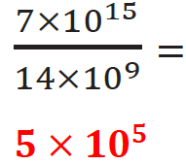
Problem 4

Slide 123
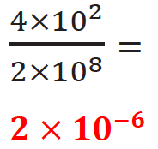
Problem 5

Slide 124
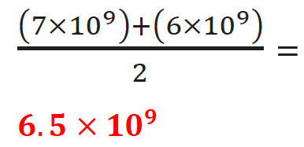
Problem 6

Slide 125
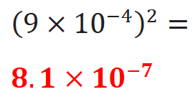
Problem 7

Slide 126
Problem 8

Slide 127
Agenda
Lesson Review 1
Module Overview
Lesson Review 2 – 6
Mid Module Assessment
Lesson Review 7 – 13
End of Module Assessment
Preparation for Implementation
Summary and Closure

Slide 128
End of Module Assessment
Briefly review the content of the Mid-Module Assessment and Exemplars.
Which problems/vocabulary will be challenging for students?
Which problems do you expect all students to be able to complete successfully?
Rubric Scoring

Slide 129
Agenda
Lesson Review 1
Module Overview
Lesson Review 2 – 6
Mid Module Assessment
Lesson Review 7 – 13
End of Module Assessment
Preparation for Implementation
Summary and Closure

Slide 130
Progression Study
What are the Progressions?
Explore: Expressions and Equations
Read page 11
Scan pages 12-13
Highlight the information relevant to the content of this module.

Slide 131
Progression Study
Study Lessons 2 & 3 and Lessons 8-10.
Then, turn and talk:
How do these lessons engage students in the work described in the Progression?

Slide 132
Coherence Within the Module
Analyze the progression of each lesson component across the Module.
What does the sequence of Fluency Practices accomplish as a whole?
How does the sequence of Discussions connect to topic/module?
How does the sequence of Exercises/Examples and Student Debrief build toward mastery of the topic/module?

Slide 133
Practice a Planning Protocol
With any topic from A Story of Ratios, read the module overview and the topic opener.
Study the module assessment, paying particular attention to the sample responses provided.

Slide 134
Practice a Planning Protocol
Read through the first lesson of the topic.
Then, take note of the lesson objective and re-examine the exit ticket with the objective in mind. What major concept is necessary to successfully complete the exit ticket?
Study the concept development and problem set. How do the CD/PS develop the major concept that is required in the exit ticket? What parts of the CD/PS go beyond this major concept?

Slide 135
Practice a Planning Protocol
How will this knowledge empower teachers to support specific groups of learners?
Turn to the subsequent lesson, and examine the exit ticket. How does this exit ticket build on the last? How are the two exit tickets similar and how are they different?
Will students have an opportunity in the second lesson to continue development of the first lesson’s objective? What level of mastery of the first lesson’s objective is necessary in preparation for the second lesson?

Slide 136
Practice a Planning Protocol
How does the new plan for implementation impact the student debrief?
Are any adjustments needed to the fluency and/or application components of the lesson?

Slide 137
Practice a Planning Protocol
Repeat this process for each lesson.
Read lesson.
Study exit ticket. Identify critical portions of concept development and problem set.
Consider needs of specific students.
Refer to subsequent exit ticket. Revise implementation plan as needed.
Make adjustments to the student debrief as needed.
Consider the other lesson components, ensuring a balance of rigor.

Slide 138
Agenda
Lesson Review 1
Module Overview
Lesson Review 2 – 6
Mid Module Assessment
Lesson Review 7 – 13
End of Module Assessment
Preparation for Implementation
Summary and Closure

Slide 139
Biggest Takeaway
I now know…
I need to figure out…

Slide 140
Key Points
Everything students learn about magnitude and scientific notation is rooted in their understanding of the Laws of Exponents.
There exists a logical sequence that moves students from powers of 10, to single digit integers times a power of 10, to scientific notation in general.
Operations with numbers written in scientific notation relies heavily on an understanding of the Laws of Exponents, as well as properties (Associative/Commutative/Distributive) and operations with rational numbers (fractions and negative fractions).

Slide 141
Next Step
The first thing I’ll do to prepare is…

