Slide 1
A Story of Functions
Geometry
Notes:
This full-day session is intended to support successful implementation of this module. Using this module as a platform for understanding our instructional approach and lesson structure, you will have the tools needed to tackle the remaining modules of the year.
Welcome participants and introduce presentation team.
Fist to Five:
- How familiar are you with Eureka Math and A Story of Functions?
Poll the participants:
Are you using the lessons on a daily basis? Or to supplement your instruction?
Are you a classroom teacher? For this grade? A different grade?
Are you a math coach? Coordinator? Resource teacher?
Are you a school-level administrator? District-level administrator?
Quickly orient participants to the day’s materials:
Full module – provided by Wiley; additional modules are available for purchase through our website, commoncore.org
Handout packet – describe the nature and purpose of both the stapled packet and the loose handouts
Materials – any announcements needed regarding materials on the tables?
TIME ALLOTTED FOR THIS SLIDE:
3 minutes
MATERIALS NEEDED:
Powerpoint
Projector
Clicker
Laptop
Document camera
Participant Binder

Slide 2
This PowerPoint presentation is provided to individuals who participated in a live training by professional developers certified by, or affiliated with, the copyright holder, Common Core, Inc. It may not be altered in any way. The presentation may be shared for non-commercial purposes only. However, Common Core makes no representations or warranties about the effectiveness of training provided by non-certified/non-affiliated presenters of the material. Any commercial use of this presentation is illegal and violates the copyrights of Common Core, Inc.

Slide 3
Participant Poll
Classroom teacher
Math trainer
Principal or school leader
District representative / leader
Other
Notes:
In order for us to better address your individual needs, it is helpful to know a little bit about you collectively.
Pick one of these categories that you most identify with. As we go through these, feel free to look around the room and identify other folks in your same role that you may want to exchange ideas with over lunch or at breaks.
By a show of hands who in the room is a classroom teacher?
Math trainer?
Principal or school-level leader
District-level leader?
And who among you feel like none of these categories really fit for you. (Perhaps ask a few of these folks what their role is).
Regardless of your role, what you all have in common is the need to understand this curriculum well enough to make good decisions about implementing it. A good part of that will happen through experiencing pieces of this curriculum and then hearing the commentary that comes from the classroom teachers and others in the group.
TIME ALLOTTED FOR THIS SLIDE:
3 minutes
MATERIALS NEEDED:
none

Slide 4
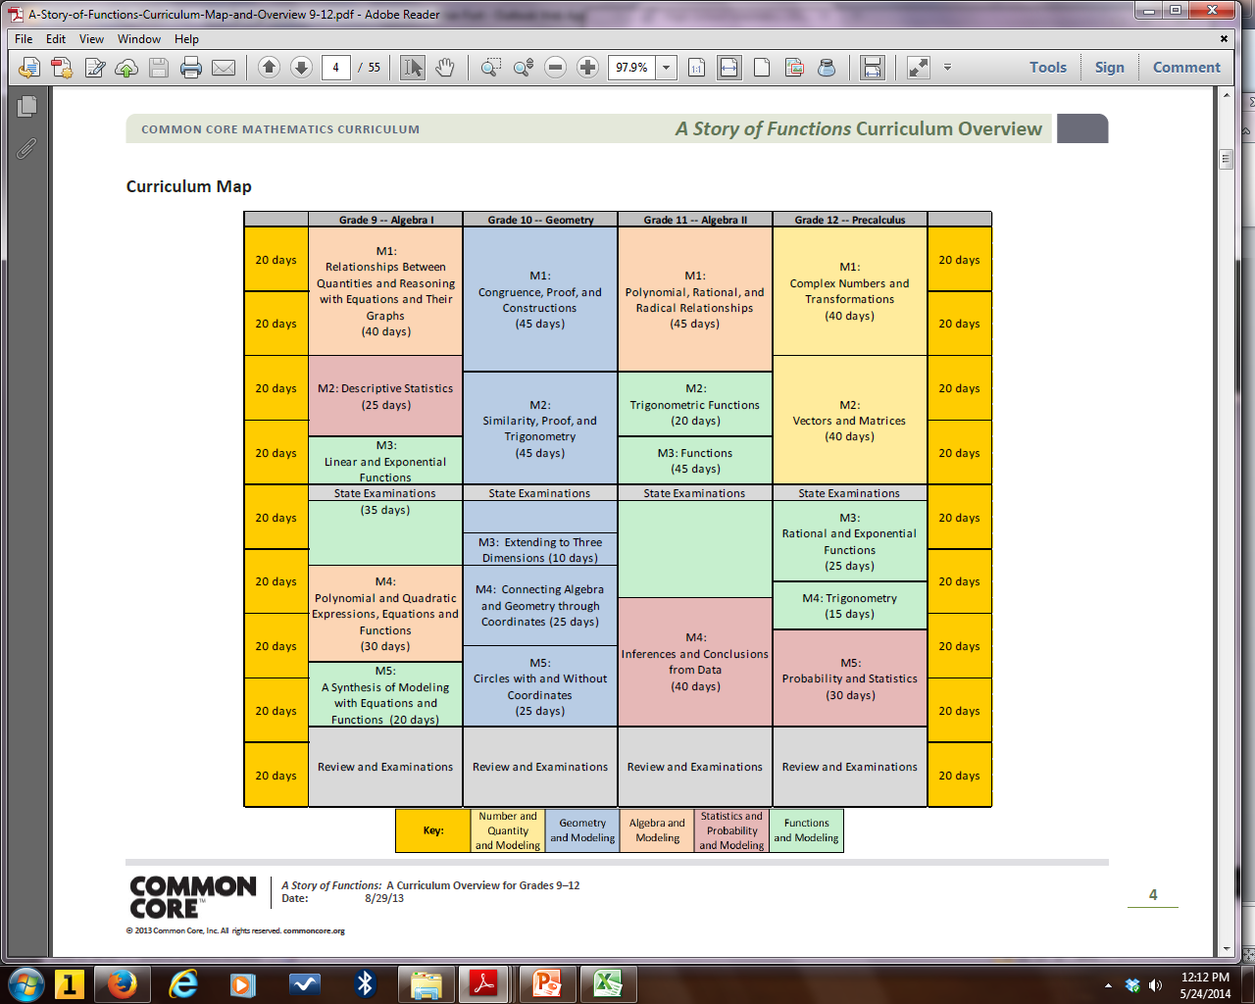
Curriculum Overview of A Story of Functions
Notes:
The first module in Grade 10 is Congruence, Proof, and Constructions. The module includes 34 lessons and is allotted 45 instructional days. Module 1 content emphasizes a major shift in the Geometry curriculum to determination of congruence based on rigid motion transformations.

Slide 5
Session Objectives
  Examine the sequence of concepts across the module.
  Study mathematical models and instructional strategies from A Story of Functions.
  Review examples that highlight themes and changes according to the Common Core State Standards.
  Prepare to implement this and other modules of A Story of Functions.
Notes:
Our objectives for this session are to:
Examine the development of mathematical understanding across the module using a focus on Concept Development within the lessons.
Look at instructional strategies used in A Story of Functions.
Look at examples that demonstrate themes and changes according to the Common Core State Standards.
Help you prepare to implement this and other modules of A Story of Functions.
TIME ALLOTTED FOR THIS SLIDE:
2 minutes
MATERIALS NEEDED:
none

Slide 6
Agenda
Lesson Structure
Instructional Sequence
Module Review
Preparation for Implementation
Notes:
We will begin by exploring the lesson structure and how it is fundamental to supporting rigorous instruction. Then we will dig in to the math of the module, examining the intentional instructional sequence that leads students toward mastery of the focus standards. Afterwards, we’ll take a look back at the module, reflecting on all the parts as one cohesive whole. Finally, we’ll talk about strategies for implementation in preparation for the beginning of the school year.
Let’s get started with the lesson structure. We’ll use Lesson 1 as our context for doing so.
TIME ALLOTTED FOR THIS SLIDE:
2 minutes
MATERIALS NEEDED:
none

Slide 7
Lesson 1: Construct an Equilateral Triangle
Flow of the lesson:
Opening Exercise: (1) A question that jogs students ideas on distance (2) key vocabulary review
Example 1: Guide students to discovering how to construct an equilateral triangle (with the use of a compass and straightedge).
Example 2: Read an excerpt from Elements that describes Euclid’s approach to constructing an equilateral triangle; have students develop their own set of steps on how to construct an equilateral triangle.
Geometry Assumptions: Introduce the notion that geometry is an axiomatic system- everything in the subject can be traced back to a short list of basic assumptions we take for granted.
Notes:
We are going to take an in-depth look at Lesson 1, and you will have an opportunity to experience it as students will experience it. The general flow of the lesson is as follows: [refer to the screen and the four major parts of the lesson]

Slide 8
Lesson 1: Construct an Equilateral Triangle
Student Outcomes
Students learn to construct an equilateral triangle.
Students communicate mathematical ideas effectively and efficiently.
Notes:
The first part of each lesson provides the expected student outcomes for the lesson. In Lesson 1, students are expected to both construct an equilateral triangle and to explain effectively and efficiently why a particular method of construction works.
TIME ALLOTTED FOR THIS SLIDE:
2 minutes
MATERIALS NEEDED:
none

Slide 9
Lesson 1: Lesson Notes
Describe the purpose of the lesson and how the lesson fits into the overall story of the module.
Notes prior knowledge expected of students.
Explains the “flow” of the lessons.
Provides any specific background knowledge useful for the teacher.
Notes:
After the student outcomes, generally there is a section of Lesson Notes to provide specific information to help the teacher with the particular lesson.
TIME ALLOTTED FOR THIS SLIDE:
2 minutes
MATERIALS NEEDED:
none

Slide 10
Lesson 1: Opening Exercise
Joe and Marty are in the park playing catch. Tony joins them, and the boys want to stand so that the distance between any two of them is the same.
How do they figure this out precisely?
What tool or tools could they use?
Notes:
An Opening Exercise appears in most lessons. Let’s examine the one appearing in Lesson 1 – the student’s first encounter with geometry on Day 1 of 10th grade.
Exercises we encounter in this presentation are in your packet so that you may try them out as a student would. Please begin with this Opening Exercise form Lesson 1.
TIME ALLOTTED FOR THIS SLIDE:
2 minutes
MATERIALS NEEDED:
none

Slide 11
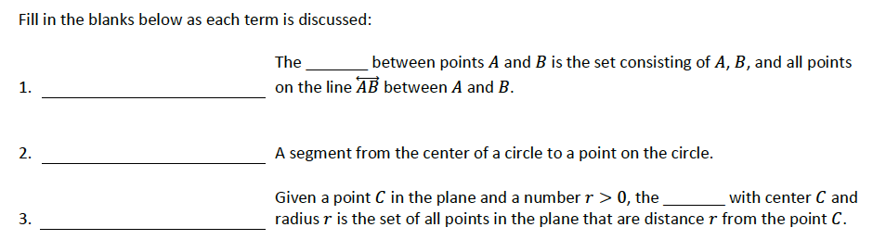
Lesson 1: Opening Exercise (cont.)
segment
radius
circle
Notes:
-- Allow participants 30 seconds to read/think about the Opening Exercise prompt, and another 30 seconds to exchange ideas. Encourage them to consider what students might say. Share out 1-2 responses.
-- Allow participants 30 seconds to read/think about the vocab terms, another few seconds to exchange answers, and finally, share out responses.
-- Have a poster ready of circle notation. Instruct participants that they may want to have such a poster ready, or some allocated space in their room to show this notation before reaching Example 2.
A circle with center C and radius CB is written as Circle_{C}, radius CB.

Slide 12
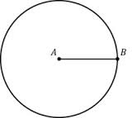

${Circle}_{A}, radius AB$
Notation is important!
Notes:
It is important to have correct notation displayed in the classroom. You may even want to have students create mini-posters illustrating specific terms and the appropriate notation to use for each as they arise in the course of the year.

Slide 13
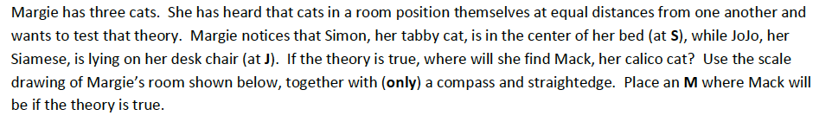
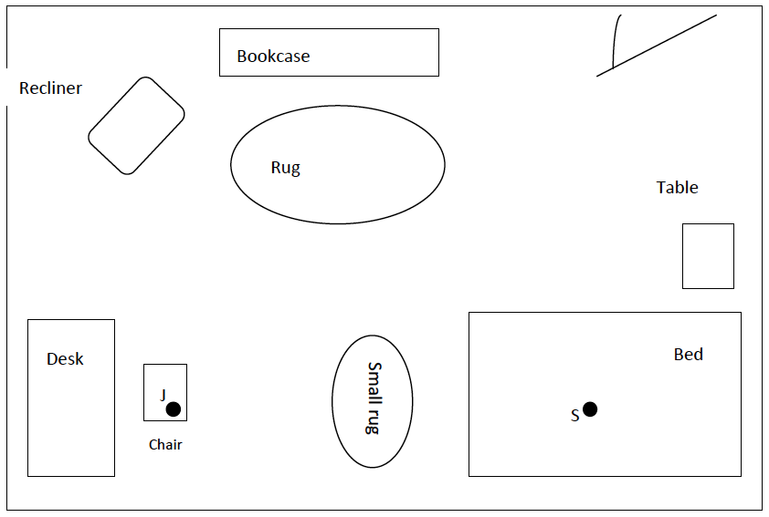
Lesson 1, Example 1
Notes:
Lesson 1 continues with Example 1, where students are asked to use a compass and straightedge to find a cat’s location in a room.
Take a moment to read through the context and try your hand at locating Mack.

Slide 14
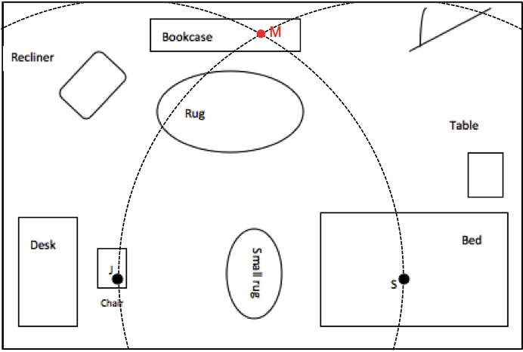
Lesson 1, Example 1
Notes:
-- Show solution.
How many noted that there may be two potential locations? What was the problem with the second location?

Slide 15
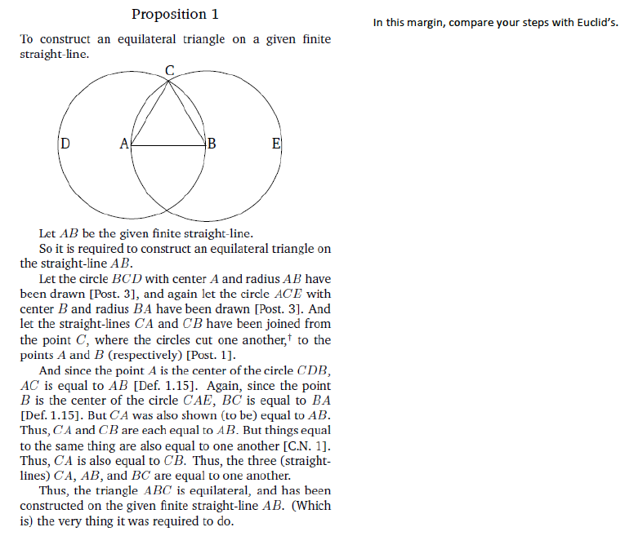
Lesson 1, Example 2
Notes:
-- Refer to the Euclid excerpt, Proposition 1. Tell participants that they can have students annotate the text and use it as a guide to writing what they believe is a clear set of instructions on how to construct an equilateral triangle. Tell them to consider using the points from Example 1 as the points to refer to in the steps.
-- Depending on who is in the audience, consider asking someone who feels they know the construction to describe the appropriate steps to the construction (maybe flip back to the solution image of the location of Mack). Elicit an informal set of steps.

Slide 16
Lesson 1, Example 2
Notes:
-- We want to highlight Example 2, as it is a prime example of students communicating their understanding about why the construction works vs. strictly completing the procedure.
To recap up until this point- students have been primed to think about distance between points, have reviewed key vocabulary, have explored how to perform the construction at hand, and now working on shaping their thoughts and language to articulate how to perform the construction. This last part emphasizes deeper understanding, especially as students compare and try out each others’ steps to constructions, and inherently involves the Math Practices (MP 3, MP 6).
Throughout Topic A, students will practice not only the constructions, but paying careful attention to the instructions that determine the construction. We want students to understand that a construction may not ever be completely perfect, due to human error, but the instructions that describe how to perform a construction do describe a perfect construction.

Slide 17
Lesson 1: Geometry Assumptions
Discussion about points, lines, planes, and distance.
Notes:
Give participants a minute or two to look over the section on Geometry Assumptions.
We used to call these assumptions “undefined terms” and simply describe them to students. Now we need to clarify that, in any logical system, there are underlying assumptions that form the basis for all assertions within the system. The emphasis is on introducing students to a logical system.
TIME ALLOTTED FOR THIS SLIDE:
2 minutes
MATERIALS NEEDED:
none

Slide 18
Lesson 1: Relevant Vocabulary
Geometric construction
Figure
Equilateral triangle
Collinear
Length of a Segment
    Notation in geometry
Coordinate System on a Line
Notes:
In many lessons, there is a section on relevant vocabulary introduced in the lesson.
Give participants a minute or two to look through the vocabulary; then ask them to note the precision with which the terms are defined (MP 6).
TIME ALLOTTED FOR THIS SLIDE:
2 minutes
MATERIALS NEEDED:
none

Slide 19
Lesson 1: Exit Ticket
We saw two different scenarios where we used the construction of an equilateral triangle to help determine a needed location (i.e., the friends playing catch in the park and the sitting cats). Can you think of another scenario where the construction of an equilateral triangle might be useful? Articulate how you would find the needed location using an equilateral triangle.
Notes:
Every lesson in each module ends with an exit ticket, so the teacher can gauge students’ understanding of the concepts and the extent to which the lesson objectives were met.
Give participants a minute to read over the exit ticket. Notice the requirement that student articulate their method. Remind participants that the outcomes for Lesson 1 included both constructing an equilateral triangle and communicating effectively and efficiently the instructions for doing this.
TIME ALLOTTED FOR THIS SLIDE:
2 minutes
MATERIALS NEEDED:
none

Slide 20
Lesson 1: Exit Ticket
Students might describe a need to determine the locations of fire hydrants, friends meeting at a restaurant, or parking lots for a stadium, etc.
Notes:
TIME ALLOTTED FOR THIS SLIDE:
2 minutes
MATERIALS NEEDED:
none

Slide 21
Lesson 1: Problem Set
Write a clear set of steps for the construction of an equilateral triangle. Use Euclid’s Proposition 1 as a guide.
Notes:
Finally, each lesson includes a Problem Set, which may be used in class, as homework, or as a review at the beginning of the next day’s class.
Review problem 1 with participants, and discuss how it fits with the student outcomes.
TIME ALLOTTED FOR THIS SLIDE:
2 minutes
MATERIALS NEEDED:
none

Slide 22
Lesson 1: Problem Set #2
Notes:
TIME ALLOTTED FOR THIS SLIDE:
2 minutes
MATERIALS NEEDED:
none

Slide 23
Lesson 1: Problem Set #2
Notes:
Note that students may not simply draw examples; they must also justify their drawings in terms of distances.
TIME ALLOTTED FOR THIS SLIDE:
2 minutes
MATERIALS NEEDED:
none

Slide 24
Lesson 1: Problem Set #2
Notes:
TIME ALLOTTED FOR THIS SLIDE:
2 minutes
MATERIALS NEEDED:
none

Slide 25
Lesson 1 Problem Set #3
Notes:
The final problem is similar to Example 1, where students were asked to locate a cat. Here, students are asked to specify two potential locations for a park. This previews a later requirement for constructing a rhombus.
Again, note the emphasis on clear communication of procedures.
TIME ALLOTTED FOR THIS SLIDE:
2 minutes
MATERIALS NEEDED:
none

Slide 26
Lesson 1 Problem Set #3
Notes:
Notice the notation students are expected to use in their writing.
TIME ALLOTTED FOR THIS SLIDE:
2 minutes
MATERIALS NEEDED:
none

Slide 27
What’s In a Module?
Teacher Materials
Module Overview
Topic Overviews
Daily Lessons
Assessments
Student Materials
Daily Lessons with Problem Sets
Copy Ready Materials
Exit Tickets
Assessments
Notes:
Each module will be delivered in 3 main files per module. The teacher materials, the student materials and a pack of copy ready materials.
Teacher materials include a module overview, and topic overviews, along with daily lessons and a mid- and end-of-module assessment. (Note that shorter modules of 20 days or less do not include a mid-module assessment.)
Student materials are simply a package of daily lessons. Each daily lesson includes any materials the student needs for the classroom exercises and examples as well as a problem set that the teacher can select from for homework assignments.
The copy ready materials are a single file that one can easily pull from to make the necessary copies for the day of items like exit tickets that wouldn’t be appropriate to give the students ahead of time, as well as the assessments.
TIME ALLOTTED FOR THIS SLIDE:
4 minutes
MATERIALS NEEDED:
None

Slide 28
What’s In a Lesson?
Teacher Materials Lessons
Student Outcomes and Lesson Notes (in select lessons)
Classwork
  General directions and guidance, including timing guidance
  Bulleted discussion points with expected student responses
  Student classwork with solutions (boxed)
Exit Ticket with Solutions
Problem Set with Solutions
Student Materials
Classwork
Problem Set
Notes:
Follow along with a lesson from the materials in your packet.
The teacher materials of each lesson all begin with the designation of the lesson type, lesson name, and then 1 or more student outcomes. Lesson notes are provided when appropriate, just after the student outcomes.
Classwork includes general guidance for leading students through the various examples, exercises, or explorations of the day, along with important discussion questions, each of which are designated by a solid square bullet. Anticipated student responses are included when relevant – these responses are below the questions; they use an empty square bullet and are italicized. Snapshots of the student materials are provided throughout the lesson along with solutions or expected responses. The snap shots appear in a box and are bold in font. Most lessons include a closing of some kind – typically a short discussion. Virtually every lesson includes a lesson ticket and a problem set.
What you won’t see is a standard associated with each lesson. Standards are identified at the topic level, and often times are covered in more than one topic or even more than one module… the curriculum is designed to make coherent connections between standards, rather than following the notion that the standards are a checklist of items to cover.
Student materials for each lesson are broken into two sections, the classwork, which allows space for the student to work right there in the materials, and the problem set which does not include space – those are intended to be done on a separate sheet so they can be turned in. Some lessons also include a lesson summary that may serve to remind students of a definition or concept from the lesson.
TIME ALLOTTED FOR THIS SLIDE:
5 minutes
MATERIALS NEEDED:
None

Slide 29




Types of Lessons
Problem Set
    Students and teachers work through examples and complete exercises to develop or reinforce a concept.
Socratic
    Teacher leads students in a conversation to develop a specific concept or proof.
Exploration
    Independent or small group work on a challenging problem followed by debrief to clarify, expand or develop math knowledge.
Modeling
    Students practice all or part of the modeling cycle with real-world or mathematical problems that are ill-defined.
Notes:
There are 4 general types of lessons in the 6-12 curriculum. There is no set formula for how many of each lesson type we included, we always use whichever type we feel is most appropriate for the content of the lesson. The types are merely a way of communicating to the teacher, what to expect from this lesson – nothing more. There are not rules or restrictions about what we put in a lesson based on the types, we’re just communicating a basic idea about the structure of the lesson.
Problem Set Lesson – Teacher and students work through a sequence of 4 to 7 examples and exercises to develop or reinforce a concept. Mostly teacher directed. Students work on exercises individually or in pairs in short time periods. The majority of time is spent alternating between the teacher working through examples with the students and the students completing exercises.
Exploration Lesson – Students are given 20 – 30 minutes to work independently or in small groups on one or more exploratory challenges followed by a debrief. This is typically a challenging problem or question that requires students to collaborate (in pairs or groups) but can be done individually. The lesson would normally conclude with a class discussion on the problem to draw conclusions and consolidate understandings.
Socratic Lesson – Teacher leads students in a conversation with the aim of developing a specific concept or proof. This lesson type is useful when conveying ideas that students cannot learn/discover on their own. The teacher asks guiding questions to make their point and engage students.
Modeling Cycle Lesson --Students are involved in practicing all or part of the modeling cycle (see p. 62 of the CCLS, or 72 of the CCSSM). The problem students are working on is either a real-world or mathematical problem that could be described as an ill-defined task, that is, students will have to make some assumptions and document those assumptions as they work on the problem. Students are likely to work in groups on these types of problems, but teachers may want students to work for a period of time individually before collaborating with others.
TIME ALLOTTED FOR THIS SLIDE:
4 minutes
MATERIALS NEEDED:
None

Slide 30
Overview of the Year
Module 1: Congruence, Proof, and Constructions
  45 days, 34 lessons
Module 2: Similarity, Proof, and Trigonometry
  45 days, 33 lessons
Module 3: Extending to Three Dimensions
  15 days, 13 lessons
Module 4: Connecting Algebra to Geometry Through Coordinates
  20 days, 15 lessons
Module 5: Circles with and without Coordinates
  25 days, 20 lessons
Notes:
The lessons in this curriculum are designed to last one 45-minute day. Several days are included in each module for assessments, review of assessments, and remediation and/or enrichment.
TIME ALLOTTED FOR THIS SLIDE:
2 minutes
MATERIALS NEEDED:
none

Slide 31
Agenda
Lesson Structure
Instructional Sequence
Module Review
Preparation for Implementation
Notes:
As you’ve seen, each lesson component has a very different purpose. Consequently, each lesson component has a different pace, so the experience feels different for students. It is important to honor each component in order to do justice both to the mathematical practices and to the balance of rigor that is expected.
TIME ALLOTTED FOR THIS SLIDE:
2 minutes
MATERIALS NEEDED:
none

Slide 32
Module Overview
Overview
Focus Standards
Foundational Standards
Mathematical Practices
Terminology
Suggested Tools
Assessment Summary
Topic Overviews
Notes:
TIME ALLOTTED FOR THIS SLIDE:
2 minutes
MATERIALS NEEDED:
none

Slide 33
Module 1: Congruence, Proof, and Constructions
Topic A: Basic Constructions
Topic B: Unknown Angles
Topic C: Transformations/Rigid Motions
Topic D: Congruence
Topic E: Proving Properties of Geometric Figures
Topic F: Advance Constructions
Topic G: Axiomatic Systems
Notes:
Module 1 is a 45 day module, in fact it is one of two 45-day modules (Module 2, Similarity is the other).
The bulk of class time is spent on Topics A-D, so let’s talk a little about the story that weaves these topics together.
Clearly, Topic C is a focus as it is going to inform how we define what congruence is. So what are Topics A and B for? Well, the purpose of looking at constructions and unknown angles is to develop the basic language of geometry. In other words, we need to know WHAT we will be transforming. It wouldn’t make sense to talk about transformations before you know what you’re transforming or before you have a way of talking about what you’re transforming.
Topic D represents a major shift under Common Core State Standards, requiring that congruence now be based on the ability to demonstrate that one figure can be mapped onto another by a series of rigid motions.
Topics E-G are relatively small sections of this module, culminating with the establishment of geometry as an axiomatic system based upon a set of underlying assumptions.
TIME ALLOTTED FOR THIS SLIDE:
8 minutes
MATERIALS NEEDED:
None

Slide 34
Key Changes in CCSS that Impact M1
“The concepts of congruence, similarity, and symmetry can be understood from the perspective of geometric transformation. Fundamental are the rigid motions: translations, rotations, reflections, and combinations of these, all of which are here assumed to preserve distance and angles (and therefore shapes generally)…
In the approach taken here, two geometric figures are defined to be congruent if there is a sequence of rigid motions that carries onto the other.”
Common Core State Standards for Mathematics, p74
Notes:
Module 1, focused on Congruence, is where some of the most significant changes are occurring in geometry vs. traditional curriculum. This is due to the way congruence is defined under the CCSS, which is with the use of ‘geometric transformation’ as stated in this quote.
Traditionally, we have called two segments (for example) congruent if they had the same lengths. It is not untrue to make this statement, however the CCSS lens allows us to declare figures as congruent in one fell swoop as opposed to making many individual measurements. Another benefit is that this approach allows us to broaden the kinds of figures we are able to compare at all. A ‘complex’ figure with not just straight edges but also curves is now among the kinds of figures we can compare. Since rigid motions preserve distances and angles, we have a way to try and manipulate the figure onto another figure for comparison. Before, by using the lengths of segments as the means of identifying two figures as congruent, we were really limited in the types of figures we could compare (we could really only compare rectilinear figures).
TIME ALLOTTED FOR THIS SLIDE:
8 minutes
MATERIALS NEEDED:
None

Slide 35
Key Changes in CCSS that Impact M1
Transformations
    How they are first introduced
    The manner in which they are described and studied
    Their use in the definition of congruence and similarity
    Other uses to which transformations are put, e.g., reasoning and steps in proofs
Notes:
So, very broadly, what is meant by ‘geometric transformation’? Are ‘transformations’ under the CCSS the same as they have been defined in geometry textbooks we have used?
Well, yes and no. Yes, because the four transformations studied in this course are question are translations, reflections, rotations, and dilations; no because the treatment they get under the CCSS is different. So how they are introduced, the way in which they are studied, what we use them towards is different.
TIME ALLOTTED FOR THIS SLIDE:
8 minutes
MATERIALS NEEDED:
None

Slide 36
Topic A: Basic Constructions
Standards
  G-CO.1, G-CO.12, G-CO.13
Constructions
  How to:
    construct an equilateral triangle
    copy an angle
    bisect an angle
    construct a perpendicular bisector
    determine the incenter and circumcenter of a triangle
Notes:
All the constructions in Topic A should look familiar (they have been part of state standards for years).
What is different here is that the focus is not solely about the procedure or the “how to”, but being about to communicate the “how to” (how to tell people to ‘how to’). The ability to describe a CONstruction precisely is the ability to give an INstruction. In this study of constructions we are extending the meaning of vocabulary and seeing it in action. We are practicing communicating ideas to one another.
Why do this? Why not just stick to the procedure? If we step back and think of what it means to understand the content deeply, we could say that Euclid represents the end of the spectrum of what it means to understand geometry deeply. He took all his understanding of geometry, started with a set of assumptions and using a deductive approach, built fact upon fact, and communicated the ideas effectively and efficiently in the books that make up Elements.
Students are on the spectrum. And to work their way along the spectrum, they need to practice communicating these mathematical ideas and give them meaning beyond the initial level of just “doing” the basic action, e.g. a construction.
Students do just this right off the bat in Lesson 1.
TIME ALLOTTED FOR THIS SLIDE:
8 minutes
MATERIALS NEEDED:
None

Slide 37
The triangle is not equilateral. Students may prove this by constructing two intersecting circles using any two vertices as the given starting segment. The third vertex will not be one of the two intersection points of the circles.
Notes:
Again, students should be required to articulate their reasoning clearly.
TIME ALLOTTED FOR THIS SLIDE:
2 minutes
MATERIALS NEEDED:
none

Slide 38
Exercise 2: Investigate How to Copy an Angle
You will need a compass and a straightedge.
You and your partner will be provided with a list of steps (in random order) needed to copy an angle using a compass and straightedge. Your task is to place the steps in the correct order, and then follow the steps to copy the angle below.
Notes:
Hand out the steps and give participants about 10 minutes to sort them.
Discuss the activity – Is it engaging to students? Does it reinforce geometry notation and clarity of communication? Does it support rigor, yet offer sufficient scaffolding to struggling students?
TIME ALLOTTED FOR THIS SLIDE:
2 minutes
MATERIALS NEEDED:
none

Slide 39
Notes:
TIME ALLOTTED FOR THIS SLIDE:
2 minutes
MATERIALS NEEDED:
none

Slide 40
Students construct the perpendicular bisector of a line segment and examine the symmetries of the construction.
They also construct the perpendicular to a line from a point not on the line.
Notes:
Construction of a perpendicular bisector is critical to understanding of transformations and plays an important part in all three rigid motions.
TIME ALLOTTED FOR THIS SLIDE:
2 minutes
MATERIALS NEEDED:
none

Slide 41
Students construct the perpendicular bisectors of all three sides of a triangle and note that the three bisectors have a point of concurrency.
They are guided to explain WHY the bisectors are concurrent, drawing on their understanding of the properties of perpendicular bisectors and their relationship to endpoints of the segments they are bisecting.
Notes:
Do you recall the name of the point of concurrency of the three perpendicular bisectors? (circumcenter)
How about the intersection of the three angle bisectors? (incenter)
The three altitudes? (orthocenter)
The three medians? (centroid)
TIME ALLOTTED FOR THIS SLIDE:
2 minutes
MATERIALS NEEDED:
none

Slide 42
Topic B: Unknown Angles
Standards
  G-CO.9
Breakdown of Lessons 6-11:
  Lessons 6-8: Unknown angle problems involving angles and lines at a point, transversals, and angles in a triangle. Students use simple justification in non-algebraic steps.
  Lessons 9-11: Unknown angle proofs, non-numeric problems emphasizing justification of a relationship, sometimes a known existing relationship.
Notes:
The motivation in Topic B is similar to that in Topic A: there is an actual task and then a step towards being able to discuss or explain the task. With unknown angle problems, students are actually solving a problem but also beginning to use justifications from their knowledge of facts related to angles. With unknown angle proofs, numbers are replaced by variables, and the focus on geometric relationships is sharper, and requires students to be attentive to the reasons that allow them to take the next step or draw the next conclusion in a problem. The practice with numeric problems makes for a smooth transition to reasoning without numbers.
Work with angles, even single step unknown angle problems (i.e. solving for the missing angle), began in Grade 4. Students see an especially closer look at unknown angle problems in Grade 7, Module 3.
It is worth noting here that as part of the transition from Topics A to B, an extensive chart of facts associated with angles learned since Grade 4 appears in Lesson 6 for student reference. This primes students with the review of needed facts to (1) solve problems and (2) explain why they take the algebraic steps they take in a problem.
TIME ALLOTTED FOR THIS SLIDE:
8 minutes
MATERIALS NEEDED:
None

Slide 43
Lesson 6: Solve for Unknown Angles – Angles and Lines at a Point
Notes:
Exercise 10
TIME ALLOTTED FOR THIS SLIDE:
2 minutes
MATERIALS NEEDED:
none

Slide 44
Lesson 7: Solve for Unknown Angles - Transversals
Notes:
Note the need for an auxiliary line.
TIME ALLOTTED FOR THIS SLIDE:
2 minutes
MATERIALS NEEDED:
none

Slide 45
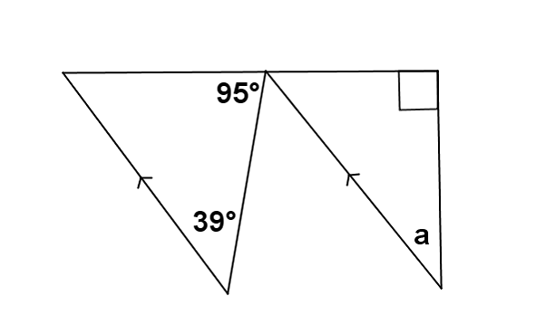

Lesson 8: Solve for Unknown Angles – Angles in a Triangle
$m∠a$ = ___________
44°
Notes:
What justification would be used to solve this problem?
Alternate interior angles, angles on a line, and sum of angles in a triangle
TIME ALLOTTED FOR THIS SLIDE:
2 minutes
MATERIALS NEEDED:
none

Slide 46
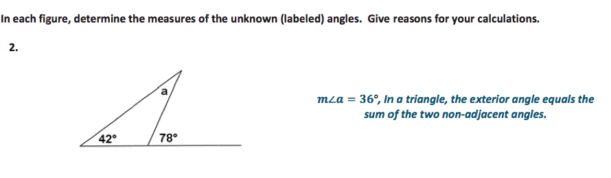
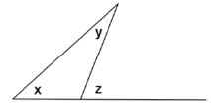
Topic B: Unknown Angles
Lesson 8, Exercise 2:
Lesson 9, Discussion:
What can be established about x, y, and z?
Notes:
Remember that Lessons 6-8 are unknown angle problems, therefore the first example is about solving for the measure of a and providing a justification for how you arrived at that answer.
-- Allow participants the opportunity to answer the question and cite a reason.
-- Step through to show the second example.
What do you notice about the second example relative to the first example?
-- Elicit that it is non-numeric and that the goal here is to establish a relationship of some sort.
You might want to say, well I still know that the sum of two remote interior angles is equal to the measure of the respective exterior angle. But is it possible to actually show this with the use of any other facts?

Slide 47
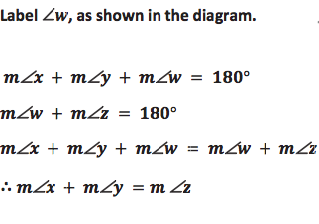
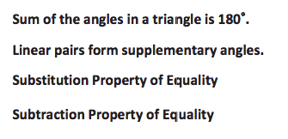
Topic B: Unknown Angles
What can be established about x, y, and z?
w
Notes:
-- Take participant suggestions about establishing a relationship between x, y, and z before reviewing the solution.
The unknown angle proofs require students to really break down relationships, including ones they know to be true; they call on simpler facts to explain newer ones. The process is deductive.

Slide 48
Lesson 9: Unknown Angle Proofs – Writing Proofs
Notes:
TIME ALLOTTED FOR THIS SLIDE:
2 minutes
MATERIALS NEEDED:
none

Slide 49
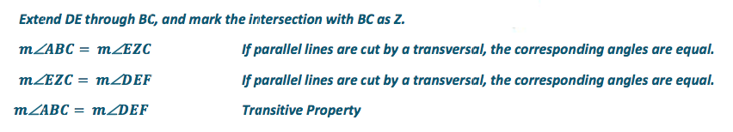
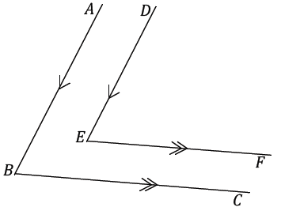
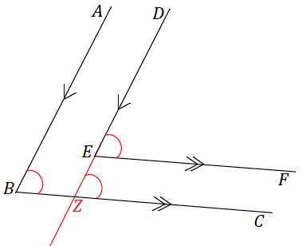
Lesson 10, Unknown Angle Proofs- Proofs with Constructions
Problem Set, 1
AB DE and . Prove that
m ABC = m DEF.
BC EF
Notes:
Again note the need for an auxiliary line.

Slide 50
Lesson 11: Unknown Angle Proofs – Proofs of Known Facts
A theorem states that in a plane, if a line is perpendicular to one of two parallel lines and intersects the other, then it is perpendicular to the other of the two parallel lines.
Prove this theorem. (a) Construct and label an appropriate figure, (b) state the given information and the theorem to be proved, and (c) list the necessary steps to demonstrate the proof.
Notes:
Problem Set 2
Students are often asked to prove a statement or theorem, providing all required diagrams, the given information, the statement to be proved, and the ordered list of reasons with justification for each.
TIME ALLOTTED FOR THIS SLIDE:
2 minutes
MATERIALS NEEDED:
none

Slide 51
Lesson 11: Unknown Angle Proofs – Proofs of Known Facts
Notes:
TIME ALLOTTED FOR THIS SLIDE:
2 minutes
MATERIALS NEEDED:
none

Slide 52
Topic C: Transformations/Rigid Motions
Standards
  G-CO.2, G-CO.3, G-CO.4, G-CO.5, G-CO.6, G-CO.7 G-CO.12
Key concepts in Lessons 12-21:
  Formal definition of each rigid motion (rotation, reflection, translation) and how each rigid motion is related to constructions
  Compositions of rigid motions
  Applications of rigid motions: discussion regarding correspondence, how congruence is defined
Notes:
We have laid the ground work in Topics A and B: we have reviewed both precise vocabulary and called explicit attention to facts that we have been learning over several years, and now we are ready to tackle transformations, specifically rigid motions.
If Topics A and B represent the “what” in geometry, figures we study, extending their meaning by using them in constructions, then in Topic C, transformations tell us how things relate or compare to one another, they help us establish what the relationship is between two things. We eventually use this for a very particular relationship, one where the rigid motions help establish whether two things are the same or not.
Specifically, students will learn the formal definitions of each rigid motion, and how to apply them to figures, how each transformation is tied to constructions, what compositions of rigid motions look like, and toward the end of Topic C, we explain congruence in terms of transformations.

Slide 53
Rigid Motions in Grade 8
What knowledge do students arrive with?
  Rigid motions first introduced in Grade 8, Module 2
  G8 focus:
    Understanding of what a transformation is
    Intuitive understanding and experimental verification of the properties of the rigid motions (translation, reflection, and rotation).
    Descriptive definitions
    Hands-on exploration with the use of transparencies
Notes:
Students study rigid motions in Grade 8, chiefly in a hands-on and descriptive approach to build intuitive understanding of how the rigid motions behave.

Slide 54
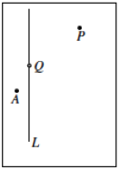
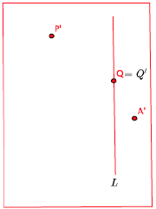
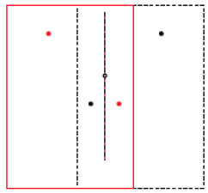
Grade 8, Module 2, Lesson 4
Grade 8 introduction to reflections:
Notes:
In grade 8 (M2, L4), reflections are introduced in the following hands-on way. Students have a piece of paper with a point Q on line L represented in black ink
-- Summarize the Grade 8 experience, the following doesn’t need to be said verbatim:
- Let L be a vertical line and let P and A be two points not on L as shown below. Also, let Q be a point on L. (The black rectangle indicates the border of the paper.)
The following is a description of how the reflection moves the points P, Q, and A by making use of the transparency:
- Trace the line L and three points onto the transparency exactly, using red. (Be sure to use a transparency that is the same size as the paper.)
- Keeping the paper fixed, flip the transparency across the vertical line (interchanging left and right) while keeping the vertical line and point Q on top of their black images.
- The position of the red figures on the transparency now represents the reflection of the original figure. Reflection(P) is the point represented by the red dot to the left of L, Reflection (A) is the red dot to the right of L, and point Reflection(Q) is point Q itself. Note that point Q is unchanged by the reflection.
The red rectangle in the picture on the next page represents the border of the transparency.
In the picture above, you see that the reflected image of the points is noted similar to how we represented translated images in Lesson 2. That is, the reflected point P is P'. More importantly, note that the line L and point Q have reflected images in exactly the same location as the original, hence ReflectionL=L and Reflection(Q)=Q, respectively.
Pictorially, reflection moves all of the points in the plane by “reflecting” them across L as if L were a mirror. The line L is called the line of reflection. A reflection across line L may also be noted as Reflection(L).

Slide 55
Topic C: Transformations/Rigid Motions
Notes:
This is the most critical topic within Module 1 and will require a great deal of careful, patient effort on the teacher’s part to help students thoroughly understand the material presented. The notation and formality of the definitions are new – both to students and to teachers – and will take some getting used to. Keep MP 1 in mind ☺
TIME ALLOTTED FOR THIS SLIDE:
2 minutes
MATERIALS NEEDED:
none

Slide 56
Lesson 12: Transformations – The Next Level
A transformation F of the plane is a function that assigns to each point P of the plane a unique point F(P) in the plane.
rotation
reflection
translation
Notes:
Emphasize the function notation. A transformation IS a function that takes one point as input, applies a “rule”, and gives another point as output.
TIME ALLOTTED FOR THIS SLIDE:
2 minutes
MATERIALS NEEDED:
none

Slide 57
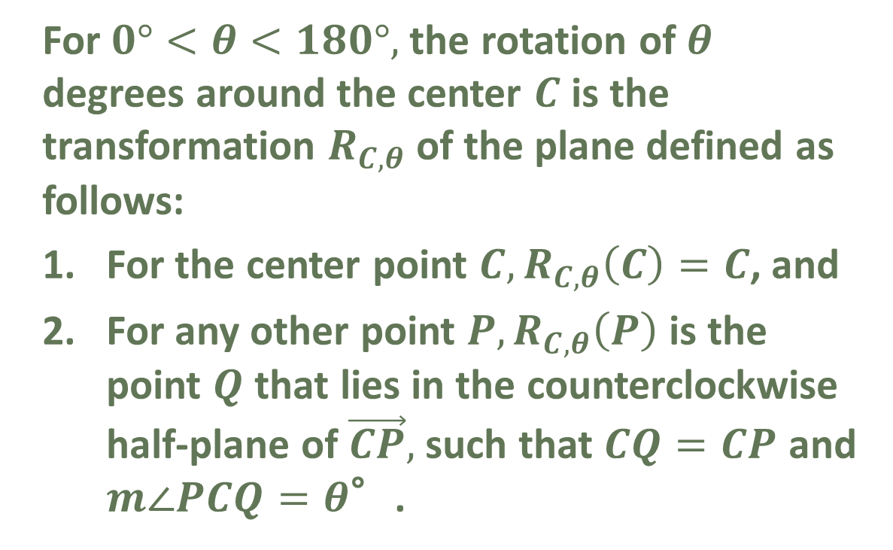
Lesson 13: Rotations
For $0°<θ<180°,$the rotation of $θ$ degrees around the center $C$ is the transformation $R_{C,θ}$of the plane defined as follows:
For the center point $C, R_{C,θ}\left(C\right)=C$, and
For any other point $P,R_{C,θ}\left(P\right)$ is the point $Q$ that lies in the counterclockwise half-plane of $\vec{CP},$such that $CQ=CP$ and $m∠PCQ=θ$°.
Notes:
Walk participant through the definition as they will walk their students through it. Emphasize the notation and the meanings.
TIME ALLOTTED FOR THIS SLIDE:
2 minutes
MATERIALS NEEDED:
none

Slide 58
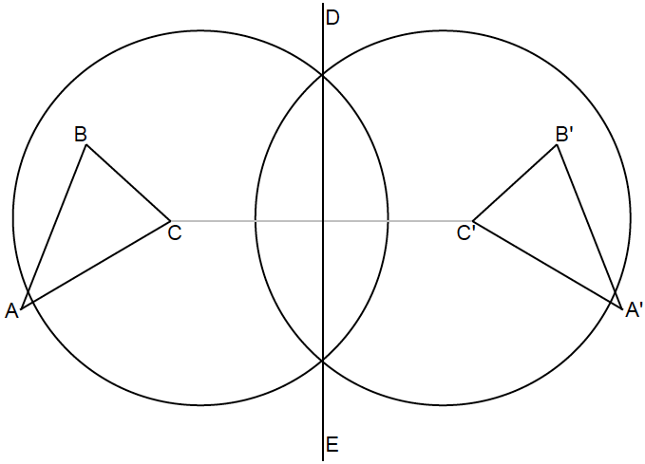
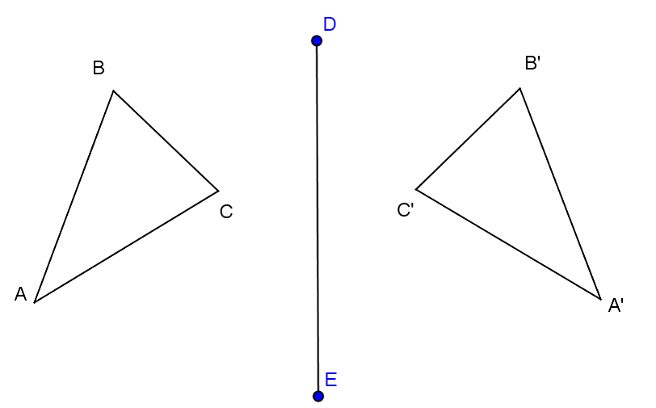
Lesson 14: Reflections
Exploratory Challenge
Notes:
Lesson 14 begins with a tie to constructions. Students discover that the line of reflection coincides with the perpendicular bisector of each segment determined by a pair of corresponding vertices in the figure. For segments AA’, BB’, and CC, the perpendicular bisector of each coincides with the line of reflection DE.
Recall that students have studied the construction of the perpendicular bisector in Lesson 4 (see next slide for reference).

Slide 59
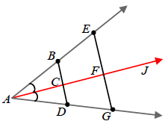
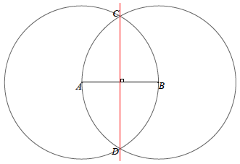
Reflections and the Perpendicular Bisector Construction
Notes:
In fact, students first learned the construction for an angle bisector, and how observations on the verification of an angle bisector construction led to the perpendicular bisector construction. Students verified an angle bisector construction by folding along the angle bisector– a look at the segment EG demonstrated whether the construction was done correctly. When the angle is folded along the bisector AJ, E should coincide with G, in fact a correct construction showed that E was as far from F as G was, or F was the midpoint of EG. Furthermore, by folding along the bisector of a correctly done construction meant that angles EFJ and GFJ should coincide, have the same measure, and since they lie on a straight line, should each have a measure of 90˚.
With this understanding, and with the knowledge of the steps of the angle angle bisector construction, students determine steps of the perpendicular bisector and have an understanding of the implications of a perpendicular bisector.

Slide 60
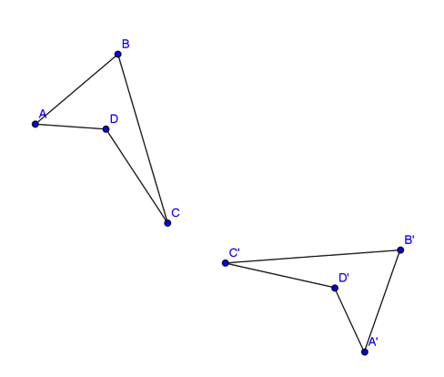
Lesson 14: Reflections
Example 1
Notes:
They use this understanding to determine a line of reflection between two figures in Example 1.
Based on the Exploratory Challenge, how is the line of reflection determined?
-- Allow the audience an attempt at the response.
Students must join any two corresponding points between the figures and construct the perpendicular bisector in order to determine the line of reflection.

Slide 61
Lesson 14: Reflections
Example 1
Notes:
This solution shows the perpendicular bisector of CC’ constructed; any two of the corresponding points used would be acceptable and would have yielded the same results.

Slide 62
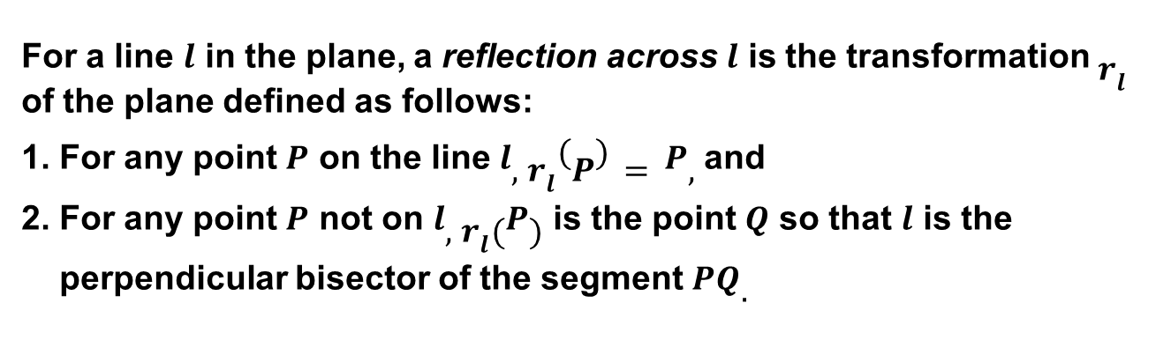
Lesson 14: Reflections
Definition of Reflection:
For a line $l$ in the plane, a reflection across $l$ is the transformation $r_{l}$ of the plane defined as follows:
1. For any point $P$ on the line $l, r_{l}\left(P\right)=P,$ and
2. For any point $P$ not on $l, r_{l}(P)$ is the point $Q$ so that $l$ is the
perpendicular bisector of the segment $PQ.$
Notes:
These exercises lead to the formal definition of reflection.
Just to review-- this definition comes after an intuitive understanding is developed and student have had experience manipulating reflections and testing out their properties with transparencies (G8), and after making a connection with constructions from the beginning of Module 1. Students have an understanding of how reflections behave and know, by construction, why they work the way they work.

Slide 63
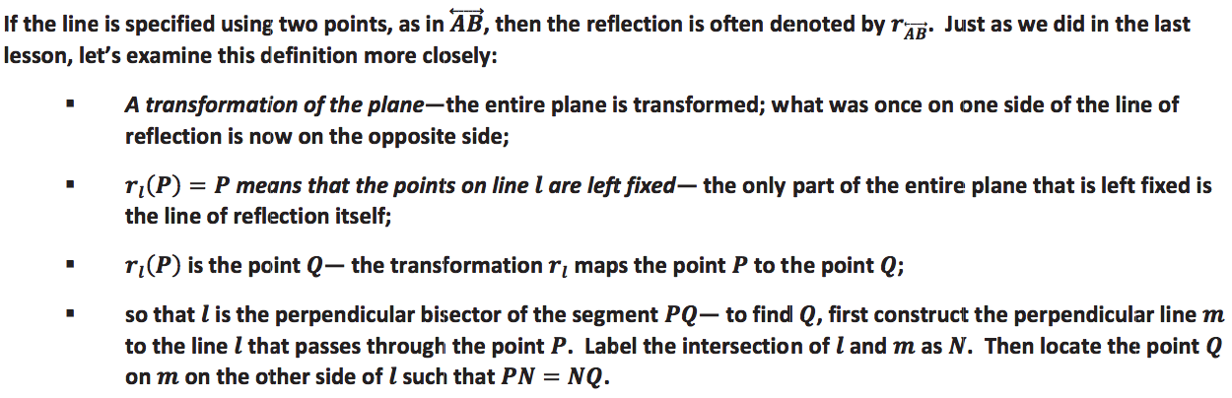
Lesson 14: Reflections
Definition of Reflection:
Notes:
In addition to however you want to break the definition down with students, the lesson provides an examination of each part of the definition.

Slide 64
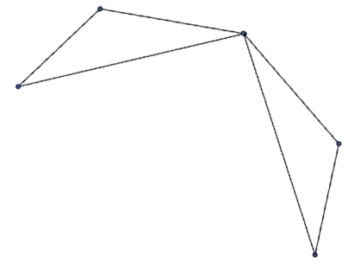
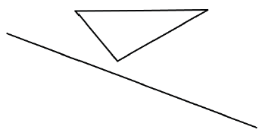
Lesson 14: Reflections
Application of Reflection:
Notes:
These are exit ticket questions for this lesson. Students are able to (1) determine the line of reflection between a figure and it’s reflected image and (2) reflect a figure across a line of reflection.
Each of the three transformation lessons builds to the formal definition and then works on the application of the transformation to figures. Each one also makes use of constructions. For example, in studying rotations, students discover that the center of rotation between a figure and its rotated image can be found with the help of perpendicular bisectors. Applying a translation to a figure involves the construction of parallel lines. So we see the progression of the topics beginning to come together.

Slide 65
Lesson 15: Rotations, Reflections, and
Symmetry
What is the relationship between a rotation and a reflection? Sketch a diagram that supports your explanation.
Reflecting a figure twice over intersecting lines yields the same results as a rotation.
Notes:
What if a figure is reflected across two parallel lines? (translation)
…across three parallel lines? (reflection)
…across any even number of parallel lines? (translation)
TIME ALLOTTED FOR THIS SLIDE:
2 minutes
MATERIALS NEEDED:
none

Slide 66
Lesson 16: Translations
Translate the figure one unit down and three units right. Draw the vector that defines the translation.
Notes:
Exit Ticket
Note that students are asked to translate objects that are not neatly tied to a grid – a much more complex transformation requiring the construction of parallel lines and congruent segments. The example provided here is EASY!
TIME ALLOTTED FOR THIS SLIDE:
2 minutes
MATERIALS NEEDED:
none

Slide 67
Lesson 17: Characterize Points on a
Perpendicular Bisector
The center of rotation is the intersection of two perpendicular bisectors, each to a segment that joins a pair of corresponding parts (between the figure and its image).
Example 3: Find the center of rotation for the transformation below. How are perpendicular bisectors a major part of finding the center of rotation? Why are they essential?
Notes:
TIME ALLOTTED FOR THIS SLIDE:
2 minutes
MATERIALS NEEDED:
none

Slide 68
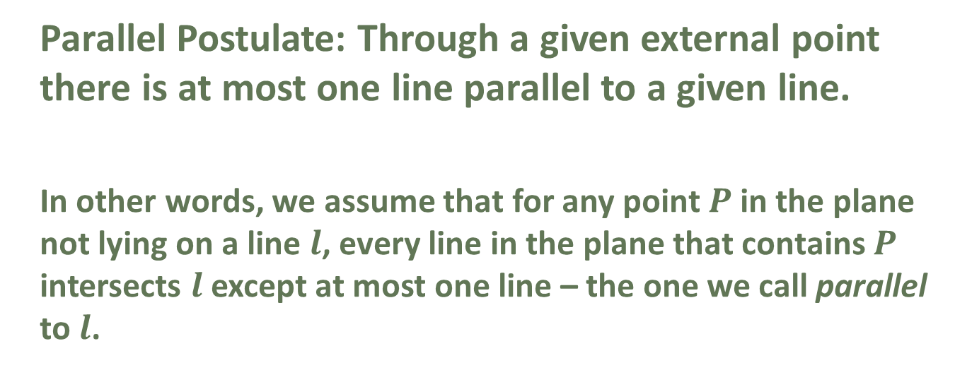
Lesson 18: Looking More Carefully at Parallel Lines
Parallel Postulate: Through a given external point there is at most one line parallel to a given line.
In other words, we assume that for any point $P$ in the plane not lying on a line $l$, every line in the plane that contains $P$ intersects $l$ except at most one line – the one we call parallel to $l$.
Notes:
The Parallel Postulate is what makes Euclidean Geometry Euclidean. For years, mathematicians tried to “prove” the postulate, only to concede finally that it cannot be proved and must instead be accepted as an underlying assumption (a postulate) in plane geometry.
TIME ALLOTTED FOR THIS SLIDE:
2 minutes
MATERIALS NEEDED:
none

Slide 69
Lesson 19: Construct and Apply a Sequence of Rigid Motions
We define two figures in the plane as congruent if there exists a finite composition of basic rigid motions that maps one figure onto the other.
  The idea of “Same size, same shape” only paints a mental picture; not specific enough.
  It is also not enough to say that two figures are alike in all respects except position in the plane.
  A congruence gives rise to a correspondence.
Notes:
Congruence is defined in L19 after a study of each basic rigid motion, as well as a look at symmetry (as a rigid motion) in Lesson 15, and the Parallel Postulate in Lesson 18.
- The idea of “Same size, same shape” only paints a mental picture; not specific enough:
Just as it is not enough to say, “Hey he looks like a sneaky, bad guy who deserves to be in jail”, it is not enough to say that two figures are congruent if they have the same size and same shape- it lacks specificity needed in a mathematical argument.
- It is also not enough to say that two figures are alike in all respects except position in the plane.
In defining congruence as a finite composition of basic rigid motions that maps one figure onto another, we need to be able to refer to and describe this rigid motion. Additionally, a congruence by one rigid motion and a congruence by a different rigid motions are two separate things. Specifying one of many possible rigid motions may be important.
- A congruence gives rise to a correspondence.
A correspondence between two figures is a function from the parts of one figure to the parts of the other, with no conditions concerning same measure or existence of rigid motions. In other words, two figures do not have to be congruent for a correspondence to exist, but a congruence always yields a correspondence. If there exists a rigid motion T that takes one figure to another, then a natural correspondence results between the parts. For example, if a figure contains a segment AB, then a congruent figure includes a corresponding segment T(A)T(B).

Slide 70
Lesson 20: Applications of Congruence in Terms of Rigid Motions
Problem Set #3:
Give an example of two triangles and a correspondence between their vertices such that (a) one angle in the first is congruent to the corresponding angle in the second and (b) two sides of the first are congruent to the corresponding sides of the second, but (c) the triangles themselves are not congruent.
Notes:
This exact figure will appear later as a justification for why SSA is NOT a triangle congruence criterion.
TIME ALLOTTED FOR THIS SLIDE:
2 minutes
MATERIALS NEEDED:
none

Slide 71
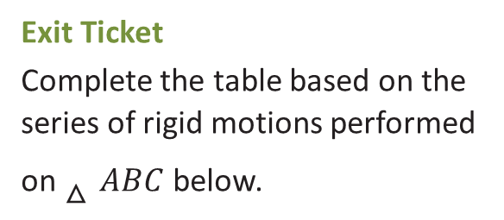
Lesson 21: Correspondence and Transformations
Sequence of rigid motions (2)
Composition in function notation
Sequence of corresponding sides
Sequence of corresponding angles
Triangle congruence statement
Exit Ticket
Complete the table based on the series of rigid motions performed on $△ABC$ below.
Notes:
Emphasize the notation for the composition of transformations – how it resembles a composition of functions in algebra.
TIME ALLOTTED FOR THIS SLIDE:
2 minutes
MATERIALS NEEDED:
none

Slide 72
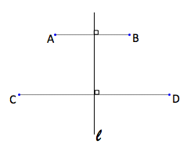
Example from Mid-Module Assessment
Notes:
-- Allow participants 2-3 minutes to consider and discuss amongst themselves.

Slide 73
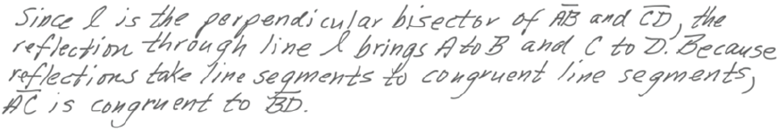
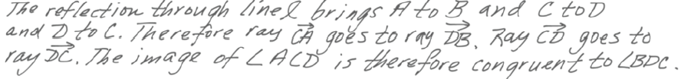
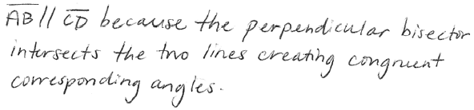
Example from Mid-Module Assessment
Notes:
-- Review solutions.

Slide 74

Topic D: Congruence
Standards
  G-CO. 7, G-CO.8
Key theme in Topic D:
Notes:
In Grade 7, students discovered that deciding whether two triangles are identical to each other does not mean that 6 measurements (3 side lengths and 3 angle measures) of both triangles had to be known. For example, they discovered that if only 3 side lengths of each triangle were known, they could predict whether the triangles would be identical or not (if the triangles had the same side length measures, they would indeed be identical because there was only one way those lengths could be put together to form a triangle; the three sides condition).
However in Grade 10, the goal is to explicitly prove why these “shortcuts” work; prior to the CCSS, we used these patterns to forecast that if the parts in the shortcut (e.g. A-S-A) were the same for both triangles, then all three side lengths and all three angle measures were the same for both triangles. Even if we know this information, we are now defining figures to be congruent if a rigid motions maps one figure to another. Students will see that the shortcuts are indicators that a rigid motion does exist in the cases those indicators hold true, but there are ways to describe the actual sequence of rigid motions that maps one figure onto a another figure.

Slide 75
Topic D: Congruence
Notes:
These are all very familiar topics to high school geometry teachers. Now, however, we begin with transformations to show congruent parts.
TIME ALLOTTED FOR THIS SLIDE:
2 minutes
MATERIALS NEEDED:
none

Slide 76
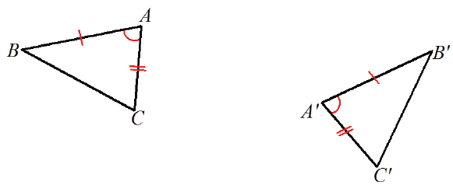
Lesson 22: Congruence Criteria for Triangles- SAS
Notes:
We are going to show that the SAS criteria for triangles indicates that the two triangles ABC and A’B’C’ are congruent because there exists a sequence of rigid motions that will map one triangle onto the other.
The two triangles are distinct. We are trying to determine if one triangle will map to the other, or coincide with the other. If the goal is to see what happens when they coincide, we must use a transformation that will bring them together.

Slide 77
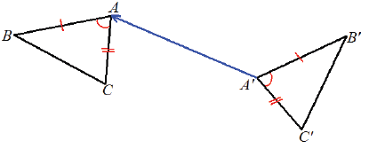
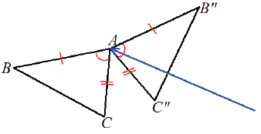
Lesson 22: Congruence Criteria for Triangles- SAS
Notes:
A translation by vector A’A will result with the two triangles coinciding at A. Could we have translated by say B’B or C’C? No, because we are working with parts we know to be equal in measure, and angle A and angle A’ are of equal measure.

Slide 78
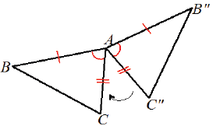
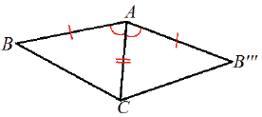
Lesson 22: Congruence Criteria for Triangles- SAS
Notes:
Continuing in our goal to try and make the triangles coincide, we can use a rotation of d degrees about A to bring AC’ to AC. We know C’ will map to C because by the assumption AC and AC’ are the same length and a rotation is distance preserving, so there is no change in any length in the transformation.

Slide 79
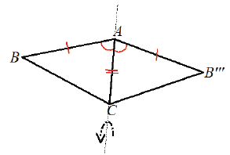
Lesson 22: Congruence Criteria for Triangles- SAS
Notes:
Again, in the pursuit to see if the triangles coincide, we see B and B’’’ are on opposite sides of AC. We use a reflection over the line that contains AC so that B’’’ maps to B. How do we know that B’’’ definitely maps to B? Because rigid motions angle measures, we know angle B’’’AC=BAC and therefore ray AB’’’ maps to AB. Additionally, by assumption we know that AB=AB’’’, so between these two facts, B’’’ definitely maps to B.
This sequence of rigid motions takes triangle A’B’C’ to triangle ABC with the use of just three known criteria from each triangle: two side lengths and the included angle measure. We can generalize this argument for any two triangles with the same criteria (distinct or coinciding along some part of the triangle). Hence we have proven that when the SAS criteria is satisfied between two triangles, there always exists a rigid motion that will map the one triangle onto the other.
Students will complete proofs for all the triangle congruence criteria using rigid motions, as well as the otherwise accepted fact that base angles of an isosceles triangle are equal in measure.

Slide 80
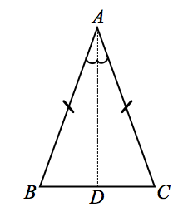
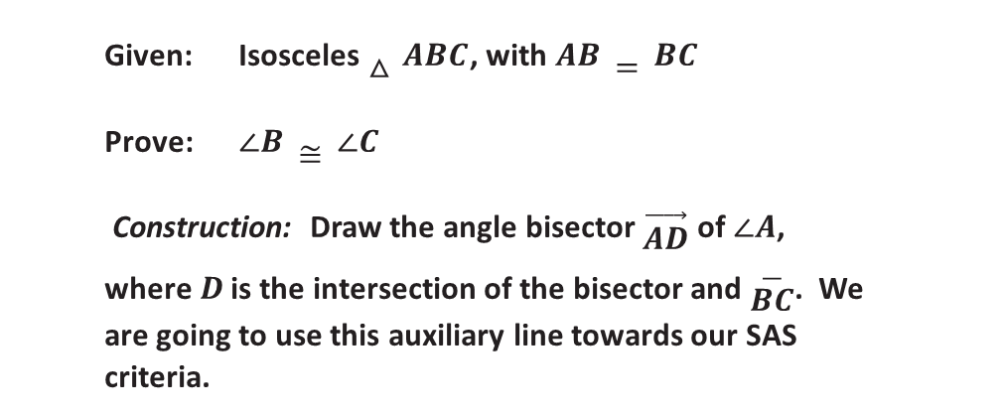
Lesson 23: Bases Angles of Isosceles Triangles
Given: Isosceles $△ABC$, with $AB=BC$
Prove: $∠B≅∠C$
Construction: Draw the angle bisector $\vec{AD}$ of $∠A$, where$D$ is the intersection of the bisector and $\overline{BC}$. We are going to use this auxiliary line towards our SAS criteria.
Notes:
In Discussion Section
What rigid motion could be used to show that the two smaller triangles are congruent? (reflection across AD)
TIME ALLOTTED FOR THIS SLIDE:
2 minutes
MATERIALS NEEDED:
none

Slide 81
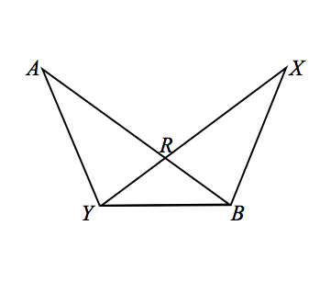
Lesson 24: Congruence Criteria for Triangles – ASA and SSS
Based on the information provided, determine whether a congruence exists between triangles. If a congruence exists between triangles or if multiple congruencies exist, state the congruencies and the criteria used to determine them.
Notes:
What rigid motion? (reflection across the line connecting R with the midpoint of YB)
TIME ALLOTTED FOR THIS SLIDE:
2 minutes
MATERIALS NEEDED:
none

Slide 82
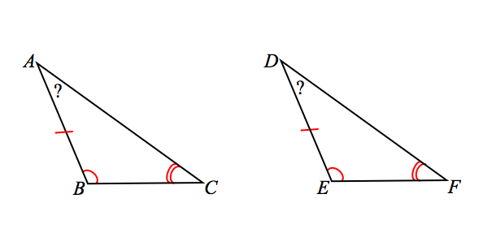

Lesson 25: Congruence Criteria for Triangles – AAS and HL
Given two triangles $ABC$ and A’B’C’. If $AB=A^{′}B′$ (Side), $m∠B=m$ $∠B$’ (Angle), and$m∠C=m$ $∠C$’ (Angle), then the triangles are congruent.
Proof: Consider a pair of triangles that meet the AAS criteria. If you knew that two angles of one triangle corresponded to and were equal in measure to two angles of the other triangle, what conclusions can you draw about the third angles of each triangle?
Given this conclusion, which formerly learned triangle congruence criteria can we use to determine if the pair of triangles are congruent?
Since the first two angles are equal in measure, the third angles must also be equal in measure.
ASA
Notes:
Rigid motion? - translation
TIME ALLOTTED FOR THIS SLIDE:
2 minutes
MATERIALS NEEDED:
none

Slide 83
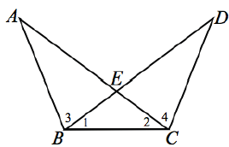

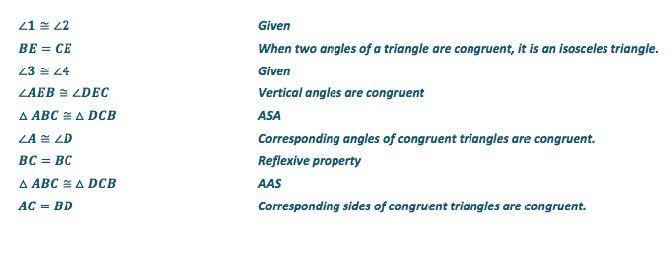
Lessons 26-27: Triangle Congruency Proofs
Lesson 26, Exercise 5
Notes:
Once the the congruence criteria are proved (and any known fact is proved), we are free to call on them in problems.

Slide 84
Topic E: Proving Properties of Geometric Figures
P
Prove theorems about lines and angles.
Prove theorems about triangles.
Prove theorems about parallelograms.
Notes:
Topic E applies the knowledge and understanding gained in earlier topics to proving facts about other figures.
TIME ALLOTTED FOR THIS SLIDE:
2 minutes
MATERIALS NEEDED:
none

Slide 85
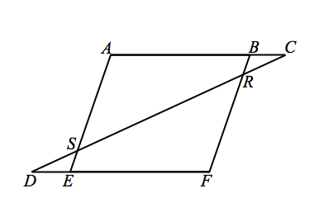
Lesson 28: Properties of Parallelograms
Notes:
Problem Set #5
What rigid motion? (rotation around midpoint of CD)
TIME ALLOTTED FOR THIS SLIDE:
2 minutes
MATERIALS NEEDED:
none

Slide 86
Lesson 29: Special Lines in Triangles -- Midsegments
Notes:
Exit Ticket
Tell participants that this type of figure will appear again in Module 2 as students work with similar triangles.
TIME ALLOTTED FOR THIS SLIDE:
2 minutes
MATERIALS NEEDED:
none

Slide 87
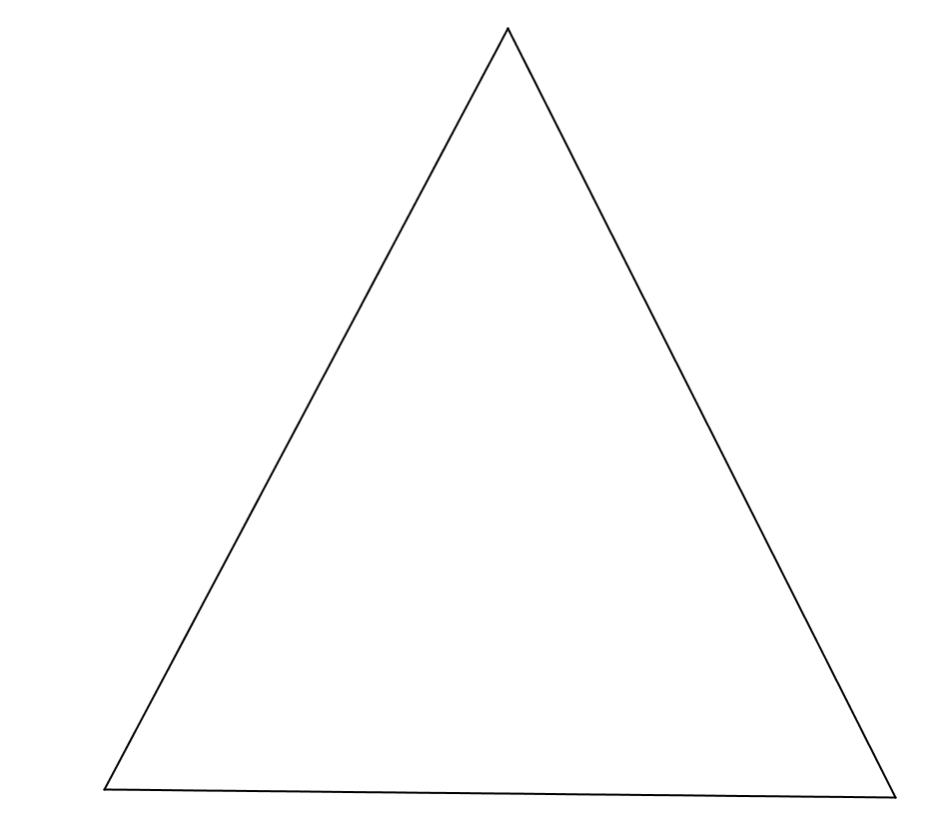
Lesson 30: Special Lines in Triangles -- Medians
Ty is building a model of a hang glider using the template below. To place his supports accurately, Ty needs to
locate the center of gravity on his model.
1. Use your compass and straightedge to locate the center
of gravity on Ty’s model.
2. Explain what the center of gravity represents on Ty’s
model.
3. Describe the relationship between the longer and
shorter sections of the line segments you drew as you
located the center of gravity.
The center of gravity is the centroid.
The centroid divides the length of each median in a ratio of 2:1.
Notes:
Problem Set
Suggest to teachers that students may enjoy creating a model of Ty’s hang glider using cardboard and balancing it on the eraser of their pencils to prove that the centroid they locate is correct.
TIME ALLOTTED FOR THIS SLIDE:
2 minutes
MATERIALS NEEDED:
none

Slide 88
Topic F: Advanced Constructions
Focus Standard:
G-CO.D.13 Construct an equilateral triangle, a square, and a regular hexagon inscribed in a circle.
Notes:
While these are not really “optional” lessons, especially the one about constructing a square, students are asked to follow a rather lengthy set of instructions in he construction of the nine-point circle. This lesson and Lesson 32 may certainly be adjusted to meet the needs of specific student groups.
TIME ALLOTTED FOR THIS SLIDE:
2 minutes
MATERIALS NEEDED:
none

Slide 89

Lesson 31: Construct a Square and a None-Point Circle
Exit Ticket
Construct a square $ABCD$ and a square $AXYZ$ so that $\overline{AB}$contains $X$ and $\overline{AD}$ contains $Z$.
Notes:
What type of constructions will be needed here? (perpendicular from a point not on a line, congruent segments)
TIME ALLOTTED FOR THIS SLIDE:
2 minutes
MATERIALS NEEDED:
none

Slide 90
Lesson 32: Construct a Nine-Point Circle
Notes:
A great review of perpendicular bisectors, orthocenters, and midpoints – excellent challenge for advanced learners (or all learners depending on available time)
TIME ALLOTTED FOR THIS SLIDE:
2 minutes
MATERIALS NEEDED:
none

Slide 91
Topic G: Axiomatic Systems
Standards
  All
A mathematician’s story:
Many years ago I taught calculus for business majors. I started my class with an offer: "We have to cover several chapters from the textbook and there are approximately forty formulas. I may offer you a deal: you will learn just four formulas and I will teach you how to get the rest out of these formulas." The students gladly agreed.
Notes:
Topic G is a summary of definitions, geometric assumptions, geometric facts, constructions, unknown angle problems and proofs, transformations, and proofs that establish properties we previously took for granted. All of the mathematicians involved in this curriculum wanted to be sure that we remember that geometry, like other subjects in math and science is a logical, deductive system. That the “beauty” of this subject (and in other deductive systems) is that the glue of what holds the subject together, is the process of examining what you know, and examining, critically, why you know it. This is what Euclid did in writing Elements, and the text has been honored for over 2000 years because of the how meticulously he put it together. Having said this, it is not part of this curriculum to understand geometry from the ground up, but to recognize that there is a short list of facts from which all other facts are derived. An in-depth study of the assumptions is left for college-level classes.
The 8 geometric assumptions, or axioms, are seen in a handful of lessons (namely 4 lessons: L1, L3, L12, and L18). We see four of them mentioned in Lesson 1. The assumptions are highlights in the lesson; they are not meant to be
-- Anecdote to share:
Many years ago I taught calculus for business majors. I started my class
with an offer: "We have to cover several chapters from the textbook and
there are approximately forty formulas. I may offer you a deal: you will learn
just four formulas and I will teach you how to get the rest out of these
formulas." The students gladly agreed.

Slide 92
Lesson 33: Review of the Assumptions
Notes:
Suggest that students/participants refer to the chart presented in Lesson 6.
TIME ALLOTTED FOR THIS SLIDE:
2 minutes
MATERIALS NEEDED:
none

Slide 93
Lesson 34: Review of the Assumptions
Problem Set #3
Notes:
TIME ALLOTTED FOR THIS SLIDE:
2 minutes
MATERIALS NEEDED:
none

Slide 94

End-of-Module Assessment
Notes:
TIME ALLOTTED FOR THIS SLIDE:
2 minutes
MATERIALS NEEDED:
none

Slide 95



End-of-Module Assessment
Notes:
TIME ALLOTTED FOR THIS SLIDE:
2 minutes
MATERIALS NEEDED:
none

Slide 96

End-of-Module Assessment
Notes:
TIME ALLOTTED FOR THIS SLIDE:
2 minutes
MATERIALS NEEDED:
none

Slide 97

End-of-Module Assessment
Notes:
TIME ALLOTTED FOR THIS SLIDE:
2 minutes
MATERIALS NEEDED:
none

Slide 98

End-of-Module Assessment
Notes:
TIME ALLOTTED FOR THIS SLIDE:
2 minutes
MATERIALS NEEDED:
none

Slide 99

End-of-Module Assessment
Notes:
TIME ALLOTTED FOR THIS SLIDE:
2 minutes
MATERIALS NEEDED:
none

Slide 100

End-of-Module Assessment
Notes:
TIME ALLOTTED FOR THIS SLIDE:
2 minutes
MATERIALS NEEDED:
none

Slide 101

End-of-Module Assessment
Notes:
TIME ALLOTTED FOR THIS SLIDE:
2 minutes
MATERIALS NEEDED:
none

Slide 102

End-of-Module Assessment
Notes:
TIME ALLOTTED FOR THIS SLIDE:
2 minutes
MATERIALS NEEDED:
none

Slide 103



End-of-Module Assessment
Notes:
TIME ALLOTTED FOR THIS SLIDE:
2 minutes
MATERIALS NEEDED:
none

Slide 104

End-of-Module Assessment
Notes:
TIME ALLOTTED FOR THIS SLIDE:
2 minutes
MATERIALS NEEDED:
none

Slide 105


End-of-Module Assessment
Notes:
TIME ALLOTTED FOR THIS SLIDE:
2 minutes
MATERIALS NEEDED:
none

Slide 106
Agenda
Lesson Structure
Instructional Sequence
Module Review
Preparation for Implementation
Notes:
We have now been through the complete instructional sequence in Module 1 and seen how the topics connect to one another and lead to an in-depth understanding of congruence through a study of constructions and proofs.
TIME ALLOTTED FOR THIS SLIDE:
2 minutes
MATERIALS NEEDED:
none

Slide 107
Key Themes of Module 1: Congruence, Proof, and Constructions
Module is anchored by the definition of congruence
Emphasis is placed on extending the meaning and use of vocabulary in constructions
There is an explicit recall and application of facts learned over the last few years in unknown angle problems and proofs
Triangle congruence criteria are indicators that a rigid motion exists that maps one triangle to another; each criterion can be proven to be true with the use of rigid motions.
Notes:
That wraps up the portion of our session on Module 1.
-- Review all four bullet points; these are the key themes in the module.
TIME ALLOTTED FOR THIS SLIDE:
8 minutes
MATERIALS NEEDED:
None

Slide 108
Agenda
Lesson Structure
Instructional Sequence
Module Review
Preparation for Implementation
Notes:
Now you’ve had a chance to examine this module at several levels. We looked at the lesson components, we explored the instructional sequence from objective to objective, and we’ve thought about what this module accomplishes in the larger scope of mathematical understanding.
Let’s spend some time now discussing strategies for implementation and preparing for the beginning of the upcoming school year.
TIME ALLOTTED FOR THIS SLIDE:
2 minutes
MATERIALS NEEDED:
none

Slide 109
Practice a Planning Protocol
With any topic from A Story of Functions, read the module overview and the topic opener.
Study the module assessment, paying particular attention to the sample responses provided.
Notes:
Click to advance the first bullet. Allow time for participants to read the module overview and the topic opener for the pre-selected topic.
Click to advance second bullet. Allow time for participants to study the sample work provided for the module assessment(s).
TIME ALLOTTED FOR THIS SLIDE:
2 minutes
MATERIALS NEEDED:
none

Slide 110
Practice a Planning Protocol
Read through the first lesson of the topic.
Then, take note of the lesson objective and re-examine the exit ticket with the objective in mind. What major concept is necessary to successfully complete the exit ticket?
Study the concept development and problem set. How do the CD/PS develop the major concept that is required in the exit ticket? What parts of the CD/PS go beyond this major concept?
Notes:
Click to advance the first bullet. Allow time for participants to read the first lesson of the pre-selected topic.
Click to advance second bullet. Read aloud the objective of the first lesson. Allow time for participants to re-read the exit ticket. Facilitate a discussion about the major concept required by the exit ticket.
Click to advance the third bullet. Allow time for participants to study the concept development and problem set. If participants have paper copies of the lessons, encourage them to highlight the portions of the CD/PS that are critical in preparation for the exit ticket. Facilitate a discussion about those portions of the lesson that are necessary in preparation for the exit ticket and those that go beyond the major concept needed for the exit ticket.
TIME ALLOTTED FOR THIS SLIDE:
2 minutes
MATERIALS NEEDED:
none

Slide 111
Practice a Planning Protocol
How will this knowledge enable teachers to support specific groups of learners?
Turn to the subsequent lesson, and examine the exit ticket. How does this exit ticket build on the last? How are the two exit tickets similar and how are they different?
Will students have an opportunity in the second lesson to continue development of the first lesson’s objective? What level of mastery of the first lesson’s objective is necessary in preparation for the second lesson?
Notes:
Click to advance the first bullet. Facilitate a discussion about how participants’ previous observations might be further impacted as they consider the needs of a specific group of students. As appropriate, draw attention to any relevant notes boxes in the margins of the lesson.
Click to advance second bullet. Allow time for participants to read the exit ticket for the next lesson. Facilitate a discussion about the relationship between the two exit tickets.
Click to advance the third bullet. Facilitate discussion about how these new observations might further impact their decisions regarding implementation of the first lesson.
TIME ALLOTTED FOR THIS SLIDE:
2 minutes
MATERIALS NEEDED:
none

Slide 112
Practice a Planning Protocol
How does the new plan for implementation impact the student debrief?
Are any adjustments needed to the fluency and/or application components of the lesson?
Notes:
Click to advance the first bullet. Facilitate a discussion about how the student debrief is impacted by the implementation decisions made thus far.
Click to advance second bullet. Facilitate a discussion about the other lesson components and the need to ensure that the balance of rigor is maintained.
TIME ALLOTTED FOR THIS SLIDE:
2 minutes
MATERIALS NEEDED:
none

Slide 113
Practice a Planning Protocol
Repeat this process for each lesson.
    Read lesson.
    Study exit ticket. Identify critical portions of concept development and problem set.
    Consider needs of specific students.
    Refer to subsequent exit ticket. Revise implementation plan as needed.
    Make adjustments to the student debrief as needed.
    Consider the other lesson components, ensuring a balance of rigor.
Notes:
Review the planning protocol. If time allows, have participants go through the cycle again for the second lesson of the topic.
TIME ALLOTTED FOR THIS SLIDE:
2 minutes
MATERIALS NEEDED:
none

Slide 114
Biggest Takeaway
What is your biggest takeaway with respect to Module 1?
How can you support successful implementation at your school/s given your role?
I now know…
I need to figure out…
Notes:
Take a few minutes to reflect on this session. You can jot your thoughts on your copy of the powerpoint. What are your biggest takeaways?
Now, consider specifically how you can support successful implementation of these materials at your schools given your role as a teacher, school leader, administrator or other representative.
Think about what you know now that you may not have known before today’s presentation. Talk it over with your group.
Think about what you still need to figure out and talk that over with your group.
Communication is the key. You have worked with many people today and will work with them and with others throughout the school year. Just as we ask students to communicate, we need teachers and school leaders to communicate if we are to effectively implement the Common Core State Standards. But we’re teachers. This is what we do. ☺
TIME ALLOTTED FOR THIS SLIDE:
5 minutes(175)
MATERIALS NEEDED:

Slide 115
THANK YOU!!!!!
Notes:
TIME ALLOTTED FOR THIS SLIDE:
2 minutes
MATERIALS NEEDED:
none

