Slide 1
A Story of Units
Grade K – Module 1
Notes:
This full-day session is intended to support successful implementation of this module. Using this module as a platform for understanding our instructional approach and lesson structure, you will have the tools needed to tackle the remaining modules of the year.
Welcome participants and introduce presentation team.
Fist to Five:
How familiar are you with Eureka Math and A Story of Units?
Quickly orient participants to the day’s materials:
Full module – provided by Wiley; additional modules are available for purchase through our website, commoncore.org
Handout packet – describe the nature and purpose of both the stapled packet and the loose handouts
Materials – any announcements needed regarding materials on the tables?
TIME ALLOTTED FOR THIS SLIDE:
6 minutes
MATERIALS NEEDED:
X

Slide 2
This PowerPoint presentation is provided to individuals who participated in a live training by professional developers certified by, or affiliated with, the copyright holder, Common Core, Inc. It may not be altered in any way. The presentation may be shared for non-commercial purposes only. However, Common Core makes no representations or warranties about the effectiveness of training provided by non-certified/non-affiliated presenters of the material. Any commercial use of this presentation is illegal and violates the copyrights of Common Core, Inc.

Slide 3
Session Objectives
  Examine the sequence of concepts across the module.
  Study mathematical models and instructional strategies from A Story of Units.
  Prepare to implement this and subsequent modules of A Story of Units.
Notes:
Our objectives for this session are to:
Examine the sequence of concepts across the module.
Study mathematical models and instructional strategies from A Story of Units.
Prepare to implement this and subsequent modules of A Story of Units.
TIME ALLOTTED FOR THIS SLIDE:
1 minute
MATERIALS NEEDED:
X

Slide 4
Participant Poll
  Classroom teacher
  School leader
  Principal
  District leader
  Other VIP
Notes:
In order for us to better address your individual needs, it is helpful to know a little bit about you collectively. Who of you are classroom teachers? (Call for a show of hands.) School-level leader? Principal? District-level leader?
NOTE TO FACILITATOR: As you poll the participants, take note of the approximate size of each group. This will make it easier for you to speak directly to the needs of your participants throughout the session.
Fist to five: how familiar are you with the modules? Fist- first time I’ve seen them. Five- I’ve had the chance to implement a module.
Regardless of your role, what you all have in common is the need to deeply understand the mathematics of the curriculum and the intentional instructional sequence in which it is brought to life for students. Throughout this session, we ask you to be cognizant of your specific educational role and how you will be able to promote successful implementation in your classroom, school, and/or district. Each time we pause to reflect, please do so through the lens of your own professional responsibilities.
TIME ALLOTTED FOR THIS SLIDE:
1 minute
MATERIALS NEEDED:
X

Slide 5
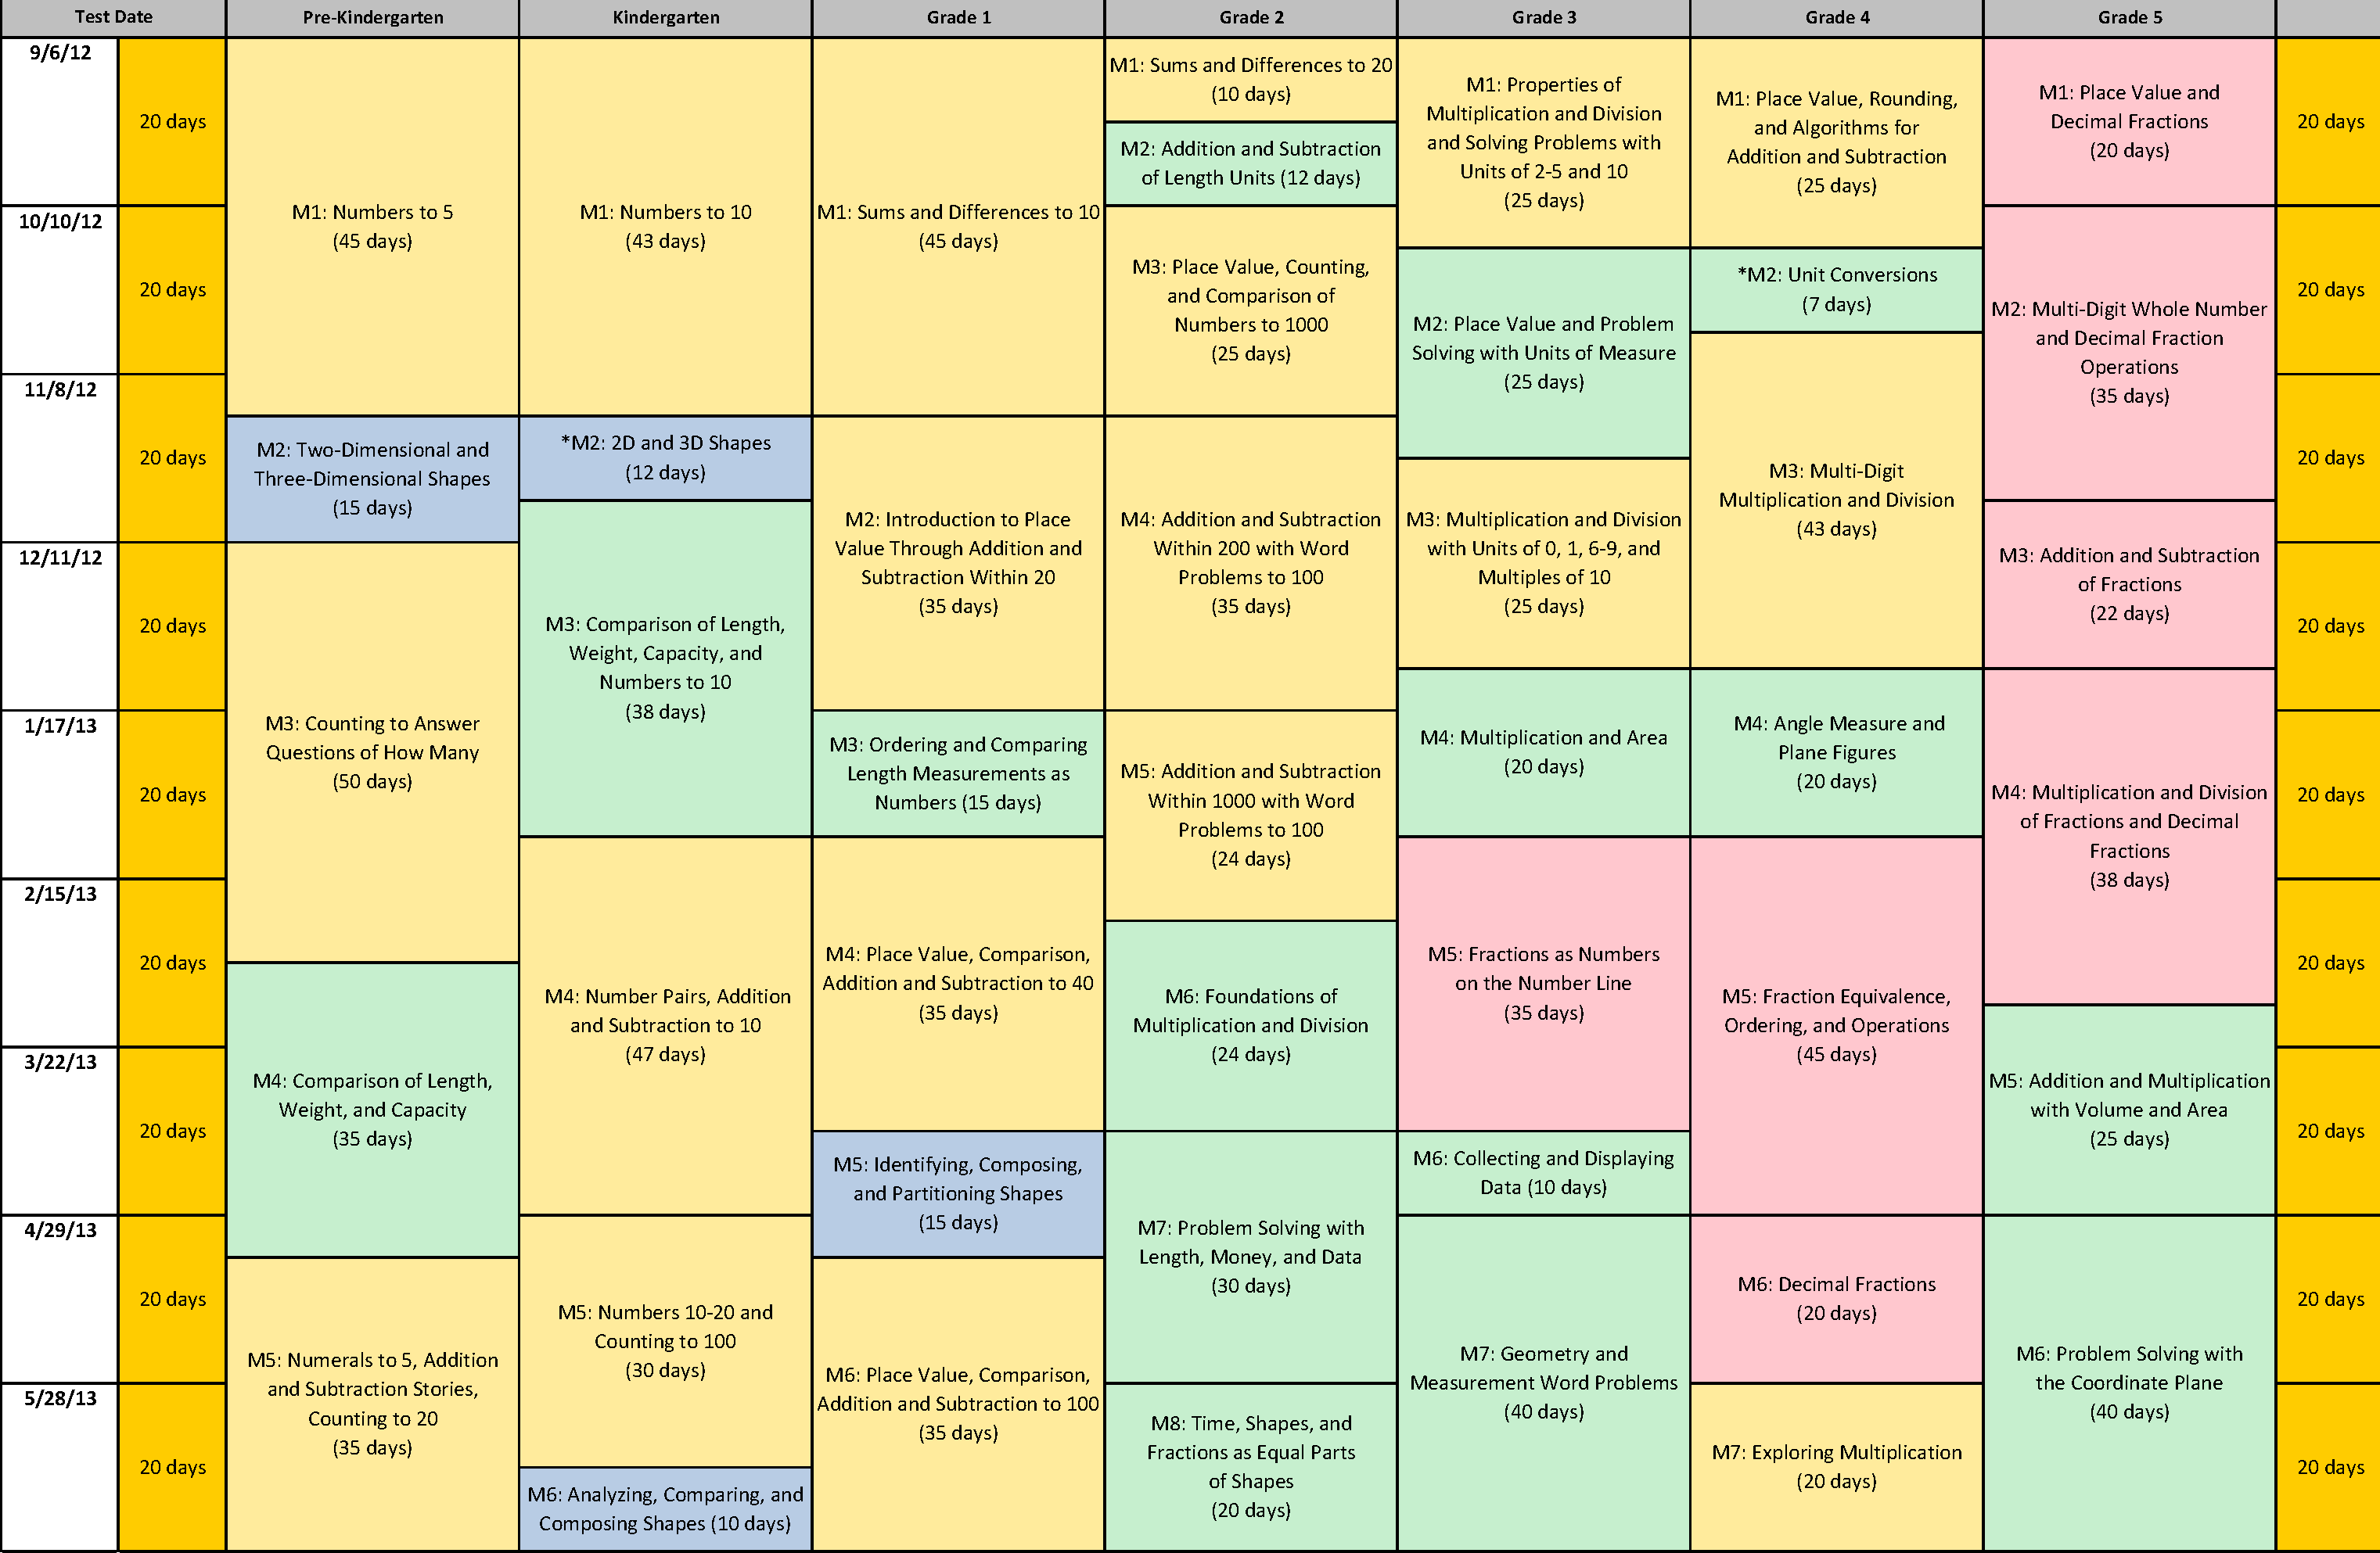
Curriculum Overview of A Story of Units
Notes:
The first module in Grade K is Numbers to 10. The module includes 37 lessons and is allotted 43 instructional days. In Kindergarten, more learning time should be spent on number than any other topic. This module helps students develop number sense about numbers 0-10, a critical foundation for the following modules.
NOTE TO FACILITATOR: If participants have not previously explored the Curriculum Overview and examined this map, it may be helpful to prompt them with the following questions. Make sure the following points are addressed, even if you need to state them directly.
What is the title of this module? (Count Numbers to 10)
How many instructional days are allotted for this module? (43)
What modules, prior to this one, might prepare students for success in this module? (None for students next year, but following years, PK M1, M3, M5)
What modules, beyond this one, might build on the concepts of this module? (G1 M1, all subsequent modules in K)
TIME ALLOTTED FOR THIS SLIDE:
3 minutes
MATERIALS NEEDED:
Curriculum Overview

Slide 6
Review of Module Structure
Module Overview
Topic
L1
Topic
L4
Topic
L5
L2
L3
L6
L7
L8
Notes:
Let’s take a minute to review the organizational structure of A Story of Units:
A Story of Units: A Curriculum Overview for Grades P-5 provides a curriculum map and grade-level overview. The curriculum map provides an at-a-glance view of the entire story, making clear the coherence of the curriculum and the role that each module plays in that progression.
Kindergarten contains 6 modules. Modules are comprised of topics, topics break into concepts, and concepts become lessons. For example, the module we are studying today has 8 topics and 37 lessons. Modules and topics will vary in length depending on the concepts addressed in each, but every lesson is designed for a 50 minute instructional period (Grades 1-5 are 60 minutes).
This graphic illustrates the breakdown of the module structure. Each component, moving from the Overview to the Lesson, provides a more specific level of information. As you plan to implement A Story of Units, each of these components will be important to your understanding of the instructional path of the module.
The Standards, both Content and Practice, come to life through the lessons. Rigorous problems are embedded throughout the module. We will spend time in the upcoming sessions exploring this further.
TIME ALLOTTED FOR THIS SLIDE:
2 minutes
MATERIALS NEEDED:
X

Slide 7
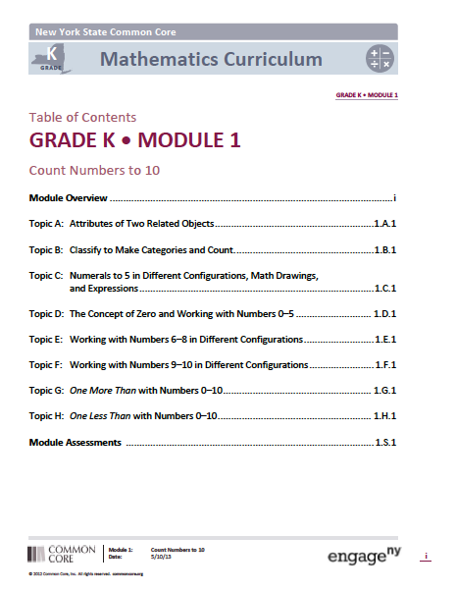
Module Overview
Read the descriptive narrative.
Make note of important information that will help educators understand the content and prepare to implement this module.
Notes:
Each Overview contains multiple components to help educators understand more clearly the focus of the module. These components include:
Table of contents: lists topics
Descriptive narrative: Zooms in to orient you to the particular material you’ll be teaching
Distribution of Instructional Minutes
Focus Grade Level Standards, Foundational Standards: current and foundational
Standards for Mathematical Practices: We chose specific ones to call out in each module based on the progressions and also the mathematics. Some lend themselves better than others.
Overview of Module Topics and Lesson Objectives: A more nuanced look at the sequencing of the mathematics through the objective chart. How many days is this, when are the assessments, for planning this is useful
Terminology
Suggested Tools and Representations: much as we try, these lists are not exhaustive. Tools are suggestions but can be substituted with available resources.
Suggested Methods of Instructional Delivery: personal white boards
Scaffolds: explain UDL boxes
Assessment Summary: In K, interview style and completed individually
Flip back to the Descriptive Narrative (page 2) and take 4 minutes to read the Descriptive Narrative. As you read, highlight a word, a phrase, or a sentence that stands out to you.
Turn and talk with others at your table. Share your observations and ask them to do the same.
NOTE TO FACILITATOR: Allow 2 minutes for participants to turn and talk about their review of the Overview and their response to the information provided there. Then facilitate a discussion in the remaining 5 minutes using the following talking points:
Your administrator is coming in for an observation sometime next week. She/he needs to know which standards you will cover. You are teaching in Topic C next week. What do you tell her/him? (K.CC4a, K.CC.4b, K.CC.5, K.OA.3, K.MD.3)
Take a look at the Distribution of Instructional Minutes on page 3. Which Mathematical Practices are addressed in Topic C? (MP.3, MP.7, MP.8) Does anyone know what MP.7 is? No? Take a look at page 5. (Look for and make use of structure.) How does the information provided inform instruction for this module? (this extra sentence ties it into the K module)
Take a look at the Terminology and Suggested Tools and Representations. How do these terms and tools support the work of this module? (Grouping at 5- color change on Rekenrek, 5-Group model; Left hand mat for Counting the May Way)
When you start your school year, which components of the Module Overview will you use in your role to implement A Story of Units?
TIME ALLOTTED FOR THIS SLIDE:
10 minutes
MATERIALS NEEDED:
Module Overview

Slide 8
Agenda
Lesson Structure
Instructional Sequence
Module Review
Preparation for Implementation
Notes:
We will begin by exploring the lesson structure and how it is fundamental to supporting rigorous instruction. Then we will dig in to the math of the module, examining the intentional instructional sequence that leads students toward mastery of the focus standards. Afterwards, we’ll take a look back at the module, reflecting on all the parts as one cohesive whole. Finally, we’ll talk about strategies for implementation in preparation for the beginning of the school year.
Let’s get started with the lesson structure. We’ll use Lesson 1 as our context for doing so.
.
Facilitator notes
This is a 6 hour session that breaks down as follows.
Lesson Structure: approx. 90 minutes
Instructional Sequence: approx. 165 minutes
Module Review: approx. 60 minutes
Preparation for Implementation: approx. 45 minutes
TIME ALLOTTED FOR THIS SLIDE:
1 minute
MATERIALS NEEDED:
X

Slide 9
Agenda
Lesson Structure
Instructional Sequence
Module Review
Preparation for Implementation
Notes:
We will begin by exploring the lesson structure and how it is fundamental to supporting rigorous instruction. Then we will dig in to the math of the module, examining the intentional instructional sequence that leads students toward mastery of the focus standards. Afterwards, we’ll take a look back at the module, reflecting on all the parts as one cohesive whole. Finally, we’ll talk about strategies for implementation in preparation for the beginning of the school year.
Let’s get started with the lesson structure.
TIME ALLOTTED FOR THIS SLIDE:
1 minute
MATERIALS NEEDED:
X

Slide 10
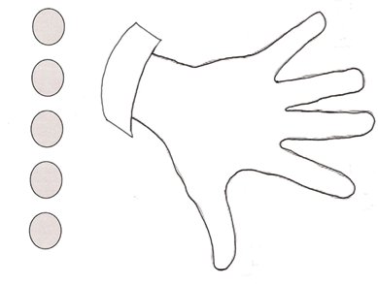
Introduction to the Lesson Structure
Counting Beans and Fingers to 3 (K.CC.4a)
Left hand mat prepares for counting the Math Way
Students count using 1:1 correspondence
Uses “exactly the same” terminology of the objective
Lesson 1, Fluency Practice
Notes:
Lesson 1 Fluency Activities:
1. Counting Beans and Fingers (counting w/1:1 correspondence)
T: Take 1 bean out of your cup and put it on your mat. Count how many beans are on your mat.
S: 1.
T: Take another bean out of your bag and put it on your mat. Count how many beans are on your mat now.
S: 1, 2.
T: Yes. Take another bean out of your cup and put it on your mat. Count how many beans are on your mat now.
S: 1, 2, 3.
T: Yes. Let’s touch and count them one at a time like this, 1, 2, 3.
S: 1, 2, 3 (as they touch each bean).
T: Move 1 bean to the pinky fingernail. How many fingers have a bean?
S: 1.
T: How many fingernails are under the bean?
S: 1.
T: Is that exactly the same number?
S: Yes!
Continue to 3 in this manner. Give time for students to touch and count, but take notice of which students must recount each time.
TIME ALLOTTED FOR THIS SLIDE:
5 minutes
MATERIALS NEEDED:
Dixie cup with 5 beans
Lesson 1 Template (can use the one in their teacher’s guide)

Slide 11
Introduction to the Lesson Structure
Show Me Beans (K.CC.4a)
Students count using 1:1 correspondence
Requires counting out a specific number of objects
Prepares for counting the Math Way
Lesson 1, Fluency Practice
Notes:
Lesson 1 Fluency Activities:
2. Show Me Beans (counting w/1:1 correspondence, making a group)
T: Now we’ll play a game called Show Me Beans. I’ll say a number, and you put that many beans on the fingernails. Remember to start on the pinky, and don’t skip any fingers! Ready? Show me 1!
S: (Place 1 bean on the pinky finger.)
T: Quick…show me 2!
S: (Place another bean on the ring finger.)
T: (Show me 1!
S: (Remove a bean from the ring finger.)
T: Show me 2!
S: (Place another bean on the ring finger.)
T: Show me 3!
S: (Place another bean on the middle finger.)
Continue changing the number by 1 within 5 as students demonstrate mastery, taking note of which students need to recount.
TIME ALLOTTED FOR THIS SLIDE:
3 minutes
MATERIALS NEEDED:
Dixie cup with 5 beans
Lesson 1 Template (can use the one in their teacher’s guide)

Slide 12
Introduction to the Lesson Structure
Counting with the Number Glove to 3 (K.CC.5)
Promotes counting the Math Way (from left pinky to right pinky)
Teacher uses glove on right hand, which looks like the left hand from students’ perspective
Lesson 1, Fluency Practice
Notes:
Lesson 1 Fluency Activities:
3. Counting with the Number Glove to 3 (counting w/1:1 correspondence, counting left to right intentionally)
T: Watch my number glove and count with me. Ready? (Begin with closed fist, then, show the pinky finger, followed by ring finger, and then middle finger.)
S: 1, 2, 3.
T: Stay here at 3. Let’s count back down to 1. Ready? (Put down the middle finger, then ring finger.)
S: 3, 2, 1.
Continue counting up and down a few more times.
T: You’re ready for something harder! This time we’ll count up and down, like a wave. Watch my glove and you’ll know just what to do.
S: 1, 2, 3, 2, 1, 2, 1, 2, 1, 2, 3, 2, 3, 2, 3…..
Listen for hesitation as students count, rather than counting along with them.
TIME ALLOTTED FOR THIS SLIDE:
2 minutes
MATERIALS NEEDED:
Number glove (rubber glove with numbers written on fingertips)

Slide 13
The Role of Fluency
Maintenance staying sharp on previously learned skills
Preparation targeted practice for the current lesson
Anticipation skills that ensure that students will be ready for the in-depth work of upcoming lessons
Notes:
Review the 3 functions of fluency. Note that the information on this slide can be found as a text box in the fluency section of the revised version of GK-M1-L1.
Point out about fluency in SOU in general, regardless of the activity’s function:
Fluency is designed to promote automaticity.
Just about every lesson has a fluency component to it.
Most lessons start with fluency to immediately engage students in the math in an exciting and fast-paced way.
Activities are meant to be fast-paced, accessible, and exciting, and almost never include completely new learning in order to make that possible.
This is a high-energy point in the lesson in which students celebrate improvement and recognize patterns and connections between material.
Most lessons have more than 1 fluency choice per day. (Talk about how teachers might use these depending on student needs. E.g., choose one, some, all, write your own.)
Stress the importance of including fluency with each lesson to maintain a balance of components that achieves the rigor specified by the shifts.
Let’s move on to the next component of the lesson.
TIME ALLOTTED FOR THIS SLIDE:
X minutes
MATERIALS NEEDED:
X

Slide 14
Introduction to the Lesson Structure
Please draw a picture of this sock.
Ties to objective: compare drawings of the sock and use exactly the same or not exactly the same during the Student Debrief
Mathematizes the world
Associates drawings with math
Lesson 1, Application Problem
Notes:
Hold up 1 blue sock. Have participants draw the sock and set aside drawing for Student Debrief. (The sock does not have to be blue but it should not have any designs.)
This Application Problem ties to the objective because it gives students something to compare in the Student Debrief, when we want them to use their new vocabulary while demonstrating conceptual understanding of similarity.
It also begins the process of helping students mathematize their world. Mathematizing means representing the world in a mathematical way. Here students are representing a real world object with a drawing (MP.4). Drawing will be a critical problem solving strategy throughout the Kindergarten year and beyond. We want children to start associating drawing with math.
TIME ALLOTTED FOR THIS SLIDE:
3 minutes
MATERIALS NEEDED:
1 sock
Blank paper (1/participant)
Crayons (1/participant)

Slide 15
Application Problems
Real world problem solving
Placement in lesson depends on function
Opportunity for informal assessment
Problem-solving process:
Read the problem
Draw and label a model to represent the problem
Write an equation and a complete word sentence
Notes:
We just solved the word problem that makes up the Application Problem component of GK-M1-L1.
Point out/discuss the following about Application Problems:
(Click to advance animation.) These are often word problems, but occasionally take other forms. They typically offer real word applications (like the example).
The number of Application Problems may vary from lesson to lesson (usually 0 if the CD is a problem solving lesson, and 1 or more for a more typical lesson).
(Click to advance animation.) Placement in the lesson depends on function.
Point out/discuss the following about the function of APs:
Those that come before the CD often:
Make an application of the new learning from the day before.
Relate to the CD by providing context or point of comparison for a later problem, or by having students solve a problem that they’ll use again in some way in the CD.
Those that come after the CD often:
Provide an immediate application of new learning before the Problem Set, (or at the end of the lesson if the PS is used during the CD).
Provide a quick opportunity for informal assessment of new learning before independent practice in the PS.
Usually, Application Problems don’t specify a model to use or way of solving. The reason is to encourage students to think quantitatively and creatively, and to give them practice with understanding how to choose and apply the correct mathematics concept to solve real world problems.
(Click to advance animation.) Because of this, APs present a good opportunity for informal assessment. Noticing how students represent problems using models and equations will provide you with lots of information about their level of comfort with recently taught material, as well as how they’re thinking through solution paths.
Think back on the problem-solving process we just went through.
What was our first step? (Read.) (Click 1x to advance animation.)
What came next? (Draw.) (Click 1x to advance animation.)
And then? (Write an equation/word sentence.) (Click 1x to advance animation.)
Throughout SOU we refer to these steps as the RDW process. (Click 1x to advance animation.)
Point out/discuss the following about the RDW process:
Usually this is the process that students use to solve word problems in SOU, including Application Problems.
We hope students internalize the process with practice over time so that it becomes a tool for problem solving.
Don’t let RDW become the focus of problem solving, but rather teach RDW as a tool for approaching problem solving.
Discuss/Point out the following tips for implementation:
If students need encouragement to draw: Provide just the stem of the problem at first. (This removes the temptation to ‘just solve’.)
Ask them to share their drawing with a neighbor.
You might present your own model to help students distinguish between a drawing and a math drawing (for example, in the G3 AP problem we’d rather not see detailed pictures of 159 boys and girls).
Once students have drawn and before they’ve seen the question, ask, “What questions could we ask based on the information we’ve been given?”
This emphasis on the drawing encourages students to use it as a tool for solving rather than as an afterthought.
TIME ALLOTTED FOR THIS SLIDE:
X minutes
MATERIALS NEEDED:
X

Slide 16
Concept Development
New material
Timing includes 10 minutes for Problem Set
Moves from simple to complex
Problem Set
Time frame rather than task frame
Closely related to the other lesson components
A good place to begin lesson planning
Notes:
The Concept Development is the part of the lesson where new material is taught. It almost always ends with a Problem Set, which offers immediate practice with the new learning.
Discuss/ask participants the following questions about the work they just did:
What do you notice about the relationship between the CD and PS?
How did the CD prepare you for the PS?/Was anything on the PS surprising?
In a moment we’ll spend some time talking just about the PS, and how you might make adjustments for different students and also for lesson pacing.
Point out/discuss the following about CDs in SOU:
Is generally the component allotted the most time within the hour long lesson.
(Click 1x to advance animation.) The time allotment for the CD includes 10 minutes for the PS.
Very few lessons don’t have any CD at all. (Might be a lesson focused on fluency, for example.)
Some CDs use the PS, which makes the 10 minutes for it at the end unnecessary.
(Click 1x to advance animation.) The CD moves from simple to complex, usually mirroring that same development on the PS.
CDs take different formats. For example: teacher directed, stations, problem solving, group work, etc.
The vignettes throughout the lesson are meant to sample what the instruction looks, sounds, and feels like. They’re definitely not meant to be followed verbatim.
Point out/discuss the following about Problem Sets: (Click 1x to advance animation.)
Simple to complex sequence.
Draw attention to the Problem Set directions in the lesson.
PS is meant to be done as a time frame rather than a task frame. (Click 1x to advance animation.)
Every student may not be assigned every problem (but ensure they get a balance of word problems and other types)
Suggestion for implementation: Take 8 minutes to get as far as possible on PS, last 2 minutes all work on a particular problem. (Ensures everyone’s done at least 1 ‘meaty’ problem to discuss in the Debrief.)
Discuss the relationship between PS and HW and PS and Exit ticket. (Click 1x to advance animation.)
Problems mirror development in CD
May want to talk about how writers wrote PS first, then CD. Suggestion for planning: start with the PS and plan the path that will get your students there. (Click 1x to advance animation.)
TIME ALLOTTED FOR THIS SLIDE:
X minutes
MATERIALS NEEDED:
X

Slide 17



Introduction to the Lesson Structure
Lesson 1, Concept Development
Notes:
Demonstrate Lesson 1 Concept Development
T: I just came back from the laundromat and now I have to match up all of these pairs of socks. Look at these two. (Hold up two blue socks.) These two are exactly the same because they are both…? (Signal to elicit the response.)
S: Blue!
T: So, they are both exactly the same color.
T: (Hold up a red knee sock and a red ankle sock.) What color are these two socks?
S: Red.
T: These two are both red, but they are not exactly the same. One is big and the other one is…? (Signal.)
S: Small!
T: So, they are not exactly the same.
T: (Hold up two socks that are similar.) Who can explain why these are not exactly the same?
S: They both have kitties on them, but the kitties on this one are orange, and the kitties on this sock are black.
Continue to talk about the attributes of the different socks, guiding students to use the new terms, exactly the same and not exactly the same.
T: Let’s play the Exactly the Same Game. When I call you, pick up one sock. (Call students until everyone has a sock.)
T: When the music begins, I want you to slowly, calmly, walk around the room until you find a sock that is exactly the same as yours. When you find the sock, link arms with the person who has it, like this (demonstrate) and say, “Our socks are exactly the same!” See if you can get together before the music stops! (Start the music—stop—check—clarify.)
T: Very good. Let’s play again. (Have students trade so that they get a new sock.)
TIME ALLOTTED FOR THIS SLIDE:
10 minutes
MATERIALS NEEDED:
Pairs of socks in a variety of patterns, colors, sizes, and lengths in a laundry bag

Slide 18
Introduction to the Lesson Structure
Lesson 1, Student Debrief
Notes:
The students have 5 minutes to complete this Problem Set. Have the students draw a line connecting similar objects using a ruler. Demonstrate the use of a ruler as a straight edge (not used as a measurement tool in Kindergarten). Possible alternatives include using a block or something with more thickness as a straight edge or not using a straight edge at all if materials management procedures are not yet learned.
If students do not yet know how to hold/use a writing tool, have them make a line with their finger between the matching animals.
TIME ALLOTTED FOR THIS SLIDE:
2 minutes
MATERIALS NEEDED:
Lesson 1 Problem Set (can use the one in their teacher’s guide)

Slide 19
Introduction to the Lesson Structure
Are your shoes exactly the same?
Does the left look exactly the same as the right?
Let’s look at our pictures of the sock. Is this picture the same as this one?
The sock was exactly the same, why are our pictures not exactly the same?
How can you tell if two things are exactly the same or not exactly the same?
Lesson 1, Student Debrief
Notes:
Bring a small group of participants to the front of the room to demonstrate the debrief. Ask these participants to bring their sock drawings from the Application Problem. Form a horseshoe so all participants can see and hear the conversation.
Demonstrate the Student Debrief:
Are your shoes exactly the same?
Does the left look exactly the same as the right?
Let’s look at our pictures of the sock. Is this picture the same as this one?
The sock was exactly the same, why are our pictures not exactly the same?
How can you tell if two things are exactly the same or not exactly the same?
Objective:
Rather than stating the objective of the lesson at its beginning, we wait until the dynamic action of the lesson has taken place. We recognize or introduce key vocabulary by helping students appropriately name the learning they describe.
Ask participants to develop a debrief question about the Problem Set and share.
TIME ALLOTTED FOR THIS SLIDE:
10 minutes
MATERIALS NEEDED:
Sock from Application Problem
Drawings from Application Problem

Slide 20
Student Debrief
Class conversation to reflect on the day’s learning
Make connections between parts of the lesson, concepts, strategies, and tools
Students ultimately articulate the learning objective
Exit Ticket
Daily formative assessment to drive instruction
Time frame rather than task frame
Tool for lesson planning
Notes:
Discuss/Point out about Student Debrief in SOU:
Students bring PS to the carpet and gather around for a conversation about the lesson.
Check PS with a partner/correct as a class.
Invite students to share work.
Students see and hear multiple perspectives from classmates.
Students reflect back on the lesson to analyze the learning that occurred. (Lesson doesn’t start by naming objective.)
(Click 1x to advance animation.) Students make connections between parts of the lesson, concepts, strategies and tools. The student debrief is not to be missed!
(Click 1x to advance animation.) Students ultimately articulate the objective/day’s learning.
Teacher reviews key vocabulary and help students name the learning they describe.
(Click 1x to advance animation.) The time allotment for the Debrief includes 3 minutes for the Exit Ticket.
Tip for implementation:
If initially your students need help learning how to have these conversations (or accountable partner talk): They can share work, but also, you might present 1-2 different solutions and have them practice explaining the model, labels, equation and solution path to their partner.
Discuss/Point out the following about the Exit Ticket:
(Click 1x to advance animation.) Daily formative assessment to drive daily instruction (use it to plan!)
Use it to close the lesson, or some people use as morning work the next day (teachers use it in lots of ways: the point is that it be useful for planning your instruction.)
(Click 1x to advance animation.) Time frame, not task frame
(Click 1x to advance animation.) Can be a tool for lesson planning because it’s a glimpse of the student outcome for each day.
TIME ALLOTTED FOR THIS SLIDE:
X minutes
MATERIALS NEEDED:
X

Slide 21
Agenda
Lesson Structure
Instructional Sequence
Module Review
Preparation for Implementation
Notes:
As you’ve seen, each lesson component has a very different purpose. Consequently, each lesson component has a different pace, so the experience feels different for students. It is important to honor each component in order to do justice both to the mathematical practices and to the balance of rigor that is expected.
Moving forward, we’ll explore the instructional sequence. In doing this, we’ll lead you through the module, modeling instruction for each objective. Along the way, we’ll also revisit the other lesson components and experience how they function in collaboration with the concept development.
TIME ALLOTTED FOR THIS SLIDE:
1 minute
MATERIALS NEEDED:
X

Slide 22
Attributes of Two Related Objects
Lesson 1: Analyze to find two objects that are exactly the same or not exactly the same.
Lesson 2: Analyze to find two similar objects – these are the same, but...
Lesson 3: Classify to find two objects that share a visual pattern, color, and use.
Topic A
Notes:
We’ve already covered Lesson 1 in Topic A. The remaining lessons in the topic continue to focus on the relationships or similarities between two objects.
Now look at the Concept Development in lessons 2 and 3 to analyze the progression from simple to complex. How do the three lessons in Topic A build in complexity?
Presenter Note: Look for some or all of the following responses:
Building vocabulary each day
Start with easiest match (exactly the same) and move to more difficult matches
Increase awareness of different types of attributes, articulate which attributes are the same and which are different
TIME ALLOTTED FOR THIS SLIDE:
5 minutes
MATERIALS NEEDED:
X

Slide 23
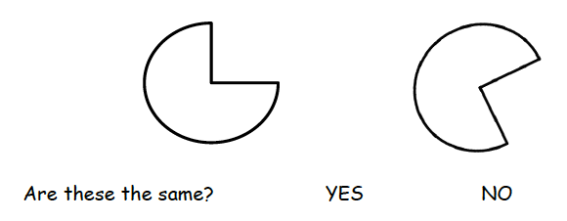
Exploring Similarity
Identify and compare attributes
Connects to geometry work in Module 2
Sets a foundation for understanding similarity of expressions
Exactly the same 10 = 10
The same, but… 10 = 5 + 5
Different 10 ≠ 12
Topic A
Notes:
Topic A begins with a relatively simple concept for most young students to grasp, similarity. They are asked to determine if two items match because they are exactly the same or the same, but…. This is a nice way for students to start the year with success and build a foundation for mathematical reasoning.
This Topic requires children to closely observe, attend to multiple attributes, and make comparisons between objects. This obviously sets the stage for sorting in Topic B. What may be less obvious is the role this Topic has in preparing children to work with geometry concepts in Module 2. When they begin their work with shapes, they must be able to identify the relevant attributes of a shape and disregard the irrelevant attributes (e.g., sides and corners are relevant but color and position are not).
This is also setting a foundation for understanding similarity in expressions and equations. Soon, students will learn to use “is the same as” as a precursor to equals.
Exactly the same 10 = 10
The same, but 10 = 5 + 5
Different 10 ≠ 12
TIME ALLOTTED FOR THIS SLIDE:
X minutes
MATERIALS NEEDED:
X

Slide 24

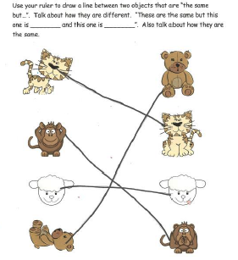
The Same, but…
Lesson 2
Notes:
“The same, but” is a refinement of “not exactly the same as,” which requires students to talk about which attributes are the same and which are different.
In this lesson, you can clearly see the progression from concrete to representative. In the first part of Concept Development, students compare real objects. In the Problem Set, they move to representative drawings. At all times, they are using new vocabulary to talk about how the objects are the same and different.
TIME ALLOTTED FOR THIS SLIDE:
X minutes
MATERIALS NEEDED:
X

Slide 25




Match by Pattern, Color, or Use
Lesson 3
Notes:
In this lesson children consider other types of matches. First, they look at items that match by pattern, working with plates, cups, and bowls of a few different patterns. They then think about items that are used together like a bowl and a spoon or a pencil and a piece of paper.
TIME ALLOTTED FOR THIS SLIDE:
X minutes
MATERIALS NEEDED:
X

Slide 26
Classify to Make Categories and Count
Lesson 4: Classify items into two pre-determined categories.
Lesson 5: Classify items into three categories, determine the count in each, and reason about those the last number named determines the total.
Lesson 6: Sort categories by count. Identify categories with two, three, and four within a given scenario.
Topic B
Notes:
In Topic A, students compared the attributes of two objects. In Topic B, they use this knowledge to create groups with one or more attributes in common. In Lessons 5 and 6, they begin to count alongside the sorting process, which serves as a transition to work with number in upcoming Topics.
TIME ALLOTTED FOR THIS SLIDE:
X minutes
MATERIALS NEEDED:
X

Slide 27
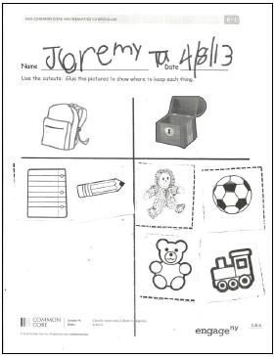
Sorting
Objective: Classify items into two pre-determined categories.
Lesson 4
Notes:
In Lesson 4, we begin to work with a larger set of objects and sort those objects into two categories. Throughout the lesson, the teacher defines the two categories. However, some of your students will be ready to define their own categories and sort the same group of objects in multiple ways. Provide extension opportunities for them to do so.
If time permits, ask for a table of participants to sort themselves into two groups. If their shoes have laces, they should stand in one place. If their shoes do not have laces, they should stand in another spot. Then, sort the same set of participants in a new way (shorts or pants, color of shirt) and ask everyone what is the same about one of the groups, then the other.
Students will practice this independently using the Problem Set.
TIME ALLOTTED FOR THIS SLIDE:
X minutes
MATERIALS NEEDED:
X

Slide 28



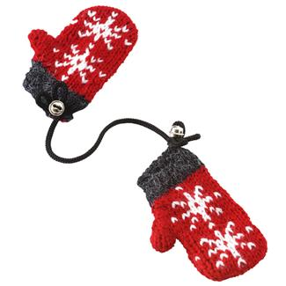





Sort and Tell How Many in Each Group
Sun | Raindrops | Snowflakes
Lesson 5
Notes:
In Lesson 5, students begin to classify items into three categories and they count the number of objects in each category. In addition to sorting, this supports understanding of 1:1 correspondence (1 count for each item) and cardinality (the last number named tells the total).
Students sort the pictures based on whether they fit better with the sun, rain, or snow. Count the items in each category and write the numeral next to category.
(Note: Real items are generally best to use with young children, but pictures can be used if materials management is an issue, especially during an implementation year.)
TIME ALLOTTED FOR THIS SLIDE:
X minutes
MATERIALS NEEDED:
X

Slide 29
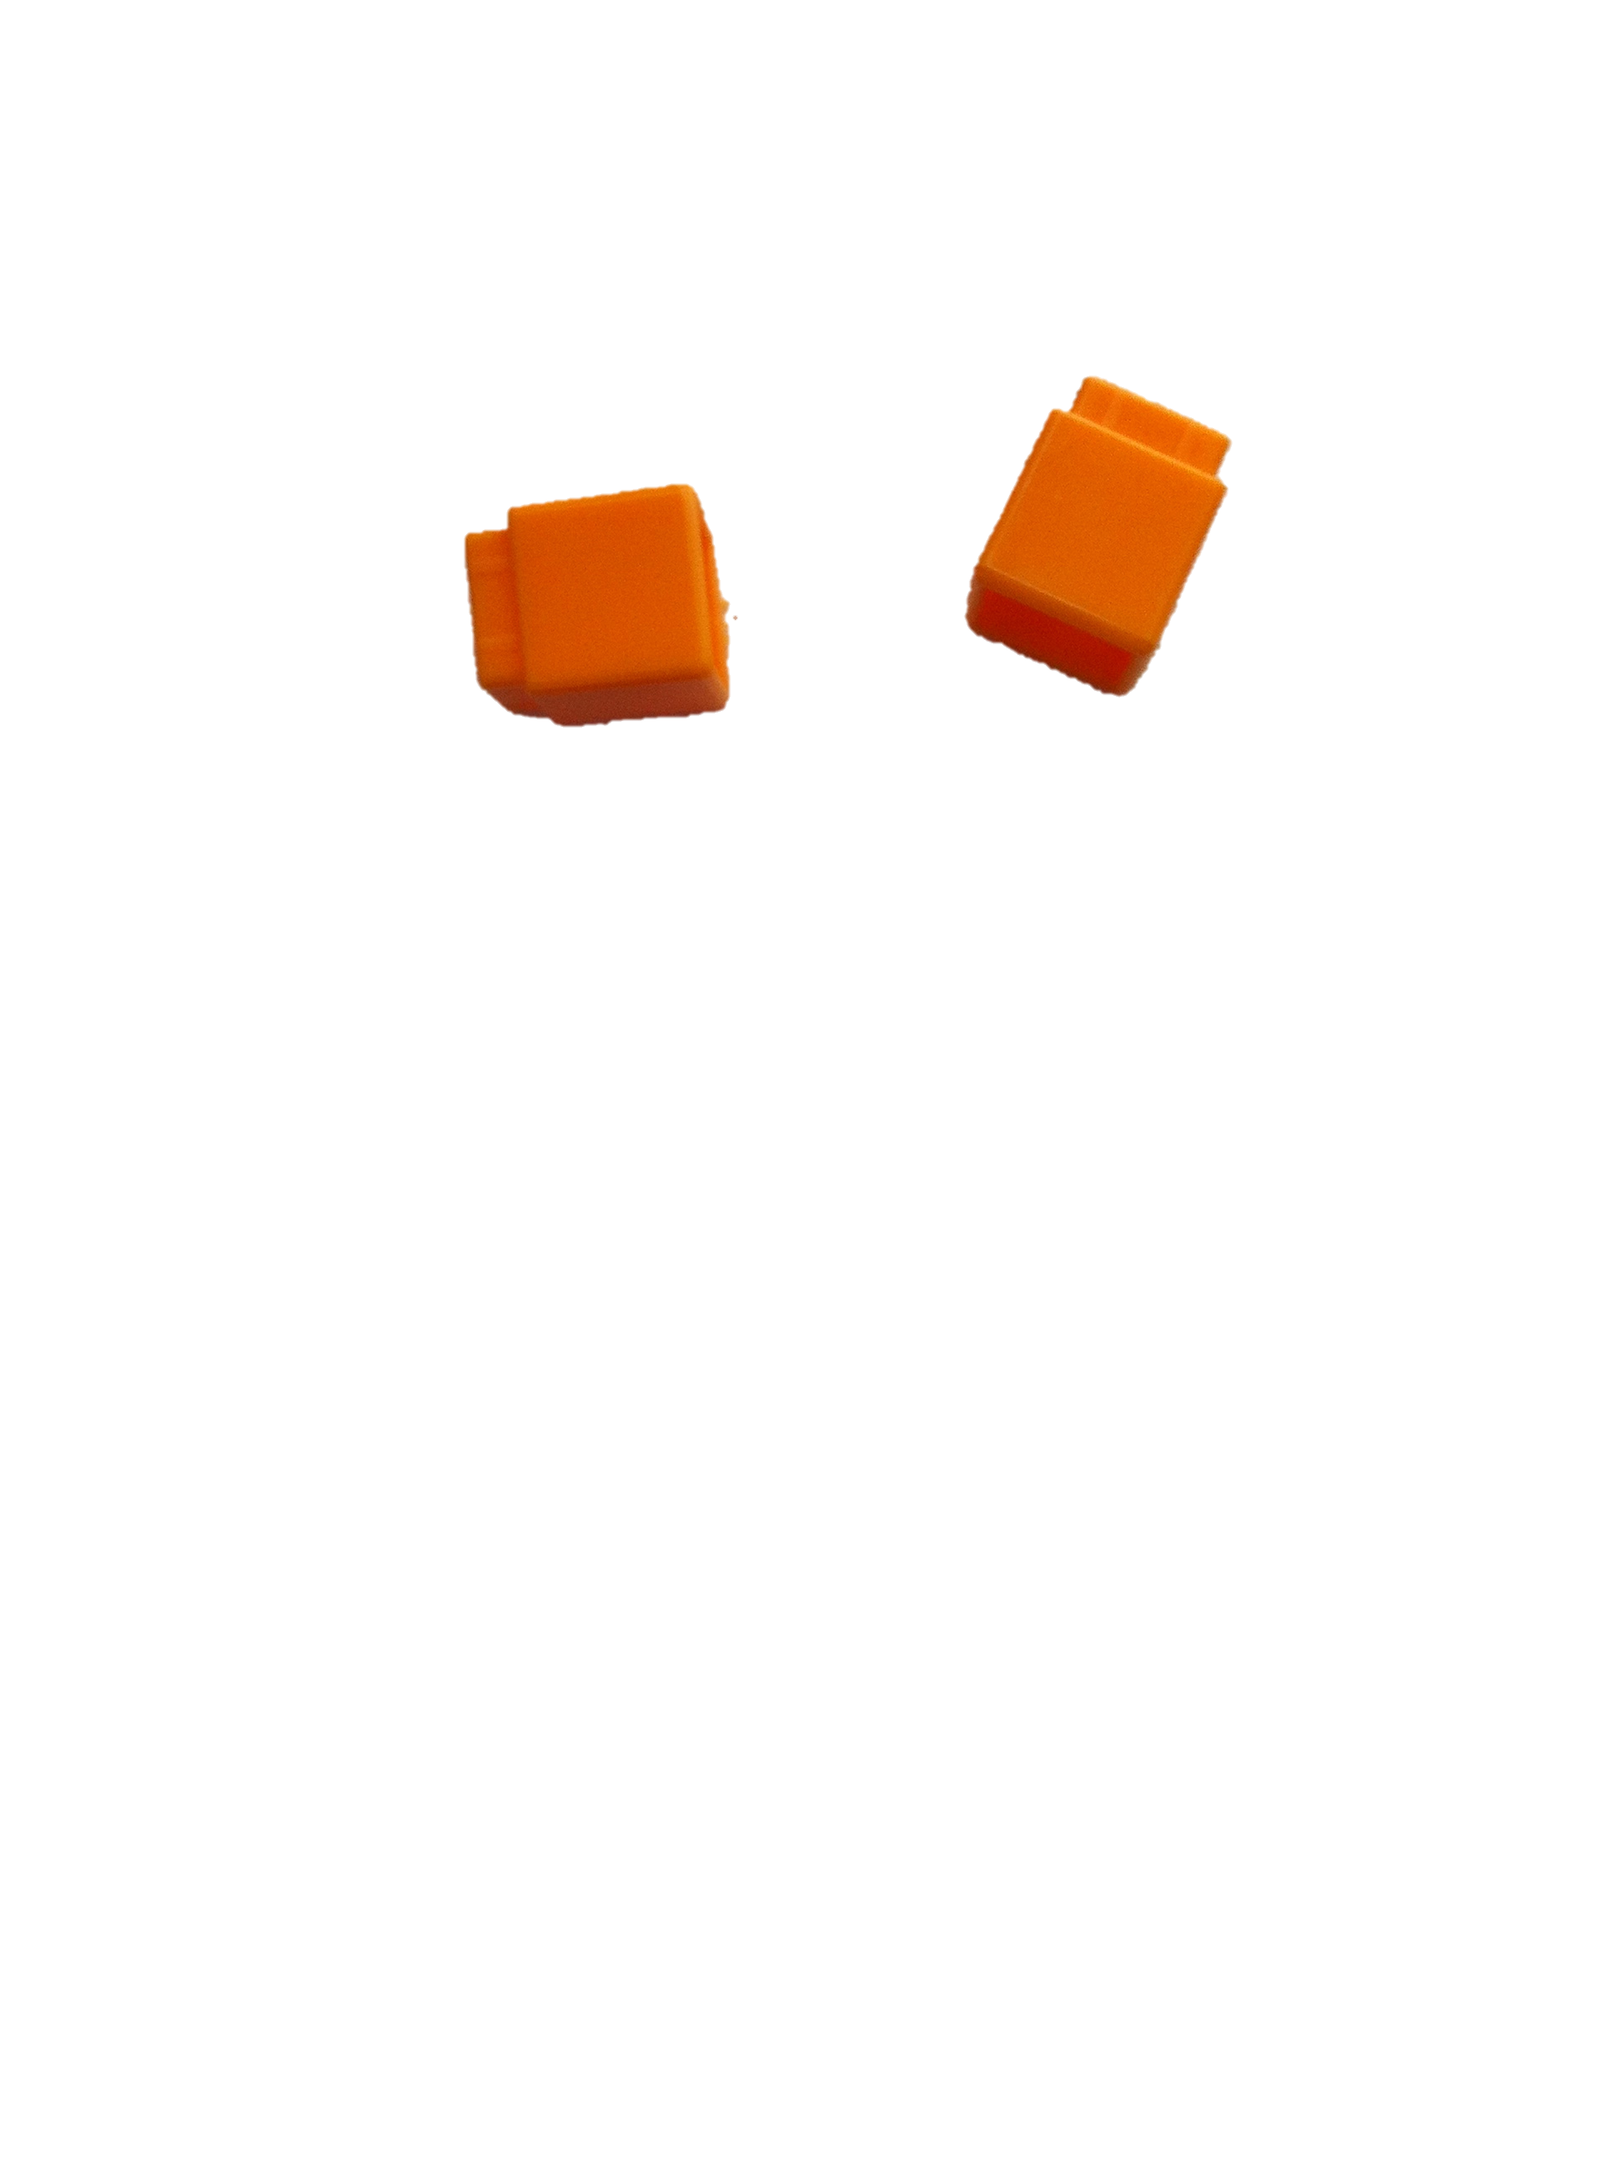
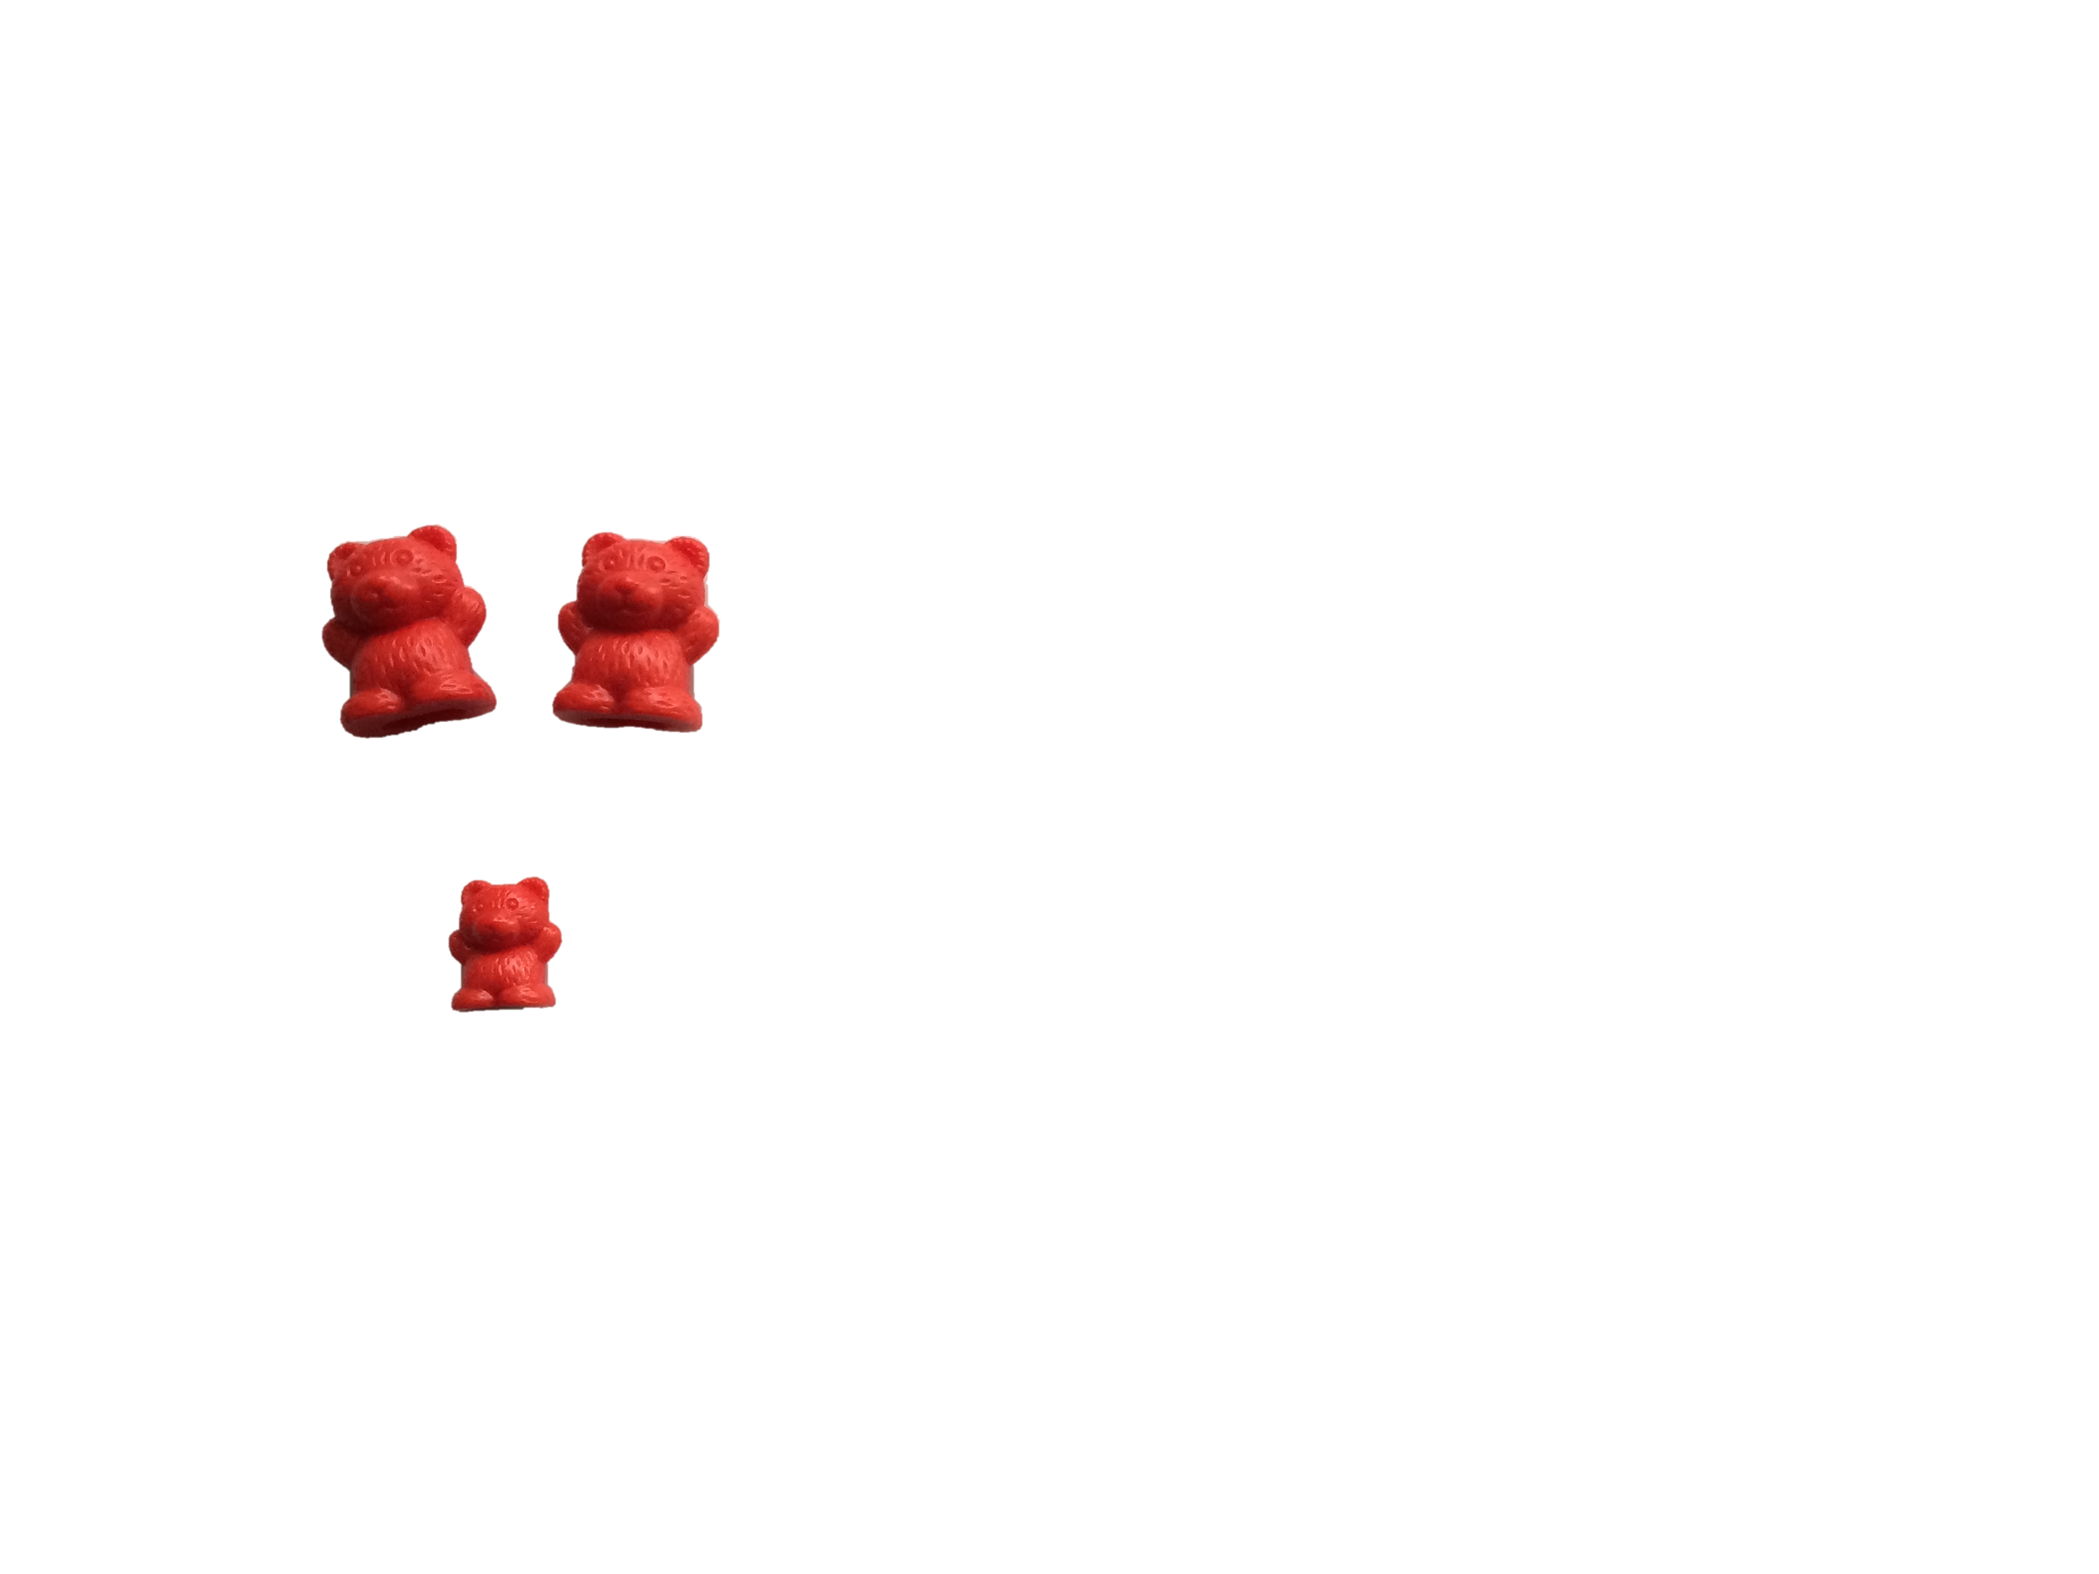




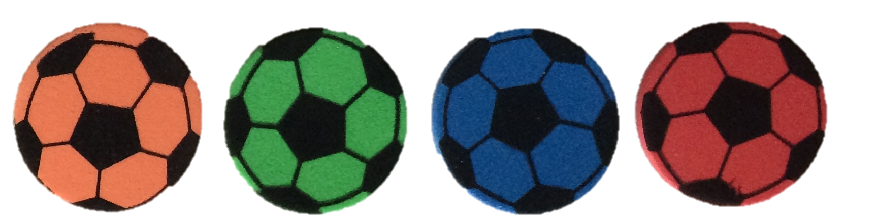

Sort by Count
2 | 3 | 4
Lesson 6
Notes:
In Lesson 6, students actually sort by count (reverse of what they did in Lesson 5). Again, this requires them to practice counting skills (only using numbers up to 5) as well as classification skills. This is also the first introduction of numerals 2-4. Some children will need support throughout the lesson to remember which numeral is which.
Here we will use pictures, but students will use real sets of common classroom objects. It’s more important to use real objects in this lesson than the last because students need to touch and count each object. Some students need the tangibility of the objects to support their count.
(Click to display first set.)
Students choose a treasure from the bag and count how many objects are in the set. Then, they put the set in the treasure chest with the matching numeral.
(Click to display all sets.)
Once they have categorized all of the sets, they count the number of sets in each treasure chest.
TIME ALLOTTED FOR THIS SLIDE:
X minutes
MATERIALS NEEDED:
X

Slide 30
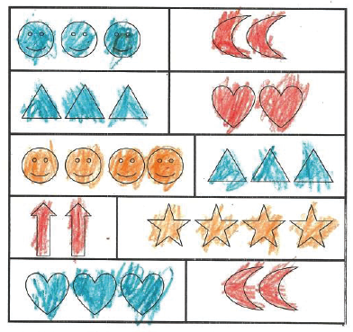



Sort by Count
Why did you color both sets of triangles blue but the sets of happy faces different colors?
Lesson 6
Notes:
Turn to your partner and talk about this Student Debrief question. How does it assess students’ conceptual understanding?
Ask participants to compose an additional debrief question that is appropriate for their particular classroom.

Slide 31
Numerals to 5 in Different Configurations, Math Drawings, and Expressions
Lesson 7: Sort by count in vertical columns and horizontal rows. Match to numerals on cards.
Lesson 8: Answer how many questions to 5 in linear configurations with 4 in an array configuration. Compare ways to count 5 fingers.
Lesson 9: Within linear and array dot configurations of numbers 3, 4, and 5, find hidden numbers.
Lesson 10: Within circular and scattered dot configurations of numbers 3, 4, and 5 find hidden partners.
Lesson 11: Model decompositions of 3 with materials, drawings, and expressions. Represent the decomposition as 1 + 2 and 2 + 1.
Topic C
Notes:
Topic C begins important work with numbers to 5. By the end of this topic, students should be able to count a set of up to 5 objects in multiple configurations. Most students should be able to recognize numerals to 5 and match them to a quantity (though the speed of this acquisition is dependent on prior experience with numbers).
Other items that are introduced in this topic will prepare students for later work with addition and subtraction. Here they will begin to decompose numbers and watch as the teacher writes simple expressions.
TIME ALLOTTED FOR THIS SLIDE:
X minutes
MATERIALS NEEDED:
X

Slide 32
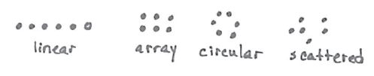
Counting Configurations
Simple → Complex
Topic C
Notes:
Throughout A Story of Units, children are presented with tasks that move from simple to complex. Counting configurations are no different. Linear configurations are easiest to count because the starting and stopping points are clear. Arrays are slightly harder, but they follow the left-to-right, top-to-bottom sequence of reading and writing, which can make tracking the count path easier.
Circular configurations are more confusing. Unless students mark the start of their count, they may continue counting around the circle indefinitely.
Scattered configurations are the most challenging because there is not an obvious counting path for children to follow. They must attend closely or use a marking strategy to remember which items they have already counted.
We start work with these four configurations with numbers to 5, but the more significant counting challenges occur with numbers 6-10 which we will explore in later topics.
TIME ALLOTTED FOR THIS SLIDE:
X minutes
MATERIALS NEEDED:
X

Slide 33
Fluency Break
Sunrise/Sunset Counting to 5 (K.CC.2)
Students rote count to 5
The movement mimics the increasing quantity as they count forward and the decreasing quantity as they count back
Lesson 7
Notes:
Teachers often ask where they can carve out remediation time within the curriculum. What do you do if your students are not rote counting accurately? You have the option to adjust the fluency selections to meet the needs of your class. Sunrise/Sunset Counting is a quick activity to get children moving and it can be used as a quick movement break throughout the day.
Sunrise/Sunset Counting to 5 (rote counting, counting forward and back)
T: Hold your arms out in a great big circle. Pretend you are the sun! It’s morning, and the sun is coming up. Let me see your sunrise. (Model how to gradually rise up from a crouching position to standing on tip-toes.)
S: (Act out the sunrise movement.)
T: Stay there. What does the sun do at night?
S: It goes down.
T: Show me your sunset (return to crouching down).
S: (Act out the sunset movement.)
T: Now we’ll count as we make the sun rise. (Begin with 1 at the lowest position and count up to 5 reaching the highest position.)
S: 1, 2, 3, 4, 5 (while making a circle with their arms and rising up on their toes).
T: Now sunset.
S: 5, 4, 3, 2, 1 (while returning to crouching position).
TIME ALLOTTED FOR THIS SLIDE:
X minutes
MATERIALS NEEDED:
X

Slide 34





Match Numerals to Quantities
Introduce numerals 1, 2, 3, 4, and 5
Sort cubes by color
Count each group and match the numeral
Lesson 7
Notes:
This lesson begins with naming the numerals 1-5 and showing the matching quantity. Students then sort a set of 15 cubes into groups by color. They count the number of cubes in each group and find the numeral that shows how many.
The linking cube sticks, also known as number towers, ensure that students are counting in a linear configuration. Let’s take a look at this 5-stick.
(Click to show 5 in vertical orientation.)
Do we need to change the numeral card if we turn the stick this way? Do we need to count the cubes again? These questions lead children to conserve number- they know that the number stays the same Some students will continue to recount for some time, but discussions like this one with peers help them move toward conservation.
TIME ALLOTTED FOR THIS SLIDE:
X minutes
MATERIALS NEEDED:
X

Slide 35
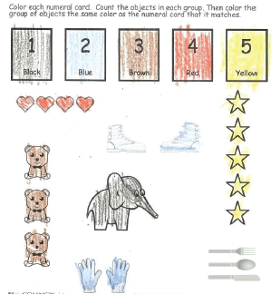
Match Numerals to Quantities
Lesson 7
Notes:
In the Problem Set, students will color each group based on its count. Work with the whole group to color the numeral boxes at the top before students begin working independently.
If you have students who are seeing the numerals for the first time or struggling with 1:1 correspondence or cardinality, keep them in a small group with you as they complete the Problem Set.
.
TIME ALLOTTED FOR THIS SLIDE:
X minutes
MATERIALS NEEDED:
X

Slide 36
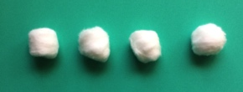
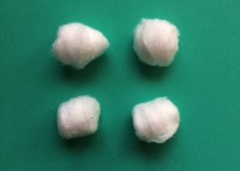
Counting Objects and Drawings
Students manipulate the objects
Include array configuration (4)
Students draw circles in different configurations
Lesson 8
Notes:
Lesson 8 builds on the work of Lesson 7 in multiple ways:
In Lesson 7, the number towers were already in a linear configuration. In this lesson, students move cotton balls around to create a linear configuration for counting.
Students work with an array of 4. Arrays have the same number of objects in each column and the same number of objects in each row. (Think full columns and full rows.)
Students also draw circles in different configurations for counting. When they draw, they are counting out a number of objects rather than counting an existing set. This is more challenging.
TIME ALLOTTED FOR THIS SLIDE:
X minutes
MATERIALS NEEDED:
X

Slide 37
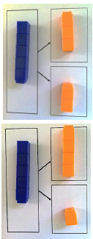
Hidden Partners
First experience with decomposition
Find smaller numbers inside larger numbers
Discover multiple hidden partners
Precursor to use of number bond in Module 4 (template shows relationship of parts and whole)
Lesson 9
Notes:
Lesson 9 provides students with their first taste of decomposition. Decomposition is simply breaking apart. Composition is putting together. Here, students break apart number towers of 5 to find the hidden partners inside. In doing so, they realize that there are multiple partners hiding in 5. They continue the exploration with 4 and 3.
Take a close look at the template they are using to organize their work. It is a precursor to the number bond. At this point, we are not talking about part-whole relationships, but the visual prepares students to see those relationships when they are ready.
TIME ALLOTTED FOR THIS SLIDE:
X minutes
MATERIALS NEEDED:
X

Slide 38
Application Problem
Use your personal white board:
Draw 5 dogs playing. Draw a fence that keeps exactly 3 of them inside.
Lesson 10
Notes:
Have participants complete the Application Problem on their boards. Talk about simplicity in math drawings (use circles to represent dogs for efficiency).
What are children learning in this problem?
Represent a situation efficiently with a math drawing
Create a group of a certain count
Decomposing 5 into 3 and 2
TIME ALLOTTED FOR THIS SLIDE:
X minutes
MATERIALS NEEDED:
X

Slide 39



Counting Path
circular
scattered
Lesson 10
Notes:
In Lesson 10, students count objects in circular and scattered configurations.
They learn to mark the start of their count in circular configurations so that they can recognize where to stop counting. They will also find hidden partners in the set of bears they are counting.
They talk about different counting paths when counting scattered configurations and find that no matter what counting path they use, the count is the same.
TIME ALLOTTED FOR THIS SLIDE:
X minutes
MATERIALS NEEDED:
X

Slide 40
Number Stories
There are 3 flowers. Two flowers are red and 1 flower is purple.
2 + 1
Lesson 11
Notes:
Concept Development
T: I’m going to tell you a number story. Draw it on your paper.
T: There are 3 flowers. Two flowers are red and 1 flower is purple. (Students draw.) CLICK
T: Find the number card that matches the number of red flowers. What number did you pull out?
S: 2.
T: Find the card that matches the number of purple flowers. What number did you pull out?
S: 1.
T: Find the card that matches the number of flowers on your paper. What number did you pull out?
S: 3. (CLICK)
T: We can show the 3 flowers with our numbers like this (CLICK).
T: We read it like this, 2 plus 1. Say it with me.
S: Two plus 1.
T: What does the 2 tell us about in the story?
S: The red flowers.
T: What does the 1 tell us about?
S: The purple flowers.
T: What does 2 + 1 tell us about?
S: All the flowers. → The 3 flowers. → The 2 red and 1 purple flower.
This lesson introduces students to expressions. They are not expected to master expressions in this module. We are simply exposing them to the concept so that they are prepared to work with expressions and equations in Module 4. Do not spend multiple days on this lesson trying to get all students to mastery. Trust that the curriculum will return to this concept many times before the end of the year.
TIME ALLOTTED FOR THIS SLIDE:
X minutes
MATERIALS NEEDED:
Half sheet of paper
2 crayons/participant
Numeral cards

Slide 41
The Concept of Zero and Working with Numbers 0-5
Lesson 12: Understand the meaning of zero. Write the numeral 0.
Lesson 13: Order and write numerals 0-3 to answer how many questions.
Lesson 14: Write numerals 1-3. Represent decompositions with materials, drawings, and equations, 3 = 2 + 1 and 3 = 1 + 2.
Lesson 15: Order and write numerals 4 and 5 to answer how many questions in categories; sort by count.
Lesson 16: Write numerals 1-5 in order. Answer and make drawings of decompositions with totals of 4 and 5 without equations.
Topic D
Notes:
Topic D opens with exploring the meaning of zero in the context of groups of objects. In Topics A–C, students were asked only to identify numerals to 5. The first two lessons in this topic introduce writing the numerals 0–3. Using the understanding that numbers correspond to a value, students can now order numbers in relation to a counting sequence.
Lesson 14 builds upon the decomposition work in Lesson 11 of Topic C. Students see both the expression 2 + 1 (Topic C) and the equation 3 = 2 + 1 (Topic D) as describing a stick of three cubes decomposed into two parts (K.OA.3). The difference now is that the equal sign is shown. Take note that the sum is written first to demonstrate something whole being separated into two parts as opposed to two parts being joined to make a whole.
Lesson 15 extends ordering and writing numerals to 5. This topic culminates with students applying their decomposition knowledge with totals of 4 and 5 without equations. For example, five bananas are in the bowl. Two are yellow, and three are green. Draw the bananas.
TIME ALLOTTED FOR THIS SLIDE:
X minutes
MATERIALS NEEDED:
X

Slide 42

Zero the Hero
The math word for none is zero
“Curve from the top; be a hero! Close the loop and make a zero.”
Be prepared to supplement the handwriting work in this lesson with additional practice
Lesson 12
Notes:
Zero is the main character in Lesson 12. Why do we wait to introduce the concept of zero until after we have explored 1-5? The concept of none, or zero, makes sense only in comparison to a quantity of one or more. It’s nothing, so there isn’t a concrete way to see zero except in relationship to something.
We start the lesson by counting objects from 1 to 5 and then counting from 5 objects to no objects. Then we introduce the math word for none, zero.
Then they spend some time writing zero. [Have participants put the Lesson 12 Practice Sheet in their white boards and practice writing while saying the rhyme. Demonstrate on doc cam or on chart paper.]

Slide 43
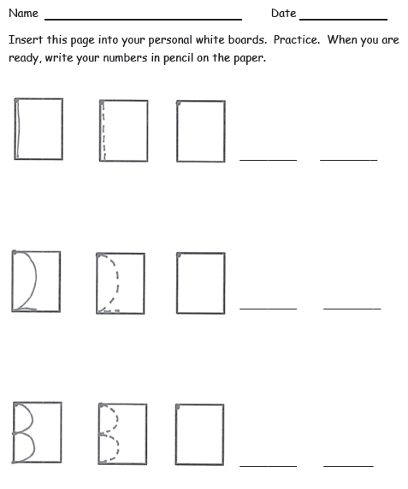
Writing 1, 2, and 3
Rhymes
Writing frames
Plan to incorporate more numeral writing practice after this lesson
Lesson 13
Notes:
Students use the same procedure used to work on writing zero (rhymes, sky writing,) to practice writing 1,2 and 3.
The practice in the lesson does not provide a sufficient amount of practice for numeral writing. Look for other times in your instructional day to provide more practice for number writing.

Slide 44
Decomposition with Number Sentences
3 = 2 + 1
Lesson 14
Notes:
In Lesson 11, we introduced expressions (2 + 1) and now we are introducing equations (3 = 2 + 1). Students will take a cube stick and break it into two parts – this is decomposition. (CLICK)
The teacher will show the special math way to write this: 3 = 2 + 1 and names it as a number sentence.
Again, we do NOT expect children to master the concept of equations and start writing them independently after completing this lesson. We are exposing them to equations so that when we begin formal work with addition and subtraction in Module 4, this is not a foreign concept.

Slide 45
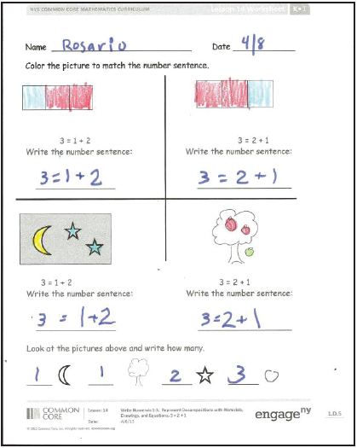
Decomposition with Number Sentences
Lesson 14
Notes:
Let’s talk about differentiation strategies for the Lesson 14 Problem Set. Some of your students will already be able to write their numbers, others just wrote numbers 1-3 for the first time in the previous lesson. If they fall into the latter category, they are likely not ready to copy the equations on this Problem Set.
Look at the first problem. Modify it by asking students to circle the 1 with the blue crayon and the 2 with the red crayon. This will help them associate the drawing with the equation- essentially they are identifying the referents by doing this.

Slide 46
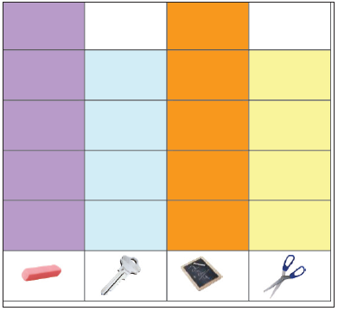
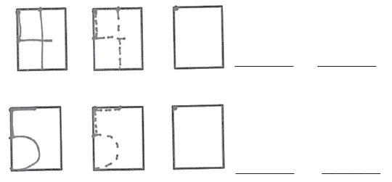
Writing 4 and 5
Lesson 15
Notes:
Lesson 15 is all about the numbers 4 and 5. There are 2 big things happening here:
Students count groups of 4 and 5 items. Then the teacher represents those counts using a graph.
Students practice writing 4 and 5 using the same techniques we used for 0-3.

Slide 47
Sequencing and Embedded Numbers
Play Mix and Fix with 5-group cards- sequencing 1, 2, 3, 4, 5.
Find embedded numbers in 4 and 5
Lesson 16
Notes:
At the beginning of Lesson 16, children will sequence their 5-group cards; first in increasing order then in decreasing order. [If time permits, have participants do this.]
They will spend the majority of the lesson finding hidden partners for numbers 4 and 5. They will use a few different models to do this, including the number towers they used back in Lesson 9 and (CLICK through for animation) shapes divided into two groups by a line. In the Problem Set, they will other pictorial models.

Slide 48
Working with Numbers 6-8 in Different Configurations
Lesson 17: Count 4-6 objects in vertical and horizontal linear configurations and array configurations. Match 6 objects to the numeral 6.
Lesson 18: Count 4-6 objects in circular and scattered configurations. Count 6 items out of a larger set. Write numerals 1-6 in order.
Lesson 19: Count 5-7 linking cubes in linear configurations. Match with the numeral 7. Count on fingers from 1 to 7 and connect to 5-group images.
Lesson 20: Reason about sets of 7 varied objects in circular and scattered configurations. Write numeral 7.
Lesson 21: Compare counts of 8 in linear and array configurations. Match with numeral 8.
Lesson 22: Arrange and strategize to count 8 beans in circular and scattered configurations. Write numeral 8.
Topic E
Notes:
Topic E, students will apply their understanding of counting in varied configurations to numbers 6-8. As the numbers grow larger, this gets harder so it is important to build on the foundation you set in Topic C. Students will also learn to write numerals 6-8 using the same strategies used to write 0-5.
As adults, we will move through this topic quickly because you have already learned most of the strategies, however, children really need practice with these larger numbers. Please don’t take the speed with which we move through this Topic as an indicator that you should speed through it with your students.
TIME ALLOTTED FOR THIS SLIDE:
X minutes
MATERIALS NEEDED:
X

Slide 49

Introducing 5-Groups
This is the first time the 5-group is named for students
Use the 5-group mat to count up to 6 in linear configuration
Lesson 17
Notes:
In Lesson 17, students name the 5-group for the first time. They first look at a number tower of 5 as a 5-group, then break the cubes apart and put them on the 5-group mat to see that 5 cubes fill up the top row.
This sets the stage for introducing 6 as 5 and 1 more. As students begin to work with numbers 6-10, they tend to have a hazy understanding of the quantities other than knowing that it is generally getting bigger. Understanding 6 as 5 and 1 makes it easier for students to truly understand the quantity of 6. The 5-group formation helps students visualize this quantity efficiently.
Student Debrief question to ask participants: How does the 5-group help us count? (Turn and talk.)

Slide 50
Counting Out a Set
Counting out a particular number of objects from a larger set is challenging.
  Remember the target number
  Accurately count with 1:1 correspondence
  Stop adding objects when the target number is reached
Lesson 18
Notes:
Ask participants to count out 6 beans.
Counting out a particular number of objects from a larger set is challenging because it requires students to hold the target number in their memory while counting in the correct sequence, with 1:1 correspondence, and an understanding of cardinality. They need to be very fluent in their counting before they can count out a group.
In lesson 18, students will count out groups of 4, 5, and 6. They will then play a game that leads them to organize their beans into circles and scattered configurations. Finally, they will learn to write the numeral 6.

Slide 51

Introducing 7
Use 5-group mat to see 7 as 5 and 2.
Make a connection between the 5-group mat and fingers
Lesson 19
Notes:
Lesson 19 builds on the work of the previous lessons to introduce 7 and have students write the numeral. The new connection in this lesson is between the 5-group model and counting on the fingers (both show 7 as 5 and 2).

Slide 52
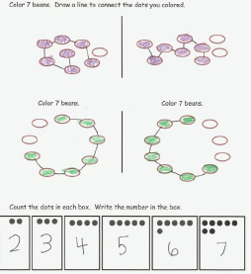
Showing the Counting Path
Track the counting path
Compare to a friend’s counting path
Sequencing numbers
Lesson 20
Notes:
As students begin to count larger numbers in circular and scattered configurations, they need strategies for tracking their counting path. You can see in this Problem Set that students begin to track their counting path with a line. They then compare their counting path with a friend’s.
Note that the bottom of the Problem Set begins work with K.CC.2: Count forward beginning with a given number within the known sequence (instead of beginning with 1)

Slide 53

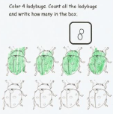
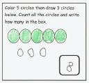
Introducing 8
Lesson 21
Notes:
In Lesson 21, children will learn to count 8 objects in linear and array configurations and write the numeral.

Slide 54
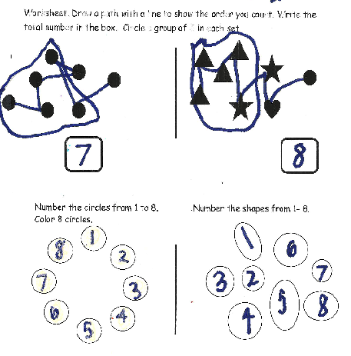
Showing the Counting Path
Read the lesson and unpack by considering the following:
How do the questions on the Problem Set correlate with the instruction in the Concept Development?
How does the Problem Set move from simple to complex?
How do the Fluency Activities and Application Problem support the objective?
You have to cut 10 minutes from this lesson. How do you do it?
Lesson 22
Notes:
At the end of the day, we will practice a planning protocol to help you make good decisions about manipulating lessons to fit the needs of your class. In preparation for that, let’s unpack Lesson 22. You’ll have 10 minutes to read the lesson and answer as many of the bulleted questions as you can (if time is short, ask them to answer 1 of the first 3 questions and the last question).
Note to presenter: This builds to the planning protocol by introducing the idea of cutting back on lesson content. The planning protocol includes a look at assessment, which will be covered in depth in the next section. DO NOT bring up assessment at this time or it will derail the presentation.

Slide 55
Working with Numbers 9-10 in Different Configurations
Lesson 23: Organize and count 9 varied geometric objects in linear and array configurations. Place objects on 5-group mat. Match with numeral 9.
Lesson 24: Strategize to count 9 objects in circular and scattered configurations printed on paper. Write numeral 9. Represent a path through the scatter count with pencil. Number each object.
Lesson 25-26: Count 10 objects in linear and array configurations. Match with numeral 10. Place on the 5-group dot mat. Write numeral 10.
Lesson 27: Count 10 objects and move between all configurations.
Lesson 28: Act out result unknown story problems without equations.
Topic F
Notes:
Topic F follows the same pattern as Topic E, but now students are working with 9 and 10. We won’t go through lessons 23-27 specifically because you are familiar with the pattern by now. However, this practice is important for students- don’t skip these lessons.
Let’s take a closer look at Lesson 28 and find out how students are going to use an important math model, the Number Path.
TIME ALLOTTED FOR THIS SLIDE:
2 minutes
MATERIALS NEEDED:
X

Slide 56
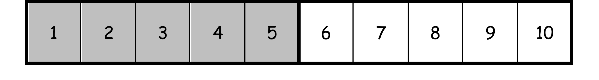
Acting Out Story Problems
Introducing the number path
Acting out stories by standing on a large scale number path
Lesson 28
Notes:
(Prep by placing number path on the floor.)
Materials: (T) 10 sheets of construction paper, each labeled with a large number (1–10) placed in a row on the floor in the front of the room to make a number path, set of number cards (1–10) (S) Bag of 20 loose linking cubes (10 red, 10 white)
Note: In preparation for the opening activity, give ten students one of the number cards.
T: We are going to have a math play! First, I need some actors. If I have given you a card, please come up to stand in that place on the number path.
S: (Find their places.)
T: (Check for accuracy and collect cards.) Now, actors, listen to my story, and do what I say. I will need help from the audience, too. (A sample story is outlined here; it may be modified to reflect other activities currently taking place in class.)
T: Once upon a time, there were some lovely children on a path in the village. How many children were on the path? (Wait for audience to count.)
S: There were 10.
T: There are 10 children and 10 squares on the number path. The children were walking to a birthday party. (Have students march in place.)
T: On the way, 5 of them got tired and had to sit down. (Indicate that the first 5 students should sit on their numbers.) How many children are on the path?
S: There are 5 sitting and 5 standing → There are 10 on the path.
T: After they rested for a little while, they got up, and the group continued on its way. (Have children march in place again.) Suddenly, the last 2 children had to stop to tie their shoes. (Have two children pretend to tie their shoes.) How many children are tying their shoes?
S: 2.
T: How many are still walking?
S: 8.
T: How many children in all?
S: 10.

Slide 57
One More Than with Numbers 0-10
Lesson 29: Order and match numeral and dot cards from 1 to 10. State one more than a given number.
Lesson 30: Exploration: Make math stairs from 1 to 10 in cooperative groups.
Lesson 31: Arrange, analyze, and draw 1 more up to 10 in configurations other than towers.
Lesson 32: Arrange, analyze, and draw sequences of quantities of 1 more, beginning with numbers other than 1.
Topic G
Notes:
So far in the module students have done a lot of counting of groups of objects in linear, array, scattered and circular configurations. Topic G explores how numbers are related to each other. Six. One more is seven.
TIME ALLOTTED FOR THIS SLIDE:
X minutes
MATERIALS NEEDED:
X

Slide 58
Exploring One More
Foundational to ordering and comparing numbers.
Students can find missing numbers in a consecutive list of numbers.
Sets a foundation for using counting on strategies.
Topic G
Notes:
Understanding the relationship between numbers is foundational to ordering number, comparing number, finding the missing number and being able to use counting on strategies.
TIME ALLOTTED FOR THIS SLIDE:
X minutes
MATERIALS NEEDED:
X

Slide 59
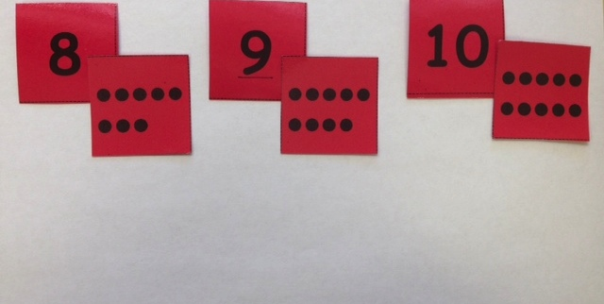
“I have 1. 1 more is 2.”
Lesson 29
Notes:
In lesson 29 students use numeral/5-group cards to order, first by number, then flip the cards to see the growth pattern of the dots on the back. Then they hold up the dot card with one more dot than the number said and finally they match the abstract numeral to objects (dots) with a partner.
It is important to understand the intentional phrasing of Kindergarten comparison statements and show restraint in introducing to much too fast.
I have 1. 1 more is 2→stating the pattern of 1 more
2 is more than 1→compare w/o quantifying (Relates to a Kindergarten standard)
2 is 1 more than 1→comparing and quantifying (Goes beyond the standards and is linguistically complex for students at this age.)
TIME ALLOTTED FOR THIS SLIDE:
X minutes
MATERIALS NEEDED:
X

Slide 60


Make Math Stairs
Lesson 30
Notes:
In this lesson students work with a partner and make a set of math stairs. Students continue to practice using language that states the pattern of one more in the context of getting baby bear to his mother . Two. One more is three.
The Math Stairs will be used in the next several lessons. Students will put the built stairs in order at the beginning of each lesson they are used. This reinforces order, the one more pattern, and the relationship between numbers (informally some students will notice that 8 is 3 more cubes than 5 simply through the activity of ordering their Math Stairs)
TIME ALLOTTED FOR THIS SLIDE:
X minutes
MATERIALS NEEDED:
X

Slide 61
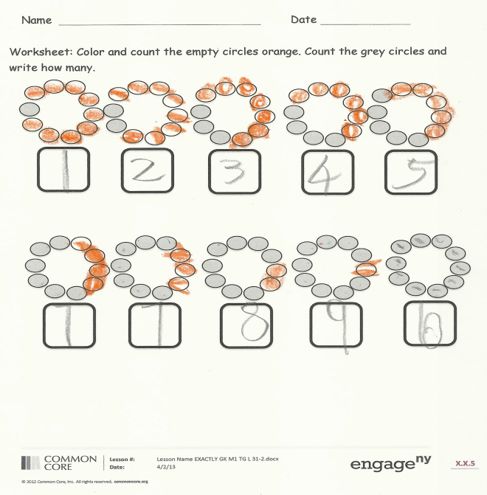
One more in a circular configuration
Lesson 31
Notes:
Note to presenter: This is a quick fluency activity if needed.
Show me 1 more with your fingers the Math Way:
T: Show me three fingers, the Math Way.
S: (Hold up the left pinky, left ring finger, and the left middle finger, to show three fingers the Math Way.)
T: Now show me 1 more.
S: (Hold up the left pinky, left ring finger, and the left middle finger, and the left index finger to show four fingers the Math Way.)
T: How many fingers are you showing me now?
S: 4
Repeat with different numbers up to 10
In lesson 31 students are challenged to add and see one more in a circular configuration in which the growth pattern is not easily recognized as they were in the math stairs. The Math Stairs are used as a scaffold from the previous day but are taken apart and placed in a circular configuration around a circle.
This lesson reviews the work from Topics E and F:
Pairing each number name to one object for numbers 1-10
Employing accurate counting all strategies in a challenging circular configuration
Embedded numbers are implied
TIME ALLOTTED FOR THIS SLIDE:
X minutes
MATERIALS NEEDED:
X

Slide 62
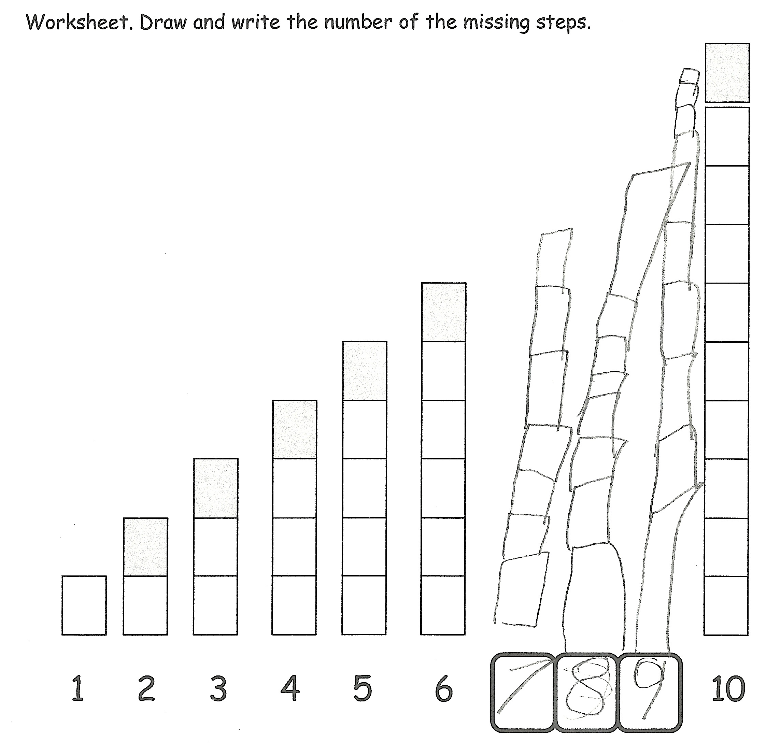
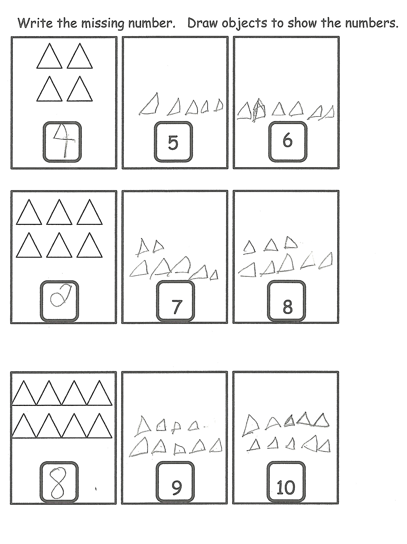
One more starting with numbers other than 1
Lesson 32
Notes:
Lesson 32 returns to Math Stairs to help students find the missing numbers and count on from numbers other than 1. This lesson is differentiated by providing the numbers beginning from 1 for those that need the support and gets more complex towards the end of the lesson.
The 2 problem sets displayed show the simple to complex progression.
The first page of the problem sets provides the scaffold of all the numbers and the pattern of the Math Stairs
The second page removes the scaffold and shows an array configuration and sets of numbers not beginning at 1.
TIME ALLOTTED FOR THIS SLIDE:
X minutes
MATERIALS NEEDED:
X

Slide 63
One Less Than with Numbers 0-10
Lesson 33: Order quantities from 10 to 1 and match numerals.
Lesson 34: Count down from 10 to 1 and state 1 less than a given number.
Lesson 35: Arrange number towers in order from 10 to 1 and describe the pattern.
Lesson 36: Arrange, analyze, and draw sequences of quantities that are 1 less in configurations other than towers.
Topic H
Notes:
Topic H mirrors Topic G exploring one less.
TIME ALLOTTED FOR THIS SLIDE:
X minutes
MATERIALS NEEDED:
X

Slide 64
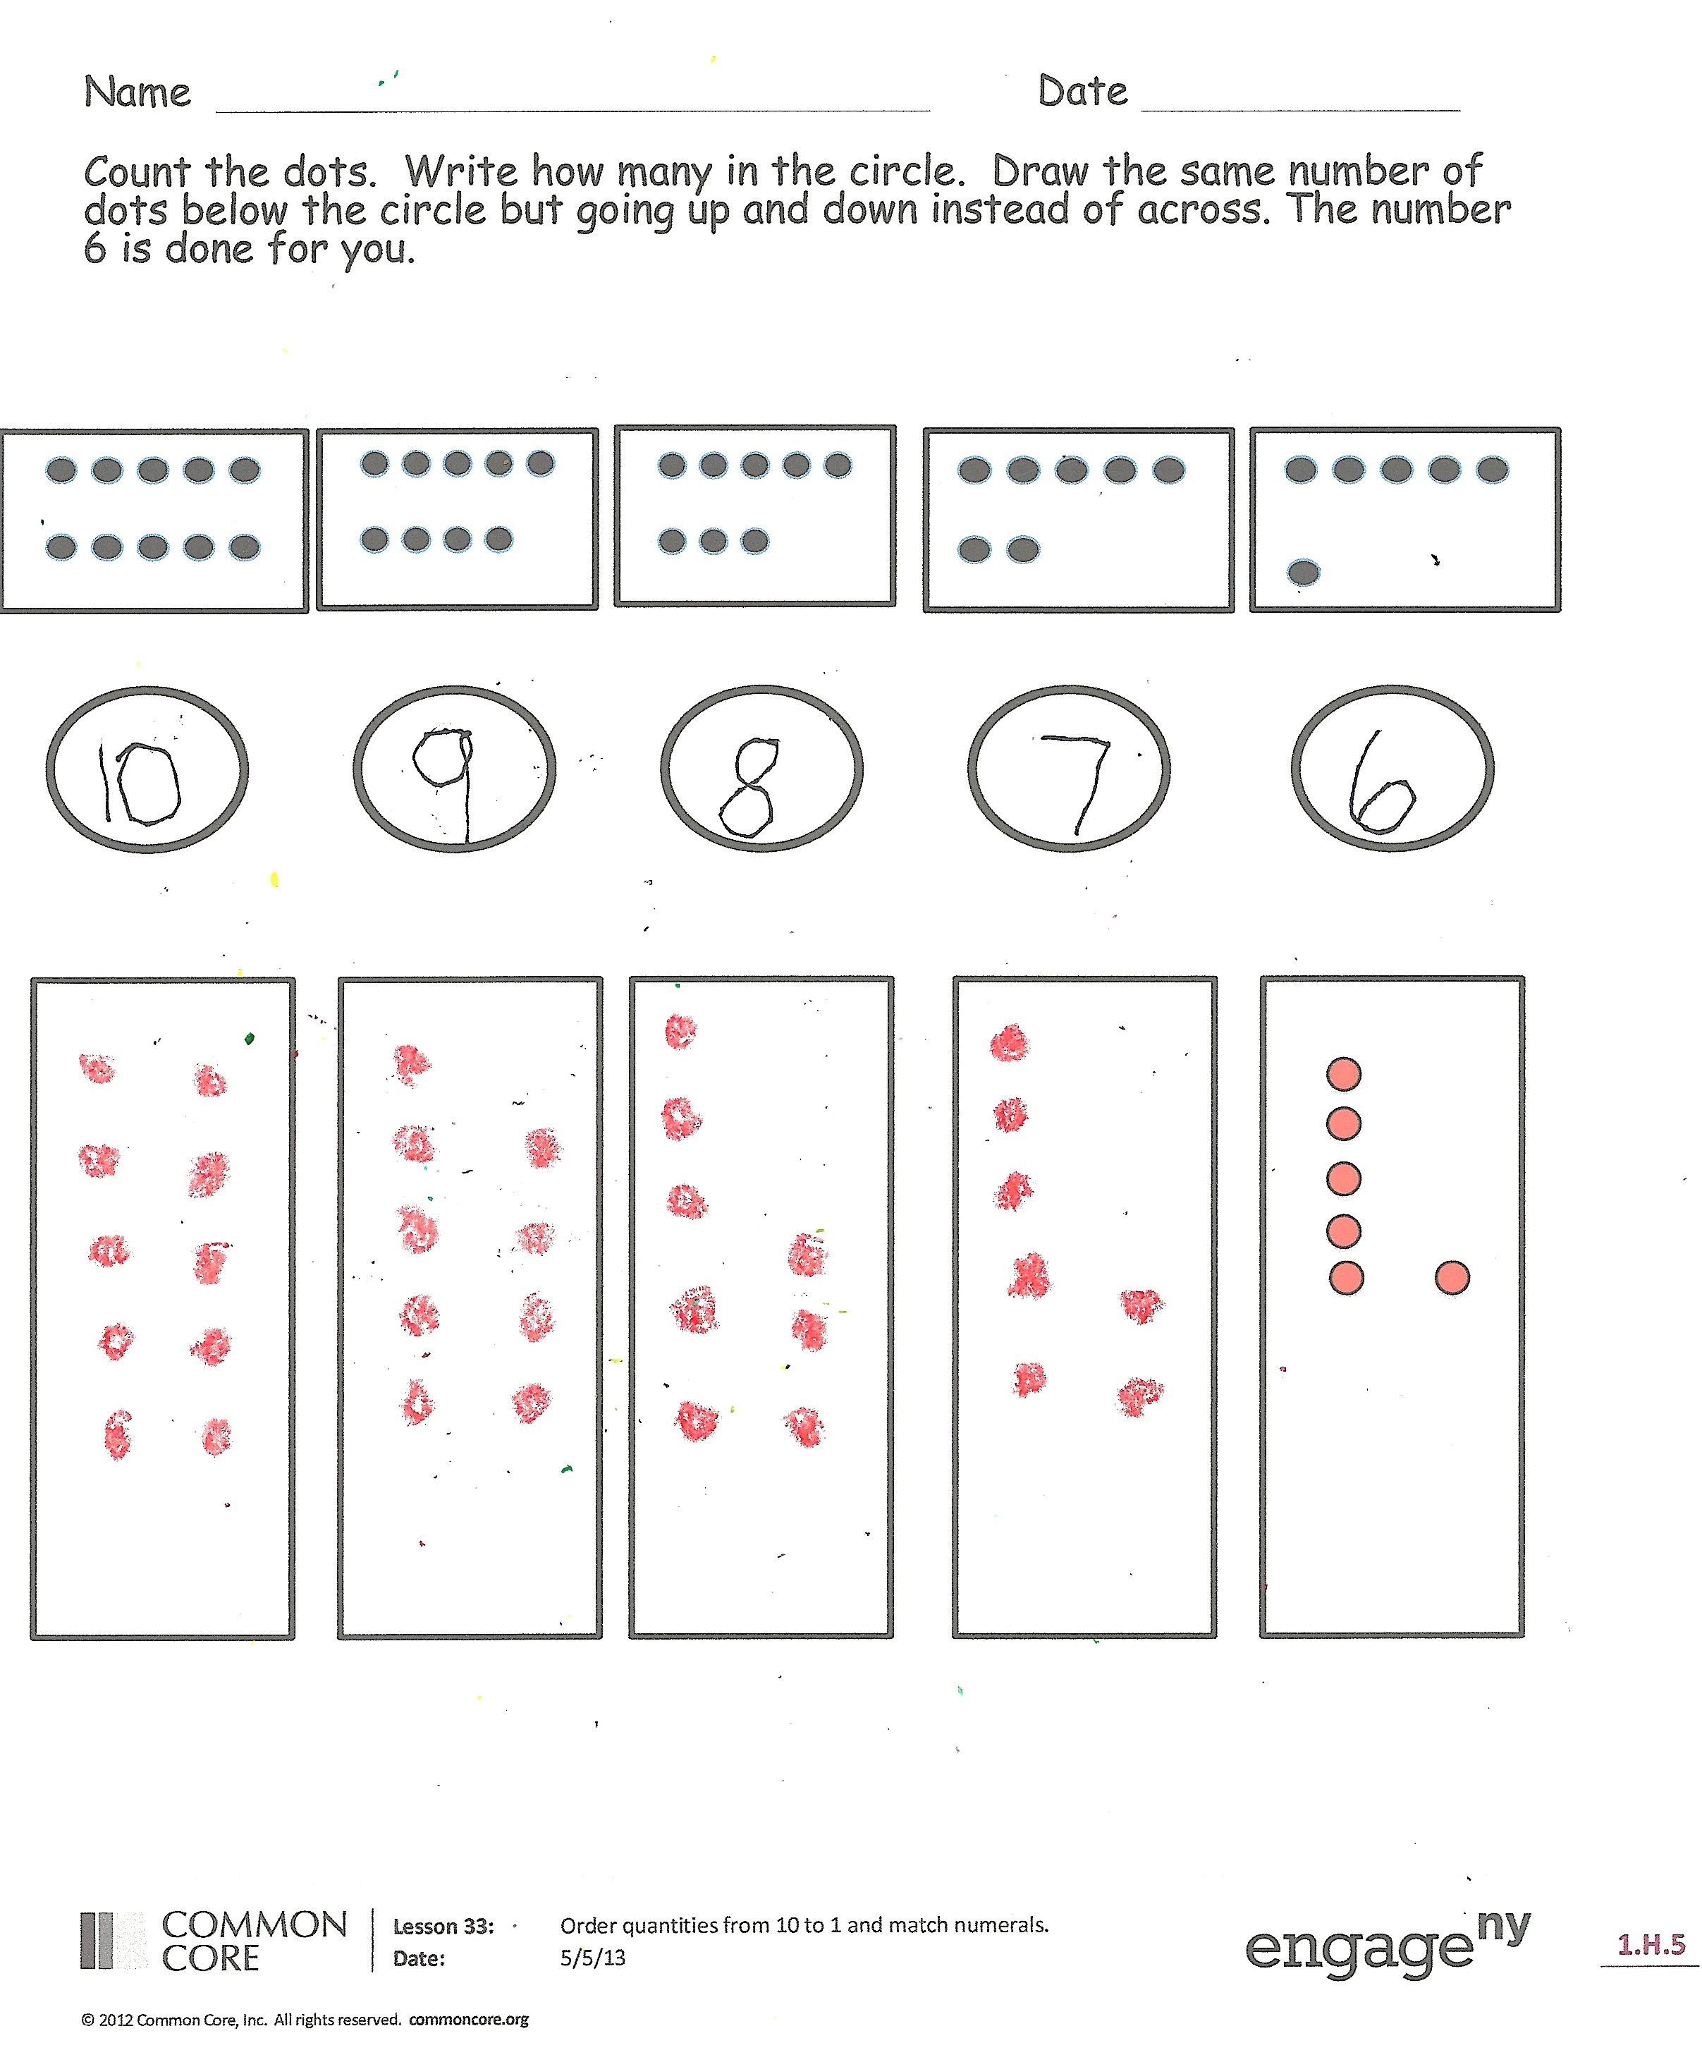
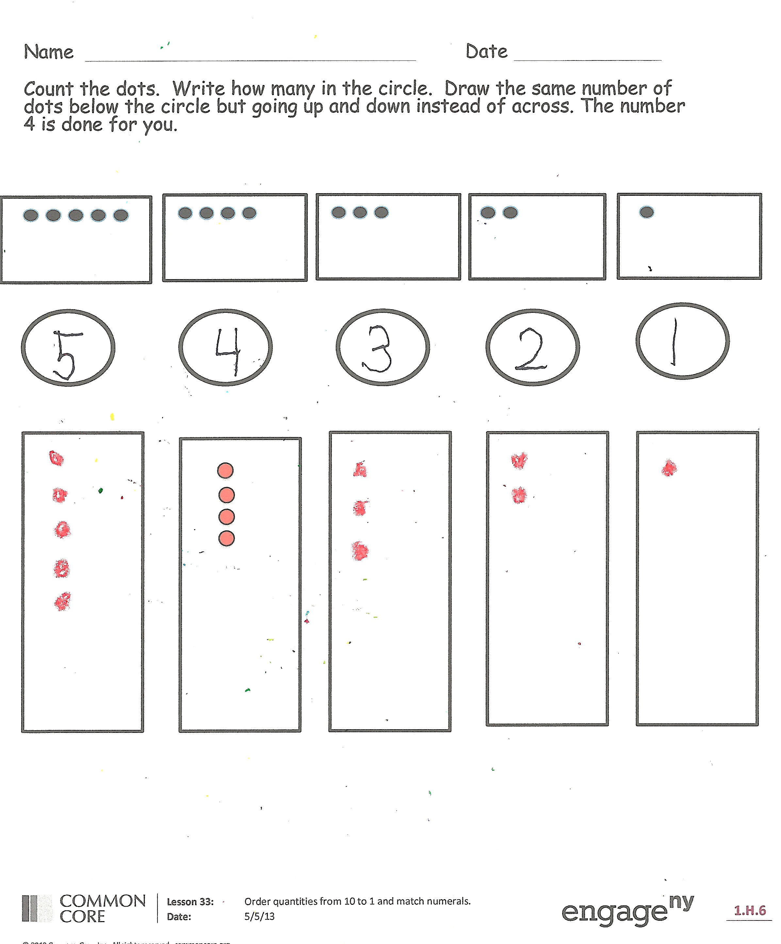
Counting from 10 to 1
Lesson 33
Notes:
In lesson 33 students use their numeral/5-group cards and linking cubes. Students use the 5-group dots as a model and arrange linking cubes in the same formation starting with 10. They take one cube away as they count down to one, making the cubes match the 5-group dots each time. Then students mix up their 5-group cards and put them in order beginning with 10.
TIME ALLOTTED FOR THIS SLIDE:
X minutes
MATERIALS NEEDED:
X

Slide 65
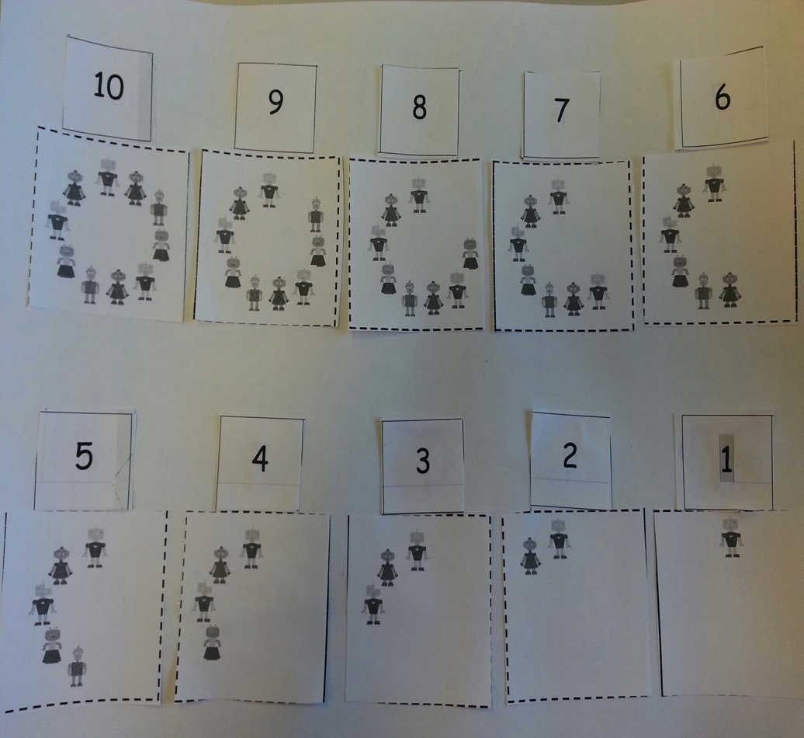
“10. 1 less is 9.”
Lesson 34
Notes:
In lesson 34 one less is embedded in a story situation. The intentional language is again reinforced. Listen for this language as I read the story from the problem set about the robots.
10 robots were playing in a circle. 1 robot’s mom called and he had to go home. 10. One less is nine. 9 robots were playing in a circle. 1 robot’s mom called and he had to go home. 9. One less is eight. 8 robots were playing in a circle. 1 robot’s mom called and he had to go home. 8. One less is seven. 7 robots were playing in a circle. 1 robot’s mom called and he had to go home. 7. One less is six. 6 robots were playing in a circle. 1 robot’s mom called and he had to go home. 6. One less is five. 5 robots were playing in a circle. 1 robot’s mom called and he had to go home. 5. One less is four. 4 robots were playing in a circle. 1 robot’s mom called and he had to go home. 4. One less is three. 3 robots were playing in a circle. 1 robot’s mom called and he had to go home. 3. One less is two. 2 robots were playing in a circle. 1 robot’s mom called and he had to go home. 2. One less is one. And he played happily ever after!
TIME ALLOTTED FOR THIS SLIDE:
X minutes
MATERIALS NEEDED:
X

Slide 66
Descending Math Stairs
Lesson 35
Notes:
Fluency activity if needed:
Beep Number- Use an imaginary number path per participant. This fluency maintains the work of identifying the missing number using what was learned about how numbers are related to each other.
Listen carefully while I count. Instead of saying a number, I’ll say beep. You can touch each number on your number path as I say it. When you know what the beep number is, raise your hand.
7, 8, beep
7, beep, 9
Beep, 8, 9
In lesson 35 students work with math stairs in a descending pattern. Pairs of students order their pre-made stairs from 10 to 1 and continue to practice using intentional language that states the pattern of one less in the context of getting baby bear some honey . Ten. One less is nine.
TIME ALLOTTED FOR THIS SLIDE:
X minutes
MATERIALS NEEDED:
X

Slide 67
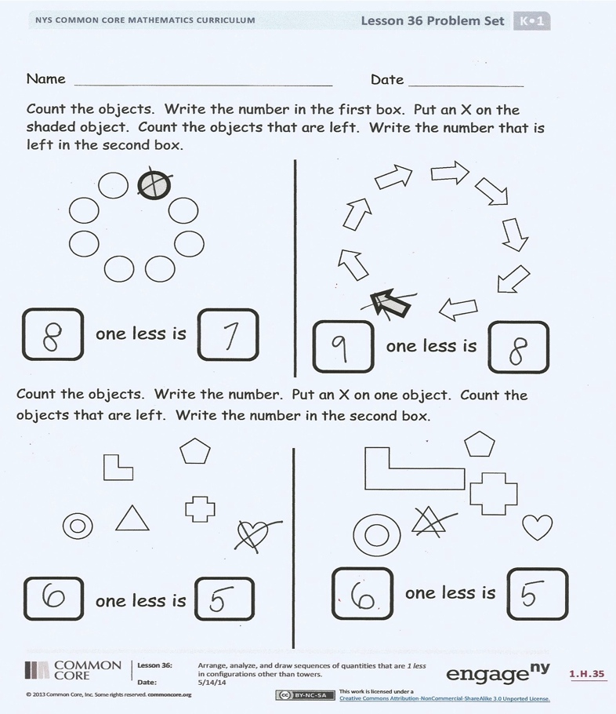
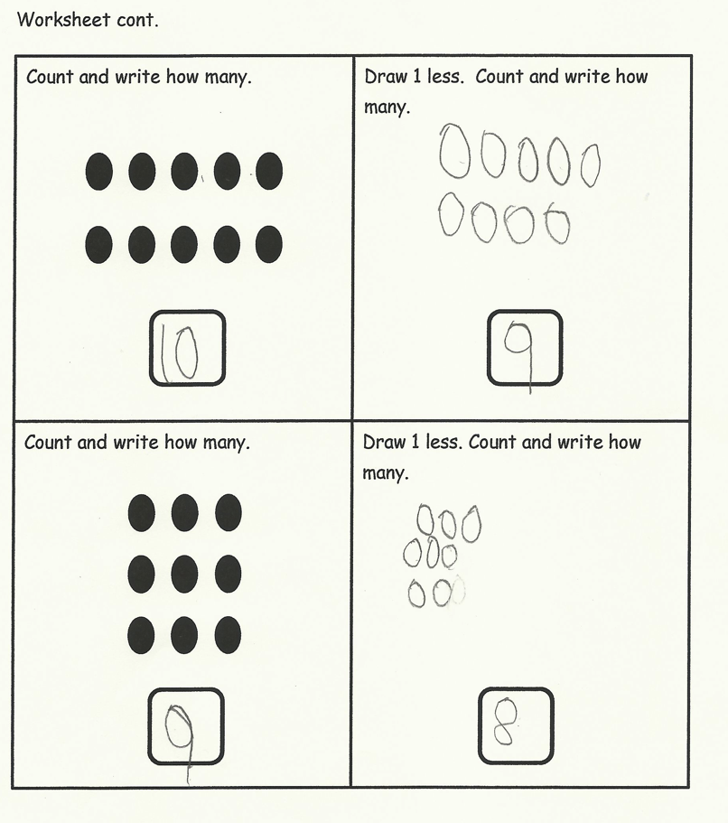
One less in a circular, scattered, and array configuration
Lesson 36
Notes:
In lesson 36 students cross out 1 object to show one less in more challenging counting configurations. Once again you see the progression from simple to complex, a characteristic seen throughout the curriculum.
Crossing out one object to see one less marks the spot to begin and stop counting what is left to find one less. (Simple)
Crossing out one object in a scattered configuration to find one less. Students still need to employ an accurate counting strategy to state one less. (More complex)
Finally students are asked to look at an array and create a drawing showing one less. (Complex)
TIME ALLOTTED FOR THIS SLIDE:
X minutes
MATERIALS NEEDED:
X

Slide 68

Number Fair! – Culminating lesson
?
Lesson 37
Notes:
Lesson 37 is a review and celebration of all the work of Module 1. Students are given a mystery bag with a varying amount of loose link cubes to 10. Stations are set up with all the materials they have used in the module:
5-group cards
5 red and 5 white beads
White board and markers
Linking cube towers/stairs
5-group mats
Rekenrek
Paper, crayons, pencils
Students are then asked to show their mystery number in as many ways as they can.
Order a set of 5-group cards to 10 to review the work of one more and one less.
TIME ALLOTTED FOR THIS SLIDE:
X minutes
MATERIALS NEEDED:
X

Slide 69
Assessment Info
1:1 assessment
Interview style
Broken into topics
Assesses only the focus standards
Rubric for scoring
End-of-Module Assessment
Notes:
Model giving the Topic E assessment with a participant. Have participants take notes and score using the rubric. Facilitate a discussion about responses given by the participant. What level of conceptual understanding is evidenced by the “student’s “ responses?
Please note that, while we certainly have a systematic approach to assessment, we do not provide a complete assessment program. At this point, a primary goal of the project has been to create a curriculum that is free and accessible to anyone, anywhere. By default, that means that the assessments are also free and accessible to anyone, anywhere. The assessments that we provide are worthy assessments, regardless of how much help individual students might have gotten at home. If a student can perform in class, getting the correct answer and demonstrating understanding through models and explanation, then that should be acknowledged and praised. However, these assessments are obviously not sufficient.
TIME ALLOTTED FOR THIS SLIDE:
X minutes
MATERIALS NEEDED:
X

Slide 70
Assessment Info
Take 5 minutes to administer the Topics G & H assessment tasks with a partner (take turns being the teacher)
How do these tasks measure the skills and understanding that are addressed in this module?
End-of-Module Assessment
Notes:
Now have participants practice administering the Topic G and H assessments with a partner. Taking turns being the teacher and the student. Stress the importance of practicing our craft. Assessments can become more systematic and less time consuming when the administration of the assessment becomes second nature.
TIME ALLOTTED FOR THIS SLIDE:
X minutes
MATERIALS NEEDED:
X

Slide 71
Agenda
Lesson Structure
Instructional Sequence
Module Review
Preparation for Implementation
Notes:
As you’ve seen, the sequence of objectives is very intentional. Each one is critical in preparing students for what comes next. We think of these objectives as rungs on a ladder that lead to success of the module’s focus. Collectively, they play a significant role in the students achieving mastery of the grade’s expectations.
Keep in mind that we only sampled a small part of each objective. When looking at the daily lesson, you’ll find that each plan is thoroughly detailed… as you experienced with Lesson 1 at the beginning of this session.
Now, we are going to examine the module in its entirety.
TIME ALLOTTED FOR THIS SLIDE:
1 minute
MATERIALS NEEDED:
X

Slide 72
Progression Study
What are the Progressions?
Explore: K-5, Operations and Algebraic Thinking Progression
      Group 1: Read pages 4-5
      Group 2: Read pages 6-7
      Group 3: Read pages 8-11
  Highlight the information relevant to the content of this module.
Notes:
What are the Progressions?
Poll participants using the fist-to-five protocol to gauge how well (if at all) they know the progression documents. Participants show zero fingers/fist if they have never heard of or seen the progressions, show 5 fingers if they have read a majority of the progressions, or some number of fingers if they are relatively familiar or have read some portion of them.
Explain what the progressions are:
The Common Core State Standards for mathematics were built from the progressions. They are a narrative document describing the progression of a topic across a number of grade levels. The progressions were guided by a child’s cognitive development and the logical structure of math when written. These documents were used to create the grade level standards, and therefore can explain why the standards are sequenced the way they are. The progressions also highlight cognitive difficulties and provide pedagogical solutions, and give greater detail on some of the particularly challenging areas of mathematics. As writers, we referred to the progressions often to guide our thinking when sequencing lesson objectives and problems within each lesson.
Progression Exploration:
To continue our study of Module 1, we’re going to first take some time to examine a portion of the Progression document (K-5, Operations and Algebraic Thinking) that serves as the foundation for this module. You’ll have about 10 minutes to read through the document independently or with a partner. As you read, highlight the information that is relevant to the content of this module.
Allow participants time to read independently. Encourage them to highlight and make notes.
TIME ALLOTTED FOR THIS SLIDE:
10 minutes
MATERIALS NEEDED:
progression document
Highlighters( optional)

Slide 73
Progression Study
Study Lessons 7 & 8 and Lessons 9 & 23.
Then, turn and talk:
    How do these lessons engage students in the work described in the Progression?
Notes:
Allow participants time to study Lessons 7-8 and 9 & 23.
Then, allow participants time to turn and talk about how these lessons engage students in the work described in the Progressions.
Consider providing sentence frames for the turn and talk.
Facilitate a whole group discussion.
TIME ALLOTTED FOR THIS SLIDE:
5 minutes
MATERIALS NEEDED:
X

Slide 74
Coherence Within the Module
Analyze the progression of each lesson component across the Module.
  What does the sequence of Fluency Practices
  accomplish as a whole?
  How does the sequence of Application
  Problems connect to topic/module?
  How does the sequence of Concept
  Development and Student Debrief build
  toward mastery of the topic/module?
Notes:
Earlier, we examined a Lesson 1 in great detail and recognized the coherence within the lesson. Now that you’ve had an opportunity to see the development of the mathematical concepts outlined in the Progression document, let’s take some time to return to Module 1 and take a look at how the module is coherent on a larger scale. Specifically, let’s look for examples of the same scaffolding that we have mentioned all day today: simple to complex and concrete to abstract.
You might each want to divide the Topics amongst your tablemates and each select a Topic to closely examine.
Be prepared to share your observations with the group.
Allow 15 minutes for participants to complete this analysis. Then advance to the next slide.
TIME ALLOTTED FOR THIS SLIDE:
15 minutes
MATERIALS NEEDED:
X

Slide 75

Coherence Within the Module
Analyze the progression of each lesson component across the Module.
  What does the sequence of Fluency Practices
  accomplish as a whole?
  How does the sequence of Application
  Problems connect to topic/module?
  How does the sequence of Concept
  Development and Student Debrief build
  toward mastery of the topic/module?
Notes:
Allow time for turn and talk, then facilitate a discussion. Be sure to include answers to the provided questions, specifically addressing the progression of mathematics in Module 1.
What does the sequence of Fluency Practices accomplish as a whole? (Counting is developed beginning with numbers 1, 2, and 3 to numbers up to 10.)
How does the sequence of Application Problems connect to topic/module? (they often build on the pervious lesson objective, they provide a variety of problem types (from the OA Progression), they provide continued practice with solution strategies, progress from simple (smaller numbers) to complex (larger numbers, linguistic expectations, and extensions), they allow for practice of simple math drawings (number bonds, equal groups drawings, arrays etc.)
How does the sequence of Concept Development and Student Debrief build
toward mastery of the topic/module? (highlight transition from concrete → abstract, and simple → complex)
TIME ALLOTTED FOR THIS SLIDE:
5minutes
MATERIALS NEEDED:
X

Slide 76
Agenda
Lesson Structure
Instructional Sequence
Module Review
Preparation for Implementation
Notes:
Now you’ve had a chance to examine this module at several levels. We looked at the lesson components, we explored the instructional sequence from objective to objective, and we’ve thought about what this module accomplishes in the larger scope of mathematical understanding.
Let’s spend some time now discussing strategies for implementation and preparing for the beginning of the upcoming school year.
TIME ALLOTTED FOR THIS SLIDE:
1 minute
MATERIALS NEEDED:
X

Slide 77
Practice a Planning Protocol
Focus: Kindergarten Module 1 Topic F
With any topic from A Story of Units, read the module overview and the topic opener.
Study the module assessment, paying particular attention to the sample responses provided.
Notes:
Click to advance the first bullet. Allow time for participants to read the module overview and the topic opener for the pre-selected topic.
Click to advance second bullet. Allow time for participants to study the Topic F assessment tasks (see EOM Assessment).
NOTE TO FACILITATORS: It is likely that participants will have already studied these documents during Session 1 of this NTI. If this is the case, there is no need to spend additional time on this slide at this point.
TIME ALLOTTED FOR THIS SLIDE:
5 minutes
MATERIALS NEEDED:
The module overview, topic opener, and applicable module assessment(s) for any topic from any module at any grade level

Slide 78
Practice a Planning Protocol
Read through the first lesson of Topic F (Lesson 23).
Then, take note of the lesson objective and re-examine the topic assessment tasks with the objective in mind. What major concept is necessary to successfully complete the assessment?
Study the Concept Development and Problem Set. How do the CD/PS develop the major concept that is required in the assessment? What parts of the CD/PS go beyond this major concept?
Notes:
Click to advance the first bullet. Allow time for participants to read the first lesson of the pre-selected topic.
Click to advance second bullet. Read aloud the objective of the first lesson. Allow time for participants to re-read the Topic F assessment tasks. Facilitate a discussion about the major concept required by the assessment.
Click to advance the third bullet. Allow time for participants to study the concept development and problem set. If participants have paper copies of the lessons, encourage them to highlight the portions of the CD/PS that are critical in preparation for the assessment. Facilitate a discussion about those portions of the lesson that are necessary in preparation for the exit ticket and those that go beyond the major concept needed for the exit ticket.
Necessary: Counting to 9, writing 9.
Beyond: Relationship between 5 and 9, thinking about 9 as missing 1 to be 2 fives, 9 as 3 rows of 3.
TIME ALLOTTED FOR THIS SLIDE:
5 minutes
MATERIALS NEEDED:
The preselected topic
Highlighters (optional)

Slide 79
Practice a Planning Protocol
How will this knowledge empower teachers to support specific groups of learners?
Turn to the subsequent lesson (Lesson 24), and examine the Problem Set. How does this Problem Set build on the last? How are the two Problem Sets similar and how are they different?
Will students have an opportunity in Lesson 24 to continue development of Lesson 23’s objective? What level of mastery of Lesson 23’s objective is necessary in preparation for Lesson 24?
Notes:
Click to advance the first bullet. Facilitate a discussion about how participants’ previous observations might be further impacted as they consider the needs of a specific group of students. As appropriate, draw attention to any relevant notes boxes in the margins of the lesson.
Click to advance second bullet. Allow time for participants to read the exit ticket for the next lesson. Facilitate a discussion about the relationship between the two Problem Sets.
Click to advance the third bullet. Facilitate discussion about how these new observations might further impact their decisions regarding implementation of the first lesson.
TIME ALLOTTED FOR THIS SLIDE:
5 minutes
MATERIALS NEEDED:
The preselected topic

Slide 80
Practice a Planning Protocol
How does the new plan for implementation impact the student debrief?
Are any adjustments needed to the fluency and/or application components of the lesson?
Notes:
Click to advance the first bullet. Facilitate a discussion about how the student debrief is impacted by the implementation decisions made thus far.
Click to advance second bullet. Facilitate a discussion about the other lesson components and the need to ensure that the balance of rigor is maintained.
TIME ALLOTTED FOR THIS SLIDE:
5 minutes
MATERIALS NEEDED:
The preselected topic

Slide 81
Practice a Planning Protocol
Repeat this process for each lesson.
    Read lesson.
    Study assessment tasks for topic. Identify critical portions of concept development and problem set.
    Consider needs of specific students.
    Refer to subsequent Problem Set. Revise implementation plan as needed.
    Make adjustments to the student debrief as needed.
    Consider the other lesson components, ensuring a balance of rigor.
Notes:
Review the planning protocol. If time allows, have participants go through the cycle again for the second lesson of the topic.
TIME ALLOTTED FOR THIS SLIDE:
5 minutes
MATERIALS NEEDED:
The preselected topic

Slide 82
Biggest Takeaway
I now know…
I need to figure out…
Notes:
Take two minutes to turn and talk with others at your table. During this session, what information was particularly helpful and/or insightful? What new questions do you have?
Allow 2 minutes for participants to turn and talk. Bring the group to order and advance to the next slide.
TIME ALLOTTED FOR THIS SLIDE:
3 minutes
MATERIALS NEEDED:
X

Slide 83
Key Points
When making instructional decisions in order to meet the needs of specific students, there are only two rules:
  Honor the objective!
  Honor the balance of rigor!
Counting and cardinality work sets the stage for work with operations and algebraic thinking in K-5.
Sorting and matching activities prepare students to closely examine an object’s attributes and classify the object based on those attributes.
Notes:
Let’s review some key points of this session.
TIME ALLOTTED FOR THIS SLIDE:
2 minutes
MATERIALS NEEDED:
X

Slide 84
Next Step
The first thing I’ll do to prepare is…
Notes:
Participants write their answers on an index card, which will be their exit tickets.
TIME ALLOTTED FOR THIS SLIDE:
5 minutes
MATERIALS NEEDED:
Index cards

