Slide 1
Rave Panic Button
Empower School Safety in Louisiana
Mark Benton
Director, State of Louisiana
mbenton@ravemobilesafety.com
225-806-4273
Notes:
Presentation title slide contains title, subtitle, and optional author info.
Background can be customized to fit specific subject matter upon request.

Slide 2
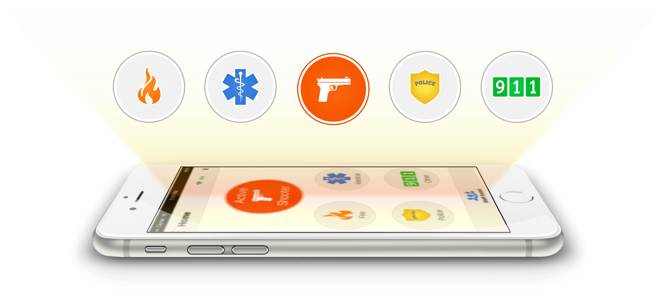
RAVE PANIC BUTTON
Mobile Incident Response App
Notify Staff and 9-1-1 with a Single Touch
Get Responders on Scene Faster and Better-Informed
Proprietary & Confidential
Notes:
(Situation, Impact) 70% of active shooters are over in less than 5 minutes. Responders can’t arrive in time.

Slide 3
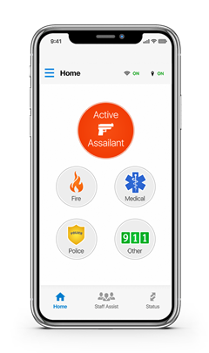
rave panic button

Slide 4
Many schools have began the implementation process for Rave Panic Button but, have stalled for several reasons
Completing the Panic Button Profile is vital to assure that your faculty, staff and first responders are informed and provided the critical information that they need.

Slide 5
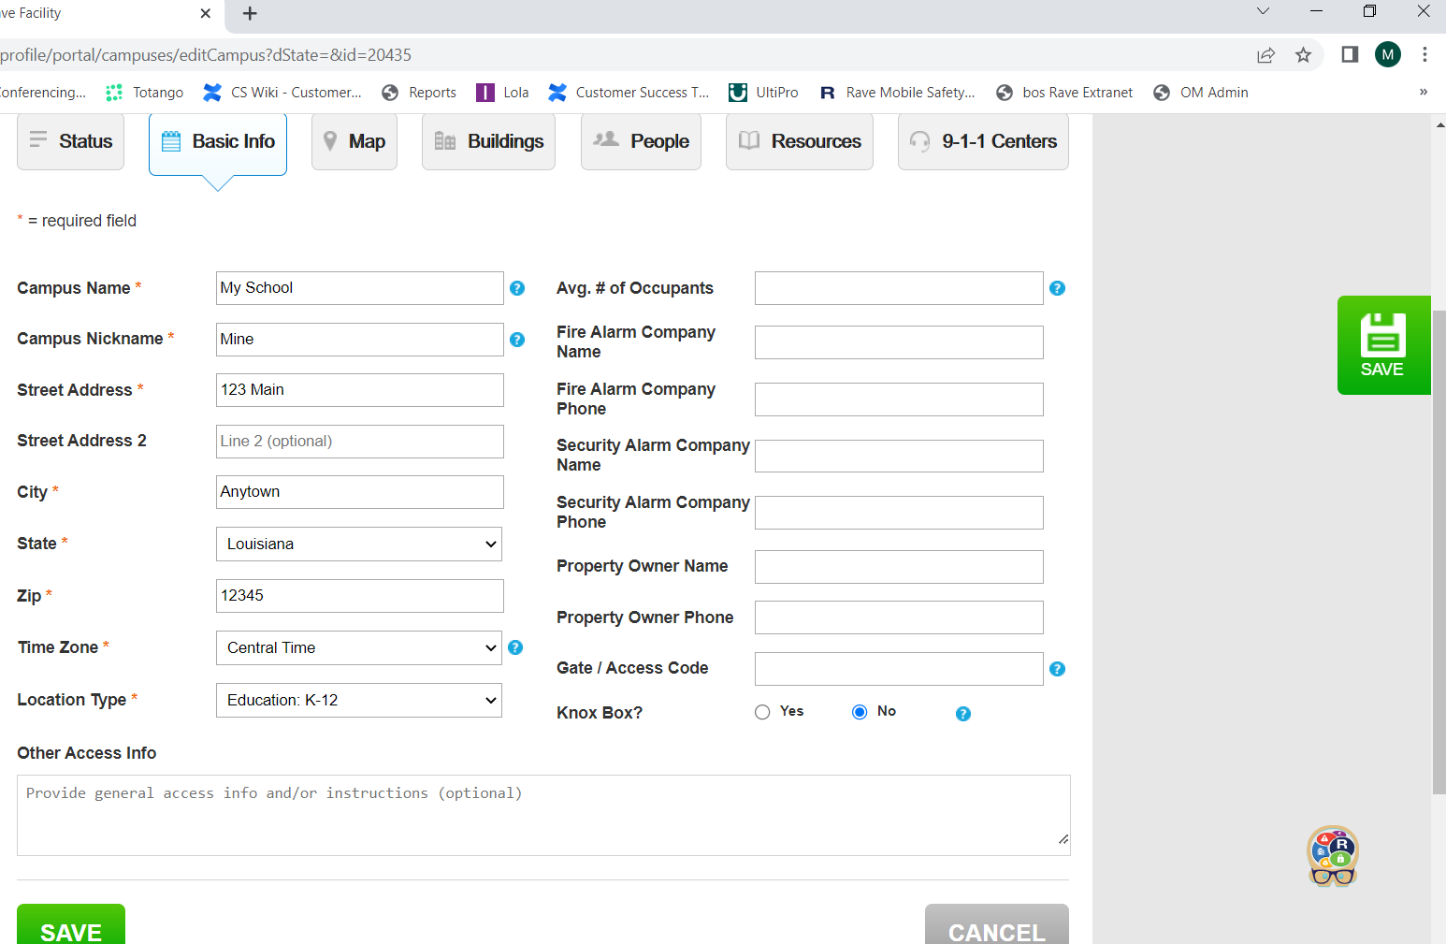
What can I do as a school administrator to assure that responders have the best and most updated info about my campus?
Complete the Panic Button Profile…

Slide 6
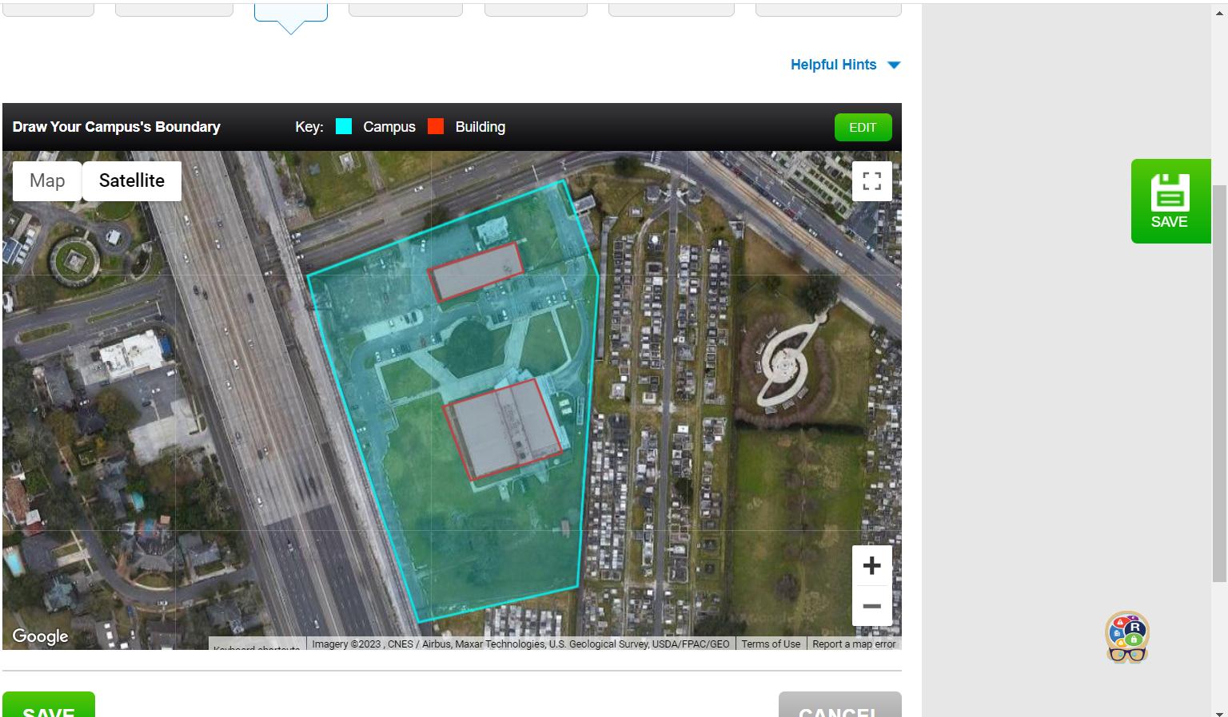
What can I do as a school administrator to assure that responders have the best and most updated info about my campus?
Geofence Campus Structures…

Slide 7
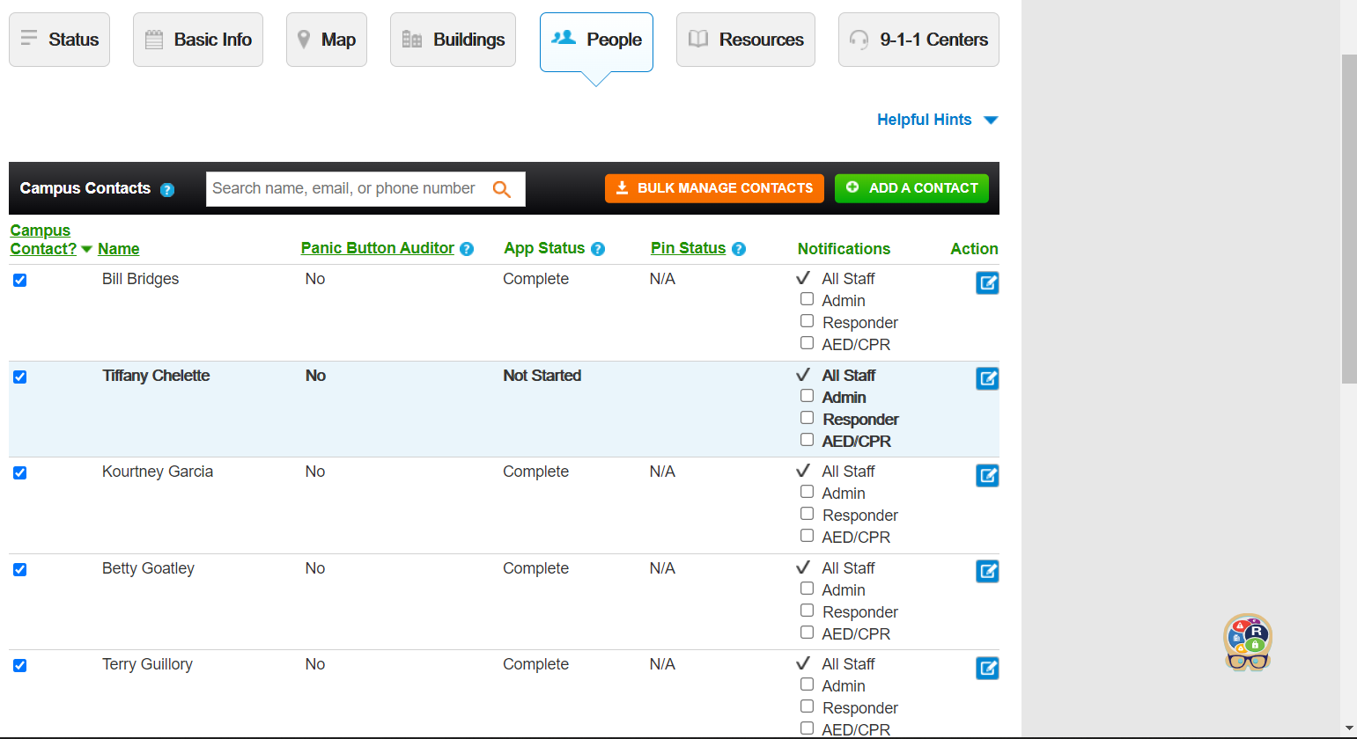
What can I do as a school administrator to assure that responders have the best and most updated info about my campus?
Update Users…

Slide 8
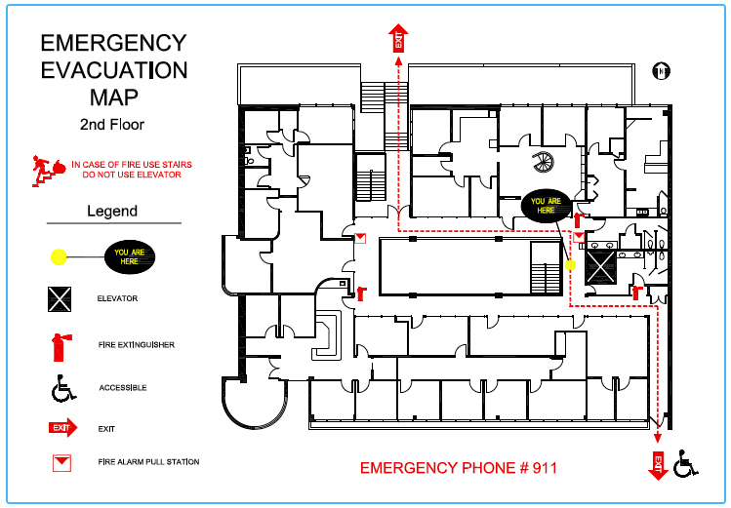
What can I do as a school administrator to assure that responders have the best and most updated info about my campus?
Upload Floor Plans…

Slide 9
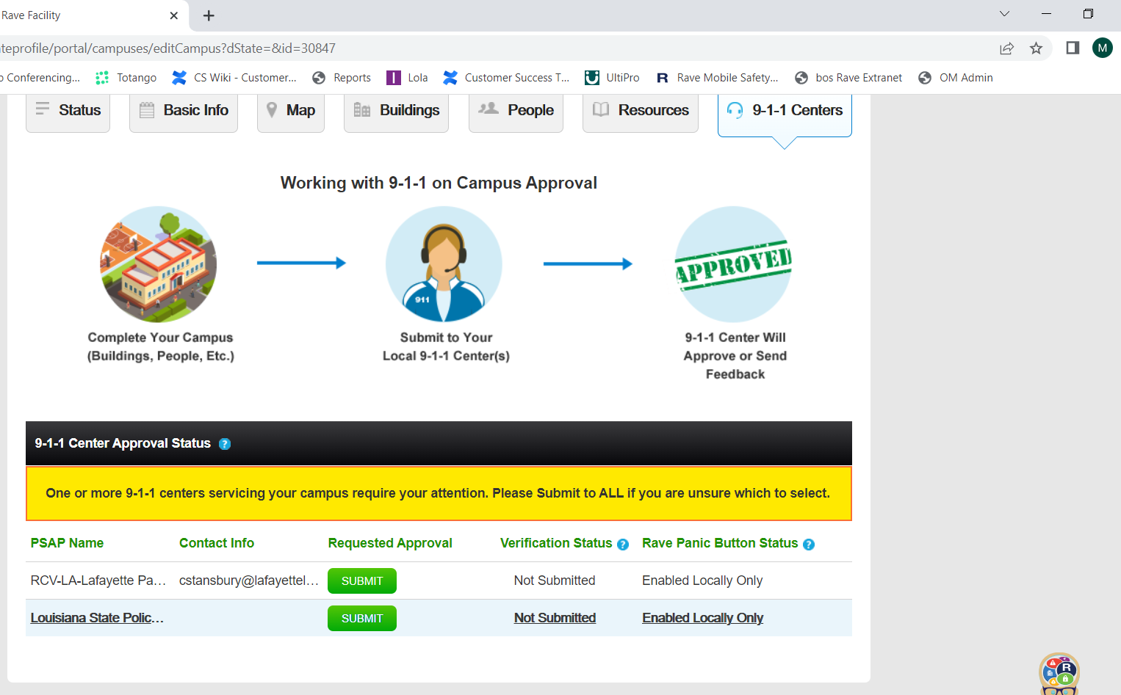
What can I do as a school administrator to assure that responders have the best and most updated info about my campus?
Submit Profiles to 911-Center…

Slide 10
How can panic button further support my school’s Emergency operation plan?
Whole-Community stakeholder approach to planning – incorporation of the Panic Button communication solution should be fully incorporated into the district & schools emergency response plan.
By learning the capabilities of the tool, improving the existing plan, and clarifying responsibilities & capabilities; the plan is revised, improved and more probable to be effective.

Slide 11
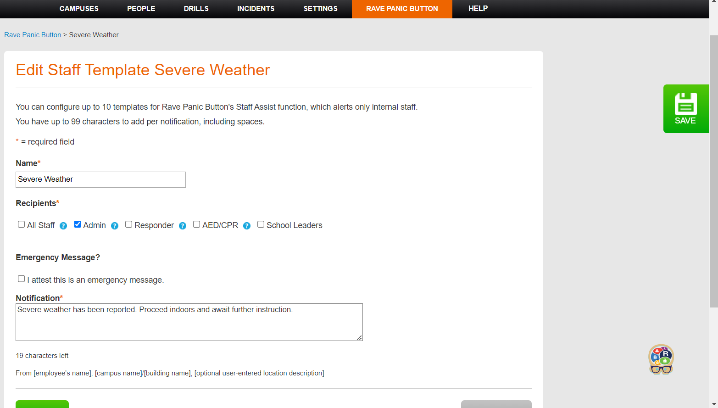
How can panic button further support my school’s Emergency operation plan?
Staff Assist templates allow schools to preload messages & streamline communications.
. Processes from the emergency operation plan can be included in messaging during planning & implementation.

Slide 12
How can panic button further support my school’s Emergency operation plan?
By geofencing both the campus & individual structures, Faculty, Staff & First Responders have an accurate location of any potential incidents on school grounds.
Providing complete, accurate information in the Panic Button profile, gives First Responders a clear picture of your campus and the challenges they might face.

Slide 13
What else can I do to make my campus safer?
Utilize Panic Button to Conduct Drills & Exercises.
Develop a relationship with your local 911-Center.
Get to know your local First Responders and include them in planning, drills & exercises.
Utilize Staff Assist on a regular basis to help faculty & staff to become familiar with Panic Button app.
Maintain Panic Button profile by regularly reviewing & updating information.
Maintain and update your Campus Emergency Operation Plan.
Plan, Practice and be Prepared!

Slide 14
Rave Panic Button
Empower School Safety in Louisiana
Mark Benton
Director, State of Louisiana
mbenton@ravemobilesafety.com
225-806-4273
Notes:
Presentation title slide contains title, subtitle, and optional author info.
Background can be customized to fit specific subject matter upon request.

