Slide 2
Youth Risk Behavior Surveillance System (YRBSS)
Question | Louisiana 2021 | United States 2021
Carried a gun | 9.9 | 3.5
Threatened or injured with a weapon on school property | 10.0 | 6.6
In physical fight | 29.3 | 18.3
Physical fight on school property | 9.0 | 5.8
Ever saw someone get physically attacked, beaten, stabbed, or shot in their neighborhood | 30.3 | 19.9
Bullied on school property | 18.5 | 15
Attempted Suicide | 17.6 | 10.2
Notes:
Set of surveys that track behaviors
Administered every other year
Measures health-related behaviors and experiences that lead to death and disability among youth and adults
Results monitor trends, identify emerging issues, and plan and evaluate programs that can help improve adolescent health

Slide 3
Student Perspective: School Safety and Mental Health
Vaishnavi Kumbala
Student at Haynes Academy

Slide 4
Student Perspective: School Safety and Mental Health
Served as a Leadership Team Member of the Louisiana Student Behavior, Mental Health, and Discipline Task Force
Represent District 1 on the Louisiana Legislative Youth Advisory Council
Student mental health is vital, especially given the stressors that many students face
Creating resources is important in order to support students
Oftentimes, there is a gap in accessibility for student mental health resources, as sometimes there are existing resources that are not widely known about
Noticed this as a student
Promoting resources more widely in accessible locations like schools, school websites, libraries, and counselors’ offices
Ensures more people can benefit

Slide 5
Student Perspective: School Safety and Mental Health
Supporting mental health is important in creating and maintaining safe school environments
Creating an atmosphere where students feel comfortable talking to teachers, school social workers, or other school officials about what may be on their minds
Voicing this support and letting students know their classroom is a safe space to talk
This can go a long way
Actively checking in with students

Slide 6
Saplings: Cultivate Happiness
In order to address student mental health in schools and help create healthier and safer school environments, I developed an app called Saplings
Mentioned in The Wall Street Journal, FEMA website, and ABC News
Provides a wide range of interactive, engaging wellness resources targeted towards teens
Used in schools through flyers in hallways and counselors’ offices, presentations, and assemblies
Working to bring Saplings into classrooms
Such as the Guiding Journaling feature being a bell-ringer activity at the start of English classes
Students being able to practice writing, while simultaneously engaging in an activity to de-stress and feel energized before the start of class.

Slide 8
Slides for Keesha Simmons start here - 3-5 slides per person please

Slide 9
Slides for start here Elnora Salone - 3-5 slides per person please

Slide 10
Restorative Practices: Another Tool to Solve Problem Behaviors & Heal Relationships in Schools

Slide 11
Restorative Practices (International Institute for Restorative Practices, IIRP)
Restorative Justice is theory of justice that emphasizes broken rules/laws as harm done to communities, and seeks to repair the harm and restore the relationship by bringing together those most affected by the wrongdoing to address the needs and responsibilities for making things right.
Restorative practices build, maintain, and repair relationships
Goal is to develop community and to manage conflict by repairing harm and restoring relationships
Restorative practices are proactive as well as reactive and serve to build relationships and shared school culture/climates in which all members of a school community feel valued and connected (students, teachers, parents, staff, etc).
Only 20% of a school’s restorative practices respond to conflict and inappropriate behavior. This approach cultivates a school climate in which negative interactions and destructive responses to behavior are less likely to occur.
Additional tools to other behavioral teaching approaches which can reduce ISS & OSS

Slide 12
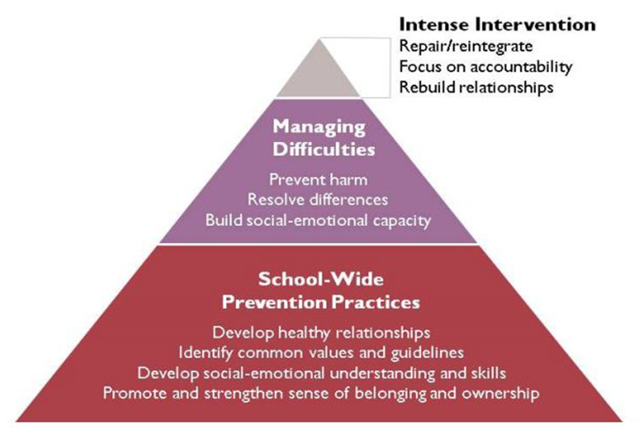
Levels of Restorative Practices

Slide 13
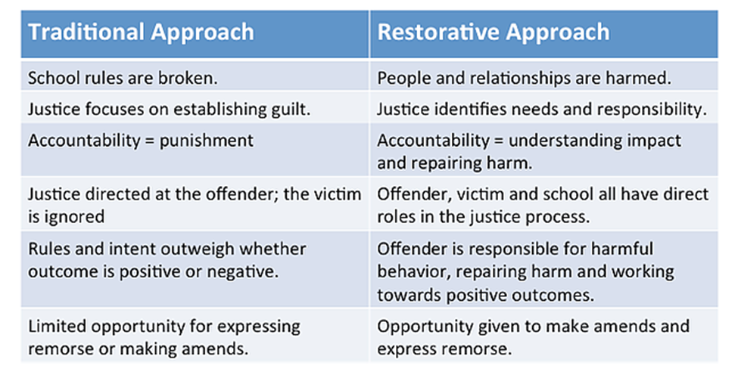
Traditional vs. Restorative Approach

Slide 14
Commitments & Benefits of Restorative Practices
Of the Region 1 schools trained in Restorative Practices, a small group are currently in their early stages of implementation (with fidelity) but are showing promising shifts in their qualitative and quantitative data (possible funding through School Climate Transformation grant).
Schools using Restorative Practices with fidelity in Region 1 have closed disproportionate minority contact gaps, increased 4-year graduation rates, successfully addressed truancy issues, and decreased suspension, expulsion, and arrests.
Success depends upon top-down support (at the district-level i.e. superintendent and school board, as well as school level i.e. principal and administration), a district/LEA-wide commitment to the work (putting Restorative Practices coordinators on-site at every school who is implementing), and allowing for the work to be slow (most schools need a one-year ramp-up period and 3-4 years of intense-support to become a restorative school site).

Slide 15
Brandon Wilks, LSSP, NCSP
Nationally Certified School Psychologist
PPSB Special Education Advisory Council (SEAC) Chair
Webmaster & Membership Chair, Louisiana School Psychological Association (LSPA)
Plaquemines Parish School Board
bwilks@ppsb.org
(504) 595-6070

Slide 16
School Based Mental Health Services In Lincoln Parish

Slide 17
PRE AND POST COVID RESPONSE TO MENTAL HEALTH
PRE-COVID
As a district the Lincoln Parish school board office has accepted and supported the need for increased mental health services for the past several years.
We have been tracking mental health data for over a decade and our procedures and training for risk assessments and mental health support have continued to grow.
Slowly, we have hired more and more qualified personnel to provide increased support in our schools. Partly, this was in response to requirements from LDOE and a documented need in our district.
Pupil Appraisal was heavily leaned on to provide mental health support by our school psychologists and social workers. Some school leaned on their guidance counselors as well, but not all schools have those in place.

Slide 18
PRE AND POST COVID RESPONSE TO MENTAL HEALTH
POST-COVID
As a district the decision was made by our superintendent to hire more qualified mental health counselors so we have a part time or full time presence at every school in our district.
LDOE also required that districts initiate Student Well-Being Committees and Student surveys assessing the mental health and well-being of students.
Pre-COVID we had 5 full time mental health professionals in our schools going to various schools to work with students.
Post-COVID 5 additional full time mental health professionals were hired.
There are 12 schools in the Lincoln Parish district - approximately 5600 students. 10.5 mental health counselors are in place to support the needs of our students (LPC’s or LCSW’s).
In addition, our district has 3 full time school psychologists, 1 school psychologist intern, and 2 social workers (LCSW’s) in Pupil Appraisal to offer additional support.

Slide 19
What else is Lincoln doing that may be different from other districts?
Panorama Education https://www.panoramaed.com/
Lincoln has utilized this tool for our student well-being surveys that we adminsiter 2-3 times per year to better understand where are students are coming from and what they are dealing with.
The teacher completed surveys for students grades K-2 focus on:
Grit, Self-Management, Self-Awareness, Self-Efficacy, Learning Strategies, Classroom Effort, Social Perspective-Taking, Emotional Regulation & Engagement
The student completed surveys for students grades 3-12 focus on:
School Climate/Safety
Challenging Feelings/Emotional Regulation/Supportive Relationships
Once survey data is collected and analyzed (average completion rate for 22-23 was 83%) threat assessments are conducted, individual and small group referrals for counseling are made, as well as data based decisions around prescribed Social Emotional Learning (SEL) for students based on their answers to the surveys.

Slide 20
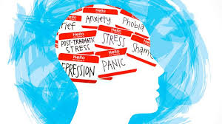
Student Well-Being and Positive Behavior Intervention Support (PBIS)/Multi-Tiered Support Systems (MTSS)
In Lincoln we have paired these two LDOE requirements and made one committee at every school to ensure we have the right individuals looking at discipline data and brainstorming about what tier of support a student may need.
We are working hard to be creative and think outside of the box when it comes to positively supporting appropriate student behaviors while giving the students the tools they need to navigate the school environment both academically and socially.
This committee is viewed as the School Building Level Committee (SBLC) for Behavior.

Slide 21
Mental Health Counselor Role
The role of the Mental Health Counselor (MHC) is different than that of any other in the district. As a result, a new job description was written specifically for that position.
The MHC is expected to: (these are just a few of the expectations)
Conduct threat assessments (but they are not the only ones on campus who conduct these assessments - a team is trained at every school)
Provide individual and small group counseling
Provide Social Emotional Learning (SEL) to classes and prescribed groups on their campus
Help with crisis situations
Expected to have a digital presence - some have a page on the school’s webpage, a Google Classroom where SEL lessons are pushed out, QR codes have been developed for students to request time with the MHC, and more

Slide 22
Becky Stutzman, LCSW-BACS, C-SSWS
School Social Worker
Pupil Appraisal/Mental Health Coordinator
Lincoln Parish Schools
Ruston, LA
rstutzman@lincolnschools.org
318-255-8451 ext. 2141

Slide 23
School-Based Health Centers
Supporting Student Mental Health and School Safety

Slide 24
Adolescent School Health Program:
School-Based Health Centers
•Screen for Risky Behaviors
•Psychosocial Evaluations
•Develop Treatment Plans
•Individual Counseling
•Group Counseling
•Family Counseling
•Refer students with greater needs
•Annual Exams
•Sports Physicals
•Illness and Injury
•Immunizations
•Management of Chronic Conditions
•STI Testing
•Abstinence Counseling
•Preventive Health Screenings
Notes:
The Adolescent School Health Program facilitates and encourages the operation of School-Based Health Centers (SBHCs). SBHCs offer medical and behavioral health services and are located on the campus of schools in communities where students have the highest needs. SBHCs are open during school hours and provide services without a direct charge to the family. Parental Consent is required.

Slide 25
The CDC’s Categories of Youth Risk Behavior
•Behaviors that contribute to unintentional injuries and violence.
•Sexual behaviors related to unintended pregnancy and sexually transmitted infections, including HIV infection.
•Alcohol and other drug use.
•Tobacco use.
•Unhealthy dietary behaviors.
•Inadequate physical activity.
Notes:
The YRBSS developed in 1990 to monitor health behaviors that contribute markedly to the leading causes of death, disability, and social problems among youth and adults in the United States.

Slide 26
Screening for Risk in SBHCs
What: Valid and reliable screening instrument
When: During annual well child visit, upon referral for behavioral health services
Why: Identify risk behaviors
Possible Solutions
Refer students to the SBHC prior to suspension/expulsion
Refer students to the SBHC with frequent absenteeism
Utilize SBHC behavioral health provider to share information with students about the services
Utilize SBHC behavioral health provider during crisis

Slide 27
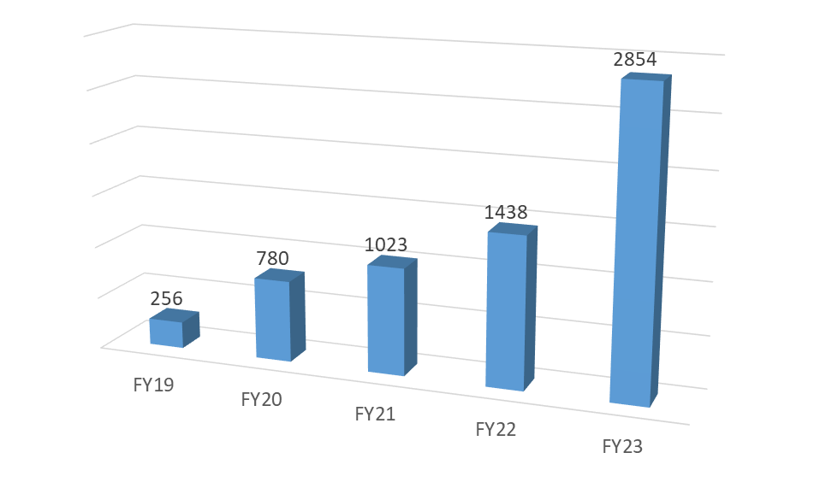
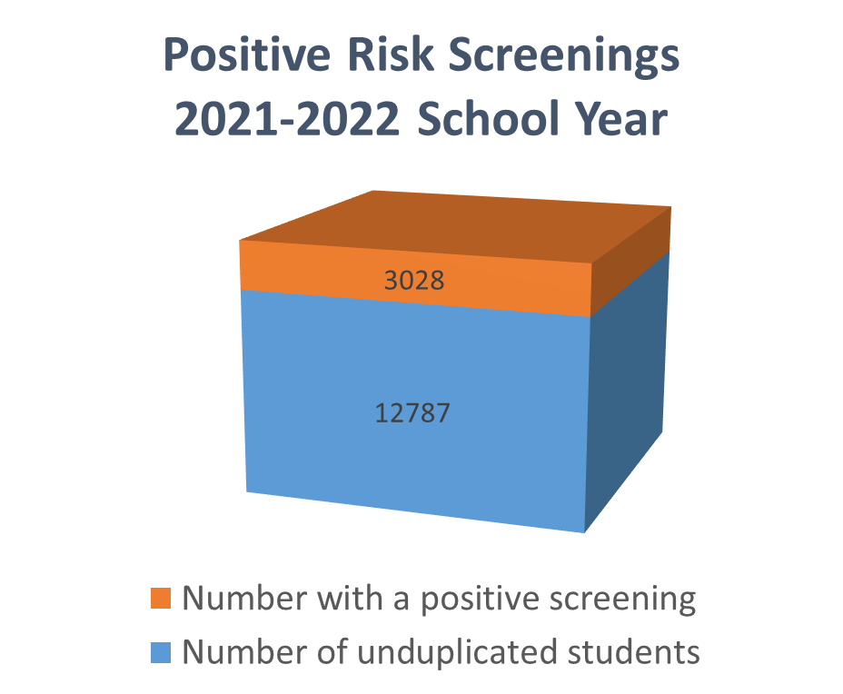
Risk Screening Data
FY 23 totals as of 5/10/23
Notes:
Each SBHC affiliated with OPH is required to select a risk screening tool. Five SBHCs have participated in a pilot study using the Rapid Adolescent Prevention screeners or RAAPS. RAAPS screenings are standardized, screening tools used to assess risk behaviors in students. Through use of a computer or tablet, students answer approximately 20 questions related to the six CDC risk categories. The students answers are reviewed and discussed. If the students answers result in a positive score (risk are identified) the behavioral health provider offers intervention services. In addition to providing services to individual students, SBHC staff are encouraged to share aggregated data with school principals. The aggregated data can provide a snap shot of the risk prevalent in the student population. In collaboration with the school administration and school staff the behavioral health provider can provide training to staff, information to the student body and work to develop strategies to increase awareness of mitigation strategies among the student body. As you can see the number of risk screenings conducted at the 5 SBHCs has increased since 2019, currently these programs are on track to double the number of risk screening conducted last year. The increase in screenings is the result of increase behavioral health needs among adolescents. Last year 24% of the students screened using the RAAPS had a positive risk screening.

Slide 28
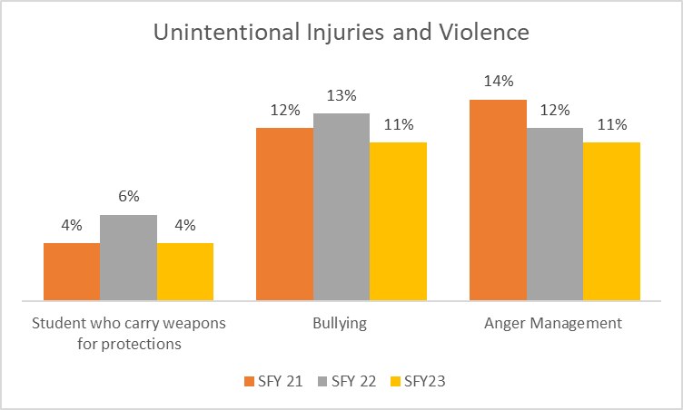
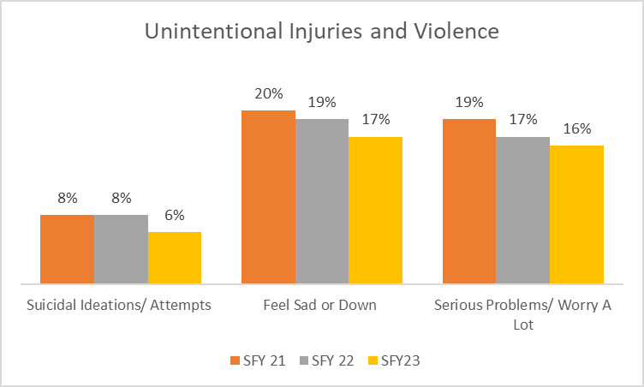
Risk Screening Data

Slide 29
Adolescent School Health Program
Faith Boudreaux M.Ed.; Program Manager
Faith.Boudreaux@LA.gov Contact #: 504.568.8164

