Slide 2



Presenters

Slide 3
Agenda
Suicide trends in Louisiana
Youth Risk Behavior Survey
Risk Factors and Warning Signs
AFSP Model School District Policy
AFSP After a Suicide: A Toolkit for Schools
Resources

Slide 4
Louisiana State Suicide Trends

Slide 5
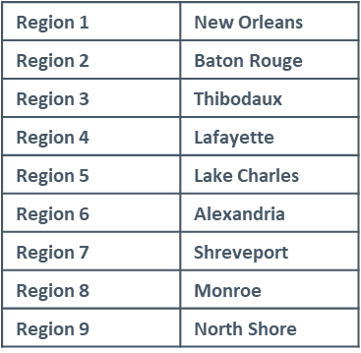
Suicide Rates by Region

Slide 6
Suicide Rates for ages 10+

Slide 7
Suicide Rates by Age Group

Slide 8
Means and Method

Slide 9
Syndromic Surveillance
A system for detecting, understanding, and monitoring health events in near-real time
Uses pre-diagnostic data from emergency departments to detect unusual trends in symptoms
Louisiana Office of Public Health collects data from 89% of emergency departments accounting for 96% of ER visits statewide

Slide 10
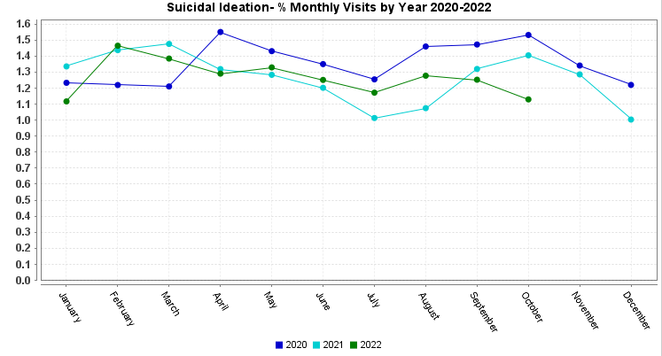
Syndromic Surveillance

Slide 11
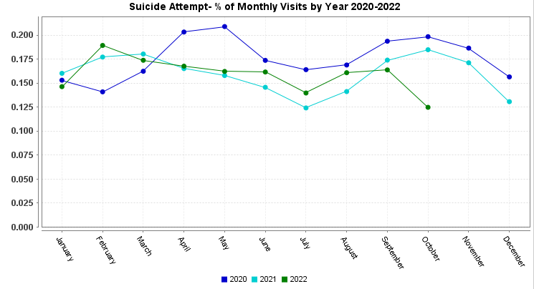
Syndromic Surveillance

Slide 12
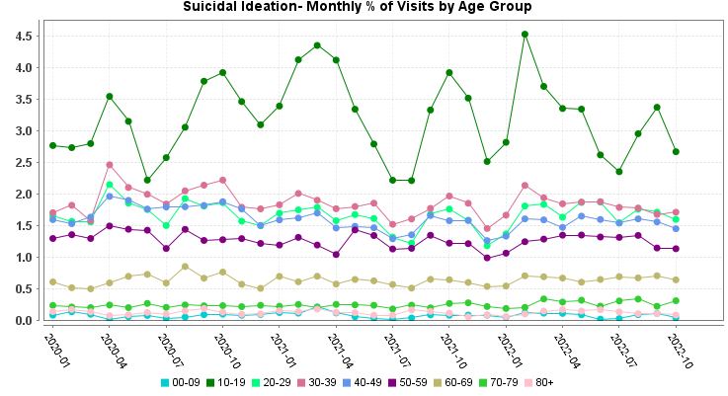
Syndromic Surveillance

Slide 13
Syndromic Surveillance

Slide 14
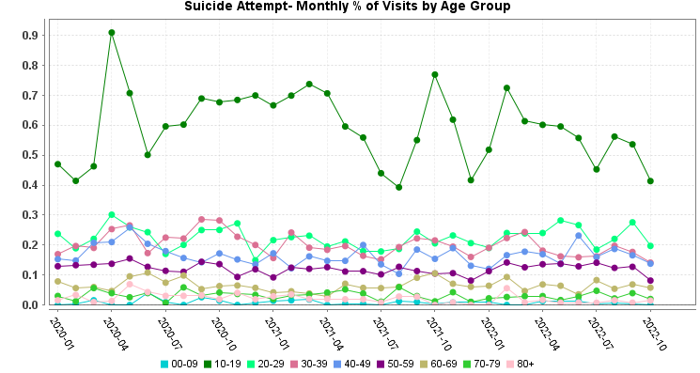
Syndromic Surveillance

Slide 15
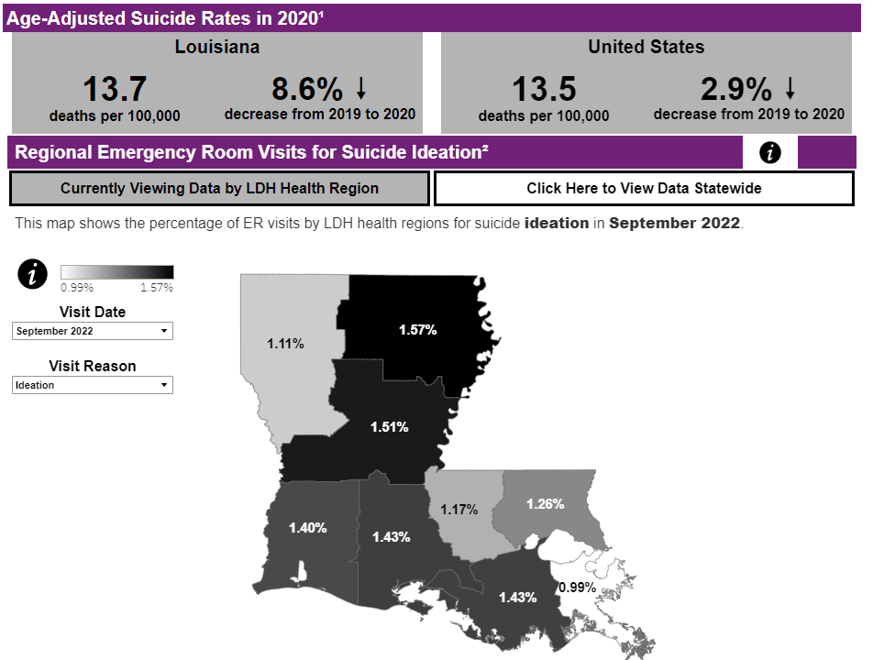
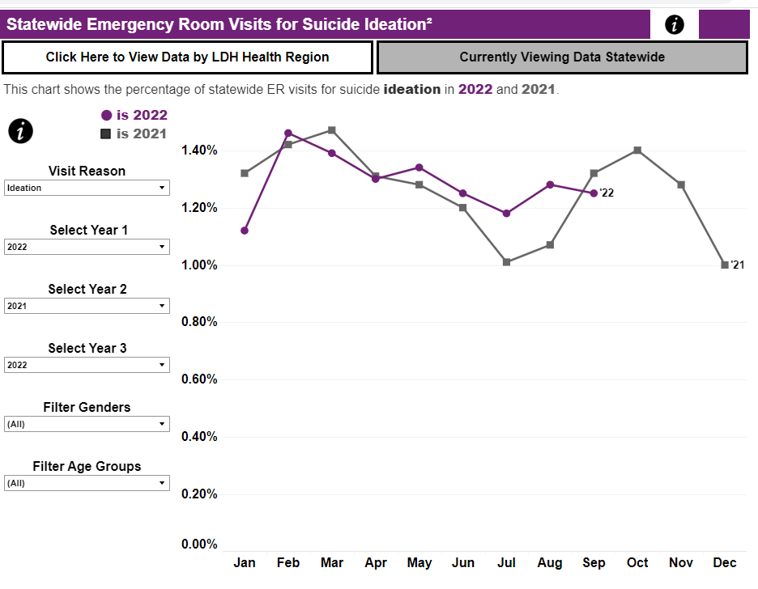
National Syndromic Surveillance Dashboard for Nonfatal Suicide Trends

Slide 16

Youth Risk Behavior Surveillance System (YRBSS)
CDC’s Youth Risk Behavior Surveillance System (YRBSS) monitors health behaviors and experiences among high school students across the country.
The Youth Risk Behavior Survey (YRBS) results help in understanding the factors that contribute to the leading causes of illness, death and disability among youth.

Slide 17
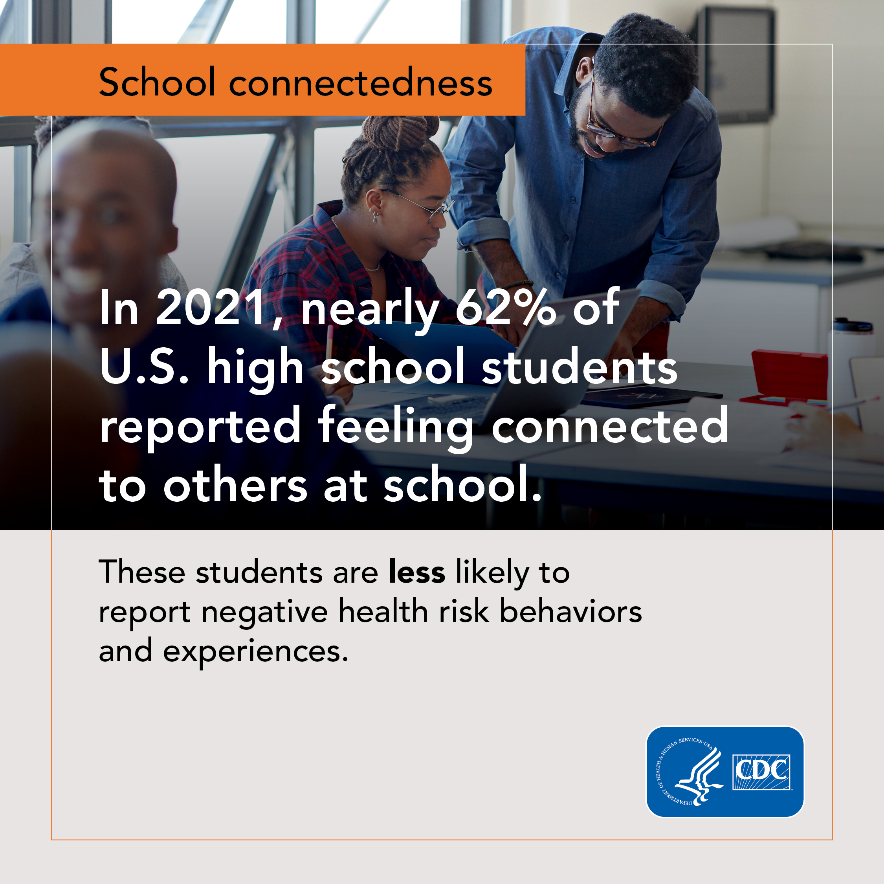
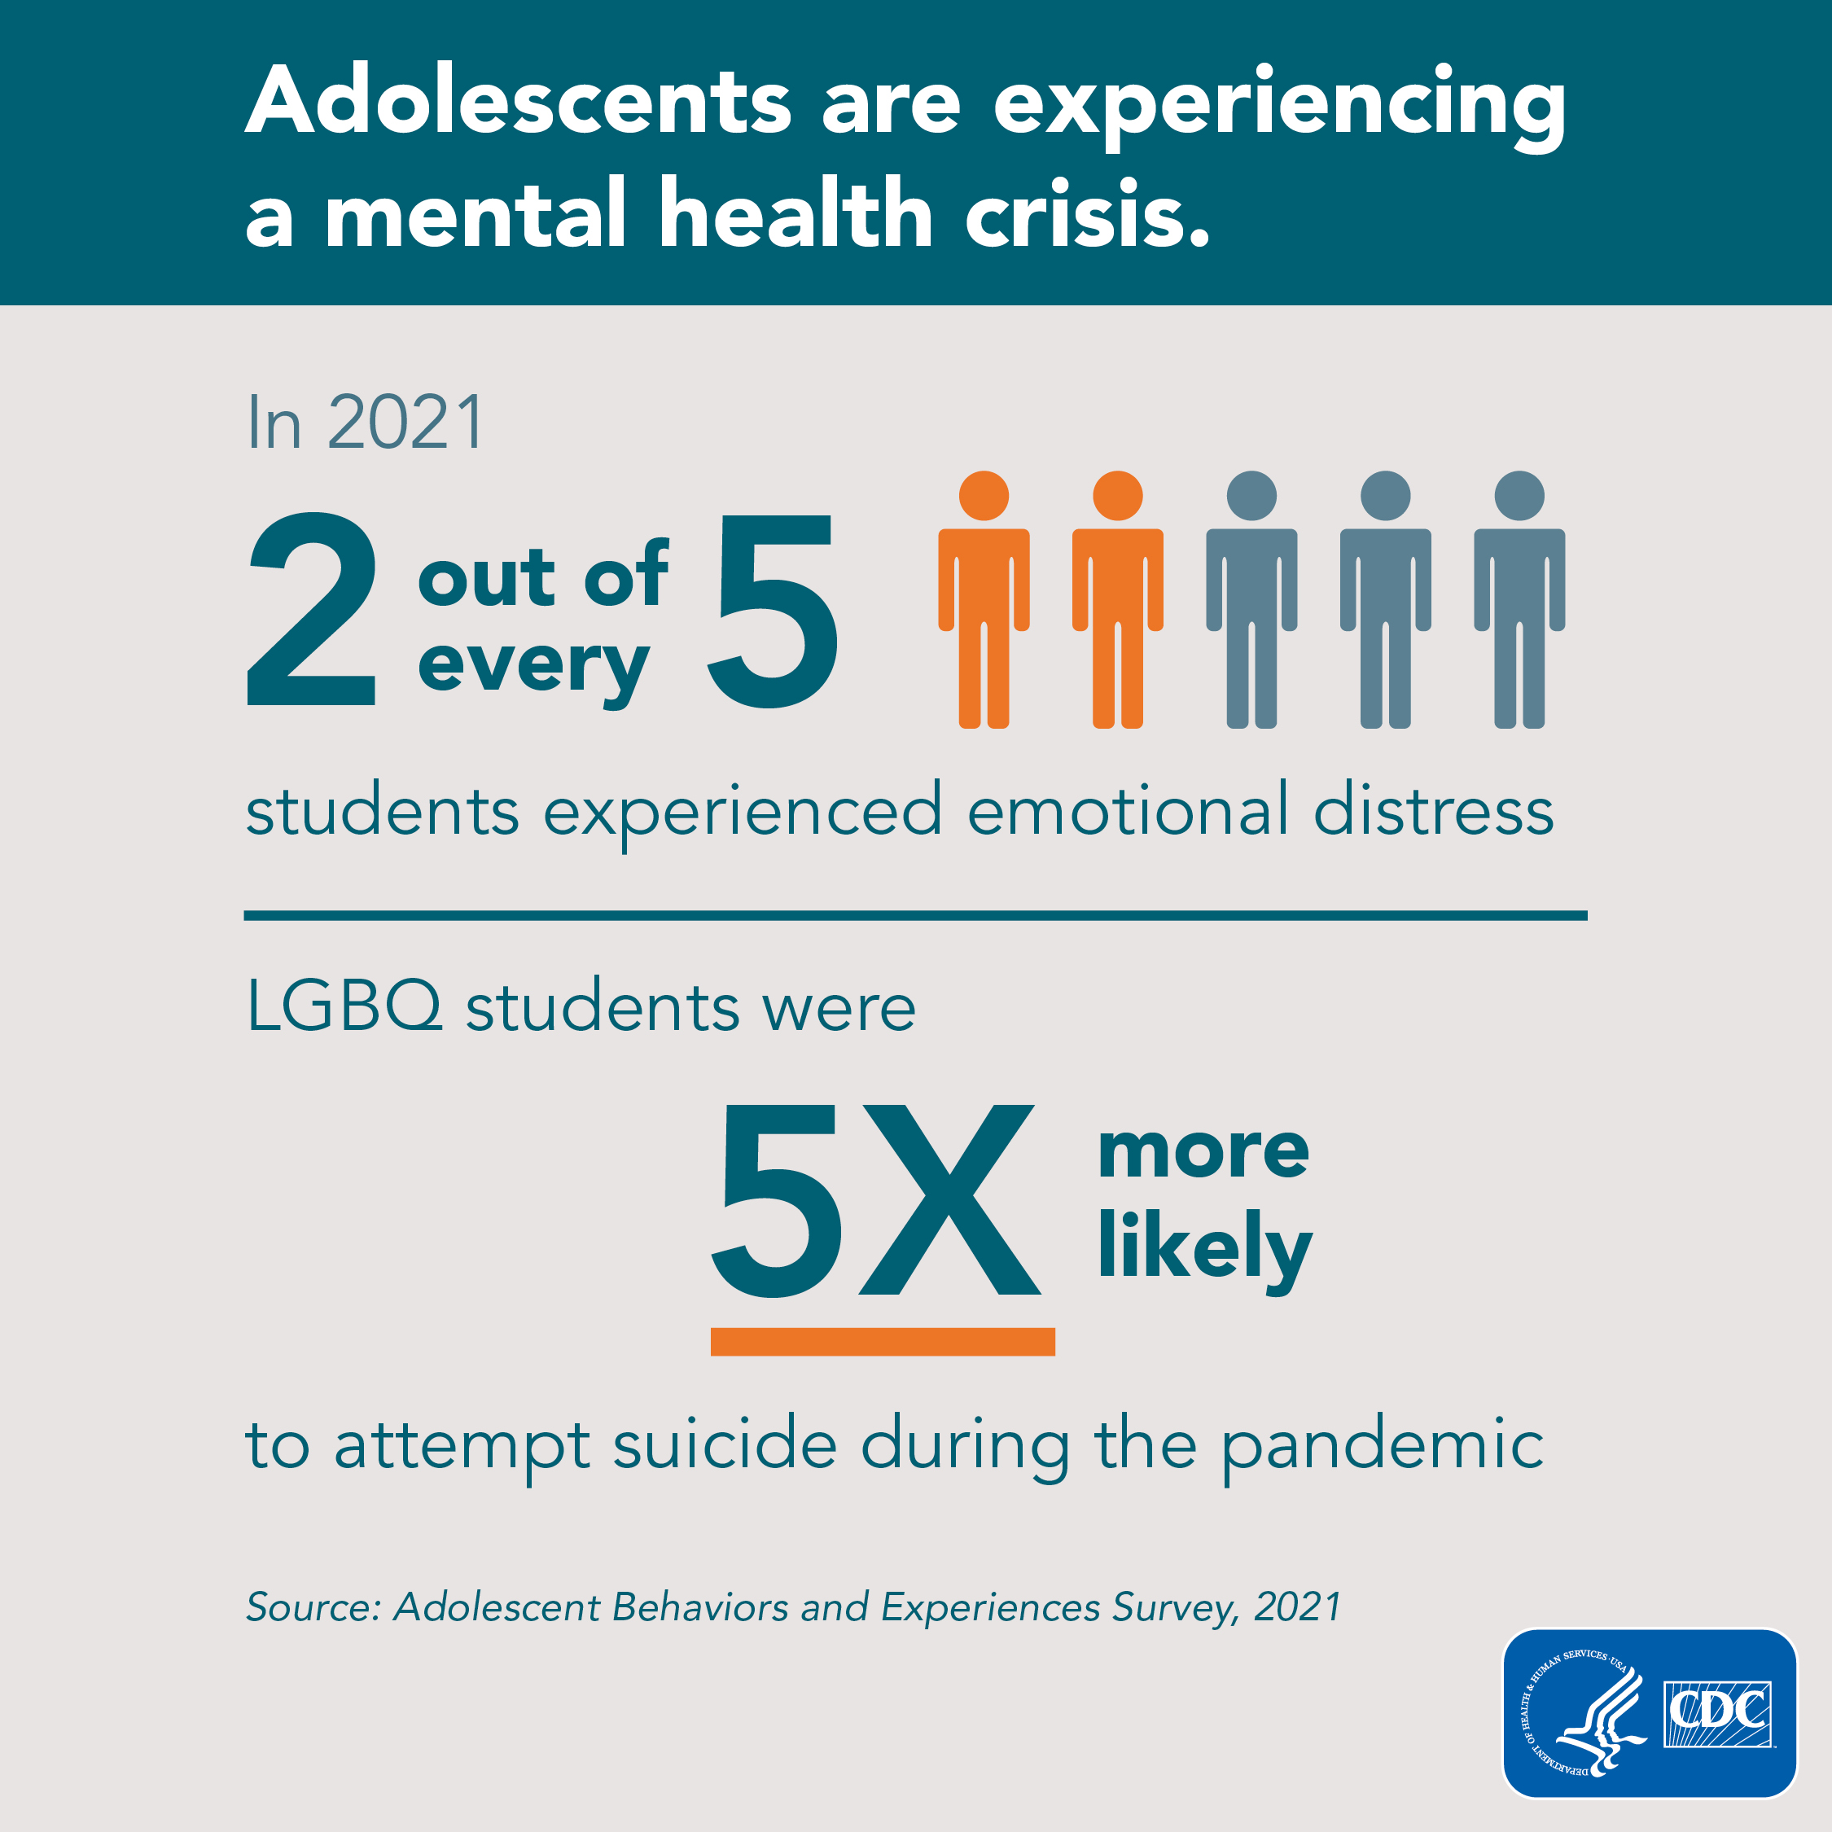
2021 Youth Risk Behaviors Survey

Slide 18
2021 Youth Risk Behavior Survey Results – Suicidal Ideation & Attempts
Question Total Female Male
Felt sad or hopeless (almost every day for 2 or more weeks in a row so that they stopped doing some usual activities, during the 12 months before the survey) | 42.3 (41.0–43.7) 16,961 | 56.6 (54.6–58.5) 8,044 | 28.6 (27.1–30.0) 8,670
Seriously considered attempting suicide (during the 12 months before the survey) | 22.2 (21.1–23.3) 16,927 | 30.0 (28.5–31.4) 8,010 | 14.3 (13.3–15.4) 8,674
Made a plan about how they would attempt suicide (during the 12 months before the survey) | 17.6 (16.4–19.0) 16,321 | 23.6 (22.1–25.1) 7,729 | 11.6 (10.5–12.8) 8,350
Actually attempted suicide (one or more times during the 12 months before the survey) | 10.2 (9.4–11.0) 15,573 | 13.3 (12.0–14.7) 7,462 | 6.6 (5.8–7.5) 7,885
Suicide attempt resulted in an injury, poisoning, or overdose that had to be treated by a doctor or nurse (during the 12 months before the survey) | 2.9 (2.5–3.4) 12,083 | 3.9 (3.1–4.8) 5,766 | 1.7 (1.4–2.0) 6,137

Slide 19
Risk Factors
Health
  Mental Health Conditions
  Serious or Chronic Health Conditions and/or Pain
  Traumatic Brain Injury
Historical
  Previous attempts
  Family history of suicide
  Childhood abuse, neglect, or trauma

Slide 20
Risk Factors
Environmental
  Access to lethal means
  Prolonged stress
  Stressful life events
  Exposure to another person's suicide

Slide 21
Warning Signs
Talk
  Speaking about suicide or killing oneself
  Feeling hopeless
  Having no reason to live
  Being a burden
  Feeling trapped or
  Unbearable pain

Slide 22
Warning Signs
Behavior
  Increased use of substances
  Searching for a way to kill oneself
  Withdrawing from activities
  Isolation
  Issues with sleep
  Visiting or calling people to say goodbye
  Giving away possessions
  Aggression
  Fatigue

Slide 23
Warning Signs
Mood
  Depression
  Anxiety
  Loss of interest
  Irritability
  Humiliation
  Agitation
  Rage

Slide 24

AFSP Model School District Policy
Contributing Groups: AFSP, American School Counselor Association, National Association of School Psychologists, and the Trevor Project
Parental Involvement
Safe Messaging
Model Language, Commentary and Resources
Prevention and Intervention
Procedures for navigating attempts and deaths
Sample language for student handbooks

Slide 25
AFSP Model School District Policy – Key Takeaways
Appointment of district-level suicide prevention coordinator, who along with building principal is responsible for policy coordination and implementation
Designation of school-based coordinator as point of contact
Emphasis on staff professional development
Importance of staff reporting students they believe are at risk to coordinator or appropriate school-based health professional

Slide 26
AFSP Model School District Policy – Key Takeaways
Assessment and referral to occur in a timely manner (within same school day)
Parental/guardian notification occurs on same school day or as soon as possible once student risk is identified
Lethal means counseling guidance provided
Re-entry procedure for students returning to school after a mental health crisis

Slide 27
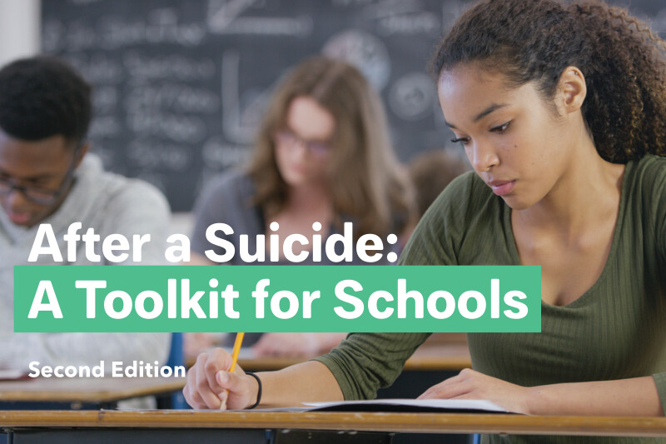
AFSP’s After a Suicide: A Toolkit for Schools
Crisis response
Helping students cope
Working with the community and media
Memorialization
Suicide contagion
Bringing in outside help

Slide 28
AFSP’s After a Suicide: A Toolkit for Schools – Key Takeaways
School staff immediately confirm death of a student
Implement crisis response to:
  Safely and effectively manage situation
  Provide opportunities for grief support
  Maintain an environment focused on normal educational activities
  Help students cope with their feelings
  Minimize the risk of suicide contagion

Slide 29
AFSP’s After a Suicide: A Toolkit for Schools – Key Takeaways
Mobilize the Crisis Response Team
The Crisis Response Team coordinator is usually the principal.
The team coordinator:
  Has overall responsibility throughout the crisis
  Is the central point of contact
  Monitors overall postvention activities throughout the school
  Handles communications with the different groups of people within the school (e.g., administration, staff, students, and parents) and the media

Slide 30
AFSP’s After a Suicide: A Toolkit for Schools – Key Takeaways
Get the facts
Plan for unconfirmed deaths
Family disclosure
Sharing the news within the School Community
Addressing cultural diversity
  Be aware that the extent to which people are able to talk about suicide varies greatly, and in some cultures suicide is still seen as a moral failing.
  Be sensitive to the beliefs and customs regarding the family and community, including rituals, funerals, the appropriate person to contact, etc.

Slide 31
AFSP’s After a Suicide: A Toolkit for Schools – Key Takeaways
Addressing cultural sensitivity continued:
  Be sensitive to how the family or community may need to respond to the death before individuals outside of the family or community intervene to provide support.
  Engage a “cultural broker” to act as a liaison between the family, community, and school if key members of school staff are not from the same racial, ethnic, or religious group as the person who died by suicide.
  Bring in interpreters and translators if there are language differences. If possible, have resource materials in different languages available for parents.

Slide 32
AFSP’s After a Suicide: A Toolkit for Schools – Key Takeaways
Addressing cultural sensitivity continued:
  Be sensitive to how the family or community may need to respond to the death before individuals outside of the family or community intervene to provide support.
  Engage a “cultural broker” to act as a liaison between the family, community, and school if key members of school staff are not from the same racial, ethnic, or religious group as the person who died by suicide.
  Bring in interpreters and translators if there are language differences. If possible, have resource materials in different languages available for parents.

Slide 33
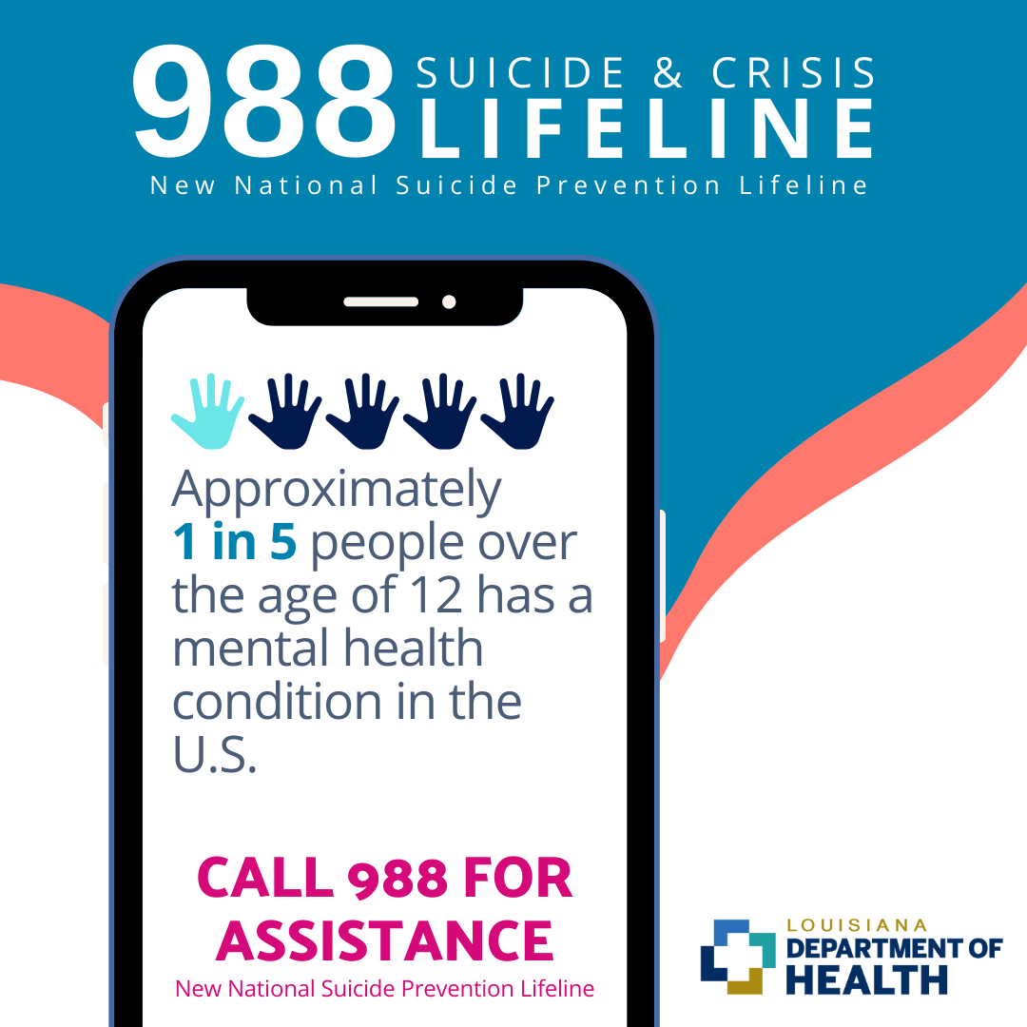
Crisis Resources: 988 National Suicide and Crisis Lifeline
National Suicide & Crisis Lifeline
Text or Call 988
Available at no-cost 24/7
Trained counselors answer calls
VIA Link & Louisiana Association on Compulsive Gambling
988lifeline.org

Slide 34

Crisis Resources: 741-741 Crisis Text Line
Crisis Text Line
Text HELLO, HELP, etc. to 741-741
Available at no-cost 24/7
Trained counselors answer calls
Crisistextline.org

Slide 35
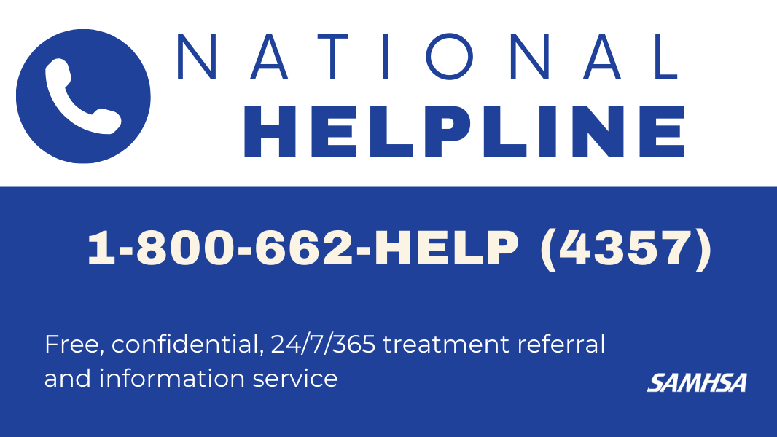
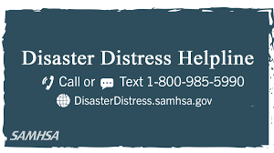
Crisis Resources: SAMHSA
SAMHSA National Helpline
1-800-662-HELP (4357)
24/7, free, confidential
For those facing mental and/or substance use disorders
SAMHSA National Disaster Distress Line
1-800-985-5990 call or text
Immediate support for human-caused or natural disasters
24/7, free, confidential

Slide 36



Additional Resources
The Trevor Project
TrevorLifeline: 1-866-488-7386
Text START to 678-678
TrevorChat: thetrevorproject.org
Seize the Awkward
seizetheawkward.org @seizetheawkward
notOK App
notokapp.com

Slide 37
Additional Resources
American Foundation for Suicide Prevention
afsp.org/Louisiana or 504-220-6100
Baton Rouge Crisis Intervention Center
brcic.org or 225-924-1431
Louisiana Department of Health
Office of Behavioral Health and Office of Public Health
Ldh.la.gov or (225) 342-2540

Slide 38
Thank you!

Slide 39
Thank you!

