Slide 1

2018 School Performance Scores

Slide 2

2017-2018 School Performance Scores

Slide 3
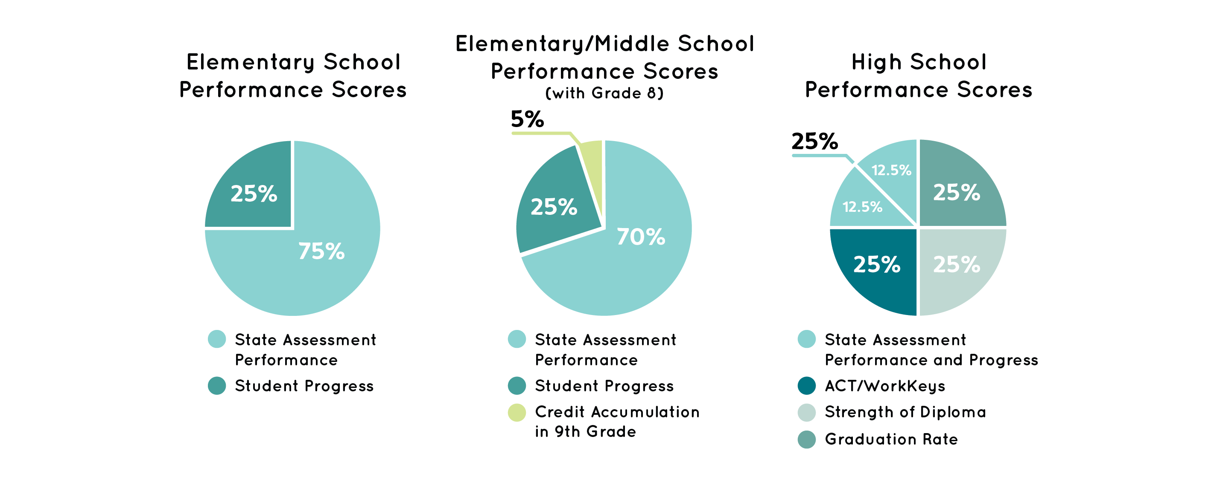
2017-2018 School Performance Score Formulae

Slide 4
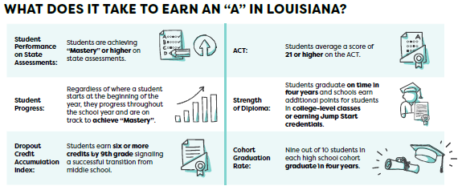
Improvements to Louisiana’s Accountability System:
Raising the Bar
The 2017-2018 school performance score calculation will represent three critical shifts in the design of Louisiana’s accountability system as a result of the Every Student Succeeds Act.
The first shift is in ensuring that by 2025 an “A” in Louisiana’s letter grade system signals mastery of fundamental skills.

Slide 5
Improvements to Louisiana’s Accountability System: Rewarding Student Progress
The second critical shift in the school accountability formula will now value the progress of every individual child through the new Student Progress Index.
The progress index measures how well students, regardless of where they start at the beginning of the year, are progressing towards “Mastery” throughout the year, and rewards schools for this growth.
Schools earns an ‘A’ in the progress index for any student who:
is on track to reach “Mastery” (or “Advanced”) by the 8th grade (or 10th grade for high schools); or
scores higher than expected based on the scores of other students similar to them.

Slide 6
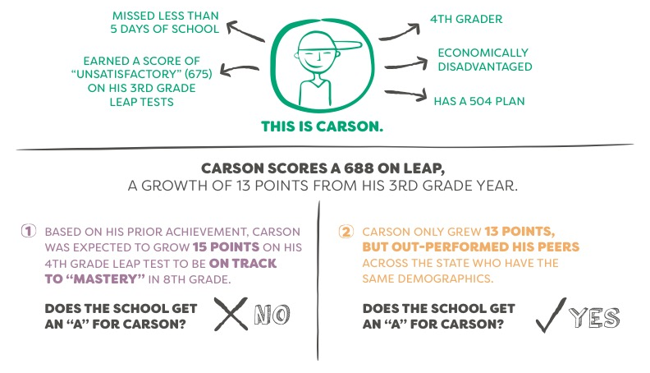
Student Progress Measure Example

Slide 7
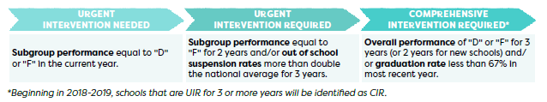
Improvements to Louisiana’s Accountability System: Transparent Reporting and Support for Struggling Students
The third shift in this year’s accountability system, and a component of Louisiana’s Every Student Succeeds Act (ESSA) plan, is that any school identified under one of the following intervention labels will be required to submit an improvement plan to the Department, and an application for funding to support its implementation.
These labels will appear on the “Overall Performance” page in the Louisiana School Finder.

Slide 8
2018 School Performance Score Resources
The Department has provided training to school and school system leaders and teachers at the Teacher Leader Summit this summer and at the September collaborations on these updates to the accountability system.
Audience | Resources
School Leaders | 2017-2018 Accountability Policy Update and Report Card Preview (Sept Collaboration) Early Childhood performance updates and improvement strategies: (TL Summit Sessions: E008, E009, E010, E017, E019, E021, E023, E024, E040, E046, E056, E057, E068, E017) Using the School Performance Score Calculator (Sept Collaboration)
Teachers | Using Measures of Student Progress to Strengthen Practice and Increase Learning (TL Summit) Deliberately Addressing Student Growth to Mastery (TL Summit) Mastery or Growth (TL Summit)

Slide 9
Reporting School Performance Scores

Slide 10
Louisiana School Finder
ESSA provides Louisiana with an opportunity to collaborate with educators, parents, business leader, and community leaders to create and report on an improved K-12 education system.
In order to provide families with information on school progress towards improving student performance and opportunities, the Department released the Louisiana School Finder (www.louisianaschools.com) last year in conjunction with the release of the 2016-2017 school performance scores.
While last year’s results only reported on the indices from the previous accountability system, this year’s results in School Finder will include the new Student Progress measure, as well as FAFSA submissions for high schools, and teacher attendance data.

Slide 11
Louisiana School Finder Data Collection
School information included in the Louisiana School Finder is pulled from data reported by school systems to the Department or from verified school accountability results.
School name, address, phone number, grade configuration: Verified in Sponsor Site
Website, social media, clubs and sports: Verified in Sponsor Site
Principal name: Reported in PEP in 2017-2018
Academic offerings and music/art: Reported in CUR/SIS/PEP in 2017-2018
Student-to-device ratio: Reported in January 2018 Technology Readiness Tool
Enrollment, discipline and attendance: Reported in SIS in 2017-2018
Academic performance: Verified accountability results
For additional information, please refer to the Louisiana School Finder Data Guide.

Slide 12

Louisiana School Finder Data Refresh
Since January 2018, the Department has completed monthly updates of the ABOUT OUR SCHOOL information in the School Finder to reflect any changes made in Sponsor Site by the end of the prior month. Additionally, principal names and course offerings were updated in January following Fall 2017 PEP, CUR, and SIS reporting.
Please reference the Louisiana School Finder Data Guide for additional information on data sources. Contact systemsupport@la.gov with any questions.
Data Source | School Finder Sections | Refresh Timeline
Sponsor Site | Website, social media, clubs and sports | Monthly
Sponsor Site | Address, phone #, grade configuration | Fall release
PEP | Principal name | January & Fall release
CUR/PEP/SIS | Academic offerings (AP, DE, foreign languages), music/art offerings | January

Slide 13
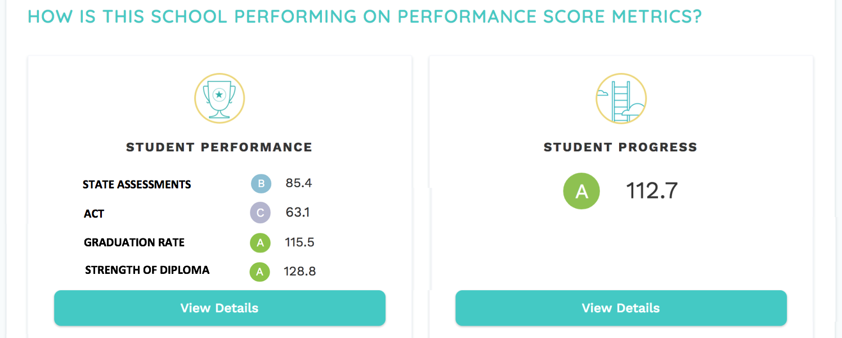
New to School Finder:
Student Performance vs Student Progress
The Department will report letter grade equivalents for student performance and progress. Based on feedback from school system leaders, high school report cards will include a letter grade equivalent for each of the four key indices.
These letter grade equivalent ratings will also be available in the public data files posted to the Department’s website.
Notes:
USE THIS SLIDE TO SHOW HOW YOUR SCHOOL PERFORMED IN OUTRIGHT STUDENT PERFORMANCE AND STUDENT PROGRESS.
Example talking point: Here you will see that while overall, we have some work to do to ensure that our students are mastering the keys skills they need to move on to the next grade as shown in our student performance score, they are improving at significant rates throughout the year as represented in our student growth score.

Slide 14
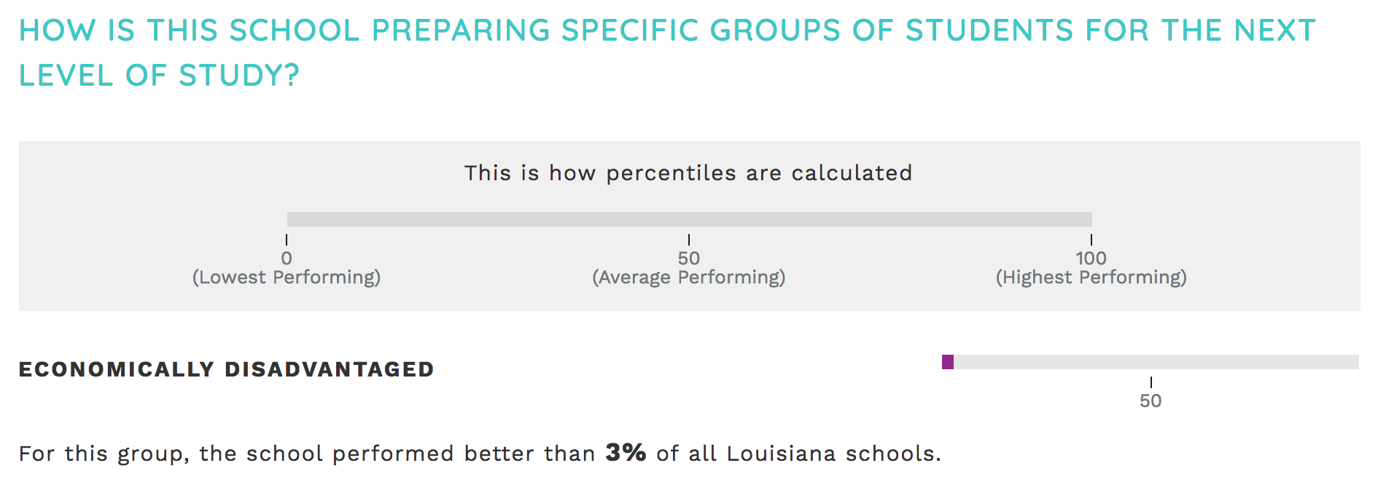
New to School Finder:
Urgent Intervention Required Labels
Schools will receive an “Urgent Intervention Required” label in School Finder and will be required to submit a school improvement plan to the Department if:
the performance of one or more subgroups is equivalent to an “F” for two years or more; or
they have an out-of-school suspension rate that doubles the national average for three consecutive years.
  PK-4 OSS rate exceeds 5.2% for three years, and/or
  5-12 OSS rate exceeds 20.2% for three years
URGENT INTERVENTION REQUIRED>

Slide 15
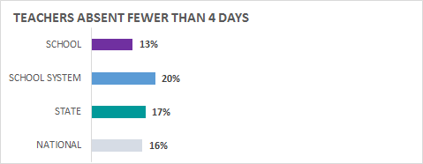
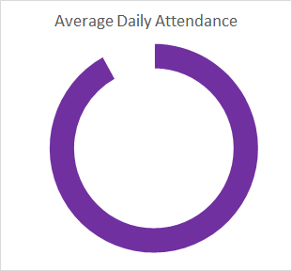
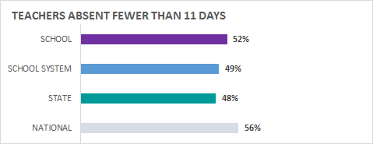
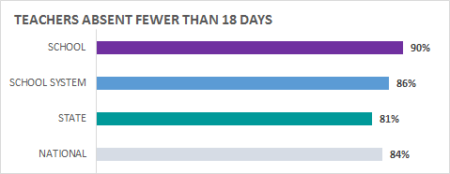
New to School Finder: Teacher Attendance Example
92%
Notes:
Here is an example of what Teacher Attendance data will look like in School Finder. The final metrics are still being determined.

Slide 16
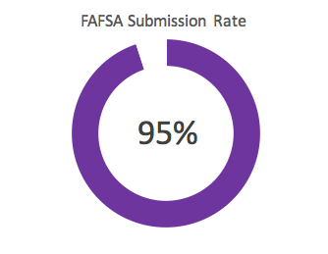
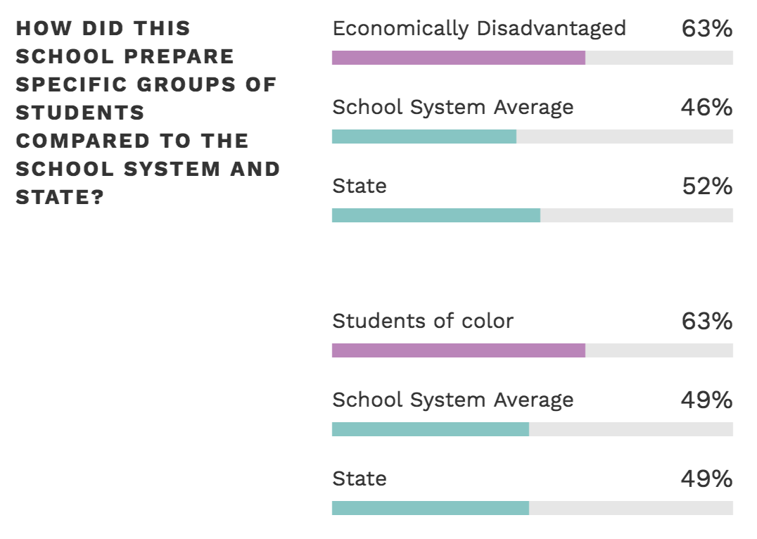
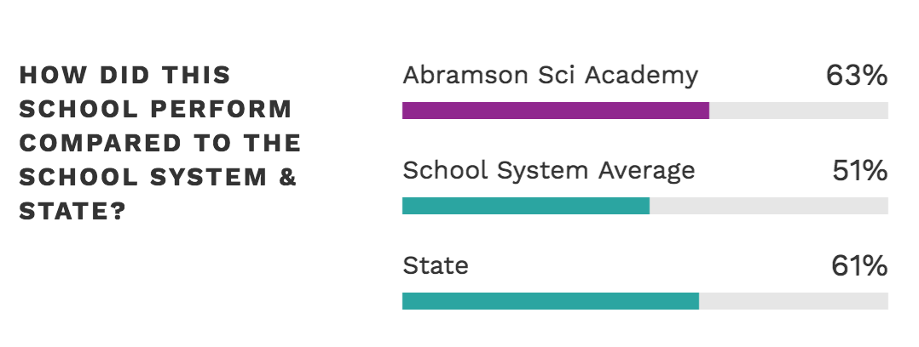
New to School Finder: FAFSA Example
School
Notes:
Here is an example of what Teacher Attendance data will look like in School Finder. The final metrics are still being determined.

Slide 17
Activity
Take 10-15 minutes to review your school’s profile in School Finder (www.louisianaschools.com) and reflect on the following questions:
Is everything reported on the “About Us” page accurate? If not, do I know who to contact to make corrections?
2. What are areas in my current data that I should celebrate with parents?
3. What are areas in my current data that could be concerning to parents?
4. How will my data look different this year? Have we improved?

Slide 18
Communicating School Performance

Slide 19
Communicating School Performance and Improvement
The Department encourages all schools to hold parent nights in order to have open and honest conversations with families about school performance and improvements.
In conversations with families about the development of the Louisiana School Finder, many parents told us that they want to hear from their principal about how the school is doing.
They accept that their school may not be an A or B as long as school leadership has a clear plan for improvement, and that the school has been improving overall for the past few years.
The release of the 2017-2018 school report cards, which will include new Urgent Intervention Required and Comprehensive Intervention Required labels, is an opportunity for schools to be proactive in addressing their school’s strengths and areas of opportunity with families, and to build partnerships that will result in increased student achievement.
As a reminder, Act 555 of the 2018 Legislative Session requires schools with state-approved school improvement plans, to present them within 60 days of approval to families at a school meeting. A template for this presentation is now available.

Slide 20
School Report Card Resources for Families
The Department has released or will release the following resources to support schools and early childhood centers in having conversations with families about the new Louisiana School Finder and report cards.
All resources can be found in the Principal Support Toolbox and on the School and Center Performance page.
Tool | Description | Release Date
Louisiana K-12 accountability system overview | One-pager providing a brief explanation of what Louisiana’s accountability system is to families and community members, and what is new for this years school performance scores | Available Now
Louisiana School Finder Flyer | Flyer directing families to the Louisiana School Finder and how to find information on their school/center | Available Now
Parent Night Presentations (K-12 and ECE) | Customizable presentations for principals and center directors to use in parent nights that will highlight school/center successes, explain the purpose of new Louisiana School Finder system and the data included in it, and how families can support learning at home | Available by October 9
Animated school and center performance score videos | Videos explaining each metric in the Louisiana School Finder related to K-12 school and Early Childhood performance, available in Spanish, Vietnamese and Arabic on the Department’s YouTube channel | Available by October 9

Slide 21
Contact the Department
For questions regarding 2017-2018 reporting, email assessment@la.gov.
For questions about data in the Louisiana School Finder, contact your school system’s data coordinator or email systemsupport@la.gov.
To request additional tools to support conversations with families about school performance, contact ldoecommunications@la.gov.

