Slide 1
Louisiana Early Childhood Quality and Progress
Parent Night Presentation
Notes:
Materials for this session:
One-pager on tax credits and bonuses

Slide 2
Communicating School and Center
Performance and Improvement
The Department encourages all schools and centers across the state to hold parent nights following the release of annual Performance Profiles in order to have open and honest conversations with families about performance and improvements.
In our conversations with families over the past year about the development of the new performance profiles and Louisiana School and Center Finder, many parents told us that they want to hear from their principal or director about how the school or center is doing. They can accept that their school or center may not be “Excellent” as long as the leadership has a clear plan for improvement.
Therefore, these parent nights are an opportunity for schools and centers to be proactive in addressing their strengths and areas of opportunity with families and building partnerships that will result in increased child progress and development toward kindergarten readiness.

Slide 3
How to Use This Presentation
This presentation is designed to provide school and center leaders with a template they can use in their conversations with families. Please customize it to meet your center’s needs.
Slide directions and talking points are in the notes section of the slides.
All RED text, on both the slides and in the talking points, should be updated with your site-specific information.
Slides in the Appendix provide Louisiana’s overall vision for birth-12 education, successes to-date, and long-term goals.
This presentation uses screenshots from the Louisiana School and Center Finder to highlight the model center’s performance. Please insert screenshots for your center.
  PC Instructions
  Mac Instructions

Slide 4
Annual Early Childhood Performance Profile Roll-Out
There are several steps sites can take to understand their profiles and prepare for conversations with families.
Review your site’s Performance Profile.
  Performance Profiles can be saved or printed directly from the website.
Use the resources from the Department to understand your profile.
  There are several resources including:
    Site Performance Profile Key and Guide
    Network Performance Profile Key and Guide
    Performance Profile FAQs
    Performance Profile Calculator
Identify strengths, areas for improvement and next steps for your site.
  Use the Five Tips for Sites as a guide.
  Consider how you will share results with and support teachers.
  Consult the Department’s toolkit to plan your community’s next steps.
  Lead Agencies, Resource and Referral Agencies and Field Support are all available to help.

Slide 5
Pelican Early Learning Center
Parent Night

Slide 6
Agenda
Looking at our Performance Profile results
Priorities for the Current Year
Supporting Child Learning and Development at Home
Appendix

Slide 7
The Importance of Quality in Early Childhood Classrooms
The years before your child enters kindergarten are very important. Their young brains are growing quickly, and they are developing important skills every day.
Children who go to high-quality Head Start, pre-K, or child care programs are better prepared to be successful in school. Your child’s early development is the foundation for lifelong success.
Classrooms that provide a welcoming and positive environment for your child and promote age-appropriate learning are more likely to promote your child’s learning and development.
Consistent high-quality teacher-child interactions are essential to increasing your child’s readiness for kindergarten and beyond.

Slide 8

Last Year’s Performance Profiles
Annually, every publicly-funded early childhood site in Louisiana receives a Performance Profile that features a rating and a score.
The Performance Profile Rating is calculated on a scale of 1 to 7, and organized into five levels: Excellent, High-Proficient, Proficient, Approaching Proficient, and Unsatisfactory.
These Performance Profiles communicate how well our center is preparing children to be ready for kindergarten.
Notes:
TEXT IN RED WILL NEED TO CHANGE BASED ON SCHOOL GRADE SPAN.
Annually, every publicly-funded early childhood site in Louisiana receives a Performance Profile that features a rating and a score. The Performance Profile Rating is calculated on a scale of 1 to 7, and organized into five levels: Excellent, High-Proficient, Proficient, Approaching Proficient, and Unsatisfactory. These Performance Profiles communicate how well our center is preparing children to be ready for kindergarten.
Let’s take a look at how school performance scores are calculated. PLAY VIDEO

Slide 9
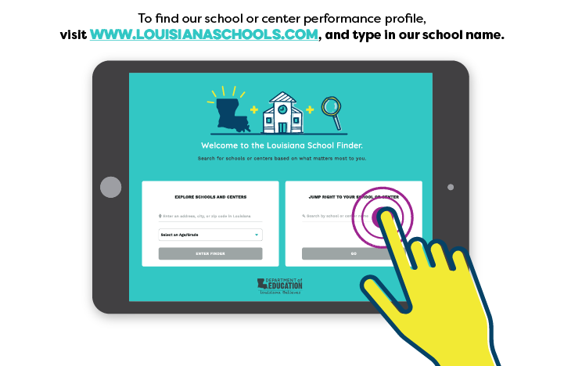
How to View Our School or Center Performance Profile
Notes:
School and Center report cards are available in Louisiana School Finder at www.louisianaschools.com. The School Finder includes information on all early childhood centers and programs, traditional public, charter, magnet and alternative schools, and schools participating in the Louisiana Scholarship program.
So let’s take a look and see how our school performed last year. If you would like to follow along, go to ww.louisianaschools.com on your phone and type in Pelican Early Learning Center.

Slide 10
Last Year’s Pelican Pride
Pelican Early Learning Center had a great year in <prior year>. Here are a few of our successes:
Our center’s performance rating improved 1.3 points, and we improved in most domains, particularly in Classroom Organization.
Our teachers successfully implemented Frog Street, a Tier I curriculum that supports our teachers to provide every child with a high-quality experience.
80% of families participated in our family engagement events and transition activities.
Our center participated in NAPSACC, an activity to promote healthy lifestyles.
Notes:
USE THIS SLIDE TO CELEBRATE YOUR SUCCESSES FROM 2018-2019.
Read Slide
Now that we have celebrated our center’s successes, let’s take an in-depth look at how our center performed last year.

Slide 11
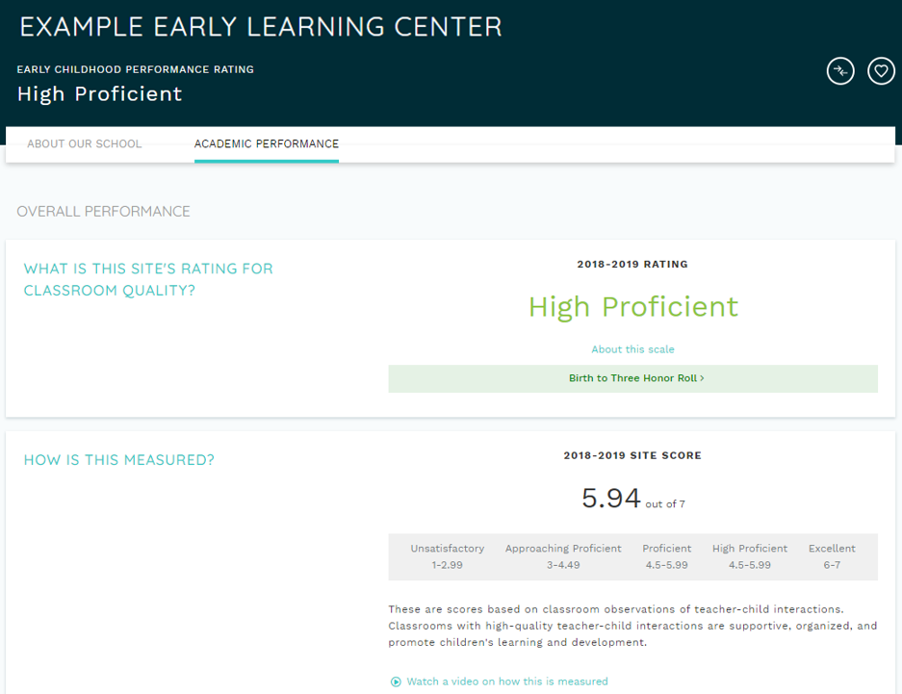
Domain Level Scores and Ratings
Notes:
Louisiana’s classrooms are observed using CLASS, a nationally recognized tool. The overall measure of classroom quality reflects all of the classroom observations done throughout the year. The scale has five levels: Unsatisfactory, Approaching Proficient, Proficient, High-Proficient, and Excellent.

Slide 12
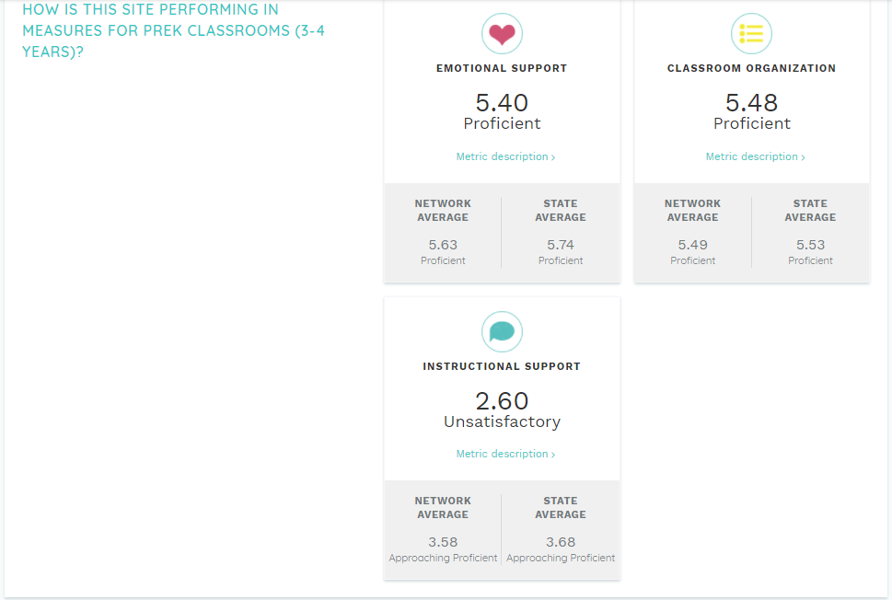
Last Year’s Performance Profile Score and Rating
Notes:
These in-depth measures show how well classrooms support children’s growth and development. Each metric can be explored by clicking the link below the rating. Additionally, the average of all of the programs that take public dollars to serve children birth through five in our community and in the state average are included as comparison.
Emotional Support measures the responsiveness and sensitivity of the classroom to children’s emotions, which helps develop their ability to interact with others.
Classroom Organization measures how the classroom is organized to manage children’s attention, time, and behavior.
And, Instructional Support measures how classroom interactions and experiences help children develope language and learn new concepts.

Slide 13
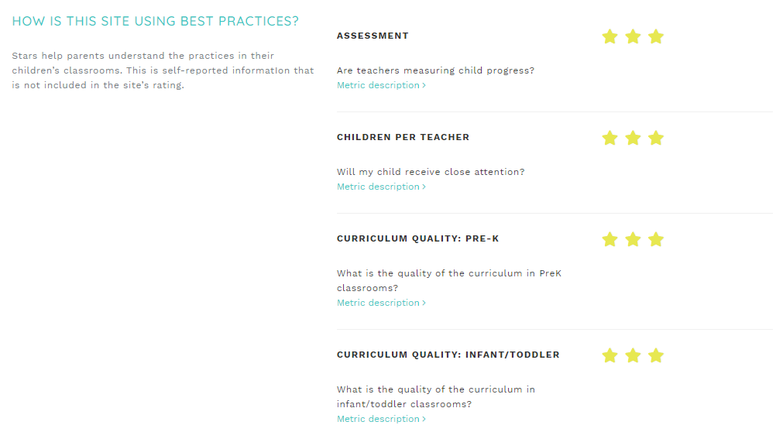
Informational Metrics
Notes:
In addition to a rating, performance profiles provide information on best practices in early learning classrooms. This information is self-reported and is not included in the rating.
Assessment shows if teachers are evaluating children’s growth and development.
Children per teacher shows the quality of the teacher:child ratios for the site.
And, Curriculum Quality shows how the site uses activities and materials to promote children’s development and learning.

Slide 14
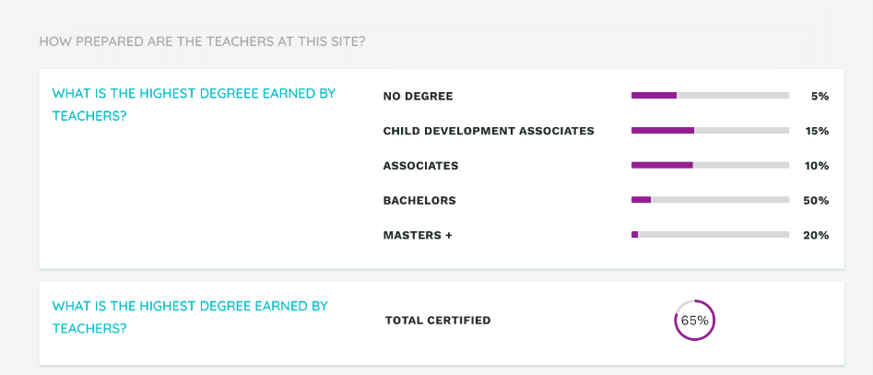
Teacher Degrees and Certification
Notes:
In addition to a rating, performance profiles provide information on best practices in early learning classrooms. This information is self-reported and is not included in the rating.
Assessment shows if teachers are evaluating children’s growth and development.
Children per teacher shows the quality of the teacher:child ratios for the site.
And, Curriculum Quality shows how the site uses activities and materials to promote children’s development and learning.

Slide 15
Agenda
Looking at our Performance Profile results
Priorities for the Current Year
Supporting Child Learning and Development at Home
Appendix

Slide 16
Current Year Pelican ELC Goals and Priorities
Based on our center’s performance last year, Pelican Early Learning Center is focused on the following priorities this year:
Improving Instructional Support scores to Proficient in our toddler and pre-K classrooms;
Providing more supports to pre-K children making the transition to kindergarten, including visits to a local kindergarten classroom and child activities in the classroom in the months before the transition;
Implementing a high-quality curriculum in every classroom; and
Providing families with activities, tools, and support they need to support child learning and development at home.
Notes:
Note: Please reference the Five Tips for Sites document to come up with your site’s priorities for 2019-2020.

Slide 17
Agenda
Looking at our Performance Profile results
Priorities for the Current Year
Supporting Child Learning and Development at Home
Appendix

Slide 18
Support Your Child’s Development
Pelican Early Learning Center is committed to providing families with meaningful, two-way communication opportunities with teachers and Director Struthers throughout the year. If you have questions or need assistance,:
Contact your child’s teachers with questions about your child’s progress, learning needs, or school events/programs. Questions may include:
    How is my child doing socially? How well does he/she share?
    How is my child doing emotionally? Is he/she reacting appropriately to various situations?
    How does my child respond to classroom rules and procedures?
    How can I support my child’s development and learning at home?
Consult reports generated through our center’s assessment for your child’s progress and discuss with your child’s teacher support you can offer at home.
Additional questions or concerns that cannot be addressed by your child’s teacher should be directed to Director Struthers at sarah.struthers@pelicancenter.org.
Notes:
USE THIS SLIDE TO INSERT INFORMATION ABOUT HOW PARENTS SHOULD COMMUNICATE WITH TEACHERS AND THE SCHOOL LEADER OR CENTER DIRECTOR THROUGHOUT THE SCHOOL YEAR.

Slide 19
Agenda
Looking at our Performance Profile results
Priorities for the Current Year
Supporting Child Learning and Development at Home
Appendix

Slide 20
Vision for Kindergarten Readiness
Louisiana is unifying the early childhood system–birth to pre-K–to prepare all children for kindergarten.
Louisiana has created shared high standards for what children should learn and what excellent teaching looks like.
Teachers are excellent at interacting with children and guiding learning.
Expectations for health, safety, and learning are consistent with adequate funding levels for programs that serve children well.
Families can easily enroll and choose the best option for their children.

Slide 21
Performance Rating Approach:
Focus on Interactions with Children
Louisiana uses CLASS® to measure, provide information on, and support improvement on the core elements needed for quality: adult-child interactions and instruction.
CLASS ® assesses how well teachers interact with children, including how well they:
CLASS ® correlates with child outcomes
  Programs that perform better on CLASS ® have better child outcomes (i.e., kindergarten readiness).
CLASS ® supports teacher growth by providing useful information for coaching
Description | Pre-K Domain | Toddler Domain | Infant Domain
Create a warm, positive environment and build trusting relationships with children | Emotional Support | Emotional & Behavioral Support | Responsive Caregiving
Organize daily routines and minimize disruptions | Classroom Organization
Help children learn concepts and connect ideas through dialogue and play | Instructional Support | Engaged Support for Learning

