Slide 1
Zoom Meeting Preparation
Please make sure your phone or computer is muted to minimize background noise.
To do this, hover over the bottom left-hand side of your screen and click “Mute.”
Please make sure you have turned off your camera to save bandwidth and prevent any connectivity issues.
To do this, hover over the bottom left-hand side of your screen and click “Stop Video.”
Please submit questions during the presentation in the “Chat” function located on the bottom of your screen.
If you require an interpreter or have other accessibility needs for future LDOE meetings, please contact LDOEcommunications@la.gov.

Slide 2
Child Welfare and Attendance
Monthly Call
June 6, 2024
Notes:
Welcome to the June Child Welfare and Attendance Webinar!

Slide 3
Agenda
Introduction / Sign In
Monthly Call Purpose
Morning Inspiration & Activity
Presentation
Unite Us: Building Healthier Communities Together
Updates
Notes:
Please make sure you have signed in with your name and the system/school/parish you support. Today we will discuss the monthly call purpose, have our morning inspiration and activity. Today we will hear from Jason Hughes of Unite Us. He will share how their platform can support your work in the field and with documentation. After the presentation I will share some updates.

Slide 4
Monthly Call Purpose
Focus: Agency, Belonging, and Connection
Purpose: To cultivate a viable network for state CWA’s to discuss evidence based best practices and offer support amongst colleagues.
Contact shelneka.adams@la.gov with questions.
Notes:
The theme this year is agency, belonging, and connection. The purpose of our meetings is to cultivate a viable network for CWAs to discuss evidence based best practices and offer support. Links are sent and we meet every first Thursday of the month at 8:00 am. We will take the month of July off. If you have any questions please contact me at shelneka.adams@la.gov

Slide 5
Morning Inspiration
Morning Inspiration
Starting School Later
Notes:
Our morning inspiration video shows a different perspective around the argument that school start times should be later for middle and high school students. Let’s watch then discuss. Disclaimer, this is not an LDOE initiative, but meant to provoke discussion.

Slide 6
Reflection and Activity
What are your observations regarding the video?
How do you believe this initiative would impact your school/system?
Why is “creative scheduling necessary” even if start times can’t be altered?
Contact shelneka.adams@la.gov with questions.
Notes:
What did you observe in the video? How will this initiative impact your school or system? Changing the start time may not be an option, but creative scheduling can be! Why do you believe it’s necessary to improve/address attendance?

Slide 7
Presentation
Unite Us
Building Healthier Communities
Together
Jason Hughes Unite Us Sr. Customer Success Manager
June 6, 2024
Notes:
Today we will hear about a platform that will help with attendance and engagement. Please welcome Mr. Jason Hughes of UniteUs.

Slide 8
Building Healthier Communities Together
We connect health and social care.
Proprietary and Confidential

Slide 9
Why are we coming together?
To connect people to care they need, faster and with fewer barriers
To strengthen existing partnerships and create change in our community

Slide 10
Our Connection to this Work
When you partner with us, you’re part of a network committed to outcomes. Our digital infrastructure supports individuals seeking services across the nation.
Community Partners
Live
Funding Partners

Slide 11
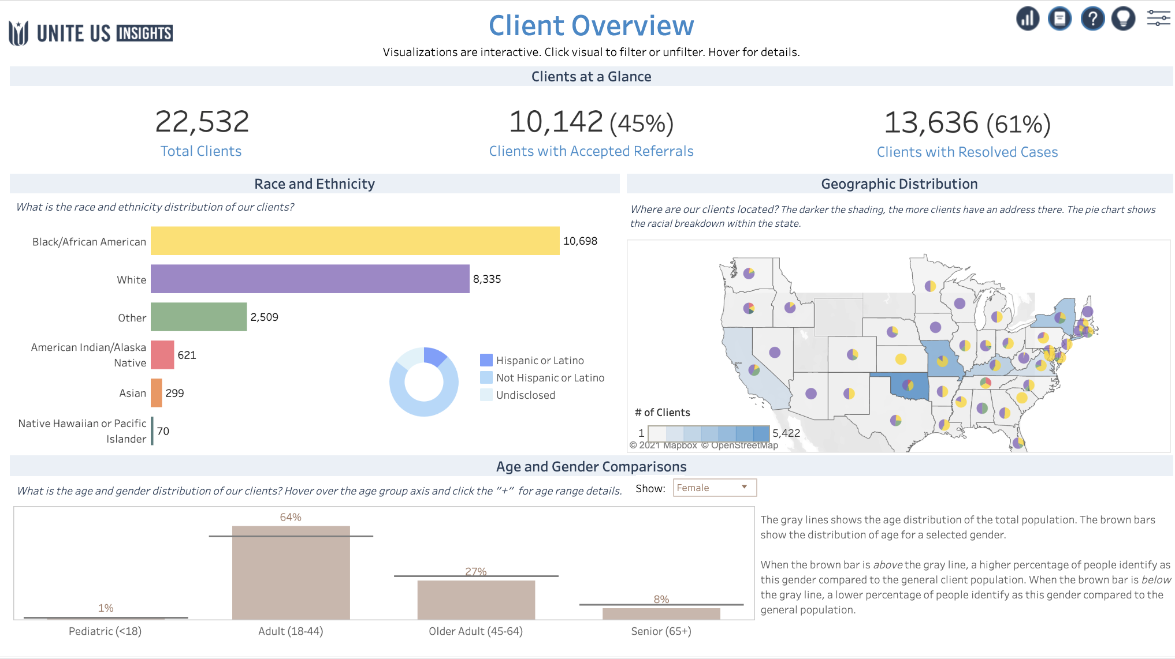
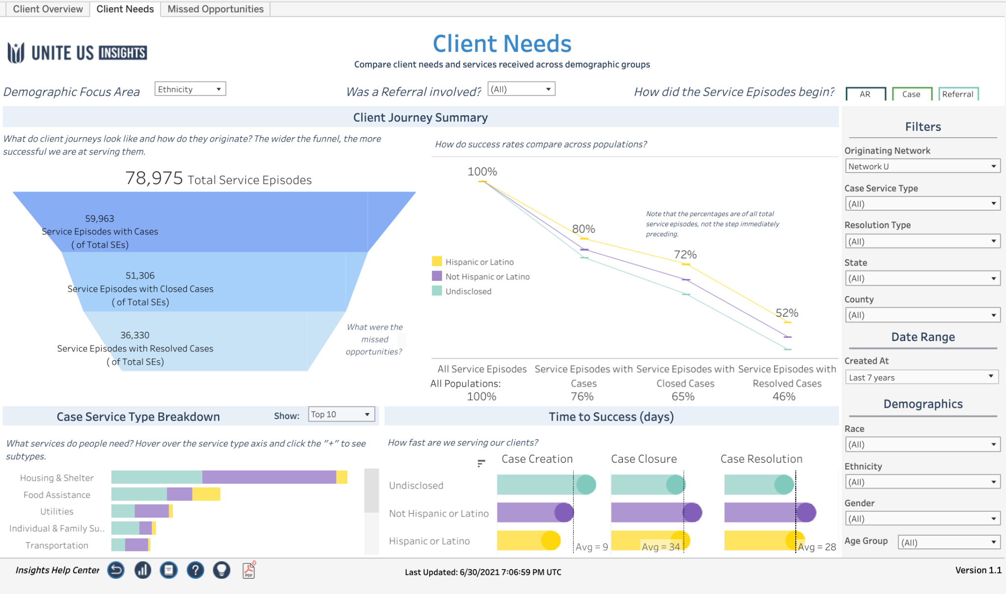
It’s your story. Tell it.
Demonstrate your organization’s outcomes and drive community change.
✓
Track your organizational activity
✓
Measure your impact through data
✓
Inform community reinvestment decisions

Slide 12
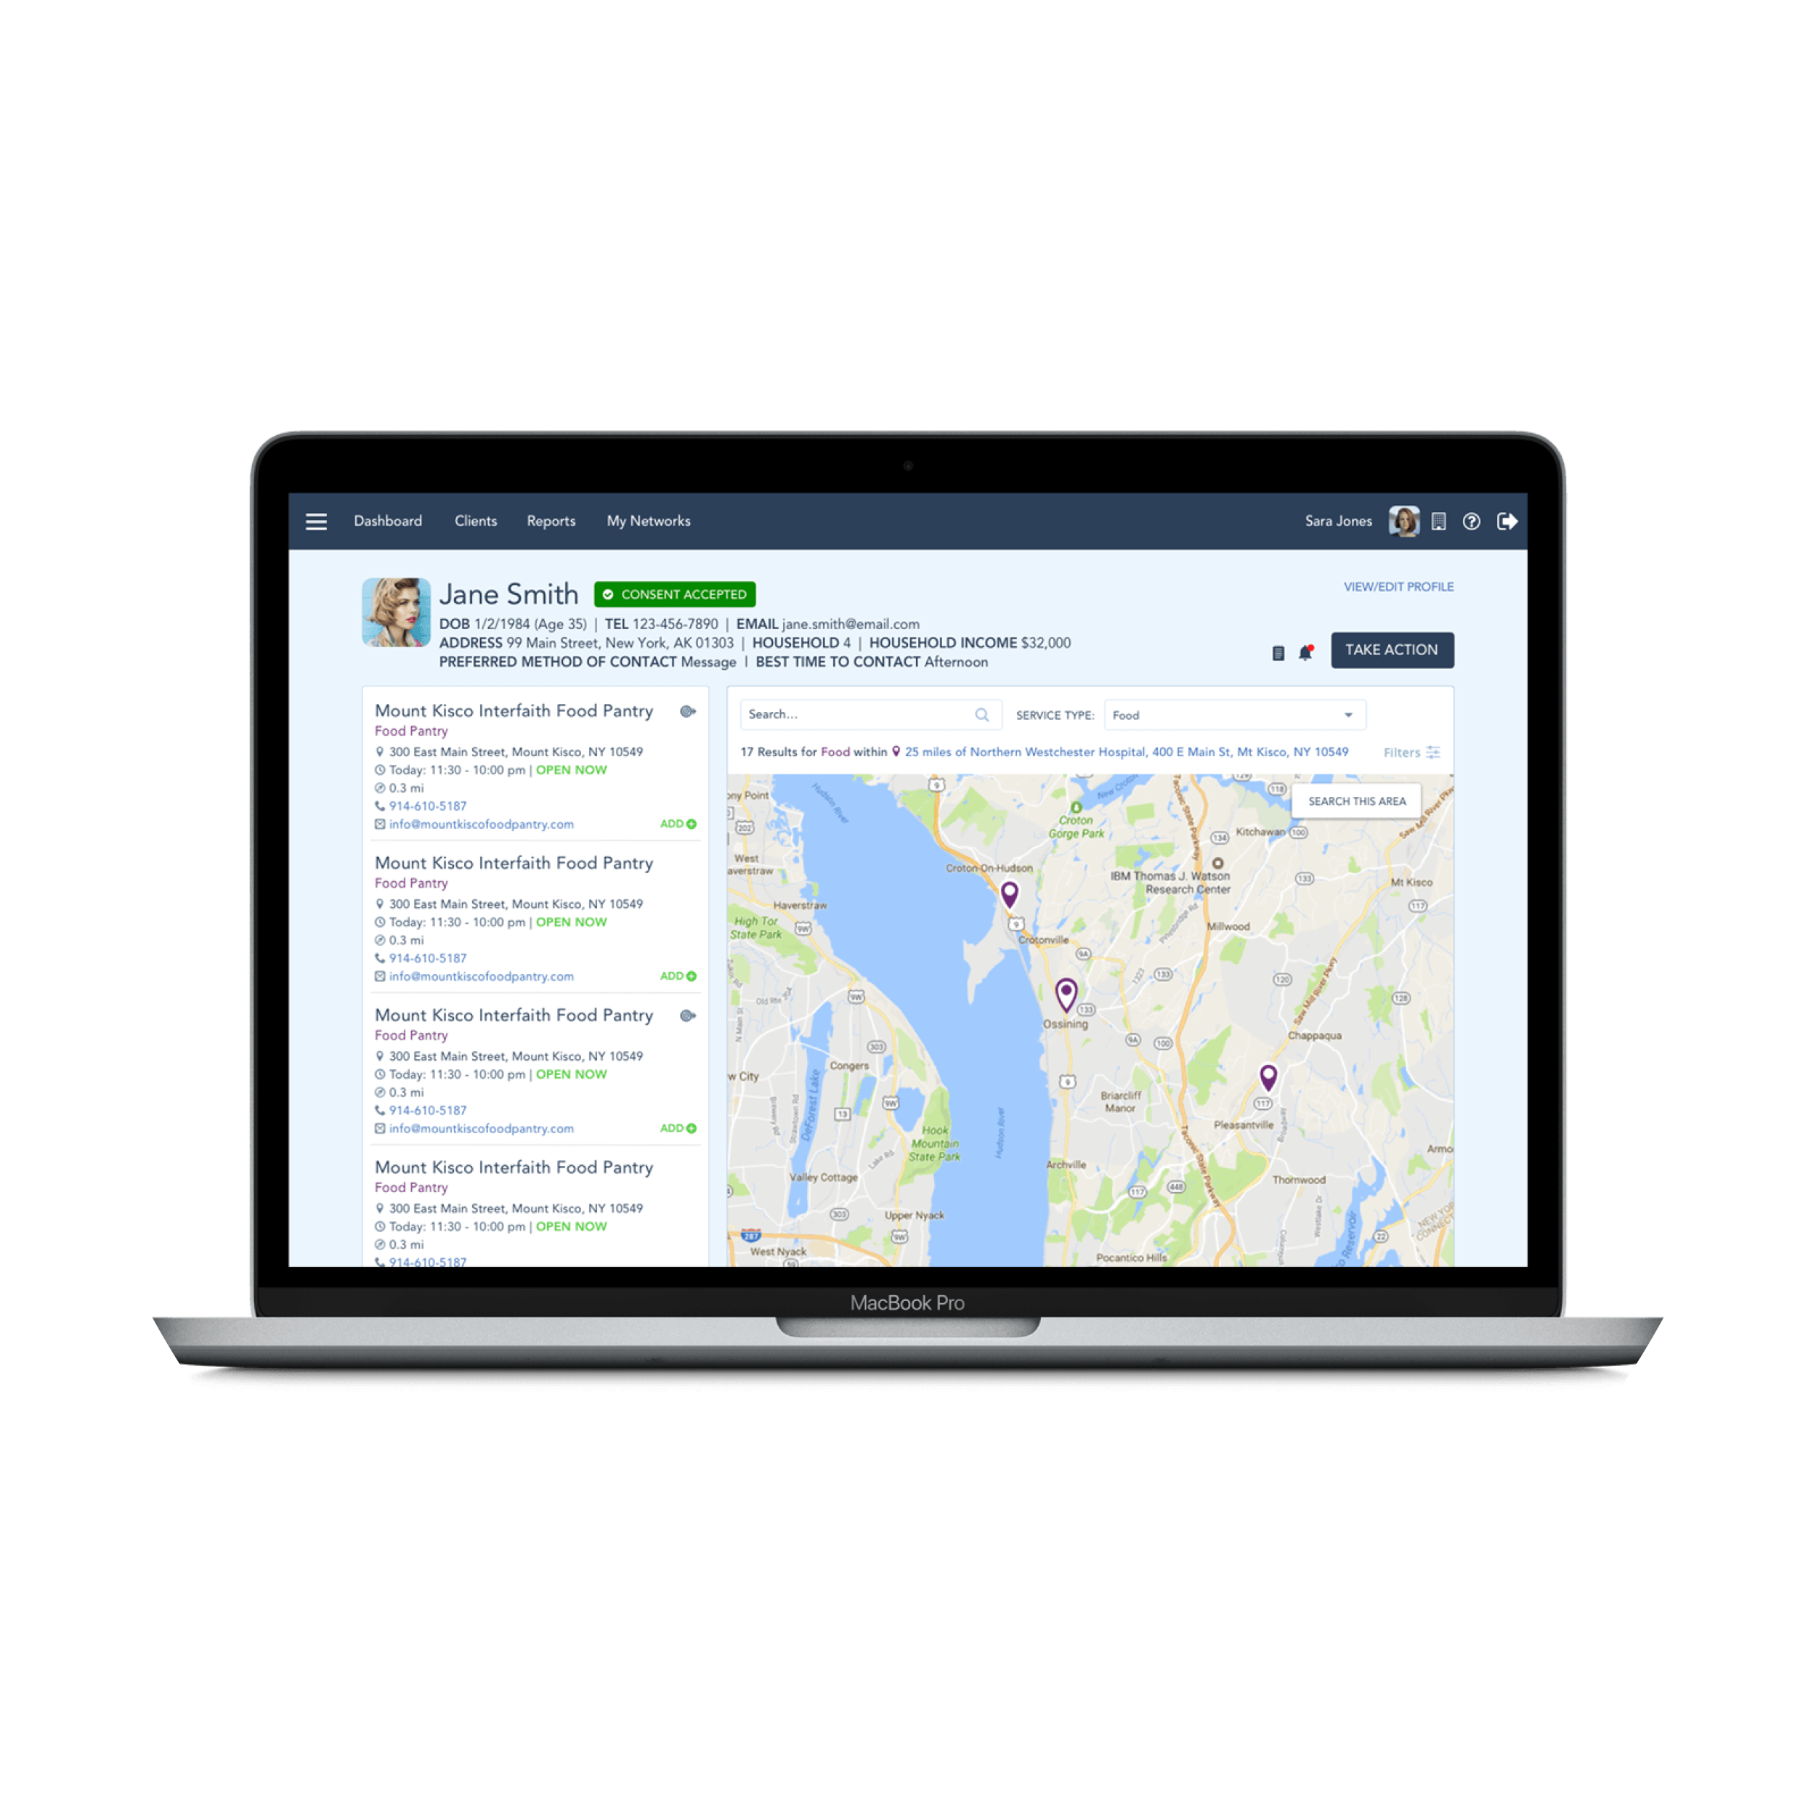
Connecting People to Care
Screening
Referral
Resolution
Feedback
John shows
up at Shelby’s
organization.
Shelby screens John and identifies that he has additional needs.
As John receives care, Sue receives real-time updates and tracks John’s total health journey.
Shelby uses Unite Us to gain digital consent and electronically refer John to multiple community partners. Through the platform, she can seamlessly communicate with the other providers in real time and securely share John’s information.

Slide 13
Scalable tracking and coordination.
Trading the old for the new.
Traditional Referral
Client
Clinical Provider
Housing Provider
Client
Clinical Provider
Housing Provider
Providers cannot always exchange PII or PHI securely
Limited prescreening for eligibility, capacity, or geography
Clients must contact each organization they were referred to
Providers have limited insight or feedback loops
Client data is siloed and transactional data is not tracked
Information is stored and transferred on Unite Us’ HIPAA, FERPA, FIPS, and 42 CFR Part 2-compliant platform
Clients are matched with the provider(s) they qualify for
Information is captured once and shared on clients’ behalf
Providers have insight into the entire client journey
Longitudinal data is tracked to allow for informed decision-making by community care teams

Slide 14
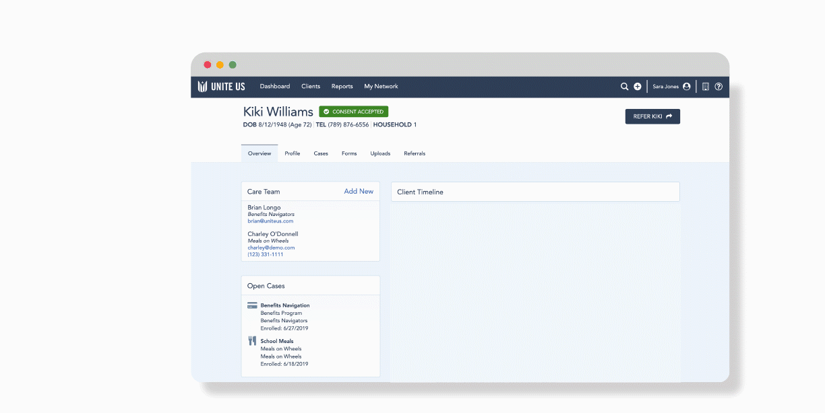
Software Demo
Notes:
Software Demo

Slide 15
Thank you!
Jason Hughes
Senior Customer Success Manager
(337) 207-5657
jason.hughes@uniteus.com
Unite Us Onboarding Form
Follow Us

Slide 16
Questions?
Notes:
Are there any questions about today’s presentation?

Slide 17
Resources
Louisiana Attendance Planning
Attendance Action Planning Workbook
Toolkit Slides
Chronic Absenteeism Rate Report
Attendance Action Plans
Peer-learning Surveys
Please contact shelneka.adams@la.gov with questions.
Notes:
This is a link for continued support with your attendance action plan workbook. If you need additional assistance please feel free to contact me for technical assistance.

Slide 18
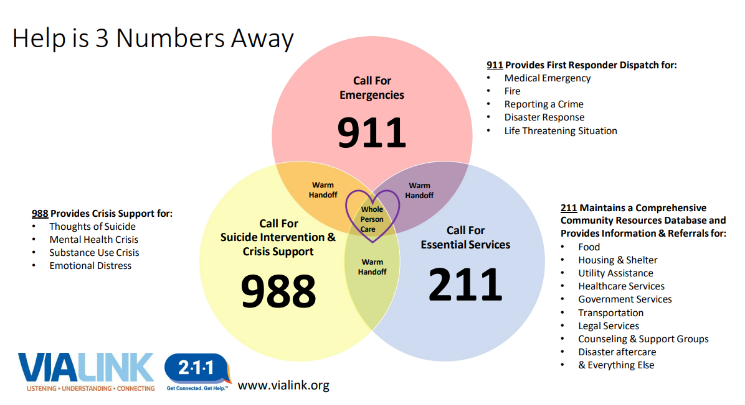
ViaLink 2-1-1
Vialink
Notes:
Another resource to support students and families. We have this information available in English, Vietnamese, Arabic, and Spanish.

Slide 19
Updates
The next monthly meeting will be August 1 at 8:00 am.
Save The Date:
Louisiana Association of Child Welfare and Attendance Professionals
Embassy Suites Baton Rouge, LA
June 17 - 19
Save The Date:
International Association for Truancy and Dropout Prevention Conference
Sheraton Le Meridien Charlotte, NC
October 6 - 9
International Network for School Attendance (INSA) Conference
Astor Crowne Plaza New Orleans, LA
October 29 - November 1
You Are Appreciated!
Contact shelneka.adams@la.gov for more information.
Notes:
Our next meeting will be August 1 at 8 am. Here are some other dates to remember.
As always, if you have not heard it today…you are appreciated!

