Slide 1
ELPT and LEAP Connect
for District Test Coordinators
September Collaborative Meetings

Slide 2
Session Objectives
By the end of this session, participants will understand the:
Vision for teaching and assessing students with unique learning needs;
Assessment administration logistics; and
What resources are available now and in the future to help prepare for the new assessments.

Slide 3
Agenda
LEAP Connect
Vision for Students with Significant Disabilities
Test Design
Administration logistics
Resources
Next Steps
ELPT
Vision for English Learners
Test Design
Administration logistics
Resources
Next Steps

Slide 4
Students with Significant Disabilities
LEAP Connect

Slide 5
Vision for
Students with Significant Disabilities
Louisiana believes that all students, including those with the most significant cognitive disabilities, deserve an education that prepares them to be independent and successful in life after high school.
Through quality and clear alignment of standards, instructional resources, and assessments, our students can achieve academically and leave high school with the skills for lifelong success.
This spring, BESE adopted the new Louisiana Connectors for students with significant cognitive disabilities that replace what were formerly known as the Extended Standards. In 2017-2018 the LEAP Connect will replace what was formerly referred to as LAA1 for ELA and Math.

Slide 6
Louisiana Connectors: Instructional Shifts
Access: The Connectors are fully-aligned to the Louisiana Student Standards and do not exist separate and apart from the expectations for all students. Teachers of students with significant disabilities provide inclusion opportunities whenever possible and help students access grade-level content and skills.
Focus: The Connectors represent the “big ideas” of the content and skills found in the Louisiana Student Standards. Teachers of students with significant disabilities focus instruction where the Connectors focus.
Pathways: The Connectors provide developmentally-appropriate benchmarks on the path to meeting the expectations of the Louisiana Student Standards. Teachers know where students are and take the right steps to help them succeed.

Slide 7
Louisiana Connectors: Instructional Shifts
The Louisiana Connectors are fully-aligned pathways that capture the “big ideas” of the Louisiana State Standards for students with significant disabilities. The Connectors are not learning standards that exist separate and apart from the common expectations we have for all students. Instead, the Connectors are designed to provide developmentally-appropriate content benchmarks toward the standards across all grade levels in English language arts and mathematics.
For the individual standards found in ELA and math, there are accompanying Connectors that represent the major benchmarks along the pathway to achieving the expectations of each standard.
Louisiana Student Standards | Louisiana Connectors
3.NBT.A.2 Fluently add and subtract within 1000 using strategies and algorithms based on place value, properties of operations, and/or the relationship between addition and subtraction. | LC.3.NBT.A.2a Use the relationships between addition and subtraction to solve problems. LC.3.NBT.A.2b Solve multi-step addition and subtraction problems up to 100. LC.3.NBT.A.2c Solve multi-digit addition and subtraction problems up to 1000.

Slide 8
Louisiana Connectors
for Students with Significant Disabilities
LDOE’s academic expectations for all students are articulated in the ELA and math Louisiana Student Standards, approved by BESE in spring 2016. In winter 2016, BESE approved aligned standards for students with significant disabilities known as the Louisiana Connectors.
The Louisiana Connectors replace the Extended Standards. In 2017-2018 the LEAP Connect will replace the LAA1 assessment for ELA and math.
 | 2016-2017 | 2017-2018
Standards | Extended Standards | Louisiana Connectors for Students with Significant Disabilities
Assessment | Louisiana Alternative Assessment (LAA1) | LEAP Connect (ELA & math) LAA 1 (science)

Slide 9
LEAP Connect Overview
Content
Students can independently show what they know at varying levels of understanding
There are four performance levels (1-4) with accompanying scaled-score ranges
Approximately 30-40 items per subject, mostly selected response, scripted directions
Administration
Administration window is February 5 - March 16, 2018
Computer-based items allow students with significant cognitive disabilities to show what they know
Testing times vary for each student
Testing may pause and resume, based on student needs
Support
Resources for the LEAP Connect administration will be provided this fall
Additional trainings will occur at the November collaborations

Slide 10
LEAP Connect Transition
Louisiana is transitioning the assessment for students with significant disabilities to align with the ELA and Math Louisiana Connector Standards. That means the following for each grade level:
Grades 3-8 ELA and math: Assessed with LEAP Connect assessment
Grades 4, 8, and 11 science: Assessed with current LAA 1 science assessment
High school ELA and math: The grade 10 assessment will transition to grade 11 in the 2018-2019 school year. As a result, this is a transition year for high school.
Students in grade 10 last year (2016-2017) who took the LAA 1 ELA and math assessments and met the graduation requirement will not take the ELA or mathematics LEAP Connect assessments in grade 11 (current year).
Current grade 10 students will not take the LAA 1 exam and will instead take LEAP Connect in 2018-2019 (grade 11).
Students who are part of the third year assessment cohort or who need to participate in LAA 1 ELA and math to meet specific requirements will take the LAA 1 ELA and math assessment.

Slide 11
LEAP Connect Transition
The assessments required for students with significant disabilities is outlined in the table below.
 | 2016-2017 | 2017-2018 | 2019 and beyond
LAA1 Science | Grades 4, 8, 11 | Grades 4, 8, 11 | TBD
LAA1 ELA/Math (old) | Grades 3-8, 10 | Students needing to take ELA/Math by 3rd year of high school | n/a
LEAP Connect ELA/Math (new) | n/a | Grades 3-8 | Grades 3-8, 11

Slide 12
Assessment Features
LEAP Connect provides the following built-in supports:
Entire test can be read aloud
Reduced passage length
Manipulatives
Pictures and graphics to support what is read
Models and demonstrations
Common geometric shapes and smaller numbers in math test
Various levels of complexity

Slide 13
Levels of Complexity
The least complex test items provide extensive adaptations, scaffolds, and supports. Other items for the same content are designed to include more complex content with fewer adaptations, scaffolds, and supports.
Each question includes scripted directions for test administrators to ensure the questions are given to students as intended. The directions also include specific ways a test administrator can adapt to the student’s mode of communication and unique needs.

Slide 14
ELA Design
ELA content assessed by LEAP Connect includes:
Reading foundational skills,
Writing,
Vocabulary, and
Comprehension of varied text types.
In grades 3 and 4, LEAP Connect reading items include the assessment of early decoding skills. These items allow both verbal and non-verbal responses.
Words are presented from simple to more complex.
Writing items focus on different types of writing—narrative, explanatory and argument—at different grade levels. The writing items included in each grade range in complexity, allowing for students to show what they know and can do.

Slide 15
ELA Design
Reading items assess students’ developing use of vocabulary and reading skills using both literary and informational texts in grade-appropriate contexts.
The literature content focuses on beginning comprehension skills (for example, describing characters in a story) as well as more advanced comprehension skills (for example, analyzing the development of theme)
The informational content focuses on, for example, identifying the purpose of charts and diagrams as well as integrating information from multiple sources of information.
The texts used in LEAP Connect are written across a range of complexity to provide an opportunity for students with different acquired reading skills to answer text-based questions.
The texts represent a range of complexity in the reading level, length, and vocabulary.
The questions also include a range of supports and scaffolds (for example, introduction to the text, rereading, pictures, prompts for what to listen for, and definitions).

Slide 16
ELA Design
Session 1: Reading | Session 2: Reading | Session 3: Writing | Session 4: Writing
Literary and informational reading passages with selected-response reading items Open-response foundational reading items (grades 3 and 4 only) | Literary and informational reading passages with selected-response reading items Open-response foundational reading items (grades 3 and 4 only) | Selected-response writing items | One constructed-response writing item

Slide 17
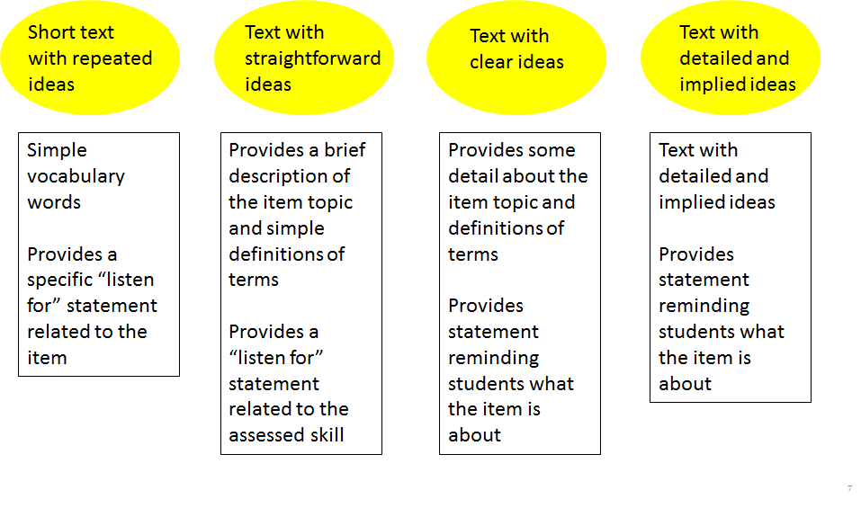
ELA Design

Slide 18
Graduated Text Complexity of Reading Passages

Slide 19
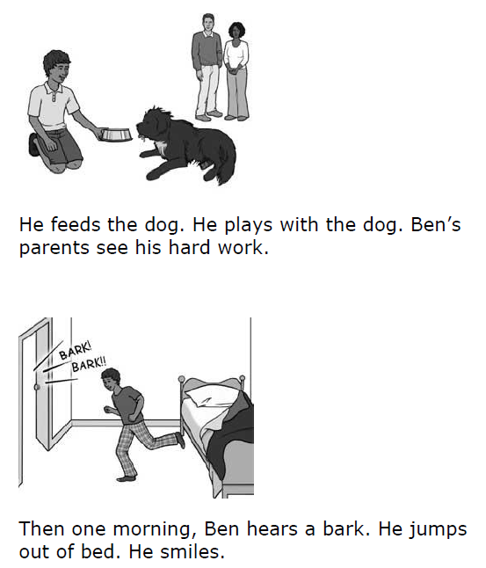
English Language Arts Sample Item
Grade 4
Statement reminding students what the item is about
Simple sentences
Visual Supports

Slide 20
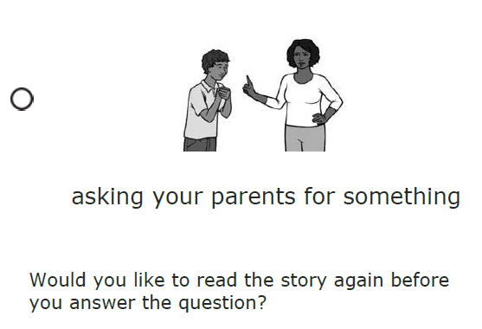
English Language Arts Sample Item
Grade 4
3 Answer Options with Visual Supports
Re-read passage or passage part

Slide 21
Mathematics Design
LEAP Connect for mathematics focuses on the mathematical skills needed for post-secondary education, workplace success, community involvement, and lifelong learning.
Elementary grades concentrate on whole number operations and relations, spatial relations, and measurement.
Middle and high-school grades concentrate on problem solving and reasoning.
Like ELA, a range of supports (for example, providing definitions, demonstrations, or graphic organizers) are provided within groups of items.
A range of complexity with the items for a given Connector allows for a sampling of an appropriate range of questions for the test.

Slide 22
Mathematics Design
Mathematics Session 1 |  | Mathematics Session 2
Selected-response mathematics items Constructed-response mathematics items in selected grades |  | Selected-response mathematics items Constructed-response mathematics items in selected grades

Slide 23
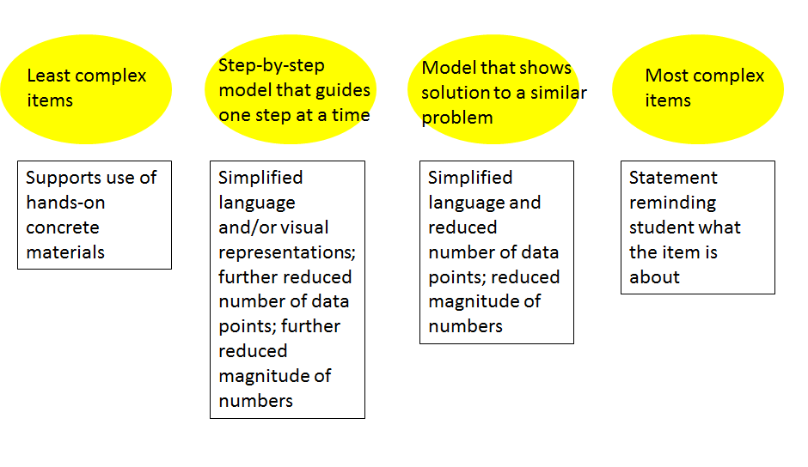
Mathematics Design

Slide 24
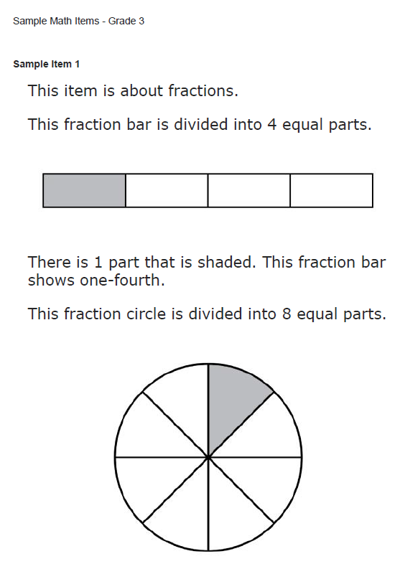
Mathematics Sample Item 1
Grade 3
Statement reminding students what the item is about
Demonstration
Simplified Language

Slide 25
Mathematics Sample Item 1
Grade 3
3 Answer Options

Slide 26
Mathematics Sample Item 2
Grade 3
Statement reminding students what the item is about
Simplified Language

Slide 27
Mathematics Sample Item 2
Grade 3
2 Answer Options

Slide 28
Test Administration

Slide 29
Test Administration
District Test Coordinators will receive Test Coordinator Manuals and Test Administrator Manuals that will outline key dates, test setup, and administration logistics.
Students will take the LEAP Connect in the INSIGHT platform, and test coordinators will use eDIRECT for test setup.

Slide 30
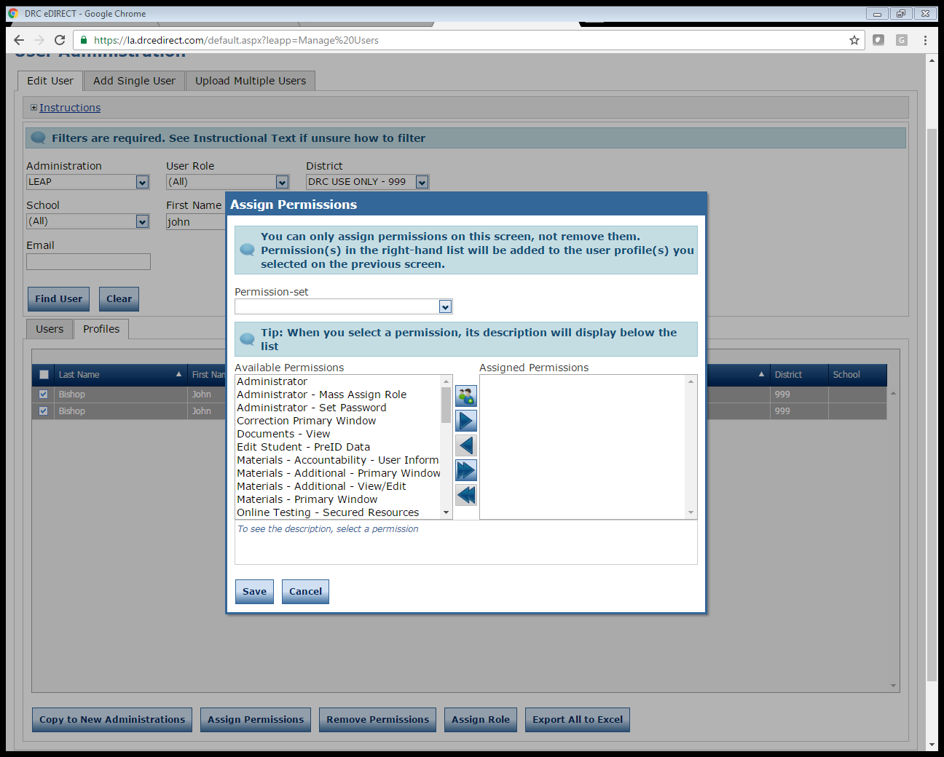
Assigning User Permissions in eDIRECT
Permission sets will need to be assigned to eDIRECT users added through Upload Multiple Users.
Select User Management
Click on the Edit User tab, enter search criteria, click Find User to display a list of users, and select the Profiles tab.
Check the checkbox on the left hand column for each user profile you want to edit.
Click on Assign Permissions
Select the user role from the Permissions Set dropdown. This will automatically select the appropriate permissions for the user’s role.
Click on the single arrow to add the permissions, click on Save.

Slide 31
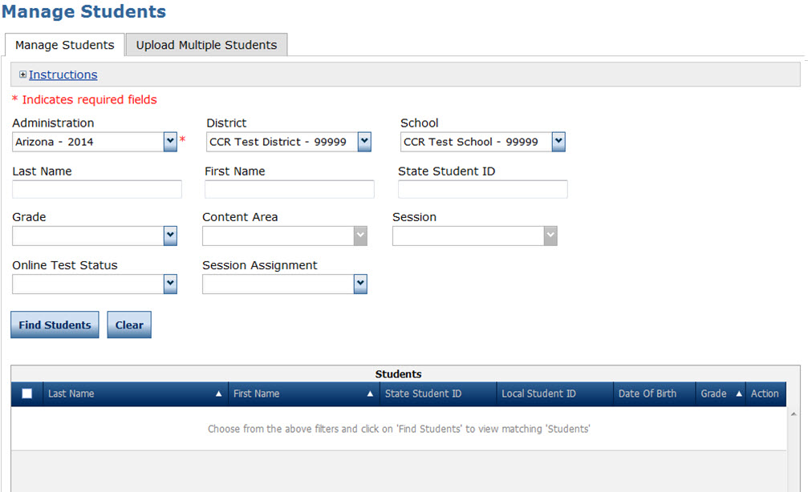
Student Management
Students may either be added individually or in an upload for multiple users.
Test coordinators can edit certain fields (e.g., 504, LEP, Sped status).
Additionally test coordinators will need to document certain accommodations within the system.

Slide 32
Uploading Students
To upload multiple students from the Student Management menu:
Select Manage Students to display the Manage Students page
Select the Upload Multiple Students tab.
Review the required file layout .PDF with instructions for how to create and format the file.
Once the .csv file is ready, upload the file. All students will automatically be placed into test sessions.

Slide 33
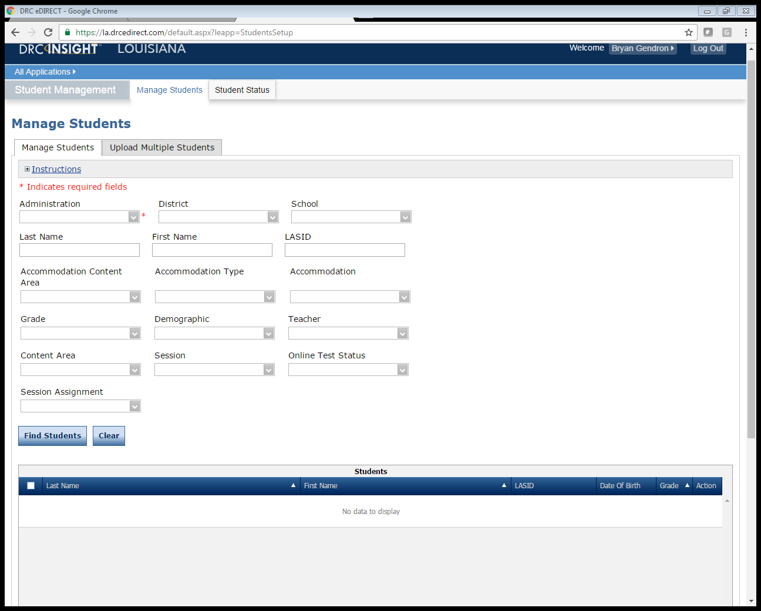
Managing Students
Student Management
Test Coordinators can search and view students by clicking Student Status. This will show all students within their school, based on their search criteria.
Using Student Status coordinators can:
Search and View Students by clicking on Student Status
Edit students by clicking on the View/Edit icon

Slide 34
Managing Students
Student Management
Test Coordinators can add and delete students by clicking Manage Student. This will show all students within their school, based on their search criteria.

Slide 35
Adding Accommodations and Accessibility Features
After a student has been added to eDIRECT, some accommodations and accessibility features will need to be entered into eDIRECT for planning and reporting purposes.
To add accommodations to a student’s profile, select the student, then click on Edit Student
Click on the Accommodations tab within Edit Student.
Select the required accommodation (s), then click on Save
Set accommodations will be indicated on test tickets.

Slide 36
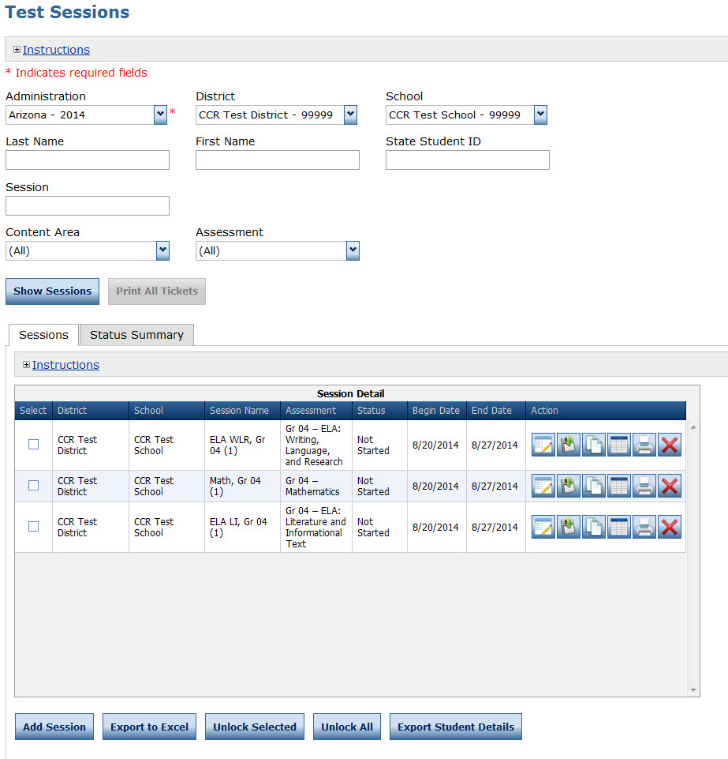
Test Session Management
Once all students are uploaded to eDIRECT, test sessions must be created. One test session is created within the system for each group of students taking a test.
Test tickets will be generated for each student for each part of the test.

Slide 37
Viewing Test Sessions
Search and view Test Sessions by clicking on Show Sessions

Slide 38
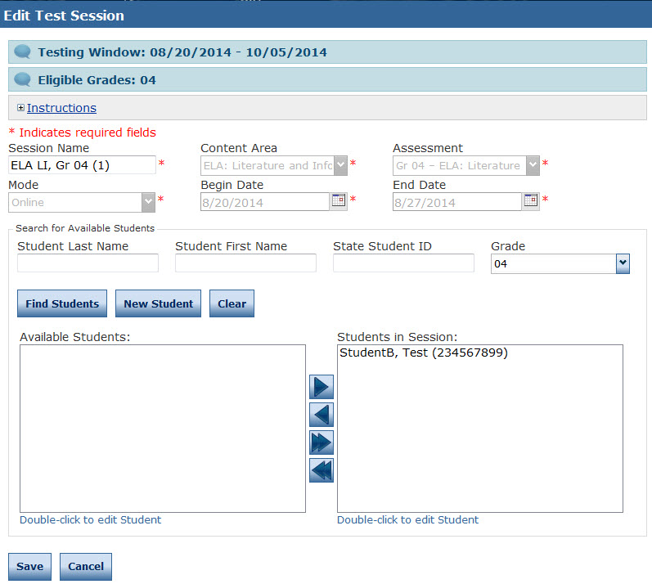
Creating and Editing Test Sessions
To create a Test Session, click on Add Session from the Test Session screen.
Populate the session details, then click on Find Students. This will display all the available students for the test session, by grade and content area.
To add the students to the test session, select the student, then click on the right facing arrow to add the students to the session.
Complete the above steps until all students are added to test sessions.
Note: For the operational tests, an Upload Multiple Test Sessions option will be available, in additional to creating individual test sessions.

Slide 39
Printing Test Tickets and Rosters
School Test Coordinators or Test Administrators must print Test Tickets and Rosters prior to testing session.
Test Tickets contain test login information; tests are activated once a student logs in with username and password provided on Test Ticket.
Test Administrators must verify that each student has their correct Test Ticket (one ticket needed per content area).
Student Test Tickets and Rosters are secure materials. They must be distributed, collected and accounted for, and securely destroyed following testing.

Slide 40
LEAP Connect Resources

Slide 41
Instructional Resources
The LDOE has developed resources and other supports to assist planning for and providing standards-based instruction for students with significant disabilities. These resources can facilitate teacher planning and implementation with regard to curriculum, assessment and instruction. The resources include:
LEAP Connectors
Louisiana Connectors Essential Elements Cards
Student Response Modes
Lesson Plan Adaptation
Case Studies for Exemplary Instruction

Slide 42
LEAP Connect Resources
 | Available Now |  | Coming Soon
Standards | K-12 Louisiana Connectors in ELA and Math |  | K-12 Louisiana Connectors in Science (2017-2018)
Assessment Resources |  |  | Assessment Guide (available late September) provides in-depth information about the test design. Online Tools Training (OTT) (available fall 2017) provides teachers and students sample items so they can become familiar with the computer-based testing format. eDIRECT User Guide
Professional Development | 2016-2017 Collaboratives – introductory trainings 2017 Teacher Leader Summit – turnkey trainings |  | 2017-2018 Collaboratives – supervisor and teacher leader trainings on assessment implications and aligned instruction
Resources for the LEAP Connect administration will be provided this fall. The Department will continue to host trainings at the November collaborations to review the assessment design in-depth.

Slide 43
English Learners
English Language Proficiency Test
(ELPT)

Slide 44
Vision for English Learners
Louisiana believes that all students, including English Learners, deserve an education that prepares them to be independent and successful in life after high school.
Acknowledging the diverse and rich language experiences they bring to school, English learners can achieve academic success through a clear and concise alignment of standards, instructional resources, and quality assessments.
This Spring, BESE adopted the Louisiana Connectors for English Learners that replace the formerly known English Language Development Standards. In 2017-18 The English Language Proficiency Test (ELPT) will replace the former English Language Development Test (ELDA).

Slide 45
Higher Expectations
Increasing the expectations for the academic content that students must master in school requires a parallel increase in expectations for English language learners.
The standards describe how language is used to meet the rigorous content demands in each grade and how students progress, by grade and grade band, toward English language proficiency.
FROM TO
What language does a student have?
What is a student able to do with language within content areas?

Slide 46
Shifts to Instruction and Program Models
Opportunity for ELs: Greater access to rigorous instruction and high expectations
New Challenge: To change how EL instruction has been approached and delivered
Emphasis on academic language
Amplification instead of simplification
Integration of academic language and content
The 10 EL Connectors are designed to be used in collaboration with the ESL/ELD specialist and content area teachers with the explicit recognition that language acquisition takes place across all content areas.

Slide 47
Louisiana Connectors
for English Language Learners
LDOE’s academic expectations for all students are articulated in the Louisiana Student Standards, approved by BESE in spring 2016. In winter 2016, BESE approved aligned standards for English Learners known as the Louisiana COnnectors for English Learners.
The Louisiana Connectors For English Learners replace the Language Development Standards. In 2017-18 the ELPT will replace the ELDA.
 | Old | New
Standards | English Language Development Standards | Louisiana Connectors for English Learners
Assessment | English Language Development Assessment (ELDA) | English Language Proficiency Test (ELPT)

Slide 48
ELPT Test Administration

Slide 49
English Language Proficiency Test
The English Language Proficiency Test (ELPT) is a test of English language proficiency. It measures English Learners; ability to meet the increased language expectations required by grade level core content as specified by the Louisiana Student Standards. Specifically the new assessment will:
Be administered February 5 - March 16, 2018.
Assess speaking, listening, reading, and writing on six grade bands (K, 1, 2-3, 4-5, 6-8, 9-12)
Report on five performance levels (Beginning, Early Intermediate, Intermediate, Early Advanced, and Advanced) in each domain and 3 overall proficiency determinations (proficient, progressing, or emerging).
Be administered in a separate online testing platform (technical specifications to be released soon); therefore, pursuant to R.S. 17:3914, LEAs and charters must have a contract or data sharing agreement in place with private vendors that deliver services in order to share personally identifiable student data.
Have an administrative portal for test coordinators to complete test setup.
Require the use of headsets (specifications to be released soon) for the speaking session.
Include a screener to use for incoming students.

Slide 50
Test Design
The charts below outline the number of tasks and points for each domain by grade band.
Grade Band | Domain | Tasks | Points
K | Listening Reading Speaking Writing | 15 13 6 13 | 28 23 27 21
1 | Listening Reading Speaking Writing | 14 21 5 14 | 24 29 25 21
2-3 | Listening Reading Speaking Writing | 14 16 5 14 | 24 34 25 24
Grade Band | Domain | Tasks | Points
4-5 | Listening Reading Speaking Writing | 16 11 5 11 | 33 28 30 30
6-8 | Listening Reading Speaking Writing | 19 8 4 6 | 34 33 27 28
9-12 | Listening Reading Speaking Writing | 12 9 4 6 | 26 35 27 28

Slide 51
Sample Task Types
Listening | Reading | Speaking | Writing
Read-Aloud Story Short Conversations Student Discussion Listen for Information Academic Debate Academic Lecture and Discussion | Argument and Support Essay Set Discrete Items Informational Set Extended Informational Set Literary Set Read for Details Procedural Text | Academic Debate Analyze a Visual and a Claim Classroom Tableau Conversation Language Arts Presentation Observe and Report Opinion Picture Description/Compare | Complete a Word Construct a Claim Opinion Picture Caption Respond to Peer Email Storyboard

Slide 52
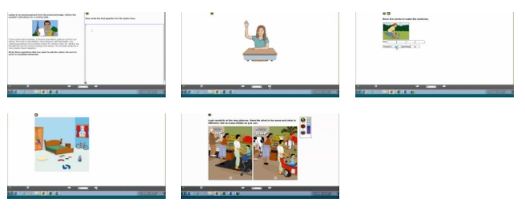
Sample Items
Sample items are available to show some of the presentation, interaction, and response actions that will appear on the English Language Proficiency Test.
The domain and grade level are indicated in the blue strip at the bottom of the screen.
Sample Items found here.

Slide 53
ELPT Resources

Slide 54
ELPT Resources
The LDOE has developed resources and other supports to assist planning for and providing standards-based instruction for English learners.. These resources can facilitate teacher planning and implementation with regard to curriculum, assessment and instruction.
Resources can be found here and they include:
Louisiana Connectors for English Learners
ELA-Connector crosswalk document
Task Analysis Tool

Slide 55
ELPT Resources
 | Available Now |  | Coming Soon
Standards | Connectors for English Learners
Assessment Resources |  |  | Assessment Guide (available late September) provides in-depth information about the test design. Online Tools Training (OTT) Test Coordinator and Administrator Manuals
Professional Development | 2016-2017 Teacher Leader and Summit Sessions |  | 2017-18 Collaborative Sessions Follow-up Summit Cohort trainings (Fall 2017 and Spring 2018)

Slide 56
Next Steps

Slide 57
Next Steps
Key Dates | Action
Now | Redeliver training to district and school staff Access the resources for Louisiana Connectors
October 23 | Plan to have teachers of students with significant disabilities attend the October webinar
November 9, 10, 14, and 16 | Plan to attend the November Supervisor Collaboration

