Slide 1
Improving Early Childhood Access and Quality

Slide 2
Agenda
Why Early Childhood Matters
Early Childhood and Super App
Early Childhood Blueprint and Super App
Early Childhood Access and Super App
Early Childhood Quality and Super App
Completing the Super App
Super App Timeline
Next Steps
Q & A

Slide 3
Notes:
2 minutes

Slide 4
Early Childhood and Super App
Academic Focus
In order to ensure students do the majority of the work every day,
All teachers—including special education, English language, and reading interventionists—are fully prepared to deliver high-quality lessons.
Principals, leadership teams, content leaders and mentor teachers use classroom observation, common planning time, and one-on-one coaching to support each teacher in delivering high-quality lessons.
School systems support principals and school teams as they provide support to teachers.
The Department supports school systems as they execute their improvement plans.
Notes:
2 minutes

Slide 5
Improvements to the 2020-2021 Strategy
CIR and UIR Improvements
Professional Development Plan: School systems submit a plan that includes content module redelivery and unit unpacking for CIR schools.
Post-secondary planning partner: Schools will have at least one partner to support Individual Graduation Plans (IGPs) at CIR high schools.
District leader responsible for UIR-D schools: School systems will have a leader to coordinate support and planning for UIR-D schools.
Other Strategy Improvements
Science: School systems can apply for funds to support the purchase of science curricula and the training of teachers on this curricula.
Early Childhood: The planning process for governance, access, and quality is now included in Super App.
Special Education: Funding for professional development on specialized supports is available for schools with a UIR label for the subgroup with students with disabilities.

Slide 6
School System Planning Framework
Area of Focus
Domain
Planning Questions
Domain and Row Number
Indicators

Slide 7
LEA Systems
This session will provide information related to the School System Planning Framework area(s) below.
LS2 | LONG TERM EARLY CHILDHOOD VISION
 | Indicator | Application Question
 | The school system, in partnership with its Lead Agency partners, has a long-term vision shared via a Community Network Blueprint. | What is the website address for the Community Network’s Blueprint?

Slide 8
LEA Systems
This session will provide information related to the School System Planning Framework area(s) below.
LS3 | EXPANDING EARLY CHILDHOOD ACCESS
 | Indicator | Application Question
 | The school system increases access to childcare centers and pre-kindergarten classrooms for children ages birth to four years old using a variety of strategies. Lead Agencies, in partnership with their early childhood community network, submit a Coordinated Funding Request. | Check all the strategies that the school system will use to maximize access to birth through three-year-old children within your community network. Check all the strategies that the school system will use to maximize access for four-year-olds within your community network. LEAs that are the Lead Agency for their early childhood community network: Please upload the completed Coordinated Funding Request template.

Slide 9
LEA Systems
This session will provide information related to the School System Planning Framework area(s) below.
LS4 | IMPROVING EARLY CHILDHOOD QUALITY
 | Indicator | Application Question
 | Teachers and staff of birth to four-year-old children have access to and implement high quality curriculum, receive orientation to curriculum training and ongoing support during the school year, and use high-quality curriculum-embedded and/or high-quality assessments to plan for individual needs of students. The Lead Agency ensures that central office and site administrators are trained on the CLASS observation tool, provide observation feedback to teachers, and use observation results to support staff improvement. | Identify the number of birth to five-year-old classrooms that will be newly using the following high quality curricula for the 2020-2021 school year. Identify the number of birth to five-year-old classrooms for which partner(s) will provide teacher professional development on the curricula. Which assessments (inclusive of screeners) will be used in pre-K (four-year-old) classrooms at CIR/UIR-Academics schools? Identify the number of birth to five-year-old classrooms for which partner(s) will provide teacher professional development on child assessments.

Slide 10
Why Early Childhood Matters

Slide 11
Why Early Childhood Matters
Brain Development
The first five years are the most critical in the development of a child’s brain. From birth to age three, children grow and learn at the most intense rate, forming more than a million neural connections every second; these are the years when children are learning how to learn. 90% of a child’s brain development happens before age 5. [1]

Slide 12
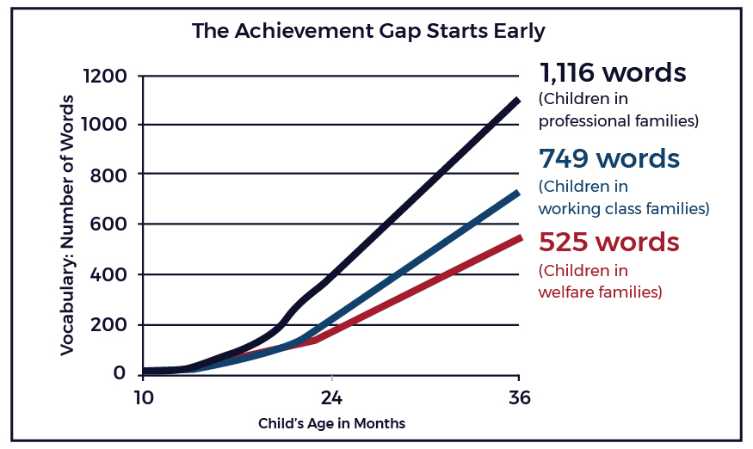
Why Early Childhood Matters
Achievement Gaps
Achievement gaps develop well before children begin kindergarten.
Unfortunately, many children who do not participate in high-quality early childhood programs are not fully prepared to begin school. Those most likely to begin kindergarten at an academic disadvantage are low-income and minority children. Children from disadvantaged families have less than 50% of the vocabulary their more affluent peers do. [2][3]
(Children in low-income families)

Slide 13
Why Early Childhood Matters
Statewide Access to Quality
Based on results from fall 2018 and the Oct. 1 child count, the majority of 4 year olds are receiving high-quality, publicly-funded care and education, but far fewer 0-3 year olds are.

Slide 14
Why Early Childhood Matters
Early Childhood Opportunity
PROBLEM
Too few children in need can access high-quality, affordable seats.

Slide 15
Early Childhood and Super App

Slide 16
Early Childhood and Super App
Overview
For the first time, communities will submit additional information related to early childhood, such as the community’s blueprint and its Coordinated Funding Request, through the Super App process.
The Early Childhood strategy sits in the LEA Structures domain.
Strategies communities will address through Super App for 2020-2021:
Blueprint: How will communities design a plan to expand access to quality early childhood programs?
Access: How can communities maximize existing funding to serve in-need children?
Communities will indicate what strategies they plan to use to expand access
Communities will submit their coordinated funding request through this process
Quality: How can communities continue to improve the quality of Birth to 5 seats through high quality curriculum, professional development, and assessments?
Guidance for completing the Early Childhood components of Super App can be found here.

Slide 17
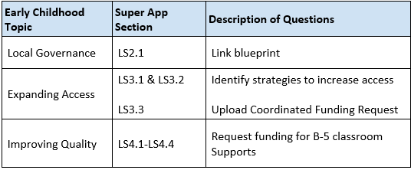
Early Childhood and Super App
Guidance
In order to complete the early childhood components of Super App, LEAs should partner with the early childhood community network’s lead agency and other community network partners. Guidance has been developed to provide additional information.
The guidance contains three key components:

Slide 18
Early Childhood and Super App
LEAs Serving as Lead Agencies
In cases where the entity completing Super App serves as both the school district and the early childhood lead agency, the entity, in coordination with their program partners, will complete all components of the Super App, including the Access and Quality questions and the Coordinated Funding Request upload.
Community networks serve children birth to five across centers and schools, and LEAs must work together with all programs to ensure all children within the community are accounted for in planning.

Slide 19
Early Childhood and Super App
LEAs Not Serving as Lead Agencies
In cases where the entity completing Super App is a Charter Management Organization (CMO) or an LEA that is not the early childhood lead agency for its community, there are special considerations for completing the early childhood components of Super App. You should work with your lead agency to:
Complete the blueprint (LS2.1) and submit the link.
Complete the Coordinated Funding Request (LS3.3) which will be submitted by your lead agency.
Prepare responses to the Access and Quality questions. All LEAs within the same community network should provide the same responses, inclusive of all sites in the community network, for these questions. They should be submitted by each LEA within the community network and reflect the collaborative strategies developed by each network.

Slide 20
Early Childhood and Super App
Who Should Complete the SuperApp, Blueprint, and CFR?
Parish or City School District | Who Completes SuperApp? | Who is responsible for the ECE Blueprint (LS2.1) and Coordinated Funding Request (LS3.3)?
Avoyelles | LEA | Volunteers of America (Avoyelles lead agency)
Central | LEA | Volunteers of America (Central lead agency)
City of Baker | LEA | East Baton Rouge Parish Schools (EBR/City of Baker lead agency)
City of Monroe | LEA | Children’s Coalition (Ouachita/City of Monroe lead agency)
Claiborne | LEA | Webster Parish Schools (Claiborne/Webster lead agency)
Madison | LEA | Delta Community Action Association, Inc. (Madison lead agency)
Morehouse | LEA | Children’s Coalition (Morehouse lead agency)
Orleans | OPSB and CMOs | NOEEN (Orleans lead agency)
Ouachita | LEA | Children’s Coalition (Ouachita/City of Monroe lead agency)
Richland | LEA | Children’s Coalition (Richland lead agency)
St. Mary | LEA | St. Mary Community Action Agency, Inc. (St. Mary lead agency)
Tensas | LEA | Catahoula Parish Schools (Catahoula/Tensas lead agency)

Slide 21
Early Childhood Blueprint and Super App

Slide 22
Early Childhood Blueprint and Super App
What is a blueprint?
The blueprint is a strategic plan, critical to any community’s success because it sets a vision for the community’s future, establishes agreed-upon goals, and lays out clear strategies to achieve those goals.
Your early childhood blueprint should include:
Analysis of network’s current state
Vision statement
Mission statement
3-5 goals on improving access to quality early childhood care and education, with accompanying strategies, resources, and performance metrics
Ready Start Networks and the Get Ready Cohort will be developing blueprints with technical assistance from the Department, but all community networks are encouraged to create one.

Slide 23
Early Childhood Blueprint and Super App
Completing the Blueprint Section
Blueprints must be developed with early childhood program partners, including Head Start and child care, and must be representative of what the community wants to achieve for children birth to five.
LEAs that are not the early childhood lead agency must work with their lead agency to develop, publish, and submit their community’s blueprint.
Communities that do not have a blueprint completed may type N/A in the box. This will impact the community’s prioritization for additional funding to improve quality and increased access.

Slide 24
Early Childhood Blueprint and Super App
Blueprint Questions
The Super App - Blueprint Guidance includes:
Details on all elements needed in the blueprint, including how to develop a mission statement, vision statement, and SMART (specific, measurable, attainable, realistic, time-bound) goals
Who should be involved in the process and and how this plan can be developed
Links to an Optional Workbook and a Suggested Template
Every district’s early childhood coordinator should know about their opportunities to get support to develop their blueprint.
They should contact lizzie.cosse@la.gov with any questions on their blueprint.

Slide 25
Early Childhood Access and
Super App

Slide 26
Early Childhood Access and Super App
Improving Early Childhood Access
Although Louisiana is serving nearly all of its in-need four year olds, affordable high-quality care is not available at the same level or scale for families of young children 0-3.
In early 2019, The Early Childhood Care and Education Commission unanimously approved recommendations for improving early care and education in Louisiana via their report, Funding Our Future: LA B to 3. This report outlines challenges experienced and suggested solutions for children birth to age three and their working parents across Louisiana relative to early learning.
While Louisiana currently serves 94% of four year olds in need, it serves 34% of threes and 7.13% of 0-2 year olds through subsidized care and education seats.
These levels of access vary by community:
While some serve every four year old in need, others may not yet have LA 4.
Some communities have several child care partners, others have few or no publicly-funded child care partners
LEAs have varying degrees of partnerships with their Head Start partners, or sometimes are the Head Start grantees
Super App asks LEAs to identify how they support access for in-need children birth to five.

Slide 27
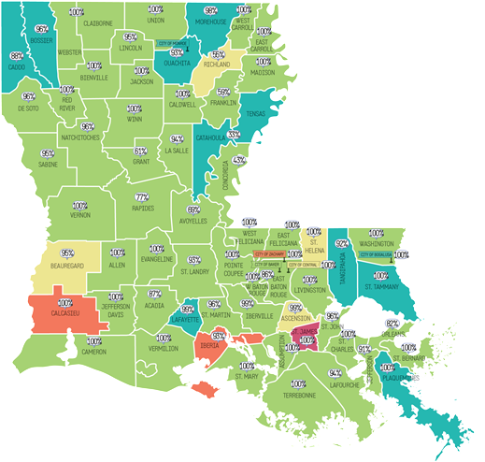
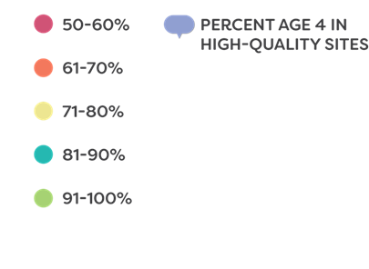
Early Childhood Access and Super App
Economically Disadvantaged Four Year Olds Served
Percent Economically Disadvantaged 4s Served

Slide 28
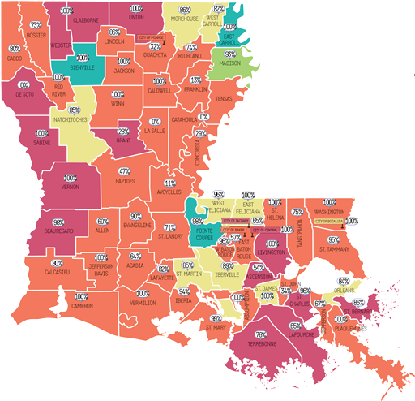
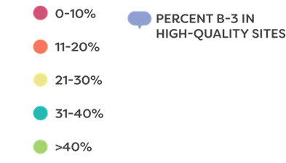
Early Childhood Access and Super App
Economically Disadvantaged Infant to Three Year Olds Served
Percent Economically Disadvantaged Infants-3 Served

Slide 29
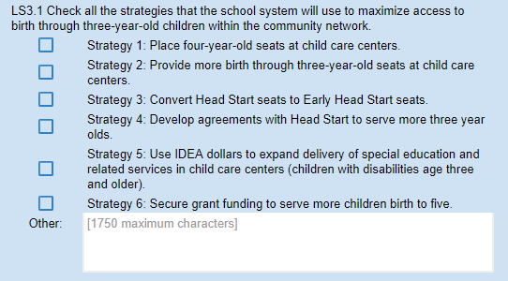
Early Childhood Access and Super App
Funding Strategies
Question LS3.1 asks LEAs to identify all funding strategies that apply to three-year-olds.
When answering this question, LEAs should identify all of the funding strategies they plan to use to serve birth through three year olds in the following school year.
If LEAs plan to use strategies not included here, they should select “Other” and provide a written description of the funding strategy(s) they plan to use.

Slide 30
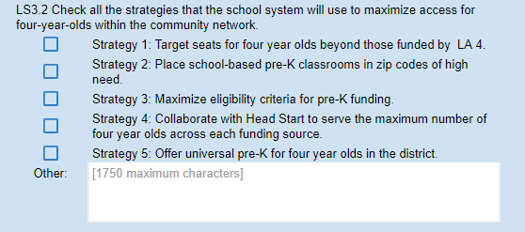
Early Childhood Access and Super App
Funding Strategies
Question LS3.2 asks LEAs to identify all funding strategies that apply to four-year-olds.
When answering this question, LEAs should identify all of the funding strategies they plan to use to serve or expand service for four year olds in the following school year.
If LEAs plan to use strategies not included here, they should select “Other” and provide a written description of the funding strategy(s) they plan to use.

Slide 31
Early Childhood Access and Super App
Coordinated Funding Request
Question LS3.3 ask LEAs that are the Lead Agency to upload the completed Coordinated Funding Request.
The link to the Coordinated Funding Request template can be located in Appendix A of the School System Planning Guide for item LS3.3. Once completed, LEAs who are Lead Agencies will upload it into Super App.

Slide 32
Early Childhood Quality and
Super App

Slide 33
Early Childhood Quality and Super App
Overview
Teachers in all early childhood settings need strong and coordinated professional development, curricula, and assessments that advance the quality and continuity of practice across early childhood and early elementary settings.
Successful implementation of high-quality curriculum and assessments requires the following:
Initial support: Provide pre-service PD for teachers and leaders that builds their familiarity with the structure, approach, and key components of high-quality curricula and assessments.
Ongoing, focused coaching: Build teachers’ and leaders’ ability to use the high-quality curricula and assessments; deepen knowledge of content and content pedagogy; build skill in using child data to meet the needs of all learners; and demonstrate how to use classroom observations to foster teacher leadership, collaboration, and improved implementation.

Slide 34
Early Childhood Quality and Super App
Overview
The Department has provided indicators of success for improving early childhood quality.
Teachers and staff of birth to five-year-old children have access to and implement high-quality curriculum, receive orientation to curriculum training and ongoing support during the school year, and use high-quality curriculum-embedded and/or high-quality assessments to plan for individual needs of students.
The lead agency ensures that central office and site administrators are trained on the CLASSⓇ observation tool, provide observation feedback to teachers, and use observation results to support staff improvement.

Slide 35
Early Childhood Quality and Super App
Overview
Each school system will respond to the following application questions relating to improving early childhood quality.
Identify the number of birth to five-year-old classrooms that will be newly using the following high-quality curricula for the 2020-2021 school year.
Identify the number of birth to five-year-old classrooms for which partner(s) will provide teacher professional development on the curricula.
Identify the number of birth to five-year-old classrooms for which partner(s) will provide teacher professional development on child assessment.

Slide 36
Early Childhood Quality and Super App
Curriculum
Question LS4.1 asks that LEAs identify high-quality curriculum.
Based on your blueprint, identify the number of birth to five-year-old classrooms, in each age band, that will be newly using the following high-quality curricula for the 2020-2021 school year.
School systems may request competitive funding at any school or center in the community network, whether it has a label or not, to support the purchase of new high-quality curriculum materials where high-quality curriculum was not previously in place.
Curriculum purchases can be made for any early childhood classroom within the district. This includes, Type III child care, Head Start/Early Head Start, and public and non-public pre-K.

Slide 37
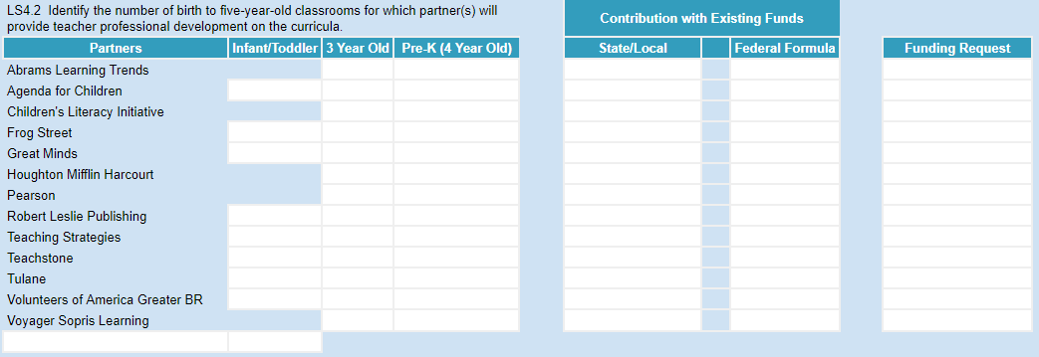
Early Childhood Quality and Super App
Curriculum-Aligned Professional Development
Question LS4.2 asks that LEAs identify curriculum-aligned professional development.
Based on your blueprint, identify the number of birth to five-year-old classrooms, in each age band, that will partner with vendors in the Professional Development (PD) Vendor Guide to provide curriculum-aligned professional development for each high-quality curriculum.
School systems may request competitive funding at any school or center in the community network, whether it has a label or not, to provide curriculum-aligned professional development.

Slide 38
Early Childhood Quality and Super App
Assessment-Aligned Professional Development
Question LS4.3 asks that LEAs identify assessment-aligned professional development.
Based on your blueprint, identify the number of birth to five-year-old classrooms, in each age band, that will partner with vendors in the PD Vendor Guide to provide assessment-aligned professional development.
School systems may request competitive funding at any school or center in the community network, whether it has a label or not, to provide assessment-aligned professional development.

Slide 39
Completing
Super App

Slide 40
Completing Super App
Overview
To complete Super App, each LEA must:
Link blueprint if available
Check strategies that apply
Upload their Coordinated Funding Request if serving as early childhood lead agency
Identify number of classrooms for which you are requesting funding to support with curriculum, PD, assessment
All of these activities will require lead agencies, LEAs, and program partners to work together to complete. Sufficient time for this coordination must be built into timeline for completing Super App.

Slide 41
Completing Super App
Additional Questions/comments
There are sections available on each tab that should be used to communicate any additional information.

Slide 42
Completing the Super App
Early Childhood Super App Timeline
School System Planning Guide, Early Childhood Super App Guidance, and Super App are released; school systems can begin the 2020-2021 planning process | November 4
Training and support for school systems is provided at Super App Launch events, including a session on early childhood and Super App | November 4-12
Training and support for early childhood lead agencies and partners at early childhood quarterly collaboration events, including a session on early childhood and Super App | November 5-14
Evaluate access strategies and finalize Coordinated Funding Request | December
Put Coordinated Funding Request out for feedback, compile responses Use performance profiles and fall CLASS® scores to help guide request for funding for curriculum, assessment and PD Finalize count of classrooms for each request | January
Super App due | February 7

Slide 43
Completing Super App
Next Steps
ECE coordinators and lead agencies will attend Early Childhood Collaborative Sessions
November 5 - Baton Rouge
November 6 - Harvey
November 13 - Baton Rouge
November 14 - Alexandria
Get Ready Webinars kick off
Wednesdays at noon from October 23 - January 22
Coordinated Funding Request Webinar
December 6 at noon
LDOE Funding/Early Childhood Quality/SRCL webinar
Late April

Slide 44
Q&A

Slide 45
Super App Support
Support for completing the Super App will be provided through
School Improvement Library
LDOE Weekly Newsletters
School System Planning and Superintendent Calls
Network Teams
Office Hours on scheduled Mondays at 11:00 AM (details via LDOE Weekly Newsletter)
Send all questions related to school system planning and Super App to LDOE.GrantsHelpDesk@la.gov and include“Super App” in the subject line.

