Slide 1
Individual Student Graduation Planning
and College and Career Transitional Supports

Slide 2
Agenda
Objectives
School System Planning
Background and Policy
Framework Question
Intervention Strategy
Cost Projections
Resources

Slide 3
Objectives
Participants will understand the importance of the individual student planning process and the components of a high-quality individual graduation plan. Participants will become familiar with intermediary support partners that can help students plan for success in high school and beyond.

Slide 5
Academic Focus
In order to ensure students do the majority of the work every day,
All teachers—including special education, English language, and reading interventionists—are fully prepared to deliver high-quality lessons.
Principals, leadership teams, content leaders and mentor teachers use classroom observation, common planning time, and one-on-one coaching to support each teacher in delivering high-quality lessons.
School systems support principals and school teams as they provide support to teachers.
The Department supports school systems as they execute their improvement plans.

Slide 6
Improvements to the 2020-2021 Strategy
CIR and UIR Improvements
Professional Development Plan: School systems submit a plan that includes content module redelivery and unit unpacking for CIR schools.
Post-secondary planning partner: Schools will have at least one partner to support Individual Graduation Plans (IGPs) at CIR high schools.
District leader responsible for UIR-D schools: School systems will have a leader to coordinate support and planning for UIR-D schools.
Other Strategy Improvements
Science: School systems can apply for funds to support the purchase of science curricula and the training of teachers on this curricula.
Early Childhood: The planning process for governance, access, and quality is now included in Super App.
Special Education: Funding for professional development on specialized supports is available for schools with a UIR label for the subgroup with students with disabilities.

Slide 7
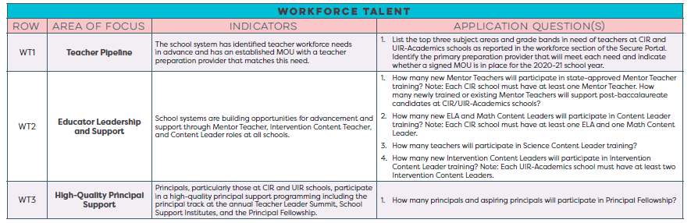
School System Planning Framework
Area of Focus
Domain
Planning Questions
Domain and Row Number
Indicators

Slide 8
Core Academics
This session will provide information related to the School System Planning Framework area(s) below.
CA4 | Individual Student Graduation Planning + College and Career Transition Supports
 | Indicator | Application Question
 | Every 9th grade student has an individual graduation plan inclusive of required coursework through the 10th grade. By the end of 10th grade each student chooses a diploma pathway, either TOPS University or Jump Start TOPS Tech and has an updated individualized graduation plan. Students have a plan that will allow them to successfully transition to college and/or career. | Which partners(s) will provide individual graduation planning (IGP) support at CIR high schools? Which partner(s) will provide financial aid planning and/or college and career transition supports at CIR high schools?

Slide 9
Background
The development and annual review of an individual graduation plan (IGP) prepares students for success in high school and beyond. Per Bulletin 741, “by the end of the eighth grade, each student shall begin to develop, with the input of his parent(s) or other legal custodians and school counselor, an individual graduation plan.” Each student chooses a diploma pathway at the end of tenth grade.
To meet this requirement, designated schools must have a comprehensive program of individual student planning for college and career readiness.
The Individual Student Graduation Planning Intervention Strategy will support, promote, and execute the IGP process at designated schools by funding intermediary support partners to assist schools in creating a comprehensive program of individual student planning for college and career readiness.

Slide 10
Intervention Strategy
All CIR schools have the opportunity to request up to $10,000 to work with an intermediary planning support partner to assist them with planning for student success.
In order to have CIR/UIR-A plans approved and to be eligible for any funding, CIR high schools must select at least one planning partner to support the IGP process and assist in creating a comprehensive program of individual student planning for college and career readiness. These partners must be selected from the Individual Student Graduation and Post-Secondary Planning Partners guide.

Slide 11
Intervention Strategy
Assistance from support partners might include the following activities:
providing professional development to strengthen knowledge of the IGP process
working directly with students to complete and maintain IGPs
  exploring career opportunities
  selecting and listing required courses
  aligning coursework to personal and academic interests
  selecting a graduation pathway
  applying for scholarships and financial aid
consulting with the school leadership team to create a comprehensive program

Slide 12
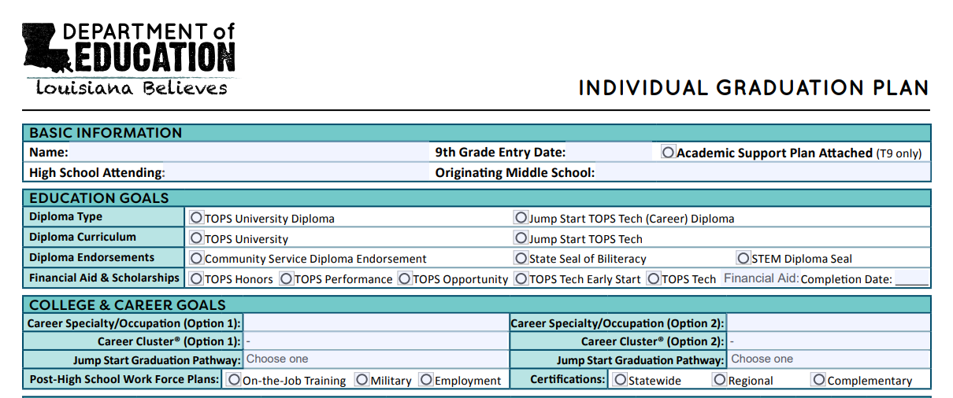
Intervention Strategy
Assistance from support partners might include the following activities:
providing professional development to strengthen knowledge of the IGP process
working directly with students to complete and maintain IGPs
  exploring career opportunities
  selecting and listing required courses
  aligning coursework to personal and academic interests
  selecting a graduation pathway
  applying for scholarships and financial aid
consulting with the school leadership team to create a comprehensive program

Slide 13
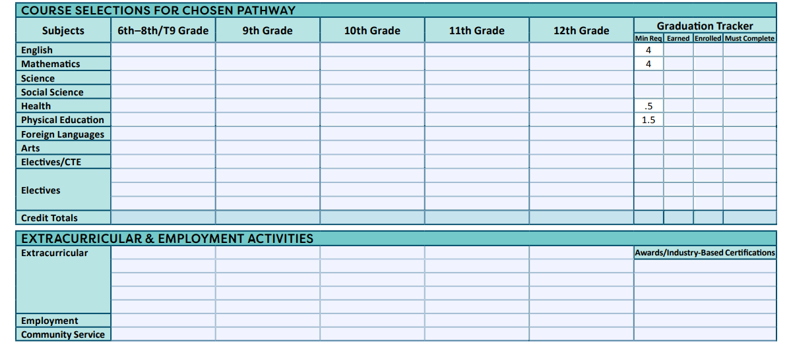
Intervention Strategy
Assistance from support partners might include the following activities:
providing professional development to strengthen knowledge of the IGP process
working directly with students to complete and maintain IGPs
  exploring career opportunities
  selecting and listing required courses
  aligning coursework to personal and academic interests
  selecting a graduation pathway
  applying for scholarships and financial aid
consulting with the school leadership team to create a comprehensive program

Slide 14
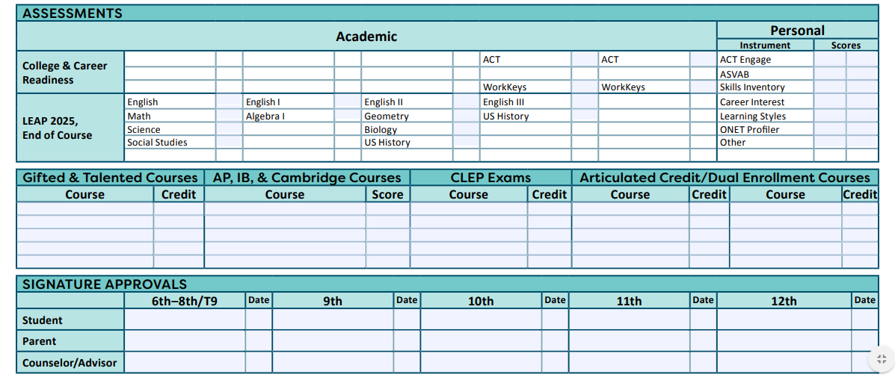
Intervention Strategy

Slide 15
Cost Projections
The Office of Student Opportunities is inviting CIR schools to apply for grants to support their IGP processes, procedures, and completions.
Up to 74 schools will receive funding to support these partnerships during the 2020-2021 academic year.
Based on the plans they submit to the Department, a school may receive a maximum allocation of $10,000 to support the IGP intervention and implementation process.

Slide 16
Resources
High School Planning Guide
Individual Graduation Plan fillable form
Individual Graduation Plan Guidance
Individual Student Graduation and Post-Secondary Planning Partners

Slide 17
Super App Support
Support for completing the Super App will be provided through
School Improvement Library
LDOE Weekly Newsletters
School System Planning and Superintendent Calls
Network Teams
Office Hours on scheduled Mondays at 11:00 AM (details via LDOE Weekly Newsletter)
Send all questions related to school system planning and Super App to LDOE.GrantsHelpDesk@la.gov and include “Super App” in the subject line.

