Slide 1
LEAP 360: Interim Assessments
District Level Administrators

Slide 2
Today’s Goals
By the end of today’s session, we’ll address these questions:
What is LEAP 360’s role in Louisiana’s classrooms, schools, and school systems?
What do LEAP 360 Interims Assessments tell us about student learning?
How does the Quick Start Guide prepare me for implementation?
What support and logistical resources are available?

Slide 3
LEAP 360: An Overview

Slide 4
LEAP 360: Streamlining Assessment
There are three main purposes for classroom assessment:
Know where students are when they enter a classroom.
Monitor how students are learning content over the year.
Verify what students have learned.
LEAP 360 pairs with LEAP 2025 to reduce overall testing time while realizing all three purposes.

Slide 5
LEAP 360:
Interim Assessments
Assessment Tool | Includes | Recommended Window | Reporting
ELA Interim Assessment for Grades 3-8, English I and English II | 2 forms in grades 3-8; 3 forms in high school courses | Based on curriculum and instructional pacing | Student, Groups, School, District, State
Math Interim Assessments for Grades 3-8, Algebra I, and Geometry
The interim assessments are designed to allow districts, schools, and teachers to:
Analyze student data to identify student-specific and classwide patterns in learning and misconceptions
Adjust instruction and target support for students in need
Gauge progress toward end-of-year goals

Slide 6
Interim Assessments
ELA Interim Assessments
There are two forms for grades 3-8 with three sessions, and three forms for high school with two sessions.
In grades 3-8, there are two versions of each form: 1A and 1B and 2A and 2B. Each version has a different writing task, (e.g., 1A has a research-focused task, 1B has a literary analysis task).
For high school, each of the three forms will focus on a different writing task: research simulation, literary analysis, and narrative.
Each form focuses on a set of standards.
Math Interim Assessments
There are two forms for grades 3-8.
Grades 3-5 Form 1 have one session and Form 2 has two sessions.
Grades 6-8 Forms 1 and 2 have two sessions.
There are three forms for high school with two sessions each.

Slide 7
Turn and Talk
How did your district implement the Diagnostic Assessments?
How have Diagnostic Assessments impacted your teachers’ instruction?
What procedures are you adjusting for Interims based off of lessons learned from Diagnostics?

Slide 8
LEAP 360 Interim Assessments:
Reporting on Student Readiness

Slide 9
Today’s Goals
By the end of today’s session, we’ll address these questions:
What is LEAP 360’s role in Louisiana’s classrooms, schools, and school systems?
What do LEAP 360 Interim Assessments tell us about student learning?
How does the Quick Start Guide prepare me for implementation?
What support and logistical resources are available?

Slide 10
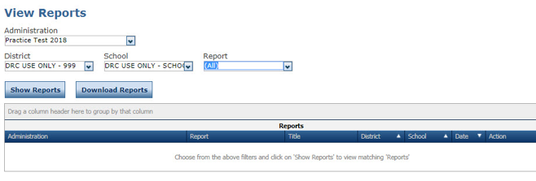
LEAP 360 Interim Assessments: Reports
To access LEAP 360 reports in eDIRECT:
Report Delivery > View Reports
Select Student Reports from the Report Delivery menu
Specify an administration, district, school, and report. You can complete other fields on the window, if needed. Click Find Students.
From the search results, you can select one or more students. Click Open Selected to open the reports for the selected students. Click Save Selected to save the reports for the selected students in .pdf format.

Slide 11
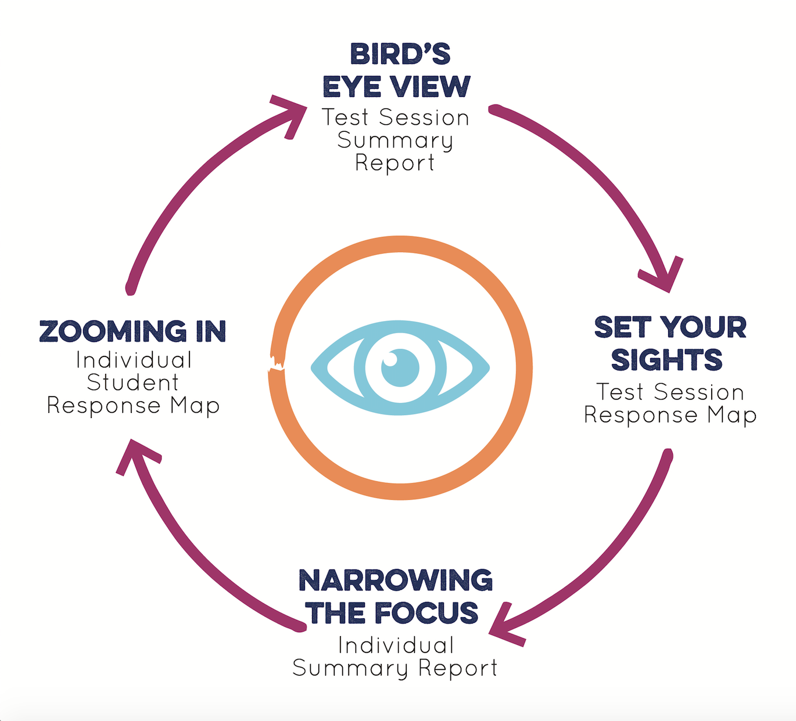
LEAP 360 Interim Assessments: Reports
LEAP 360 reports are designed to work together, taking teachers through a specific process.
Group Analysis:
Test Session Summary Report
Test Sessions Response Map
School Summary Report
Individual Analysis:
Student Summary Report
Student Response Map

Slide 12
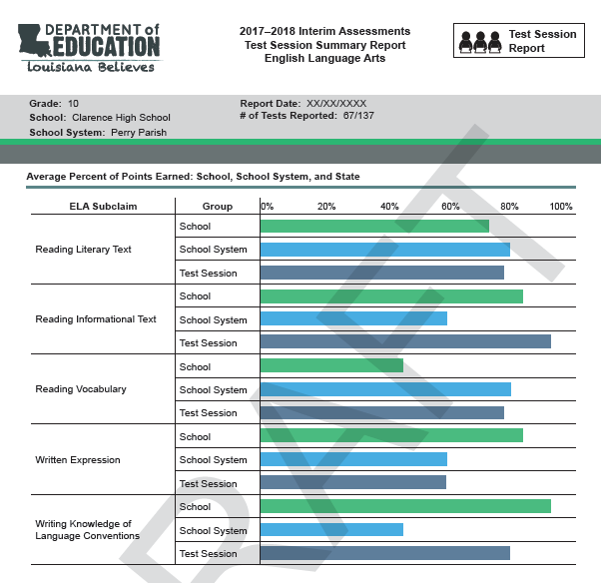
LEAP Interim Assessments: Reports
Bird’s Eye View:
Test Session Summary Report
used to get a quick overview of student performance in a test session
gives a visual representation of areas of readiness and areas for intervention
most common “group” is a class; schools and districts set up the test groups in a variety of ways
Indicates level of report and give contextual information
Teacher can see class/ group performance as it compares to school and district performance

Slide 13
LEAP 360 Interim Assessments: Reports
Bird’s Eye View:
Test Session Summary Report
ELA reports out by reading and writing sub claim
Math reports out by domain of major work
The information on this report is relative to the progress of all possible testers and test sessions
Summary reports will be updated every two weeks.

Slide 14
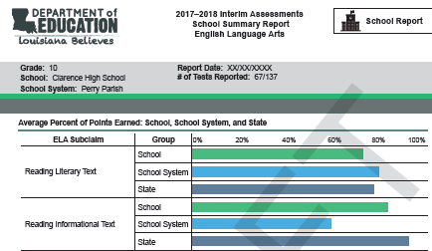
LEAP 360 Interim Assessments: Reports
Bird’s Eye View: School Summary Report:
ELA reports out by reading and writing subclaims
Math reports out by domains of major work
The information on this report is relative to the progress of all possible testers and test sessions.
Summary reports are updated every two weeks.

Slide 15
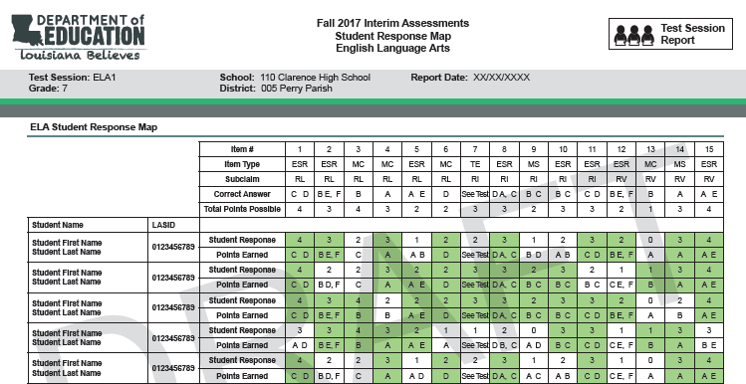
LEAP 360 Interim Assessments: Reports
Set Your Sights:
Test Session Response Map
Includes responses of all students within a test session
Provides information about item type, subclaim alignment, correct answer, and total points possible.
Color-coding quickly identifies right and wrong responses.

Slide 16
LEAP 360 Interim Assessments: Reports
Set Your Sights:
Test Session Response Map
When read horizontally, a teacher can see each individual student’s response to each item.
When read vertically, a teacher can see how the whole group performed on a single item
Patterns for both group and individual patterns emerge

Slide 17
LEAP 360 Interim Assessments: Reports
Set Your Sights:
Test Session Response Map
Pairs well with test answer keys to uncover specific standards or skills that will require additional instructional planning
This information can be used to make decisions about pacing for the coming year

Slide 18
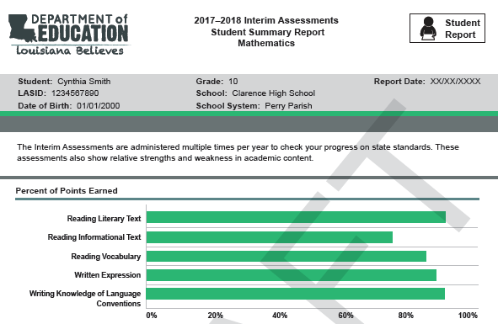
LEAP 360 Interim Assessments: Reports
Narrowing the Focus
Student Summary Report
provides a snapshot information of a single student’s performance
Identifies relative areas of strength and weakness
Provides an opportunity to observe change in performance from one interim to another
Teachers, students, and even parents can see a student’s relative areas of strength or weakness.

Slide 19
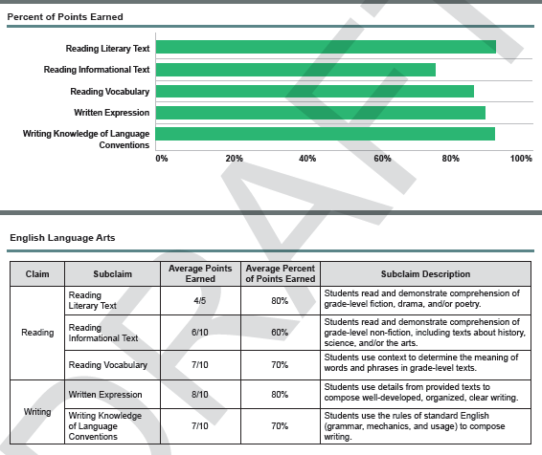
LEAP 360 Interim Assessments: Reports
Narrowing the Focus
Student Summary Report
gives a visual representation of areas of relative strengths and weaknesses
useful in parent-teacher conferences or in goal-setting conferences with students

Slide 20
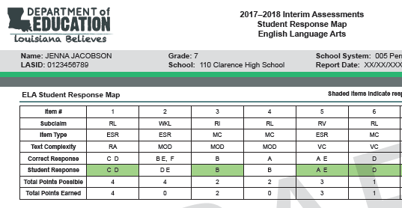
LEAP 360 Interim Assessments: Reports
Zooming In:
Student Response Map
Pinpoint student abilities and investigate misconceptions
Provides information about item type, subclaim alignment, text complexity, correct answer, and total points possible.
Color-coding quickly identifies right and wrong responses.

Slide 21
LEAP 360 Interim Assessments: Reports
Zooming In:
Student Response Map
Works well with existing instructional support tools
Diverse Learners Guide for ELA
Remediation Guides for mathematics

Slide 22
LEAP 360 Interims Assessments: Instructional Planning
Once this level of analysis occurs, teachers should:
Work with students to monitor learning goals for the year
Identify specific content that will need more intensive instruction as it is approached throughout the year and work to build-in additional time or scaffolding accordingly
Recognize patterns in both individual and group learning or learning misconceptions and use that information to create focused intervention groups
Once this level of analysis occurs, teachers should not:
Reteach the lessons addressing the missed standards to the entire class again and readminister the interim assessment to see if students “got it”
Have students work the problems on the interim assessment repeatedly

Slide 23
LEAP 360 Interim Assessments: Instructional Planning
Where to Go and What to Do
More than likely, LEAP 360 assessments will indicate that individual students, groups of students, or even whole classes are in need of additional support or remediation in specific areas.
The K-12 ELA Planning Resources page provides links to a variety of resources that give teachers access to Guidebook 2.0, instructional strategies, LEAP 2025 assessment guides, and several other tools.
The K-12 Math Planning Resources page provides links to a variety of resources including sample year plans, companion documents, LEAP 2025 assessment guides, and several other tools.

Slide 24
Math Resources
Math Tools on the Math Planning Page
Understand the Standards
K-12 Louisiana Student Standards for Math
Teacher Companion Documents
Focus Documents
Rigor Documents
Implement the Eureka Curriculum
Louisiana Eureka Guides (updated)
Help Students who Struggle
Remediation Guides
Eureka Remediation Tools (new)
Assess the Standards
LEAP 360 (diagnostics, interims, EAGLE)
Summative Assessment Guidance
Year-long Planning
Sample Year Plans
Sample Middle School Accelerated Plans

Slide 25
English Language Arts Resources
Understand the Standards
K-12 Louisiana Student Standards for ELA
Implement the Guidebooks 2.0
Guidebooks 2.0
Approach Guides, Learning Tools, and Instructional Strategies
Language Tasks – Mentor Sentences
Help Students who Struggle
Diverse Learners Guide
Louisiana Connectors for Students with Significant Disabilities
Louisiana Connectors for ELS
Assess the Standards
LEAP 360 (diagnostics, interims, EAGLE)
Summative Assessment Guidance

Slide 26
Accessing the LEAP 360 ELA Interim Assessments
Teachers can use the LEAP 360 Interim Assessment Teacher Access link to access the Interim assessments. Teacher access for Interim 1 for grades 3 through high school and Interim 2 for high school are currently available. The usernames and passwords below are for Interim 1.
Grade | Option 1A |  | Option 1B
 | User Name | Password | User Name | Password
3 | INT1_ELA1A3 | LEAP360 | INT1_ELA1B3 | LEAP360
4 | INT1_ELA1A4 | LEAP360 | INT1_ELA1B4 | LEAP360
5 | INT1_ELA1A5 | LEAP360 | INT1_ELA1B5 | LEAP360
6 | INT1_ELA1A6 | LEAP360 | INT1_ELA1B6 | LEAP360
7 | INT1_ELA1A7 | LEAP360 | INT1_ELA1B7 | LEAP360
8 | INT1_ELA1A8 | LEAP360 | INT1_ELA1B8 | LEAP360
High School
Eng I | INT1_ENG1 |  | LEAP360
Eng II | INT1_ENG2 |  | LEAP360

Slide 27
Accessing the LEAP 360 Math Interim Assessments
Teachers can use the LEAP 360 Interim Assessment Teacher Access link to access the Interim assessments. Teacher access for Interim 1 for grades 3 through high school and Interim 2 for high school are currently available. The usernames and passwords below are for Interim 1.
Grade | User Name | Password
3 | INT1_MATH3 | LEAP360
4 | INT1_MATH4 | LEAP360
5 | INT1_MATH5 | LEAP360
6 | INT1_MATH6 | LEAP360
7 | INT1_MATH7 | LEAP360
8 | INT1_MATH8 | LEAP360
Algebra | INT1_ALG1 | LEAP360
Geometry | INT1_GEOM | LEAP360

Slide 28
Today’s Goals
By the end of today’s session, we’ll address these questions:
What is LEAP 360’s role in Louisiana’s classrooms, schools, and school systems?
What do LEAP 360 Interim Assessments tell us about student learning?
How does the Quick Start Guide prepare me for implementation?
What support and logistical resources are available?

Slide 29
LEAP 360 Interim Assessments:
Quick Start Specifics

Slide 30
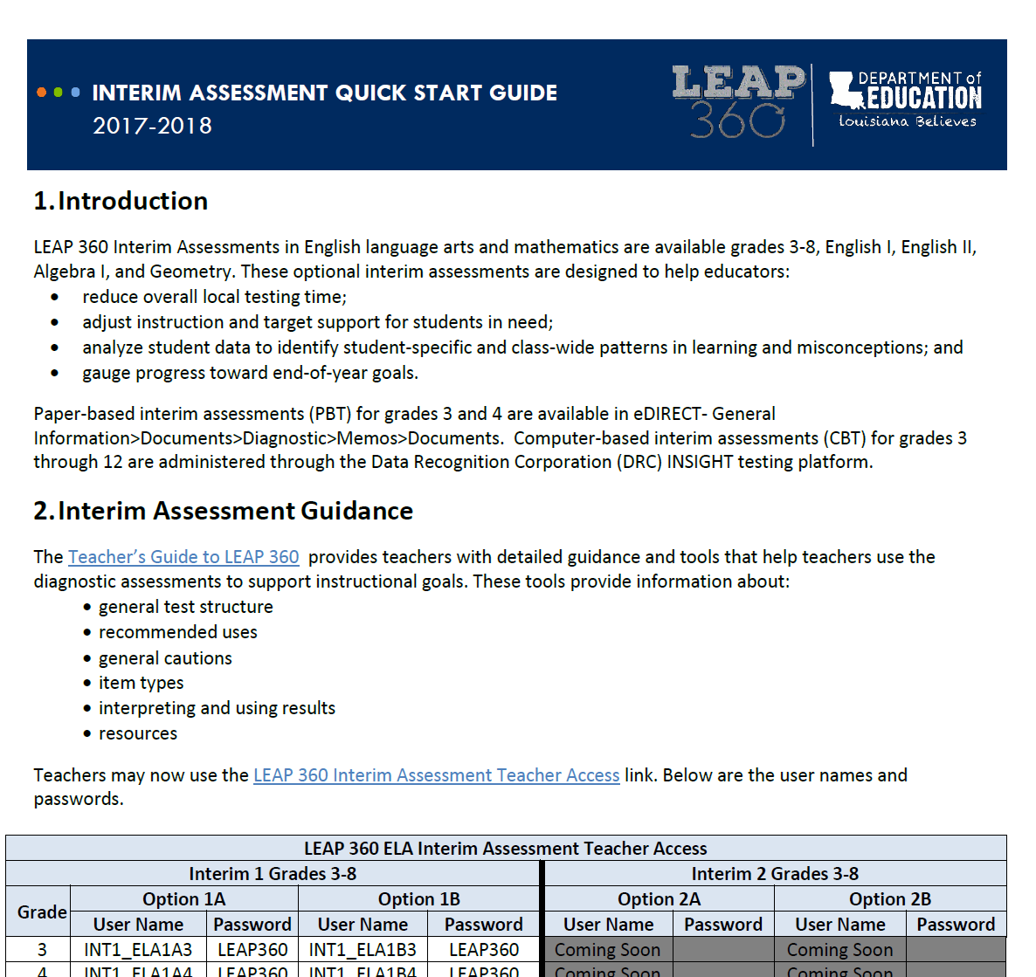
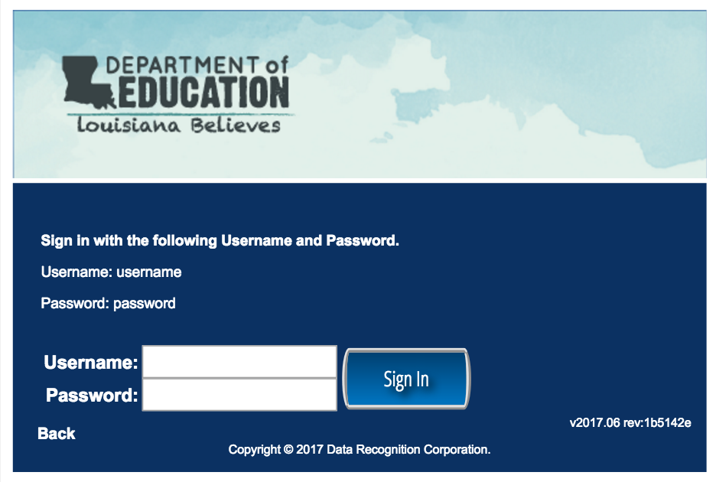
LEAP 360 Interim Assessments: Teacher Access
To access LEAP 360 Interim Assessments, teachers should:
Visit the LEAP 360 webpage to access the Interim Assessment Quick Start Guide.
Using Google Chrome, follow the Teacher Access link and enter the username and password for desired content area and grade level.

Slide 31
Interim Assessment Guidance
Interim Assessment Guidance documents are highlighted in the second section of the Quick Start Guide.
Guidance documents for ELA and mathematics provide information as to how teachers may use the interim assessments to support their instructional goals. The guidance documents, located in the Teacher’s Guide to LEAP 360, include information about:
General test structure
Recommended uses of the interim tests
General cautions
Item types
Interpreting and using results
Resources

Slide 32
Online Test Administration
The third section of the Quick Start Guide provides information about test administration.
To prepare for the administration of the Interim Assessment, districts must complete the following tasks in eDIRECT:
Upload students
Assign and view accommodations
Create test sessions
Generate and print test tickets
Review resources in eDIRECT

Slide 33
Nonsummative Test Security
Nonsummative Test Security Reminders
All LEAP 360 system components are considered copyrighted materials and therefore belong to the originator and shall not be considered LEA property. All applicable copyright laws shall be enforced and adhered to under the terms of this agreement.
The content may NOT be used or published in part or in whole outside of the prescribed purposes set forth by the Louisiana Department of Education (LDOE). Assessment items and passages can only be used in the assessment delivery platform operated by DRC.
Accommodated Materials Reminder
Secure documents must be kept in a locked, secure area before and after testing. It must be returned immediately to the School Test Coordinator after the scheduled testing has ended for the day. When testing is completed, the School Test Coordinator must return the materials to the District Test Coordinator.

Slide 34
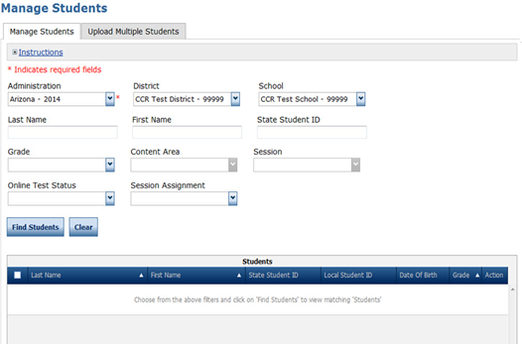
Student Management
Students may either be added individually or in an upload for multiple students.
Districts will use a file layout inclusive of accommodations. This file layout can be used for all
non-summative assessments.

Slide 35
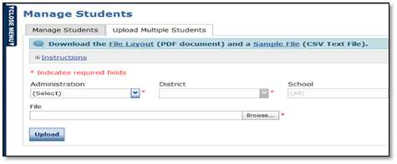
Uploading Students
To upload multiple students from the Student Management menu:
Select Manage Students to display the Manage Students page
Select the Upload Multiple Students tab.
Review the required file layout .PDF with instructions for how to create and format the file.
Once the .csv file is ready, upload the file. All students will automatically be placed into test sessions.
All Interim assessments are all housed under the Interim administration. Schools will create test sessions by Interim and content. Districts will not need to upload separate files for Interims 2 and 3.

Slide 36
Adding Accommodations and Accessibility Features
If accommodations need to be added manually, use the following steps:
Go to the Student Management tab and search for the student.
Select the student, then click on Edit Student.
Click on the Accommodations tab within Edit Student.
Select the required accommodation (s), then click on Save.
Set accommodations will be indicated on test tickets.

Slide 37
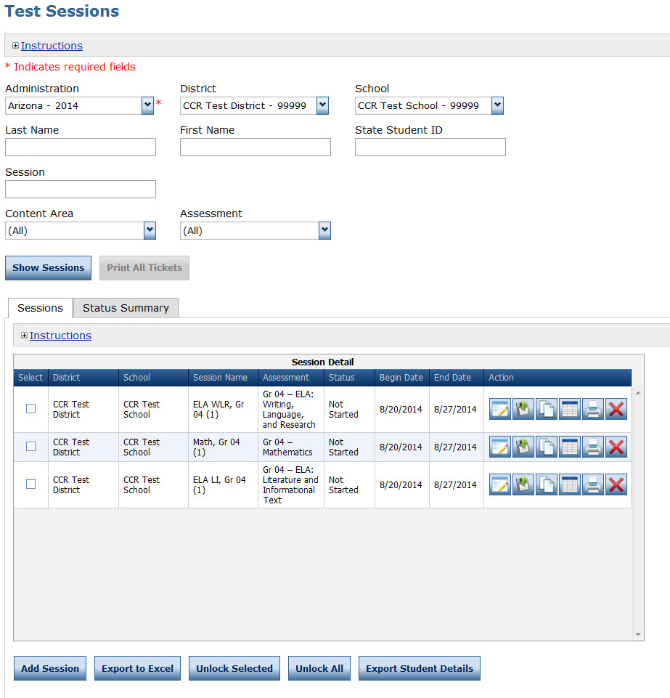
Test Session Management
Once all students are uploaded to eDIRECT, test sessions must be created. One test session is created within the system for each group of students taking a test.
For example, a group of students taking the 3rd grade Math Interim would be grouped into one test session which would generate a test ticket for each student for each part of the test.

Slide 38
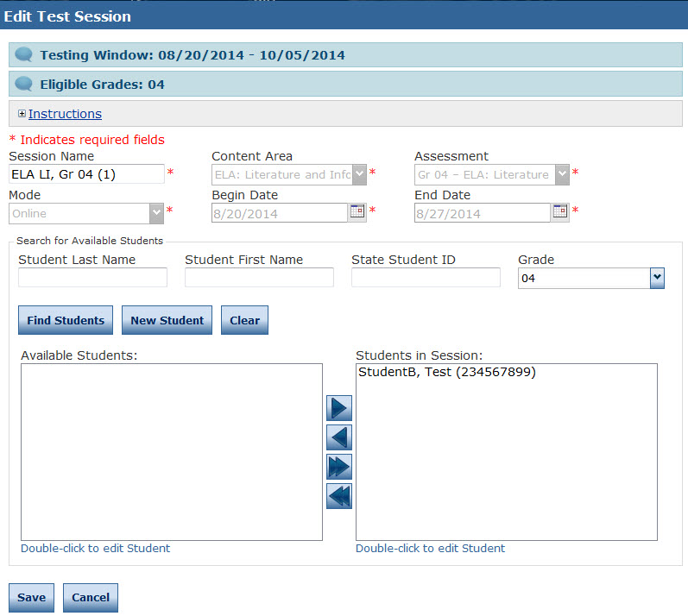
Creating and Editing Test Sessions
To create a Test Session, click on Add Session from the Test Session screen.
Populate the session details, then click on Find Students. This will display all the available students for the test session, by grade and content area.
To add the students to the test session, select the student, then click on the right facing arrow to add the students to the session.
Complete the above steps until all students are added to test sessions.

Slide 39
Viewing Test Sessions
Search and view Test Sessions by clicking on Show Sessions.

Slide 40
Printing Test Tickets and Rosters
School Test Coordinators or Test Administrators must print Test Tickets and Rosters prior to testing session.
Test Tickets contain test login information; tests are activated once a student logs in with username and password provided on Test Ticket.
Test Administrators must verify that each student has their correct Test Ticket.

Slide 41
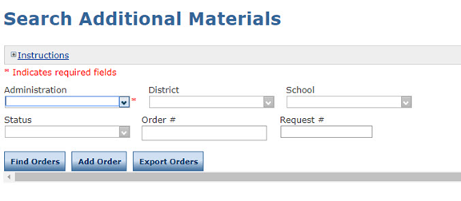
Accommodated Materials
Accommodated materials will be housed in eDIRECT. Only braille is ordered as additional materials.
To order additional materials, select Additional Materials from the Materials menu. The Search Additional Materials window will open.
To place a new order, select an Administration, District, and School, then click Add Order.
Enter material counts for the additional materials the district requires.

Slide 42
General Scoring Information
The fourth section of the Interim Quick Start Guide provides information and links to resources needed to score both the paper- and computer-based tests.
The way in which Interim tests are scored depends upon the mode in which the test is administered—either paper-based or computer-based.

Slide 43
LEAP 360 Interim Assessments: Scoring
The interim assessments will be scored like the practice tests:
Paper-based interims will be scored by teachers
Computer-based interims will be scored using a combination of automated and teacher scoring
Answer keys for and scoring guidance will be provided
The following interim reports will be available:
Item response maps
Summary reports
In order to generate a report, paper-based test responses must be transferred to the online platform.
The Educator Scoring system is available from 6:00 AM to 9:30 PM everyday.

Slide 44
Scoring Responses
A few general notes about using the Educator Scoring application:
Teachers will need to be given Educator Scoring permissions within eDIRECT in order to score student responses.
Rubrics and scoring guides for constructed- and extended-response items are located in the Answer Key documents in eDIRECT.
DRC INSIGHT does not need to be installed on the machine used for scoring.
Scoring is to be completed using a computer or laptop with Chrome or Internet Explorer 11 installed.
Teachers may include comments and other notations on student responses while scoring.
The ability to print student responses is available to users when scoring activity is live. If you wish to print a copy of the response, you MUST use the Export to PDF tool to print the student's response and educator feedback that is displayed on the screen. This must be done PRIOR to submitting the score.

Slide 45
Online Reporting
The final section of the Interim Quick Start Guide focuses on reporting.
Points for constructed response items will be be added to the reports no later than 24 hours after the teacher completes the scoring process.
The following report types will be available to schools and districts within 24 hours of test completion.
Group Analysis:
Test Session Summary Report
Test Sessions Response Map
School Summary Report
Individual Analysis:
Student Summary Report
Student Response Map

Slide 46
Accessing Reports
The eDIRECT User Guide explains how to access the computer-based test reports in eDIRECT and gives an explanation of the reports provided. All reports are available under the Reports Delivery tab. There are two options: Student Reports and View Reports.
Student Reports displays student reports that include all tests a student has taken for that administration.
View Reports displays reports by test session.

Slide 47
LEAP 360 Interim Assessments:
Support and Logistical Resources

Slide 48
Today’s Goals
By the end of today’s session, we’ll address these questions:
What is LEAP 360’s role in Louisiana’s classrooms, schools, and school systems?
What do LEAP 360 Interim Assessments tell us about student learning?
How does the Quick Start Guide prepare me for implementation?
What support and logistical resources are available?

Slide 49
Turn and Talk
How has your district planned for Interim implementation?
How will your schools schedule the Interim assessments?
What are schools doing after they receive Interim data?
How are you ensuring principals and teachers understand the purposes of Interims?

Slide 50
LEAP 360 Interim Assessments: Resources
The following resources are available to help teachers understand, access, and use the LEAP 360 Interim assessments:
LEAP 360 webpage
A Teacher’s Guide to LEAP 360
LEAP 360 Interim Assessment Quick Start Guide
eDIRECT
2017-2018 Educator Resource Guide
Accessibility Features and Accommodations Overview
Please contact assessment@la.gov with any LEAP 360 questions or suggestions throughout the school year.

