Slide 1
Mentors and Content Leader: Trainings and Policy
November 2019

Slide 2
Objectives
In this session, participants will:
Understand how to ensure that Mentors and Content Leaders are appropriately prepared and certified.
Discuss strategies for ensuring that teachers complete required assessments needed to become appropriately certified.
Understand how Mentors and Content Leaders can be used as part of a high-quality plan for teacher professional development and support.

Slide 3
Agenda
Background and Policy
Accessing Mentor and Content Leader training
Assessment requirements and certification
Using Mentors and Content Leaders for high-quality PD

Slide 5
Academic Focus
In order to ensure students do the majority of the work every day,
All teachers—including special education, English language, and reading interventionists—are fully prepared to deliver high-quality lessons.
Principals, leadership teams, content leaders and mentor teachers use classroom observation, common planning time, and one-on-one coaching to support each teacher in delivering high-quality lessons.
School systems support principals and school teams as they provide support to teachers.
The Department supports school systems as they execute their improvement plans.

Slide 6
Improvements to the 2020-2021 Strategy
CIR and UIR Improvements
Professional Development Plan: School systems submit a plan that includes content module redelivery and unit unpacking for CIR schools.
Post-secondary planning partner: Schools will have at least one partner to support Individual Graduation Plans (IGPs) at CIR high schools.
District leader responsible for UIR-D schools: School systems will have a leader to coordinate support and planning for UIR-D schools.
Other Strategy Improvements
Science: School systems can apply for funds to support the purchase of science curricula and the training of teachers on this curricula.
Early Childhood: The planning process for governance, access, and quality is now included in Super App.
Special Education: Funding for professional development on specialized supports is available for schools with a UIR label for the subgroup with students with disabilities.

Slide 7
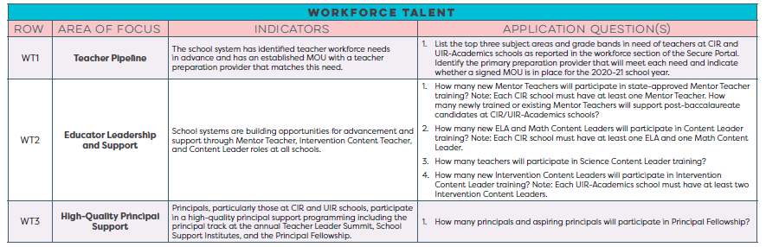
School System Planning Framework
Area of Focus
Domain
Planning Questions
Domain and Row Number
Indicators

Slide 8
Workforce Talent
This session will provide information related to the School System Planning Framework area(s) below.
WT2 | Educator Leadership and Support
 | Indicator | Application Question
 | School systems are building opportunities for advancement and support through Mentor Teacher, Intervention Content Teacher, and Content Leader roles at all schools. | How many new Mentor Teachers will participate in state-approved Mentor Teacher training? Note: Each CIR school must have at least one Mentor Teacher. How many newly trained or existing Mentor Teachers will support post-baccalaureate candidates at CIR/UIR-Academics schools? How many new ELA and Math Content Leaders will participate in Content Leader training? Note: Each CIR school must have at least one ELA and one Math Content Leader. How many teachers will participate in Science Content Leader training? How many new Intervention Content Leaders will participate in Intervention Content Leader training? Note: Each UIR-Academics school must have at least two Intervention Content Leaders.

Slide 9
Background and Policy

Slide 10

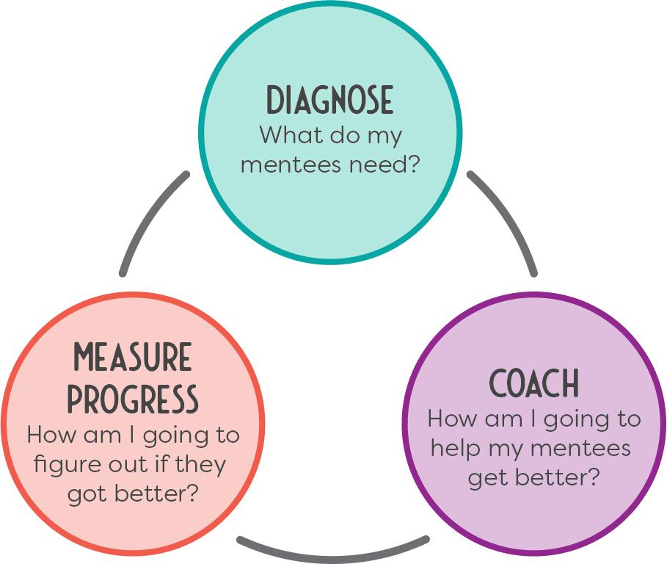
Leadership Roles
Content Leaders
Provide content- and curriculum-specific professional development to teachers in their school and school system using turnkey session materials
Lead professional learning communities in schools
Lead sessions at school and school system professional development days
Mentor Teachers
Host an undergraduate resident and co-teach with that resident for the full school year.
Mentor post-baccalaureate residents who are teaching while earning their initial license or mentor experienced teachers in need of support.
  Provide one-on-one coaching
  Review instructional materials and student work
  Lead frequent observation/feedback cycles

Slide 11
Intervention Content Leader
Who are they?
Intervention Content Leaders are teachers and administrators who work together in their respective roles to
ensure all students who struggle can access a high-quality, on grade level curriculum.
What do they do?
Intervention Content Leaders (Teachers)
Train teachers to use core instruction and intervention time effectively through PLC facilitation
Support general education teachers in lesson preparation
Intervention Content Leaders (Administrators)
Ensure all teachers in the school use effective intervention strategies and that staffing and scheduling decisions support collaboration and lesson preparation

Slide 12
Policy Update
In the fall of 2017, the LDE launched a statewide training initiative to develop a cadre of Mentor Teachers and Content Leaders.
In October 2018, BESE approved regulations to establish mentor teacher and content leader credentials in the form of an ancillary certificate.
Additionally, BESE approved regulations that will enable mentor teacher or content leader training, experience, and credentialing to contribute to a school leader license.
These shifts honor the hard work and expertise of those serving as trained mentors or content leaders.

Slide 13
Policy Timeline
Summer 2019
Department begins to issue Content Leader and Mentor Teacher ancillary certificates to individuals who have successfully completed a state-approved Content Leader or Mentor Teacher training program, including state-led training, and have a passing score on the Louisiana Content Leader or Mentor Teacher Assessment Series
September 1, 2020
Mentor Teacher ancillary certificate required for individuals who serve as a mentor of undergraduate or post-baccalaureate teacher residents
September 1, 2023
Supervisor of Student Teaching certificate replaced by Mentor Teacher ancillary certificate

Slide 14
Training

Slide 15
Mentor Teacher Training
Mentor Teachers will have the knowledge, skills, and resources to provide effective, ongoing one-on-one support to new and current teachers in their schools. To accomplish this, Mentor Teachers receive Nine (9) days of high-quality, content-rich and curriculum-specific trainings which teaches them how to:
establish a strong relationship and use a coaching cycle to support teachers’ growth
prioritize the needs of residents, new, and/or developing teachers based on teacher preparation competencies
build deep knowledge of content and content pedagogy in their subject(s)
gain the knowledge and skills they need to effectively help others use high-quality instructional materials

Slide 16
Content Leader Training
Content Leaders will have the knowledge, skills, and concrete resources to provide high-quality professional development to new and current teachers in their district.
To accomplish this, Content Leaders will receive:
  Nine (9) days of free, high-quality, content-rich and curriculum-specific trainings
    deep knowledge of ELA or math content and content pedagogy,
    the knowledge and skills they need to effectively use and help others use the ELA Guidebooks 2.0 or Eureka Mathematics curriculum, and
    best practices for facilitating high-quality learning experiences for fellow educators.
  Free access to and training on six (6), turn-key ELA (grades 3-10) or math (grades K-9) content modules to use to train fellow educators (36 hours total)
*In addition to ELA and Math Science Content Leader training will be added in summer of 2020

Slide 17
Mentor Teacher and Content Leader Trainings
To transition to state-provided training to state-approved trainings for Mentor Teachers and Content Leaders after 2019-2020, BESE has begun to approve several providers to offer these trainings.
The following programs are approved for their Mentor Teacher or Content Leader training programs.
Mentor Teacher Training | Mentor Teacher Training | ELA Content Leader Training | Math Content Leader Training
A+PEL Grambling State University Learning Forward* Louisiana Tech University NIET Nicholls State University McNeese State University | Southeastern Louisiana University Southern University and A&M College Teaching and Learning Center University of Louisiana at Lafayette University of Louisiana at Monroe | Great Minds Louisiana Tech University School Kit* Teaching Lab* | Louisiana Tech University University of Texas Dana Center*

Slide 18
Accessing Mentor and Content Leader Training
In order to access Mentor and Content Leader training school systems should take the following steps:
Identify the number of Mentors and Content Leaders your school system will need based on numbers of CIR and UIR schools, undergraduate residents, and post-baccalaureate candidates anticipated.
Identify an approved training provider.
Contact the approved trainer to negotiate a contract.
Ensure that access to the assessment series is included, or contract with assessment vendor.
Develop structures to support participants through the training and distinction process.

Slide 19
Assessments

Slide 20


Ancillary Certification
Mentor Teachers and Content Leaders who attend all of the trainings and successfully complete the assessment series indicating that they have the knowledge and skills to support other teachers will be eligible for an ancillary certificate from the Louisiana Department of Education.
This certification designates that teachers have successfully completed a state- approved training and assessment, and have the skills and knowledge needed to effectively serve in a Mentor Teacher or Content Leader role.
+
=

Slide 21
Assessment Series
When designing the Content Leader and Mentor Teacher training much thought and consideration was given to what particular skills and knowledge Mentor Teachers and Content Leaders would need to effectively serve in these roles.
The Assessment Series was designed to ensure that teacher leaders serving in these roles had the skills and knowledge they needed to do so effectively.
Completion of the assessment series indicates that a participant was not simply a passive participant in the training experience, but that they are able to demonstrate the skills they were taught.

Slide 22
Assessment Overview
Unlike traditional paper and pencil assessments, these assessments are based on and draw from a teacher’s work as a Mentor Teacher or Content Leader.
The assessments are based on artifacts from the teacher’s work with students, mentees, and other teachers to demonstrate sufficient knowledge and skill to successfully serve in these roles.
Teachers submit artifacts through a secure online system managed by Bloomboard.
Ideally, teachers create many of the artifacts needed to earn distinction through the course of the trainings and as they serve in the role.

Slide 23
Assessment Series: Mentor Teachers
Elementary Mentors | Secondary ELA Mentors | Secondary Math Mentors | Secondary Universal Mentors
Mentoring to Improve Classroom Management | Mentoring to Improve Classroom Management | Mentoring to Improve Classroom Management | Mentoring to Improve Classroom Management
Mentoring to Improve Content Instruction | Mentoring to Improve Content Instruction | Mentoring to Improve Content Instruction | Mentoring to Improve Content Instruction
Expressing Understanding of Text through Writing | Expressing Understanding of Text through Writing | Demonstrating Math Content Knowledge | Building Knowledge through Content-Rich Non-Fiction
Reading Complex Grade-level Texts | Reading Complex Grade-level Texts | Facilitating Mathematically Productive Discussions | Adapting High-Quality Materials to Meet Student Needs
Demonstrating Math Content Knowledge
Facilitating Mathematically Productive Discussions

Slide 24
Assessment Series: Content Leaders
ELA Content Leaders | Math Content Leaders
Collaborating with School Leaders to Achieve the School Goals | Collaborating with School Leaders to Achieve the School Goals
Adult Group Learning Facilitation | Adult Group Learning Facilitation
Expressing Understanding of Text through Writing | Demonstrating Math Content Knowledge
Reading Complex Grade-Level Texts | Facilitating Mathematically Productive Discussions
Expressing Understanding of Text through Speaking and Listening | Coherence and Alignment of the LSSM

Slide 25
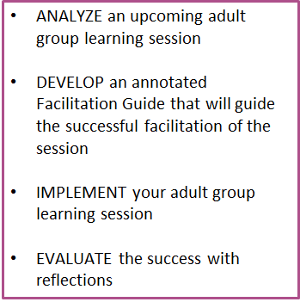
Structure of all Assessments
Adult Group Learning Facilitation
Facilitating adult group learning requires a strong grasp of content, purposeful planning, and methods to assess the impact of that learning. Content Leaders will incorporate effective learning models, structures, and processes into their plan and delivery of an adult group learning session. When adult learners are engaged in experiential learning that links directly to their professional learning needs, instructional practices improve and have a direct impact on student achievement.

Slide 26
Support on the Distinction Process
School systems who have successfully supported Mentors and Content Leaders in completing the assessment series have done the following:
Identify an owner of the initiative at the district level.
Ensure Mentors and Content Leaders are connected to others who are also completing the assessment series either informally or through structured monthly collaboration.
Identify an assessment coach who can review and provide support on artifacts prior to submission.
Ensure Mentors have a mentee to support, as this is required to complete the assessment series.
Ensure Content Leaders have dedicated time to redeliver Content Modules, as this is required to complete the assessment series.

Slide 27
Utilization

Slide 28
2019-2020 Academic Focus
In order to ensure students do the majority of the work everyday,
All Teachers—including special education, English language, and reading interventionists—are fully prepared to deliver high quality lessons.
Principals, leadership teams, content leaders and mentor teachers use classroom observation, common planning time, and one-on-one coaching to support each teacher to deliver high quality lessons.
School systems support principals and school teams as they provide support to teachers.
The Department supports school systems to execute their improvement plans.
Notes:
Kunjan

Slide 29
Value of Mentor Teachers
In what ways will Mentor Teachers help you achieve your school and school system academic and workforce goals?
Build the capacity of school leadership by providing support to other teachers.
Expand deep knowledge of content and content pedagogy into schools and school systems
Recruit and retain high quality teachers through structured and tiered teacher leadership
Provide access to a group of highly-trained educators:
  Mentor Teachers can support and mentor new, resident, or experienced teachers to increase retention and performance by using a structured coaching cycle
  Mentor Teachers can help your teachers effectively use Guidebooks 2.0 and Eureka to ensure students master important content

Slide 30
Structures to Support Mentors
What structures do you currently have in place to ensure that Mentors are able to effectively support teachers?
Key Questions | Undergraduate Residents | Post- Baccalaureate Participants | Current Teachers
Is the mentee a teacher of record with their own classroom? | No | Often yes | Yes
Is this a co-teaching setting? | Yes | Usually not | No
What structures need to be in place? | Co-teaching structure allowing co-planning and ongoing use of the coaching cycle | Strategic scheduling allowing co-planning and ongoing use of the coaching cycle | Strategic scheduling allowing co-planning and ongoing use of the coaching cycle
Who is supporting the mentor to ensure that they are using the coaching cycle? | School or school system leader who is able to observe and provide feedback on coaching cycle
 | Undergraduate program staff | Post- baccalaureate program staff

Slide 31
School and School Systems Leader Responsibilities
Meet with Mentor Teachers to establish a shared vision and goals, including how the Mentor Teacher will use a coaching cycle to support residents and new teachers, with a particular focus on using their curriculum
Ensure Mentor Teachers have the time, structures and support necessary to effectively host undergraduate or post-baccalaureate residents, or new teachers
Meet with Mentor Teachers at regular intervals to discuss resident progress and solve issues
Observe and provide feedback to Mentor Teachers

Slide 32
Value of Content Leaders: Math K-5 Content Modules
Module | Title
1 | Setting the foundation for implementing the curriculum
2 | Operations and Algebraic Thinking: Addition and Subtraction of Whole Numbers and Problem Types
3 | Operations and Algebraic Thinking: Multiplication and Division of Whole Numbers and Problem Types
4 | Numbers and Base Ten: Place Value and Fluency
5 | Numbers and Operations—Fractions: Understanding Fractions
6 | Number and Operations—Fractions: Operations With Fractions

Slide 33
Value of Content Leaders: ELA Content Modules
Module | Title
1 | Unpacking the Guidebooks
2 | Building Knowledge to Support Understanding
3 | Close Reading to Build Understanding
4 | Supporting All Students
5 | Developing Writing and Language Skills
6 | Supporting All Students

Slide 34
School and School Systems Leader Responsibilities
Meet with Content Leaders to establish a shared vision and goals, including how the Content Leader will support implementation of Tier 1 curricula in the school or school system
Ensure content module redelivery is included in school and school system PD Plans
  Create/modify the professional development structures necessary to deliver the content modules (e.g., staff development days, professional learning communities) and motivate teachers to attend
  Modify staffing structures so Content Leaders have the time deliver the content modules (e.g., reduced teaching load for Content Leaders)
The most important step you can take to support your Content Leaders is to ensure they have designated time with fellow teachers set aside to redeliver the 36 hours of content modules.

Slide 35
Next Steps
Identify the number of Mentors and Content Leaders your school system will need based on numbers of CIR and UIR schools, undergraduate residents, and post-baccalaureate candidates anticipated.
Identify an approved training provider.
Contact the approved trainer to negotiate a contract.
Ensure that access to the assessment series is included, or contract with assessment vendor.
Develop structures to support participants through the training and distinction process.

Slide 36
Super App Support
Support for completing the Super App will be provided through
School Improvement Library
LDOE Weekly Newsletters
School System Planning and Superintendent Calls
Network Teams
Office Hours on scheduled Mondays at 11:00 AM (details via LDOE Weekly Newsletter)
Send all questions related to school system planning and Super App to LDOE.GrantsHelpDesk@la.gov and include “Super App” in the subject line.

