Slide 1
CARES Act
Equitable Services Update
July 1, 2020

Slide 2
Agenda
CARES Act Equitable Services
Calculating Equitable Share
Strong Start Application Updates for Equitable Services
Consultation and Support

Slide 3
CARES Act Equitable Services Requirement

Slide 4
Equitable Services Under the CARES Act
The CARES Act includes provisions for equitable services to nonpublic schools:
ASSISTANCE TO NON-PUBLIC SCHOOLS SEC. 18005. (a) IN GENERAL.—A local educational agency receiving funds under sections 18002 [GEERF] or 18003 [ESSERF] of this title shall provide equitable services in the same manner as provided under section 1117 [Title I, Part A] of the ESEA of 1965 to students and teachers in non-public schools, as determined in consultation with representatives of non-public schools.
This means that the equitable services provision applies to all GEERF, ESSER Formula, ESSER Incentive subgrants to LEAs.

Slide 5
USED’s Interim Final Rule
On Thursday, June 25th, Secretary DeVos provided notice of a rule regarding the CARES Act equitable services provision, known as an “interim final rule” (IFR).
ED has unofficially published the IFR on its website.
The Rule will be effective immediately upon publication in the Federal Register (likely July 1)
ED will provide opportunity for stakeholders to provide comment for a period of 30 days, after which it could consider modifications to the IFR based on the comments received.

Slide 6
Interim Final Rule Overview
LEAs have two options for calculating the nonpublic equitable services share:
  Option 1 - LEA uses all of its CARES Act funds to serve only Title I schools
The LEA calculates the nonpublic equitable share by using a proportional share of low-income students in participating public Title I schools and low-income students attending participating nonpublic schools.
  Option 2 - Any LEA not choosing Option 1 (i.e., uses CARES Act funds in non-Title I schools or for districtwide activities)
The LEA calculates the nonpublic equitable share by comparing the total enrollment of both public schools and participating nonpublic schools in the LEA.

Slide 7
Interim Final Rule Note
The regulation states that a LEA could choose a different option for each CARES Act program:
  ESSER Formula grants
  ESSER Incentive grants
  GEER grants
The rule also states that the method an LEA chooses to use to determine the proportional share for equitable services does not limit its obligation to provide any students and teachers in a nonpublic school in the LEA with the opportunity to receive equitable services.

Slide 8
Options for Calculating Equitable Share

Slide 9
Option 1: Based on Title I
LEA Targets CARES Act funding to Title I Schools Only - Low Income Student Counts
The LEA calculates proportional share by one of two ways:
  Using the proportional share of Title I funds calculated for SY 2019-20, OR
  Based on a new count of low-income students
    October 2019 K-12 low-income counts of public participating Title I schools
    October 2019 K-12 low-income counts of nonpublic schools in the LEA that choose to participate in the CARES Act programs.
Reminder: Equitable Services applies to all nonpublic schools wanting to participate, whether the school serves students from low-income families.

Slide 10
Option 1 and Supplanting Requirements
If choosing Option 1 and calculating equitable share based on students in poverty ages 5-17, Title I “supplement, not supplant” rules (ESEA 1118(b)) will apply:
LEAs must neutrally distribute state and local funds without consideration of whether the school receives Title I funding.
SNS specifically prohibits the LEA from allocating CARES Act funds to Title I schools and then redirecting state or local funds to non-Title I schools.

Slide 11
Option 2: Not Exclusive to Title I
LEA can use CARES Act funding for any school - Total Enrollment Student Counts
  All public schools are eligible to participate
  For calculating the equitable share, LDOE has available:
  October 2019 student counts for public schools
  Current nonpublic enrollment data. These counts are included on the Non-public Schools Academic Classification List.
  Supplement not supplant does not apply.

Slide 12
Strong Start Application Updates

Slide 13
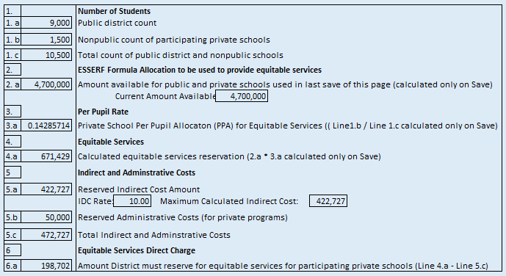
Equitable Share Calculation
LEAs can now budget for administrative and indirect costs for providing equitable services.

Slide 14
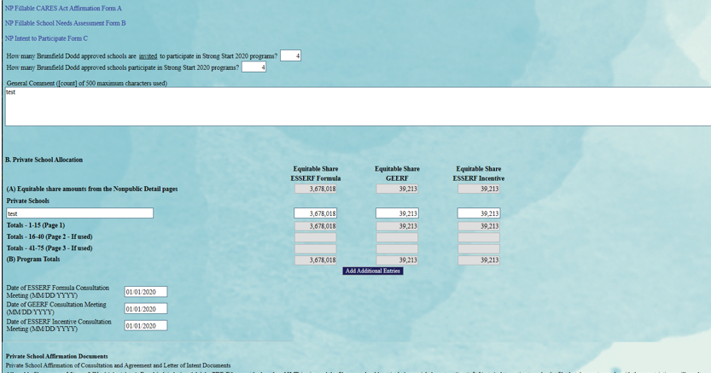
Equitable Share School Allocations

Slide 15
Consultation & Support

Slide 16
Consultation Reminders
LEAs must conduct timely and meaningful consultation in accordance with ESEA Section 1117 prior to applying to the LDOE or before making any decisions.
LEAs must allow nonpublic school officials to have significant input and give consideration to nonpublic school official’s views that benefit/address equitable participation for students and teachers.
Consultation must include a discussion of service delivery mechanisms an LEA may use.
Use CARES Act Affirmation of Consultation and Agreement forms.

Slide 17
Consultation Next Steps
Nonpublic school officials should be contacted regarding the following:
  Participation with GEER and ESSER Incentives Funds
  Completing GEER and ESSER Incentive Funds Needs Assessment
  Changes regarding equitable services calculations
    Written statement needed for disagreements
  Nonpublic schools ESSER Formula allocation changes due to LEAs budgeting for administrative and indirect cost

Slide 18
Consultation Rights
Non-public school officials that have not been contacted by the LEA should contact the LEA or state ombudsman to inquire about equitable services.
As with Title I, if a LEA disagrees with the views of nonpublic school officials during consultation, the LEA must provide in writing to the nonpublic school officials the reasons why the LEA disagrees.
Nonpublic school officials have a right to file a complaint with the SEA. If the SEA determines that the LEA did not meet applicable requirements, the SEA must provide services directly or through contracts if requested to do so by nonpublic school officials.

Slide 19
Consultation Forms Protocols
To save time, LEAs should update the current CARES Act Affirmation form by:
Contacting nonpublic officials (verbal or virtual) to obtain participation agreement regarding GEER and ESSER Incentive funds.
Noting resolves on the existing affirmation form with initials and dates.
Sending updated CARES Act Affirmation form to the nonpublic official for their records.
Uploading the updated form(s) to the nonpublic consultation page in eGMS.
Consulting with nonpublic schools on allowable use of allocations/funds for GEERF and Incentive grants and request individual Needs Assessment for each fund
LEAs and nonpublic officials should work together to expedite the forms needed for the Strong Start Application.

Slide 20
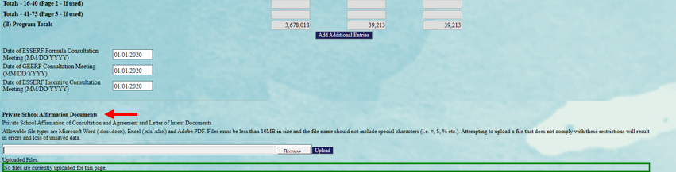
Private School Affirmation of Consultation Documents Upload
Notes:
.

Slide 21
State Ombudsman
The state ombudsman monitors equitable services requirements to help ensure that LEAs provide equitable services to students and teachers in non-public schools.
If a LEA cannot conduct the required consultation, it must notify the State Ombudsman for assistance.
Contact Daphne Flentroy, LDOE State Ombudsman, at Daphne.Flentroy@la.gov

Slide 22
For assistance with the Strong Start 2020 Application, including questions about the nonpublic section, please contact LDOE’s Grants Helpdesk:
LDOE.GrantsHelpdesk@la.gov

