Slide 1
Strong Start Incentive Funding Webinar
June 25, 2020

Slide 2
Agenda
Strong Start - Overview
Strong Start - Incentive Allocations
Budgeting Incentive Allocations
Non-Public Equitable Services Update
Addressing Review Checklist Comments
Next Steps

Slide 3
Strong Start Overview

Slide 4
Strong Start 2020
In order to ensure a strong start for every student and for school systems to have a continuous education plan, LDOE released the Strong Start 2020 plan to support school systems in planning for and funding priorities aligned to their current, coherent school system plan.
Strong Start for Every Student
Identifying students needs
Plans for every student
Supporting high school students and graduates
Continuous Education Planning
1:1 device and internet access
Strategy communications plan
Versatile delivery methods
Adaptive staffing models
Flexible and opportunistic calendars and school schedules

Slide 5
Strong Start - Incentive Allocations

Slide 6
Incentive Allocations
The Department has reviewed each LEA’s Strong Start application and has awarded incentive funding to support Strong Start priorities.
On Friday, June 19, the Department provided notification of awards to school systems via the Strong Start Funding Summary document.
In early July, the Department will upload incentive allocations to the FY 20-21 Strong Start Application.
Note: ESSERF Incentive allocations do not include funding for student devices and connectivity. This will be funded by another grant.

Slide 7
Strong Start Funding Summary
This document, emailed to school systems on Friday, June 19, provides:
Share ESSERF Incentive allocations, and
Identify eligible expenditures for grant awards.
Please note: ESSERF Incentive grants do not include funding for student devices and connectivity. This will be funded by another grant.

Slide 8
Strong Start Funding Summary
LEAs can decide how to use their allocated funds towards these allowable expenditures.
Priority | Eligible Expenditures
CA2: Core Curriculum | Additional materials or online access required for distance learning for the school system’s approved, Tier 1 curriculum
CA3: Non-Core Curriculum | Software licenses required for CTE and non-core curriculum for individual students Subscriptions to online course and content providers for CTE and non-core curriculum materials required for transition to virtual learning
CA4: Post- Secondary Prep Providers | Work with one or more approved planning partners for individual graduation planning for students in grades 9-12 and/or college and career transitions for graduated seniors

Slide 9
Strong Start Funding Summary
LEAs can decide how to use their allocated funds towards these allowable expenditures.
Priority | Eligible Expenditures
SDN2: English Learners | English learner supports required for distance learning for the school system’s approved, Tier 1 curriculum
SDN3: Assistive Technology | Augmentative and alternative communication (AAC) devices for students with disabilities – both dedicated and non-dedicated – such as Chromebooks with touchscreens, iPads, switches, and boards AT software for dedicated and non-dedicated devices for SWD
SDN3: Direct Service Providers | Training on remote service delivery to students with disabilities from organizations with the Continuous Learning (CL) designation in the Partnerships for Success Guide

Slide 10
Strong Start Funding Summary
LEAs can decide how to use their allocated funds towards these allowable expenditures.
Priority | Eligible Expenditures
WT1: Core Curriculum Professional Development Partners | Work with one or more approved professional learning partners in LDOE’s PD Vendor Guide for virtual delivery of PD in alignment with the school system’s PD plan and/or training on distance learning methods
WT3: Staffing Plan Partners | Partner with an organization listed in the Maximizing Learning Time through Adaptive and Flexible Staffing Plans document to develop adaptive and flexible staffing plans
LS5: Four-year-old Seats | 4yo seats to ensure the school system, at minimum, maintains the number of four-year-old seats filled in the 2019- 2020 school year

Slide 11
Incentive Funds Planning
School systems were charged to build planning teams responsible for developing and submitting the Strong Start Application.
The team should come back together and assess the Incentive funds received and determine how these funds can best be spent to support the school systems needs. (School systems can supplement their incentive funding levels with their ESSA Title funds where appropriate (i.e. Title II for Professional Development)).
As a reminder, LEAs should claim reimbursements for 2019-20 Redesign funds, which expire June 30, 2020. Carryover funding for 2019-20 Redesign funding is not anticipated.

Slide 12
Budgeting Incentive Allocations

Slide 13
Budgeting ESSERF Incentive Funds
LaGov Transition
In early July, the Department will upload incentive allocations to the FY 20-21 Strong Start Application.
Central Data
Save Strong Start Assurances and Save Strong Start Contacts
Create Strong Start application
Administration Tab
Non-public Tab
Include any Administrative and Indirect Cost amounts for Equitable Share
Budget allocations according to fund source (ESSERF Incentive).

Slide 14
Budgeting ESSERF Formula Allocations
Budget process
ESSERF Formula Allocations will be budgeted in the FY 20-21 Strong Start Application
Upon completion and submission of the 6/30 Periodic Expense Report (PER).
LDOE will process and approve the 6/30 PER.
Strong Start ESSERF Formula Funds remaining balances from FY 19-20 are now ready to budget.
Budget allocations according to funds source (ESSERF Formula).

Slide 15
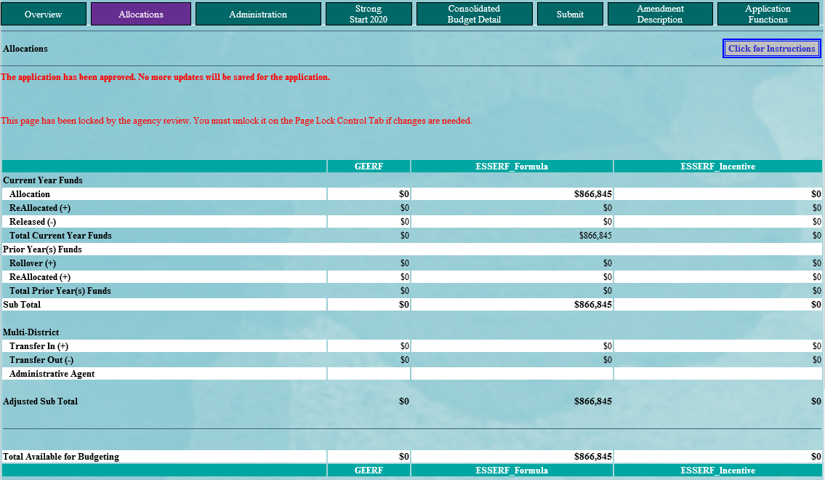
Strong Start Allocations

Slide 16
Period of Availability in Strong Start
Source | Funding Period
ESSERF Formula | 05/01/2020 - 09/30/2022 *
ESSERF Incentive | 06/17/2020 - 01/15/2021
*Pre-award costs are allowable for expenses incurred from March 13, 2020 to April 30,2020.

Slide 17
Non-Public Equitable Services Update

Slide 18
Equitable Services Under the CARES Act
The CARES Act includes provisions for equitable services to nonpublic schools:
ASSISTANCE TO NON-PUBLIC SCHOOLS SEC. 18005. (a) IN GENERAL.—A local educational agency receiving funds under sections 18002 [GEERF] or 18003 [ESSERF] of this title shall provide equitable services in the same manner as provided under section 1117 [Title I, Part A] of the ESEA of 1965 to students and teachers in non-public schools, as determined in consultation with representatives of non-public schools.
Equitable services will be applied to both GEERF and ESSERF (Formula and Incentive) subgrants to LEAs

Slide 19
Non-Public Equitable Services Reminders
Districts should have included the following in their original Strong Start Applications:
Affirmation of Consultation and Agreement *
Equitable services activities in the ESSER consolidated budget
Individual private school allocations
*Upload for all Brumfield Dodd approved non-profit private schools on the non-public consultation page in the Administration section of the application.

Slide 20
Updated Non-Public Proportionate Share Calculation
Below is the recommended sequence for completing the Equitable Share page:
Determine any non-public admin services
Note - the EIC has been provided in the budget detail drop down
EIC - NPADM
Administrative cost must be reasonable and necessary
Determine the non-public IDC
Save Page
The max IDC for the budget detail will be recalculated
Note the total proportionate share adjustment to be allocated to each non-public school.
Proceed to making final budget adjustments aligned to new proportionate share total

Slide 21
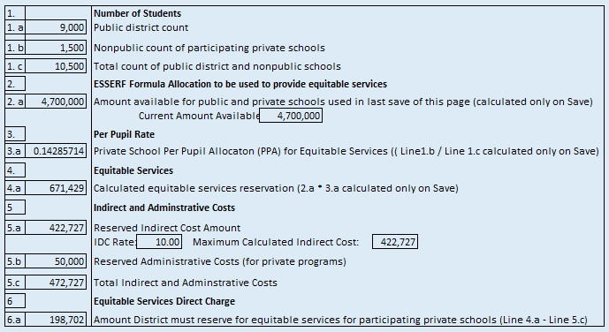
Updated Non-Public Proportionate Share Calculation

Slide 22
Addressing Review Checklist Comments

Slide 23
19-20 Strong Start Application:
Review Summary
My original application has been “Accepted with Comment” or “Returned for change” - now what?
Review Summary

Slide 24
19-20 Strong Start Application:
Review Summary
Review Checklist
To access Reviewers Comments
Select the radio button next to the appropriate review checklist.
Click “Review Checklist”.
If checklist does not open in a separate window, check to see if the “Pop-up Blocker” in your browser is turned Off.

Slide 25
Next Steps

Slide 26
LaGov Transition
Due to the transition occurring with the state’s accounting system that will take place on June 30, the following applications will require budgeting and resubmission for FY 20-21:
2020 Strong Start
2020 Family Childcare Pilot
2020 Get Ready Cohort
2020 Infant Class Support
2019/2020 Ready Start Network
2019/2020 Charter School Applications (Startup, Planning, Imp. 1 and 2)
2019 Charter School Dissemination
21st CCLC
High Cost Services Round 1 & 2
LA Mental Health
2020 PBCS TIF
SIG Round 7
Please contact ldoe.grantshelpdesk@la.gov with questions.

Slide 27
The Department is committed to providing support to LEAs throughout the process.
If you have questions, please email:
LDOE.GrantsHelpdesk@la.gov

