Slide 1
April 30, 2020

Slide 2
Agenda
Overview
Strong Start 2020
Strong Start 2020 Application
Funding
Administration
Strong Start 2020 Planning Priorities
Closing
Timeline
Support

Slide 3
Overview
Since Louisiana’s school facilities first closed in response to the COVID-19 pandemic, school systems and the LDOE ensured that the safety of students and staff was of utmost priority. Additionally, LDOE and school systems have worked together on ensuring that all students have access to continuous learning while remaining safely at home.
In anticipation of school facility closure or modified operations in the coming year, the Department is focused on ensuring that school systems are prepared for a strong start to the 2020-2021 academic year. School systems’ plans, submitted through the Super App process, set a coherent academic foundation.
To ensure a strong start in 2020-2021 and the continued implementation of these plans, the Department has released guidance and funding to provide quality and consistency of instruction and access to continuous learning in safe, healthy facilities.

Slide 6
Louisiana School System Planning Process
School systems review data and identify priorities for the coming year.
School systems budget formula funds and request competitive funds in alignment with priorities.
School systems implement approved plans with support from Network teams and vendor partners.

Slide 7
Foundation to Strong Start 2020: School System Plans
A strong start to the 2020-2021 academic year builds on the academic priorities and decisions to which school systems have already committed in their approved school system plans submitted via Super App. This included a coherent academic plan for:
High-quality curriculum
High-quality teacher development
High-quality assessments
Strong Start 2020 ensures the school system’s plan is augmented to meet new academic and operational demands so that all students have access to continuous learning.

Slide 8
A Strong Start for Every Student
In addition to the continued implementation of school system plans, a strong start to 2020-2021 will ensure:
Every student’s academic needs are identified at the beginning of the year using high-quality, standards-aligned diagnostic tools and assessments.
There is a plan for every student, including extra time and support for students with the greatest unfinished learning from the prior year.
Curricular tools, enhancements, and supports to address unfinished learning
Robust support for early grade reading
Emotional, behavioral, mental health screening and services
Compensatory education and support for students with disabilities
An updated professional development plan with options for versatile delivery of training on curriculum, as well as online mentor training and content modules
There are clear next steps for every high school student and recent graduate, who will enter a new economy.
Funding for updated individual graduation plans (IGPs)
College and career transitional supports for recent graduates through December 2020

Slide 9
Continuous Education Planning
Additionally, all school systems must have strong yet agile continuous education plans that provide standards-aligned instruction using high-quality curriculum during school facilities closures or modified operations, including provisions for:
1:1 device and internet access, including assistive technology for students with disabilities
A strategic communications plan to connect with every student on a daily basis, provide weekly feedback on students’ work, and communicate a family’s role in supporting their child’s continuous learning.
Versatile delivery methods for instruction, related services, and professional development
Adaptive staffing models that optimize teaching talent and student support
Flexible and opportunistic calendars and school schedules that maximize learning opportunities in a dynamic public health context

Slide 10
Planning Priorities and Supports
The Department will provide the following supports and resources for Strong Start 2020:
Updated Tier 1 Curriculum that addresses:
How to deliver content virtually
Training for teachers on virtual delivery
Addressing unfinished learning via the curriculum
State-negotiated pricing and bulk purchasing for student devices and WIFI access
Screeners for preK-3; ELA and math diagnostic tools and reports, grades 3-12
Mental health screener for all students and mental health consultation supports
Incentive grants to support key Strong Start 2020 Planning Priorities, including funds to support curricular adaptations for continuous learning, high school transitions, professional development plans, special education, and student devices and connectivity.

Slide 11
Strong Start 2020 Application

Slide 12
CARES Act Education Funding
*Elementary and Secondary School Emergency Relief Fund (ESSERF)
ESSER Formula Funds
LEAs will receive 90 percent of the state ESSERF allocation.
Each LEA will receive a proportional share based on its proportional share of the 2019-2020 Title I, Part A allocation (note: ESSER is *NOT* a Title I program)
ESSER Incentive Funds
Incentive funds will be available to support some of the Strong Start 2020 Planning Priorities.
School systems that agree to implement each priority will be eligible to receive incentive funds.
As in Super App, school systems will have opportunities to make funding requests in the Strong Start 2020 application.
*Governor’s Emergency Education Relief Fund (GEERF)

Slide 13
ESSERF Formula Allowability
The CARES Act outlines 12 broad uses for ESSERF Formula Funds. These include:
Activities authorized by ESEA/ESSA, IDEA, Perkins, McKinney-Vento
Coordination of preparedness and response efforts
Providing principals the resources necessary to address school needs
Activities to address needs of students with disabilities, ELs, foster youth, etc.
Developing and implementing procedures and systems to improve preparedness and response efforts of LEAs
Training and PD for staff on sanitation and minimizing spread of infectious disease
Purchasing supplies to sanitize and clean facilities
Planning for and coordinating during closures, including providing meals, providing technology for online learning, IDEA guidance, etc.
Purchasing educational technology (including hardware, software, and connectivity)
Providing mental health services and supports
Planning and implementing activities related to summer learning and after-school programs
Other activities necessary to maintain the operation of and continuity of services and continuing to employ existing staff of the LEA

Slide 14
ESSERF Assurances
The LEA will use ESSER funds for activities allowable under section 18003(d) of Division B of the CARES Act. (See Appendix A.)
Note: The U.S. Department of Education generally does not consider the following to be an allowable use of ESSER funds, under any part of 18003: 1) subsidizing or offsetting executive salaries and benefits of individuals who are not employees of the LEAs or 2) expenditures related to state or local teacher or faculty unions or associations.
The LEA will, to the greatest extent practicable, continue to compensate its employees and contractors during the period of any disruptions or closures related to COVID-19 in compliance with Section 18006 of Division B of the CARES Act. In addition, the LEA will continue to pay employees and contractors to the greatest extent practicable based on the unique financial circumstances of the entity. CARES Act funds generally will not be used for bonuses, merit pay, or similar expenditures, unless related to disruptions or closures resulting from COVID-19.

Slide 15
Reporting and Coding
Reporting Assurance in Central Data:
The LEA will comply with all reporting requirements, including those in Section 15011(b)(2) of Division B of the CARES Act, and any others required by the Louisiana Department of Education in order to comply with federal reporting requirements.
Note: The U.S. Department of Education notified States that it may require additional reporting in the future, which may include: the methodology LEAs will use to provide services or assistance to students and staff in both public and non-public schools, the uses of funds by the LEAs or other entities and demonstration of their compliance with Section 18003(d), such as any use of funds addressing the digital divide, including securing access to home-based connectivity and remote-use devices, related issues in supporting remote learning for all students, including disadvantaged populations.
Each fund within the Strong Start 2020 Application will have a set of EICs to assist with reporting. School Systems should refer to the Planning Guide for descriptions of each code.

Slide 16
Equitable Services
The CARES Act provides:
ASSISTANCE TO NON-PUBLIC SCHOOLS SEC. 18005.
(a) IN GENERAL.—A local educational agency receiving funds under sections 18002 or 18003 of this title shall provide equitable services in the same manner as provided under section 1117 of the ESEA of 1965 to students and teachers in non-public schools, as determined in consultation with representatives of non-public schools.
Because ED has not yet released guidance regarding equitable services:
The Department will host a webinar on Thursday, May 7, at 11 AM to provide more information.
In the meantime, school systems can estimate the equitable share using the nonpublic percentage in Targeting Step 4 of the 2019-2020 Super App.

Slide 17
GEPA 427
To address General Education Provisions Act (GEPA) Section 427 (20 U.S.C. 1228a), each LEA will have to address the following under the “Administration” tab of the application:
Instructions: Describe (1-2 paragraphs) how the LEA, when using CARES Act grant funds, will ensure that students, teachers, and other beneficiaries with special needs will have equitable access to, and participation in, grant-funded activities. Potential barriers that can impede equal access and participation include barriers based on gender, race, color, national origin, disability, and age.
Note: A general statement of the LEA’s nondiscriminatory hiring policy is not sufficient; this statement should specifically address the LEA’s proposed CARES Act-funded activities.

Slide 18
GEPA Example
Instructions:
Include a short description (1-2 paragraphs; no longer than three pages) of how your LEA, when using SRSA grant funds, will ensure that students, teachers, and other beneficiaries with special needs will have equitable access to be able to participate in SRSA-funded activities.
Sample Response:
We will use SRSA grant funds to purchase computers and laptops as part of our schoolwide technology upgrade. Because a significant portion of our students are from families where Spanish is the primary language spoken at home, we will provide user instructions for the computers both in Spanish and in English.

Slide 19
Strong Start 2020 Planning Priorities

Slide 20
Strong Start 2020 Planning Guide
In support of the work that school systems will do to incorporate these new priorities into their plans for the school year, the Department has released the Strong Start 2020 Planning Guide.
The Strong Start 2020 Planning Guide describes the Planning Priorities and is the basis for guidance on elementary and secondary education funding provided by the CARES Act.

Slide 21
Strong Start 2020 Planning Priorities Overview
The Planning Priorities are designed to support school systems as they plan for a strong start to the 2020-2021 academic year. The priorities focus on actions and supports that:
Address unfinished learning from the 2019-2020 school year,
Set the foundation for continuous learning in 2020-2021, and
Prepare for school facility closures and modified operations.
Aligned to the School System Planning Domains, the Planning Priorities address the unique circumstances school systems must consider for the upcoming year and are organized by:
Domain
Priority
Priority Funding Guidance
Application Questions, and
Resources.

Slide 22
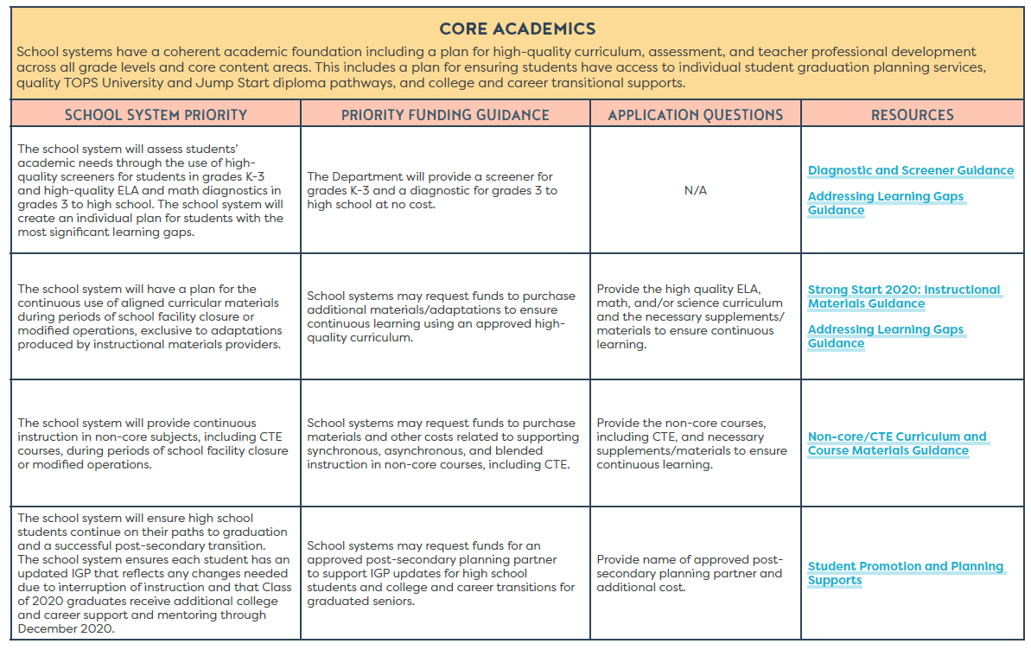
Planning Priorities: Core Academics
The Core Academics Domain focuses on:
Addressing individual student needs
Planning for continuous use of aligned curricular materials
Providing continuous instruction for non-core subjects, including CTE
High school students are on track to graduation

Slide 23
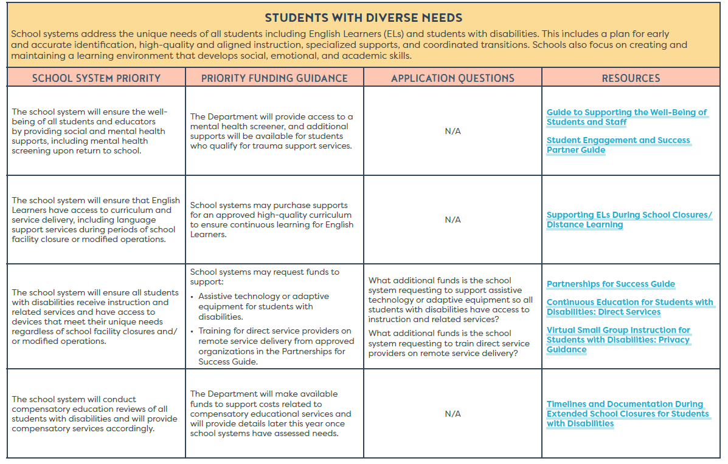
Planning Priorities: Students with Diverse Needs
The Students with Diverse Needs Domain focuses on:
Ensuring student and staff well-being
Supporting the needs of English learners
Supporting the needs of students with disabilities
Providing compensatory education services for students with disabilities

Slide 24
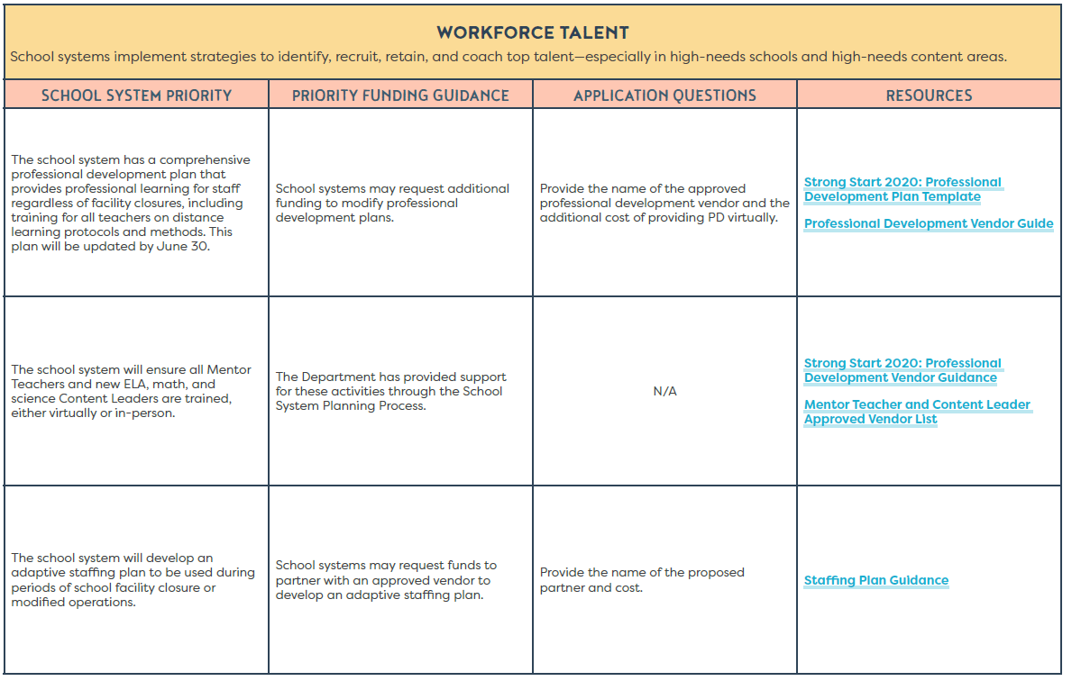
Planning Priorities: Workforce Talent
The Workforce Talent Domain focuses on:
A comprehensive professional development plan that accounts for school closures and tech training
Maintaining Mentor Teacher and Content Leader training
Adaptive staffing plans

Slide 25
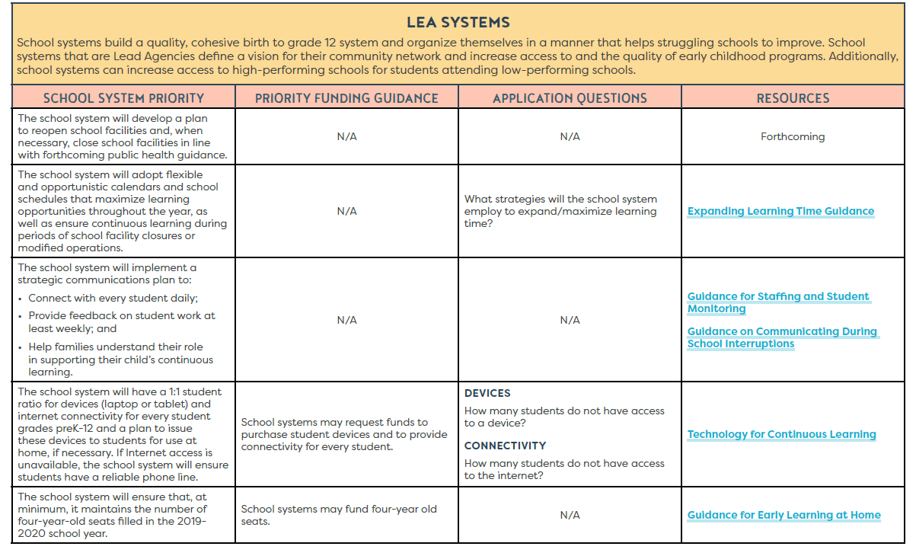
Planning Priorities: LEA Systems
The LEA Systems Domain focuses on:
A plan to reopen facilities
Flexible school calendars and schedules
Strategic student/family communications plan
Achieving a 1:1 student to device ratio and internet connectivity
Sustaining early childhood seats

Slide 26
Next Steps

Slide 27
Timeline
Action | Date
Strong Start 2020 Planning Guide released | April 30
LDOE hosts Strong Start 2020 webinar | April 30 at 1 PM
ESSERF Formula allocation uploaded to the Strong Start 2020 Application | May 1
LDOE host CARES Act equitable services webinar | May 7 at 11 AM
Strong Start 2020 resources are available* | May 8
Submit the Strong Start 2020 Application to be eligible for Incentive funds | May 29
BESE approves ESSERF Incentive allocations | June 17
ESSERF Incentive allocations uploaded to eGMS | June 19
* Note: Given evolving circumstances and the interconnectedness of guidance from multiple agencies, all resources are subject to updates. School systems should ensure that they are using the latest available version.

Slide 28
Support
Support for completing the Strong Start 2020 application will be provided through:
Strong Start 2020 Library (Available May 8)
LDOE Weekly Newsletters
School System Planning and Superintendent Calls
Network Teams
Email: LDOE.GrantsHelpDesk@la.gov and include “Strong Start 2020” in the subject line.

