Slide 1
The CARES Act - Equitable Services
May 7, 2020
Follow-up May 14, 2020

Slide 2
Agenda
CARES Act Overview
Equitable Services Overview
Fiscal Guidance
Consultation
State Ombudsman Support

Slide 3
CARES Act Overview

Slide 4
K-12 Education Funding Provided by the CARES Act
There are two sources of K-12 funding available in the CARES Act:
Elementary and Secondary School Emergency Relief Fund (ESSERF)
ESSER Formula Funds - each LEA receives a proportional share based on its proportional share of the 2019-2020 Title I, Part A allocation (note: ESSER is *NOT* a Title I program)
ESSER Incentive Funds - Incentive grants will be available to support some of the Strong Start 2020 Planning Priorities.
Governor’s Emergency Education Relief Fund (GEERF)

Slide 5
Equitable Services Overview

Slide 6
Nonpublic School Eligibility Requirements
The LEA in which a non-public school is located is responsible for providing equitable services to students and teachers in the school.
Nonpublic/private schools must be non-profit schools. For-profit schools are not eligible to participate.
All nonpublic schools located within the LEAs boundary and listed on the Nonpublic Schools Academic Classification List are eligible to participate.
An LEA must offer to provide equitable services under the CARES Act programs to students and teachers in all non-public schools located in the LEA, even if a non-public school has not previously participated under Title I, Part A or Title VIII of the ESEA.

Slide 7
Equitable Services Protocols
LEAs can provide the equitable services directly to the nonpublic school or contract with a public, private or third party contractor/entity.
Pooling within an LEA is permissible
Administrative cost that is reasonable and necessary is allowable
Services must be secular, neutral and non-ideological, as well as, timely and equitable
Under the CARES Act programs, an LEA must provide services and other benefits for nonpublic school students and teachers in a timely manner that are equitable in comparison to the services and benefits provided for public school students and teachers.
The needs of the nonpublic school may be different from the needs of the public school

Slide 8
Fiscal Guidance

Slide 9
Fiscal Guidance
The period of availability for ESSER Formula funds is May 1, 2020 - September 30, 2022.
Pre-award costs are allowed from March 13, 2020.
LEAs must maintain public control of CARES Act funds for services and assistance provided to nonpublic schools (e.g. materials, equipment, and property purchases).
LEAs cannot directly provide funding to nonpublic schools, only services are to be provided.
Supplement, not supplant does not apply to ESSERF or GEERF.
Services may benefit the nonpublic school itself, general/specific student needs
Allocations for services cannot be used until the LEAs have all consultation documents/needs assessments, required for processing and obtaining an approved Strong Start application.

Slide 10
Allowable Use of Funds for the CARES Act
During the consultation the LEAs must review the items on the Affirmation of Consultation and Agreement and inform the nonpublic schools on the following use of the CARES Act funds:
Activities authorized by the ESEA, IDEA, and a variety of other federal programs
Providing allocations to school principals to address their individual needs
Activities to address homelessness, low income, minority and other disadvantaged students
Purchasing related supplies
Advance planning for coronavirus – related closures
Buying technology for students served by the nonpublic schools
Providing mental health services
Summer and afterschool programs
Improving the preparedness efforts of nonpublic schools themselves
Related training for staff

Slide 11
Determining Equitable Share

Slide 12
Equitable Services Under the CARES Act
The CARES Act includes provisions for equitable services to nonpublic schools:
ASSISTANCE TO NON-PUBLIC SCHOOLS SEC. 18005. (a) IN GENERAL.—A local educational agency receiving funds under sections 18002 [GEERF] or 18003 [ESSERF] of this title shall provide equitable services in the same manner as provided under section 1117 [Title I, Part A] of the ESEA of 1965 to students and teachers in non-public schools, as determined in consultation with representatives of non-public schools.
Equitable services applies to GEERF and ESSERF subgrants to LEAs, unless the governor or SEA targets a specific purpose or specific population of students.

Slide 13
Equitable Services Guidance by ED
ED provided guidance regarding equitable services:
7. How does an LEA that receives funds under the CARES Act programs provide equitable services “in the same manner as provided under section 1117 of the ESEA”?
1117(a)(4)(A) – Under both Title I, Part A and the CARES Act programs, an LEA must determine the proportional share available to provide equitable services to students and teachers in non-public schools based on the total amount of funds an LEA receives prior to any allowable expenditures or transfers. Under the CARES Act programs, the LEA calculates the proportional share based on the number of children enrolled in each non-public school whose students or teachers participate in the CARES Act programs compared to the number of students enrolled in public schools in the LEA.

Slide 14
ED’s Guidance for Calculating Equitable Share
According to this guidance from the U.S. Department of Education (ED) regarding the equitable share calculation for funds provided by the CARES Act to LEAs:
The proportional share is calculated by using the total K-12 enrollment at the LEA and the k-12 enrollment in participating nonpublic schools. It is not based on the low - income student counts as previously stated.
These is similar to the enrollment numbers LEAs use to calculate the proportionate share for Titles II and IV. These counts are included on the Nonpublic Schools Academic Classification List.

Slide 15
Requests for Clarification of ED’s Guidance
On May 7, the Council of Chief State School Officers sent a letter to Secretary DeVos, asking for clarification of its guidance:
The information provided is counter to the CARES Act statute and the Department’s long standing interpretations of the Elementary and Secondary Education Act of 1965 (ESEA), and could significantly harm the vulnerable students who were intended to benefit the most from the critical federal COVID-19 education relief funds Congress has provided.
In addition, CCSSO Past President Pedro Rivera wrote a letter to Assistant Secretary Frank Brogan asking for clarification and requesting that ED direct LEAs to use the Title I equitable share calculations for FY19-20.

Slide 16
Additional Information
Edweek published an analysis of the impact for each parish/city school system in Louisiana.
There also have been several articles on this matter:
Guidance from DeVos means more coronavirus relief for private schools
Backlash Grows to DeVos Push for COVID-19 Aid to Help All Private School Students
Indiana rejects guidance from DeVos to reroute more coronavirus relief to private schools

Slide 17
HEROES
The Health and Economic Recovery Omnibus Emergency Solutions (HEROES) Act is a 4th COVID-19 emergency supplemental appropriations package.
The HEROES Act would appropriate $90 billion for Education:
65% to LEAs by Title I formula and 30% to public higher education
$1.5 billion for E-Rate to address the homework gap by providing greater access to broadband in homes.
This proposed legislation also includes statutory language to clarify CARES Act Equitable Services.

Slide 18
Equitable Share Counts
Districts will calculate the nonpublic equitable share in the Strong Start 2020 application in eGMS:
From this calculation, the application will derive a per pupil allocation (PPA) for equitable services. It is the responsibility of the LEA to consult with each nonpublic school about the equitable services it will provide. The LEA will record the consultation results in eGMS to submit the Strong Start application.

Slide 19
Nonpublic Equitable Share
Example:
LEA’s ESSERF Award = $1,000,000
Total Count of Public and Nonpublic Schools = 1000 Students
LEA’s Count = 900 students (90%)
Participating Nonpublic Schools Count = 100 students (10%)
Nonpublic Proportionate Share (NPS) = LEA ESSERF Award x % nonpublic count
NPS = $1,000,000 x 10% = $100,000 is the nonpublic equitable share

Slide 20
Calculating Nonpublic School Allocations
Nonpublic School Detail:
Nonpublic School #1 = 25 students
Nonpublic School #2 = 10 students
Nonpublic School Allocations:
Per Pupil Amount (PPA) = Total NPS/Total nonpublic count
$100,000/200 nonpublic students = $500/student
NPS1 Allocation = count x PPA = 25 students x $500 = $12,500
NPS2 Allocation = count x PPA = 10 students x $500 = $5,000

Slide 21
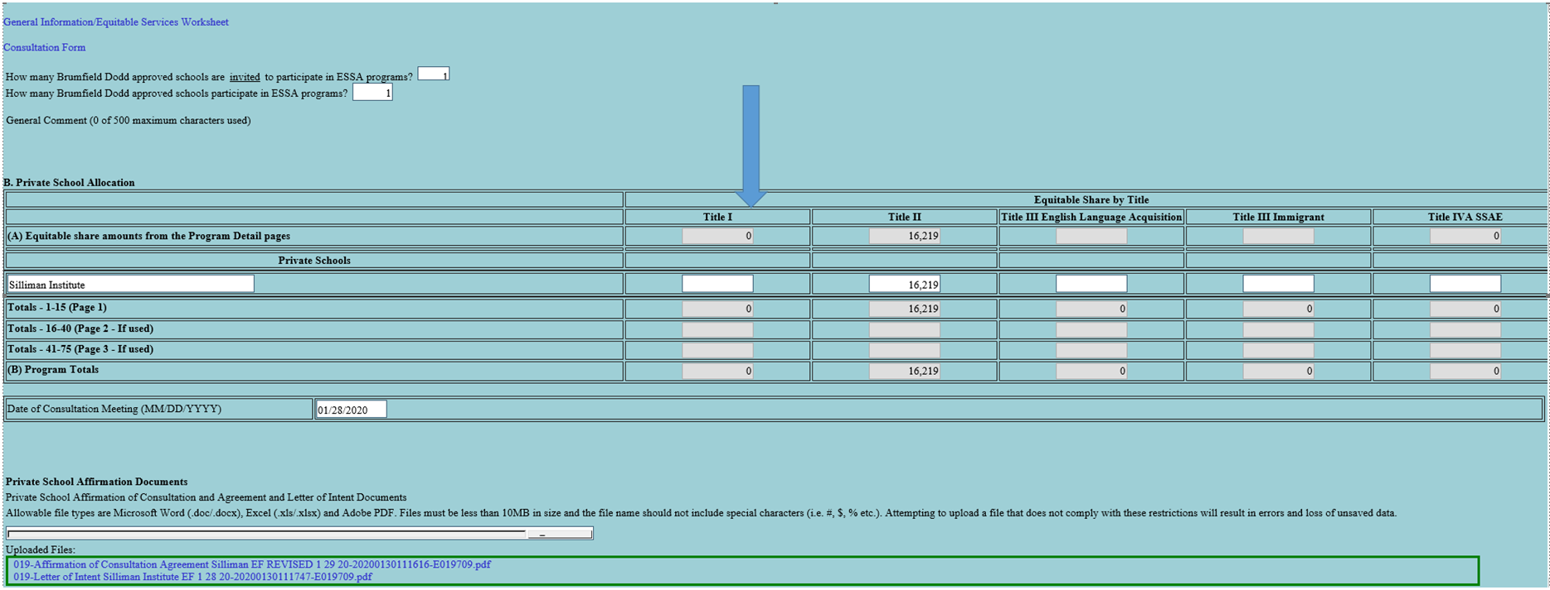
Proportionate Share Calculation Protocols

Slide 22
CARES Act Consultation

Slide 23
Consultation Requirements
LEAs are required to conduct timely and meaningful consultation in accordance with Section 1117 of ESEA prior to applying to the LDOE or before making any decisions.
LEAs must allow nonpublic school officials to have significant input and give consideration to nonpublic school official’s views that benefit/address equitable participation for students and teachers
Consultation must include a discussion of service delivery mechanisms an LEA may use.
Do not use the regular ESSA Affirmation of Consultation and Agreement forms.

Slide 24
Consultation Process
LEAs are to use virtual, online, and physical distance forms of communication to schedule and conduct the timely and meaningful consultation required for the CARES Act.
Once the conference is scheduled, send the nonpublic/private schools officials the CARES Act consultation forms to review, complete, and return in order to expedite the process for equitable services program participation.
LEAs must be able to document/demonstrate a good faith contact effort for nonpublic school outreach
If nonpublic schools do not reply or declines equitable services, the LEA has no further responsibility to provide CARES Act equitable services.

Slide 25
Consultation Rights
Nonpublic school officials that have not been contacted, are to contact the LEA or State ombudsman to inquire about equitable services
Under both Title I, Part A and the CARES Act programs, if an LEA disagrees with the views of nonpublic school officials during consultation, the LEA must provide in writing to the nonpublic school officials the reasons why the LEA disagrees.
Under both Title I, Part A and the CARES Act programs, nonpublic school officials have a right to file a complaint with the SEA; the SEA must provide services directly or through contracts if requested to do so by non-public school officials and the SEA determines that the LEA did not meet applicable requirements.

Slide 26
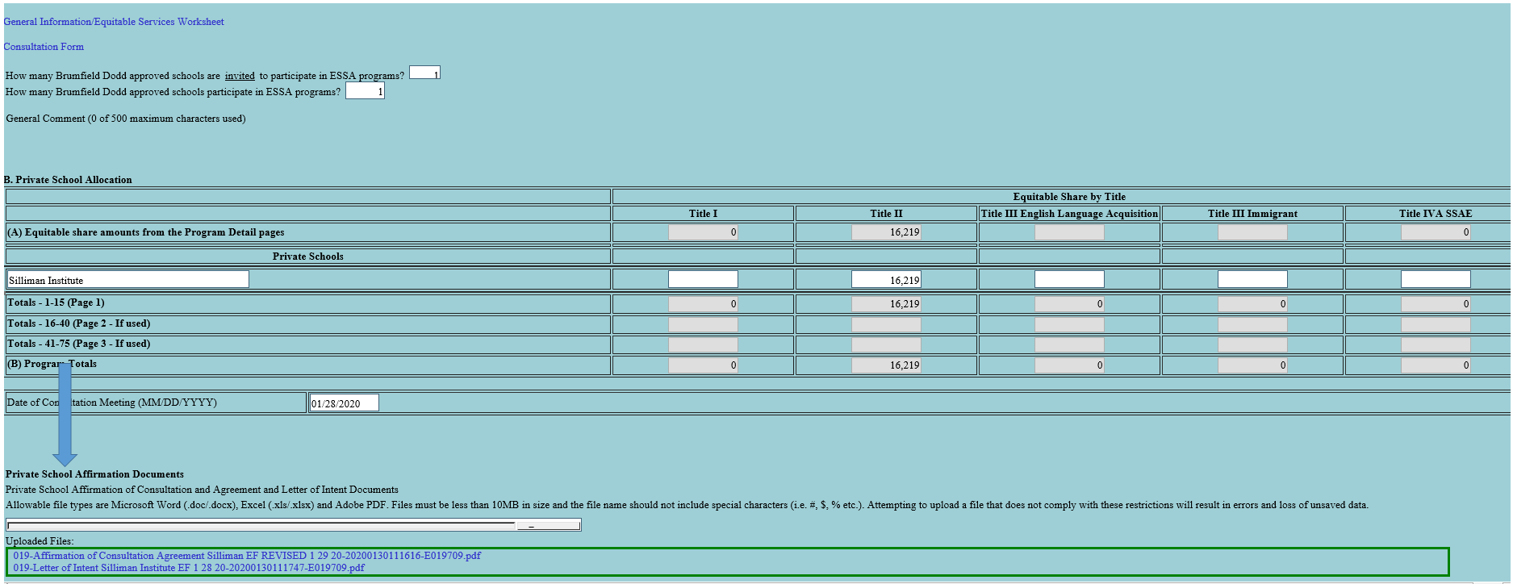
Private School Affirmation Documents

Slide 27
Consultation Forms Guide and Timeline
Nonpublic School Status | Forms to Send
Current participating non-profit Nonpublic/Private Schools | Nonpublic/Private Fillable CARES Act Affirmation of Consultation and Agreement Nonpublic/Private Fillable Needs Assessment and Activity Chart Due upon submission
New/non-participating non-profit Nonpublic/Private Schools agreeing to services | Nonpublic Letter of Intent to Participate Nonpublic/Private Fillable CARES Act Affirmation of Consultation and Agreement Nonpublic/Private Fillable Needs Assessment and Activity Chart Due upon submission
New/non – participating Nonpublic/Private School declining services | Nonpublic Letter of Intent to Participate Nonpublic/Private Fillable CARES Act Affirmation of Consultation and Agreement Forms must be signed and state services are declined Due upon

Slide 28
State Ombudsman

Slide 29
State Ombudsman Responsibilities
The state ombudsman will monitor and enforce the equitable services requirements to help ensure that LEAs provide equitable services to students and teachers in nonpublic schools.
If LEA cannot conduct the required consultation it must notify the State Ombudsman via email for assistance.
Contact Daphne Flentroy, LDOE State Ombudsman, at Daphne.Flentroy@la.gov

