Slide 1
Implementing Strong Start 2020:
A Toolkit for Teaching and Learning for Schools

Slide 2
Agenda
Strong Start Overview
Toolkit Overview
Resources
Closing

Slide 4
Foundation to Strong Start 2020: School System Plans
A strong start to the 2020-2021 academic year builds on the academic priorities and decisions to which school systems have already committed in their approved school system plans submitted via Super App. This included a coherent academic plan for:
High-quality curriculum
High-quality teacher development
High-quality assessments
Strong Start 2020 ensures the school system’s plan is augmented to meet new academic and operational demands, so that all students have access to continuous learning.

Slide 5
Strong Start 2020 Planning Guide
In support of the work that school systems will do to incorporate these new priorities into their plans for the school year, the Department released the Strong Start 2020 Planning Guide.
The Strong Start 2020 Planning Guide describes the Planning Priorities and is the basis for guidance on elementary and secondary education funding provided by the CARES Act.

Slide 6
Strong Start 2020 Planning Priorities Overview
The Planning Priorities are designed to support school systems as they plan for a strong start to the 2020-2021 academic year. The priorities focus on actions and supports that:
Address unfinished learning from the 2019-2020 school year,
Set the foundation for continuous learning in 2020-2021, and
Prepare for school facility closures and modified operations.
Aligned to the School System Planning Domains, the Planning Priorities address the unique circumstances school systems must consider for the upcoming year and are organized by:
Domain
Priority
Priority Funding Guidance
Application Questions, and
Resources.

Slide 7
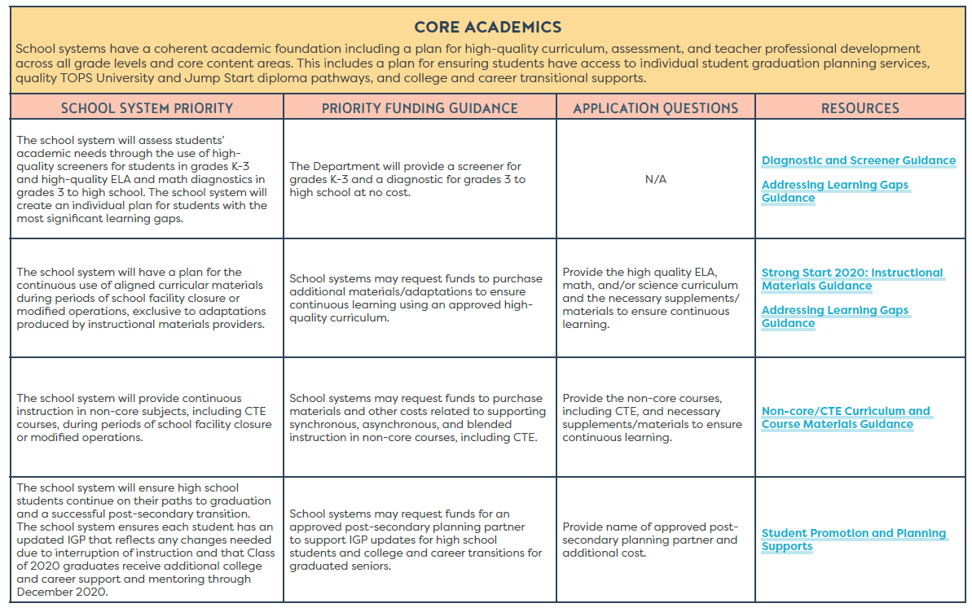
Planning Priorities: Core Academics
The Core Academics Domain focuses on:
Addressing individual student needs
Planning for continuous use of aligned curricular materials
Providing continuous instruction for non-core subjects, including CTE
High school students are on track to graduation

Slide 8
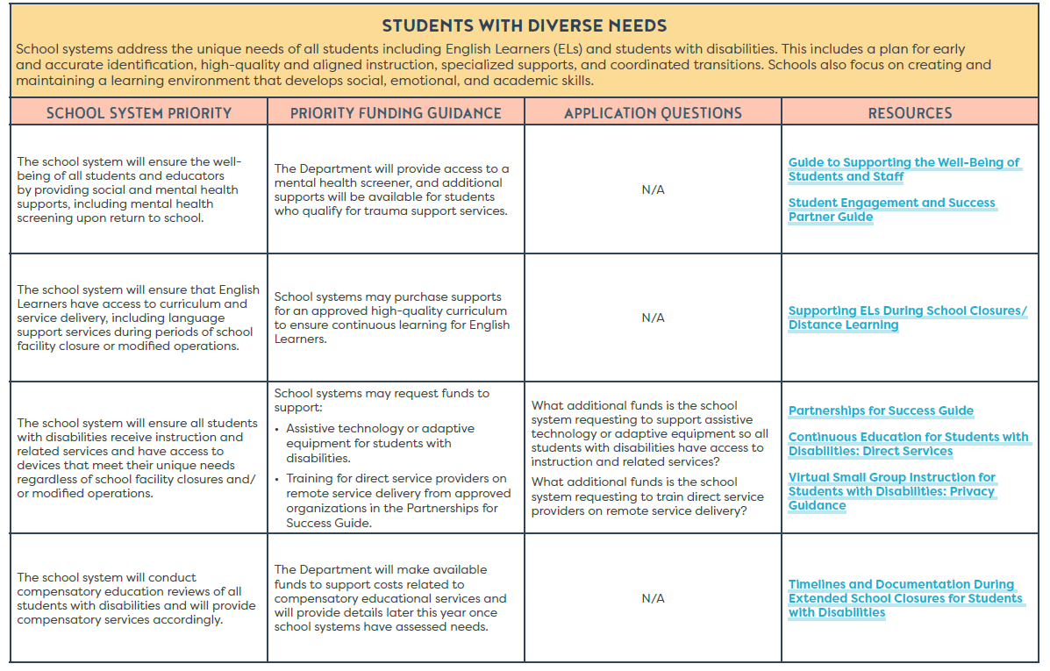
Planning Priorities: Students with Diverse Needs
The Students with Diverse Needs Domain focuses on:
Ensuring student and staff well-being
Supporting the needs of English learners
Supporting the needs of students with disabilities
Providing compensatory education services for students with disabilities

Slide 9
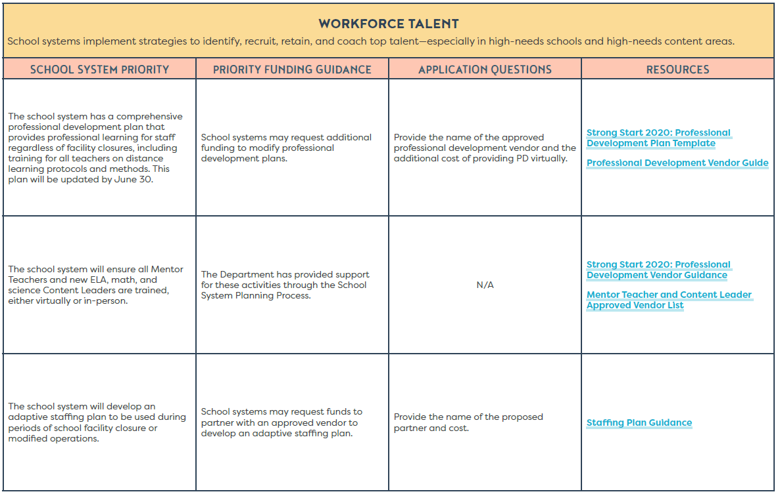
Planning Priorities: Workforce Talent
The Workforce Talent Domain focuses on:
A comprehensive professional development plan that accounts for school closures and tech training
Maintaining Mentor Teacher and Content Leader training
Adaptive staffing plans

Slide 10
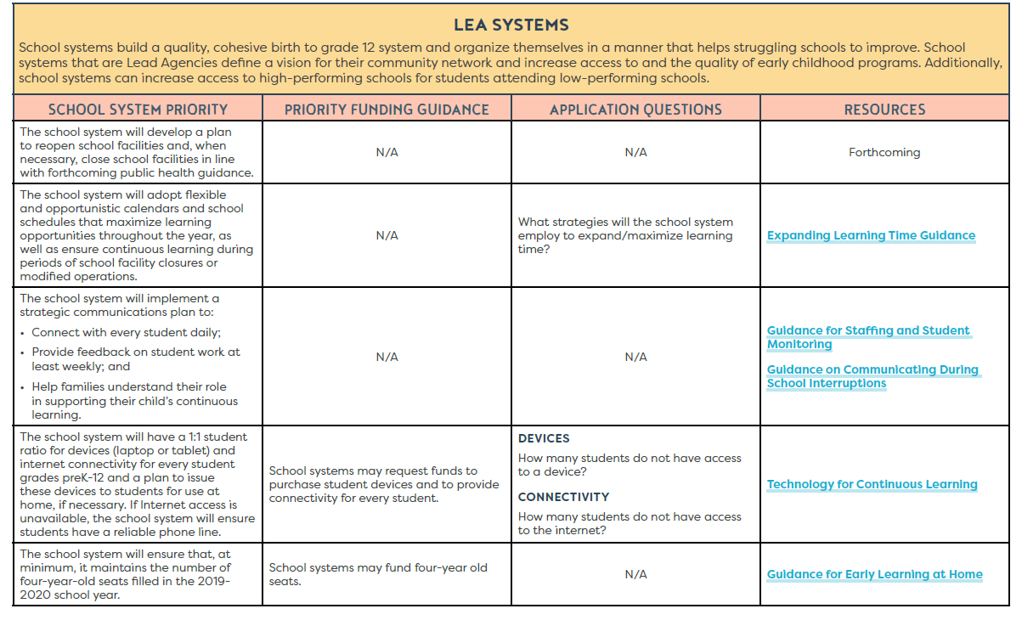
Planning Priorities: LEA Systems
The LEA Systems Domain focuses on:
A plan to reopen facilities
Flexible school calendars and schedules
Strategic student/family communications plan
Achieving a 1:1 student to device ratio and internet connectivity
Sustaining early childhood seats

Slide 11
A Toolkit for Teaching and Learning for Schools

Slide 12
Toolkit Overview
Since implementation of most of the Strong Start priorities happens at the school level, this toolkit supports school leaders and teachers.
This toolkit was designed to include:
Strong Start priorities aligned to teaching and learning
One document per priority that includes samples, models, and plans from school systems and organizations in Louisiana and across the country for implementing each priority
School actions for each priority that are a starting point for school leaders and teachers to prepare for the most important actions for the upcoming school year

Slide 13
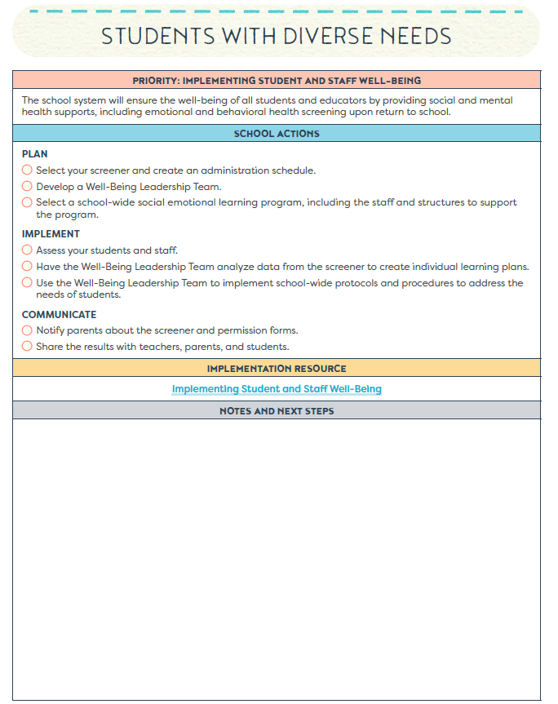
Toolkit Structure
Each domain has:
The Strong Start 2020 priority.
School actions on how to plan, implement, and communicate.
An Implementation Resource.
Space for teams to identify notes and next steps.

Slide 14
Implementation Resources

Slide 15
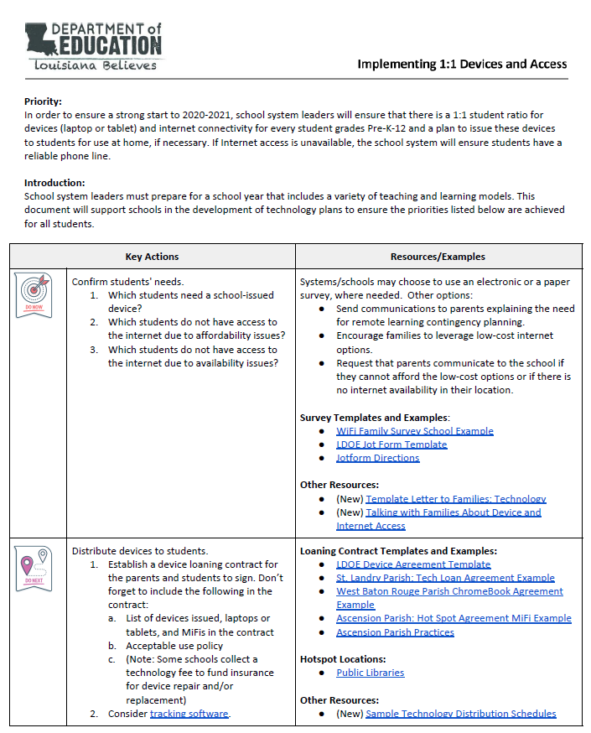
Implementation Resources
Each priority has one implementation resource. This resource includes resources, samples, and plans for school leaders and teachers to implement the priority at the school level.
Actions are categorized by tasks to Do Now or Do Next.
New resources are denoted.
Samples from school systems or organizations are labeled with their name.

Slide 16
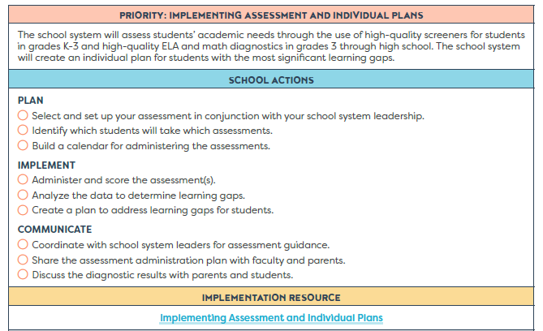
Implementing Assessment and Individual Plans
Priority: The school system will assess students’ academic needs through the use of high-quality screeners for students in grades K-3 and high-quality ELA and math diagnostics in grades 3 through high school. The school system will create an individual plan for students with the most significant learning gaps.
Highlights
Sample assessment calendars
Sample learning plans
Sample parent letter for remote administration
Resources for ELA and Math instructional planning
Resources for assessing students and addressing learning gaps

Slide 17
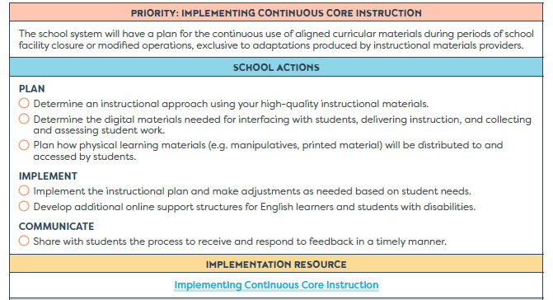
Implementing Continuous Core Instruction
Priority: The school system will have a plan for the continuous use of aligned curricular materials during periods of school facility closure or modified operations, exclusive to adaptations produced by instructional materials providers.
Highlights
Samples of providing feedback in a virtual setting
Sample parent letter
Sample lesson adaptations
Resources for best practices in a virtual setting
Resources for adapting lessons to a hybrid/virtual model

Slide 18
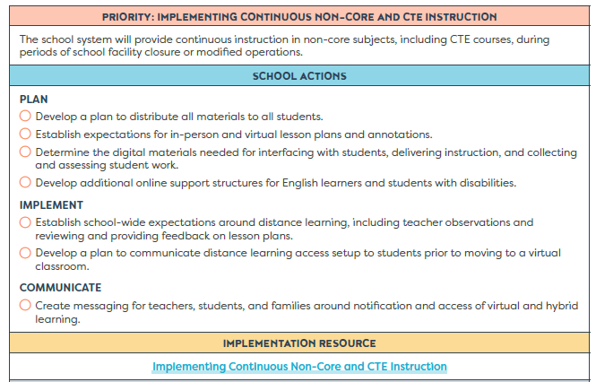
Implementing Continuous Non-Core Instruction
Priority: The school system will provide continuous instruction in non-core subjects, including CTE courses, during periods of school facility closure or modified operations.
Highlights
Samples classroom support tool for Non-Core and CTE courses
Sample communications for parents
Material distribution guidance
Resources for adapting lessons to a hybrid/virtual model

Slide 19
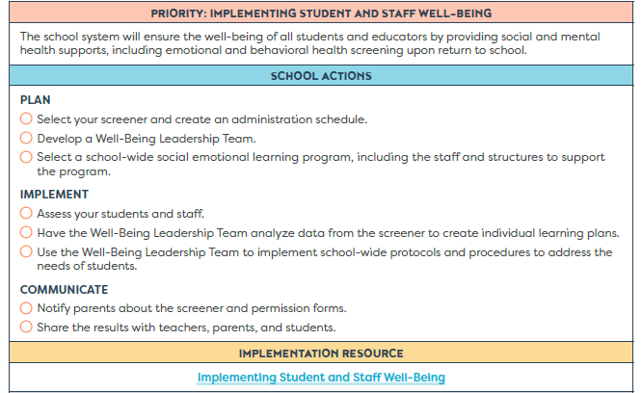
Implementing Student and Staff Well-Being
Priority: The school system will ensure the well-being of all students and educators by providing social, emotional and behavioral health supports, including emotional and behavioral health screening for students upon return to school.
Highlights
Sample schedule for well-being support
Sample culture and climate surveys
Sample individual student plans
Resources for administering and interpreting screeners

Slide 20
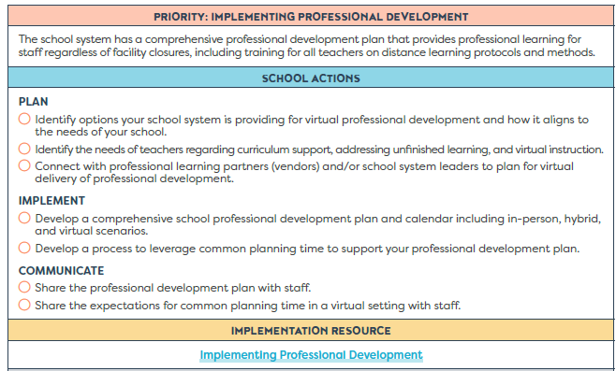
Implementing Professional Development
Priority: The school system has a comprehensive professional development plan that provides professional learning for staff regardless of facility closures, including training for all teachers on distance learning protocols and methods.
Highlights
Sample PD calendars and plans
Sample best practices and agendas for virtual common planning meetings
Resources for planning PD

Slide 21
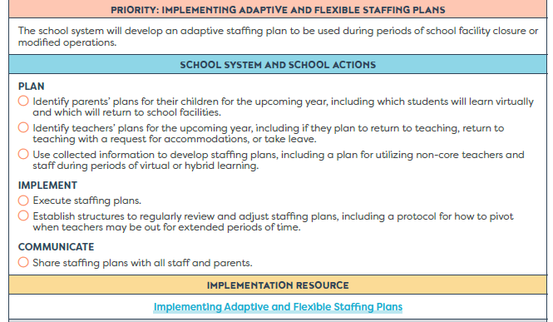
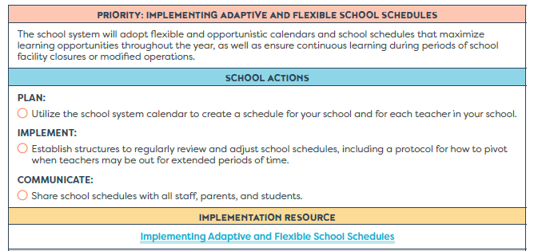
Implementing Staffing Plans and School Schedules
Priorities:
The school system will develop an adaptive staffing plan to be used during periods of school facility closure or modified operations.
The school system will adopt flexible and opportunistic calendars and school schedules that maximize learning opportunities throughout the year, as well as ensure continuous learning during periods of school facility closures and modified operations.
Highlights
Sample personnel surveys
Resources for building an adaptive staffing plan and designing school schedules
Sample comeback models

Slide 22
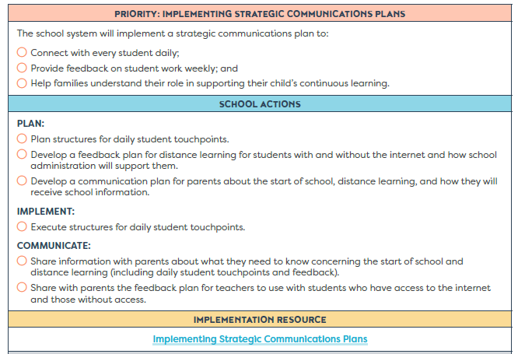
Implementing Strategic Communications Plans
Priority: The school system will implement a strategic communications plan to:
Connect with every student daily;
Provide feedback on student work weekly; and
Help families understand their role in supporting their child’s continuous earning.
Highlights
Sample student engagement templates
Sample school reopening communications plan
Resources for using data from student outreach

Slide 23
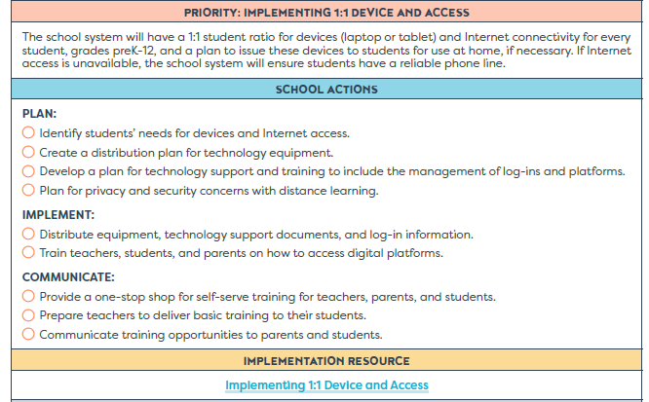
Implementing 1:1 Device and Access
Priority: School system leaders will ensure that there is a 1:1 student ratio for devices (laptop or tablet) and internet connectivity for every student grades Pre-K-12 and a plan to issue these devices to students for use at home, if necessary. If Internet access is unavailable, the school system will ensure students have a reliable phone line.
Highlights
Sample device and access surveys and distribution schedules
Sample technology letters to families
Examples of loaning contract agreements
Sample training options for teachers, students, and parents

Slide 24
Closing

Slide 25
Resources
Implementing Strong Start 2020: A Toolkit for Teaching and Learning for Schools
Strong Start 2020 Library
Strong Start 2020 landing page
Strong Start 2020 Planning Guide
School Reopening Guidelines and Resources

Slide 26
Support
Strong Start Reopening Office Hours will occur Thursdays at 3:00 p.m. through September 3, 2020. Details are below.
Zoom: https://ldoe.zoom.us/j/91419461028
Phone: 301-715-8592
Meeting ID: 914 1946 1028
Password: 408891
Email LDOECOVID19support@la.gov with questions.

