Slide 1
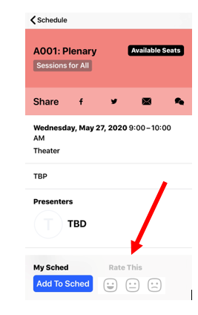
Session Feedback
Thank you for attending today’s session. You can leave feedback on this session using the Teacher Leader Summit app. It takes less than a minute.
How to leave feedback:
At the bottom right corner of your session window in the app, click on “Rate This”.
In the window that pops up, choose the facial expression that reflects your experience.
You can also leave an optional comment in the window that pops up.
Click submit to finalize.

