Slide 1

District Planning Call
October 29, 2014

Slide 2
Welcome
District Planning Calls are designed to bring together key leaders in the district to hear information about Department resources to support decisions at the district level. The Department recommends bringing together your district’s Superintendent, Chief Academic Officer, Chief Finance Officer, Chief Technology Officer, Special Education Director, evaluators of principals and any other major decision makers.
On this call we will:
Review 2013-14 district performance
Describe current and future assessment resources available to districts
Review content of current and future teacher collaboration events
Share guidance on components of data privacy legislation

Slide 3
Agenda
    2013-14 Performance
    Assessment and Curriculum Resources
    Teacher Leader & Principal Resources
    Student Opportunities
    Policy

Slide 4
Accountability & Assessment Background
Louisiana’s jobs have changed: In 2011, twenty-eight percent of Louisiana’s workforce had a 2- or 4-year degree. To meet future needs, that number must double.
Our students are just as capable as their peers around the country: While a score of “mastery” denotes readiness to complete a year of technical college or university on-time, in our state “basic” has been accepted as full proficiency.
Our students deserve high expectations: Over the last 10 years we have seen a steady increase in our students’ “basic” proficiency (over a 15 point increase). We now must turn our attention to increasing “mastery” student performance.
Assessment | Level 1 | Level 2 | Level 3 | Level 4 | Level 5
LEAP | Unsatisfactory | Approaching Basic | Basic | Mastery | Advanced
NAEP | Below Basic |  | Basic | Proficient | Advanced
PARCC | Minimal Command | Partial Command | Moderate Command | Strong Command | Distinguished Command

Slide 5
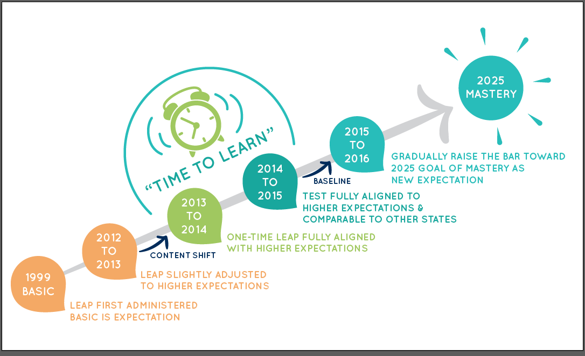
Path to 2025

Slide 6
Transition Policies
As we continue giving educators time to learn the new expectations and adjust their practice, BESE approved a series of policies to support educator and student learning.
  School accountability. Letter grade distributions will remain the same from 2013 to 2014 and 2015. During the two-year transition, any school or district that maintained or improved its annual performance score will not experience a decrease in its current letter grade. As in any other year, if a school improves, the performance score and letter grade may go up.
  Teacher accountability. For 2014 and 2015, the state will not produce “value-added data” because there will be no baseline from which to calculate. Compass policies will remain in effect, but student learning scores will not need to be based on value-added data.
  Student accountability. In 2014 and 2015, the state will maintain current 4th grade policy, but allow districts to issue waivers for students demonstrating readiness to progress. The state will shift the 8th grade retention standard to be a remedial standard and require that remediation take place on the high school campus in a “transitional 9th grade” year.
  For more information on the transition policies, click here.

Slide 7
School Performance Results
For 2014, school letter grade distributions must be the same or better than distributions in 2013 by school type (e.g., K8 v. K8, HS v. HS), per BESE transition policies.
Overall, the distribution is steady with improvements at the highest levels.
School Letter Grades | 2012-2013 Number of Schools | 2013-2014 Number of Schools
A | 187 | 241
B | 388 | 366
C | 382 | 350
D | 270 | 268
F | 109 | 104
Note: school years 2012-13 and 2013-14 include schools that closed at the end of that academic year. T schools not included.

Slide 8
Principal Report Cards
With the annual school report card release, the Department provided districts with a Principal Report Card for every school.
The Principal Report Card is an internal document designed to provide school leaders with key data about teacher and student performance from the 2013-2014 school year.
Leaders can use Principal Report Cards to:
  Identify areas of growth or decline
  Identify areas of strength or weakness, as compared to peers in district or peers with similar letter grades statewide
  Ensure principal SLTs are focused on the greatest areas of need
  Ensure school structures, areas of focus and/or plans align with needs
For more information on the Principal Report Cards, the Department will host a second webinar on Thursday October 30th at 9 am. Access to the webinar is available here.

Slide 9
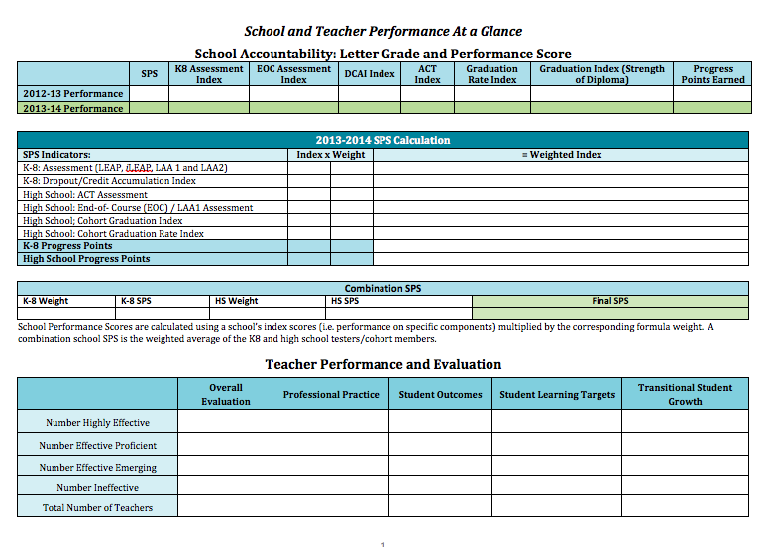
Principal Report Card

Slide 10
Agenda
    2013-14 Performance
    Assessment and Curriculum Resources
    Teacher Leader & Principal Resources
    Student Opportunities
    Policy

Slide 11
14-15 Assessment Plan
Grade | Subject | 13-14 Assessment | 14-15 Assessment
Grades 3 to 8 | ELA | LEAP and iLEAP | LEAP and iLEAP: PARCC Test
 | Math | LEAP and iLEAP | LEAP and iLEAP: PARCC Test
 | Science | LEAP and iLEAP | LEAP and iLEAP
 | Social Studies | LEAP and iLEAP | LEAP and iLEAP
High School | All subjects | ACT series Advanced Placement | ACT series, including WorkKEYS Advanced Placement & CLEP
 | ELA | English II EOC English III EOC | English II EOC English III EOC
 | Math | Algebra I EOC Geometry EOC | Algebra I EOC Geometry EOC
 | Science | Biology EOC | Biology EOC
 | Social Studies | US History EOC | US History EOC
Alternate Assessments | ELA, Math, Science (varies by grade level) | LAA1 | LAA1
 | ELA, Math, Science, Social Studies (varies by grade level) | LAA2 | LAA2 eligible testers entering high school prior to 2014-15
 | English Language | ELDA | ELDA

Slide 12
Assessment Updates & Resources
District Assessment Update Webinar
When: Friday, October 31st at 1:00 PM
Where: Conference number: 800-747-5150 Code 3423600 and https://louisianaschools.adobeconnect.com/media/
Notes: No pre-registration required. Recommended for all district assessment contacts. For additional information, please contact assessment@la.gov.
Resources to understand and prepare for state assessments:
Assessment guides for every state assessment in grades 3 through high school
Sample assessment items and practice tests
Eagle now featuring printable versions of all guidebook tasks and soon to come search and test building features
Curriculum guides in math and ELA that include rigorous, end-of-year assessment-aligned practice items
Ed Connect and Teacher Leaders newsletters include new resources and tasks

Slide 13
Curricular Resource Reviews 2014-2015
The Department is reviewing curricular tools earlier than last year to ensure that districts have reviews to guide purchasing choices earlier in the year. The Department will review the following in Math and ELA for the alignment to the standards:
Full curricula
Interim benchmark assessments
Supplemental tools *New
Remediation tools *New
District play a critical role in determining which programs get reviewed.
Reach out to vendors that you would like reviewed and ask them to submit. Send them this link to review the guidelines and to submit.
Reach out to us at the Department to ask vendors to submit. We will put all district requested vendors at the top of the list. Reach us at LouisianaCurriculumReview@la.gov.
Encourage your community and parents to submit reviews during the public review windows. Guidance included here: http://www.louisianabelieves.com/academics/instructional-materials-review.

Slide 14
Agenda
    2013-14 Performance
    Assessment and Curriculum Resources
    Teacher Leader & Principal Resources
    Student Opportunities
    Policy

Slide 15
Teacher Leader 14-15 Support
Support Structures | Details | Dates
Virtual Trainings | ELA Book Clubs Eureka Math Trainings | Bi-Monthly beginning the week of August 18th. each group will have their own calendar.
Regional Collaborations | Collaborations led by Teacher Leaders around the state that help teachers reflect on student learning, share best practices and prepare for implementation | Week of 10/20 Week of 12/8 Week of 1/26 Week of 3/2
Monthly Newsletter | Monthly newsletter spotlights achievements from classrooms, shares the newest available resources and details monthly training opportunities | Last Wednesday of each month
Online Collaboration Site | Teacher Leaders are encouraged to participate in a free Edmodo online collaboration site. This site facilitates conversations among educators and the sharing of resources. | Ongoing
Toolbox Resources | The next wave of high-quality instructional materials and resources will continue to be posted in the Teacher Toolbox. | Ongoing resources featured in the monthly newsletters

Slide 16
October 20th Teacher Leader Collaborations
ELA Collaboration Focus:
1. Read and comprehend complex texts:
  Use language and vocabulary to comprehend what the text says
  Use topics, themes, and main ideas to comprehend what the text means
2. Express understanding of complex texts:
  Build opinions about the text using evidence (through discussion)
  Assert claims about the text using evidence (through writing)
Math Collaboration Focus:
  Demonstrate understanding of the math concept, not just the procedure
  Apply their understanding to real world examples
  Use accurate procedures and skills to answer questions
  Demonstrate mathematical reasoning by explaining, justifying, or critiquing with precision

Slide 17
October 20th Teacher Leader Collaborations
Collaboration Goals:
  Clarify state-wide assessments
  Focus teachers on key math and ELA skills students will need to be successful Elevate use of the Guidebooks and Eagle to support teachers with these skills
District Next Steps:
  Focus principals on observing key student skills in ELA and math
  Focus principals and teachers on using tasks from guidebooks and EAGLE for instruction and assessment
  Work with Teacher to train and share content with other teachers in your district

Slide 18
December 8th Teacher Leader Collaborations
In December, teachers will be able to choose their area of focus.
  Modeling of key math and ELA instructional strategies
  Lesson modeling
  Assessment updates
Locations: The week of December 8th, four collaborations will be held in the following locations:
  Lafayette
  Jefferson Parish
  Ruston
  Fourth site waiting on confirmation from teacher feedback
Logistics: Registration opens the week of November 17th via the Teacher Leader Newsletter

Slide 19
Principal Support
OBSERVATION AND FEEDBACK
At this time of year, principals are likely monitoring progress toward the goals they have set and working to answer the question “To what degree are students in my school mastering critical math and ELA content?”
To support this work, the Department has developed tools focused on Domain 3: Instruction.
ELA Instructional Observation & Feedback Guide
  Two Versions: Outline Format & Note Taking Format
  Look-Fors in the ELA Classroom
  Content Focused Feedback Questions
  Appendix of Resources (Videos, Sample Lessons, Aligned Materials)
Math Instructional Observation & Feedback Guide
  Two Versions: Outline Format & Note Taking Format
  Look-Fors in the Mathematics Classroom
  Content Focused Feedback Questions
  Appendix of Resources (Videos, Sample Lessons, Aligned Materials)
Contact your Network Team for more information on how to incorporate these tools as you support teachers and student learning.

Slide 20
ELA Observation Indicators
3b. USING QUESTIONING/PROMPTS AND DISCUSSION: Quality of questions/prompts, Discussion techniques, Student Participation
Read and understand complex texts: Whole-class discussion is about texts at or above the grade-level. Express understanding of complex texts: During discussions, students build opinions about complex texts using evidence. During discussions, students respond to peers, make connections between texts, and/or change thinking based on discussion and evidence from complex texts.
3c. ENGAGING STUDENTS IN LEARNING: Activities & Assignments, Grouping of students, Instructional materials, Structure & Pacing
Read and understand complex texts: Students read, write, and speak about complex texts for the majority of the lesson. Students use language and vocabulary independently and in groups to comprehend what complex texts say. Students use topics, themes, and main ideas independently and in groups to comprehend what complex texts mean. Express understanding of complex texts: Students express their understanding of complex texts through speaking and writing using evidence. Students make connections between complex texts and tasks from lesson to lesson.
3d. USING ASSESSMENT IN INSTRUCTION: Assessment criteria, Monitoring student learning, Feedback, & Student self-assessment/monitoring of progress
Read and understand complex texts: Students act on teacher and peer feedback to improve their understanding of complex texts. Express understanding of complex texts: Teacher monitors students’ understanding of complex texts and ability to meet task expectations and provides feedback to improve student understanding. Students explain how they plan to approach a speaking or writing task with complex texts.

Slide 21
Math Observation Indicators
3b. USING QUESTIONING/PROMPTS AND DISCUSSION: Quality of questions/prompts, Discussion techniques, Student Participation
Mastery of priority content Students answer questions about on-grade level content. In discussions, students share different approaches to answer questions and deepen each other’s understanding. Students present justifications (written or spoken) for how they arrived at that answer. Targeted remediation When appropriate, the teacher asks remedial questions aligned to the skills being taught.
3c. ENGAGING STUDENTS IN LEARNING: Activities & Assignments, Grouping of students, Instructional materials, Structure & Pacing
Mastery of priority content Students engage in challenging problems where they may struggle but still persevere. Tasks ask students to use various explanations, representations and examples. Students engage in tasks that require real life application and conceptual understanding. Targeted remediation When appropriate, remedial tasks are focused on the standards that most prepare students for on-grade level practice.
3d. USING ASSESSMENT IN INSTRUCTION: Assessment criteria, Monitoring student learning, Feedback, & Student self-assessment/monitoring of progress
Mastery of priority content Throughout the lesson, the teacher asks intentional questions that prompt students to discuss or demonstrate their developing thinking about content. Questions and tasks require students to demonstrate conceptual understanding, procedural skill and fluency, and application. Questions and tasks require students to justify their reasoning using precise mathematical language. Targeted remediation When appropriate, the teacher adjusts instruction by providing remediation on the necessary foundational standards from previous content.

Slide 22
Next Steps
Ensure Teacher Leaders sign up for upcoming collaboration events.
Ensure principals and teachers are using important assessment resources.
Share new observation guides with principals.
Use guides in partnership with principals to support teacher improvement.

Slide 23
Agenda
    2013-14 Performance
    Assessment and Curriculum Resources
    Teacher Leader & Principal Resources
    Student Opportunities
    Policy

Slide 24


Jump Start Update
Timeframe | Action Steps
October | BESE announced Round 1 winners for the second wave of Jump Starting Jump Start Grants BESE approved first group of Regional Jump Start Team Pathways TOPS TECH Early Start Training Provider RFA Released Course Choice Year 3 Course Provider RFA Released Planning continues for the January Jump Start Statewide Convention
November - December | Spring 15’ Course Choice – SCA registration system opens BESE announces Round 2 winners for the second wave of Jump Starting Jump Start Grants BESE approves second group of Regional Jump Start Team Pathways TOPS TECH Early Start Training Providers approved Course Choice Year 3 Course Providers approved
  For Weekly Jump Start Updates subscribe to the What’s New With Jump Start blog at www.JumpStartLA.wordpress.com
  Please continue to send questions to: JumpStart@la.gov

Slide 25
Supplemental Course Allocation
Registration is currently closed for Supplemental Course Allocation (SCA).
Registration will reopen for spring semester on November 19, 2014 at http://lacourses.net/.
SCA enables every school district and charter school to fund courses not typically provided by high schools to all eligible students.
The Fall ‘14 roster Reconciliation Process is occurring at this time. Districts/Independent schools should have received a notification of their enrollments and the amount that has been allocated from a Department Course Choice/SCA staff member. Through this method LEAs were asked to verify the enrollments from K-12 and Higher Ed. The Department continues to work with some districts on this process to determine the actual SCA funds used during the Fall enrollment period.
(The Department will pay course provider invoices for LEAs that executed SCA collaborative endeavor agreements.)
For questions please contact SCA@la.gov

Slide 26
College Credit Opportunities/Advanced Courses
Getting Started with CLEP Webinar:
The College-Level Examination Program® (CLEP) helps students receive college credit for what they already know, for a fraction of the cost of a college course. Developed by the College Board, CLEP is the most widely accepted credit-by-examination program, available at more than 2,900 colleges and universities for clear guidelines on CLEP credit policy, CLEP subject areas, exam preparation, and how to become an authorized CLEP administration center.
Date: November 6th and November 20th from 2:00 p.m. to 3:00 p.m.
The new cohort graduation index recognizes a score of 50 or higher on at least one CLEP exam as the highest level of achievement earned by a cohort graduate. Each student with at least one CLEP score of 50 or higher will earn the maximum 150 points toward the graduation index.

Slide 27
Agenda
    2013-14 Performance
    Assessment and Curriculum Resources
    Teacher Leader & Principal Resources
    Student Opportunities
    Policy

Slide 28
Special Education- Act 833 Implementation Timeline
After BESE approved the policy related to Act 833, the Department shifted its attention to guidance for IEP teams. This will continue to be a focus throughout the school year.
Past events:
  September 24th: How to identify and plan for students who are eligible for Act 833 (Special Education Advisory Panel discussion)
  September 29th and 30th: How to implement the graduation components of Act 833
  October 9th and 10th: How to implement the promotion components of Act 833
Upcoming events:
  November 12th: Review of guidance on assessing proficiency through alternate means (Special Education Advisory Panel and Act 833 Leadership Steering Committee discussions)
  Week of November 17th: Guidance on assessing proficiency through alternate means (District webinar)

Slide 29
Act 833 LEA Actions
Graduation
Schools should analyze special education data to determine which students are eligible and prioritize planning for students who:
  Have passed courses required for graduation, but have not achieved the necessary score on the corresponding EOC test
  Have not taken courses or EOC tests required for graduation
  Have not passed courses required for graduation or corresponding EOC test
Promotion
Schools should analyze 2013-2014 LEAP data for special education students and prioritize planning for students eligible for an IEP team promotion decision who:
  Are currently enrolled in grades that have state-established proficiency requirements on assessments (4th and 8th grades)
  Did not meet state-established proficiency requirements on the 2013-2014 assessment

Slide 30
Student Privacy
The Department released new resources to support LEAs in implementing Act 837 and Act 677:
Additionally, the Department released the request for proposals to develop the unique statewide student identifier system.
Policy Requirement | New Resources
Implement new student privacy legislation | Act 837 and 677 policy guidance
Gather parental consent annually for sharing PII with postsecondary institutions and LOSFA for purposes of admission and financial aid. | Parental consent guidance and data systems documentation
Modify and publicly post agreements that require sharing students’ PII. | Standard contract language

Slide 31
Student Privacy: Parental Consent
Act 837 requires parents to give consent to share data with the Louisiana Office of Student Financial Assistance and Board of Regents for students to be considered for financial aid, including TOPS, and postsecondary admission.
To accomplish this LEA’s should:
Action | Deadline
Distribute and collect parental consent forms for students in grades 8-12. | Immediately
Modify local student transcript system to track whether consent was given and on what date. | January 15, 2015
Indicate in local student transcript system which students have consent and date consent was given. | January 15, 2015
Submit student-level data in STS with parental consent flag. | January 15, 2015
Maintain original copies of signed consent forms. | Immediately

Slide 32
Student Privacy: Parental Consent
TIPS:
Make sure consent is in writing.
If a student is eighteen years or older, they should grant or deny consent.
Consent can be granted or revoked at any time.
LEAs should still provide information to military and college recruiters unless a parent opts out.

Slide 33
Student Privacy: Contractual Language
Act 837 and 677 requires LEAs to modify and post agreements that involve the sharing of students’ personally identifiable information (PII). To comply with both student privacy laws, LEAs should:
St. Tammany Parish created standard contract language that LEAs can use language to amend existing contracts and post by January 1, 2015.
Action | Deadline
Review existing and establish new contracts and agreements that involve the sharing of students’ PII. This could include but is not limited to student information, assessment, and/or learning managements systems. | Immediately
Ensure existing contracts and agreements include the required terms outlined in Act 837. If not, amend the contract and agreements. | Immediately
Post agreements and required information on LEA website. | January 1, 2015
Establish method of receiving and addressing complaints that involve the sharing of students’ PII. | January 1, 2015

Slide 34
Student Privacy: Unique ID System Overview
The Department issued a request for proposals that includes three primary phases of work:
Create a unique statewide student identifier system
Conduct initial assignment of unique student identifiers
Provide training to State and LEA staff
The unique statewide student identifier system will:
Provide LEAs two options to integrate with their student information systems
Require minimal changes to LEAs’ record layout and data submission process
Allow LEAs to manage transfer students and ensure they maintain the same unique ID
Limit the Department’s access to students’ PII as required by Act 837

Slide 35
District Next Steps
Next Steps
Ensure all teachers are aware of assessment changes and assessment resources
Share the new observation tools with principals to ensure their feedback to teachers is focused on the critical components of ELA/math classrooms
Refer any publishers to the Department for the resource review
Begin collecting student consent forms for 8-12th graders
Identify and modify contracts and prepare to post all relevant contract information by January 1
Our next call will be December 10, at 1:00 p.m. For questions: districtsupport@la.gov
Available resources: This presentation, along with all other materials, is available in the district toolbox here: http://www.louisianabelieves.com/resources/classroom-support-toolbox/district-support-toolbox
Louisiana Believes

