Slide 1
Designing and Creating
an Infrastructure Trial
“Dress Rehearsal”
Notes:
Setting up an Infrastructure Trial/Dress Rehearsal

Slide 2
Topics to be Covered
Infrastructure Trial Introduction
What , How, When, Where, Why, How: Questions about Infrastructure Trial
Getting Started
Infrastructure Trial Implementation Models
Phases and Steps of an Infrastructure Trial
Resources
Notes:
During this presentation, we will provide a brief introduction of the purpose of an Infrastructure Trial. We will provide information on resources available to prepare for the Infrastructure Trial as well as basic activities for technology and administrative staff. We will discuss the importance of developing a communication plan. Finally, we will provide contact information for the PARCC support staff. Remember, you can call the PARCC support help desk for support throughout the Infrastructure Trial.

Slide 3
Infrastructure Trial Introduction
What is the purpose of an Infrastructure Trial?
Answer:
The Infrastructure Trial serves as a low-stakes “dress rehearsal” of our PARCC assessment system. LEAs will review their device, network, and staff readiness to ensure they are prepared for online testing. The trail will utilize the PearsonAccess training platform and does not use real student information.
An infrastructure will allow your LEA to confirm:
TestNav is configured correctly
Devices can successfully run TestNav
Network will bear the full load
Participating staff are trained and know their roles and responsibilities during testing
Students are able to log in and navigate the “actual” test system.
Notes:
What is an Infrastructure Trial?
An Infrastructure Trial is a “dress rehearsal” of a computer-based assessment. Unlike a live assessment, you will not use real student information; instead “dummy” student information is created and used. During this low-stakes trial you will confirm that:
* TestNav is configured correctly
* Devices can successfully run TestNav
* Network will bear the full load
* Participating staff know their roles and responsibilities during testing
An Infrastructure Trial provides an opportunity to review your device, network, and staff readiness in a low-stakes assessment and most importantly, providing the least impact on students.

Slide 4
Infrastructure Trial Introduction
Who should be involved in an Infrastructure Trial?
Answer:
Everyone within the LEA who will have a role in the computer-based PARCC assessments could be included in the Infrastructure Trial. Each LEA must decide who to include based on their needs.
Test Coordinators
Test Administrators
LEA technology staff
School technology staff
Notes:
Who should be involved in an Infrastructure Trial?
You should involve any district and school staff responsible for participating in a computer-based assessment. It provides the opportunity to collectively evaluate the test environment and identify and resolve potential issues prior to the operational assessment. For example, you would want to include:
* Test Coordinators * Test Administrators
* LEA technology staff
* School technology staff

Slide 5
Infrastructure Trial Introduction
Where do I access the Infrastructure Trial?
Answer:
The Infrastructure Trial is conducted using the PARCC Training Center at http://PARCC.Pearson.com/TrainingCenter.
Notes:
Where do I access the Infrastructure Trial?
The PARCC Training Center, accessible at http://PARCC.Pearson.com/TrainingCenter, is where the Infrastructure Trial will be conducted. In the PARCC Training Center, you will need to:
* Set up login access for your staff
* Create “dummy” students for the Infrastructure Trial and assign them to test sessions
* Confirm your technology setup and configurations using the Infrastructure Trial test
Please note, the “create students” wizard is only available in the PARCC Training Center to reduce setup time. During the live assessment, the state or LEA/district can bulk upload students via a student data file. You should not include real student identifying information in the Training Center environment.
The window for conducting an Infrastructure Trial opens in the PARCC Training Center January 2014. Use the Infrastructure Trial opportunity to be sure that you have a comprehensive communication plan between school test coordinators and district administrative staff.

Slide 6
Infrastructure Trial Introduction
When is the Infrastructure Trial?
Answer:
Plan to conduct an Infrastructure Trial only after you have confirmed site and staff readiness. Louisiana LEAs should complete this trial prior to March 10.
Complete training activities
Confirm network and assessment environment configuration
Develop a communication plan
Complete survey on your readiness status
Notes:
When is the Infrastructure Trial?
The Infrastructure Trial window begins in February 2014 and is available through March 2014. You should plan to conduct an Infrastructure Trial only after you have confirmed site and staff readiness. Louisiana LEAs should complete this trial prior to March 10. During this window, you will want to:
* Complete training activities
* Confirm your network and assessment environment configuration
Develop a communication plan
Complete survey on your readiness status
It is especially important to use the Infrastructure Trial opportunity to be sure that you have a comprehensive communication plan between school coordinators and LEA administrative staff.

Slide 7
Infrastructure Trial Introduction
Why is an Infrastructure Trial necessary?
Answer:
Reviewing set up and communications prior to testing in an Infrastructure Trial can avoid possible problems and delays during the live assessment.
Validates device and system configuration set up
Provides practice for all participating users
Minimal additional activities are needed to conduct an Infrastructure Trial
Students and test results are not affected
Provides practice of communication plans to be sure everyone knows who to contact for help
Allows students practice in the actual test environment
Notes:
Why is an Infrastructure Trial necessary?
The Infrastructure Trial gives you an opportunity to review your technology set up and communication plan prior to testing. If you have never administered a computer-based assessment, an Infrastructure Trial is strongly recommended. It provides an opportunity to practice in a low-stakes environment to avoid problems and possible delays during the live assessment. With the exception of creating “dummy” student data and configuring TestNav in the PARCC Training Center, most activities will already be needed for the high-stakes live assessment. The same installation of proctor caching can be used for both the Infrastructure Trial and the operational environment. Working through an Infrastructure Trial will help you to identify gaps in communication and training. In review, Infrastructure Trial highlights include:
* Practice in a low-stakes environment for all participating users
* Minimal additional activities are needed to conduct an Infrastructure Trial
* Live students and test results are not affected * The opportunity to practice communication plans to be sure everyone knows who to contact for help
* The ability to validate device and system configuration set up

Slide 8
Infrastructure Trial Introduction
How do I know when the Infrastructure Trial is complete?
Answer:
The Infrastructure Trial is complete when you can confirm that you are ready for the computer-based assessment. You may use the trial, as needed, to confirm readiness.
Check progress with schools
Correct configurations and environment settings
Try again if needed
Make changes to communication plan as needed
Notes:
How do I know when the Infrastructure Trial is complete?
The Infrastructure Trial is complete when you can confirm that you are ready for the computer-based assessment. You may use the trial in the following ways to confirm readiness: * Check progress with schools
* Correct technology configurations and environment settings, if needed
* You can run a trial as often as needed to prepare for the live assessments
* A trial can help identify areas where you may need to make changes to your communication plan
An Infrastructure Trial should only be scheduled after you have completed training and all setup activities in preparation for the high-stakes computer-based assessment; however, if your Infrastructure Trial reveals significant issues or gaps within your setup, communication plan or training, you may want to review the training modules and materials and schedule a second Infrastructure Trial. You may need to create additional “dummy” students and create new test sessions for additional Infrastructure Trial attempts.

Slide 9
Infrastructure Trail Models

Slide 10
Infrastructure Trial Introduction
Option 1: IT ONLY
Ensures:
TestNav is configured correctly
Devices can successfully run TestNav
Network will bear the full load
IT Staff knows how to support the test, administrators and users
Communication plan around technical challenges is developed

Slide 11
Infrastructure Trial Introduction
Option 2: IT and DTC Trial
Ensures goals of option 1 are covered as well as:
IT and DTC staff are trained on both the test system, warnings and processess
Ensures both IT and DTC staff know their roles and responsibilities during testing
Expands the communication plan to include test administration roles, responsibilities and communications for both IT and DTCs
Notes:
How do I know when the Infrastructure Trial is complete?
The Infrastructure Trial is complete when you can confirm that you are ready for the computer-based assessment. You may use the trial in the following ways to confirm readiness: * Check progress with schools
* Correct technology configurations and environment settings, if needed
* You can run a trial as often as needed to prepare for the live assessments
* A trial can help identify areas where you may need to make changes to your communication plan
An Infrastructure Trial should only be scheduled after you have completed training and all setup activities in preparation for the high-stakes computer-based assessment; however, if your Infrastructure Trial reveals significant issues or gaps within your setup, communication plan or training, you may want to review the training modules and materials and schedule a second Infrastructure Trial. You may need to create additional “dummy” students and create new test sessions for additional Infrastructure Trial attempts.

Slide 12
Infrastructure Trial Introduction
Option 3: IT, DTC and STC Trial
Ensures goals of option 2 are covered as well as:
Expands training on both the test system, warnings and processes to STC staff
Ensures STC staff know their roles and responsibilities during testing
Provides a “live” test of procedures and test security policies
Expands the communication plan to include test administration roles, responsibilities and communications for STC staff
Notes:
How do I know when the Infrastructure Trial is complete?
The Infrastructure Trial is complete when you can confirm that you are ready for the computer-based assessment. You may use the trial in the following ways to confirm readiness: * Check progress with schools
* Correct technology configurations and environment settings, if needed
* You can run a trial as often as needed to prepare for the live assessments
* A trial can help identify areas where you may need to make changes to your communication plan
An Infrastructure Trial should only be scheduled after you have completed training and all setup activities in preparation for the high-stakes computer-based assessment; however, if your Infrastructure Trial reveals significant issues or gaps within your setup, communication plan or training, you may want to review the training modules and materials and schedule a second Infrastructure Trial. You may need to create additional “dummy” students and create new test sessions for additional Infrastructure Trial attempts.

Slide 13
Infrastructure Trial Introduction
Option 4: IT, DTC, STC, and TA (or TP) Trial
Ensures goals of option 3 are covered as well as:
Expands training on both the test system, warnings and processes to TA or TP staff
Ensures TA or TP staff know their roles and responsibilities during testing
Provides a “live” test of procedures and test security policies
Expands the communication plan to include test administration roles, responsibilities and communications for TA or Test Proctor staff

Slide 14
Infrastructure Trial Introduction
Option 5: All Staff Training plus Student Training
Ensures goals of option 4 are covered as well as:
Provides a “live” test of procedures and test security policies
Provides students with a chance to practice not only sample questions but also test day procedures (log-in, log-out, warnings or errors)
Provides administrators an opportunity to reflects on what policies and procedures may need revising in their communication plan

Slide 15
Getting Started
Notes:
Developing a communication plan

Slide 16
Getting Started: Communication
Communication between staff is critical
Content Filters
Proctor Caching
Firewalls
Proxies
TestNav
District IT Communications
Special Alerts
New Tools
New Processes
Guidance
Training
Important Notices
Important Notices
Test Security
Testing Policies & Procedures
Test Warnings
TestNav
IT Communications
Testing Policies & Procedures
Notes:
A key best practice for a successful computer-based testing experience is developing a communication plan for all staff who have a role in computer-based assessments. If you are a district coordinator, you need to make sure that you establish best practices for communicating with your technology staff Early, before testing is scheduled, during the testing window, and most importantly, often, whenever you receive a communication from PARCC or Pearson that is related to computer-based testing. District coordinators will be the primary recipients of broadcast e-mails that provide important information about computer-based testing including when tests are available for proctor caching download. Tests are typically available a week before the start of the testing window and we strongly recommend that your technology staff configures the proctor caching work stations and downloads the test content before test day.
It is important that all technology staff receive the proper training before they begin setting up the environment for computer-based testing. Technology staff must also sign an oath.
We also recommend that you develop a communication plan with your technology staff so that you can reach your staff during testing and make sure that they have all the appropriate contact information to get assistance during testing if needed. It is not uncommon for technology staff to try and troubleshoot the problem before reaching out for assistance only to learn that they have deleted an important piece of information necessary for the recovery of student responses. So, Contact before you act and when in doubt check it out. Pearson’s level II support staff is available to help make sure that your technology is set up correctly and testing computers are able to communicate with the Pearson servers to transmit student responses and have a smooth computer-based testing experience.

Slide 17
Getting Started: Devising a Plan
Devising a Plan
LEAs must first determine how detailed and which components of an Infrastructure Trial is required for their school(s) and district. Not all schools or districts need to perform every component.
Questions to ask:
Have I tested and confirmed all devices can run the test, TestNav is configured properly and the district and school infrastructures can handle the full testing capacity needed?
Do all staff know their roles, responsibilities and tasks?
Have we tested and communicated our support plans to test administration staff?
Are all staff trained and prepared to address all aspects of the tests to ensure a successful test administration?

Slide 18
Phases and Steps of an Infrastructure Trial
Phase 1
Phase 2
Bandwidth & Hardware Configuration
Assessment Environment Configuration
TestNav Configuration in PearsonAccess
Infrastructure Verification
Test Setup, Training and Verification
Test Administration, Training and Verification
TestNav Early Warning System Training and Communication
Communications and Support Plan
Test Policy and Procedures Training and Verification
Pre-administration Checklist
Notes:
Phase 1
Bandwidth and Hardware Configuration and Verification
Assessment Environment Configuration and Verification
TestNav Configuration and Verification
Phase 2
Test Setup, Training and Verification for Coordinators
Test Administration Training and Verification for test proctors
Includes training on the TestNav Early Warning System and troubleshooting other routine errors or issues
Test Policy and Procedures Training and Verification
Communications and Support Plan Training and Verification
During phase 5, “Pre-administration Checklist,” the technology staff will need to review phases 1-3 in the operational PARCC PearsonAccess environment to prepare for the operational PARCC Field Test. Technology staff will need to set up the TestNav configuration in the PARCC PearsonAccess operational site using the information tested in the Training Center during the Infrastructure Trial.

Slide 19
Infrastructure Trial Participants
Steps | Personnel Responsible
Phase 1, Step 1: Bandwidth & Hardware Configuration | ■
Phase 1, Step 2: Assessment Environment Configuration | ■
Phase 1, Step 3: TestNav Configuration in PearsonAccess | ■
Phase 1, Step 4: Infrastructure Verification | ■
Phase 2, Step 1: Test Setup, Training and Verification | ■ |  | ❖
Phase 2, Step 2: Test Administration, Training and Verification | ■ | ✪ | ❖
Phase 2, Step 3: Test Policy and Procedures Training and Verification | ■ | ✪ | ❖
Phase 2, Step 4: Communications and Support Plan | ■ | ✪ | ❖
■ IT Staff  DTC ✪ STC & TA /Proctors

Slide 20
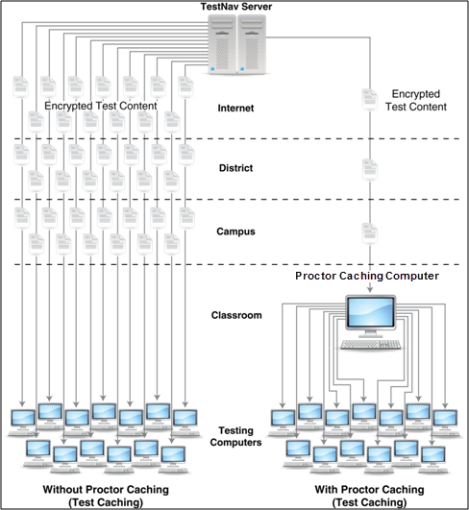
Bandwidth & Hardware Configuration
Phase 1: Step 1
Pearson strongly recommends installing and using proctor caching to locally deliver test content for computer-based assessments
Set firewall and content filter permissions to allow all Pearson domains
Complete SystemCheck verification on all assessment environments
Notes:
The first phase is to verify bandwidth and hardware readiness. Pearson strongly recommends installing and using proctor caching to locally deliver test content for computer-based assessments. This diagram represents the difference in network usage when using and not using proctor caching. The software can be downloaded from the Technology Information tab on the PearsonAccess resources page at http://PARCC.Pearson.com/TechInformation. A training module and guide is available to describe installation and use of proctor caching. Proctor caching software is free and does not require secure login access to download.
Internet firewalls, content filters, or spam filters must be configured to allow pass through to the Pearson domains. For more information about Pearson domains review the Technical Setup Training module or review the TestNav 8 User’s Guide.
Use SystemCheck for TestNav to verify device and network readiness. More information about SystemCheck will be discussed in the next slide.

Slide 21
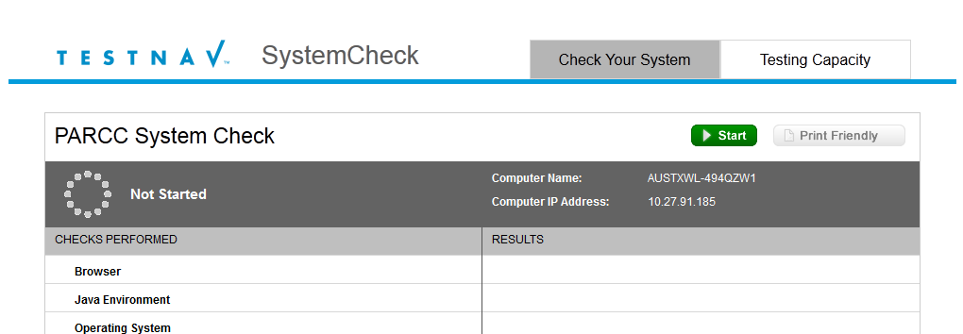
Bandwidth & Hardware Configuration
SystemCheck validates testing workstations meet the minimum requirements to run TestNav 8.
To gather realistic results, SystemCheck should be run from a student testing machine on the same day of week/time of day as when you anticipate performing online testing.
Launch SystemCheck from http://PARCC.Pearson.com/SystemCheck.
Learn more about SystemCheck by visiting http://PARCC.Pearson.com/TechInformation.
Notes:
SystemCheck was developed for customers to validate their testing workstations meet the minimum system requirements needed to run TestNav and to provide information about network capacity for student testing. To gather realistic results, SystemCheck should be run from a student testing machine on the same day of week/time of day as when you anticipate performing online testing. For example, if you plan to test on a Monday morning at 9am, run your checks on a Monday morning at 9am; running in the afternoon or on a weekend will not replicate the testing environment. SystemCheck will only need to be run once on a computer for each administration unless changes are made to the operating system or Java.
To access SystemCheck, visit http://PARCC.Pearson.com/SystemCheck.
To learn more about SystemCheck for TestNav, visit theTechnology Information Resources page at http://PARCC.Pearson.com/TechInformation.
Note: SystemCheck cannot be launched on iPads and Chromebooks. Also, iPad-mini devices are not supported devices..

Slide 22
Assessment Environment Configuration
Phase 1: Step 2
Assessment Environment Configuration
Disable applications that could launch automatically
Verify that testing workstations meet minimum requirements
Verify that the TestNav content and certificates are trusted on testing workstations.
Verify that the latest version of Java is installed and that the Java applet associated with the test is authorized to run.
Notes:
The second phase of preparation is configuring the assessment environment. First, disable any background application that may automatically launch during testing. Background applications that attempt to launch while TestNav is running in secure desktop mode will cause TestNav to close and the student will need to be resumed by the test administrator to continue testing.
TestNav will only launch on devices that meet the minimum system requirements. For more information about minimum system requirements and supported devices, go to the http://PARCC.Pearson.com/Requirements or use SystemCheck to review devices for system requirements. The minimum system requirements for prior versions of TestNav will vary so be sure to use the PARCC system requirements when verifying device readiness.
Finally, verify that the TestNav content and certificates are trusted on testing workstations.

Slide 23
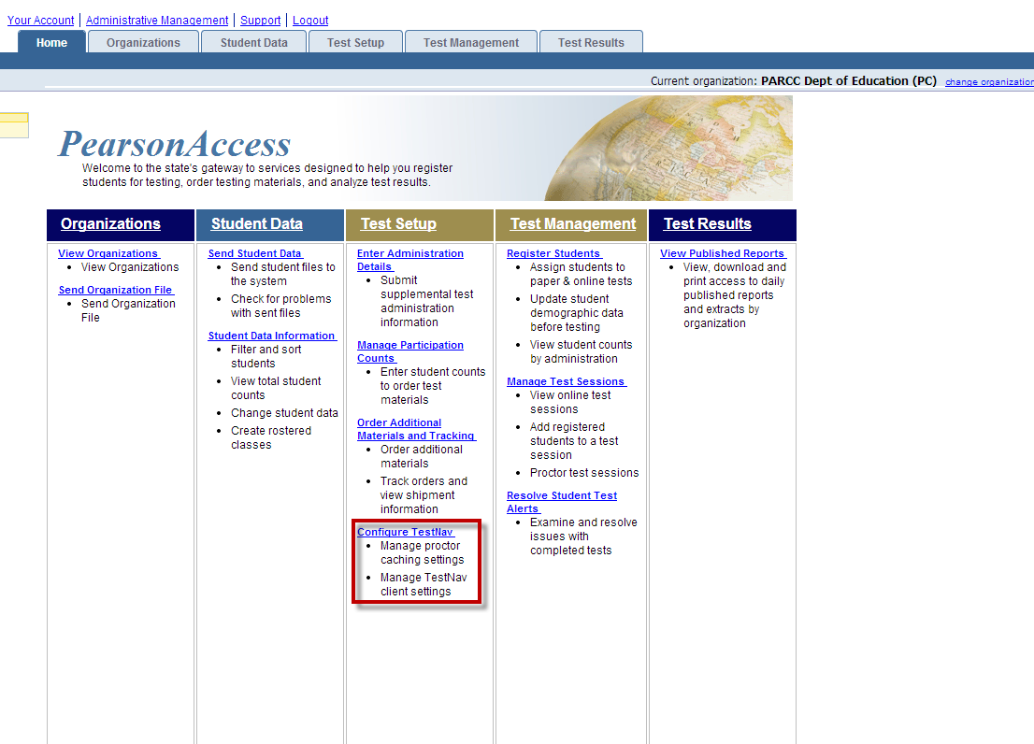
TestNav Configuration in PearsonAccess
Phase 1: Step 3
To create and maintain TestNav configurations, log into PearsonAccess and select Configure TestNav from the Test Setup menu
NOTE: A user must have the Technology Staff role assigned to their login id to create TestNav configurations.
Notes:
In phase 3, technology staff will create TestNav configurations to designate proctor caching computers and student response file save locations. You will need to verify that all school technology staff members have received user IDs and passwords for the PARCC Training Center with appropriate permissions. Technology Staff will log into PearsonAccess to access the Configure TestNav page. TestNav configurations are used to indicate the IP address for proctor caching and identify student response file save locations. Students will need to have appropriate read and write permissions to access the designated save locations.
The Configure TestNav menu can be selected from the homepage within PARCC Training Center. This setup activity will need to be repeated in the live PARCC PearsonAccess site.

Slide 24
IT Infrastructure Verification
Phase 1: Step 4
Infrastructure Verification
Once you have completed the first three steps, conduct a trial to verify your device, infrastructure, and assessment configurations for each school in your district and evaluate the outcome.
Make adjustments to devices, networks, and re-train staff if necessary. Make sure that everyone with a role in the computer-based assessment understands what to do and who to contact for assistance.
Notes:
Once you have completed the first three phases of preparing for a computer-based assessment, conduct an Infrastructure Trial at each school within your district and evaluate the outcome for phase 4.
During phase 4, you should make any necessary adjustments to district and/or school devices and networks, and re-train any staff if necessary. You should also make sure that everyone with a role in the computer-based assessment understands what to do and who to contact for assistance.
The PARCC support center will be available to assist you throughout the Infrastructure Trial window. Support is available Monday-Friday, 6:00am to 8:00pm central time.

Slide 25
Infrastructure Trial: Phase 2
Using the PARCC Training Center
http://PARCC.Pearson.com/TrainingCenter
Notes:
Preparing for the Infrastructure Trial: Using the PARCC Training Center

Slide 26
Test Setup, Training, and Verification
Phase 2: Step 1
IT “run through” and verifications should be completed and verified before scheduling other testing, training and verification sessions with other staff members.
Infrastructure test will use “dummy” student accounts. Actual test will use real student data, which will be loaded into the system by the Department of Education.
The infrastructure trial should mimic the same number of test session to be given as well as the same capacity of simulated students.
There is no limit to the number of students or test sessions that can be created in the Training Center.
Changes in Training Center do not carry over to live site.
All district and school level administrators should be trained in creating “dummy” student accounts and test sessions.
If you are using proctor caching, remember to download the test cache for each proctor server and document who will be performing this task during actual testing.

Slide 27
PARCC Training Center Log In
The Infrastructure Trial is conducted in the secure PARCC Training Center.
Notes:
You can access the PARCC Training Center From the PearsonAccess site Training Center tab. Sign in once you have received your login access information. If you are the LEA/district coordinator, you will need to provide login access to all users that will have a role in the computer-based assessment or delegate responsibility for this activity. Learn more about creating login access in the PARCC PearsonAccess User Guide. You will notice that there is a visual difference between the Training Center site and the live assessment site. The Training Center uses a brown theme in order to distinguish it from the blue live assessment theme. It is important that you are aware of which environment you are working in so that you do not inadvertently input real student information into the Training Center.
NOTE: If your state currently uses PearsonAccess for other assessments, you will have a separate login and password for the PARCC Training Center and PARCC operational PearsonAccess site. From the login screen, the PARCC logo will be present in the header to help identify the site.

Slide 28
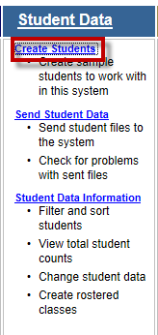
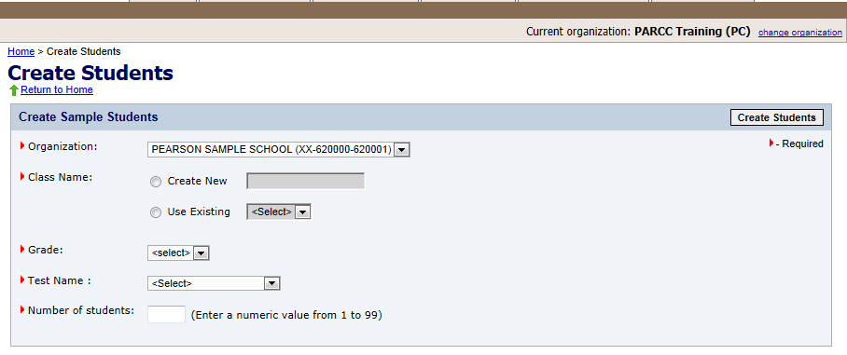
Creating “Dummy” Students
Create “Dummy” Student Data for Practice
Create mock students using the Create Students option from the Student Data menu. Create as many students as needed to represent the number of simultaneous test takers that would be tested on a typical day during the live test window.
Choose the organization (school), create a class (group) name, select the grade, test name, and choose the number of students you would like to create for practice in the organization you have selected.
Notes:
The ability to create students in bulk is only available in the Training Center using the Create Students wizard. This wizard allows you to quickly create multiple “dummy” students in the Training Center environment for the purpose of practicing the steps for creating online sessions and administering a computer-based assessment. During the live high-stakes assessment, you can either upload student data files to load students in bulk or manually enter students to add new students one at a time.
The wizard will require you to choose a school organization, create or use an existing class (group) name, select the applicable grade, select which test to use, and then choose the number of students you would like to create for practice in the organization you have selected. In the Training Center environment, you may create as many as 99 sample students at a time. Repeat this step as many times as needed to create enough records for your Infrastructure Trial assessment.

Slide 29
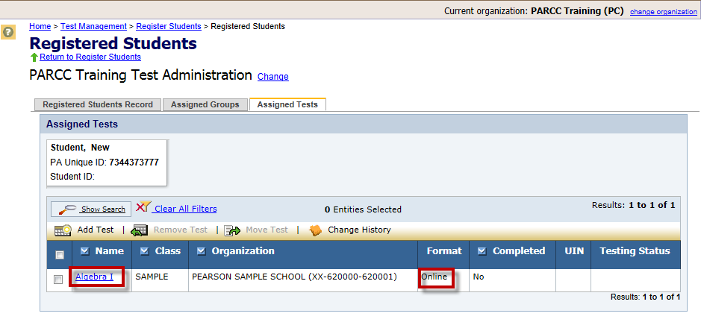
Creating “Dummy” Students Continued
In the PARCC Training Center, new students created using the wizard will automatically be registered for the computer-based test mode of the test selected in the Create Students step.
Notes:
All students enrolled in the Training Center using the wizard will be automatically be registered to the test administration selected in the Create Students wizard, and the students will be assigned to the “online” format for computer-based testing. Students assigned to the paper test mode are not eligible to be added to an online session and will not appear in the list of students eligible to be added to an online session.
These “dummy” students can now be added to online test sessions to be ready for use in the Infrastructure Trial.

Slide 30
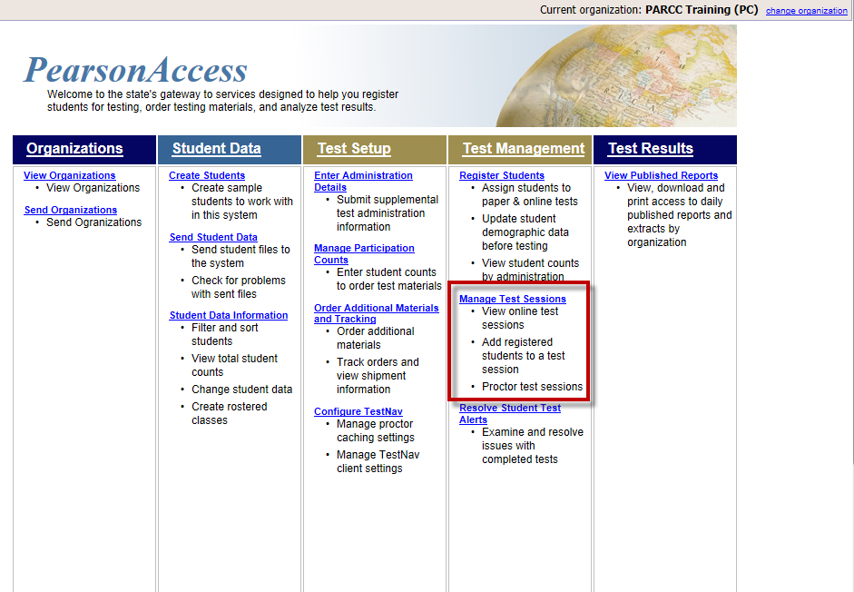
Test Setup: Create and Manage Test Sessions
Notes:
Test Management allows you create and manage online sessions. Within the online session, you can select the Proctor Caching button to download encrypted test content to a local caching computer designated in your TestNav configuration.
For more information about creating and managing test sessions, view the “Test Administration Training for Computer-Based Testing” module or review the “Test Management” section of the PARCC PearsonAccess User Guide.

Slide 31
Test Setup Continued
Create Test Sessions for Practice
Notes:
To create an online test session, you must enter all the required information indicated with a red triangle marker. Students can be added to sessions in groups or individually. For more information about creating and managing online sessions, view the Computer-Based Test Administration training module.
Students may only be assigned to one test session per test to be administered. If you do not see your student or group in the list of available students that can be added to the online session, verify that the student has not already been added to another online session and that the student has been registered to test in the online mode.

Slide 32
Test Administration, Training, and Verification
Phase 2: Step 2
Be sure someone starts the test sessions on or prior to the first day of testing.
The system can generate error codes due to lost connectivity, incomplete technology setup, or other factors. Be sure to provide all proctors, school test administrators, and district test administrators with a copy of the codes and instructions on how to handle each one (contact tech staff vs. contact Pearson directly).
Conduct one or more training sessions with all testing staff prior to testing period.

Slide 33
Test Policy, Procedures Training & Verification
Manage Test Sessions
Notes:
Manage Test Sessions allows you to create and view online session status. Users will see all of the sessions that have been created for the organization-level assigned to their user id for the selected administration. Users that have access to multiple organizations, such as a district coordinator with access to all schools within the district, can set the organization level to filter the list by organization. For example, a district coordinator may choose to view activity for a single school within the district. The district coordinator can set the organization-level to the school and then view available sessions for the school by choosing the Manage Test Sessions menu options. Selecting the Session Name from the session list will link to the Session Details screen where more details and actions are available.
Also, when working in the operational site for the PARCC field test, users will need to change the test administration name as appropriate. The PARCC Field Test will have a performance-based assessment (PBA) and an End-of-Year assessment (EOY.)

Slide 34
Session Details
Notes:
In the Session Details screen, you can start and stop a test session, print Student Authorizations and/or seal codes, proctor cache test content, print a session roster, edit the TestNav configuration to update the proctor caching server information, monitor individual student’s test, resume a test, mark a test complete, and add/remove/move students. The ability to mark tests completed may not apply to all roles. Verify user roles to determine which users can perform which actions. Also, students can be added to a session as a group or one at a time.
You can also view student progress by selecting the View Progress link. The View Progress page will display which items the student has visited, answered, and not visited; however, this page will not display the response entered by the student.
NOTE: Students will not be able to launch a test in TestNav until their associated session has been started. Also, student authorization tickets will need to be printed and distributed for the Infrastructure Trial. For more information about managing test sessions, please view the “Test Administration Training for Computer-Based Testing” module.

Slide 35
Test Policy, Procedures Training & Verification
Phase 2: Step 3
Determine, in advance, district rules and responsibilities relating to all aspects of test:
Monitoring of students during testing
Creating test sessions and “dummy” students,
Starting, resuming, and closing tests
Downloading tests when proctor caching
Provide all necessary documentation to all involved parties
Manuals
Error response guidelines
Timelines
Checklists

Slide 36
Communications and Support Plan
Phase 2: Step 4
The Communication and Support plan should contain:
Roles and responsibilities of every staff member in the testing process
Standard communications
Routing protocols for issues or anomalies
Checklists and tasks to ensure all steps and phases have been completed
Follow-up and revision plans

Slide 37
Pre-administration Checklist
Pre-Administration
Coordinate computer-based testing with your Internet service provider
Limit high bandwidth network activity other than computer-based testing during the window and avoid technology changes
Validate Phase 1-3 Activities have been completed
Pre-cache tests by selecting the Proctor Caching button within the Session Details page
Notes:
Finally, you will prepare for the live PARCC Field-Test assessment.
Before the administration begins, you should contact your Internet service provider and ask about any upcoming outage or activities that could affect testing during the administration window.
You should try to limit network activity to reduce unnecessary bandwidth utilization during testing. Also, verify that there have been no updates or changes within your environment that could affect testing.
Be sure to complete phases 1-3 to setup the testing environment. You will need to repeat the TestNav configuration setup step within the live PARCC PearsonAccess site. Also, make sure that technology staff have login access to the live PARCC PearsonAccess environment.
After online sessions have been created in the PARCC PearsonAccess site, select the Proctor Caching button found on the Session Details page to pre-cache test content. Typically, tests are available for caching within one week of the assessment window. If tests are not yet available, the button will be greyed out to inform you that tests are not available for pre-caching.

Slide 38
Test Security
Notes:
Preparing for the Infrastructure Trial: Using the PARCC Training Center

Slide 39
Testing Security
PARCC guidance for testing security policies will be provided in the Test Coordinator and Test Administration manuals
Many modern school networks have software installed that allows a teacher’s computer to display in real time what is on a student’s monitor. LEAs may want to consider policies that clearly disallow the use of such technology during the administration of the test, as this technology can allow exposure of test content intended only for viewing by an individual tester.
Many portable electronic devices feature additional functionality such as cameras, text notepads, calculators, and other capabilities that can potentially compromise the security of the test environment. Policies may be needed regarding collection or prohibition of these devices during testing.
Notes:
[read slide]

Slide 40
Testing Security
Student access to testing workstations prior to beginning the test should be carefully monitored, in order to ensure that students are not activating software or other resources that could interfere with the security and integrity of the test. Best practices for student testing should ensure that no student is aware of which computer he or she will use for testing until it is time for testing to begin.
Any scratch paper or work folders distributed in compliance with the test administration instructions should be collected along with the authorization ticket and stored or disposed of via secure methods, just as would be employed for a paper-based test.
Notes:
[read slide]

Slide 41
Testing Security
Testing lab configuration can also help facilitate test security. The following configuration options can help prevent students from viewing another’s computer-bases assessment.
Placement and spacing of testing workstations
Privacy screen filters
Computer hoods/visors
Once testing has begun, Test Administrators are generally expected to be actively monitoring the entire class of students. Test Administrators may need to be advised not to allow individual issues of a lengthy or complicated nature, such as technical problems with a single student’s computer, to distract from their active monitoring role. As a best practice, it is recommended that appropriate IT resources be contacted ahead of time, to be available to assist proctors with such issues.
Notes:
[read slide]

Slide 42
Testing Security
LEAs may want to consider a policy for local IT personnel regarding the importance of not viewing secure content within a student’s test while trouble-shooting and problem-solving.
IT personnel will be required to sign the security agreement so they must attend the same security training that Test Administrators or Test Proctors receive.
Notes:
[read slide]

Slide 43
Resources and Modules
Notes:
Preparing for the Infrastructure Trial: Using the PARCC Training Center

Slide 44
Training Resources and Modules
Training Resources and Modules
For Technology Coordinators and Technology Staff:
SystemCheck for TestNav
Technical Setup
Emerging Technologies and Security with Computer-Based Testing
http://PARCC.Pearson.com/Support
http://PARCC.Pearson.com/TechInformation
For Testing Coordinators and Test Administrators:
Computer-Based Testing: Test Administration Training
Accessibility Features and Accommodations with Computer-Based Testing
Paper-Based Testing: Test Administration Training
Notes:
Pearson is developing training modules to assist users with preparing for a computer-based assessment. Test Administration Training is designed to instruct the school coordinators and test administrators on all of the test administration activities using PearsonAccess with special notes to indicate comparisons for other state computer-based testing with Pearson. While Test Administrator Training is designed for users who will be responsible for administering the computer-based assessment, it is recommended that technology staff also review the test administration training modules to understand the responsibilities of the test administrators they will be supporting.
Pearson is also developing training modules designed to assist technology staff with setting up and configuring the environment for computer-based assessments. SystemCheck for TestNav can be used to determine whether your devices have met the minimum system requirements for TestNav and that your network can support testing of all your students scheduled to test in the computer-based PARCC field test assessment. The Technical Setup training module will include special notes for states that have prior computer-based testing experience with Pearson. The notes will highlight similarities and differences of previous versions of proctor caching, SystemCheck, and TestNav.

Slide 45
Guides and Manuals
Available Guides and Manuals
Materials for School Coordinators and Test Administrators
PARCC Test Administrator Manual
PARCC Test Coordinator Manual for Computer-Based Testing
PARCC PearsonAccess User Guide
Infrastructure Trial Readiness Guide
Materials for LEA and School Technology Coordinators
TestNav 8 User Guide
TestNav Proctor Caching Guide
Quick Start Guides for TestNav 8 and Proctor Caching
Infrastructure Trial Readiness Guide
PARCC PearsonAccess User Guide
Notes:
There are a variety of manuals and guides designed to describe the technical and administrative tasks necessary to prepare for an computer-based assessment including a guide which describes the purpose and steps to conducting an Infrastructure Trial. These resources are posted in the non-secure resources page at http://PARCC.Pearson.com/Resources.

Slide 46
Support Contacts
PARCC Support Center
888-493-9888
PARCC@support.pearson.com
LDOE Contacts
TECHNOLOGY:
EdTech@la.gov
Carol Mosley (Carol.Mosley@la.gov)
Caroline Porche (Caroline.Porche@la.gov)
Allen Childress (Allen.Childress@la.gov)
ASSESSMENT:
Assessment@la.gov
Kristina Bradford (Kristina.Bradford@la.gov)
Susan Khan (Susan.Khan@la.gov)
Notes:
That concludes our presentation. For additional support, you may contact the PARCC Support Center at 888-493-9888 or by email at PARCC@support.pearson.com or contact your LDOE support team at:
TECHNOLOGY:
EdTech@la.gov
Carol Mosley (Carol.Mosley@la.gov)
Caroline Porche (Caroline.Porche@la.gov)
Allen Childress (Allen.Childress@la.gov)
ASSESSMENT:
Assessment@la.gov
Kristina Bradford (Kristina.Bradford@la.gov)
Susan Khan (Susan.Khan@la.gov)

