Slide 1

PARCC Field Test
Test Administration Training
Spring 2014

Slide 2
2014-2015 Assessment Plan
Grade | Subject | 13-14 Assessment | 14-15 Assessment
Grades 3 to 8 | ELA | LEAP and iLEAP | PARCC
 | Math | LEAP and iLEAP | PARCC
 | Science | LEAP and iLEAP | LEAP and iLEAP
 | Social Studies | LEAP and iLEAP | LEAP and iLEAP
High School | All subjects | ACT Advanced Placement | ACT Advanced Placement
 | ELA | English II EOC English III EOC | English II EOC English III EOC
 | Math | Algebra I EOC Geometry EOC | Algebra I EOC Geometry EOC
 | Science | Biology EOC | Biology EOC
 | Social Studies | US History EOC | US History EOC
Alternate Assessments | ELA, Math, Science (varies by grade level) | LAA1 | LAA1
 | ELA, Math, Science, Social Studies (varies by grade level) | LAA2 | LAA2 for eligible re-testers (high school)
 | English Language | ELDA | ELDA

Slide 3
PARCC Spring 2014 Field Test
The majority of districts will have exposure to PARCC prior to implementation.
65 traditional districts and 33 nontraditional schools/charters elected to participate (645 schools and approximately 50,000 students)
Sampling eased the burden for participation
  only 2-3 grade levels within a school
  only selecting 1-2 classes within a grade level
Students will participate in either the ELA or math component, not both
Students will participate in either the phase I, phase II or both components ranging from 2-5 sessions
Testing dates: PBA: March 24-April 11, 2014 and EOY: May 5-June 6, 2014
Louisiana Believes

Slide 4
Spring Field Test Expectations
The Spring field test is a learning experience for states, districts, schools, teachers, and students.
The field test will allow:
Districts across the state to practice implementing the online assessment
Students to experience the PARCC items
Educators to learn about the accessibility and accommodations features
Louisiana teachers, students, families and districts to provide feedback on improving the assessment
The Department to receive feedback on what improvements are necessary before the full test

Slide 5
Today’s Objective
To understand elements of the Spring 2014 PARCC Field Test administration, including:
  key dates
  design
  administration
  accommodations
  security
  reporting
  resources

Slide 6
KEY DATES

Slide 7
February 2014
Sun | Mon | Tue | Wed | Thu | Fri | Sat
 |  |  |  |  |  | 1
2 | 3 | 4 | 5 Deadline for Classroom Selection and EOC/Field Test Rosters | 6 | 7 | 8
9 | 10 | 11 | 12 Technology Preparation Iberville Building, Baton Rouge, LA 9:00-12:00 | 13 | 14 Technology Preparation Monroe, LA 9:00-12:00 | 15
16 | 17 Apple IOS Training Shreveport, LA 8:30-11:30 | 18 Test Administration Webinar 10:00-11:00 | 19 Apple IOS Training Baton Rouge, LA 8:30-11:30 | 20 | 21 Apple IOS Training Abbeville, LA 8:30-11:30 | 22
23 | 24 Hands On Pearson Access Training Gonzales, LA Two Sessions: 8:30-11:30; 12:30-3:30 | 25 Hands On Pearson Access Training Alexandria, LA Two Sessions: 8:30-11:30; 12:30-3:30 |  | 27 | 28 Hands On Pearson Access Training Bossier, LA Two Sessions: 8:30-11:30; 12:30-3:30

Slide 8
March 2014
Sun | Mon | Tue | Wed | Thu | Fri | Sat
 |  |  |  |  |  | 1
2 | 3 | 4 Mardi Gras | 5 | 6 | 7 | 8
9 | 10 Deadline to Complete Infrastructure Trial and Survey | 11 | 12 | 13 | 14 | 15
16 | 17 PBA Materials Delivery: PBY | 18 | 19 | 20 | 21 | 22
23 | 24 | 25 | 26 | 27 | 28 | 29
30 | 31
Spring 2014 PARCC Field Test Phase I: PBA
Spring 2014 PARCC Field Test Phase I: PBA

Slide 9
April 2014
Sun | Mon | Tue | Wed | Thu | Fri | Sat
 |  | 1 | 2 | 3 | 4 | 5
6 | 7 | 8 | 9 | 10 | 11 | 12
13 | 14 | 15 | 16 | 17 | 18 | 19
20 | 21 Complete Second Infrastructure Trial or System Check | 22 | 23 | 24 | 25 | 26
27 | 28 Hands On Pearson Access Training Gonzales, LA Two Sessions: 8:30-11:30; 12:30-3:30 EOY Materials Delivery: PBT | 29 Hands On Pearson Access Training Alexandria, LA Two Sessions: 8:30-11:30; 12:30-3:30 | 30 Hands On Pearson Access Training Bossier, LA Two Sessions: 8:30-11:30; 12:30-3:30
Spring 2014 PARCC Field Test Phase I: PBA
Spring 2014 PARCC Field Test Phase I: PBA

Slide 10
May 2014
Sun | Mon | Tue | Wed | Thu | Fri | Sat
 |  |  |  | 1 | 2 | 3
4 | 5 | 6 | 7 | 8 | 9 | 10
11 | 12 | 13 | 14 | 15 | 16 | 17
18 | 19 | 20 | 21 | 22 | 23 | 24
25 | 26 | 27 | 28 | 29 | 30 | 31
Spring 2014 PARCC Field Test Phase II: EOY
Spring 2014 PARCC Field Test Phase II: EOY
Spring 2014 PARCC Field Test Phase II: EOY
Spring 2014 PARCC Field Test Phase II: EOY

Slide 11
DESIGN

Slide 12
Schedule
Schools can schedule testing at any time during the Field Test testing windows:
Component | Administration Dates
Phase I: Performance-Based Assessment (PBA) | March 24 to April 11, 2014
Phase II: End-of-Year (EOY) | May 5 to June 6, 2014
Louisiana Believes

Slide 13
Testing Components
Component | Format and Administration
PHASE I Performance-Based Assessment (PBA) Hand scored & Computer scored | Format Approximately 75% of the way through the year 3 ELA sessions (40-80 min/session) 2 math sessions (50 minutes/session) Administration 15 day testing window: March 24-April11, 2014
PHASE II End-of-Year Assessment (EOY) Computer scored | Format Approximately 90% of the way through the year 2 ELA sessions (40-70 minutes/session) 2 math sessions (55 minutes/session) Administration 20 day testing window : May 5-June 6, 2014

Slide 14
Testing Times
The field test will be timed. Each grade level and content area has a unique set of testing times.
Session time: The amount of time anticipated allocated for the section
Additional time: The amount of extra time that can be offered for all students
Students with IEPs/504 plans: If the student has an ‘extended time’ accommodation, he/she should be granted additional time
A complete list of testing times is available in the Test Coordinators Manual.
 |  | Performance Based Test |  |  | End of Year
ELA Grade 3 | Administration time | Literary Analysis | Research Simulation | Narrative Writing | Session 1 | Session 2
 | Session time | 60 | 60 | 40 | 70 | 50
 | Additional time | 30 | 30 | 20 | 35 | 25
 | Total time | 90 | 90 | 60 | 105 | 75

Slide 15
Transfer Policy
For the Spring 2014 PARCC Field Test, students will not be added to the participation sample once the Student Data Upload has been completed.

Slide 16
ADMINISTRATION

Slide 17

Pearson Access
Access to the Test Administrations tools, Training Site, Manuals and Training Modules can be found in Pearson Access:
  Type into web: www.pearsonaccess.com
  Select PARCC from the dropdown menu
  Three tabs:
    Home (used to log into Pearson Access live site)
    Support (manuals and training modules)
    Training (used to log into Pearson Training site)
Louisiana Believes

Slide 18
Live vs. Training Center
 | Live Site | Training Center
Location | http://parcc.pearson.com | Start at http://parcc.pearson.com then click on Training Center tab.
Uses | Load Student Data for students participating the Spring 2014 PARCC Field Test Set up and manage test sessions for live, online testing Order additional paper test materials once initial shipments are received | Run infrastructure trial Practice setting up and managing test sessions for online testing NOTE: Accommodations are not available in Training Center during the Infrastructure Trial.
Louisiana Believes

Slide 19
Support
Technology Information
  Proctor Cache Installer and Manual
  TestNav 8 Manual
Manuals and Documents
  Pearson Access User Guide
  Test Coordinator and Administrator Manuals (PBT & CBT)
Templates
  User File Layout and Field Definitions
Training
  Technology Training
    Infrastructure Trial, Tech Set-up, Emerging Technologies
  Test Administration
    Accessibility/Accommodations, CBT and PBT Administration
Louisiana Believes

Slide 20
Test Coordinator Manual (TCM)
Table of Contents
  Assessment Overview
  Test Security Protocols
  Tasks to Complete Before, During, and After Testing
  Administering the PARCC Field Test
  Appendices (i.e., forms, checklists, glossary)
Louisiana Believes

Slide 21
Pearson Access

Slide 22
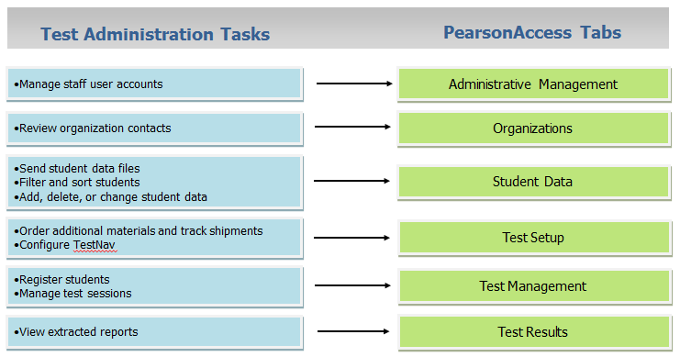
Pearson Access

Slide 23
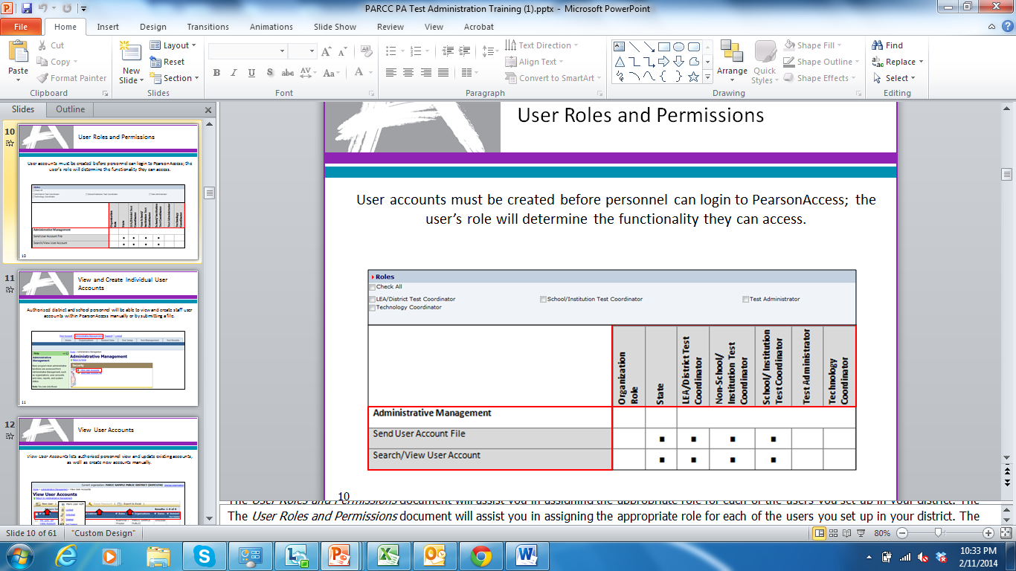
User Roles and Permissions
  User account information is provided via secure email upon establishment within the PearsonAccess system.

Slide 24
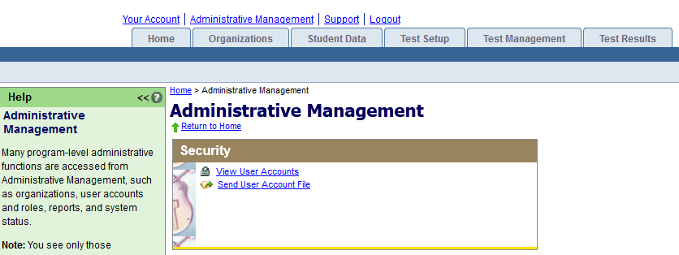
Individual User Accounts
Authorized district and school personnel will be able to view and create staff user accounts within PearsonAccess manually or by submitting a file.

Slide 25
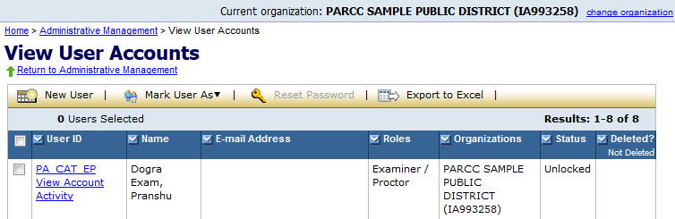
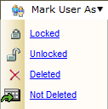
View User Accounts
View User Accounts lets authorized personnel view and update existing accounts, as well as create new accounts manually.
Louisiana Believes

Slide 26
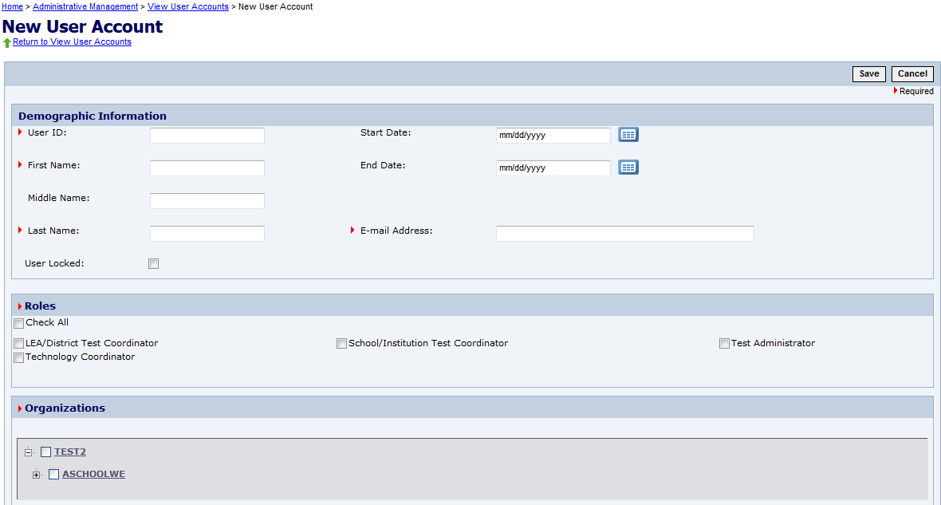
Create a New User Account
A user’s role and organization will determine the functionality they can access.
Louisiana Believes

Slide 27
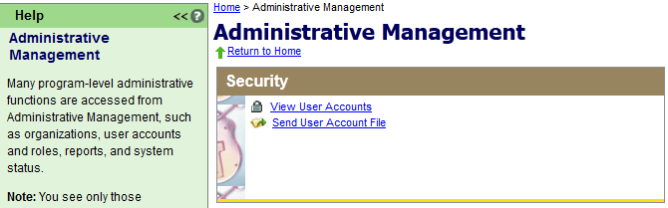
Send User Account File
User accounts may also be created or maintained by submitting a user account file; this is especially helpful when working with accounts in bulk.
Louisiana Believes

Slide 28
User Account File
By using the Export to Excel button on the View User Accounts page, a template is created for submitting a User Account file.
Louisiana Believes

Slide 29
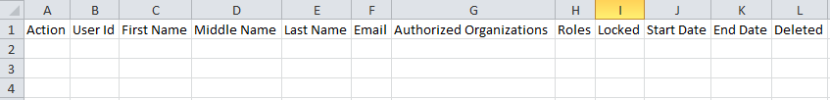
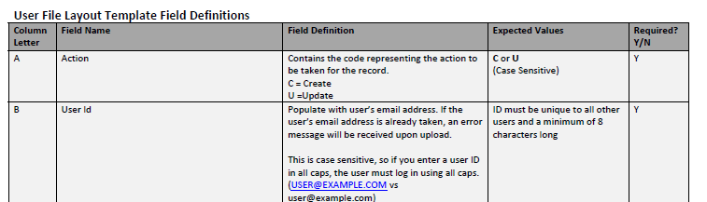
User Account File Fields
The User Account File template
Directions and Field Definitions for the User Account File Upload
Both files are available in the Support Tab of Pearson Access
Louisiana Believes

Slide 30
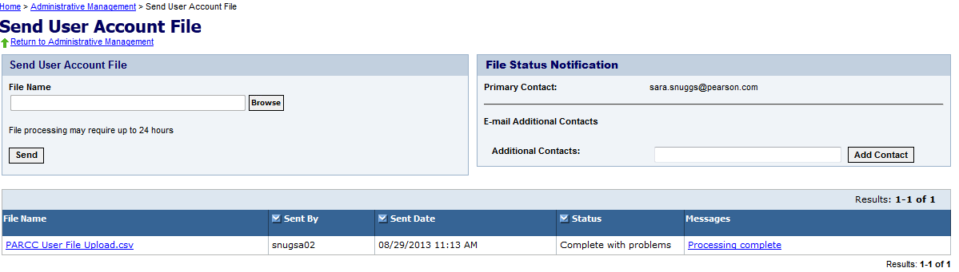
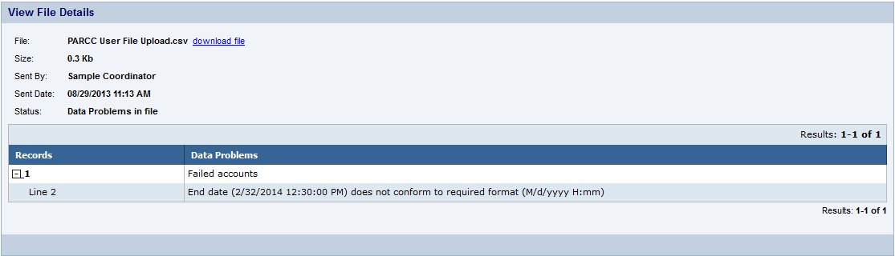
Send User Account File
Submit the file for processing at
Administrative Management > Send User Account File.
Louisiana Believes

Slide 31
Test Setup

Slide 32
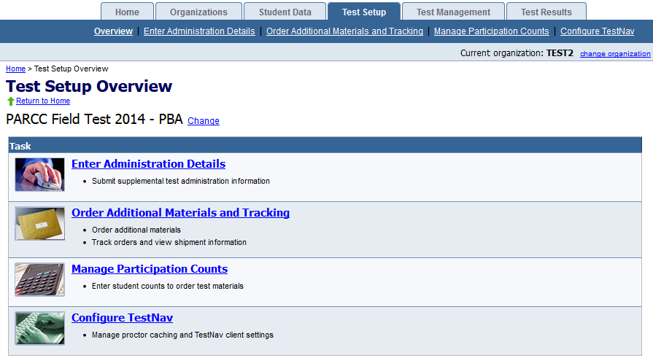
Test Setup
Test Setup activities help you to prepare for both PBT and CBT by ordering and tracking materials, managing participation counts, and configuring Test Nav.
Louisiana Believes

Slide 33
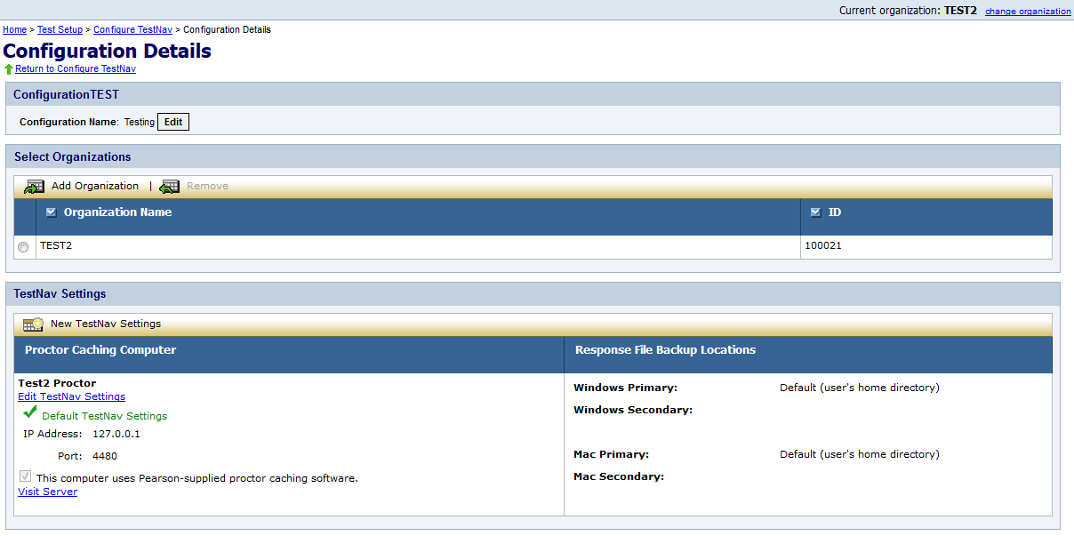
Configure Test Nav
Using Configure TestNav, you can manage proctor caching computer configurations and response file save locations.
Louisiana Believes

Slide 34
Test Management

Slide 35
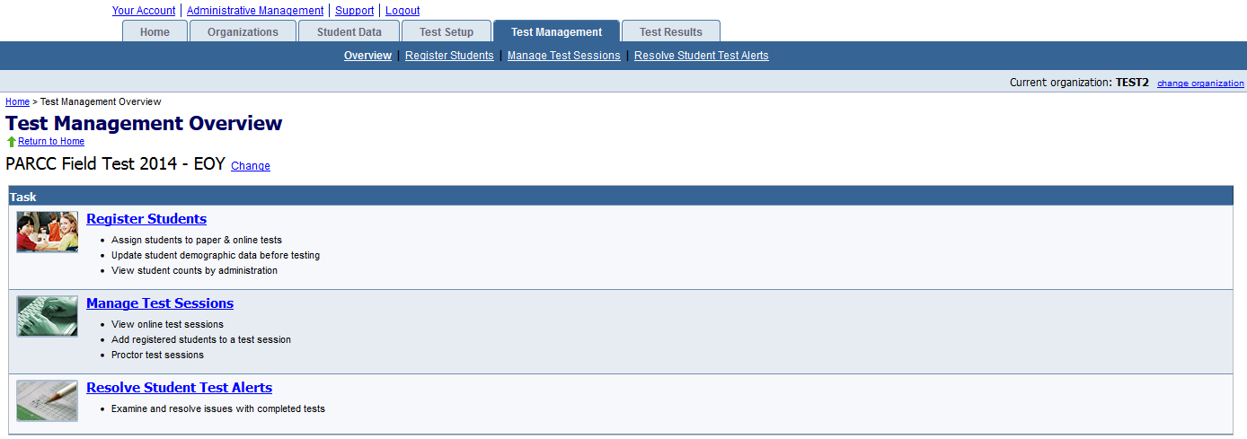
Test Management
The primary test management activities are registering students and managing test sessions.
Register Students allows you to manually assign students to paper & online tests, update student demographic data before testing, and view student counts by administration.
Managing Test Sessions is one of the main activities for computer-based testing.
Louisiana Believes

Slide 36
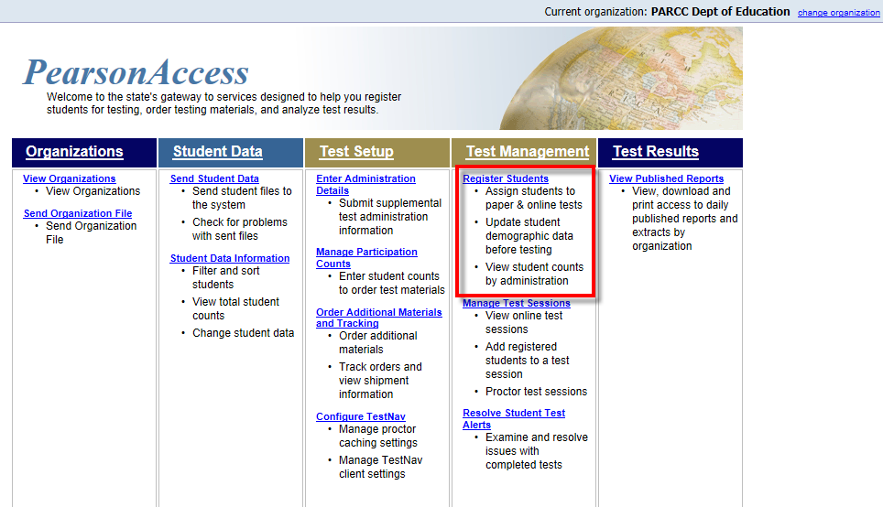
Student Registration Details
Accommodations are assigned on the student registration record
Louisiana Believes

Slide 37
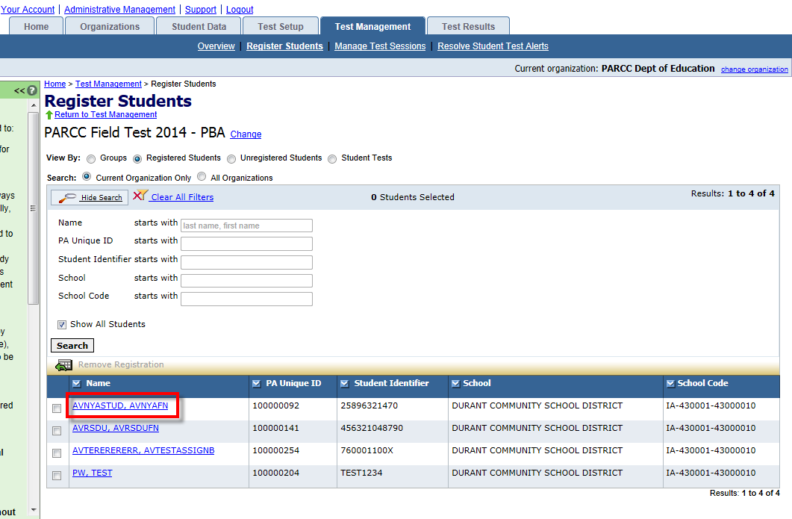
Student Registration Details
Select the student requiring an accessibility feature or accommodation from the list of registered students.
Louisiana Believes

Slide 38
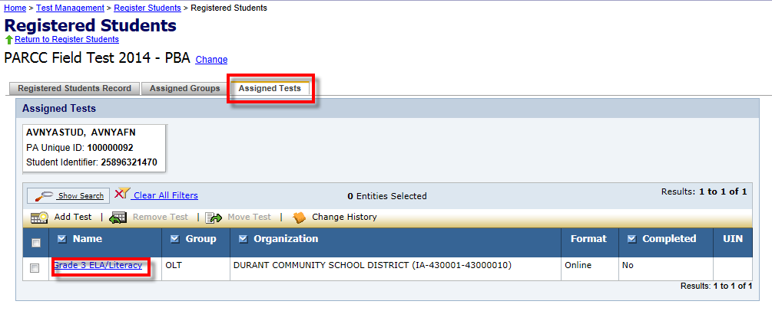
Student Registration Details
Go to the Assigned Tests tab to locate the test that will be assigned an accessibility feature or accommodation.
Then select the test from the list of registered tests.
Louisiana Believes

Slide 39
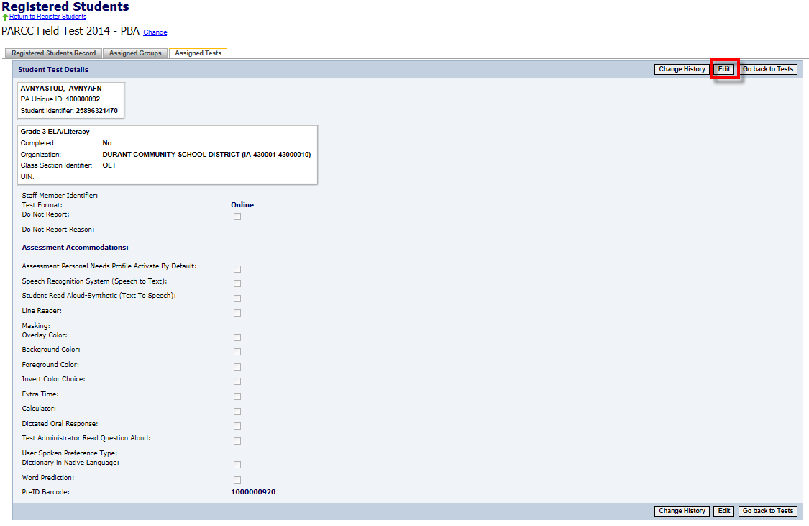
CBT: Student Registration Details
Select the Edit button to edit the student registration to assign accommodations from the available options.
Line Reader is available to all students and does not need to be selected
Select “Extra Time” to indicate an extended time accommodation
Select “Dictated Oral Response “ to indicate scribe
Louisiana Believes

Slide 40
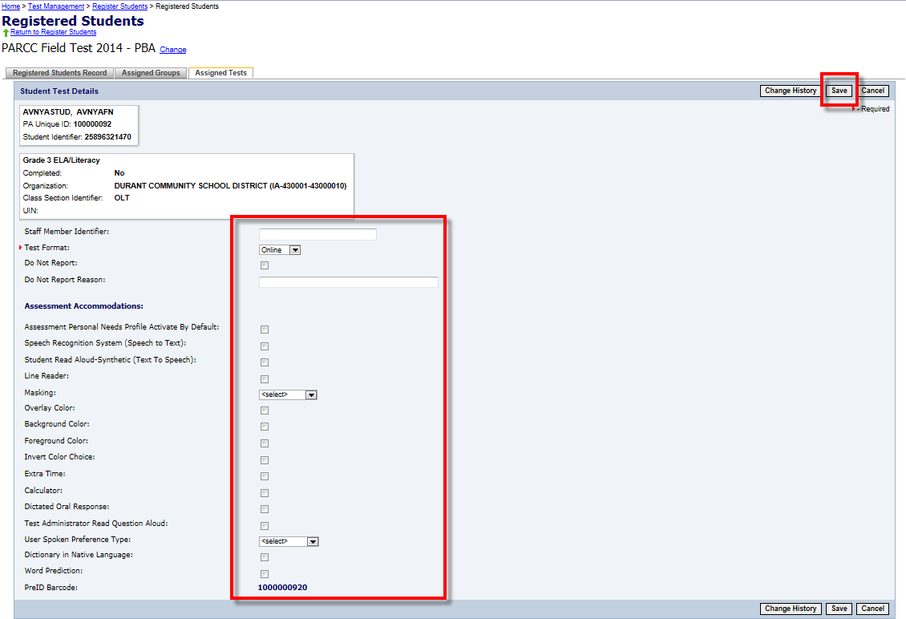
CBT: Student Registration Details
Choose “Answer” for Masking choice for Field Test
Only select if a student will use foreground and background color options as an accessibility feature under PARCC policy
Louisiana Believes

Slide 41
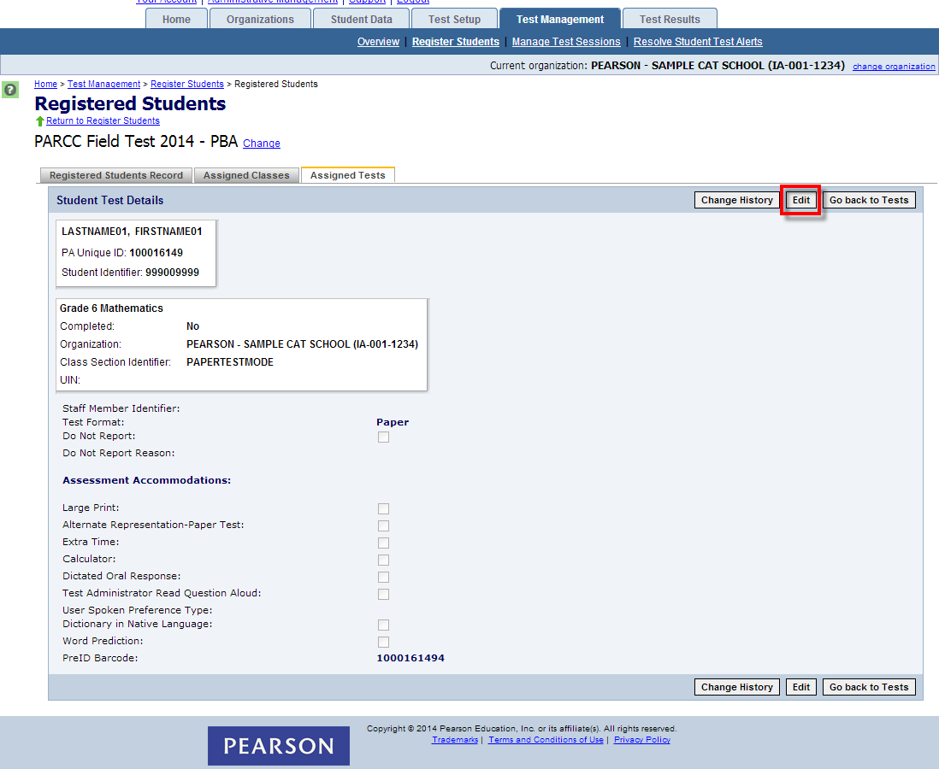
PBT: Student Registration Details
Louisiana Believes

Slide 42
Accessibility Features and Accommodations Available by Test Form Only
These features and accommodations may either be assigned by choosing the appropriate form for an entire session or by choosing the “Main” form and selecting features and accommodations for individual students.
Accessibility Features or Accommodation Form | Assessment Component, Content Area and Grades available
Answer Masking | EOY Only
 | ELA: Grades 3, 5, 8, 11
 | Math: Grades 4, 7, Algebra I, and Geometry
Background/Font Color (Color Contrast) | PBA and EOY
 | ELA: Grades 3, 5, 8, 11
 | Math: Grades 4, 7, Algebra I, and Geometry
Text-to-Speech for the Mathematics Assessments | PBA/EOY
 | Grades 4, 7 Algebra I
Text-to-Speech for the ELA/Literacy Assessments including items, response options, and passages | PBA/EOY
 | ELA: Grades 5, 8, 11
For the Field test a human reader may be used where text to speech is not available.
Louisiana Believes

Slide 43
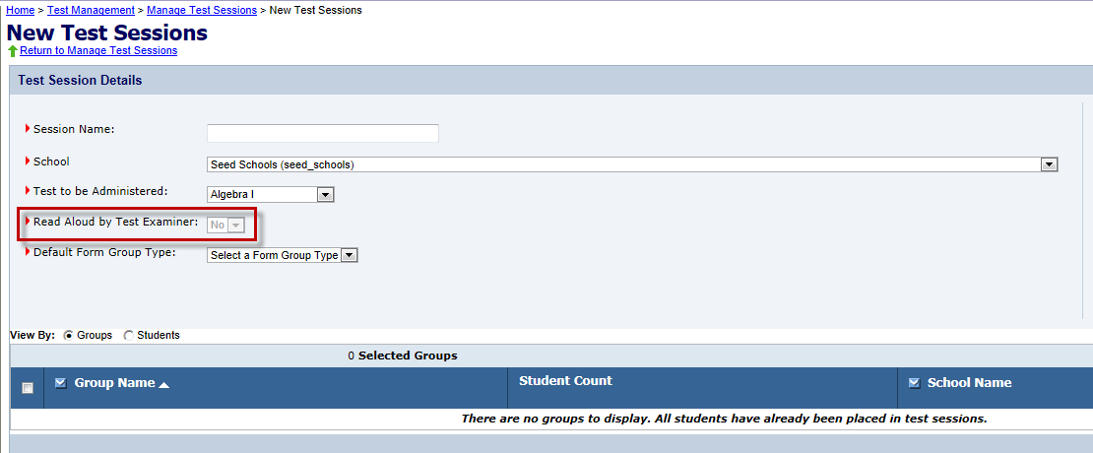
Read-Aloud Accessibility Feature
Creating a Session for a Read-Aloud Administration
A separate test session must be created for a read-aloud session.
You may add multiple students to the session, as long as they are all receiving the same read-aloud accommodation. These students will all receive the same test form.
To assign the read-aloud accommodation, select “Yes” from the drop down for “Read Aloud by Test Examiner” during the create new session step. If the drop down is unavailable (grayed out) then a read-aloud accommodation is not valid for the test to be administered.
Available as an Accessibility Feature for Mathematics or an Accommodation for ELA/Literacy
Louisiana Believes

Slide 44
PBT: Large Print Accommodation
To order materials for a Large Print Accommodation.
Order via Additional Orders in PearsonAccess beginning March 19th
Each Large Print Accommodation kit includes:
One Large Print test booklet
One regular print response document for transcription (Consumable test booklet for grade 3, scannable answer document for grades 4 – HS)
No deadline to order but allow 2 days for shipping
Louisiana Believes

Slide 45
Manage Test Session

Slide 46
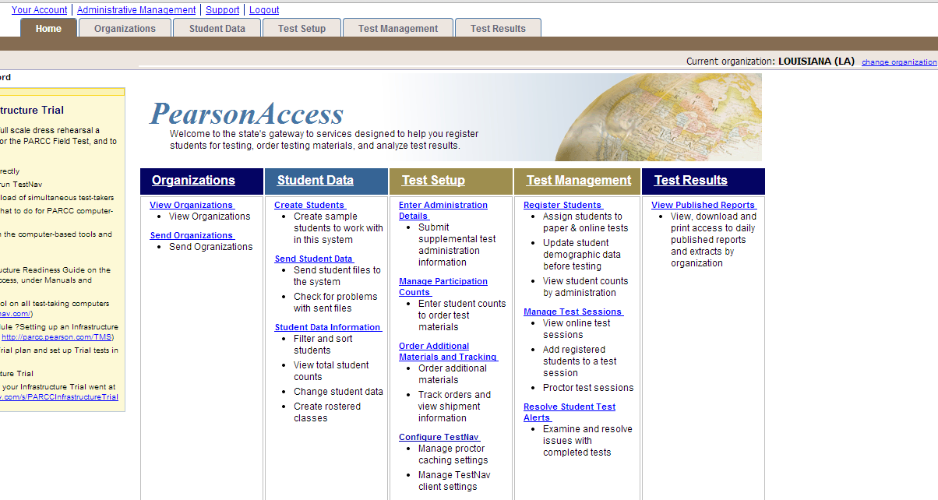
Manage Test Sessions
View, create, and edit test sessions
Louisiana Believes

Slide 47
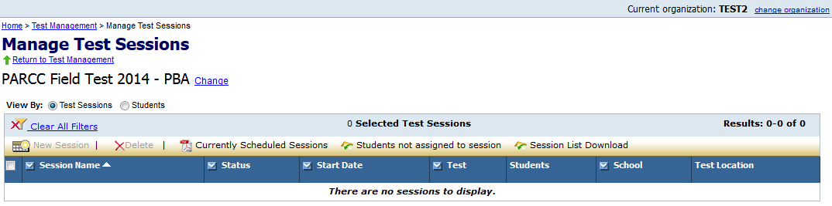
Manage Test Sessions
Most activities associated with CBT sessions will be performed on Manage Test Sessions.
To view or edit an existing session, click on the session name.
To create a new session, click New Session.
To delete a session, place a check mark next to the session name and then click Delete.
To view details about currently scheduled test sessions, click Currently Scheduled Sessions.
To view a CSV file with students registered to test but not in a session, click Students not assigned to session.
To download the session list as a CSV file, click Session List Download.
Louisiana Believes

Slide 48
Creating Test Sessions
Before students can take a CBT, test sessions must be created.
Click the New Session button.
Enter a session name and select a school.
Enter the remaining session details. Required fields are designated with a red arrow.
If applicable, select “No” from the Read Aloud by Test Examiner drop-down menu.
For administrations in which there is only one form, “Main” must be selected from the Form Group Type drop-down menu.
If applicable, a proctor caching computer should be selected from the Proctor Caching Computer drop-down menu.
To grant school-level users the ability to assign district-level proctor caching computers to test sessions, select the “Include caching computers defined for the District” checkbox.
You may add students now, or you can add students later.
Click the Save button after completing all session details.
Louisiana Believes

Slide 49
Session Details
The Session Details screen allows you to manage the details of each test session.
In the Session Details screen, you can:
  start and stop a test session,
  print Student Authorizations and/or seal codes,
  print Proctor Authorizations (for Read Aloud administrations),
  proctor cache test content,
  print a session roster,
  apply TestNav configurations,
  monitor individual student’s tests,
  resume a student’s test,
  mark a test complete, and
  add/remove/move students.
Louisiana Believes

Slide 50
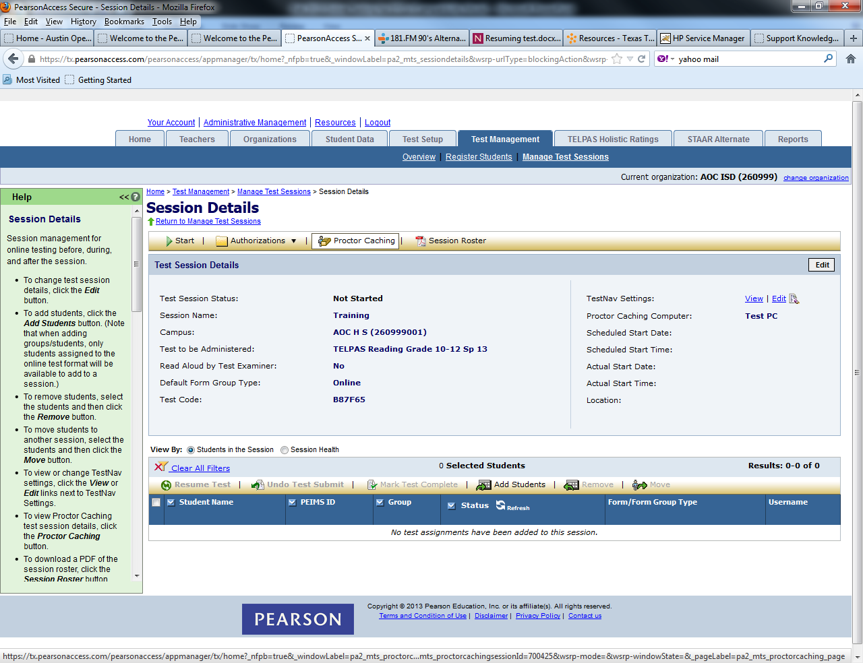
Assign a Proctor Caching Site to a Session
Proctor caching refers to downloading encrypted test content from the Pearson testing server to a secure local computer prior to starting a test session.
Proctor caching is completed at the session level, on the Session Details screen.
  The Proctor Caching button will be disabled and you will not be able to cache the test content for the test session if you do not have access to proctor caching or if you are not within the proctor caching window.
Proctor caching is available up to one week before an administration; districts will receive notification when it is available.
Louisiana Believes

Slide 51
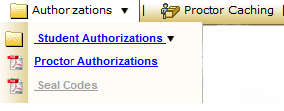
Student and Proctor Authorizations
Student and Proctor (TA) authorizations are needed to perform certain functions at the session level.
Each student must have an authorization in order to log in to a test.
Proctor authorizations (log in for test administrator) are only for Read Aloud Administrations.
Authorizations contain:
  the URL to access tests through the browser-based TestNav,
  a unique login ID, and
  the test code needed to log in.
Student authorizations also contain the keystrokes available for navigating through TestNav.
Louisiana Believes

Slide 52
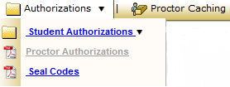
Authorizations - Seal Codes
Seal codes are the electronic equivalents of the adhesive tabs that are used to seal sections of paper test booklets.
There will be one set of seal codes assigned to each test session.
Before students in a test session can go to the next sealed section of an electronic test, they must enter the appropriate four-digit seal code.
Seal codes for a specific test session are listed on the seal codes document.
Louisiana Believes

Slide 53
Starting Test Sessions
A test session must be started before students can begin testing.
Scheduling a date and time for a new test session is intended primarily for planning purposes.
A test session will not start until you click the Start button on the Session Details screen, regardless of the scheduled start date and time.
NOTE: If you do not have access to start a test session, the Start button will be disabled and you will not be able to start the test session.
Louisiana Believes

Slide 54
Monitoring Test Sessions
Possible statuses for students as they test.
Status | Meaning
Ready | The student has not yet started the test.
Active | The student has logged in and started the test.
Exited | The student has exited TestNav but has not submitted test responses, e.g. took a break. (Student must be resumed by a test administrator to continue testing.)
Resumed | The student has been authorized by a test administrator to resume the test.
Resumed-Upload | The student has been authorized to resume the test, and any responses saved locally can be uploaded when the student is ready to continue testing.
Completed | The test has been submitted by the student through TestNav and the data has been processed.
Marked Complete | The student has exited TestNav and will not resume the same test, e.g left due to illness.
Louisiana Believes

Slide 55
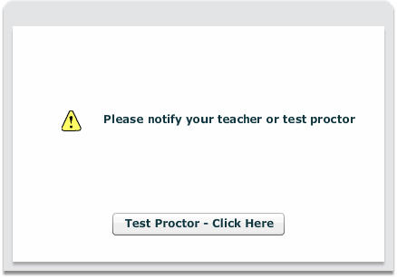
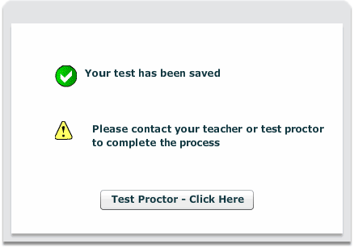
Early Warning System
One of the following screens will appear if errors occur either with accessing the test or saving and submitting student responses. Additionally an error code may appear with the notification. The error code should be noted in order to allow for appropriate identification of the error.
Students should be instructed to ALWAYS raise their hand when presented with either of the Test Proctor Click Here screens. They should NEVER click the Test Proctor-Click Here button without notifying the test administrator.
NOTE: It may be necessary to contact your local Technology Coordinator to determine the appropriate course of action.
Louisiana Believes

Slide 56
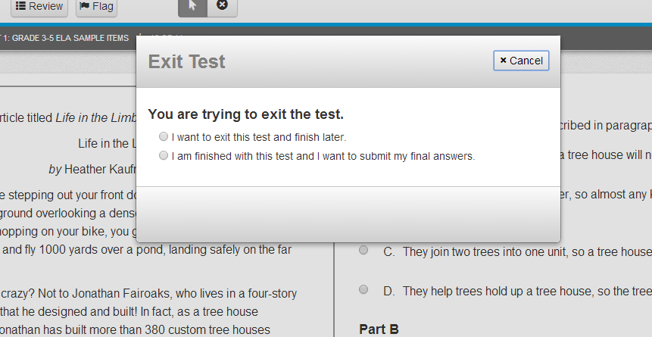
Exiting the Test Session
Students will receive the pop up message below when logging out of the test system.
Students that have not completed all parts of the PBA or EOY assessment should choose “I want to exit this test and finish later.”
EX:
Louisiana Believes

Slide 57
Submitting Final Answers
Students that have completed every part of the assessment should choose “I am finished with this test and I want to submit my final answers.”
Once a student has submitted final answers, the session (PBA/EOY) CANNOT be resumed.
Louisiana Believes

Slide 58
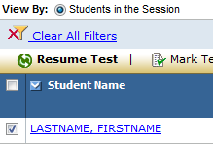
Resuming a Student’s Test
A proctor (TA) must resume an Exited student’s test in order for the student to complete testing.
Select the checkbox for the student on the Session Details screen.
Click the Resume Test button. The student’s status will change to “Resumed” (if the student was in “Exited” status) or “Resumed-Upload” (if the student was in “Active” status).
  The student’s test will be resumed from the point at which it was exited or interrupted. Any saved test responses that the student entered will be uploaded when the connection to the Pearson testing server is reestablished.
Have the student log in using their original student authorization.
Louisiana Believes

Slide 59

View Test Progress
The Status column in the Session Details allows administrators to view test progress.
When available, select the student’s View Progress link to review test progress. Users with Organization and Technology Coordinator Roles only do not have access to view progress.
Status | Meaning
Visited/No Response Required | Student has visited the item but no response is required.
Visited/Answered | Student has visited the item and entered a response.
Visited/Not Answered | Student has visited the item but has not entered a response.
Not Visited | Student has not visited the item.
Louisiana Believes

Slide 60
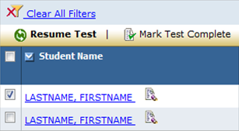
Mark Test Complete
If a student has exited a test and will not resume testing, the test can be manually marked “complete.”
Select the checkbox for the student on the Session Details screen.
Click the Mark Test Complete button. You will be prompted to enter the reason for marking the test “complete.”
Click the Save button.
The student’s status will change to “Marked Complete.”
Louisiana Believes

Slide 61
Stopping Test Sessions
You cannot stop a test session until all students in the session are in “Completed” or “Marked Complete” status.
After all students have completed the test and submitted their responses, or been marked “complete,” you should stop the session.
Click the Stop button.
NOTE: A session does not stop until you click the Stop button. The system will NOT automatically start or stop a session. Once a session has been stopped, it can no longer be modified.
Louisiana Believes

Slide 62
ACCOMMODATIONS

Slide 63



Accessibility & Accommodations
Louisiana Believes

Slide 64
Accessibility Features & Accommodations
The PARCC field test offers accessibility features and accommodations for students.
Access for All features available at any point to all students:
Tools built into the assessment such as choice elimination, line reader
Does not require an ‘opt in’ prior to the test
Accessibility features that need to be ‘turned on’:
Available to any student taking the PARCC assessments
Allows for even more individualized support for students
Students/teachers ‘opt in’ to these features during or prior to the test
Accommodations:
Aligned to students’ IEP, 504, or LEP accommodations plans
Intended to reduce the impact of the students’ disability on their test performance but not intended to lower expectations for students

Slide 65
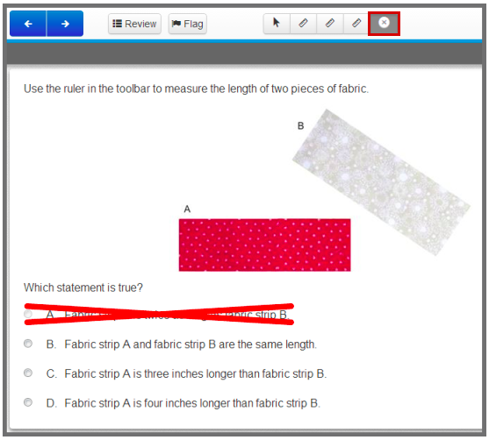
Feature for All: Eliminate Choice Tool
Louisiana Believes

Slide 66
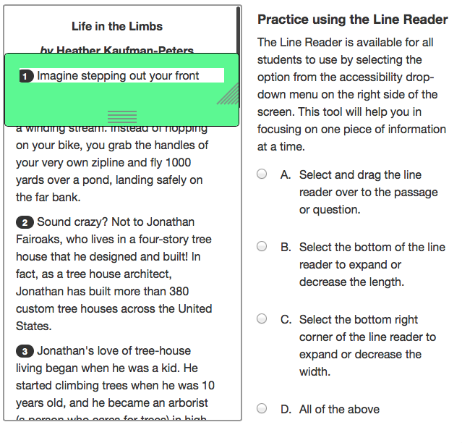
Feature for All: Line Reader
Louisiana Believes

Slide 67
Accessibility Features
Accessibility features assigned by the test administrator prior to the test session:
Support | Mode | Field test?
Answer Masking: The student electronically “covers” answer options or other text, as needed. | Computer | Yes
Invert Color Choice (i.e. Background/Font color, color contrast): The student changes the onscreen background and/or font color based on need or preference. | Computer | Yes
Text-to-Speech for Mathematics: Text is read aloud to the student using embedded text-to-speech software. Student must be tested in a separate setting if unable to wear headphones. | Computer | Yes

Slide 68
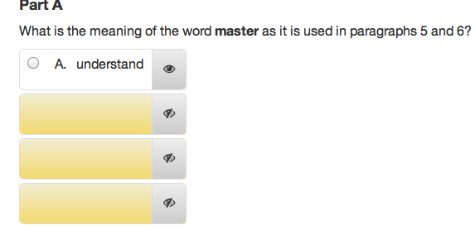
Accessibility Feature: Answer Masking
This is an example of the ‘answer masking’ accessibility feature:

Slide 69
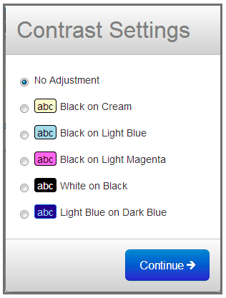
Accessibility Feature: Color Contrast
Louisiana Believes

Slide 70
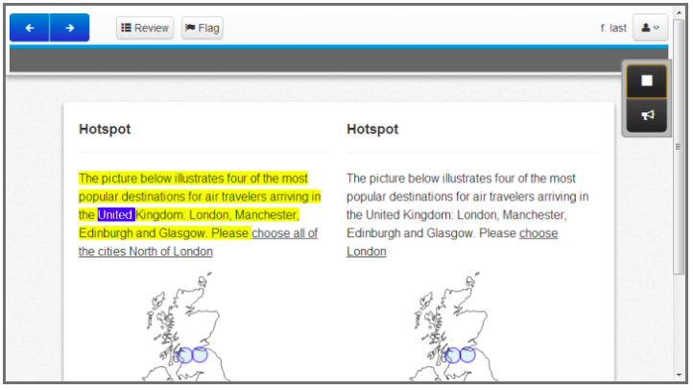
Accessibility Feature: Text-to-Speech
Louisiana Believes

Slide 71
Assigning Accommodations
    Assign accommodations and Accessibility according to current IEP, 504 IAP, or LEP accommodations plan
    Accommodations should not be changed to better match those available in the field test
Louisiana Believes

Slide 72
Accommodation Differences
Read Aloud
  Read Aloud is allowed for all students on the Mathematics assessment as a pre-determined accessibility feature.
  Read Aloud is allowed on the entire test including Reading Comprehension for students receiving the Read Aloud Accommodation.
  Read Aloud is not an accommodation allowed for English Language Learners unless part of an IEP or 504 plan. However, they may receive the read aloud accessibility option on the Mathematics assessment.
Extended Time
  This is a timed assessment with a estimated amount of time that a typical amount of time that a typical student will take to complete each test component (listed as Session Time) plus a set amount of additional time, for all students who need it, to complete the session.
  Students receiving the accommodation of Extended Time will have one school day to complete the test session.
Calculator
  Students may use either the calculator embedded in Test Nav8 or an appropriate hand-held calculator.
  Students with Calculator Accommodation will be allowed to use the calculator on all parts except on fluency items at the end of the testing session (Grades 3-6).
Louisiana Believes

Slide 73
SECURITY

Slide 74
SBESE Bulletin 118
Chapter 3: Test Security
All persons involved in assessment programs must abide by the security policies and procedures.
Procedures for
  investigating testing irregularities
  maintaining security of test materials
  maintaining security of student data
  handling of emergencies during testing
DTCs, STCs, TAs sign the Oath of Confidentiality and
Security Agreement after test administration.

Slide 75
REPORTING

Slide 76
Survey
Students and test administrators will complete a survey at the conclusion of each session.
Student level data will not be reported for the Spring 2014 field test

Slide 77
RESOURCES

Slide 78
Manuals and Training Modules
In the Support Tab of Pearson Access the following resources are available:
  Technology Information: Proctor Caching Installer and Guide, Test Nav 8 User Guide, Five Steps to Computer Based Testing, Pearson Hardware and Software Guidelines
  Manuals and Documents: Pearson Access User Guide, Test Coordinator Manual for PBT & CBT, Test Administrator Manual for PBT & CBT, Infrastructure Readiness Guide
    Templates: User Roles Matrix of Permissions, User File Layout, User File Field Definitions, Test Codes for PBA & EOY
    Training: Technology Training Modules (Infrastructure, Tech Set-up, Emerging Technologies) and Test Administration Modules (Test Administration of CBT & PBT and Accommodations/Accessibilities)

Slide 79
Sample Items and Tutorials
This week, the Department is sharing two tools that will allow parents, teachers, students and district staff to learn the testing platform for the field test.
  Tutorial: This tutorial guides users through all of the features of the online system. The tutorial can be accessed an unlimited number of times.
  Sample items: These are previously released PARCC items that have now been loaded onto the technology platform. These can be accessed an unlimited number of times.
Please ensure you check the technology specifications for use of these assessments. Google Chrome and Safari are the most compatible browsers. Certain versions of Internet Explorer are not compatible.
Please send any feedback to districtsupport@la.gov.

Slide 80
Additional Supports
LDOE field test website
Sample items and tutorials
Technology diagnostic tools
School Test Coordinators and Test Administrators half day sessions for participants in Phase I (PBA)
  February 24 - Ascension Parish
  February 25 - Rapides Parish
  February 28 - Bossier Parish
Repeat offerings of these sessions will be available for participants in Phase II (EOY) of the Spring 2014 Field Test at one of the following locations.
  April 28 - Ascension Parish
  April 29 - Rapides Parish
  April 30 - Bossier Parish

Slide 81
Next Steps
Review policies and instructions for test administration in both the School Test Coordinator Manual and Test Administrator Manual
Review School Test Coordinator, Test Administrator, and Technology Coordinator checklists
Sign Security Agreement
Complete recommended training
Ensure the School Test Coordinators and Test Administrators complete appropriate training
Add Users into Pearson Access as appropriate
Complete Infrastructure Trial
Prepare for Proctor Caching
Indicate Student Accommodation and Accessibility feature usage through Pearson Access
Set up Test Sessions
Order any additional materials including Large Print
Louisiana Believes

Slide 82

Contact
Additional Assessment Questions:
assessment@la.gov
Additional Technology Questions:
edtech@la.gov

