Slide 1

Hands on Training
Spring 2014 Field Test

Slide 2
2014-2015 Assessment Plan
Grade | Subject | 13-14 Assessment | 14-15 Assessment
Grades 3 to 8 | ELA | LEAP and iLEAP | PARCC
 | Math | LEAP and iLEAP | PARCC
 | Science | LEAP and iLEAP | LEAP and iLEAP
 | Social Studies | LEAP and iLEAP | LEAP and iLEAP
High School | All subjects | ACT Advanced Placement | ACT Advanced Placement
 | ELA | English II EOC English III EOC | English II EOC English III EOC
 | Math | Algebra I EOC Geometry EOC | Algebra I EOC Geometry EOC
 | Science | Biology EOC | Biology EOC
 | Social Studies | US History EOC | US History EOC
Alternate Assessments | ELA, Math, Science (varies by grade level) | LAA1 | LAA1
 | ELA, Math, Science, Social Studies (varies by grade level) | LAA2 | LAA2 for eligible re-testers (high school)
 | English Language | ELDA | ELDA

Slide 3
PARCC Spring 2014 Field Test
The majority of districts will have exposure to PARCC prior to implementation.
65 traditional districts and 33 nontraditional schools/charters elected to participate (645 schools and approximately 50,000 students)
Sampling eased the burden for participation
  only 2-3 grade levels within a school
  only selecting 1-2 classes within a grade level
  Students will participate in either the ELA or math component, not both
  Students will participate in either the phase I, phase II or both components ranging from 2-5 sessions
Testing dates: PBA: March 24-April 11, 2014 and EOY: May 5-June 6, 2014
Louisiana Believes

Slide 4
Spring Field Test Expectations
The Spring field test is a learning experience for states, districts, schools, teachers, and students.
The field test will allow:
Districts across the state to practice implementing the online assessment
Students to experience the PARCC items
Educators to learn about the accessibility and accommodations features
Louisiana teachers, students, families and districts to provide feedback on improving the assessment

Slide 5
Agenda
  Design of the Field Test
  Review Access for All, Accessibility Features, and Accommodations
  Provide overview of Pearson Access
  Complete key tasks in the Pearson Access Training Site
    Creating and Managing User Accounts
    Creating and Managing Test Sessions
  Reporting
  Resources
  Explore Sample Sets and Tutorial

Slide 6
Handouts Provided
  Power Point Presentation
  User Roles in Pearson Access
  Louisiana Guide to Accessibility and Accommodations for PARCC Field Test
  Accommodations and Accessibilities Features Descriptors for PARCC Field Test

Slide 7
Design

Slide 8
Agenda
  Design of the Field Test
  Review Access for All, Accessibility Features, and Accommodations
  Provide overview of Pearson Access
  Complete key tasks in the Pearson Access Training Site
    Creating and Managing User Accounts
    Creating and Managing Test Sessions
  Reporting
  Resources
  Explore Sample Sets and Tutorial

Slide 9
Schedule
Schools can schedule testing at any time during the Field Test testing windows:
Component | Administration Dates
Phase I: Performance-Based Assessment (PBA) | March 24 to April 11, 2014 15 days
Phase II: End-of-Year (EOY) | May 5 to June 6, 2014 20 days
Louisiana Believes

Slide 10
Testing Components
Component | Format and Administration
PHASE I Performance-Based Assessment (PBA) Hand scored & Computer scored | Format Approximately 75% of the way through the year 3 ELA sessions (40-80 min/session) 2 math sessions (50 minutes/session) Administration 15 day testing window: March 24-April11, 2014
PHASE II End-of-Year Assessment (EOY) Computer scored | Format Approximately 90% of the way through the year 2 ELA sessions (40-70 minutes/session) 2 math sessions (55 minutes/session) Administration 20 day testing window : May 5-June 6, 2014

Slide 11
Testing Times
The field test will be timed. Each grade level and content area has a unique set of testing times.
Session time: The amount of time anticipated allocated for the section
Additional time: The amount of extra time that can be offered for all students
Students with IEPs/504 plans: If the student has an ‘extended time’ accommodation, he/she should be granted additional time
A complete list of testing times is available in the Test Coordinators Manual.
 |  | Performance Based Test |  |  | End of Year
ELA Grade 3 | Administration time | Literary Analysis | Research Simulation | Narrative Writing | Session 1 | Session 2
 | Session time | 60 | 60 | 40 | 70 | 50
 | Additional time | 30 | 30 | 20 | 35 | 25
 | Total time | 90 | 90 | 60 | 105 | 75

Slide 12
Review of Accessibility Features and Accommodations

Slide 13
Agenda
  Design of the Field Test
  Review Access for All, Accessibility Features, and Accommodations
  Provide overview of Pearson Access
  Complete key tasks in the Pearson Access Training Site
    Creating and Managing User Accounts
    Creating and Managing Test Sessions
  Reporting
  Resources
  Explore Sample Sets and Tutorial

Slide 14



Types of Accessibility Features and Accommodations
Features for All Students
Accessibility Features
Accommodations
Notes:
The Accessibility Features and Accommodations Manual details a three-tiered process to providing access to the assessments for all students:
Features for All Students: Tools embedded in the computer-delivered system available to all students to use (e.g. font magnification, highlighting tool, bolding, underlining)
Accessibility Features: Tools embedded in the computer-delivered system open to all students to use, but must be made available at the discretion of school-based educators (e.g. background/font color, answer masking)
Accommodations: Supports for SWD and ELs that increase access while maintaining a valid and reliable score (e.g. braille form, extended time, small group testing, word-to-word native language dictionary)

Slide 15
Accessibility Features & Accommodations
The PARCC field test offers accessibility features and accommodations for students.
Features for All:
Tools built into the assessment such as choice elimination, line reader
Does not require an ‘opt in’ prior to the test
Accessibility features that need to be ‘turned on’:
Available to any student taking the PARCC assessments
Allows for even more individualized support for students
Students/teachers ‘opt in’ to these features during or prior to the test
Accommodations:
Aligned to students’ IEP or 504 plans
Also available for ELL students

Slide 16
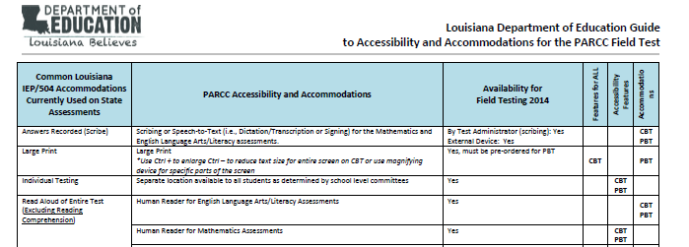
Field Test Guides
The Guide and Descriptors published Tuesday explain which features are available as features for all, accessibility features and accommodations.
Louisiana Believes
Notes:
Hyperlink to guide and descriptors

Slide 17
Key Accommodation Notes
Read Aloud
  All students are permitted to have the math assessment read aloud as a pre-determined accessibility feature.
  Students with the read aloud accommodation may also have the reading comprehension test read aloud.
  English Language Learners can opt in to the read aloud accessibility feature in math. However read aloud is not an accommodation allowed for English Language Learners on unless part of an IEP or 504 plan.
Extended Time
  This is a timed assessment with a estimated amount of time plus a set amount of additional time, for all students who need it, to complete the session.
  Students receiving the accommodation of extended time will have one school day to complete the test session.
Calculator
  Students may use either the calculator embedded in within the test or an appropriate hand-held calculator.
  Students with the calculator accommodation will be allowed to use the calculator on all parts except on fluency items at the end of the testing session (Grades 3-6).

Slide 18
Overview of Pearson Access

Slide 19
Agenda
  Design of the Field Test
  Review Access for All, Accessibility Features, and Accommodations
  Provide overview of Pearson Access
  Complete key tasks in the Pearson Access Training Site
    Creating and Managing User Accounts
    Creating and Managing Test Sessions
  Reporting
  Resources
  Explore Sample Sets and Tutorial

Slide 20

Pearson Access
Access to the Test Administrations tools, Training Site, Manuals and Training Modules can be found in Pearson Access:
  Type into web: www.pearsonaccess.com
  Select PARCC from the dropdown menu
  Three tabs:
    Home (used to log into Pearson Access live site)
    Support (manuals and training modules)
    Training (used to log into Pearson Training site)
Louisiana Believes

Slide 21
Live vs. Training Center
 | Live Site | Training Center
Location | http://parcc.pearson.com | Start at http://parcc.pearson.com then click on Training Center tab.
Uses | Load Student Data for students participating the Spring 2014 PARCC Field Test Set up and manage test sessions for live, online testing Order additional paper test materials once initial shipments are received | Run infrastructure trial Practice setting up and managing test sessions for online testing NOTE: Accommodations are not available in Training Center during the Infrastructure Trial.
Louisiana Believes

Slide 22
Support
Technology Information
  Proctor Cache Installer and Manual
  TestNav 8 Manual
Manuals and Documents
  Pearson Access User Guide
  Test Coordinator and Administrator Manuals (PBT & CBT)
Templates
  User File Layout and Field Definitions
Training
  Technology Training
    Infrastructure Trial, Tech Set-up, Emerging Technologies
  Test Administration
    Accessibility/Accommodations, CBT and PBT Administration
Louisiana Believes

Slide 23
Test Coordinator and Administrator Manuals
Table of Contents
  Assessment Overview
  Test Security Protocols
  Tasks to Complete Before, During, and After Testing
  Administering the PARCC Field Test
  Appendices (i.e., forms, checklists, glossary)
Louisiana Believes

Slide 24
Key Tasks in Pearson Access
Notes:
Through this section attendees will be logging into the training site and carrying out tasks

Slide 25
Agenda
  Design of the Field Test
  Review Access for All, Accessibility Features, and Accommodations
  Provide overview of Pearson Access
  Complete key tasks in the Pearson Access Training Site
    Creating and Managing User Accounts
    Creating and Managing Test Sessions
  Reporting
  Resources
  Explore Sample Sets and Tutorial

Slide 26
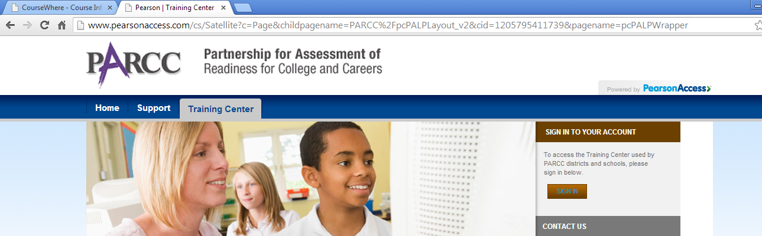
Logging into the Training Site
Use the provided login or your own to enter the training site as STC
STC Training Login: STCTestUser__ (insert number from handout)
Password: Educate2014
TA Training Login: TATestUser__ (insert number from handout)
Password: Educate2014
Louisiana Believes

Slide 27
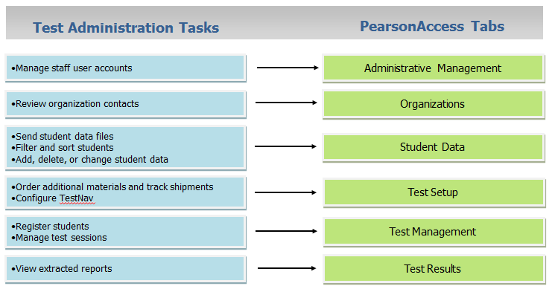
Pearson Access

Slide 28
Creating and Managing User Roles
Notes:
Through this section attendees will be logging into the training site and carrying out tasks

Slide 29
Agenda
  Design of the Field Test
  Review Access for All, Accessibility Features, and Accommodations
  Provide overview of Pearson Access
  Complete key tasks in the Pearson Access Training Site
    Creating and Managing User Accounts
    Creating and Managing Test Sessions
  Reporting
  Resources
  Explore Sample Sets and Tutorial

Slide 30
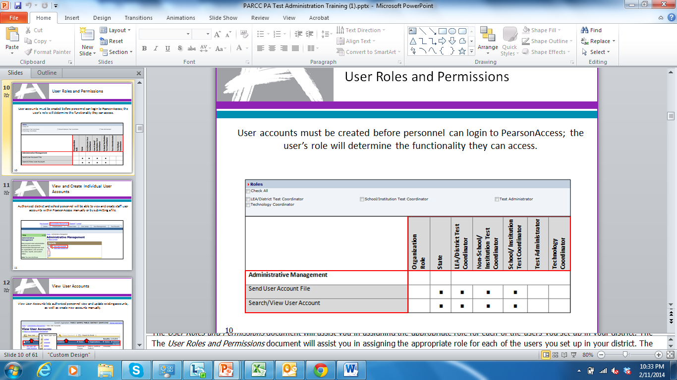
User Roles and Permissions
  User account information is provided via secure email upon establishment within the PearsonAccess system.
Notes:
Handout

Slide 31
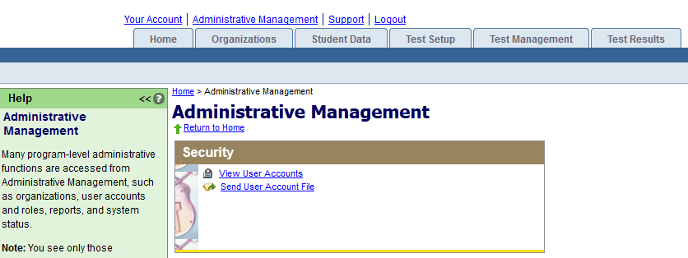
Individual User Accounts
Authorized district and school personnel will be able to view and create staff user accounts within PearsonAccess manually or by submitting a file.

Slide 32
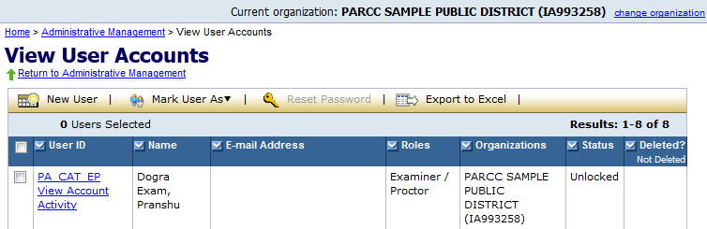
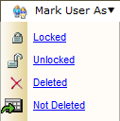
View User Accounts
View User Accounts lets authorized personnel view and update existing accounts, as well as create new accounts manually.
Louisiana Believes

Slide 33
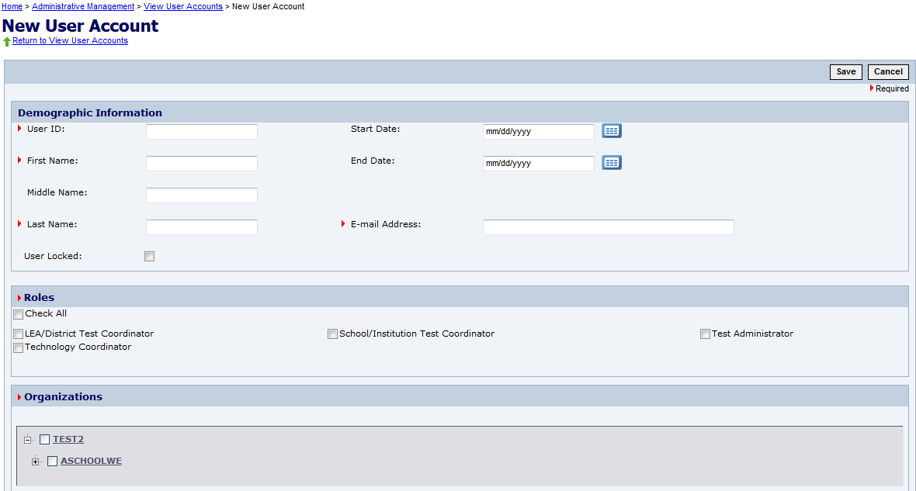
Create a New User Account
A user’s role and organization will determine the functionality they can access.
Louisiana Believes

Slide 34
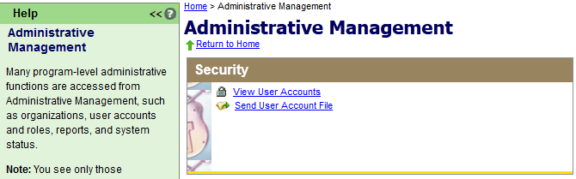
Send User Account File
User accounts may also be created or maintained by submitting a user account file; this is especially helpful when working with accounts in bulk.
Louisiana Believes

Slide 35
User Account File
By using the Export to Excel button on the View User Accounts page, a template is created for submitting a User Account file.
Louisiana Believes

Slide 36
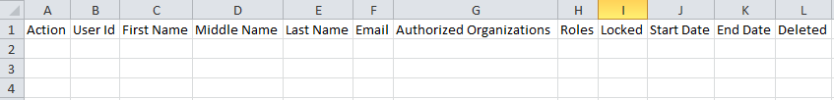
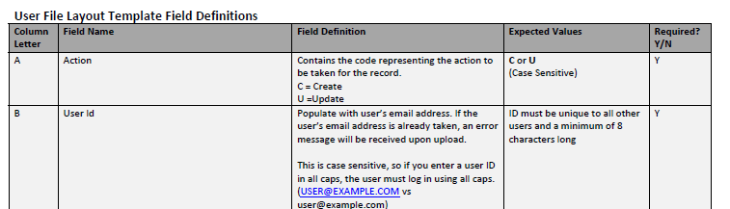
User Account File Fields
The User Account File template
Directions and Field Definitions for the User Account File Upload
Both files are available in the Support Tab of Pearson Access
Louisiana Believes

Slide 37
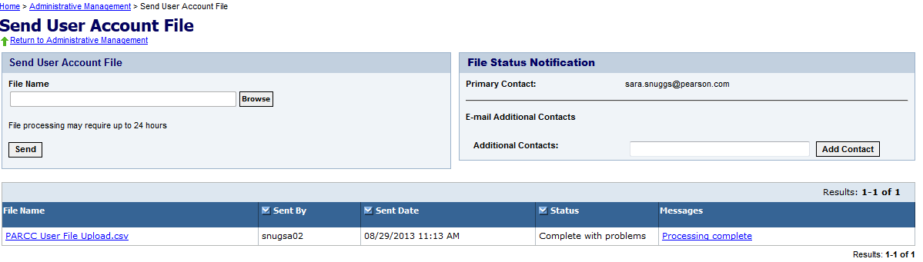
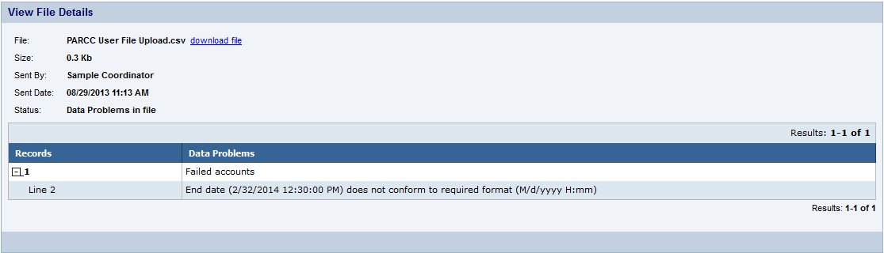
Send User Account File
Submit the file for processing at
Administrative Management > Send User Account File.
Louisiana Believes

Slide 38
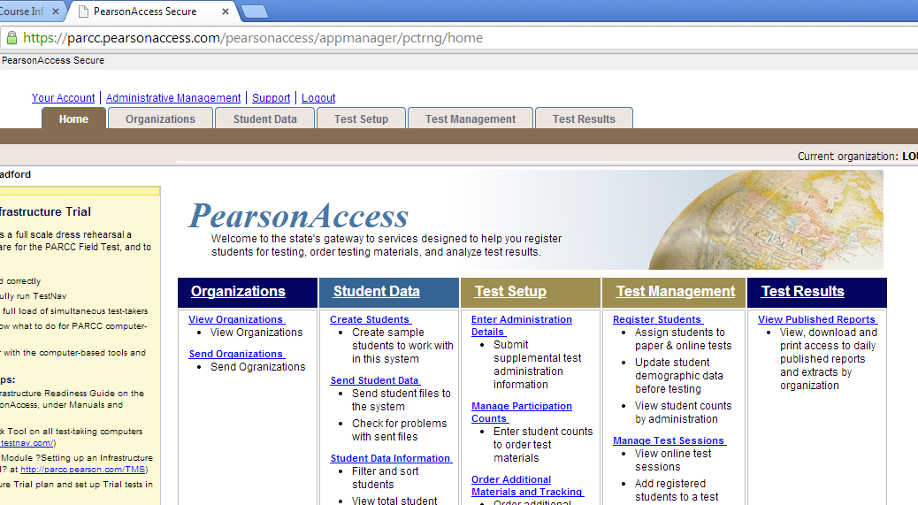
Creating Dummy Student Accounts
The Creating Students Wizard will create up to 99 anonymous student user accounts for infrastructure trial or training purposes.
Louisiana Believes

Slide 39
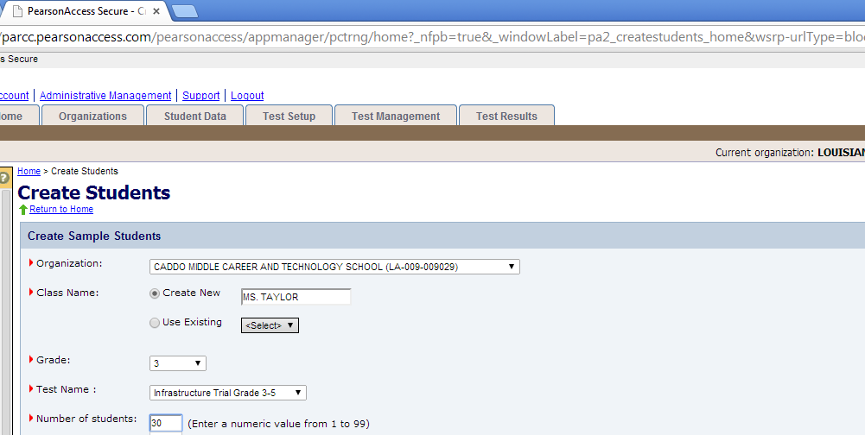
Creating Dummy Student Accounts
The Creating Students Wizard will create up to 99 anonymous student user accounts for infrastructure trial or training purposes.
Louisiana Believes

Slide 40
Creating and Managing Test Sessions

Slide 41
Agenda
  Design of the Field Test
  Review Access for All, Accessibility Features, and Accommodations
  Provide overview of Pearson Access
  Complete key tasks in the Pearson Access Training Site
    Creating and Managing User Accounts
    Creating and Managing Test Sessions
  Reporting
  Resources
  Explore Sample Sets and Tutorial

Slide 42
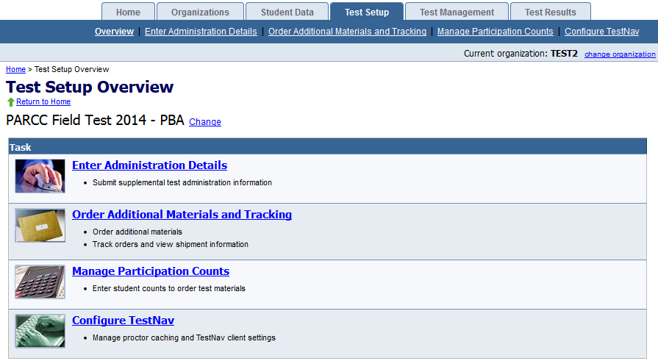
Test Setup
Test Setup activities help you to prepare for both PBT and CBT by ordering and tracking materials, managing participation counts, and configuring Test Nav.
Louisiana Believes

Slide 43
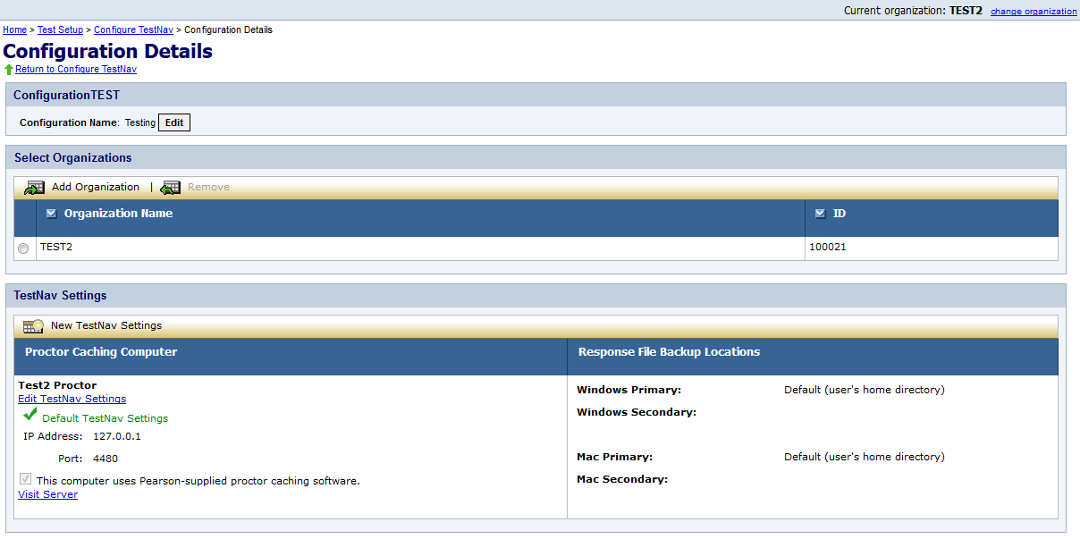
Configure Test Nav
Using Configure TestNav, you can manage proctor caching computer configurations and response file save locations.
Louisiana Believes

Slide 44
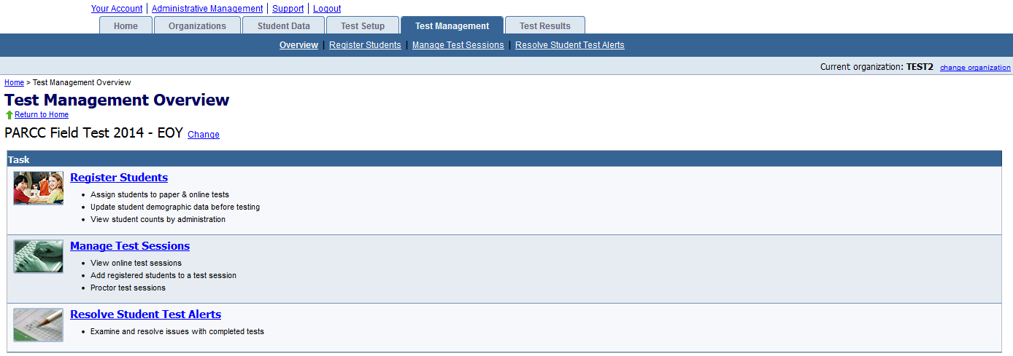
Test Management
The primary test management activities are registering students and managing test sessions.
Register Students allows you to manually assign students to paper & online tests, update student demographic data before testing, and view student counts by administration.
Managing Test Sessions is one of the main activities for computer-based testing.
Louisiana Believes

Slide 45
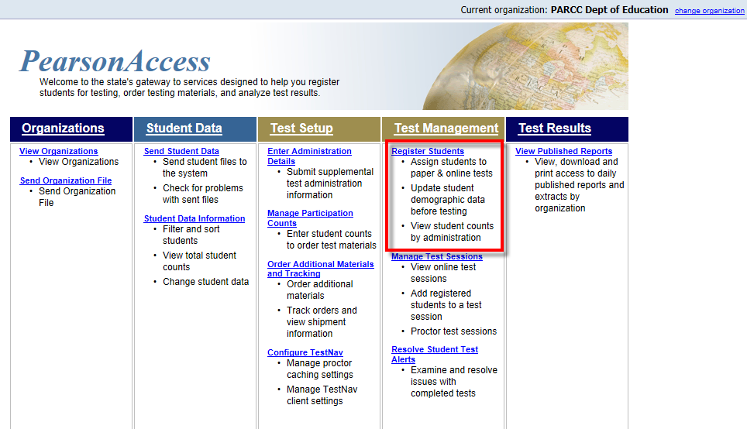
Student Registration Details
Accommodations are assigned on the student registration record
Louisiana Believes

Slide 46
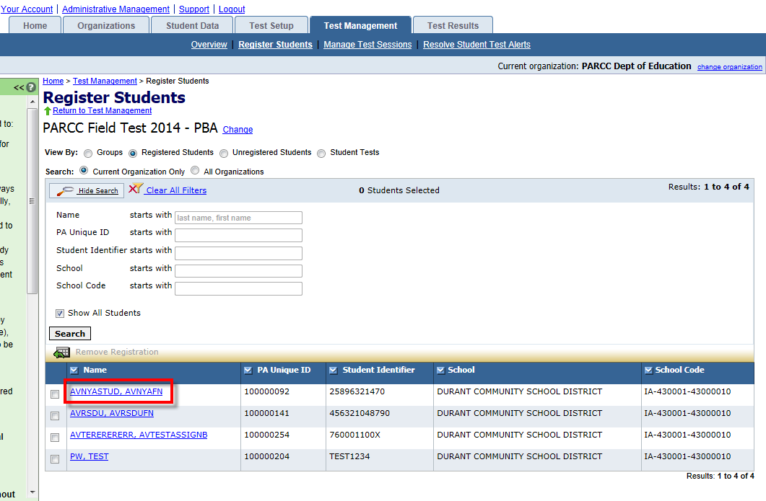
Student Registration Details
Select the student requiring an accessibility feature or accommodation from the list of registered students.
Louisiana Believes

Slide 47
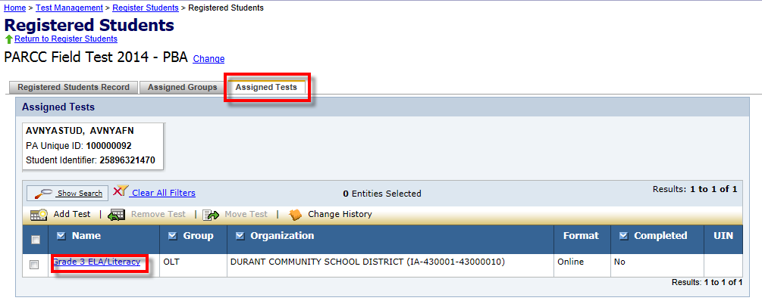
Student Registration Details
Go to the Assigned Tests tab to locate the test that will be assigned an accessibility feature or accommodation.
Then select the test from the list of registered tests.
Louisiana Believes

Slide 48
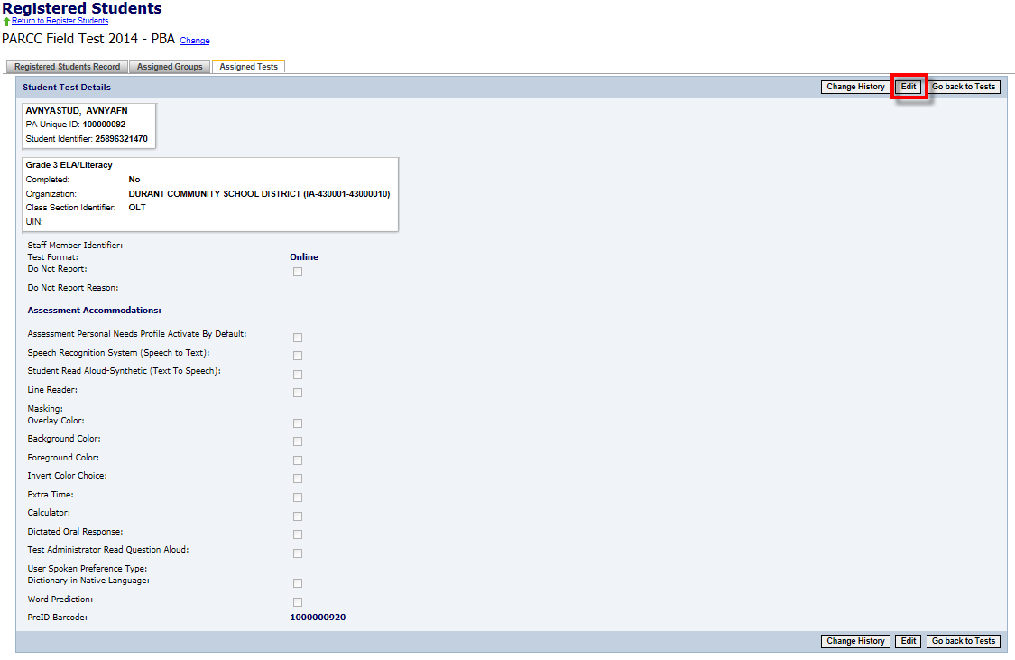
CBT: Student Registration Details
Select the Edit button to edit the student registration to assign accommodations from the available options.
Line Reader is available to all students and does not need to be selected
Select “Extra Time” to indicate an extended time accommodation
Select “Dictated Oral Response “ to indicate scribe
Louisiana Believes

Slide 49
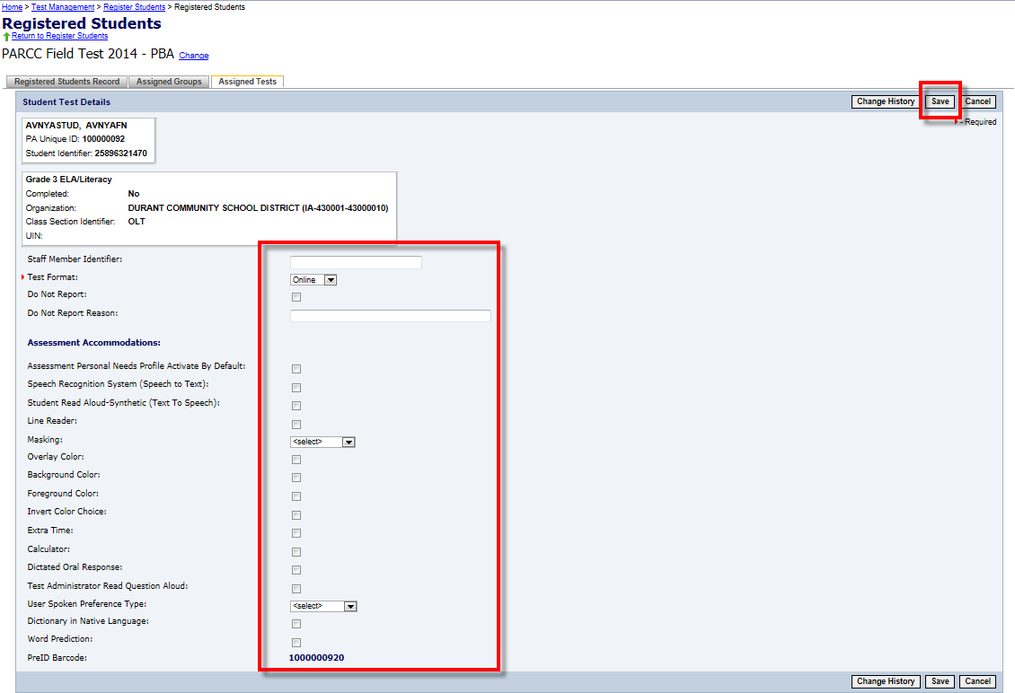
CBT: Student Registration Details
Choose “Answer” for Masking choice for Field Test
Only select if a student will use foreground and background color options as an accessibility feature under PARCC policy
Louisiana Believes

Slide 50
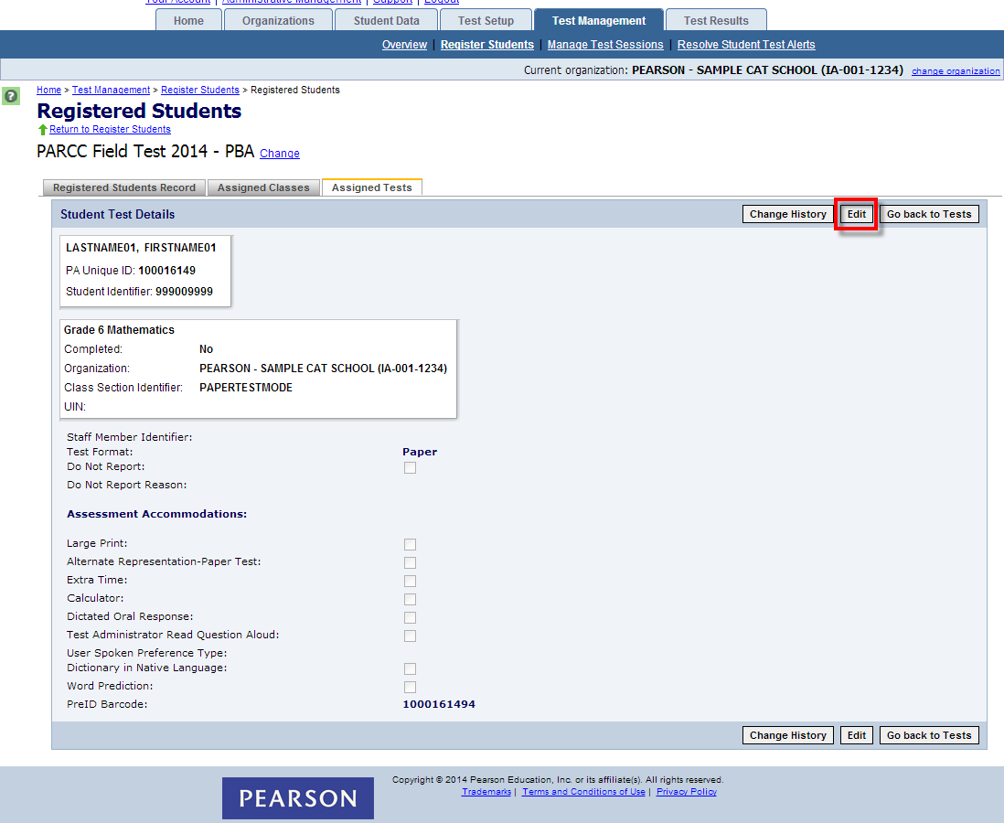
PBT: Student Registration Details
Louisiana Believes

Slide 51
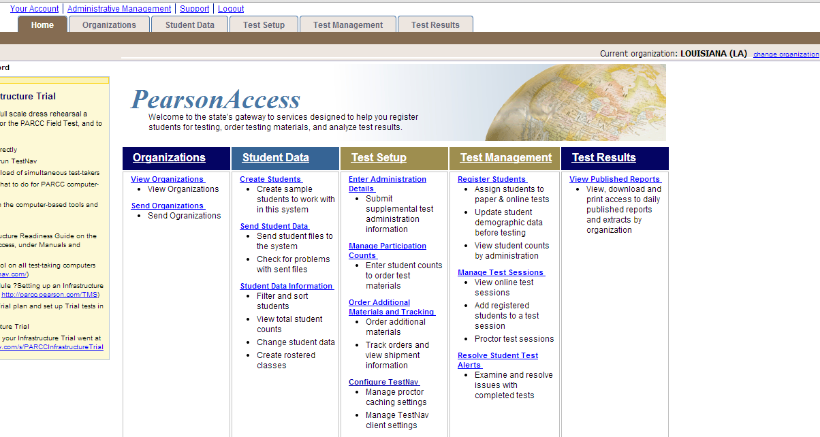
Manage Test Sessions
View, create, and edit test sessions
Louisiana Believes

Slide 52
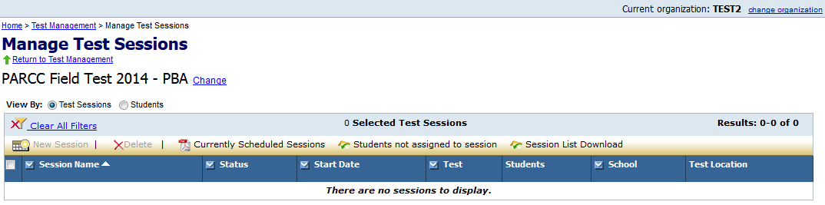
Manage Test Sessions
Most activities associated with CBT sessions will be performed on Manage Test Sessions.
To view or edit an existing session, click on the session name.
To create a new session, click New Session.
To delete a session, place a check mark next to the session name and then click Delete.
To view details about currently scheduled test sessions, click Currently Scheduled Sessions.
To view a CSV file with students registered to test but not in a session, click Students not assigned to session.
To download the session list as a CSV file, click Session List Download.
Louisiana Believes

Slide 53
Test Sessions in Pearson vs. PARCC Test Sessions
When creating test sessions within the Pearson site you are creating sessions for PBA ELA, EOY ELA, PBA Math, or EOY Math
Policies referring to completing a session in one school day refer to PARCC Sessions
Pearson Session | PARCC Session
PBA ELA | Literary Analysis Session, Research Simulation Session, Narrative Writing Session
EOY ELA | Session 1, Session 2
PBA Math | Session 1, Session 2
EOY Math | Session 1, Session 2

Slide 54
Consideration for Scheduling Test Sessions
Number and Length of PARCC Test Sessions
Technology Resources
  Devices
  Network capabilities
  Support staff
Time of Day when allowing time for Extended Time accommodations

Slide 55
Accessibility Features and Accommodations Available by Test Form
These features and accommodations may either be assigned by choosing the appropriate form for an entire session or by choosing the “Main” form and selecting features and accommodations for individual students.
Accessibility Features or Accommodation Form | Assessment Component, Content Area and Grades available
Answer Masking | EOY Only
 | ELA: Grades 3, 5, 8, 11
 | Math: Grades 4, 7, Algebra I, and Geometry
Background/Font Color (Color Contrast) | PBA and EOY
 | ELA: Grades 3, 5, 8, 11
 | Math: Grades 4, 7, Algebra I, and Geometry
Text-to-Speech for the Mathematics Assessments | PBA/EOY
 | Grades 4, 7 Algebra I
Text-to-Speech for the ELA/Literacy Assessments including items, response options, and passages | PBA/EOY
 | ELA: Grades 5, 8, 11
For the Field test a human reader may be used where text to speech is not available.
Louisiana Believes

Slide 56
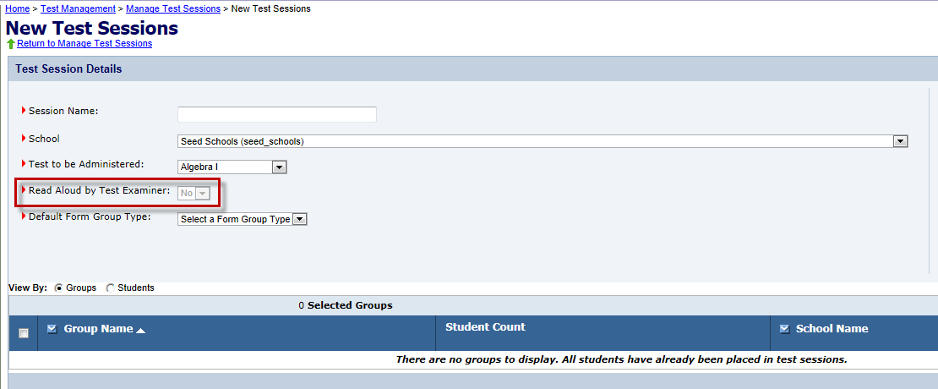
Read-Aloud Accessibility Feature
Creating a Session for a Read-Aloud Administration
A separate test session must be created for a read-aloud session.
You may add multiple students to the session, as long as they are all receiving the same read-aloud accommodation. These students will all receive the same test form.
To assign the read-aloud accommodation, select “Yes” from the drop down for “Read Aloud by Test Examiner” during the create new session step. If the drop down is unavailable (grayed out) then a read-aloud accommodation is not valid for the test to be administered.
Available as an Accessibility Feature for Mathematics or an Accommodation for ELA/Literacy
Louisiana Believes

Slide 57
PBT: Large Print Accommodation
To order materials for a Large Print Accommodation.
Order via Additional Orders in PearsonAccess beginning March 19th
Each Large Print Accommodation kit includes:
One Large Print test booklet
One regular print response document for transcription (Consumable test booklet for grade 3, scannable answer document for grades 4 – HS)
Louisiana Believes

Slide 58
Creating Test Sessions
Before students can take a CBT, test sessions must be created by either the District or School Test Coordinator.
Click the New Session button.
Enter a session name and select a school.
Enter the remaining session details. Required fields are designated with a red arrow.
If applicable, select “No” from the Read Aloud by Test Examiner drop-down menu.
For administrations in which there is only one form, “Main” must be selected from the Form Group Type drop-down menu.
If applicable, a proctor caching computer should be selected from the Proctor Caching Computer drop-down menu.
To grant school-level users the ability to assign district-level proctor caching computers to test sessions, select the “Include caching computers defined for the District” checkbox.
You may add students now, or you can add students later.
Test Administrators are not assigned to a particular session within the system but it may help to name the sessions so that they are identifiable to the TA.
Click the Save button after completing all session details.
Louisiana Believes

Slide 59
Session Details
The Session Details screen allows you to manage the details of each test session.
In the Session Details screen, you can:
  start and stop a test session,
  print Student Authorizations and/or seal codes,
  print Proctor Authorizations (for Read Aloud administrations),
  proctor cache test content,
  print a session roster,
  apply TestNav configurations,
  monitor individual student’s tests,
  resume a student’s test,
  mark a test complete, and
  add/remove/move students.
Louisiana Believes

Slide 60
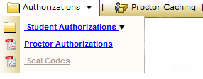
Student and Proctor Authorizations
Student and Proctor (TA) authorizations are needed to perform certain functions at the session level.
Each student must have an authorization in order to log in to a test.
Proctor authorizations (log in for test administrator) are only for Read Aloud Administrations.
Authorizations contain:
  the URL to access tests through the browser-based TestNav,
  a unique login ID, and
  the test code needed to log in.
Student authorizations also contain the keystrokes available for navigating through TestNav.
Louisiana Believes

Slide 61
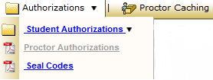
Authorizations - Seal Codes
Seal codes are the electronic equivalents of the adhesive tabs that are used to seal sections of paper test booklets.
There will be one set of seal codes assigned to each test session.
Before students in a test session can go to the next sealed section of an electronic test, they must enter the appropriate four-digit seal code.
Seal codes for a specific test session are listed on the seal codes document.
Louisiana Believes

Slide 62
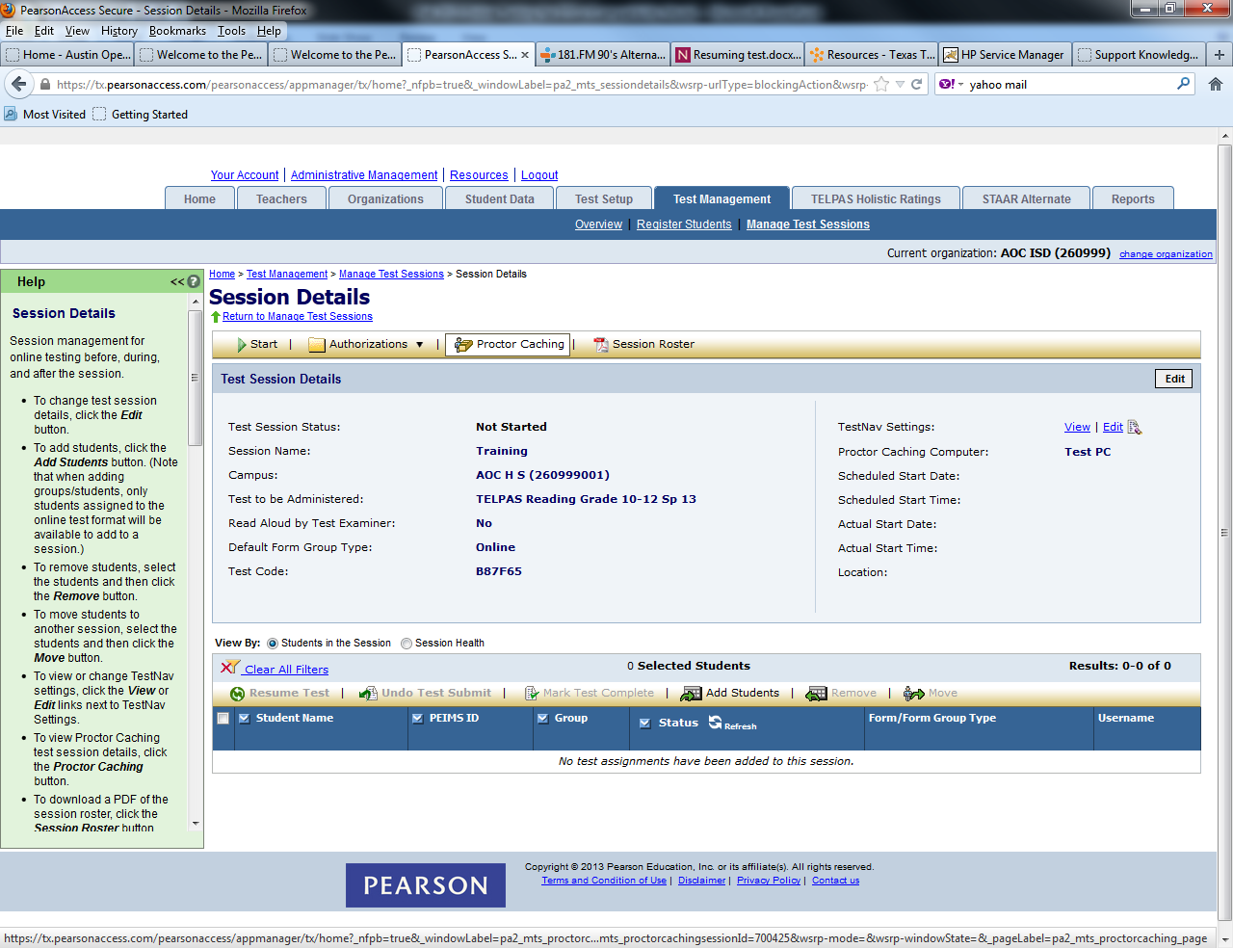
Assign a Proctor Caching Site to a Session
Proctor caching refers to downloading encrypted test content from the Pearson testing server to a secure local computer prior to starting a test session.
Proctor caching is completed at the session level, on the Session Details screen.
  The Proctor Caching button will be disabled and you will not be able to cache the test content for the test session if you do not have access to proctor caching or if you are not within the proctor caching window.
Proctor caching is available up to one week before an administration; districts will receive notification when it is available.
Louisiana Believes

Slide 63
Logging into the Training Site
Use the provided login or your own to enter the training site as TA
STC Training Login: STCTestUser__ (insert number from handout)
Password: Educate2014
TA Training Login: TATestUser__ (insert number from handout)
Password: Educate2014
Louisiana Believes

Slide 64
Starting Test Sessions
A test session must be started before students can begin testing.
Scheduling a date and time for a new test session is intended primarily for planning purposes.
A test session will not start until you click the Start button on the Session Details screen, regardless of the scheduled start date and time.
NOTE: If you do not have access to start a test session, the Start button will be disabled and you will not be able to start the test session.
Louisiana Believes

Slide 65
Monitoring Test Sessions
Possible statuses for students as they test.
Status | Meaning
Ready | The student has not yet started the test.
Active | The student has logged in and started the test.
Exited | The student has exited TestNav but has not submitted test responses, e.g. took a break. (Student must be resumed by a test administrator to continue testing.)
Resumed | The student has been authorized by a test administrator to resume the test.
Resumed-Upload | The student has been authorized to resume the test, and any responses saved locally can be uploaded when the student is ready to continue testing.
Completed | The test has been submitted by the student through TestNav and the data has been processed.
Marked Complete | The student has exited TestNav and will not resume the same test, e.g left due to illness.
Louisiana Believes

Slide 66
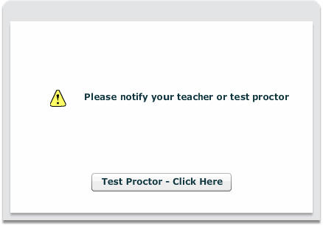
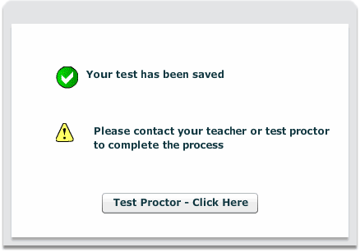
Early Warning System
One of the following screens will appear if errors occur either with accessing the test or saving and submitting student responses.
The error code should be noted in order to allow for appropriate identification of the error.
Students should be instructed to ALWAYS raise their hand when presented with either of the Test Proctor Click Here screens.
Louisiana Believes

Slide 67
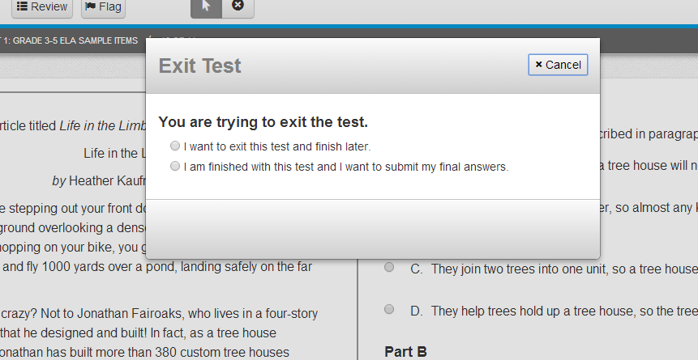
Exiting the Test Session
Students will receive the pop up message below when logging out of the test system.
Students that have not completed all parts of the PBA or EOY assessment (Pearson Session) should choose “I want to exit this test and finish later.”
EX:
Louisiana Believes

Slide 68
Submitting Final Answers
Students that have completed every part of the assessment (Pearson Session) should choose “I am finished with this test and I want to submit my final answers.”
Once a student has submitted final answers, the session (PBA/EOY) CANNOT be resumed.
Louisiana Believes

Slide 69
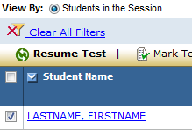
Resuming a Student’s Test
Following short breaks or prior to beginning a new PARCC Session, Test Administrator must resume an Exited student’s test in order for the student to complete testing.
Select the checkbox for the student on the Session Details screen.
Click the Resume Test button. The student’s status will change to “Resumed” (if the student was in “Exited” status) or “Resumed-Upload” (if the student was in “Active” status).
  The student’s test will be resumed from the point at which it was exited or interrupted. Any saved test responses that the student entered will be uploaded when the connection to the Pearson testing server is reestablished.
Have the student log in using their original student authorization.
Louisiana Believes

Slide 70

View Test Progress
The Status column in the Session Details allows administrators to view test progress.
When available, select the student’s View Progress link to review test progress. Users with Organization and Technology Coordinator Roles only do not have access to view progress.
Status | Meaning
Visited/No Response Required | Student has visited the item but no response is required.
Visited/Answered | Student has visited the item and entered a response.
Visited/Not Answered | Student has visited the item but has not entered a response.
Not Visited | Student has not visited the item.
Louisiana Believes

Slide 71
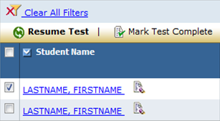
Mark Test Complete
If a student has exited a test and will not resume testing, the test can be manually marked “complete”.
Select the checkbox for the student on the Session Details screen.
Click the Mark Test Complete button. You will be prompted to enter the reason for marking the test “complete.”
Click the Save button.
The student’s status will change to “Marked Complete.”
Louisiana Believes

Slide 72
Stopping Test Sessions
You cannot stop a test session until all students in the session are in “Completed” or “Marked Complete” status.
Additionally, Sessions should not be Stopped until students have completed the entire assessment (Pearson Session).
After all students have completed the test and submitted their responses, or been marked “complete,” you should stop the session.
Click the Stop button.
NOTE: A session does not stop until you click the Stop button. The system will NOT automatically start or stop a session. Once a session has been stopped, it can no longer be modified.
Louisiana Believes

Slide 73
Reporting

Slide 74
Agenda
  Design of the Field Test
  Review Access for All, Accessibility Features, and Accommodations
  Provide overview of Pearson Access
  Complete key tasks in the Pearson Access Training Site
    Creating and Managing User Accounts
    Creating and Managing Test Sessions
  Reporting
  Resources
  Explore Sample Sets and Tutorial

Slide 75
Survey
Students and test administrators will complete a survey at the conclusion of each session.
Test Administrators access the survey at:
https://www.surveymonkey.com/s/3ZJSXH3
Information from the survey will be used to inform future PARCC testing efforts
Student level data will not be reported for the Spring 2014 field test

Slide 76
Resources

Slide 77
Agenda
  Design of the Field Test
  Review Access for All, Accessibility Features, and Accommodations
  Provide overview of Pearson Access
  Complete key tasks in the Pearson Access Training Site
    Creating and Managing User Accounts
    Creating and Managing Test Sessions
  Reporting
  Resources
  Explore Sample Sets and Tutorial

Slide 78
Manuals and Training Modules
In the Support Tab of Pearson Access the following resources are available:
  Technology Information: Proctor Caching Installer and Guide, Test Nav 8 User Guide, Five Steps to Computer Based Testing, Pearson Hardware and Software Guidelines
  Manuals and Documents: Pearson Access User Guide, Test Coordinator Manual for PBT & CBT, Test Administrator Manual for PBT & CBT, Infrastructure Readiness Guide
    Templates: User Roles Matrix of Permissions, User File Layout, User File Field Definitions, Test Codes for PBA & EOY
    Training: Technology Training Modules (Infrastructure, Tech Set-up, Emerging Technologies) and Test Administration Modules for DTC and STC (Test Administration of CBT & PBT and Accommodations/Accessibilities), Trainings specifically for TA’s

Slide 79
Additional Supports
LDOE field test website
Sample items and tutorials
Technology diagnostic tools
School Test Coordinators and Test Administrators half day sessions for participants in Phase I (PBA)
  March 11 - Calcasieu Parish
  March 12 - Jefferson Parish
  March 13 - Concordia Parish
Repeat offerings of these sessions will be available for participants in Phase II (EOY) of the Spring 2014 Field Test at one of the following locations.
  April 28 - Ascension Parish
  April 29 - Rapides Parish
  April 30 - Bossier Parish

Slide 80
PARCC Sample Sets and Tutorial

Slide 81
Agenda
  Design of the Field Test
  Review Access for All, Accessibility Features, and Accommodations
  Provide overview of Pearson Access
  Complete key tasks in the Pearson Access Training Site
    Creating and Managing User Accounts
    Creating and Managing Test Sessions
  Reporting
  Resources
  Explore Sample Sets and Tutorial

Slide 82
Sample Items and Tutorials
The Department has shared two tools that will allow parents, teachers, students and district staff to learn the testing platform for the field test.
  Tutorial: This tutorial guides users through all of the features of the online system. The tutorial can be accessed an unlimited number of times.
  Sample items: These are previously released PARCC items that have now been loaded onto the technology platform. These can be accessed an unlimited number of times.
Please ensure you check the technology specifications for use of these assessments. Google Chrome and Safari are the most compatible browsers. Certain versions of Internet Explorer are not compatible.
Link to both: www.practice.parcc.testnav.com

Slide 83
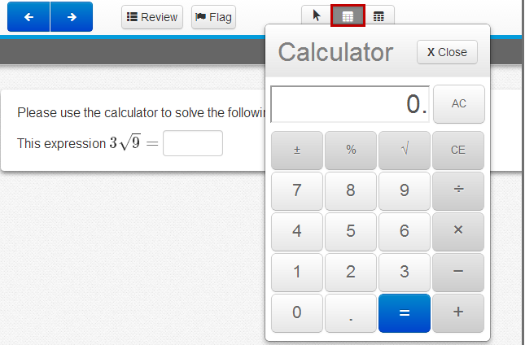
Helping Students: Calculator

Slide 84
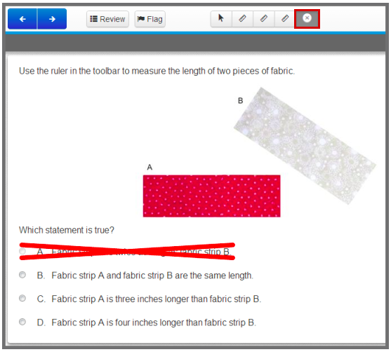
Helping Students: Eliminate Choice Tool

Slide 85
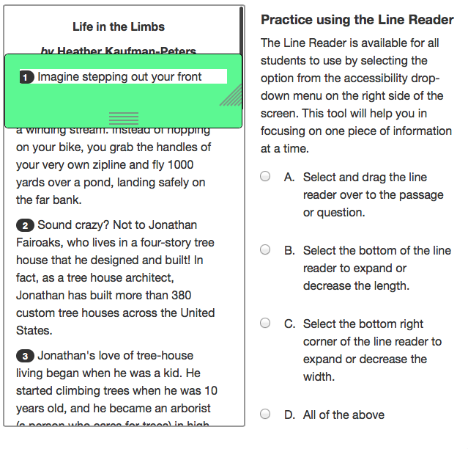
Helping Students: Line Reader

Slide 86
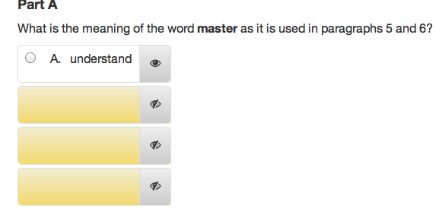
Helping Students: Masking
This is an example of the ‘answer masking’ accessibility feature:

Slide 87
Next Steps

Slide 88
Next Steps for School Test Coordinators
Review policies and instructions for test administration in both the School Test Coordinator Manual and Test Administrator Manual
Review School Test Coordinator and Test Administrator Checklists
Complete recommended training and ensure TA training
Add Users into Pearson Access as appropriate
Prepare for Proctor Caching
Indicate Student Accommodation and Accessibility feature usage through Pearson Access
Set up Test Sessions
Order any additional materials including Large Print
Louisiana Believes

Slide 89
Next Steps for Test Administrators
  Review policies and instructions for test administration in the Test Administrator Manual
  Review Test Administrator Checklists
  Complete recommended training
Louisiana Believes

Slide 90

Contact
Additional Assessment Questions:
assessment@la.gov
Additional Technology Questions:
edtech@la.gov

