Slide 1
Pre-Educator Pathway
School System Lead Professional Learning Community
April 10, 2025

Slide 2
Chat Check-In
In the chat, write the following:
Who is here? Share your school system, role, and email address
What topics would you like to see in future calls?
Also, rate yourself from 1 - 5:
1
2
3
4
5
We are doing our research during Fall 2024 with hopes to kick-off in the Spring 2025 or Fall 2025.
We have been doing this work for several years. We are experienced with this work and want to help others.

Slide 3
Agenda
Focus Topic - Aspiring Educators Summer Academy/ Guest Speaker Morgan Willis - LSUA
Updates
Closing

Slide 4
Guest Speaker: Morgan Willis from Louisiana State University at Alexandria

Slide 5
Overview of the 2025 Louisiana Aspiring Educators Summer Academy
The 2025 Louisiana Aspiring Educators Summer Academy is hosted by the LDOE at LSUA and consists of a five-day summer camp and professional learning experience for high school students enrolled in the Louisiana Pre-Educator Pathway or other coursework aimed at attracting and developing future Louisiana educators.
Location: Louisiana State University of Alexandria
Date: July 14-18
Goals:
Continue to increase skills and knowledge related to becoming a highly-effective educator
Develop steps to increase leadership skills
Network and build a community amongst other Louisiana aspiring educators.
Please contact mwillis@lsua.edu
Notes:
https://youtu.be/aBPwRWQxaTc - last year’s video

Slide 6
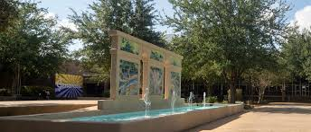
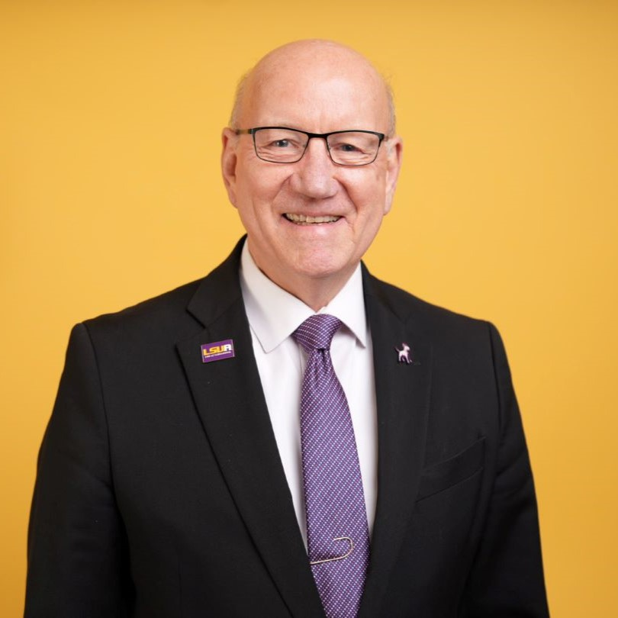
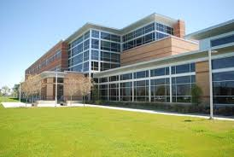
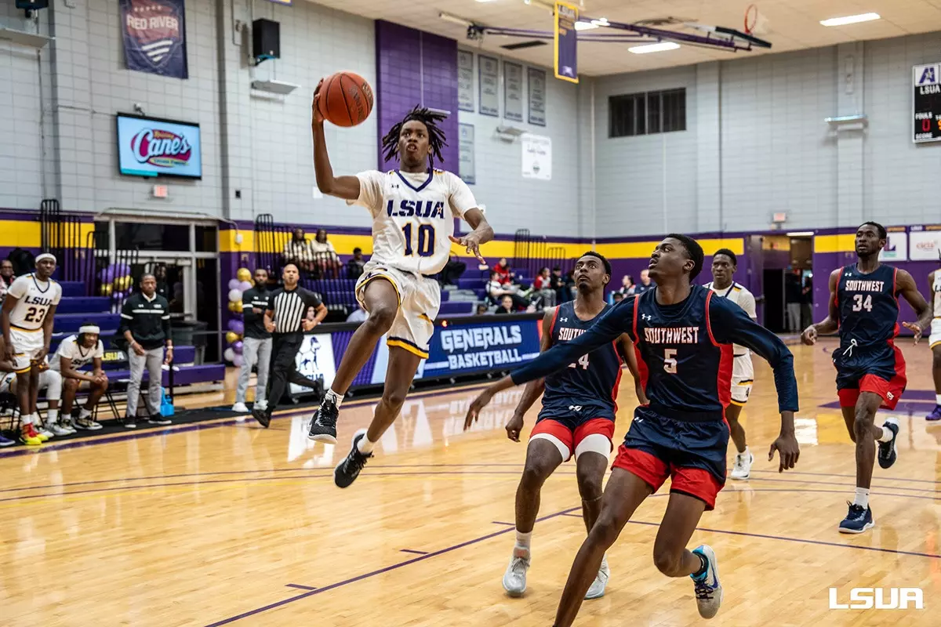
Where is LSUA?

Slide 7
Eligibility
Who will be there?
Students:
Up to 100 Aspiring Educators from around the state. You must currently be involved in a pre-educator pathway course, or are registered for a course for the upcoming year.
Staff:
20 College Coaches: Aspiring Educators from around the state enrolled in a Teacher Preparation Program, including those who may graduate Spring 2025.
10 Advisors: Current classroom teachers, professors, or other practicing educators.
Notes:
A Teacher Leader must confirm student eligibility to attend the academy, by completing a follow-up recommendation, to be sent once nominations close. This camp is for students currently in 9th grade or up. There is no fee to participate, but students or systems are responsible for travel to and from campus.
Both staff positions are paid! Staff Camp dates are July 13-18.

Slide 8
Sample Schedule
Time | Activity | Description
8:30-9:15 | Breakfast | LSUA Cafe
9:15-9:30 | Morning Huddle | Day Overview and Daily Goal Setting
9:30-11:30 | Morning Camp Clinical Experience | Partner with Children’s Academic Program Summer Camp for students grades 3rd-8th. Camp topics include drones, forensics, medical exploration, ceramics, basketball, pickleball.
11:30-12:30 | Clinical Experience Debrief | Reflect on camp and prepare for next experience.
12:30-1:30 | Lunch | LSUA Cafeteria
1:30-3:00 | Seminar | Guest Speakers and Workshops in Coughlin Auditorium
3:00-4:30 | Campus Time | Be with peers on campus, take a nap, play games, call family and friends, visit bookstore or coffee shop on campus.
4:30-6:00 | Seminar | Guest Speakers and Workshops
6:00-9:00 | Dinner and Evening Events | Each night, a different social event on or off campus.
9:00-9:30 | Evening Huddle | Reflect on the day, share highlights, lowlights, and goals for tomorrow.

Slide 9
Possible Seminar Topics
Professionalism | Classroom Environment
Building Relationships with Students | Facilitating Learning
Making a Difference | Building Community within the School and Stakeholders
Responsive Teaching | Student Well-Being
Educational Technology | Communication
Literacy | Active Learning Strategies
Movement in the Classroom | Partnering with Parents for Student Success

Slide 10
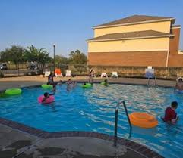
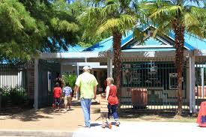
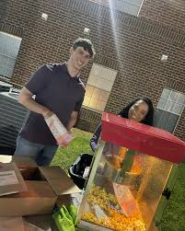
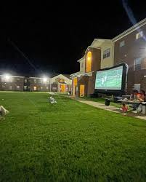
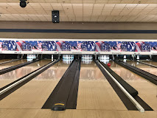
Night Life Examples
Alexandria Zoo
Pool Party on Campus
Movie Night on the Lawn
Four Seasons Bowling Center

Slide 11
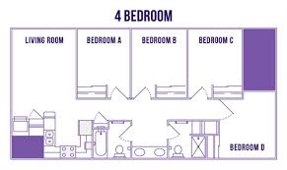
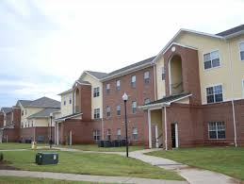
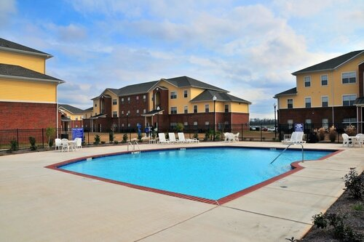
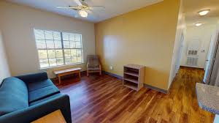
Apartment Information

Slide 12
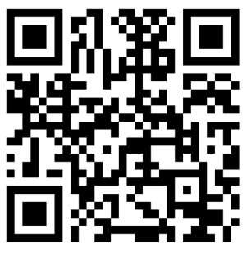
How To Register: Participants
Students can self nominate or be nominated by a Pre-Educator Pathway Teacher or System Leader.
All students will be required to obtain a teacher recommendation upon acceptance into the academy.
Teacher Leaders, please ensure students you nominate are aware you are nominating them.

Slide 13
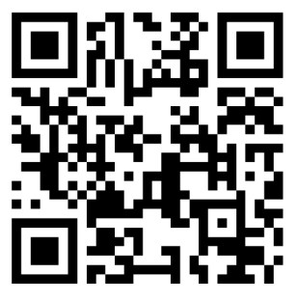
How To Register: Coaching and Advising Staff
Coaches and advisors will use the same application.
Aspiring Educators from around the state enrolled in a Teacher Preparation Program, including those graduating Spring 2025 may apply for Coaching staff.
Teaching Professionals with teacher of record experience for 1 or more years are eligible for Advising staff.
All staffing positions are paid.
Notes:
Recommendation references will be checked upon completion of the application.

Slide 14
Questions for Guest Speaker
Let’s take a few minutes for any follow up questions.
Contact Information:
Morgan Willis mwillis@lsua.edu

Slide 15
Updates and Reminders

Slide 16
LDOE’s New Aspiring Educators Curriculum Coming Soon!
The LDOE is excited to announce that we will be releasing an open-sourced Pre-Educator Pathway Curriculum for the 2025-2026 academic school year at Teacher Leader Summit 2025. Aspiring Educators: Shaping Louisiana’s Future will consist of 2 courses, Foundations of Education and Learning Communities. The curriculum will be located on LDOE’s professional learning platform, Canopy.

Slide 17
Site Visits
System Leads, Teacher Leaders, and Postsecondary Teacher Preparation Partners are invited to attend a Learning Visit for a day of learning and community building. During Learning Visits, participants will have an opportunity to observe Grow Your Own work that is being done in another school system and strategize to improve Grow Your Own efforts in their system.
Please reach out if you are interested in hosting a site visit for the 2025-2026 academic year.
Contact brandy.morin@la.gov with any questions about the visits.

Slide 18
2024-2025 Development, Implementation, and Expansion Support
Implementation Guidance document
Resource Library
System Lead Professional Learning Community calls
October 3, 2024
November 14, 2024
March 21, 2025 In person @ Ed Rising State Conference
April 10, 2025
Grow Your Own Learning Visits
Ascension Parish - October 24, 2024
McNeese Unlock Education Event - January 23, 2025
Rapides Parish - April 9, 2025
Pre-Educator Pathway Contact List
Notes:
Ask who is interested in hosting a site visit next year will need to start planning those in the summer

Slide 19
Closing
Pre-Educator Pathway Contact List
Questions can be sent to believeandprepare@la.gov.
Invite the LDOE to your system to attend or participate in any upcoming Aspiring Educator experiences.

Slide 20
Contact Information
believeandprepare@la.gov
brandy.morin@la.gov

