Slide 1
Pre-Educator Pathway
School System Lead Professional Learning Community
November 14, 2024

Slide 2
Chat Check-In
In the chat, write the following:
Who is here? Share your school system, role, and email address
What topics would you like to see in future calls?
Also, rate yourself from 1 - 5:
1
2
3
4
5
We are doing our research during Fall 2024 with hopes to kick-off in the Spring 2025 or Fall 2025.
We have been doing this work for several years. We are experienced with this work and want to help others.

Slide 3
System Lead Professional Learning Community
Offered quarterly, the Pre-Educator Pathway System Lead Professional Learning Community are virtual opportunities for Pre-Educator Pathway/Grow Your Own System Leads to share best practices related to developing and expanding access to the Pre-Educator Pathway. All school systems are encouraged to attend regardless of current pathway status.
Quarter 1: October 3, 2024 10:00 a.m. - 11:00 a.m.
Quarter 2: November 14, 2024 10:00 a.m. - 11:00 a.m.
Quarter 3: March 21 Breakout Session Ed Rising State Conference at ULL
Quarter 4: April 10, 2025 10:00 a.m. - 11:00 a.m.

Slide 4
Agenda
Focus Topic - Field Experiences/ Guest Speakers Lori Benoit and Chaz Campbell from McNeese State University
Updates
Closing

Slide 5
Guest Speakers: Lori Benoit & Chaz Campbell from McNeese State University

Slide 6
Conferences = Field Experience
Regional, state, and national conferences provide unique and valuable field experience opportunities.
Attendees learn from a wide range of like-minded students and educators.
Students can compete and present.
Conferences are modeled after professional education conferences which allows students to visualize their future professional lives.

Slide 7
Unlock Education Regional Conference
McNeese State University in Lake Charles is hosting Unlock Education Regional Conference.
Currently seeking participants, competitors, and session proposals.
Deadline for all three is December 17.
Flyer is at right and in chat.
Contacts:
Chaz Campbell ccampbell11@mcneese.edu
Lori Benoit lbenoit11@mcneese.edu

Slide 8
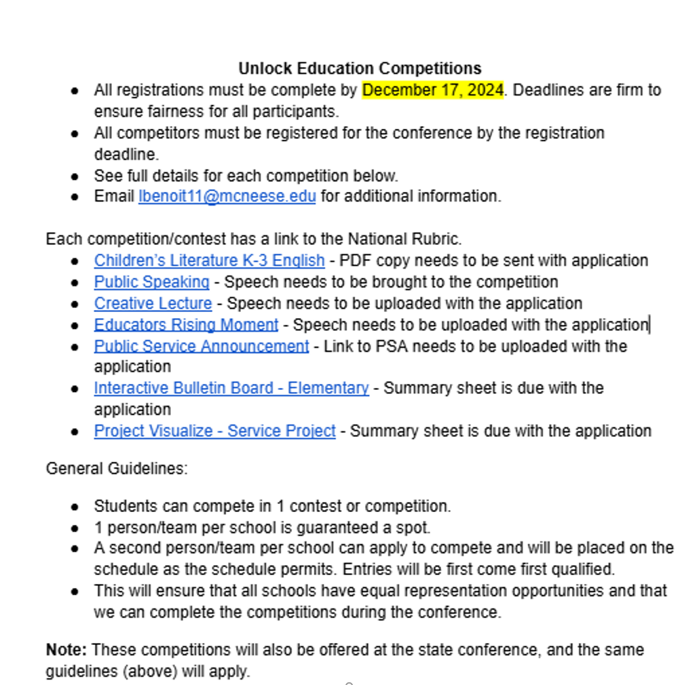
Competitions
Aligned to state conference offerings and guidelines.
Embed practice in your courses and club meetings.
Regional competitions are excellent venues to receive feedback for state.
Valuable field experience opportunities for students to plan, execute, and refine a product or presentation for an authentic audience.

Slide 9
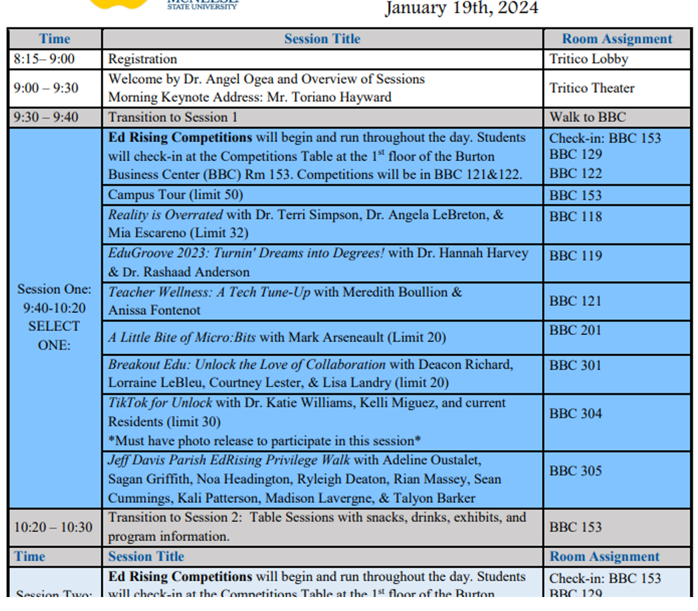
Sessions
At right is an excerpt of last year’s sessions.
Topics included student well being, asset based teaching, technology, gamification, and more.
All sessions are hands-on and are provided by a wide range of EdRising students, professors, teacher residents, local and state educators, and more.
Valuable field experience opportunity which can be leveraged to provide inspiration to students.

Slide 10
Questions for Guest Speakers
Let’s take a few minutes for any follow up questions.
Contact Information:
Chaz Campbell ccampbell11@mcneese.edu
Lori Benoit lbenoit11@mcneese.edu

Slide 11
Updates and Reminders

Slide 12
LDOE’s New Aspiring Educators Curriculum Coming Soon!
The LDOE is excited to announce that we will be releasing an open-sourced Pre-Educator Pathway Curriculum for the 2025-2026 academic school year. Aspiring Educators: Shaping Louisiana’s Future will consist of 2 courses, Foundations of Education and Learning Communities. More information coming soon!

Slide 13
Regional Conferences
Various universities will be hosting regional conferences for Louisiana Aspiring Educators. Save the dates:
January 23: McNeese will host the Unlock Education regional at McNeese University. Registration deadline is December 17.
January 31: Nicholls State University will host a regional conference.
February 7: Louisiana State University at Alexandria will host their 7th Annual Educators Rising Regional Conference.
February 12: Northwestern State University’s regional conference. Registration deadline is December 13 and late registration is January 17.
April (date TBD): University of Louisiana at Monroe will host a regional conference.
Please contact believeandprepare@la.gov with questions

Slide 14
Educators Rising State Conference
Save the date, the 2025 Louisiana Educators Rising State Conference will be held on March 21 at University of Louisiana at Lafayette.
Louisiana Aspiring Educators from middle schools, high schools, and colleges are welcome. Events for the day include Educators Rising competitions, professional learning, and lunch. More details will be posted soon along with a link to submit conference proposals. Please contact edrising@louisiana.edu for more information.
Please contact edrising@louisiana.edu with questions.

Slide 15
Professional Learning Community Calls
Offered quarterly, the Pre-Educator Pathway System Lead Professional Learning Community Calls are virtual opportunities for Grow Your Own System Leads to share best practices related to developing and expanding access to the Pre-Educator Pathway. All school systems are encouraged to attend regardless of current pathway status.
Date and Time: March 21, 2025, Time TBA
Location in Person: Educators Rising State Conference @ ULL
Contact believeandprepare@la.gov with any questions.

Slide 16
Site Visits
System Leads, Teacher Leaders, and Postsecondary Teacher Preparation Partners are invited to attend a Learning Visit for a day of learning and community building. During Learning Visits, participants will have an opportunity to observe Grow Your Own work that is being done in another school system and strategize to improve Grow Your Own efforts in their system. Please use this Registration Link to sign up for a visit.
McNeese Unlock Education Event- January 23, 2025
Contact brandy.morin@la.gov with any questions about the visits.

Slide 17
Aspiring Educators Attending 2025 Teacher Leader Summit
The LDOE has limited funding to help offset the costs for sending high school aspiring educators to Teacher Leader Summit. Allowable expenses for this funding include:
Student registration fees
Student lodging and transportation fees
Sponsor lodging and transportation fees
Funding allocations will be based on system need, and will be considered on a first-come first-served basis. The deadline for completing this form is Friday, January 17 at 5:00 p.m.
Please contact believeandprepare@la.gov with questions.

Slide 18
2024-2025 Development, Implementation, and Expansion Support
Implementation Guidance document
Resource Library
System Lead Professional Learning Community calls
October 3, 2024
November 14, 2024
March 21, 2025 In person @ Ed Rising State Conference
April 3, 2025
Grow Your Own Learning Visits
Ascension Parish - October 24, 2024
McNeese Unlock Education Event - January 23, 2025
Pre-Educator Pathway Contact List
Notes:
Ask who is interested in hosting a site visit next year will need to start planning those in the summer

Slide 19
Closing
Pre-Educator Pathway Contact List
Questions can be sent to believeandprepare@la.gov.
Invite the LDOE to your system to attend or participate in any upcoming Aspiring Educator experiences.

Slide 20
Contact Information
believeandprepare@la.gov
brandy.morin@la.gov

