Slide 2
What will we do today?

Slide 3
How we will spend our time?

Slide 4
If Louisiana Believes that all students can achieve, then we have to believe in the adults who work with them.

Slide 5
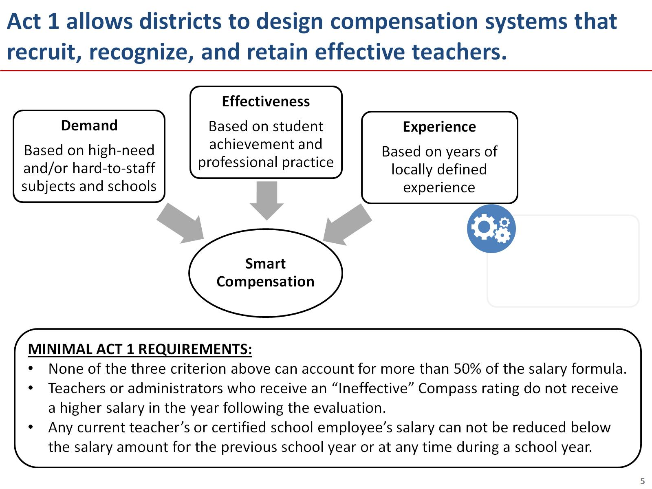

Slide 7
Today we’ll discuss the purpose of testing for sustainability and how to do it.

Slide 8
What is sustainability training?

Slide 9
To do this, you’ll use the same data and assumptions used to develop your compensation model.

Slide 10
Compensation design and sustainability testing is not a one-time activity, but a cycle.

Slide 12
Sustainability testing will require assumptions about your workforce so that you can simulate your future costs.

Slide 13
Let’s practice making assumptions about your future teaching force.

Slide 14
Agenda

Slide 15
First, input the compensation model you want to test for sustainability.

Slide 16
Second, input your assumptions about your future teaching force and your compensation budget.

Slide 17
Finally, run simulations to see if your expenditures are within budget.

Slide 18
How to align costs and budget if sustainability testing shows your system to exceed available funds

Slide 19
Agenda

Slide 20
Next steps

Slide 21
Appendix

