Slide 2
What will we do today?

Slide 3
Agenda

Slide 4
Districts have the opportunity to move from a rigid system to a customized system that meets their needs.

Slide 5
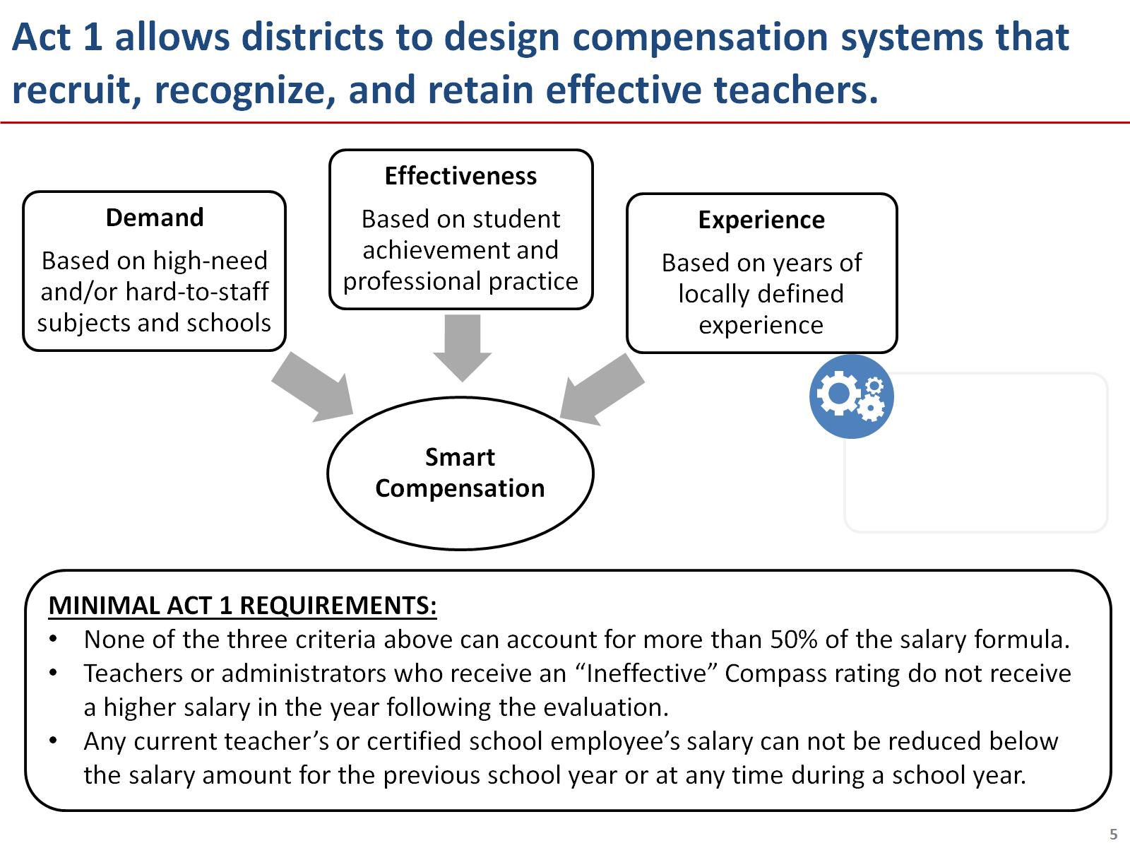

Slide 6
What is challenging in communicating about your new compensation plan compared to your current plan?

Slide 7
Communicating with teachers about these changes can be difficult – but clear, consistent messaging is key.

Slide 8
Agenda

Slide 9
There are various channels to communicate messages about your new compensation system.

Slide 10
Three tools can serve as the foundation of your communications strategy.

Slide 11
Success will require making communications a priority at the district and building level.

Slide 12
Pair and Share: A successful communications strategy uses the right channels at the right time.

Slide 13
It is important to utilize the tools and channels available to communicate frequently and early.

Slide 14
Agenda

Slide 15
Anticipating challenges: How would you respond to the following scenarios?

Slide 16
Leaders in other school districts have developed their messages for talking about compensation reform.

Slide 17
Tip #1: Make sure to focus on the big picture of what these reforms mean for teachers and students.

Slide 18
Tip #2: Look for opportunities to emphasize the positive benefits for teachers.

Slide 19
Tip #3: Don’t get bogged down by details or distracted by speculation.

Slide 20
Pair and Share: With these three tips in mind, discuss the essential ideas you want to share with teachers.

Slide 21
Final thoughts: As a district leader, you are a key messenger for this important work.

Slide 22
Revisiting challenges: After today’s discussion, how would you respond to the following scenarios?

Slide 23
Questions?

Slide 24
Appendix 1: Sample messages from around the country.

