Slide 1
Education Technology Monthly Call
July 16, 2020
Download slides at: https://tinyurl.com/EdTech-JULY2020

Slide 2
Agenda
Strong Start Updates
National Broadband Efforts
E-Rate
Technology Readiness Data Collection
Education Technology Professional Development
Assessments
Suggested participants for this call:
Chief Technology Officers
Information Technology Staff
E-Rate Coordinators
Privacy Coordinators
Education Technology Staff

Slide 3

Strong Start

Slide 4

Strong Start Implementation Survey
This week the department released the summer Strong Start 2020 Implementation Survey for school systems and lead agencies to complete. School system leadership should work with their team to develop and review a set of answers to the survey questions in the fillable PDF version of the survey. Only one response per school system or lead agency can be submitted. A designated point of contact should submit the survey via Jot Form. School systems and lead agencies must complete the survey by July 28.
Contact Network Coaches or em.cooper@la.gov with questions.
Notes:
The survey contain questions relative to Devices and Access as well as software, tools, curriculum and resources.

Slide 5
CTE Guidance and Resources
As school systems are planning device and broadband purchases, school systems need to invest in technology and educational resources that ensures continuous student access to Career and Technical Education (CTE) curriculum. To assist in this process, LDOE has released the Career and Technical Education Curriculum Guide which contains not only online options such as eBooks, interactive content and labs, assessments, and study guides for Career and Technical Education content, but also includes funding options and technology requirements.
NOTE: Not all CTE courses and curriculum can be delivered using a Chromebook. Some courses will require students to have access to a Microsoft Windows or Apple OS and specialized software. The technology requirements may also require additional memory, hard drive space, and/or processing power to support applications as well as access continuous access to the Internet. IT staff should work with the school system’s CTE Supervisor to determine what CTE funds are available and/or what programs areas need a more robust computer than a Chromebook.

Slide 6
Broadband Planning and Identification
How can school systems help plan, inform and support broadband expansion and mapping to ensure all students have access to the Internet?
School systems are being requested to provide 911 addresses for identifying and mapping student and staff coverage location needs and to identify available broadband services and providers. School systems can use the sample 911 data layout guide for formatting their file. Files can be uploaded to the Data Management FTP site. The State will then provide school systems coverage information and maps for planning and on-going support.
Provide information to EdTech@la.gov on potential locations where regional access to broadband internet service and Wi-Fi can be expanded, including current unused towers, placement of new towers and other access options for students.
Identify and publish maps of free public Wi-Fi locations that can serve as access points for staff, students and families in need. School systems can submit location information to EdTech@la.gov to have locations added to an overall state map of Wi-Fi locations for parents

Slide 7

Broadband Planning and Identification
Have students and families complete Internet speed tests and provide data to the State for better mapping and actual bandwidth speeds/coverage for areas across the state.
Identify school technology leaders and community partners who would be willing to participate in state or regional K12 technology and broadband advisory committee whose aim is to ensure all students have broadband access.

Slide 8
Technology for Continuous Learning
Verizon Broadband Update
A new firmware update for Verizon devices is being rolled out and tested. This update will allow school systems to tether the MIFI device to the school laptop only. This will provide school systems with additional options for complying with CIPA regulations.
New KORE Cellular Internet Offering In Process
Business class multi-carrier cellular support option using LTE and 4G routers for areas where cellular service using a consumer device may not be adequate for continuous learning.
One-time charges for devices ($120-135) and/or SIM cards ($2)
Optional Remote Management System
Data Plans based on pooled minutes and set plan pricing
New AT&T Offering In Process
A new unlimited plan offering is under final negotiations with AT&T. This offer will provide more flexibility, option for a free device, CIPA compliance, 12 and 24 month terms, and options for a free device. More details coming very soon.

Slide 9
Technology for Continuous Learning
T-Mobile Empower ED Program
Option 1: 10 inch LG G Pad 5 ($299.99-promotion) at no charge when on the $20.00 unlimited education plan - 24 month agreement. Tablet spec; https://www.t-mobile.com/tablet/lg-g-pad-5-10-1-fhd
Option 2: a hotspot on $10.00 unlimited data with 2GB of 4GLTE high speed data with 50% off a hotspot - 12 month agreement. School pays $42.00/hotspot for the device
Option 3: a hotspot on $20.00 Unlimited 4GLTE data plan with a free hotspot-12 month agreement.
Option 4: a hotspot on $29.40 Unlimited 4GLTE high speed plan with a free hotspot on 24 month agreement. Non student usage.
* For qualified schools no charge CIPA compliant filtering along with logistic team involvement to label units and preload
Contact: Dan McGovern Email:Dan.McGovern1@T-Mobile.com Cell: 504-415-2019

Slide 10
Technology for Continuous Learning
Contracted Helpdesk Support Options for School System
The state has been negotiating with two vendors on contracts to provide call desk and in-person help desk support for students and families as well as school system IT staff. Contract pricing is being set up under a per-pupil and statewide price. In order to finalize pricing and offers, the State must provide an interest level by school systems. We will hold a call on Thursday, July 23 at 10:00 am to provide information and details on the two options in order to define services that are most advantageous to school systems both in services and costs.
When: Thu 23-Jul-20 10:00a - 11:00a
Where: https://ldoe.zoom.us/j/91923584628?pwd=NnIyaHNWbWdNWGhOeWFXSzdaMEU1QT09
Phone number: 1-301-715-8592
Meeting ID: 91923584628
Password: 2020-202!

Slide 11
Governor’s Emergency Education Relief Fund
The Coronavirus Aid, Relief and Economic Security (CARES) included a grant called Governor’s Emergency Education Relief Fund (GEER) which provides local educational agencies (LEAs) with assistance as a result of the Novel Coronavirus Disease 2019 (COVID-19).
K – 12 education was awarded $32.3 M for devices and internet connectivity.
School systems and schools requested funding in a variety of ways including only for devices, only for internet connectivity, or for both devices and internet connectivity based on the latest estimated needs.
Estimated need for devices and internet exceeded funding available so consideration was given to certain factors and helped to allocate the funding to those with the most challenging circumstances.
Some examples of eligible expenses for GEERs funding include: laptop and desktop computers, home or cellular internet services and hardware, CIPA compliance software/services, webcams, WiFI and cellular antennas, broadband routers, and Absolute software. Contact ldoe.grantshelpdesk@la.gov if you have questions about eligibility.

Slide 12
Governor’s Emergency Education Relief Fund
Device and internet connectivity needs, once confirmed, were funded at percentage of the original request.
School systems and schools were placed in one of three possible funding categories by ranking the ability to locally support education in their communities and the degree to which their students are economically disadvantaged.
Funds may be used as a block grant with no specific portion of the allocation reserved for devices or internet connectivity.
Expenditures must be directly related to devices and internet connectivity or supplementary equipment or software needed to establish or enhance distance learning systems.
Rules that govern all federal grants must be adhered to when spending these funds including regulations governing issues such as allowability, accounting, reporting, and inventory management.
GEER funds are subject to the federal Equitable Services provision similar to the ESSER funds and this provision must be taken into consideration when budgeting these funds.

Slide 13
Governor’s Emergency Education Relief Fund
Through the Governor's Emergency Education Relief (GEER) Fund, all public and private schools and students will be provided free access to Edgenuity’s online Social Emotional Learning (SEL) Purpose Prep content library and curriculum which includes:
Character & Leadership Development
College & Career Readiness
Mental Health & Wellness
Personal Development
Social & Emotional Success
Unlock Your Purpose
School systems and schools can sign-up to participate in this program by completing an addendum with the State and working directly with Edgenuity’s sales representative Roe Wilkinson to implement and manage their student’s access to the content library. The agreement and addendum can be found on the Department’s Data Sharing Agreement webpage. Please contact EdTech@la.gov with questions.

Slide 14
National Broadband Efforts

Slide 15
Broadband Funding Bills
Momentum continues to build for additional pandemic relief legislation including funding for broadband services generally and more specifically to support remote learning at home. Congressional action last week included the introduction of the following legislation:
The House passed the Moving America Forward Act (H.R. 2) that would provide $80 billion to deploy broadband in underserved areas and included $5 billion to expand the Federal Communications Commission’s E-rate program to fund more home broadband connections (both wired and wireless), laptops and tablets for rural students, and mobile hotspot-lending for schools and libraries. To further help students with long travel times to school, the legislation would require the FCC to make Wi-Fi access on school buses eligible for E-rate funding. The bill now moves to the Senate for debate.
The Accessible, Affordable Internet for All Act, introduced by Senator Amy Klobuchar (D‑MN), a companion to a House bill introduced the previous week by House Majority Whip James E. Clyburn (D-SC), would invest $100 billion into broadband infrastructure.

Slide 16
Broadband Funding Bills - Continued
The Library Stabilization Fund Act, introduced by Senator Jack Reed (D-RI) and Representative Andy Levin (D-MI), would provide $2 billion of emergency support for libraries including support for digital literacy training and resources for remote learning.
The Emergency Educational Connections Act, filed as an amendment to the National defense Authorization Act by Senator Edward Markey (D-MA) and others, would provide $4 billion for elementary and secondary schools and libraries to provide Wi-Fi equipment, devices, and Internet services to students, staff, and patrons tied to guidelines of the E-rate program.

Slide 17
National Broadband Principals Being Discussed
The U.S. Chamber of Commerce weighed in on “Why Congress Must Act Now on Broadband” promoting the following principles to guide legislative action:
Three principles broadly supporting broadband in underserved areas.
Technology neutral
Collocation support
Speed to market
Five principles specifically addressing immediate remote learning needs.
Funding from general appropriations (i.e., not from the Universal Service Fund)
Separate from E-rate (although perhaps leveraging some E-rate rules)
Targeted to low-income households for the duration of the national emergency
Technology neutral
Limited eligibility for connectivity, service equipment, and devices

Slide 18
E-Rate

Slide 19
Funding Status - FY2020
  Wave 10 for FY 2020 was released on Thursday, July 9th for a total of $32.8 million. Cumulative commitments through July 9th are $1.10 billion. Nationwide, USAC has now funded over 72% of the FY 2020 applications received during the filing window representing 38% of the requested funding.

Slide 20

Multi-factor Authentication Coming to E-Rate
  Starting July 27, USAC will implement multi-factor authentication (“MFA”) as a requirement for E-rate applicants to access EPC or the BEAR Form system through the new “One Portal” MFA security system.
  On July 27, after MFA has been deployed and new user accounts created, we will send a second email with instructions on how to log in and how to set up your second verification factor.
  USAC will automatically creating One Portal accounts for EPC users under their EPC username, and for BEAR Form filers who are not EPC users under their BEAR Form email address. All users will login to One Portal using the blue Sign In button at the top of the main page of the USAC website.
  After you log in to One Portal, you will see a dashboard with links to the application(s) you can access (your “entitlements”). For example, if your username in EPC is also the email address you use to file BEAR Forms, you will see a dashboard after you log in with links to EPC and the BEAR Form.
  E-Rate applicantes with only one entitlement, will only see a popup window with a single link instead of a dashboard.

Slide 21
How to Prepare for MFA and One Portal Access
  Add noreply@usac.org to your safe senders list. After USAC creates applicant’s One Portal account, USAC will send each current EPC and BEAR user an email from noreply@usac.org with instructions on how to log in for the first time.
  Verify the email address connected to each EPC username or BEAR Form login is correct and able to receive emails. If a different email address is listed as the primary email address, verify that email address too. All emails and notifications will be sent to the primary email address if one has been identified. USAC will still use the applicant’s EPC login email address for the One Portal username.
  Each applicant will need to decide how they would like to receive their second verification factor (code). USAC will send a new code each time an applicant logs into One Portal. Codes can be sent to:
    an email address,
    another alternative email address, or
    a cell phone.
  Current EPC and BEAR user should watch for an email from USAC at the end of July.

Slide 22
Form 470 for FY 2021
  As of July 1st, the EPC portal was updated to permit the submission of Form 470s for FY 2021.
  The FCC had planned to update the Form 470 with less confusing drop-down menus for service types, will remain the same. Applicants must be careful to select the appropriate choice(s) for Internet access and related transport services. Specifically:
  The appropriate drop-down option for an applicant seeking bids for Internet access delivered to its premises (i.e., a service that includes data transmission service) is either Leased Lit Fiber (with or without Internet Access) or Internet Access and Transport Bundled (Non-Fiber).
  The appropriate drop-down option for an applicant seeking bids on bulk Internet, which the applicant is responsible for transporting to its premises, is Internet Access: ISP Service Only (No Transport Circuit Included).

Slide 23
2020 Funding Cap
  FCC Public Notice (DA 20-712) released the week of July 5, 2020 formally directed USAC to fund all eligible Category 1 and Category 2 funding requests for FY 2020. The Notice was expected given (a) the E-rate funding cap for FY 2020, adjusted for inflation, is $4.23 billion; (b) an additional $500 million in previously unused funds is available for carry-over into FY 2020; and (c) USAC’s preliminary estimate of demand for FY 2020 is only $2.91 billion.

Slide 24
Ban of Chinese Companies
  Last November, the FCC adopted an Order (FCC 19-121) barring the use of Universal Service Fund (“USF”) subsidies to fund equipment and services from companies deemed to provide a national security risk.
  The FCC has formally designated two Chinese companies — Huawei Technologies Company (DA 20-690) and ZTE Corporation (DA 20-691) — as covered companies for purposes on the November 2019 ban.
  As a result of this action, money from the FCC’s Universal Service Fund may no longer be used to purchase or upgrade any equipment or services from either company or source through non-affiliated suppliers.
  School systems who have purchased devices which are made in whole or in part by either of these two companies should begin working on plans to replace these devices. Additionally, any short-term maintenance or support costs of these devices should consider paying for these services with local or other non-federal funding.

Slide 25
User Experience Enhancements
  USAC is continuing to ask applicants to provide feedback on USAC’s IT systems using the Share Your E-rate User-Experience System Ideas form on USAC’s website. USAC has also begun including a list of enhancements that have been implemented based on feedback from the stakeholder community,.

Slide 26
2020-2021 E-Rate Training
  In light of continuing COVID-19 spread and concerns, USAC will not be holding in person trainings around the country this Fall. Once remote training plans are confirmed, USAC will release that information on the training page of their website.
  State E-Rate training dates for school systems are currently being scheduled. All initial trainings will be held online and will be broken up into several smaller learning opportunities around specific E-Rate forms and topics versus in-depth half and full-day trainings.

Slide 27
Technology Readiness Data Collection

Slide 28
Technology Readiness Data Collection
As required by State Law, the department will again be collecting data relative to technology readiness; however the department is currently reviewing each of our data collection tools and methods to both streamline the collection process and eliminate duplications. Typically we collected data in both the spring and fall semester but due to COVID closures, the spring collection did not occur and we have not set dates for the fall collection.
At this time, we are recommending school systems keep documentation on new device acquisitions/disposals, broadband and network changes, and other infrastructure efforts which are typically collected as part of the technology readiness survey. More details on the collection methods and dates will be forthcoming after school starts.

Slide 29
New Legislation Passed

Slide 30
Act 155
Act 155 Abstract: Requires certain state agency officials and employees to complete annual cybersecurity awareness training.
Proposed law provides that the Dept. of State Civil Service shall create and implement cybersecurity awareness training for state and local agency officials and employees and contractors who have access to their agency's information technology assets. Additionally provides that each new state and local agency official or employee with such access shall complete cybersecurity awareness training within the first 30 days of employment. An agency head shall verify and report to the Dept. of State Civil Service on the completion of cybersecurity training by such agency employees and contractors. The agency head shall periodically require an internal review to ensure compliance. The cost of the cybersecurity awareness training shall be paid by agencies employing state classified employees, by means of fees generated by the program, and by means of any other funds made available to the Dept. of State Civil Service through the federal government, nonprofit corporations, or any other source, public or private. Provides that the department shall make the training available to local agencies at minimal cost.
This act

Slide 31
Education Technology Professional Development

Slide 32

LACUE Cares - Professional Development
LaCUE is launching a series of FREE virtual professional development events starting July 1 and continuing through the end of 2020. The first event will be held July 1-2, 2020 with headline Thomas. C. Murray and focusing on Self Care, Cares Act Implementation and Moving Towards Distance Education. Please share this event with your district’s administrators and teachers.
Additional events focus on the latest important topics will be held on:
-- July 23-24, 2020
-- August 22, 2020 EdCamp
-- September 18-19, 2020
-- October 17, 2020
-- November 13-14, 2020
-- December 4-5, 2020
Go to LaCUE’s website to register for any of the LaCUE Cares FREE virtual sessions.

Slide 33
Assessments

Slide 34
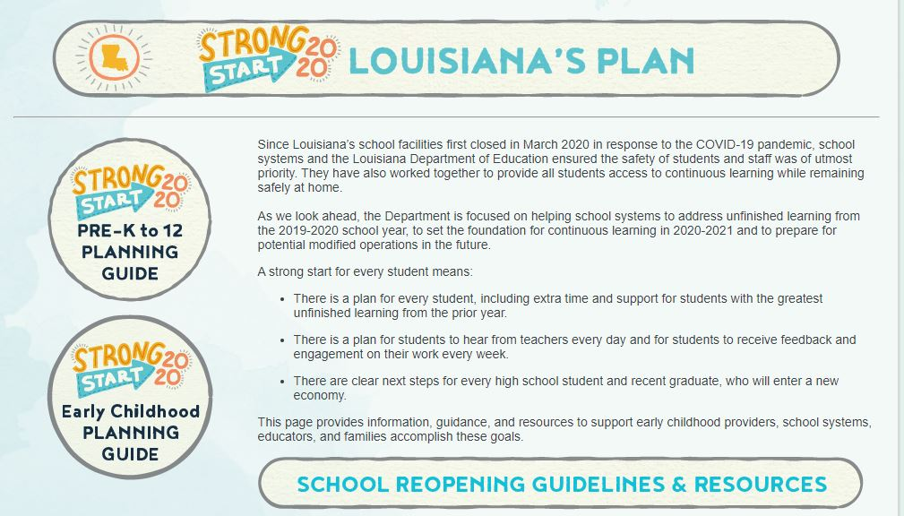
June Assessment and Accountability Checklist
The month-by-month checklist is being updated and will be released at the end of July. The Department will continue to provide updates to school systems through normal forms of communication, as well as updates that are made through Strong Start.
Notes:
Note: technical requirements

Slide 35
LEAP 360 Updates
During the 2020-2021 school year LEAP 360 Diagnostics is available remotely. Remote administration allows students to take the LEAP 360 Diagnostic from home or another location outside of the school building. Data from the assessment can be used to identify students’ areas of strengths and weakness as soon as possible and begin targeted instruction as soon as school starts. ELA and math diagnostics are administered to students in grades 3-8. High school students who are enrolled in English I, English II, Algebra I, and Geometry courses take the corresponding LEAP 360 diagnostic assessment.
The Remote Access and Administration document includes information about device setup, accessing the diagnostics remotely, student training and tutorials, and taking the test.
Notes:
Note: technical requirements

Slide 36
LEAP Humanities Assessment
The test administration windows for LEAP Humanities are listed below, and are now added to the assessment calendar.. Additional dates regarding student file uploads, reporting and other testing activities will be released closer to the administration window.
Window 1: October 19-October 30
Window 2: January 25-Feb 5
Window 3: March 29-April 30

Slide 37
Assessment Calendar
The 2020-2021 assessment calendar has been updated in the Assessment Library.
Updates include:
LEAP Humanities
WorkKeys Accommodated Windows

Slide 38
New DRC Technology User Guide Released
DRC released a new INSIGHT Technology User Guide (TUG) on June 29, 2020. The new user guide contains a number of corrections and updates but no major changes for the 2020-21 school year. The department is continuing to work with DRC on options for distance testing in light of the different COVID phases and needs of students.
You can download the new TUG from within the Insight portal under the Documents/User Guide section.

Slide 39
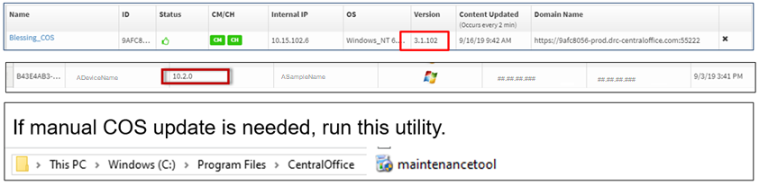
Updates to DRC INSIGHT and COS Service Device
  New versions of the the COS-SD and DRC INSIGHT Secure Applications were released in late June.
  The DRC INSIGHT Secure Applications is now version 11.x and if needed, will automatically update when the DRC INSIGHT Secure Application is launched.
  COS-SD should have automatically updated to version 4.x if the server was on and connected to the Internet. If a manual update is needed, the update can be forced by running the maintenance tool found in the Central Office Folder on the COS server as shown below.
COS Dashboard in DRC INSIGHT Portal
Readiness Check in DRC INSIGHT
Central Office Folder in COS

Slide 40
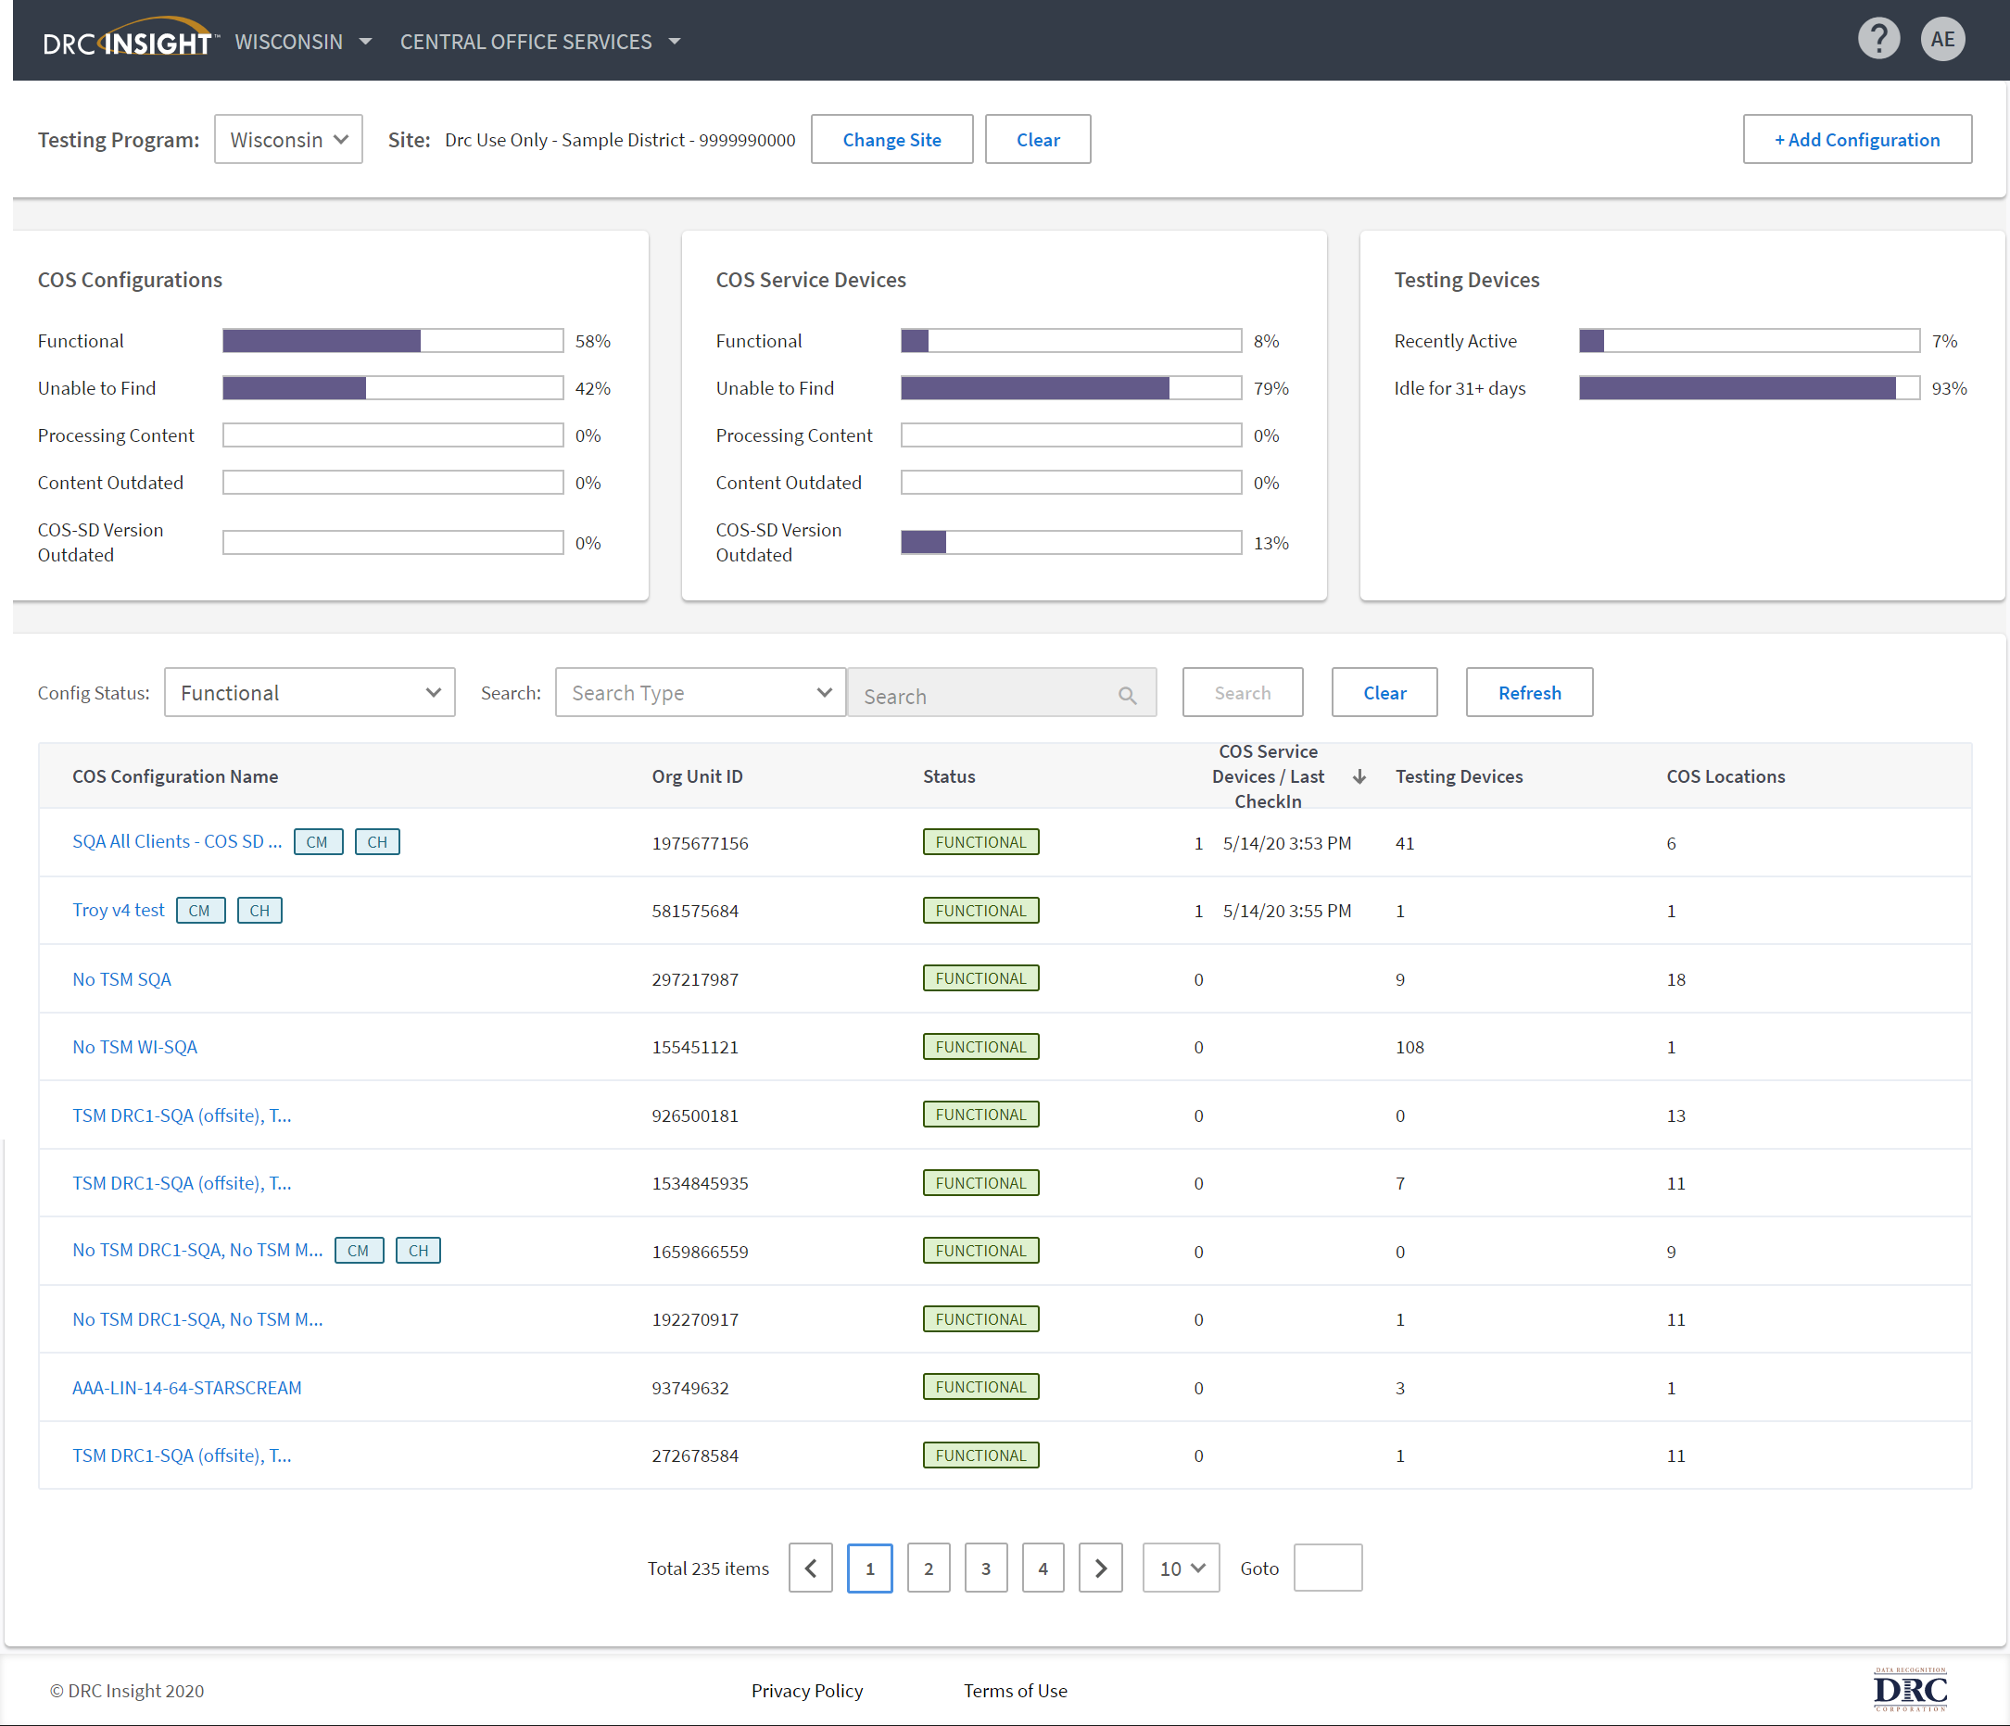
Updates to DRC INSIGHT and COS Service Device
  The refresh of the DRC INSIGHT Portal Central Office Services were made to:
    Deliver an easier and more intuitive user interface,
    Enhance accessibility compliance,
    Build on the framework for evolving DRC INSIGHT Portal applications, and
    Remove references to the Testing Site Manager (TSM) and Device Toolkit (DTK).
  The updated COS Dashboard also offers enhanced filtering and searching of a site’s available COS Configurations. Also, note the removal of the reference to Device Toolkit from the page, and Add Configuration is now a button in the upper right corner of the page rather than a separate tab.

Slide 41
School System Supports
The Assessment team offers multiple avenues of support to districts, schools, and teachers seeking information or assistance about assessment administration and accountability.
Weekly Newsletters
Assessment and accountability information and deadlines are released each week in the district newsletter.
Weekly Assessment & Accountability Calls
Each Tuesday at 4:15 PM these webinars are held to provide training, updates, and important information to DTCs and Accountability Contacts.
Assessment Library and Accountability Library
The Assessment Library contains resources for DTCs including the Assessment Schedule and the Assessment and Accountability Month-by-Month Checklist. The Accountability Library contains resources for accountability contacts including the School Performance Score (SPS) calculators as well as information on data certification and federal accountability.

Slide 42
2019-2020 Assessment and Accountability Webinar Dates
The chart lists the details for accessing upcoming Assessment and Accountability Monthly Calls. The entire calendar is located in the 2020-2021 School System Support Calendar.
NEW: Beginning July 21, a password will be required. 2020-202!
Assessment and Accountability Monthly Calls
Webinar Dates | August 18 September 15 October 20 November 17 December 15 January 19
Webinar Time | 4:15 PM
Webinar Link | https://ldoe.zoom.us/j/202189164
Phone Number | 16468769923,,202189164#
Meeting ID | Meeting ID: 202 189 164 Password: 2020202!

Slide 43
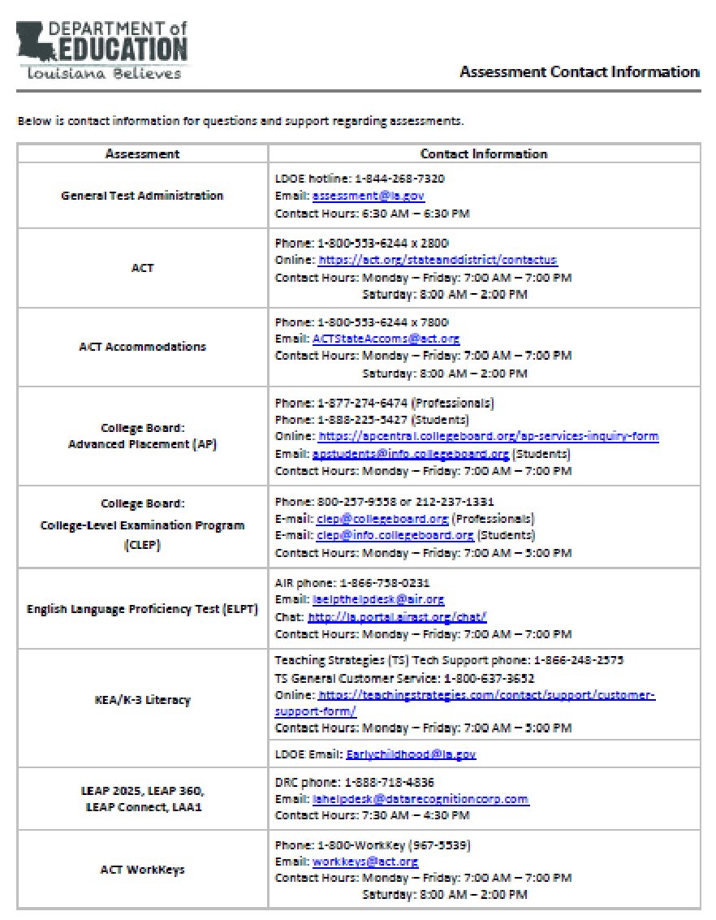
Assessments Customer Service
The Assessments Customer Service Contact Information has been posted to the Assessment Library. This provides customer service contact information for all assessments.

Slide 44
Assessments Next Steps
Dates | Action
Past Due | LEAP 360 MOU
July 13 | Diagnostic testing window opens
July 13 | LEAP 2025 high school summer administration testing window opens
July 18 | ACT National Testing (sites can request change to July 25)
July 24 | LEAP 2025 high school summer administration testing window closes
July 29 | LEAP 2025 high school assessment voids due to assessment@la.gov
August 3 | PearsonAccess opens for October makeup testing participation management
August 18 | ACT Q & A regarding accommodations or supports
August 24 | Last day to request rescore for LEAP 2025 high school summer assessments
August 28 | Last day to request ACT accommodations or supports for eligible examinees in TAA
September 15 | ACT MOU due for October testing

Slide 45
Questions?

Slide 46
2020-2021 Education Technology Webinar Dates
The chart lists the details for accessing upcoming Education Technology Monthly Calls. The entire calendar is located in the 2020-2021 School System Support Calendar.
NEW: Beginning July 21, a password will be required. 2020-202!
Education Technology Monthly Calls
Webinar Dates | Jul 16, 2020 11:00 AM Aug 20, 2020 11:00 AM Sep 24, 2020 09:00 AM Oct 22, 2020 09:00 AM Nov 19, 2020 09:00 AM Dec 17, 2020 09:00 AM Jan 28, 2021 09:00 AM Feb 25, 2021 09:00 AM Mar 25, 2021 09:00 AM Apr 22, 2021 09:00 AM May 27, 2021 09:00 AM
Webinar Link | https://ldoe.zoom.us/j/575223228
Phone Number | 1-301-715-8592
Meeting ID | Meeting ID: 575 223 228 Password: 2020-202!

Slide 47
Contact Information
ERate@la.gov
All stakeholders are encouraged to email E-Rate questions and/or concerns to ERate@la.gov.
EdTech@la.gov
All stakeholders are encouraged to email technology readiness questions and/or concerns to edtech@la.gov.
Assessment@la.gov
All stakeholders are encouraged to email assessment and accountability questions and/or concerns to assessment@la.gov.
Assessment Hotline
For immediate assistance regarding assessment and accountability, district-level staff may call the Assessment Hotline at 1-844-268-7320.

